Slide 1

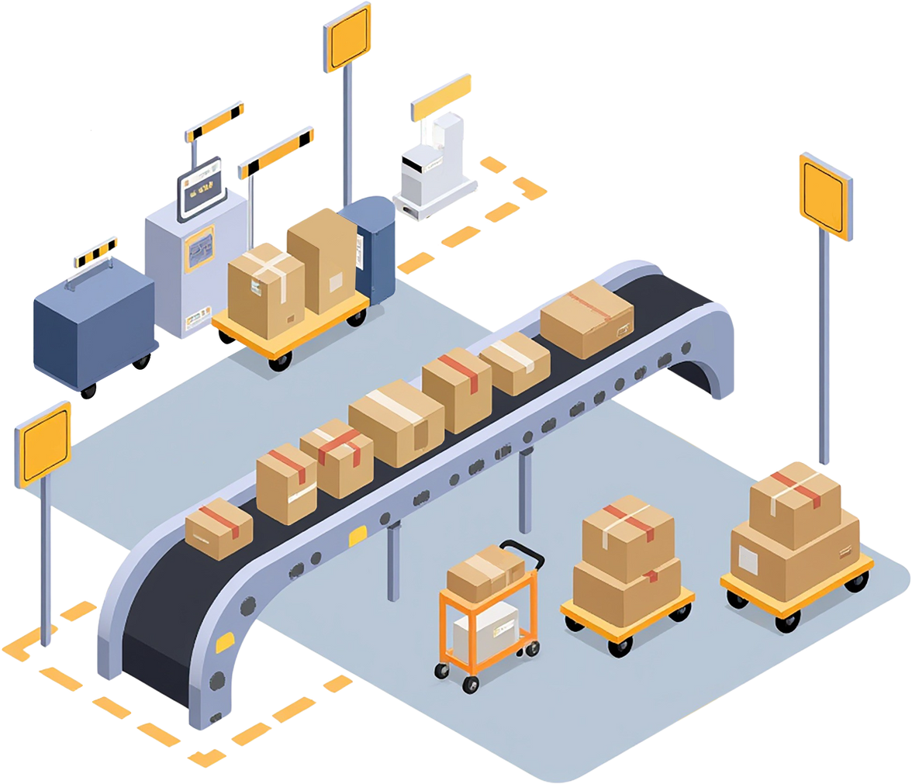
Smart Robotic Warehouse Management System
PRESENTED BY:
SUPERVISED
Dr.Raed Qadi
Mohammad Murad Esawi
Jawad Nimer Hamdan

Slide 2

TABLE OF CONTENTS
Introduction
Project Objectives
System Overview
Hardware Components
System Workflow
Future Enhancements
Challenges & Limitations
Conclusion

Slide 3
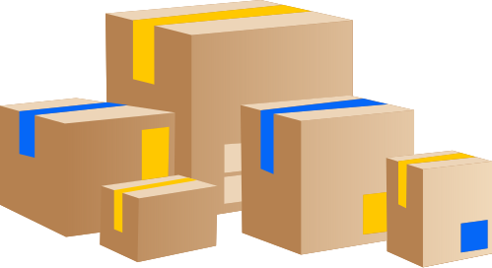
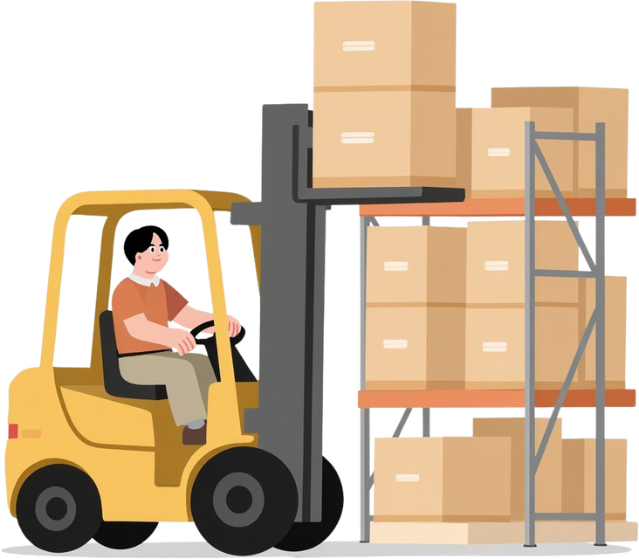
Introduction
  This project presents a Smart Robotic Warehouse Management System designed to automate the process of storing and retrieving products.
  Products are placed on a conveyor belt, where each product contains an RFID tag used to identify it.
  The RFID reader detects the product, and a robotic arm picks it up and stores it in the warehouse according to a selected storage strategy.
  The system can operate in automatic mode or manual mode, and it is controlled through a web-based interface that replaces a traditional touch screen, providing flexible and real-time control.

Slide 4

Project Objectives
To design and implement a smart automated warehouse system.
To identify products automatically using RFID technology.
To automate the pick and place process using a robotic arm.
To store products efficiently based on predefined storage strategies.
To enable automatic and manual control modes.
To provide real-time monitoring and control through a web-based interface.
To reduce human intervention, errors, and operation time.
To demonstrate the integration of embedded systems,and robotics

Slide 5
System Overview
The Smart Robotic Warehouse Management System consists of a conveyor belt, RFID system, robotic arm, storage rack, and a web-based control system.
Products are first placed on the conveyor belt, where an RFID reader scans the product tag to identify the product type.
Once identified, a robotic arm picks the product from the conveyor and moves it to the storage area.
The product is stored according to a selected storage strategy, such as a fixed location or the nearest available empty cell.
The system also supports retrieving products and placing them into a loading zone when required.
All operations are monitored and controlled through a web interface, which allows switching between automatic and manual modes.

Slide 6
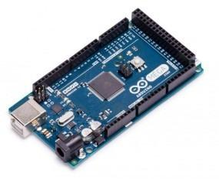
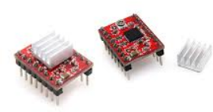
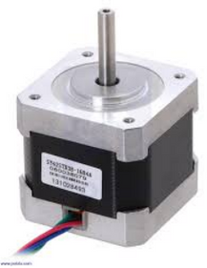
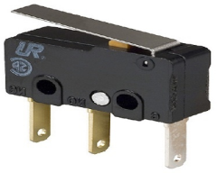
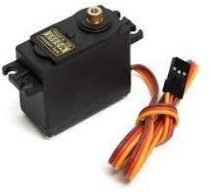
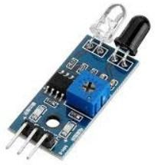
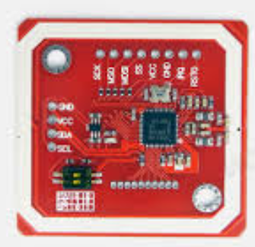
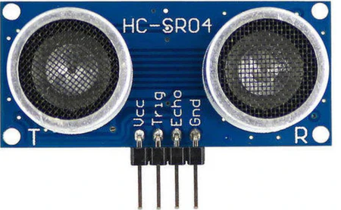
Hardware Components
Arduino Mega
A4988 stepper drivers
Nema 17 stepper motors
Limit Switch
Servo Motor
IR sensor
PN532 NFC RFID
Ultrasonic

Slide 7
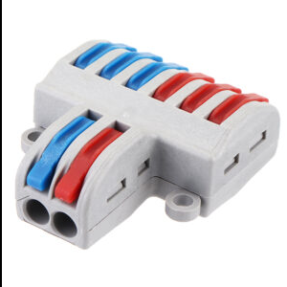
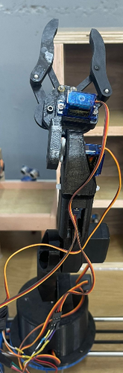
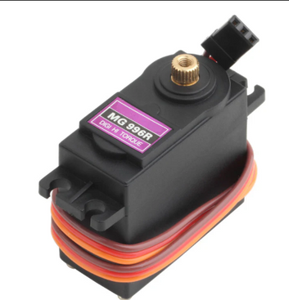
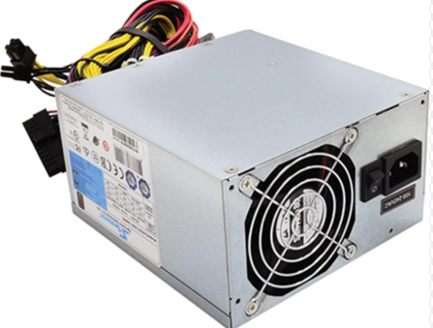
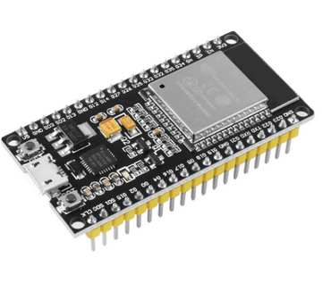
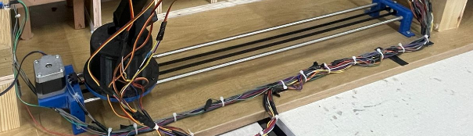
Hardware Components
connecter
servo mg996r
power supply
Arm Robot
esp32
linear motion Rail

Slide 8

System Workflow
1-Place Product on Conveyor
The product is placed on the conveyor belt to start the process.
2-Detect Product Position
Sensors detect the product reaching the scanning / pickup area.
3-Read RFID Tag
The RFID reader scans the tag to identify the product type.
4-Pick the Product
  The robotic arm moves to the pickup point and grabs the product.
5-Select Storage Location (Strategy)
  The system chooses where to store the product based on the selected strategy:
  a-Fixed Location (predefined cell)
  b-Nearest Empty Cell (first available cell)
6-Update Product Tracking
  The system records the product location so it always knows where each item is stored.
7-Retrieve (When Requested)
  When a retrieval command is given, the arm picks the product from its cell.
8-Move to Loading Zone
  The product is placed in the loading zone for delivery or pickup.

Slide 9
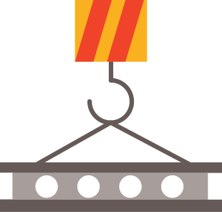

Future Enhancements
1-Adding a second robotic arm to transfer products from the loading zone to delivery trucks.
2-Replacing RFID with a camera-based system to read QR codes.
3-Improving system intelligence using AI-based storage optimization.
4-Integrating mobile or cloud-based control applications.

Slide 10
Challenges & Limitations
1-Power stability issues when multiple components operate simultaneously.
2-Sensor noise and inaccurate readings, especially in real-time operation.
3-RFID reading reliability, particularly when tags are not well aligned.
4-Timing and synchronization between conveyor movement and arm actions.

Slide 11
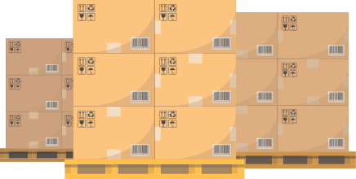
Conclusion
This project successfully demonstrates the design and implementation of a Smart Robotic Warehouse Management System.
By integrating RFID technology, a conveyor belt, a robotic arm, and a web-based control system, the system automates product storage and retrieval efficiently.
The project shows how embedded systems, robotics, and IoT can work together to reduce human effort, improve accuracy, and enhance warehouse operations.

Slide 12
Any Questions?

Slide 13
Thank You

