Slide 1

Traffic Management for West Central Business District of Nablus
بسم الله الرحمن الرحيم
An-Najah National University
Civil Engineering Department
Graduation Project 2
Prepared by: SAEED KAMAL KHAYYAT
Supervision by : PROF. SAMEER ABU-EISHEH

Slide 2
G.P 2
INTRODUCTION
METHODOLOGY
DATA COLLECTION
DATA ANALYSIS & AND SCENARIOS TESTING
CONCLUSION
RECOMMENDATION

Slide 3
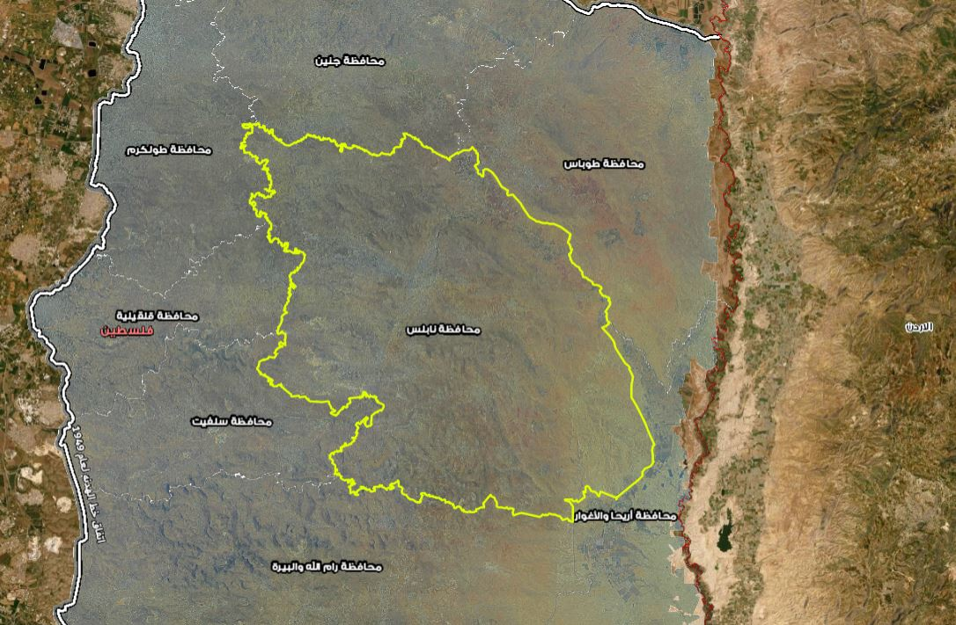
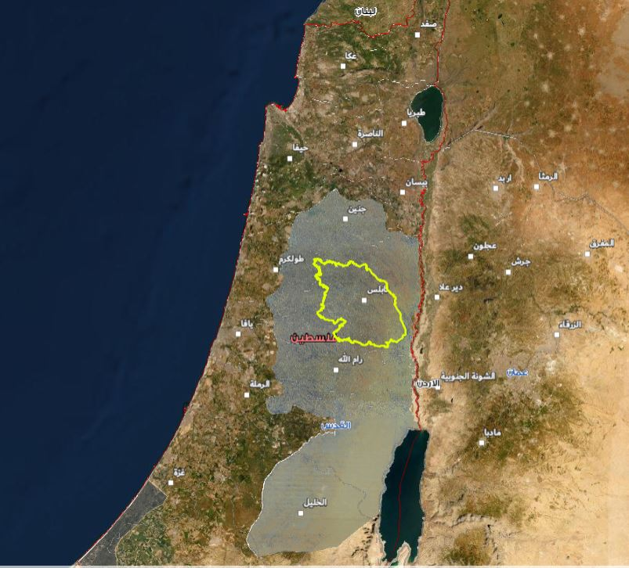
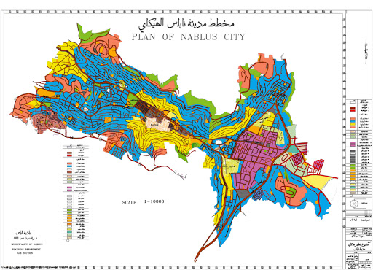
INTRODUCION
STUDY AREA :

Slide 4
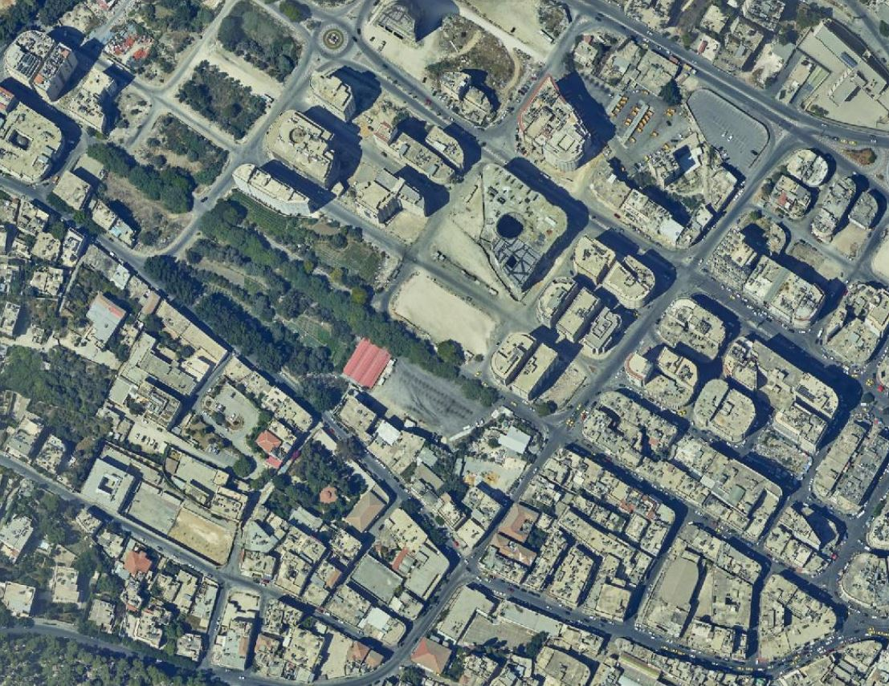
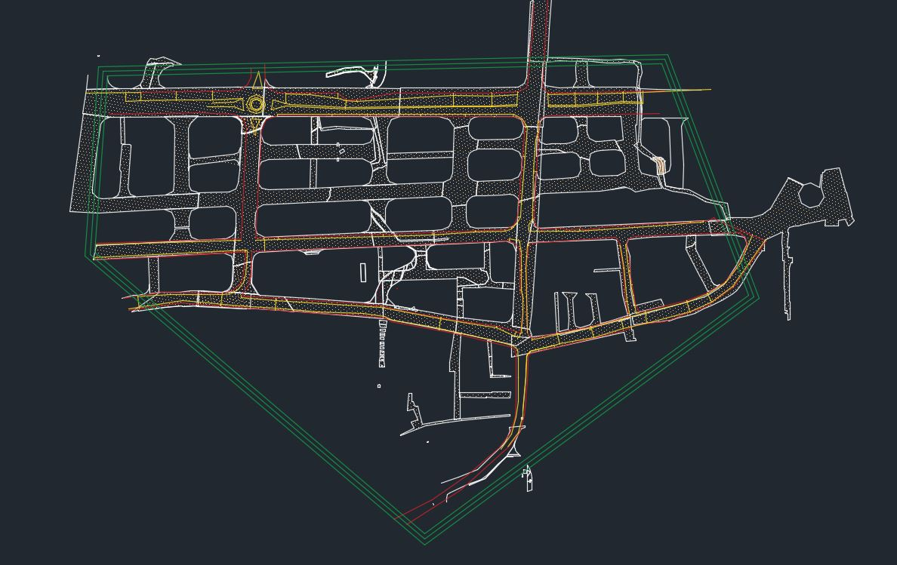
City center

Slide 5
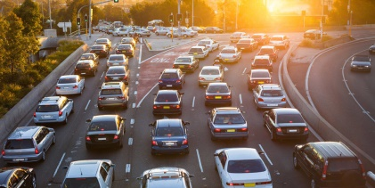

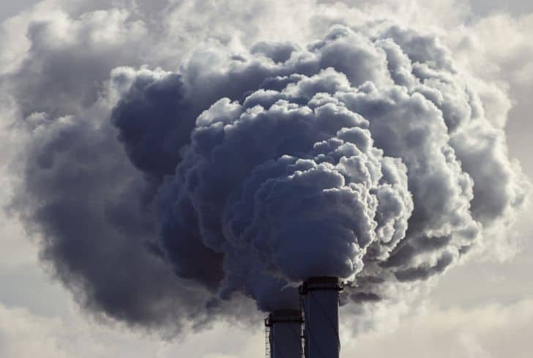
The problems suffering the region
traffic congestion.
delay.
environmental and audio pollution.

Slide 6
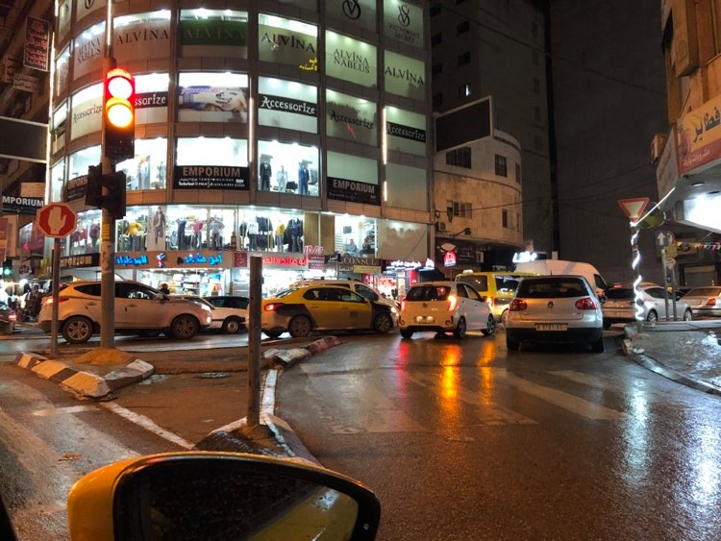
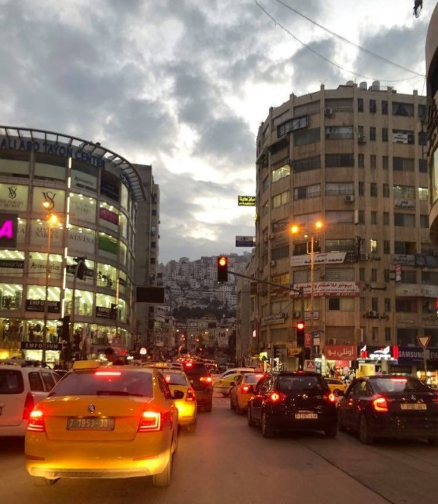
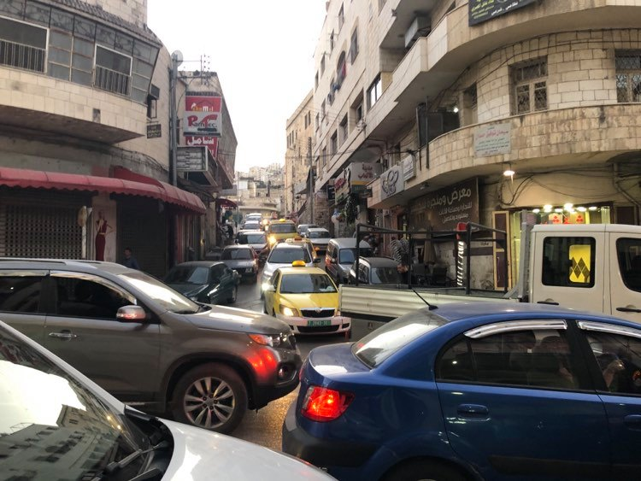
Traffic Congestion & Delay
Sufyan int. with Palestine Bank int. 14/Nov/2020
AlWakalah with pal. St. int.1/Nov/2020
Sufyan intersection 21/Nov/2020

Slide 7


METHODOLOGY
The first step in the project is to identify all the existing problems by gathering the information and data necessary to evaluate the problem and to develop appropriate solutions.

Slide 8

DATA COLLECTION
Required data: building plans, streets, aerial photos, vehicle numbers, traffic volume, Peak hour, etc.
In the last semester, data for the number of cars, Peak hour, and Peak hour volumes were collected with the help of
Dr. Sameer and previous projects.
In this semester, the city center plan without street detail is taken from Dr. Samir.
Visiting the site, and with the help of aerial photos from the websites, every detail of the streets and sidewalks was drawn with accurate measurements.

Slide 9
DATA ANALYSIS & AND SCENARIOS TESTING
Three scenarios were presented and each intersection analyzed twice, once in 2020 and the other in 2025 :
The first scenario "do nothing" and its analysis on Syncro program.
The second scenario is to demolish some buildings to expand the streets, and to analyze it on Syncro program.
The third scenario is to remove the light signals and place the star islands in the intersection and analyze it on Syncro program.

Slide 10
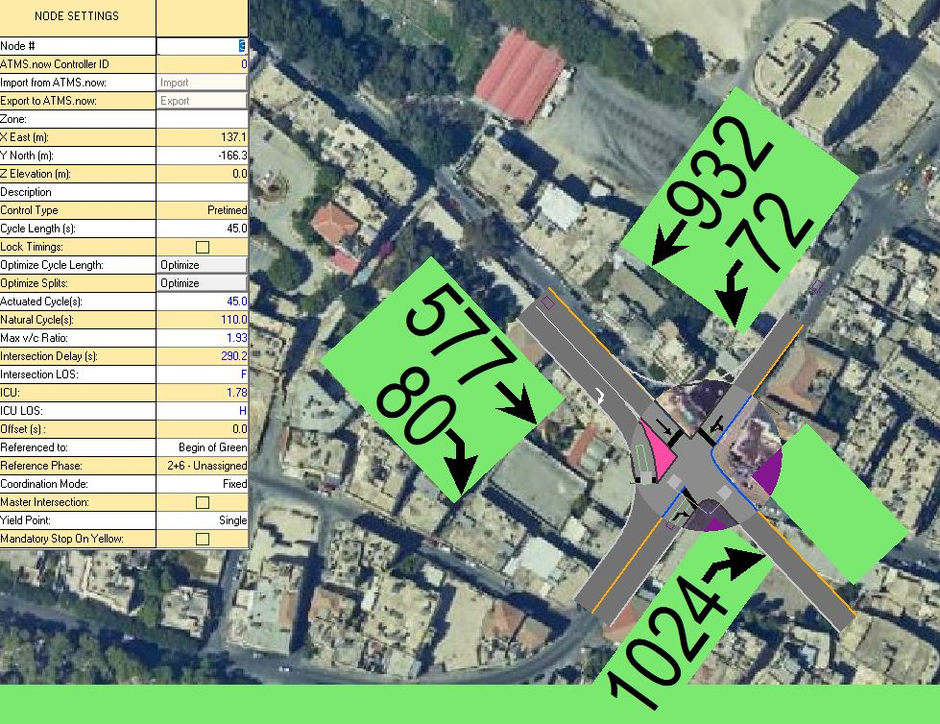
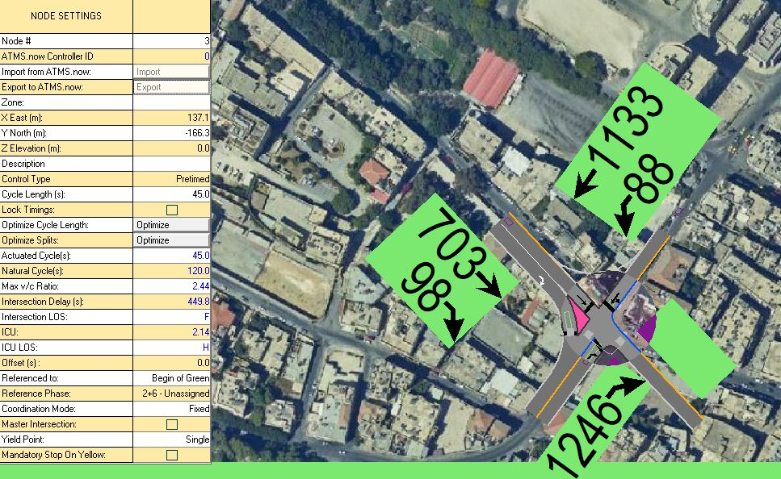
1– Do Nothing Scenario
Fatemyah Intersection analysis
2020
(actual data)
Fatemyah Intersection analysis
2025
(simulated data)

Slide 11
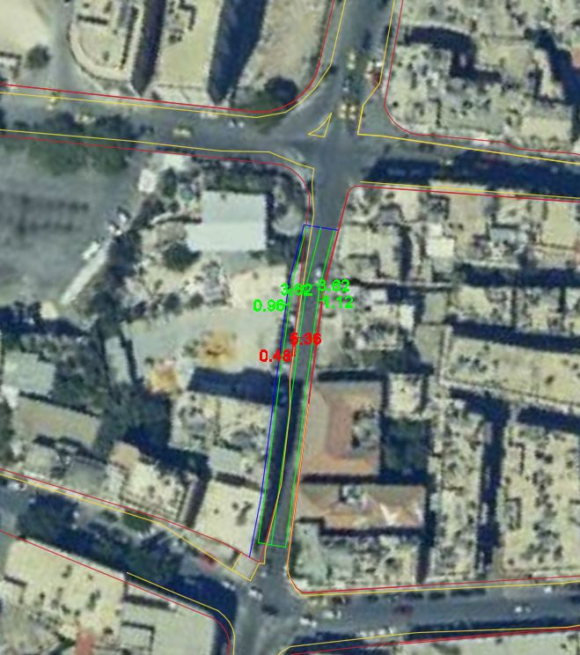
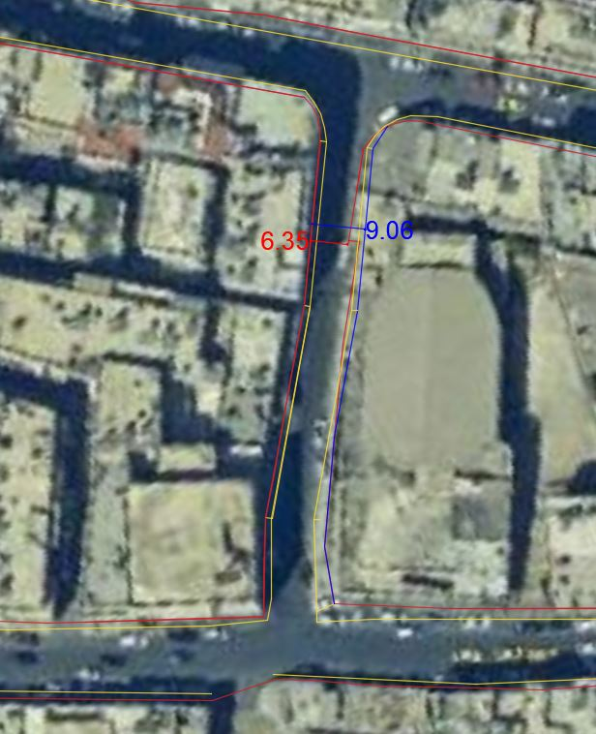
2- Demolition/removal scenario
Current building Boarder
Current asphalt Boarder
Suggested building Boarder
Fatemyah Intersection and Palestine intersection
Khan al Wakalah Intersection and Palestine street

Slide 12
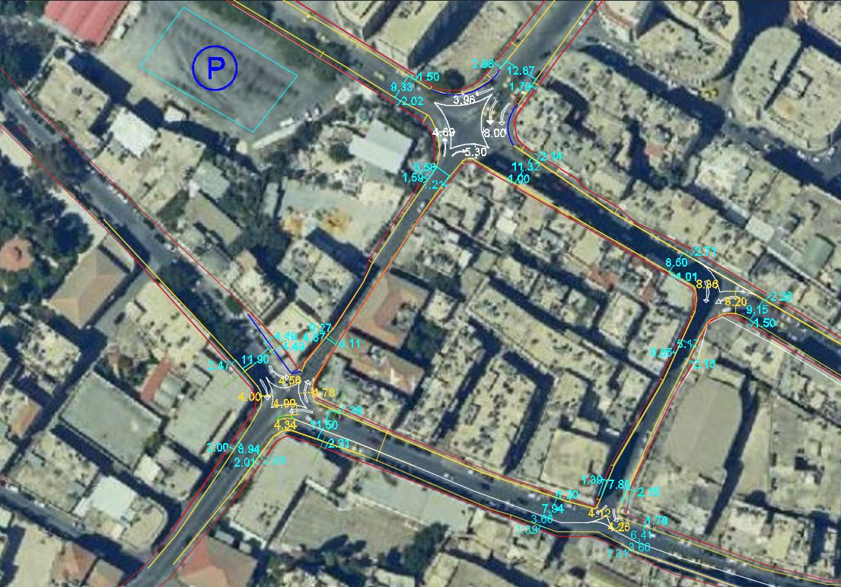
3- Star_Shaped Islands
Current building Boarder
Current asphalt Boarder
Suggested building Boarder

Slide 13
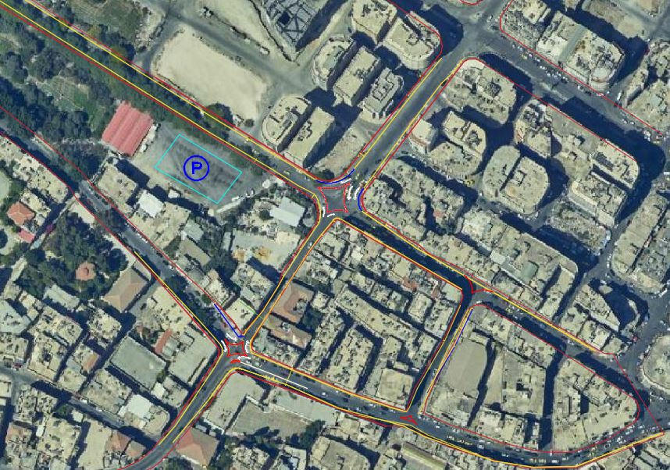
Suggested building Boarder
Current asphalt Boarder
Current building Boarder

Slide 14
Results:
Based on level of service from A to H, where A is the best and F is the worse:
 |  | Scenarios
Intersection | Year | Do nothing | Removal | Star Island
 | LEVEL OF SERVICE
Fatemyah Intersection | 20 | F , H | F ,H | B , D
 | 25 | F , H | F ,H | B , F
Palestine Bank Intersection | 20 | F , D | F , D | A , E
 | 25 | F , F | F, F | A , D
Sufyan Intersection | 20 | F , F | F, F
 | 25 | F ,H | F ,H
Bab al Wakalah , Palestine intersection | 20 |  |  | A , A
 | 25 |  |  | A , B

Slide 15
Conclusion
Removing crossing points through replacing it by star shape islands will induce safety traffic.
Reducing the operational costs for two traffic lights and promoting the ease of vehicles movement through.
Removing the adverse effect caused by the heavy traffic within short distance between intersections, through increasing the pass length between each of them.

Slide 16
Cont. Conclusion
Easing the movement of pedestrians through improving their personal visibility, and providing rest space in the middle of intersections.
Reducing the environmental pollution resulted from vehicle delays between intersections through easing their moves without much more emissions.
Saving old building from demolition by construction of new park place with high capacity.

Slide 17
Recommendations
Nablus Municipality is highly encouraged to take the results of this work into account to avoiding the worse scenario caused by increasing the traffic in the city center.
Star shape islands are the best current solution to avoid any demolition of ancient city building.
Conducting new similar studies about integrated approaches that take larger area and longer years scenarios are also encouraged.

Slide 18
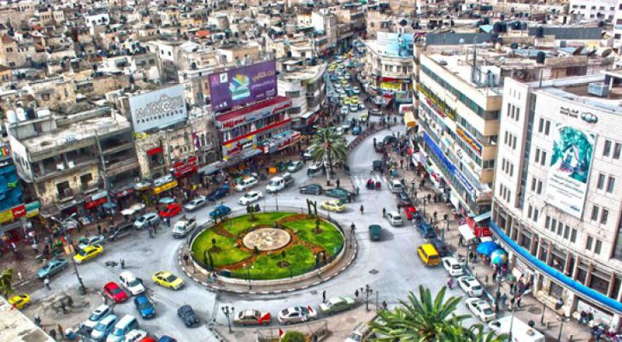
Thank you for your attendance
Questions??

