Slide 1
Assessment of AL-QUSRA School
Quantity Survey and Cost Estimate
By: Saleem Nehad Taqatqah
Zayd Omar Nassar
Zayd Zafer Anabtawi

Slide 2
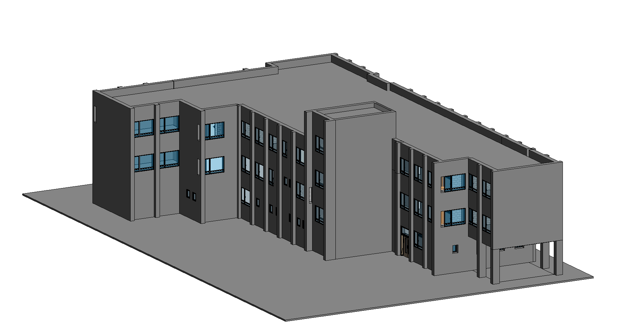
Chapter 5
Revit Architectural Survey

Slide 3
Plastering & Painting
Plastering
Floor | Quantities(m²)
GF | 1485
1ST F | 1980
2ND F | 1716
RF | 759
Total | 5940M2
Floor | Quantities(m²)
GF | 1485
1ST F | 1980
2ND F | 1716
RF | 759

Slide 4

Tiles
Quantities of tiles for each floor
Added quantities
The amount of gravel needed is 218.4 C.M
The amount of cement needed is 87.36 C.M

Slide 5
Windows
Ground floor windows
Floor | Duration (Day) | Type | Material | Num
GF | 4 | W1 Alum. Tilt | Aluminum & Glass | 9
 |  | W2 TWO UPPER SLIDING PANELS & ONE LOWER FIXED PANEL | Aluminum & Glass | 11
 |  | W3 FOUR UPPER SLIDING PANELS & TWO LOWER FIXED PANELS | Aluminum & Glass | 10
 |  | W4 FOUR SLIDING PANELS | Aluminum & Glass | 6
 |  | W5 FOUR UPPER SLIDING PANELS & TWO LOWER FIXED PANELS | Aluminum & Glass | 1
 |  | TOTAL |  | 37
First floor windows
Floor | Type | Material | Num
1ST F | W1 Alum. Tilt | Aluminum & Glass | 2
 | W2 TWO UPPER SLIDING PANELS & ONE LOWER FIXED PANEL | Aluminum & Glass | 7
 | W3 FOUR UPPER SLIDING PANELS & TWO LOWER FIXED PANELS | Aluminum & Glass | 29
 | W4 FOUR SLIDING PANELS | Aluminum & Glass | 8
 | W5 FOUR UPPER SLIDING PANELS & TWO LOWER FIXED PANELS | Aluminum & Glass | 1
 | TOTAL |  | 47

Slide 6
Windows
Second floor windows
Floor | Type | Material | Num
2ND F | W1 Alum. Tilt | Aluminum & Glass | 0
 | W2 TWO UPPER SLIDING PANELS & ONE LOWER FIXED PANEL | Aluminum & Glass | 7
 | W3 FOUR UPPER SLIDING PANELS & TWO LOWER FIXED PANELS | Aluminum & Glass | 29
 | W4 FOUR SLIDING PANELS | Aluminum & Glass | 11
 | W5 FOUR UPPER SLIDING PANELS & TWO LOWER FIXED PANELS | Aluminum & Glass | 1
 | TOTAL |  | 48
Roof Windows
Floor | Type | Material | Num
Roof | W3 FOUR UPPER SLIDING PANELS & TWO LOWER FIXED PANELS | Aluminum & Glass | 1
 | TOTAL |  | 1
The total number of windows in the building is 133 windows and area of 355 Sqm.

Slide 7
Doors
Floor | Type | Material | Num
GF | D1(ONE HINGED LEAF) | Wood | 12
 | D2(ONE HINGED LEAF) | Steel & Glass | 4
 | D3(ONE HINGED LEAF) | Wood & Glass | 5
 | D4(ONE HINGED LEAF) | Wood & Glass | 2
 | D5(ONE HINGED LEAF) | Steel & Glass | 1
 | D7(DOUBLE HINGED LEAF) | Steel & Glass | 4
 | D8(FOUR HINGED LEAVES (FOLDING)) | Wood | 2
 | D10(ONE HINGED LEAF) | Wood | 0
 | D11(ONE HINGED LEAF) | Steel | 0
 | D12(ONE HINGED LEAF) | Steel Fire Rating | 0
 | TOTAL |  | 30
Floor | Type | Material | Num
1st F | D1(ONE HINGED LEAF) | Wood | 2
 | D2(ONE HINGED LEAF) | Steel & Glass | 3
 | D3(ONE HINGED LEAF) | Wood & Glass | 1
 | D4(ONE HINGED LEAF) | Wood & Glass | 6
 | D5(ONE HINGED LEAF) | Steel & Glass | 0
 | D7(DOUBLE HINGED LEAF) | Steel & Glass | 0
 | D8(FOUR HINGED LEAVES (FOLDING)) | Wood | 0
 | D10(ONE HINGED LEAF) | Wood | 0
 | D11(ONE HINGED LEAF) | Steel | 0
 | D12(ONE HINGED LEAF) | Steel Fire Rating | 1
 | TOTAL |  | 13

Slide 8
Doors
Floor | Duration (Day) | Type | Material | Num
2nd F | 1 | D1(ONE HINGED LEAF) | Wood | 0
 |  | D2(ONE HINGED LEAF) | Steel & Glass | 1
 |  | D3(ONE HINGED LEAF) | Wood & Glass | 0
 |  | D4(ONE HINGED LEAF) | Wood & Glass | 6
 |  | D5(ONE HINGED LEAF) | Steel & Glass | 3
 |  | D7(DOUBLE HINGED LEAF) | Steel & Glass | 1
 |  | D8(FOUR HINGED LEAVES (FOLDING)) | Wood | 0
 |  | D10(ONE HINGED LEAF) | Wood | 2
 |  | D11(ONE HINGED LEAF) | Steel | 0
 |  | D12(ONE HINGED LEAF) | Steel Fire Rating | 1
 |  | TOTAL |  | 14
Floor | Type | Material | Num
Roof | D11(ONE HINGED LEAF) | Steel | 1
 | TOTAL |  | 1
The Total Number of doors is 58
And they compose of four general types
Wood doors
Steel doors
Steel & glass doors
Wood & glass doors

Slide 9
CHAPTER SIX
TIME & COST CALCULATIONS

Slide 10
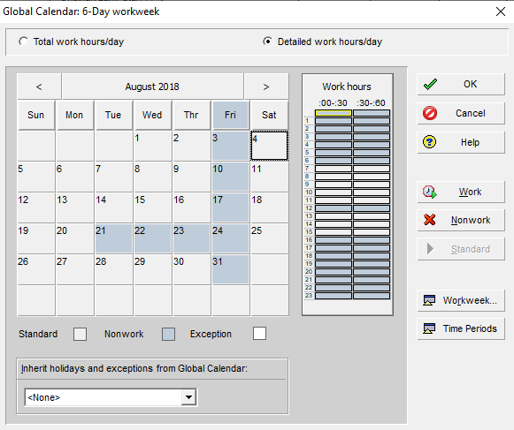
Time & Cost Calculations.
The project will start 1/8/2018.
This is the calendar for the project 6 days a week 8 hours a day
The holidays has been. Included

Slide 11
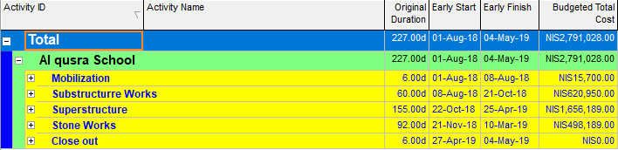
Main deviations
Mobilization
Substructure works
Superstructure works
Stone works
Close out

Slide 12

Way of calculations
For time and productivity rates.
For costs.

Slide 13
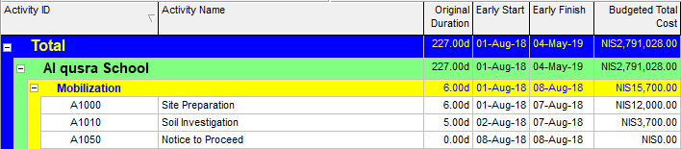
Mobilization.
Site preparation.
Soil investigation.

Slide 14
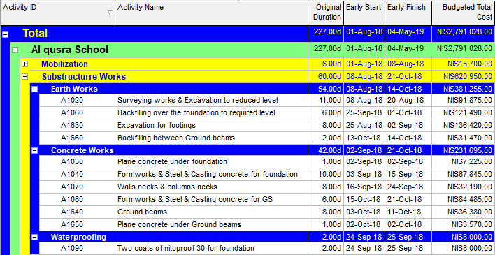
Substructure works.
Earth Works.
Concrete works.
Waterproofing.

Slide 15
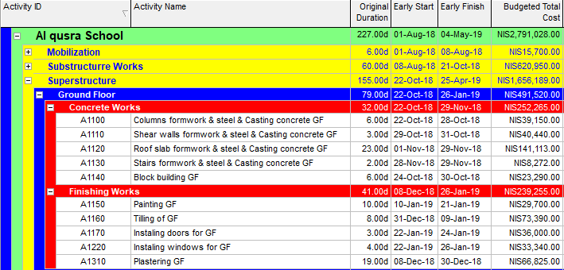
Superstructure works.
Concrete works GF.
Finishing works GF.

Slide 16
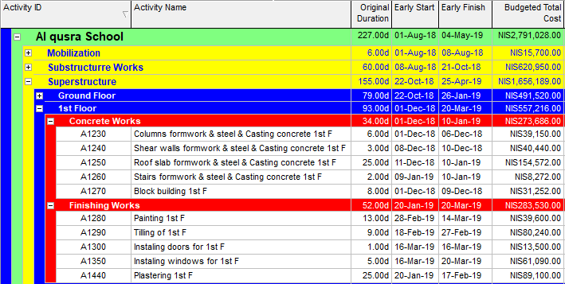
Superstructure works.
Concrete works 1st F.
Finishing works 1st F.

Slide 17
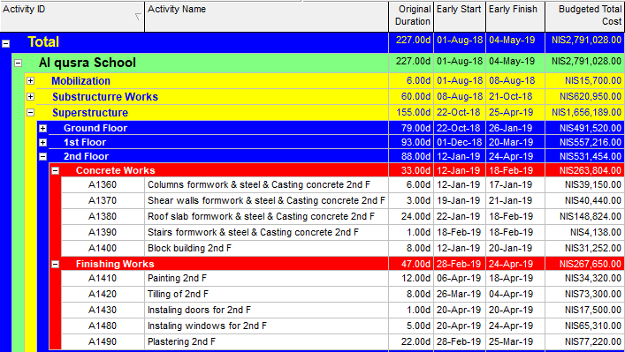
Superstructure works.
Concrete works 2nd F
Finishing works 2nd F

Slide 18
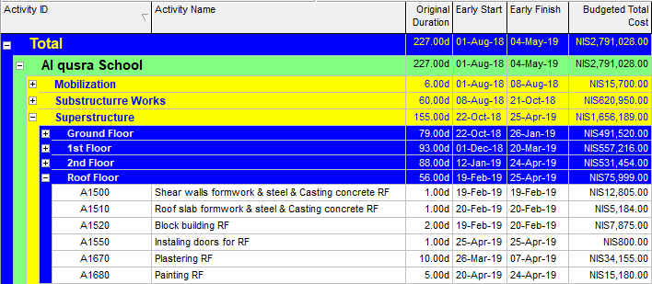
Superstructure works.
Roof Floor.

Slide 19
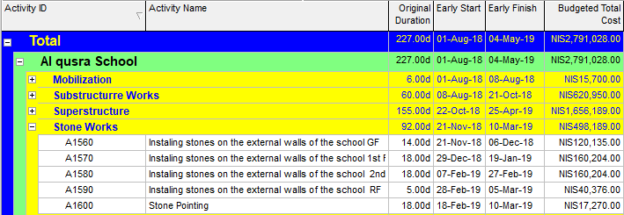
Stones works.
Stones for GF
Stones for 1ST F
Stones for 2ND F
Stones for RF

Slide 20

Totals
Total budgeted cost is 2,791.028 NIS
The price after the 15% addition is 3,209,682 NIS.
Unfortunately we couldn't have the bid price from the engineering office to compare our results with the actual results.

Slide 21

TIME SCALE AND THE S CURVE
Time scale and total duration of the project.
The s-curve for the project.

Slide 22


Chapter 7
Conclusion & Recommendations

Slide 23

Conclusions
1. The working days for the school project was estimated to be 227 days.
2. The calendar days for the school project was estimated to be 277 days.
3. The total budget cost for the project was estimated to be (2,791.028) NIS.
4. The total quantities for concrete were estimated to be (914.75) m³. While the total budgeted cost were estimated to be (273,667) NIS.
5. The total budgeted quantities of steel were estimated to be (126.95) Tons, while the total budgeted cost of the steel was estimated to be (380,850) NIS.
6. The total quantities of stone used in the project were estimated to be (1570) m², while the total budgeted cost is estimated to be (219,800) NIS
The total price for this school project was estimated to be (3,209,682) NIS.

Slide 24

Recommendations
1. When choosing a contractor, the focus should not be only on the financial part, but the selection should also depend on the technical offer so that the contractor has administrative and technical capabilities to complete the project with minimum delays and problems.
2. The consultant, while working on the plans, must implement them accurately and give them enough time to minimize errors or changing orders during implementation.
3. The contractor must complete the activities within the specified time and make the resources profile to set all the resources needed by the project and to request them before a certain period so that there is no delay in the project.
4. The owner should pay the contractor the financial payments at time so that there will be delay in the project due to lack of fund.

