Slide 1
A 4 Switch Buck-Boost DC/DC Converter for Electric Vehicle
By:
Eng. Batool Hanini
Eng. Dareen Nofal
Eng. Mohammad Ghazzawi
Supervisor:
Prof. Kamel Subhi Saleh.
June 2025

Slide 2
Outline
Project Overview
System Design
Operation & Control
Results & Conclusions

Slide 3
Project Concept and Significance
Design Objectives
Problems Solved
This project presents the design and implementation of a bidirectional 4-switch Buck-Boost converter, specifically developed for electric vehicles. It uses an Arduino microcontroller with a PID algorithm to precisely control the charging and discharging of lithium-ion batteries. The converter performs both step-up and step-down operations to enable energy recovery and enhance battery management.
Extends driving range through optimized battery capacity utilization
Prevents dangerous overcharging and thermal runaway conditions
Ensures stable voltage and current control in both operational modes
Enhances overall system reliability and charging efficiency

Slide 4
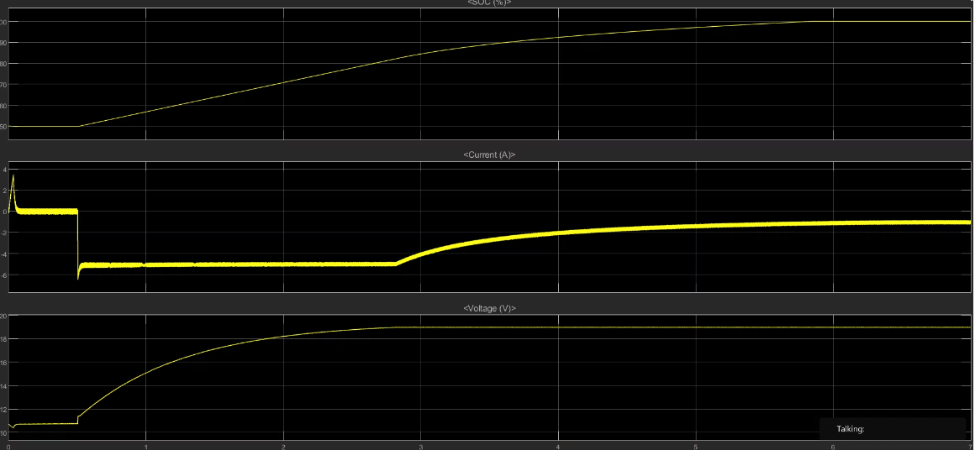
Simulink Results

Slide 5
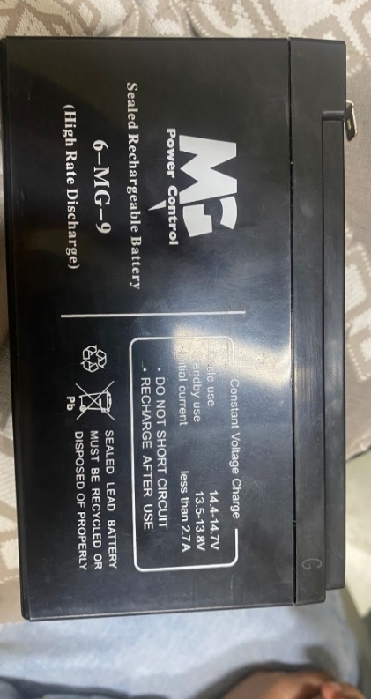
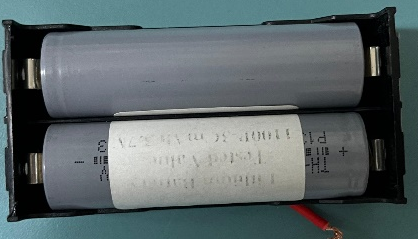


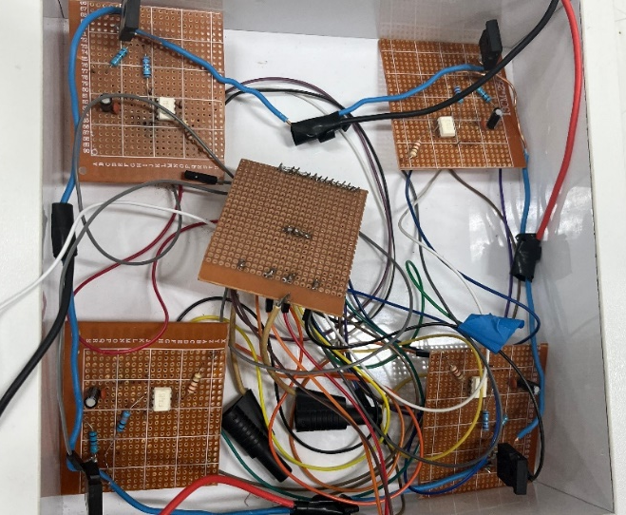
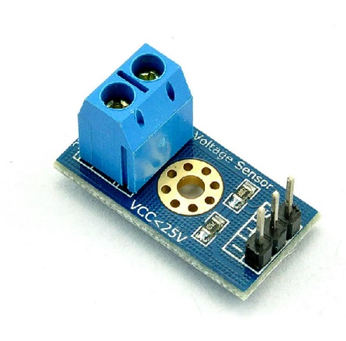
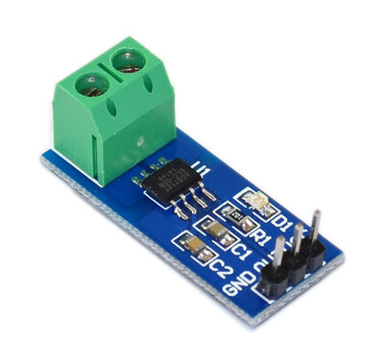



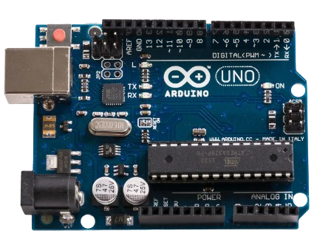
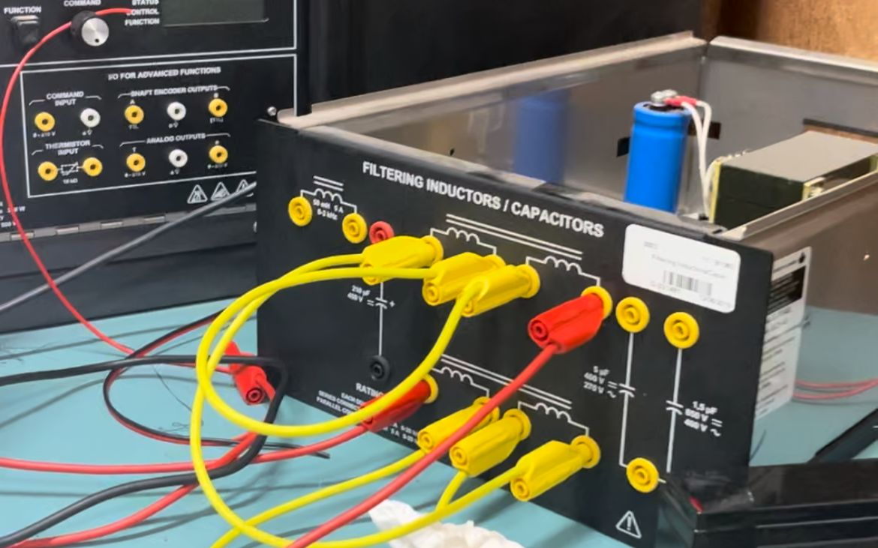

System Components and Hardware Design
Power Source
H-Bridge Circuit
Inductor
Sensors
Arduino Uno
Lithium Battery

Slide 6
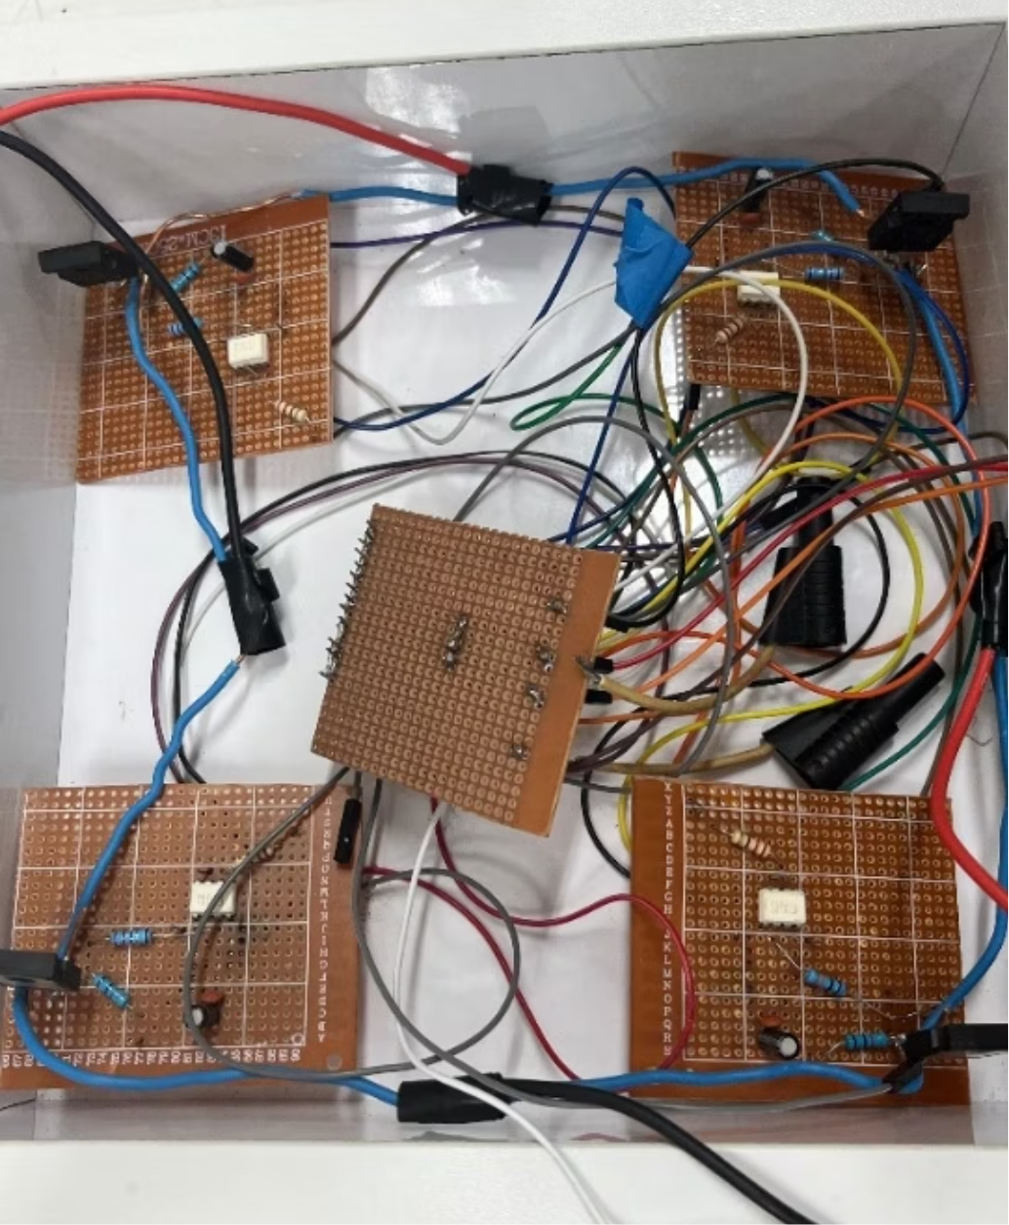
H-Bridge Circuit Implementation
Power Switches
4 IGBTs (60N60)
Gate Drivers
4 TLP250 optocouplers
Filter Capacitors
4 × 10μF and 4 × 0.1μF (104)
Gate Resistors
4 × 22Ω
Pull-down Resistors
4 × 220Ω

Slide 7
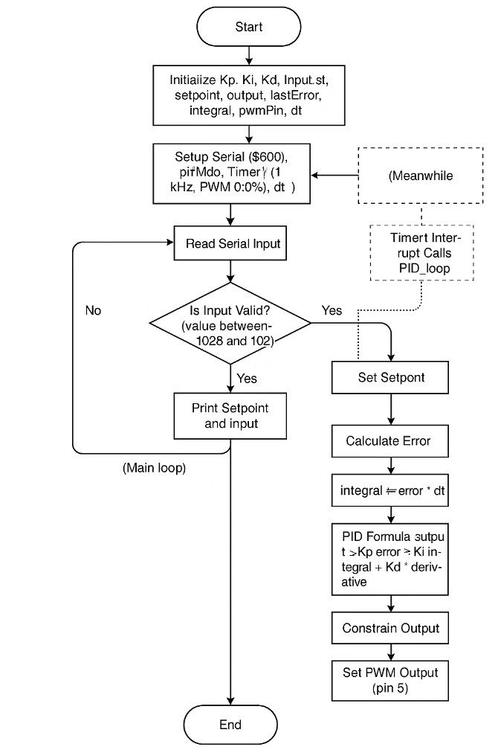
Control Logic Implementation

Slide 8
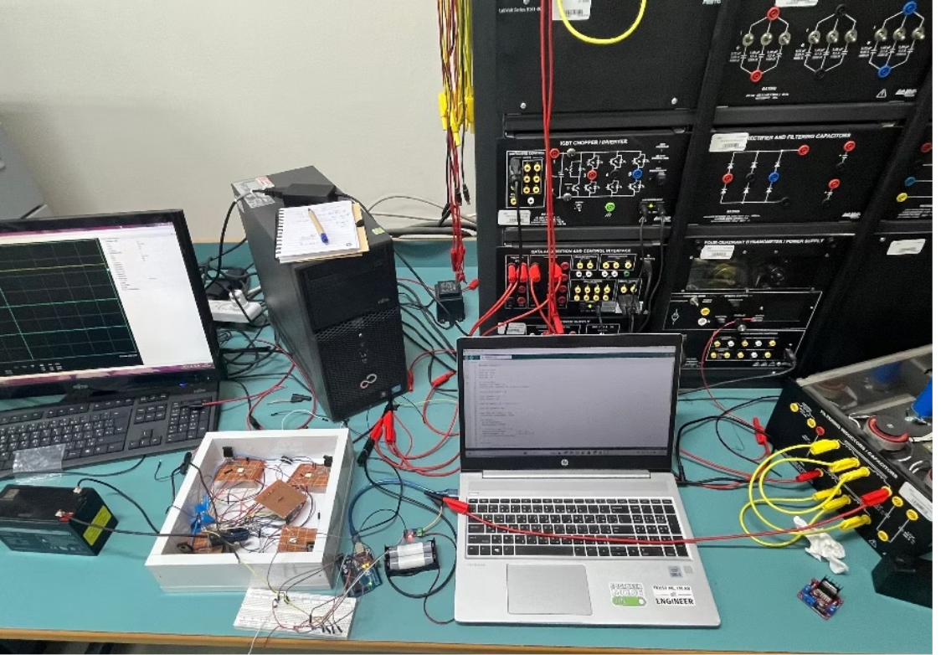
System Operation
After assembling the circuit and uploading the control code to the Arduino, the system operated as an integrated unit. Sensors measure the battery current and send it to the Arduino, which compares it to the setpoint and adjusts the PWM signal to control the H-Bridge.
The system operates in Buck mode to charge the battery from a 12V source, and in Boost mode to discharge it back to the source or a load.
The inductor smooths the current and ensures efficient, stable power transfer, while the control algorithm keeps voltage and current within safe limits. The system’s performance can be monitored in real time using the oscilloscope and Serial Plotter.

Slide 9
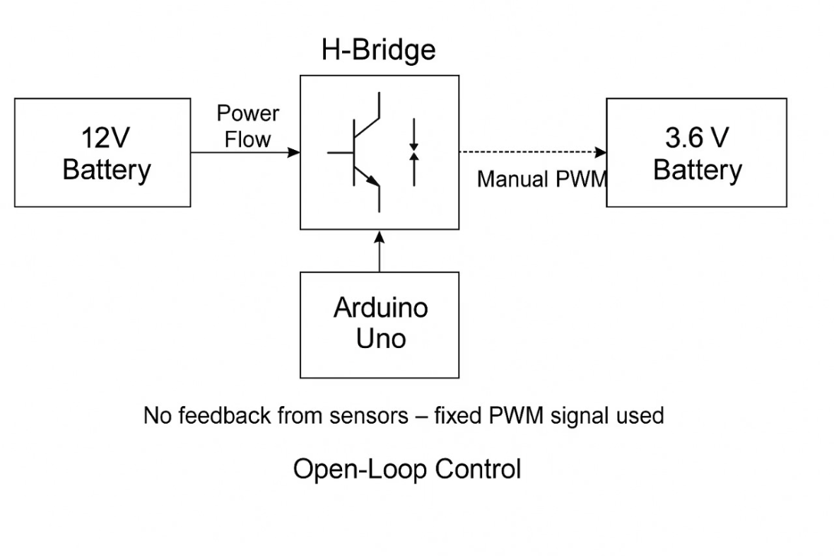
The system operates without feedback, using a fixed PWM based on a manually set value, without responding to the battery’s actual condition."
Open Loop Operation Mode
This diagram illustrates the open-loop control system, where a fixed PWM signal is sent from the Arduino to the H-Bridge without feedback.
The current direction depends on the difference between the H-Bridge output voltage and the battery voltage.
If the output voltage is higher, the battery charges; if lower, discharging may occur.
The system lacks feedback and does not adjust its output according to the battery’s real-time condition

Slide 10
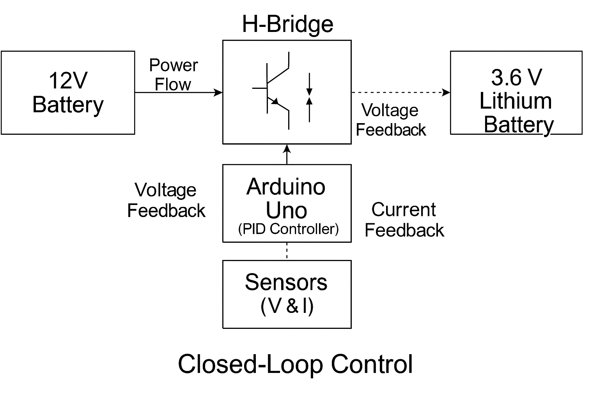
Closed Loop Operation Mode
The 12V battery powers the H-Bridge, which is controlled by PWM signals from the Arduino. The output voltage depends on the PWM value and is sent to the 3.6V lithium battery.
Voltage and current sensors measure the actual values and send them to the Arduino. The PID algorithm compares them with target values and adjusts the PWM accordingly.
So, in Closed-Loop mode:
The PWM is continuously updated based on feedback.
The PWM controls the output voltage, not just the voltage difference.
Charging (Buck) happens when output > battery voltage.
Discharging (Boost) happens when output < battery voltage.
This ensures safe, accurate, and automatic control of the battery.

Slide 11
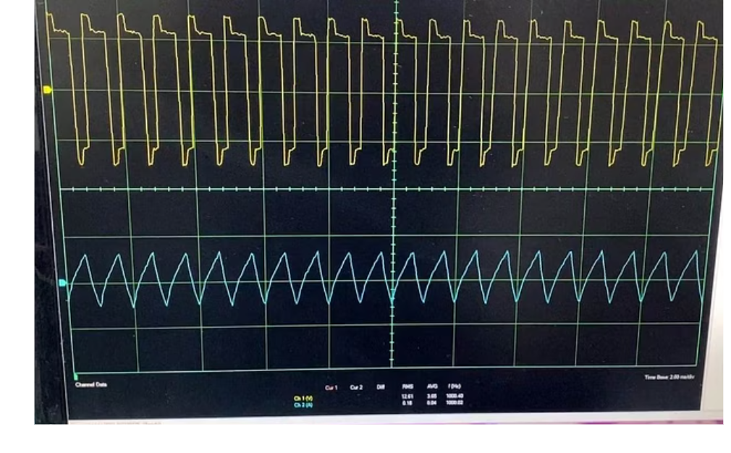
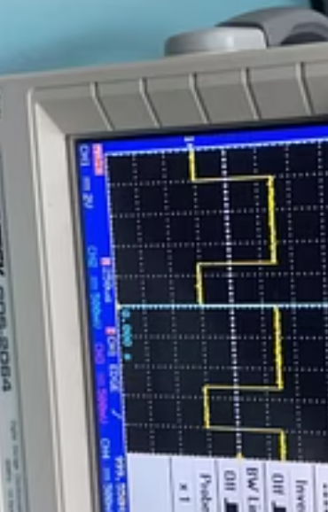
Open Loop Test Results: PWM Calibration
Neutral Baseline Test (Value: 670)
During initial system calibration, we determined that a PWM value of 670 (approximately 65.5% duty cycle) creates a balanced state in the H-Bridge circuit. This configuration results in nearly zero net current through the system and serves as a neutral reference point for subsequent closed-loop operations.
The oscilloscope measurements confirm this balanced state, showing complementary PWM signals with appropriate dead time between switching transitions. This calibration is critical for preventing shoot-through conditions and establishing the zero-current reference for the control system.
The oscilloscope readings display a clean PWM waveform with minimal noise and ringing, indicating proper gate driver operation and adequate circuit protection. This baseline calibration ensures that subsequent closed-loop tests begin from a well-defined neutral state.

Slide 12
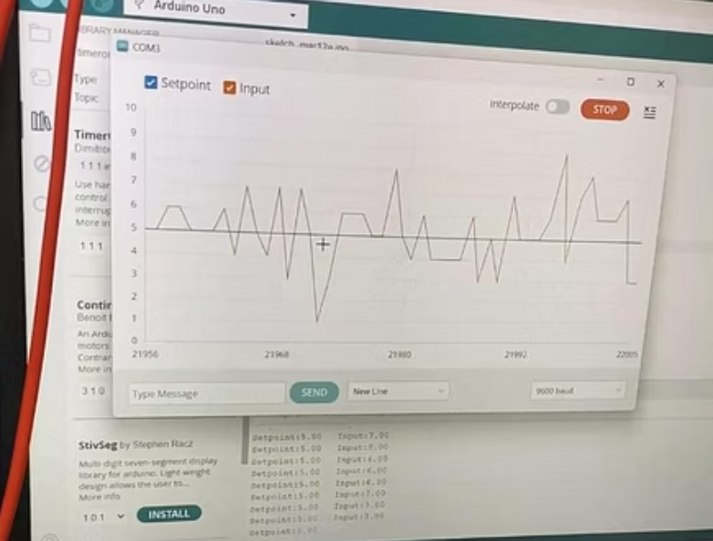
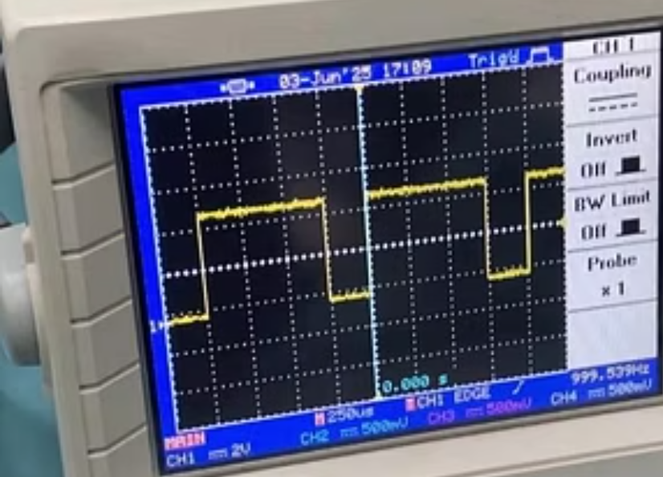
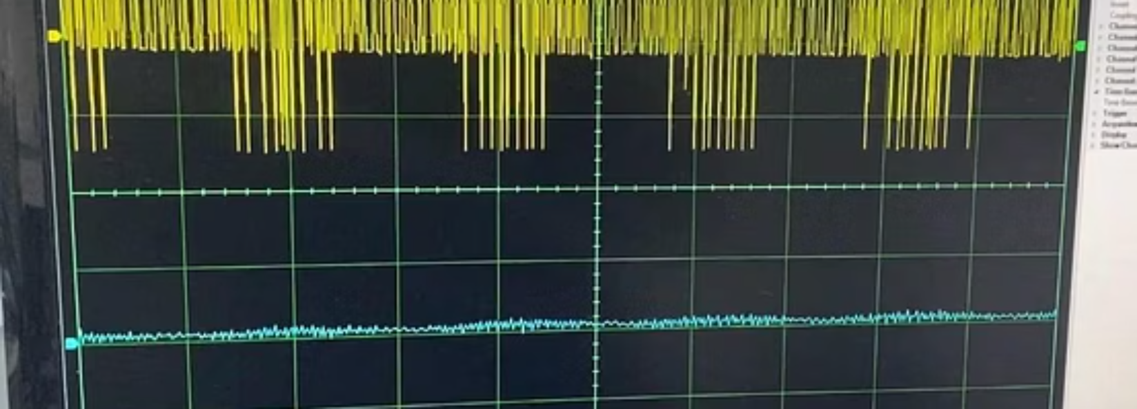
Closed Loop Test Results: Discharging Mode
Boost Mode Operation (Setpoint: -5)
In this test configuration, we entered a negative setpoint value of -5, instructing the system to operate in boost mode and discharge the lithium battery. The negative value signifies current flowing from the lower-voltage battery (3.6V) toward the higher-voltage source (12V), effectively demonstrating the converter's bidirectional capability.
The Arduino controller responded by adjusting the PWM signals and reversing the H-Bridge polarity to enable boost mode operation. The current sensor detected a negative current flow, which the PID controller stabilized at the target value through continuous PWM adjustments.
The Serial Plotter output confirms successful boost mode operation, showing the measured current (blue line) converging toward and stabilizing at the -5 setpoint (red line). This demonstrates the system's ability to extract energy from the lithium battery and step up the voltage—a crucial function for regenerative braking in EV applications.

Slide 13
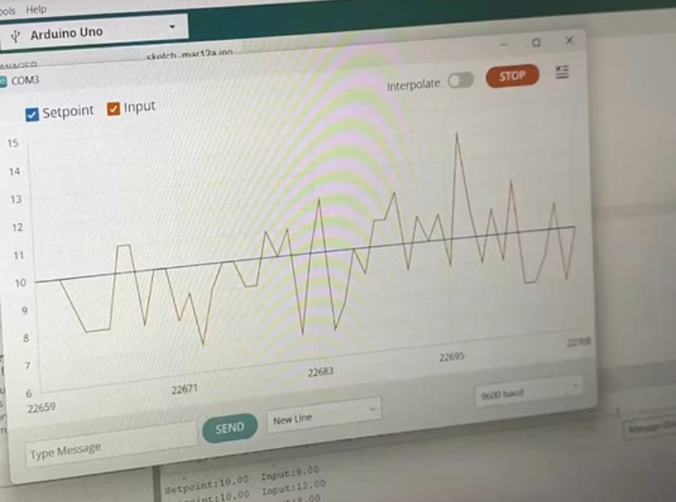
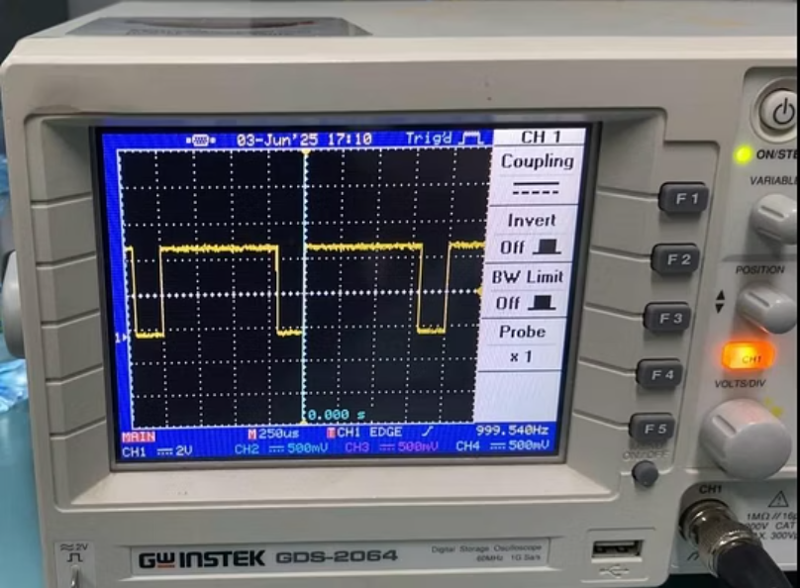
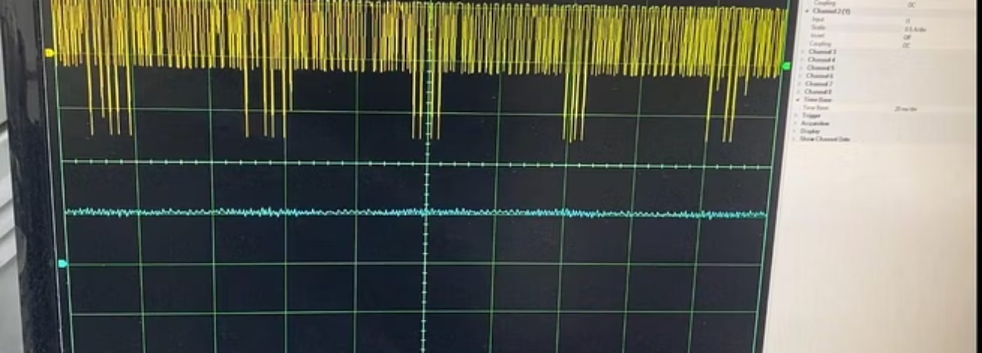
Closed Loop Test Results: Charging Mode
Buck Mode Operation (Setpoint: 5)
For this test, we programmed a positive setpoint value of 5, directing the system to operate in buck mode and charge the lithium battery at a moderate current. The positive value indicates current flowing from the higher-voltage source (12V) to the lower-voltage battery (3.6V).
The Arduino PID controller continuously compared the measured current with the setpoint and dynamically adjusted the PWM duty cycle to maintain the target charging current. The system demonstrated excellent stability and rapid response to minor variations in the battery's charging impedance.
The Serial Plotter visualization shows the measured current (blue line) gradually approaching and stabilizing at the 5.0 setpoint (red line), with minimal overshoot and steady-state error. The oscilloscope readings confirm a clean PWM waveform with a duty cycle appropriate for buck mode operation. These results validate the system's ability to safely and efficiently charge lithium batteries with precise current control.

Slide 14






Technical Challenges and Solutions
Thermal Management
High currents generated excessive heat in switching components. Solution included aluminum heat sinks and thermal compound on critical elements.
Component Sensitivity
IGBTs and gate drivers required ESD protection during handling. We implemented strict protocols throughout assembly and testing phases.
Safety Concerns
High-power operation demanded robust protection. We implemented overcurrent, overvoltage, and thermal shutdown safeguards for reliable operation.
These challenges required iterative design improvements and testing. Each solution enhanced reliability and safety, essential for practical EV applications.

Slide 15
Conclusion and Future Work
Key Accomplishments
Future Development Directions
Successfully developed a bidirectional DC/DC converter capable of precise voltage and current control during both charging and discharging operations
High-Power Scaling
Test and optimize the system for higher power EV battery packs with increased voltage and current requirements
Simulation results demonstrated smooth transitions between buck and boost modes with stable output characteristics
Thermal Enhancements
The hardware implementation with Arduino, PID control, and IGBT switching achieved accurate real-time current regulation
Implement advanced cooling systems and thermal monitoring to improve reliability during sustained high-power operation
The system proved suitable for EV applications, offering efficiency, safety, and reliability under various operating conditions
User Interface
Develop LCD display or mobile application interfaces for monitoring and controlling the charging process
Smart Control
Implement AI-based predictive control algorithms to optimize charging efficiency and battery longevity
Renewable Integration
Adapt the system for direct integration with solar energy sources and charging stations

Slide 16
Driven by Innovation, Powered by Efficiency
Thank You! ⚡⚡

