Slide 1

An-Najah National University
Faculty of Engineering and Information Technology
Industrial engineering department
جامعة النجاح الوطنية
كلية الهندسة وتكنولوجيا المعلومات
قسم الهندسة الصناعية
An-Najah National University
Faculty of Engineering and Information Technology
Industrial Engineering Department
Graduation Project 2
Inventory Management and Control Improvement at HTM company
Prepared By:
-Duha Abu Gharbieh
-Jenan Maree
-Nour Salous
-Yasmeen Mohsen
Supervised By:
-Dr. Yahya Saleh
-Eng. Basheer Shaheen
-Eng. Ghassan Sleem

Slide 2
Outline:
Overview about (HTM) Company
Problem Statement
Methodology
ABC analysis
Forecasting
Economic Order Quantity (EOQ)
safety stock and reorder point
Current & Improvement layout of HTM main warehouse .
Material handling in HTM main warehouse.
Conclusion & Recommendations.

Slide 3

  Overview about (HTM) Company
HTM Company is one of the auto spare parts and oils companies.
HTM has two main warehouses in the industrial zone – Nablus with a large products' variety including, automobiles oils & spare parts.

Slide 4
  Problem Statement
The company has been encountering many problems through the existing warehouse management system, such as products classification, managing inventory and other order fulfillment, liquid products storage, material handling tools, inventory planning /orders dispatching and others.

Slide 5
  Problem Statement
The efficiency and effectiveness of the existing inventory management systems at HTM’s main warehouses will be enhanced by applying inventory management and control tools such as, ABC inventory analysis, warehouse layout design and management, material handling improvement, safety stock management and orders forecasting

Slide 6
  Methodology
The data that was collected from HTM company is considered as historical data, this collected data contains different product families, the data was gathered for a time span of thirteen months.
This data was used to classify the products into A,B and C classes.
Many forecasting methods were used to anticipate the next order.
Some concepts such as EOQ, ROP and Safety stock were explained by doing some calculations.
An improved layout for the main warehouse was proposed.

Slide 7
  ABC Analysis
ABC analysis is a system for inventory control and management used to classify inventory items.
ABC analysis for inventory management is based mainly on the Italian Economist theory VILFREDO PARETO, which is widely known as “80/20 rule

Slide 8
  ABC analysis
Table 1 number of items for each product family.
Category | Number of Items | Percentage
A | 102 | 79.875%
B | 166 | 15.117%
C | 372 | 5.008 %

Slide 9
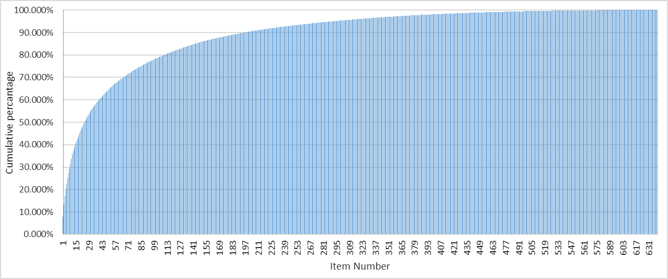
  ABC analysis
C
B
A
Figure 1: ABC classification

Slide 10
  ABC analysis
In the tables below show the number of products that classified into A, B and C.
Table 2: A-Classified Families
Table 3: B-Classified Families
Table 3: C-Classified Families
Family Product | Number of items
Bizol | 24
ACDelco | 1
Bosch | 24
Elec Parts | 2
Flamingo | 1
HMG | 2
Milpet | 1
North Sea | 17
Remax | 3
Samitto | 22
Sauer | 1
TEXTAR | 2
Lubricants and oils | 2
Family Product | Number of items
Bizol | 11
Bosch | 98
Elec Parts | 20
Flamingo | 7
HMG | 1
Milpet | 1
North Sea | 12
Remax | 1
Samitto | 10
TEXTAR | 2
Lubricants and oils | 3
Family Product | Number of items
Bizol | 16
Bosch | 252
Elec Parts | 57
HMG | 17
Milpet | 1
North Sea | 7
Remax | 4
Samitto | 3
Lubricants and oils | 15

Slide 11

  Forecasting
Products forecasting was done for seven months ahead using the forecasting methods(MAPA, simple Moving Average 2, simple moving average 3, Naïve, Holt’s) by using R-program and Excel.
What is R-program?
R-Program is an integrated group of software for statistical calculation, graphical, and data processing. R program includes libraries that are used for forecasting such as MAPA and Holt which are used in our project to forecast intermittent demand

Slide 12

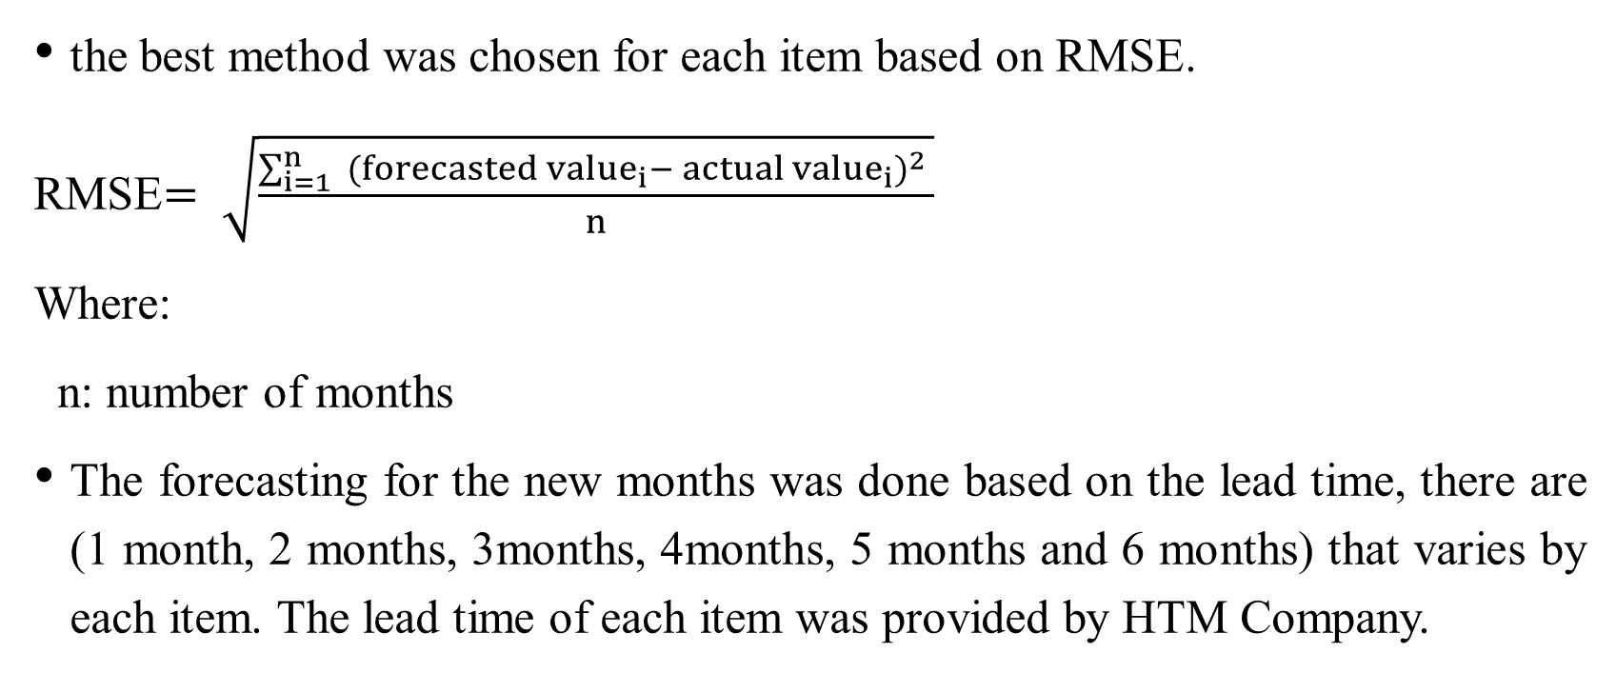
the best method was chosen for each item based on RMSE.
RMSE$= \sqrt{\frac{\sum_{i=1}^{n}{ ({forecasted value}_{i}−{{ actual value}_{i})}^{2} }}{n}}$
Where:
n: number of months
The forecasting for the new months was done based on the lead time, there are (1 month, 2 months, 3months, 4months, 5 months and 6 months) that varies by each item. The lead time of each item was provided by HTM Company.

Slide 13
  Result of forecasting
Table 5:Results of forecasting methods
Forecasting method | Number of items | Number of A items | Number of B items | Number of C items
Naïve | 89 | 50 | 21 | 18
Holt | 67 | 13 | 13 | 41
Simple Moving Average 2 | 22 | 6 | 11 | 5
Simple Moving Average 3 | 202 | 21 | 53 | 128
MAPA | 260 | 12 | 68 | 180

Slide 14
  Result of forecasting
Table 6:Results of forecasting methods
Barcode | Name of item | Lead time | The Method | Forecast
188408414 | SAMITTO HYDRAULIC 10 16L | 2 | Simple Moving Average 2 | 215
83016 | Bizol Allround10W-40 /لتر4 | 3 | Naïve | 708
86012 | Bizol truck essentail 15w-40 /لتر20 | 3 | Holt | 97
725601 | North sea TIDAL POWER HDX 15W-40 IBC 1000 L | 3 | MAPA | 5
85216 | BIZOL Protect 5W-40 /لتر4 | 3 | Naive | 432

Slide 15
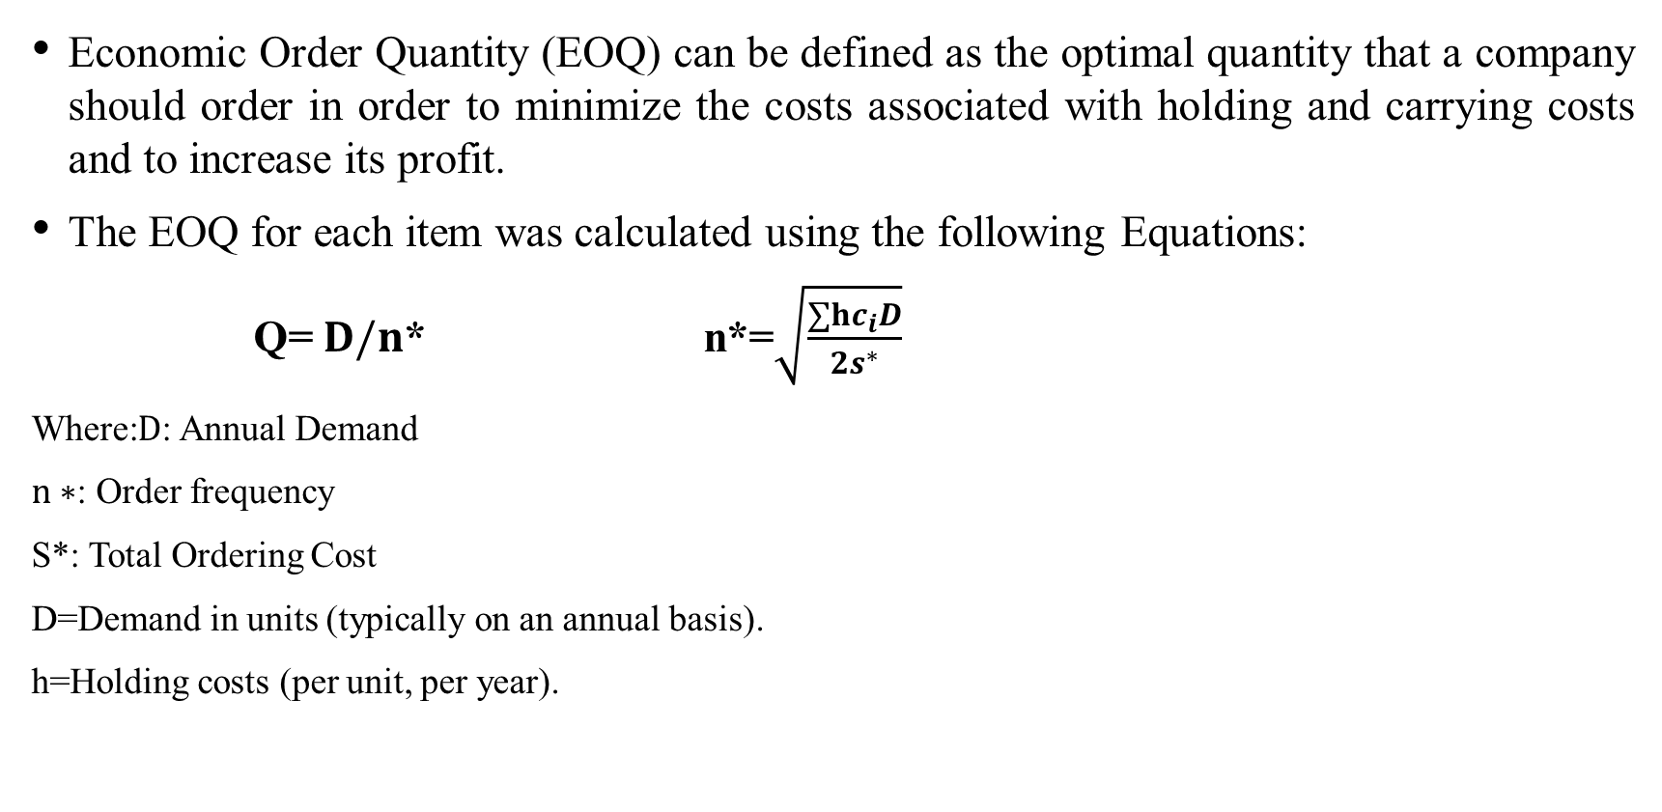
  Economic Order Quantity (EOQ)
Economic Order Quantity (EOQ) can be defined as the optimal quantity that a company should order in order to minimize the costs associated with holding and carrying costs and to increase its profit.
The EOQ for each item was calculated using the following Equations:
Q= $D/n$* n*=$\sqrt{\frac{∑hc_{i}D}{2s^{∗}}}$
Where:$D$: Annual Demand
$n∗$: Order frequency
S*: Total Ordering Cost
D=Demand in units (typically on an annual basis).
h=Holding costs (per unit, per year).​

Slide 16
  Economic Order Quantity (EOQ)
Table 7: EOQ calculation
Barcode | Name of item | Annual demand | Holding cost | Ordering cost | n | EOQ
135405201 | SAMITTO HYDRAULIC 68 16L | 6991.200 | 14.730 | 6.776 | 20 | 349.560
166789987 | SAMITTO 15W-40 16L | 5205.600 | 14.730 | 6.776 | 20 | 260.280
362950050 | SAMITTO HD 40 1L | 36660.000 | 1.236 | 0.569 | 20 | 1833.000
82012 | Bizol Allround 15W-40 /لتر20 | 1120.800 | 37.845 | 17.787 | 11 | 101.891
250552479 | SAMITTO ATF DEXRON II (Red) 1L | 27216.000 | 1.236 | 0.569 | 20 | 1360.800
148645136 | SAMITTO GREEN RUBBER GREASE NO:0 | 2400.000 | 14.009 | 6.444 | 20 | 120.000

Slide 17
  Safety Stock
Safety stock must be calculated to keep a suitable quantity of products and goods in the stock and to avoid shortages. In our project, after calculating the EOQ, the safety stock should be calculated for both normal and non-normal data.

Slide 18
  Normality test
The normality test is a test used to determine whether the data is following the normal distribution or not. The normality test in this project was done using SPSS Program.
The data was classified into normal and non-normal as shown in the table below.
Table8 : Normality test
Normality test | Number of items | Percentage
Continuously-distributed demand (Normal) | 57 | 8.9 %
Intermittent demand (Non-normal) | 583 | 91.09%

Slide 19

  Safety stock for normal data
The Safety Stock was calculated using the following Equation
$$SS=√l∗σ∗z_{0.95}$$
Where:
SS: Safety Stock
$d$: Demand
$l$: Lead time
$σ:$Standard deviation
$z_{0.95}$=1.65

Slide 20
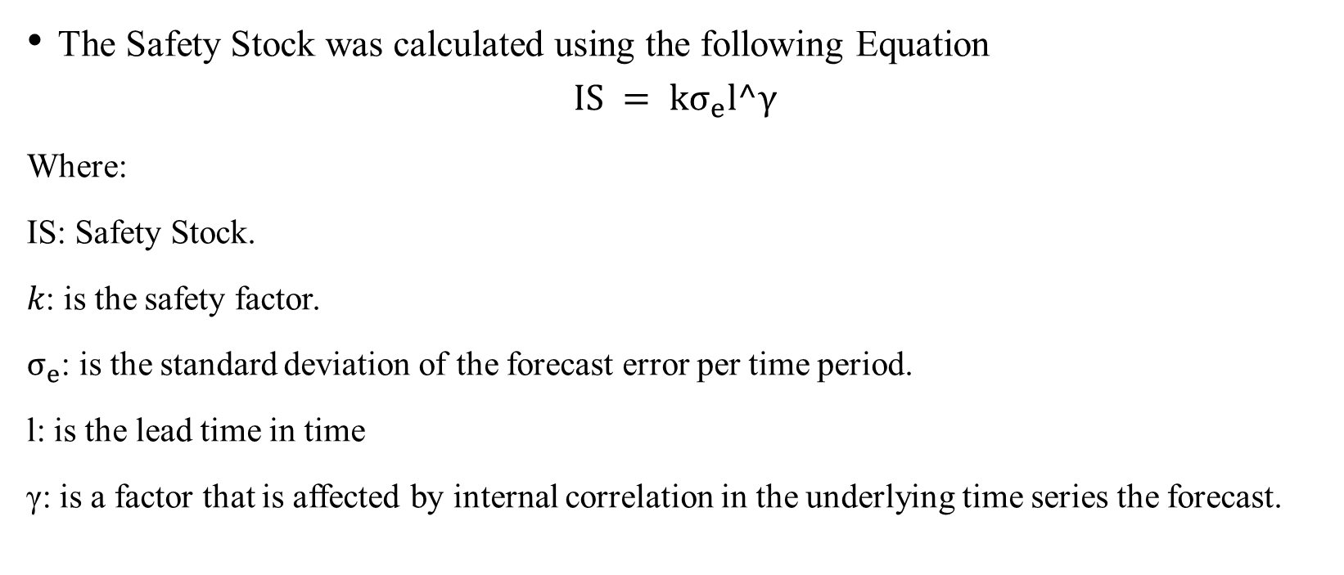
  Safety stock for non-normal data
The Safety Stock was calculated using the following Equation
$$IS = kσ_{e}l^γ$$
Where:
IS: Safety Stock.
𝑘: is the safety factor.
$σ_{e}$: is the standard deviation of the forecast error per time period.
l: is the lead time in time
γ: is a factor that is affected by internal correlation in the underlying time series the forecast.

Slide 21
  Reorder point (ROP)
A reorder point (ROP) is a threshold or limit that any inventory item stock shouldn’t go below. Therefore, the ideal inventory reorder point allows for adequate time to make a new order before running out of stock. The ROP for each item was calculated using the following Equation:
ROP = d*l + SS
Where
ROP: Reorder Point
d: Demand
l: lead time
SS: Safety Stock

Slide 22
  Results of safety stock and reorder point
The table below shows results of SS and ROP for some items
Table9 : SS and ROP for some items
Barcode | Code | Demand | Lead time | Safety stock | Reorder point
135405201 | 1 | 750 | 2 | 819.2751299 | 2319.27513
166789987 | 2 | 450 | 2 | 743.4515014 | 1643.451501
362950050 | 3 | 9062 | 2 | 3182.829043 | 21306.82904
82012 | 4 | 180 | 3 | 114.8869301 | 654.8869301
250552479 | 5 | 6356 | 2 | 2181.777973 | 14893.77797
148645136 | 6 | 210 | 2 | 486.9915113 | 906.9915113
735663 | 7 | 75 | 3 | 304.9362049 | 529.9362049
85116 | 8 | 537 | 3 | 168.9009345 | 1779.900935
85821 | 9 | 156 | 3 | 69.67520784 | 537.6752078
188408414 | 10 | 214.25 | 2 | 327.6167139 | 756.1167139

Slide 23
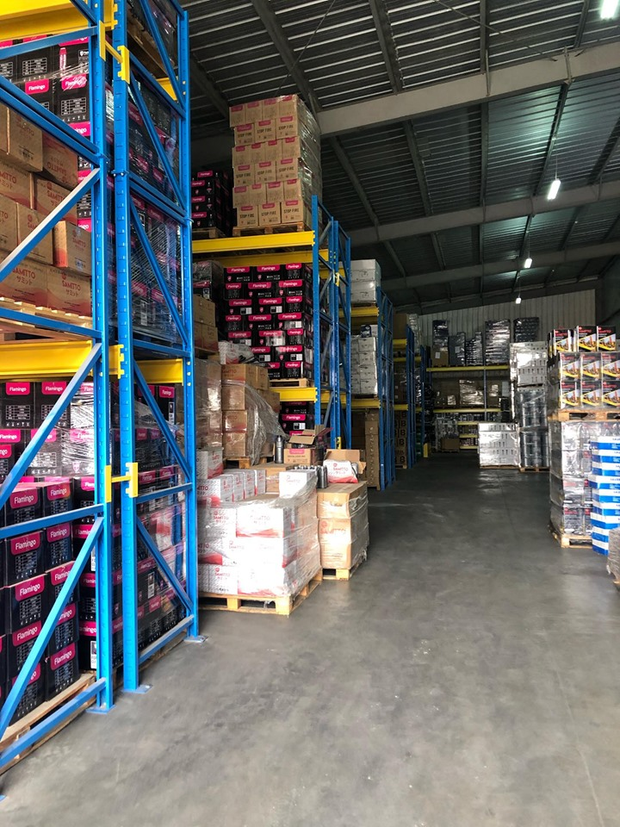
  Current layout of HTM main warehouse
the current layout of HTM warehouse may be considered as good, but there are some mistakes that are needed to be fixed.
The main warehouse of HTM company is divided into two sides, the left one consists of shelves and the products are stored on it vertically as shown in the following figure.

Slide 24
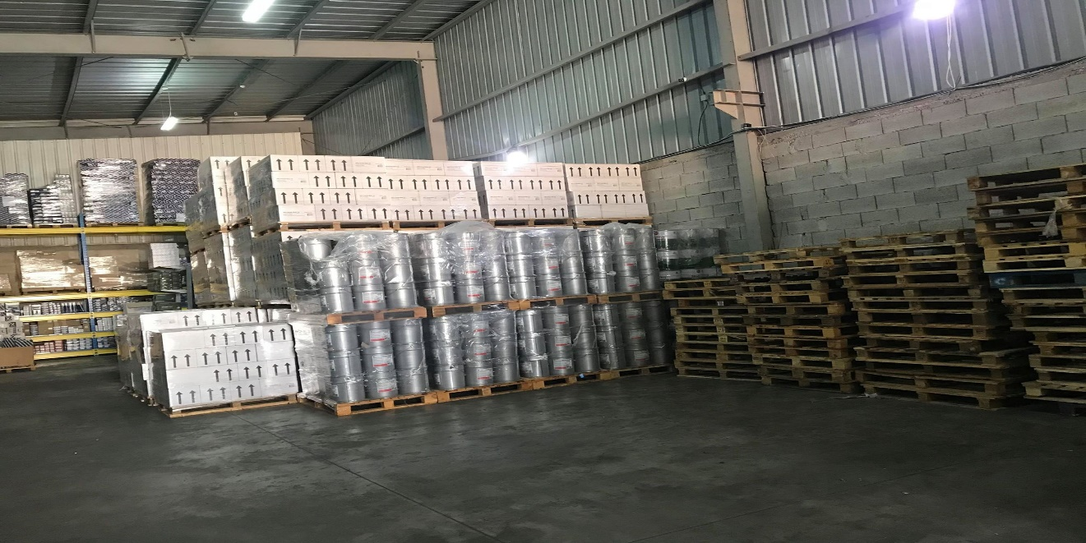
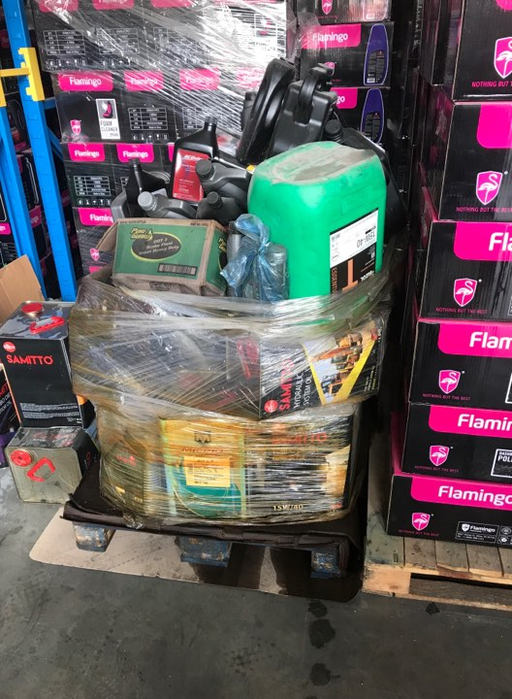
  Current layout of HTM main warehouse
On the other side, there are no products stored on the shelves, but they are stored on the top of each other so that many defects may be occurred

Slide 25
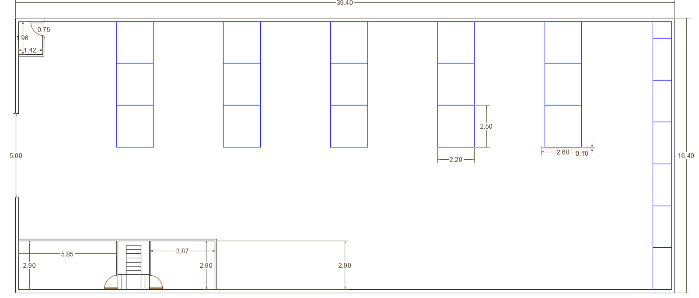
  Current layout of HTM main warehouse

Slide 26
  Improved layout of HTM main warehouse
The quantity of the products will be increased according to the study of inventory management, and the company should increase the capacity of the warehouse.
We suggest that the shelves are the solution, when the shelves are added in the right side of the warehouse, the utilization of the vertical space will be increased. The capacity of the warehouse will be increased. This solution will help the company to reduce the defects of products.

Slide 27
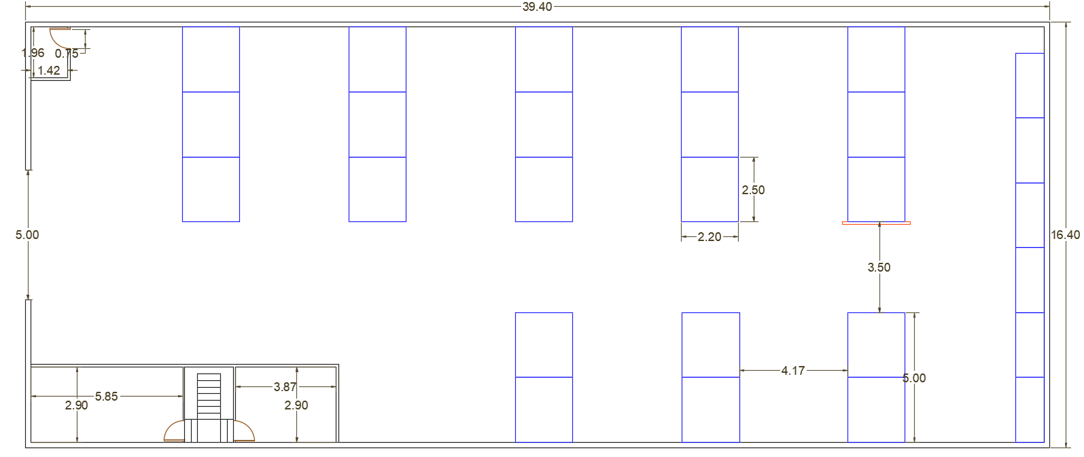
  Improved layout of HTM main warehouse

Slide 28
  Material handling in HTM main warehouse
In the main warehouse of HTM company, pallet truck, forklift and palletize used to transport the products.
Forklift used in material handling operations in warehouse because they can easily move. But because of the excess use of the forklift in the warehouse, the outer part of it is completely worn.

Slide 29
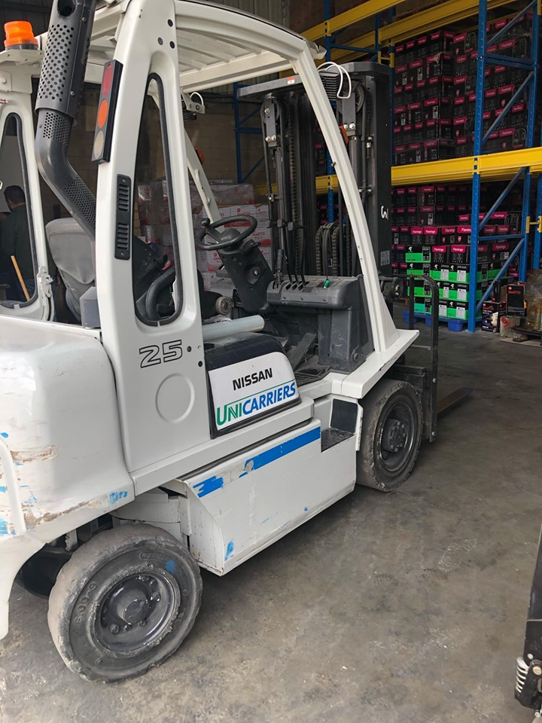
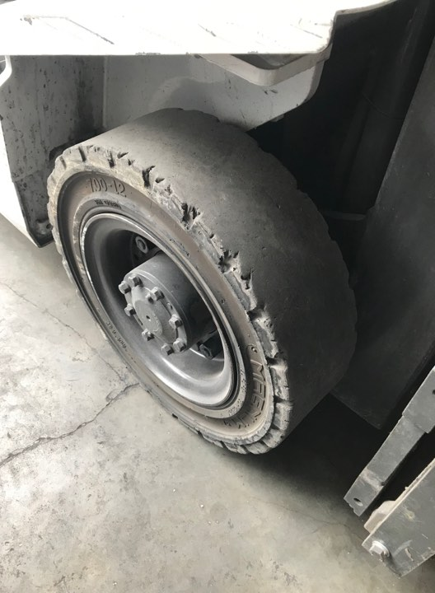
  Material handling in HTM main warehouse

Slide 30
  Conclusion
From our results we conclude that applying scientific-based forecasting using different forecasting methods such as MAPA, naïve, Simple Moving Average and others gave more precise results which if it was followed will yield to better service level and reduced costs.
Despite that no accidents happened so far, but from ethical and tactical aspects, safety rules must be taken into consideration to get rid of any future accident.
ABC classification helps the company to identify the most important items.
The total cost was reduced by nearly 80,000 NIS.

Slide 31
  Recommendations
After studying the current status of the HTM main warehouse, we recommend that some changes should be applied to improve the inventory management. Recommendation are:
The classification of ABC should be taken into account.
Discounts and offers should be provided to get rid of overstock of C items.
The forecasting method should be chosen as suggested according to the calculations of each item.
The current stock differs from the calculations of safety stock, so the quantity that should be ordered is equal to reorder point plus EOQ minus current stock of each item.
To improve the current layout of main warehouse, the proposed layout should be applied.
To avoid hazard, the guidelines of storing flammable materials should be followed.
Some safety rules and instructions must be seriously taken to avoid some hazards and accidents.

Slide 32
  Research gap
In this project, most of issues related to inventory management were performed. Due to the limited time, there are some topics and ideas were not possible to implement such as the concept of using the electrical forklift instead of the traditional one. This suggestion will help company properly utilize the available space as well as provide an easy access to several stored products. We recommend to complete this study and to search if this proposed idea which is to replace the traditional forklift with the electrical one is a feasible solution or not.

Slide 33
Thank You

