Slide 1

Karam Shawish & Zuhair AlSader
Supervisors:
Dr. Ashraf Armoush & Dr. Samer Arandi
19/5/2016

Slide 2
Explore sites beyond your sight.
Let your creativity speak loud.
Notes:
It’s for people who like to explore new places, and who value creative works.
It’s also for people who like their creativity to speak out loud and be heard.

Slide 3
ViPolis is a network of creative works augmenting the real world.
Augmented Reality with Location
Notes:
Let me explain what it means..

Slide 4
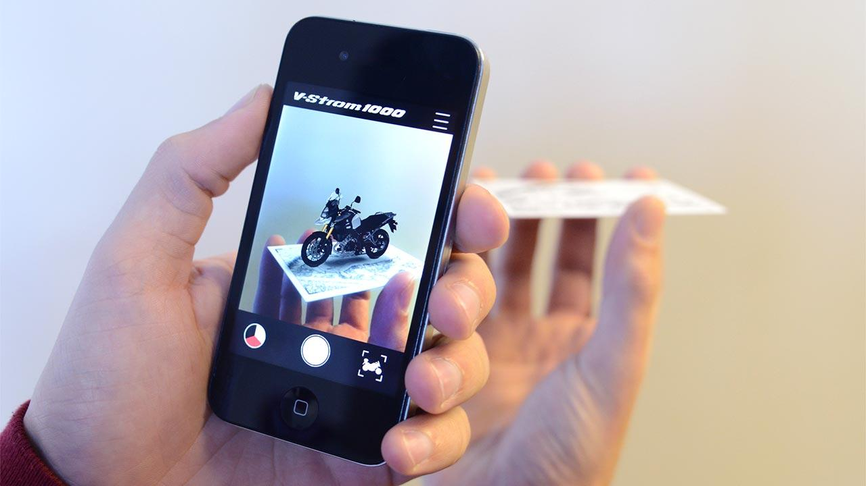
Augmented Reality (AR)
Buzzword.
Supplementing the real world with static or interactive text, images, videos, or 3D objects, where the real view is modified by a computer.
The view isn’t completely replaced - that’s the territory of virtual reality.
Mostly real-time.
Mobile phones take the lead.
Notes:
Takes many forms - the simplest yet most common one is within your hands.

Slide 5
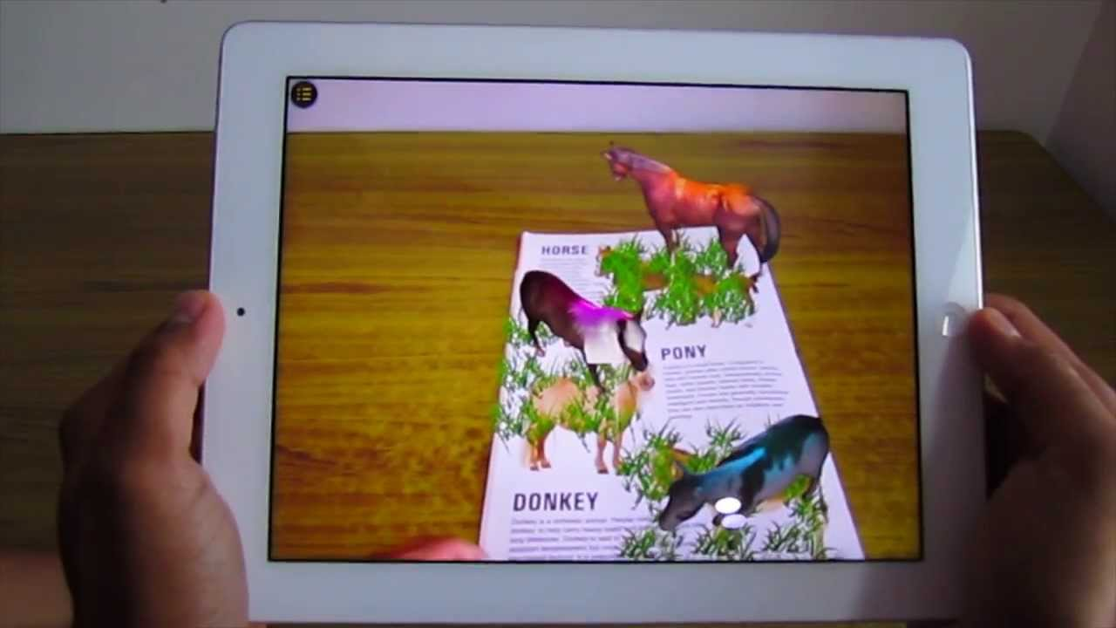
But..
Mostly imprisoned inside of books or indoors.
Some people prefer to be outdoors.
#FreeTheAR
Notes:
While it might sound like good news for introverts and book worms,

Slide 6
The Idea
Allow creative people to show off their work in an AR experience.
  Creative works are attached to a picture marker (can be a field view)
  The location of the work is determined and saved along with the object.
App users can discover nearby objects that they can hunt and search for.
  One of the objects is chosen, and it’s viewed if the marker matches.

Slide 7











ViPolis: Aerial View
Notes:
Elastic beanstalk

Slide 8
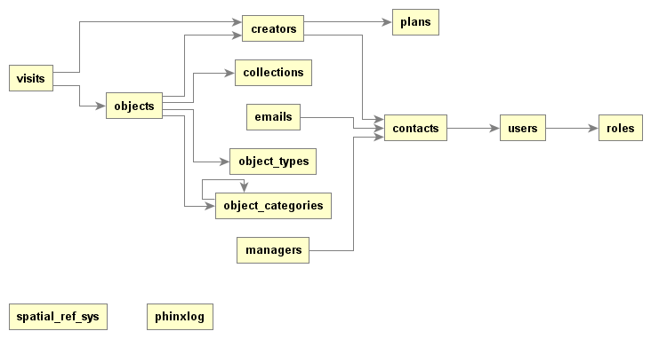
Class Diagram:

Slide 9
Why ?
Image recognition + AR SaaS.
Relatively good benchmarks.
Works better than others outside.
Has better (and well-documented) web API, including management API.
Use is less restricted than others. (Terms of Use)
Can be deployed on-premise. (Future plans?)
Allows for offline recognition.
Offers a reasonably good free plan.
Tried tonnes of other frameworks to finally anchor on this: Vuforia, GlorAR, Wikitude, Augment, ...
Notes:
@Karam?

Slide 10
CraftAR API
Management API:
  Manage your account.
  Add items, targets & media.
  Media includes images, text, videos & 3D objects.
  Used by server.
Image recognition API:
  Recognizes images, returns only text.
Cloud AR:
  Recognizes images; downloads and caches 3D scenes to be rendered by the device.

Slide 11
CraftAR Collections
Collections contain multiple objects that can be recognized from the same view.
We used collections to group objects that reside within the same area.
That way, you can easily explore nearby objects.

Slide 12
Server API for mobile.
Login:
Accepts: Username, Password, Device ID.
Returns: User profile, token, meta.
Get nearby objects:
Accepts: Location (from GPS), Object Category (optional), Range, User token.
Returns: List of objects located within ‘range’ around ‘location’.
Get specific object:
Accepts: Object identifier, User token
Returns: More information about the object. Detection uuid and collection token.

Slide 13
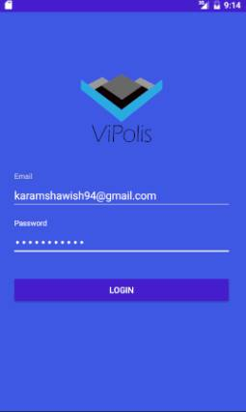
Mobile

Slide 14
Video Demo

Slide 15
Mini-Business Model:
Cost Structure:
  Servers: generally low-cost.
  CraftAR €99/mo. €1990 cloud AR set-up.
Revenue Model:
  Free plan: 1 public object. Pay for more.
  Design services, and custom experiences.
Key partnerships:
  CraftAR
  Real-estate
  Architects
  Government

Slide 16
Possible Competitors
The frameworks themselves
WallAMe - not popular and no 3D objects.
TAGD: specific for street art.
Notes:
@Karam

Slide 17
Limitations
Financial limtations - seed funding.
Technical limitations during image capture.
Connectivity: our app needs at least 3G.
Speed: 3D models are often huge, so better connectivity means better performance.
Spread and community: to be successful, we need big community.
Locaility: Both a pro and a con.

Slide 18
Future work
Bluetooth beacons
Marketing
Gamification
Treasure hunt

Slide 19
Thanks for Listening

