Slide 1
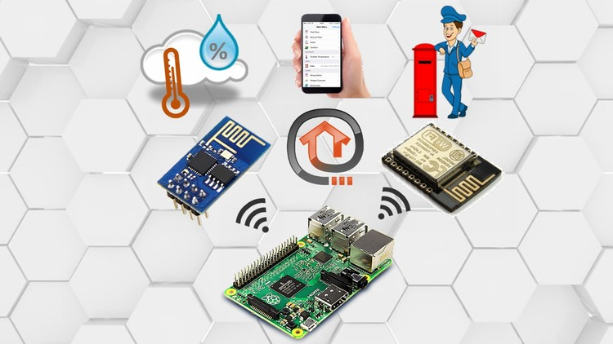
Home Automation System
Supervisor : Dr.Rae’d Al-Qadi
Azza Abdulghani & Raghad Sayeh

Slide 2
Outline
Home Automation System
About MQTT protocol
Components and Tools
Functionalities
Google Assistant
Limitations and Future work
Demo

Slide 3
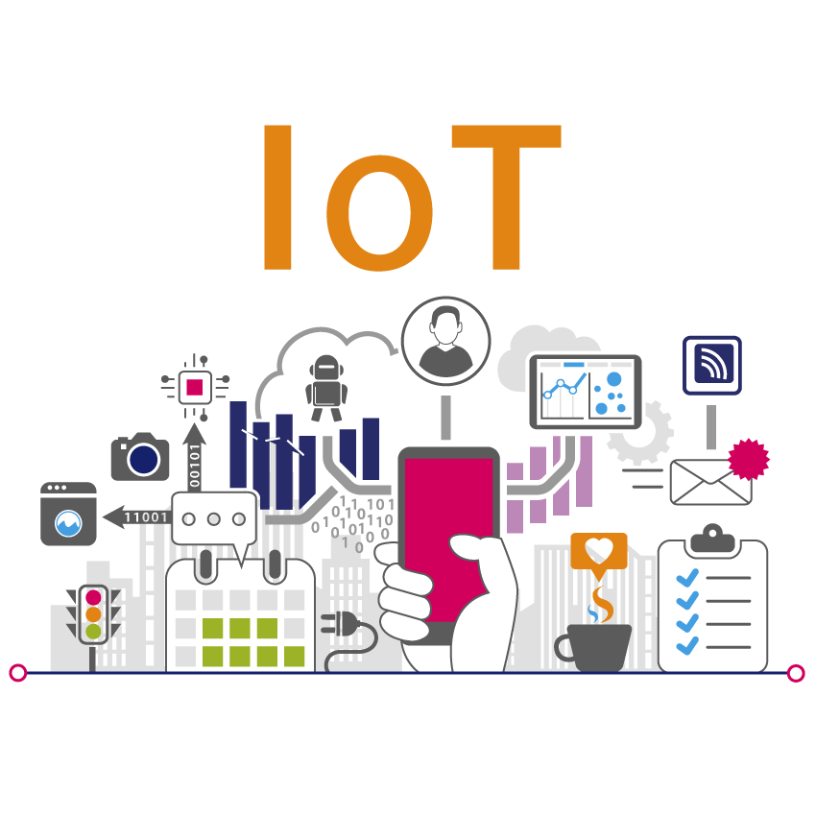
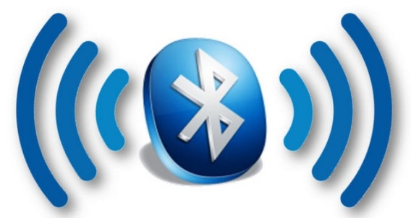

Home Automation Systems:
Home Automation = Smart Home
Controlling
Security
Alarms

Slide 4
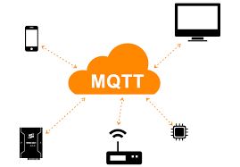
MQTT
MQTT message queue telemetry transport
Advantages: low bandwidth, security, QoS, distribution.
Components: Broker, Clients and topics

Slide 5
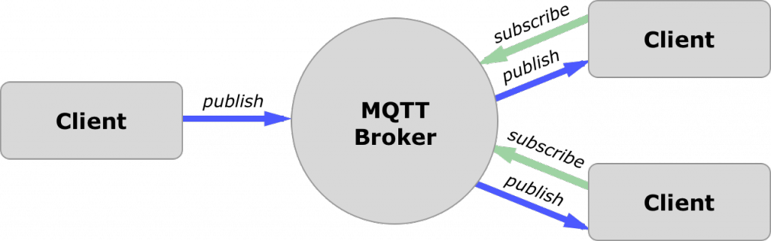
Pub/Sub protocol
The pub/sub model decouples the client that sends a message from the other client that receive messages.
The connection between them is handled by the broker.

Slide 6

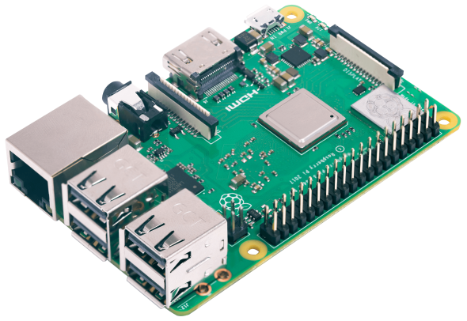
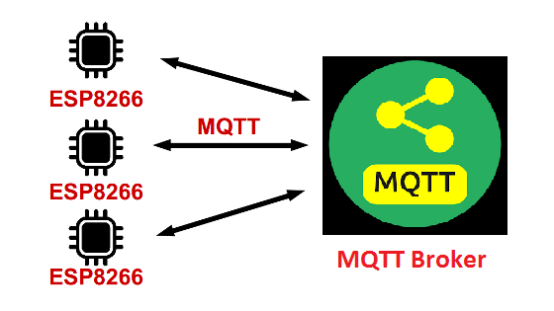
Raspberry pi = Broker
CPU on board
MQTT Server = Mosquitto(OS)
MQTT server is a device or program that interconnects the MQTT clients.

Slide 7
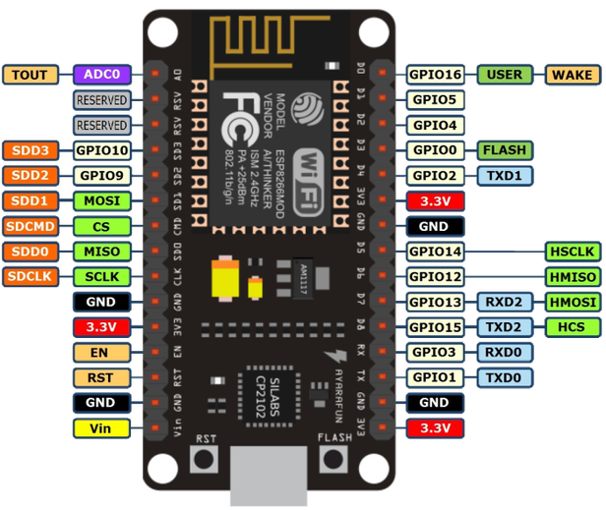
Nodemcu = clients
NodeMCU is an open source IoT platform.
Has ESP8266 Wi-Fi module.
2 Nodemcu are MQTT clients.
Each Nodemcu has different
topics and devices .

Slide 8
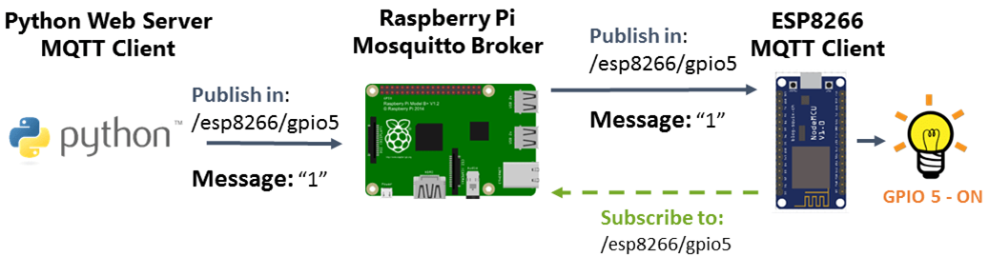
1. Control Lights
This is done using power light.
connected on nodemcu
(client1).
Process:

Slide 9
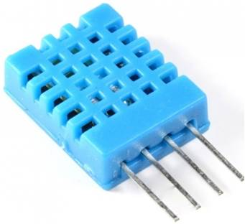
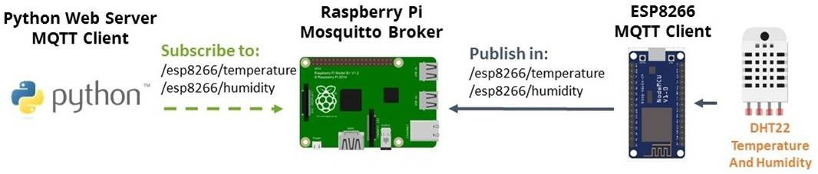
2. Sensor Readings
DHT11 sensor for temperature and humidity.
Connected on nodemcu(client1)
through a resistor.
Process:

Slide 10
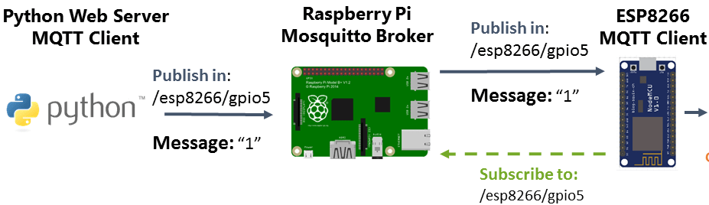

3. Garage Door
Connected to nodemcu2 (client 2)
To open or close the garage door
Using Servo Motor
Process :

Slide 11
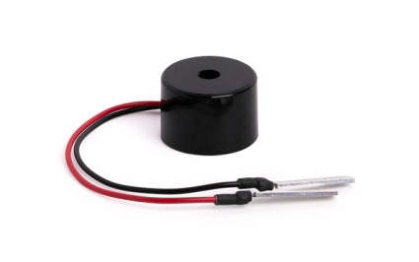
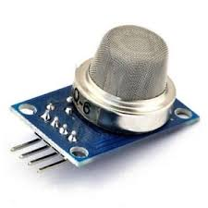

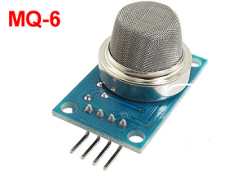
4. Gas Leakage Detection
If there is a gas leakage, a buzzer will turn on amd a window will open.
A message will show in MQTT client.
Using MQ6 Gas sensor and buzzer
Process :

Slide 12
Google Assistant
It is Google’s voice-controlled smart home.
It can achieve these things: control devices and find the information about the device’s status.
It works with IFTTT and Adafruit IO, this combination will perform voice-controlled home.

Slide 13
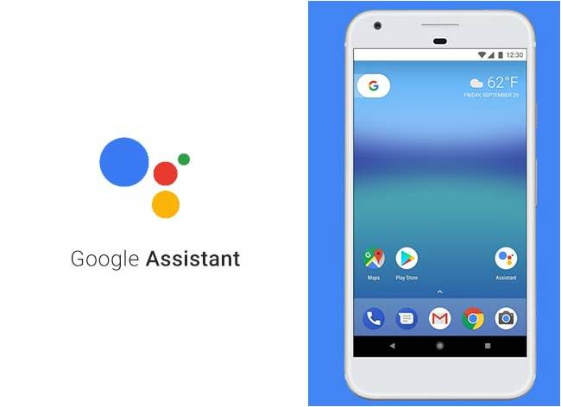


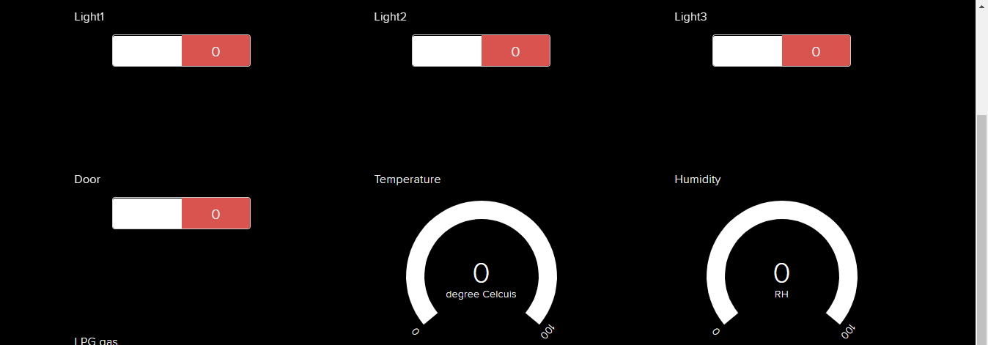

Slide 14
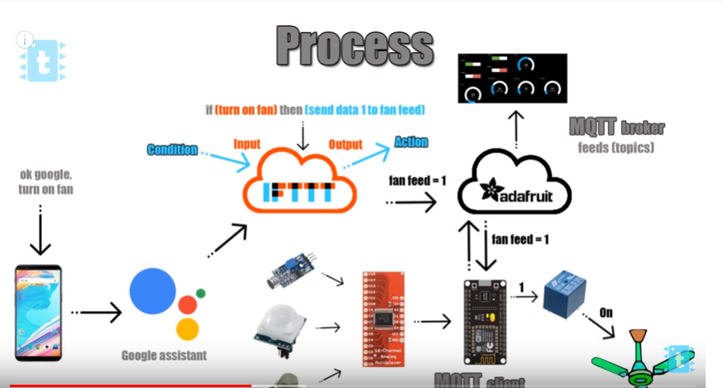
GA process

Slide 15
Limitations and Future work
Limitation :
Google Assistant app is incompatible in our country.
Future work :
Using Google assistant in Real home.
Expanding the functionalities.

Slide 16
Demo

