Slide 1

-
LTE Planning
and Specific Propagation Model Selection
Prepared by:
Khawla Daraghmeh
Ola Mashaqi
Suhad Malayshi
Supervisor: Dr.Yousef Dama

Slide 2
Outline
Aims
Network Planning phases
What we have done regarding planning
    Coverage Capacity: initial planning results
    Cell Capacity: initial planning results
Site Allocation stages and results
Site Specific Propagation Model
    Hata and Cost Hata
    Full 3D
Design Description
Path loss , received power and propagation path results
conclusion

Slide 3
Aims
Two Main Aims
To design LTE network for Nablus city.
To Select specific propagation model Accurately

Slide 4
Network Planning Phases (general overview)
1
Pre_Planning Phase
Dimensioning
2
Planning Phase
Coverage
Capacity
3
3
Detailed Planning
Frequency
Neighbour
Parameter
4 Optimization

Slide 5
What we have done regarding planning
Coverage Planning
link budget
Cell and Site areas
Number of sites
Capacity Planning
Site and Cell Capacity
Site Allocation
Google earth + MP

Slide 6


Coverage Results
Rural | Suburban | Urban | Dense Urban
6.899 | 1.282 | .471 | .295 | Cell Range (km)
3-sector antenna, BW<=90˚ |  |  |  | Site Layout
3 |  |  |  | Number of Cells per Site
10.349 | 1.922 | .707 | .443 | Inter Site Distance (km)
.019 | 6.900 | 20.000 | .550 | Deployment area (km2)
1 | 4 | 78 | 9 | Site Count
Total number of sites to be allocated = 92

Slide 7
Cell Capacity: initial planning results
site capacity (Mbps) |  | area
DL | UP
59.824 | 29.282 | Dense Urban
56.288 | 26.985 | Urban
39.835 | 16.441 | Suburban
30.194 | 8.732 | Rural

Slide 8


Site Allocation
Site allocation gives an indication of how the network behavior will be after deployment, so it is an important step in LTE network planning.
Tools

Slide 9
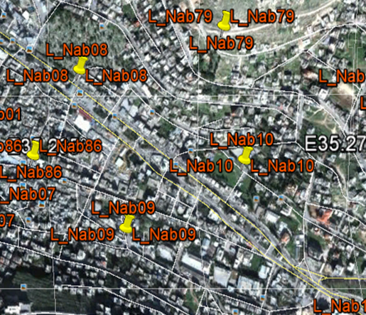
Site Allocation Stages
Stage One
Allocate sites on Google Earth.

Slide 10
Site Allocation Stages
Stage Two
Site coordinates uploaded to Mentum Planet tool

Slide 11
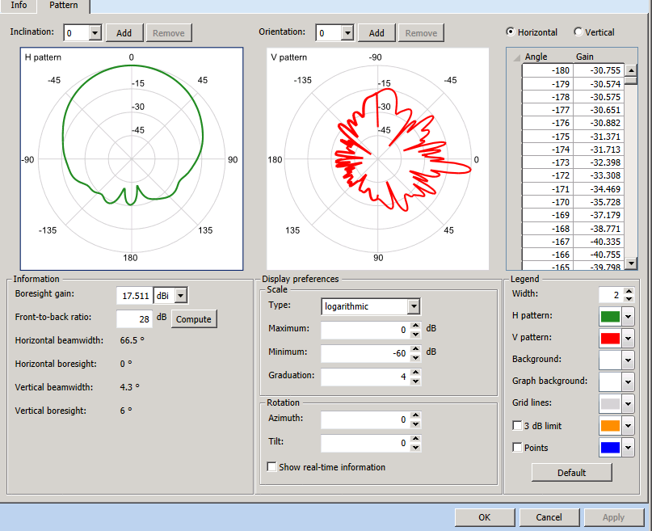
Site Allocation Stages
Stage Three : Antenna Parameters

Slide 12
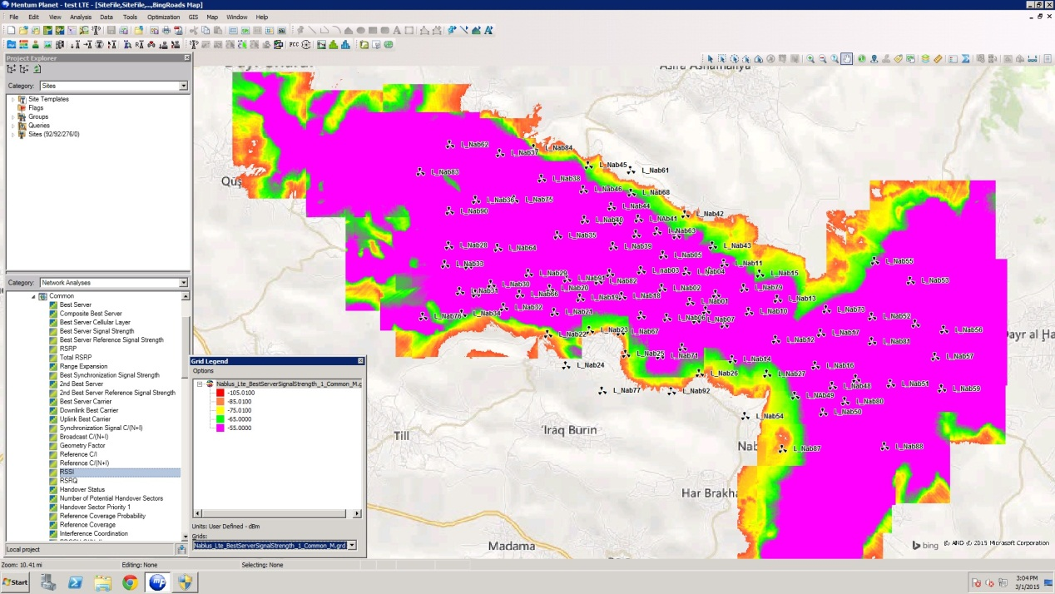
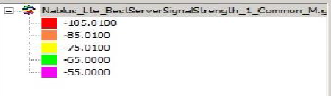
Site Allocation Results
Rx level

Slide 13
Rx level

Slide 14
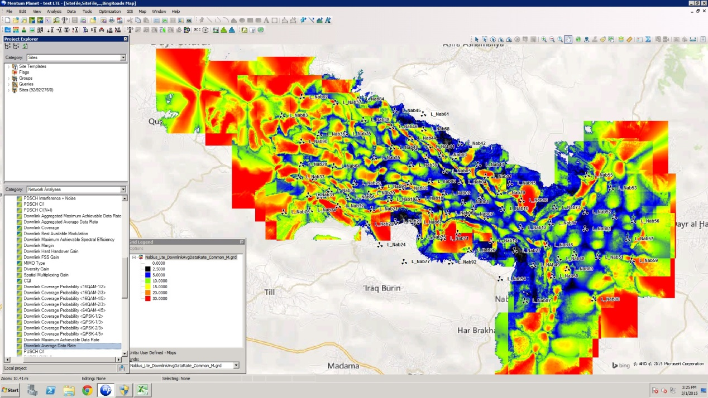
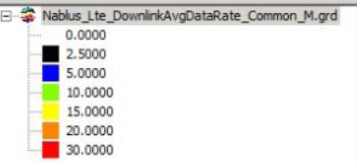
Site Allocation Results
Maximum Achievable Data rate for each user

Slide 15
Percentage Total Area

Slide 16
Site Specific Propagation Model
Propagation models have been developed to be able to
estimate the radio wave propagation as accurately as possible
predict the path loss between the transmitter and receiver

Slide 17
Models Under Study
Hata's propagation model is the basis for several widely used propagation models in the cellular industry. The main attraction of Hata's model is its simplicity. Hata's basic model is valid in the frequency range of 150-1500 MHz
Cost-Hata model is also known as COST-231 Hata model. It is the extension of Hata model (Okumura Hata model) and it can be used for the frequencies up to 2000 MHz

Slide 18
Models Under Study
Full 3D
Places no restriction on object shape; it allows buildings to have sloped roofs.
It is also the only model which includes transmission through surfaces.
It is the only ray-based model .
Minimum frequency: 100 MHz
Maximum frequency : depends on application

Slide 19
Wireless InSite Tool
Our model was created by using Wirless InSite designed by remcom USA
powerful electromagnetic modeling
predicting the effects of buildings and terrain on the propagation of electromagnetic waves.
It predicts how the locations of the transmitters and receivers within an urban area affect signal strength.

Slide 20
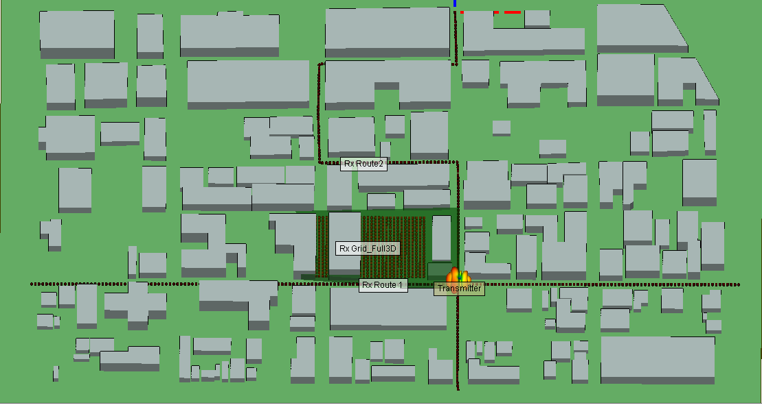
Design Description
A model similar to Nablus city was used to study the propagation environment.

Slide 21
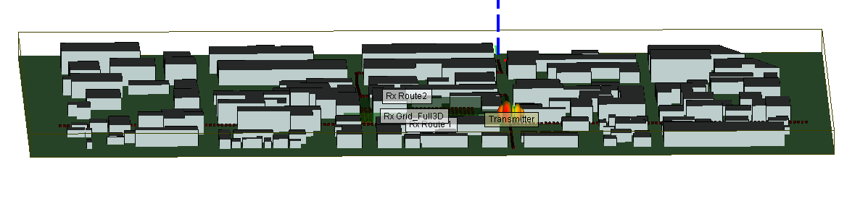
Design Description
The measurements were made on These specifications
1000 m x 600 m area
transmitters height =18 m
buildings around transmitter
height from 12 to16 m

Slide 22
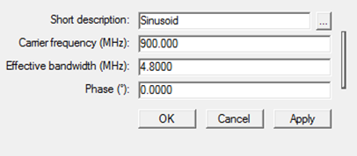
Design Description
Materials
Building material is concrete with thickness 0.3 m
Antenna Waveforms
waveform with carrier frequency 900MHz (within GSM900 band) with effective bandwidth 4.8 MHZ (Jawwal Bandwidth)

Slide 23
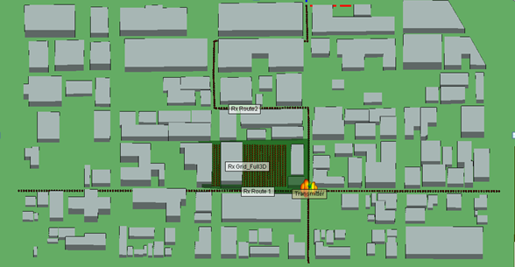
Receiving Point Scenarios
First Scenario
two routs ,200 measurements points, 5 meter spacing , around 950 m with height 1.5 m .

Slide 24
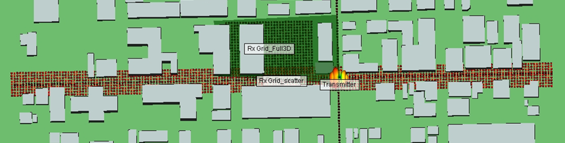
Receiving Point Scenarios
Second Scenario
Grid of receiver points ,to show the behavior of models

Slide 25

Propagation Models Results

Slide 26
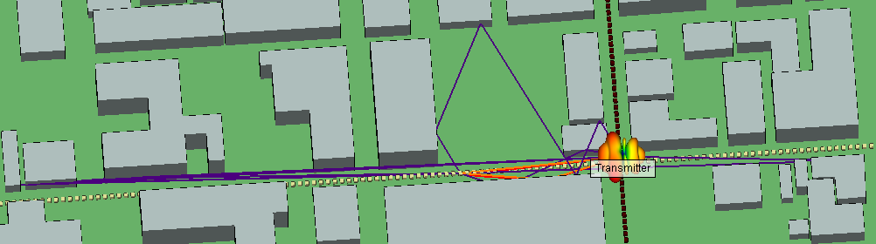
Full 3D propagation path

Slide 27
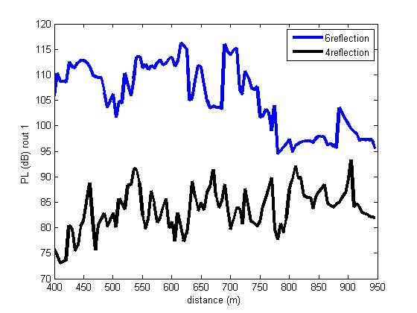
Effects of number of reflections

Slide 28
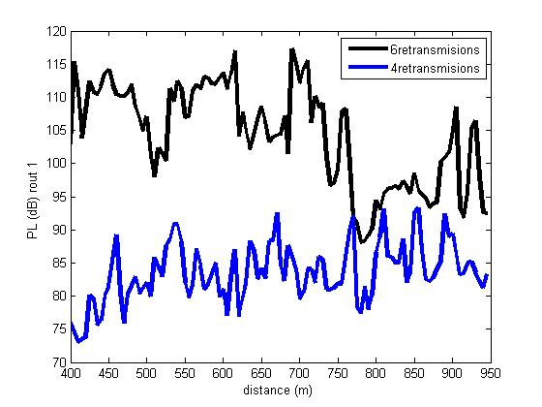
Effects of number of Transmissions

Slide 29
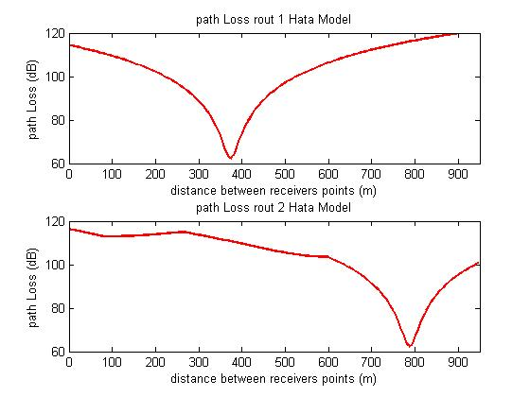
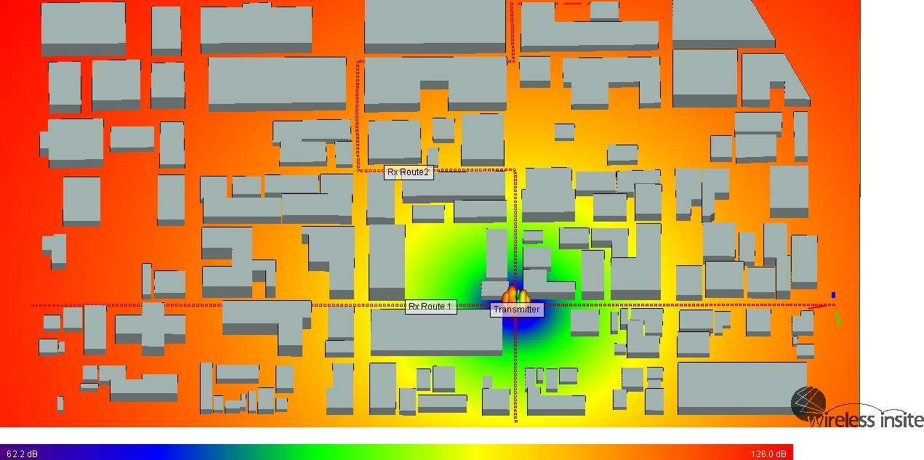
Hata Path Loss

Slide 30
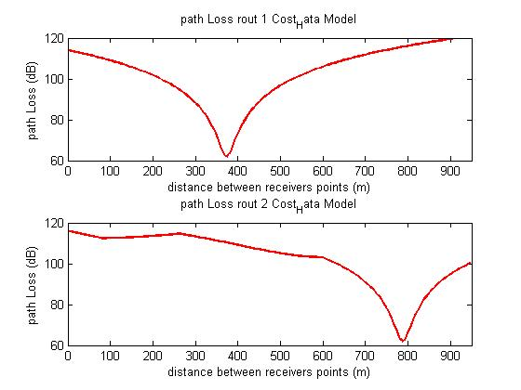
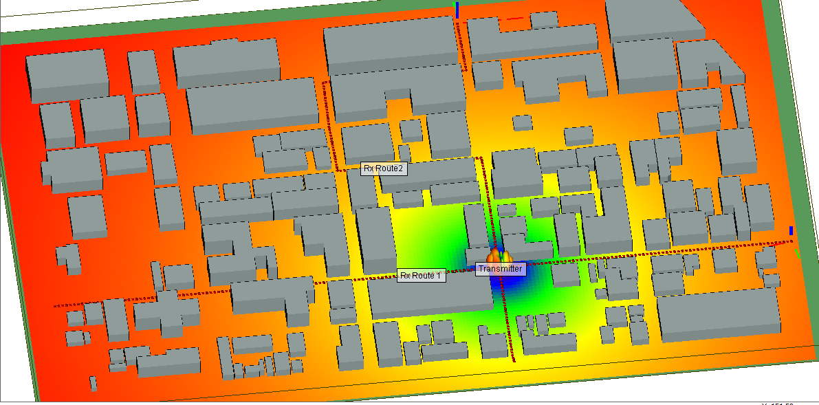
Cost Hata Path Loss

Slide 31
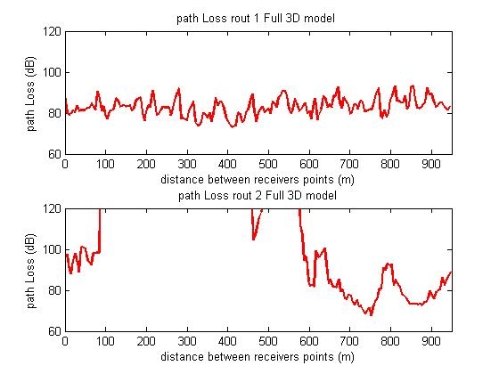
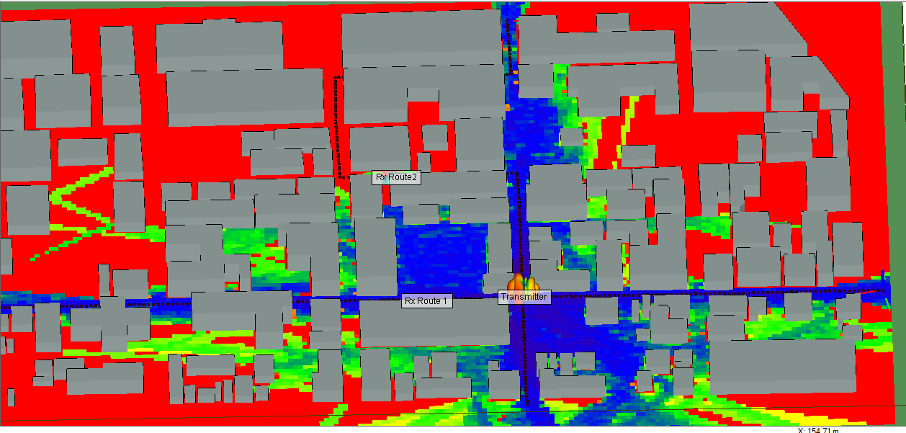
Full 3D Path Loss

Slide 32
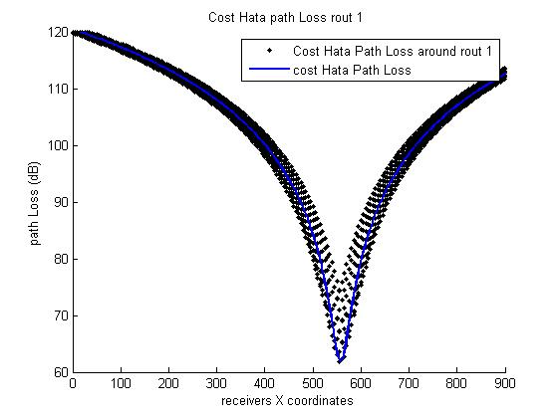
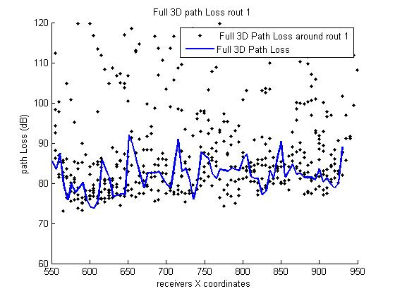
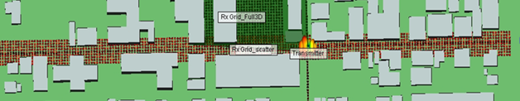
Scenario 2 results

Slide 33
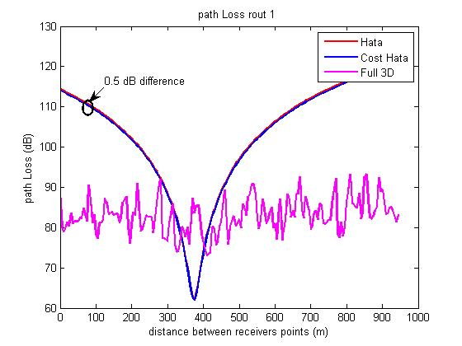
Summery Path Loss results (rout1)

Slide 34
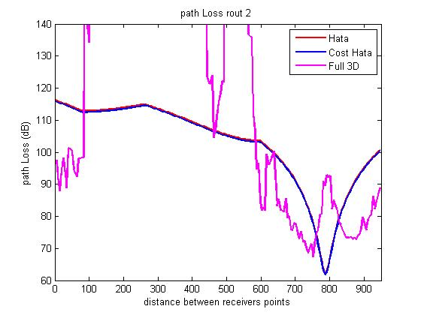
Summery Of Path Loss results (rout2)

Slide 35
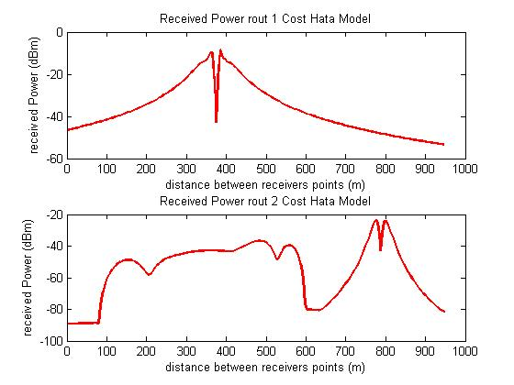
Hata Received Power

Slide 36
Cost Hata Received Power

Slide 37
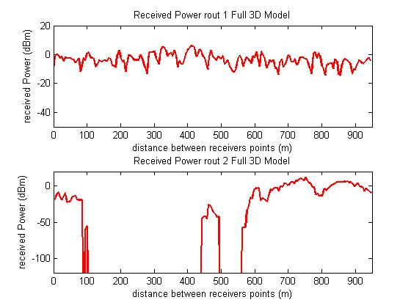
Full 3D Received Power

Slide 38
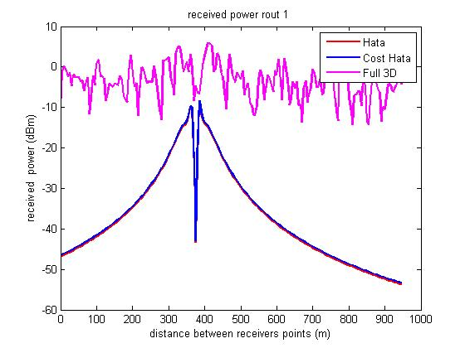
Summery Of Received Power(rout1)

Slide 39
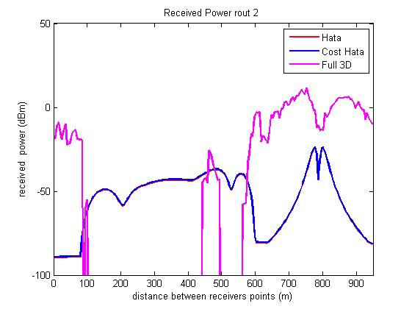
Summery Of Received Power(rout2)

Slide 40
Conclusion
We completed site allocation for Nablus city
We used the and the MP tool provided by Jawwal to allocate the sites and the to estimate the received power and the individual data
A comparison between Cost-Hata, Hata and Full 3D models using site specific tool named Wireless Insite was carried out.
A model similar to Nablus city was used to model the received power, path loss and delay spread where number of reflections and transmissions was modified and studied

Slide 41

+-*-/*/-9rr

