Slide 1
Hand Gestures Controlled Robot
Prepared by:
Samah Raby’ah & Maha Rabay’ah
Supervisor:
Eng. Asmaa Afeefi

Slide 2
Outline
Motivation
Objectives
Hardware Tools
How the project work ?
Hand Gestures
Demo
Constraints
Future work

Slide 3
Motivation
Remote control has become very widespread these days!
Hand gestures are an effective and very easy method

Slide 4
Objectives
A robot that is fully controlled by hand gestures.
Barriers Avoidance.
Remembering the last path.

Slide 5
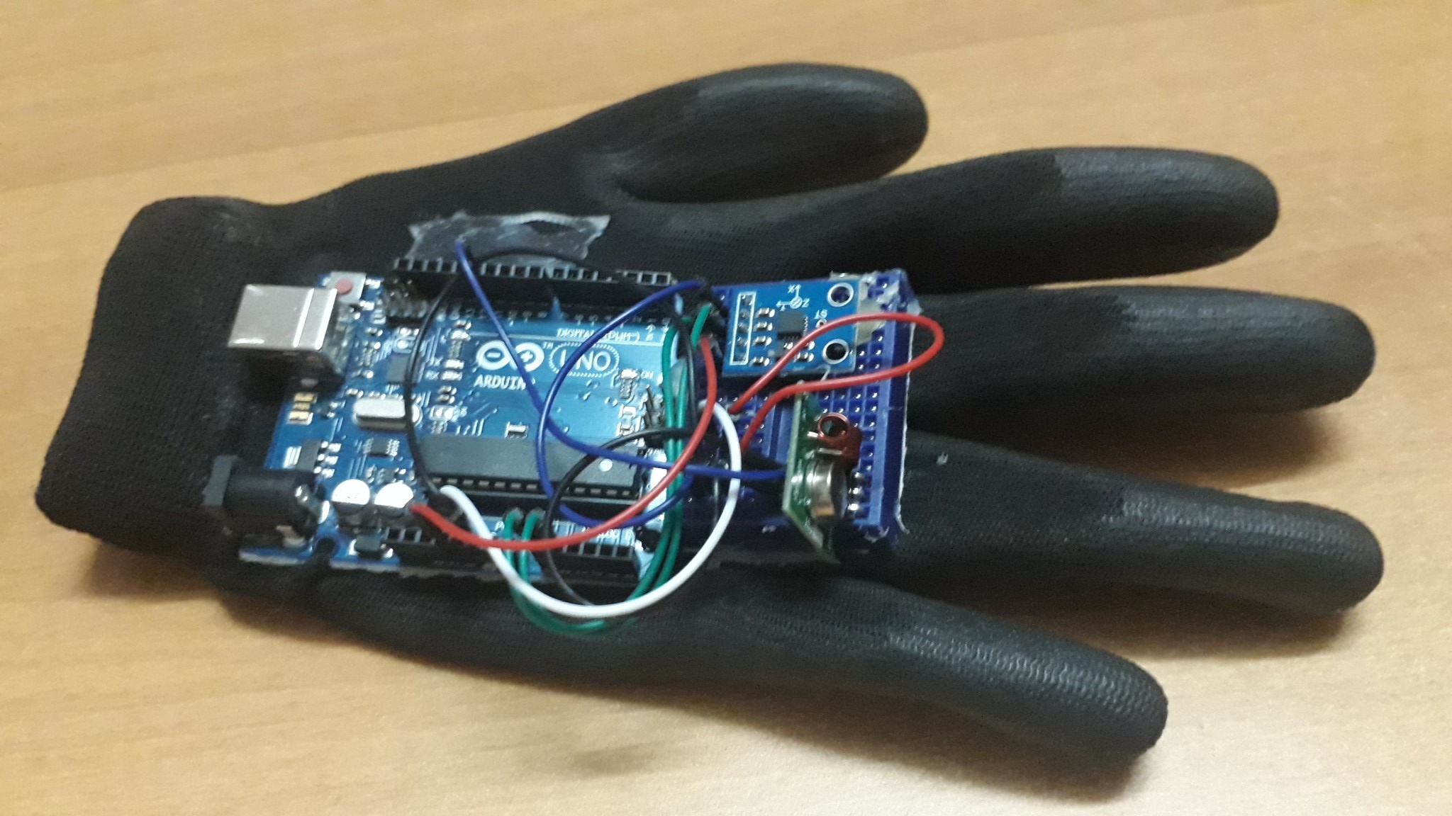
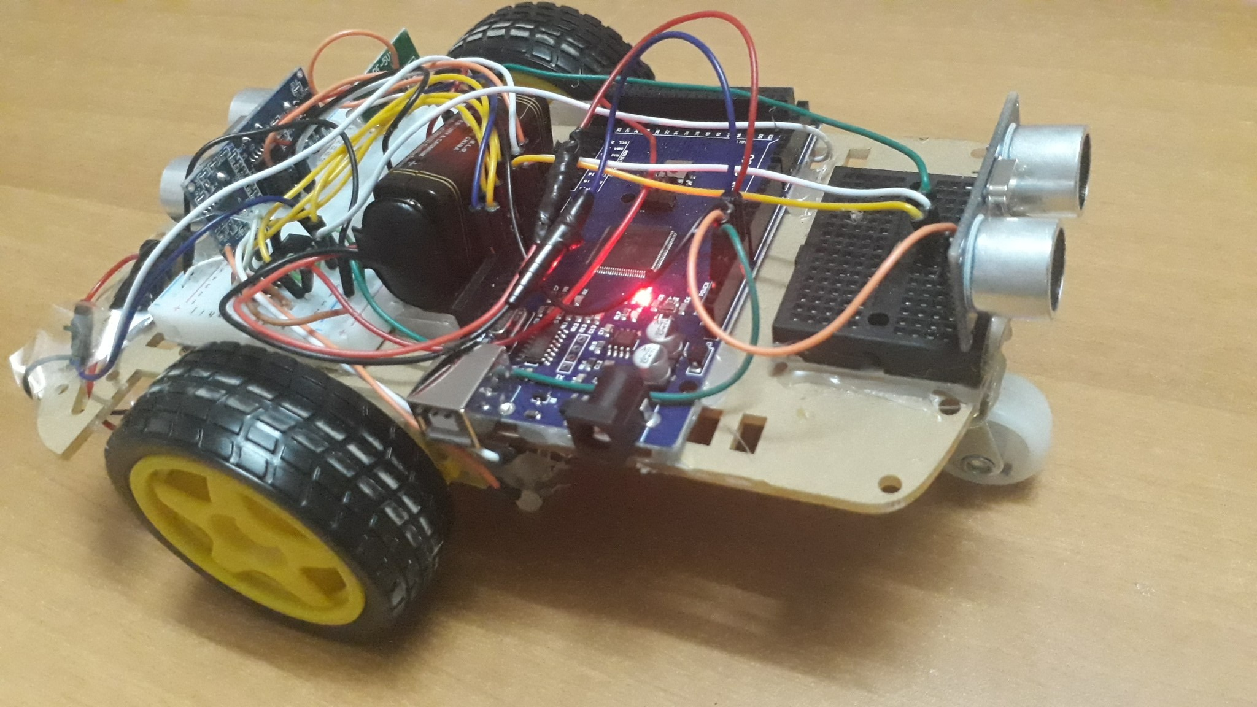
Project Parts
Transmitter & Receiver

Slide 6
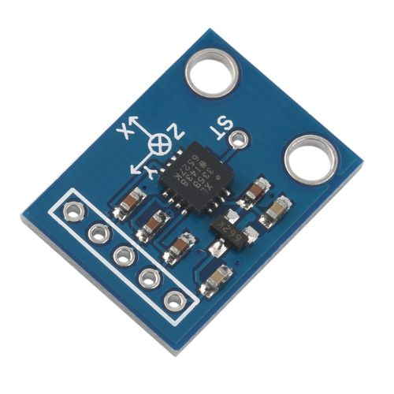
Hardware Tools
Transmitter Circuit:
ADXL335 Accelerometer
3-axis sensor, it reads the X, Y and Z coordinates.

Slide 7
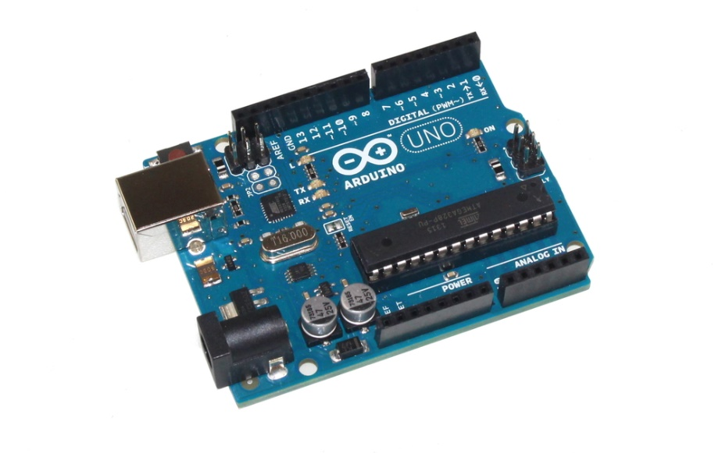
Hardware Tools
Transmitter Circuit:
Arduino Uno
A microcontroller board

Slide 8
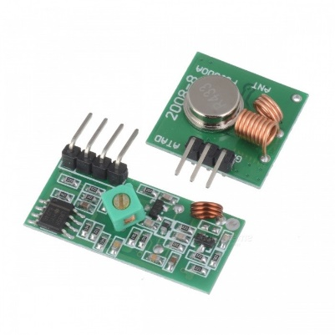
Hardware Tools
433 MHz Rf module
Send and receive radio signals between two devices

Slide 9
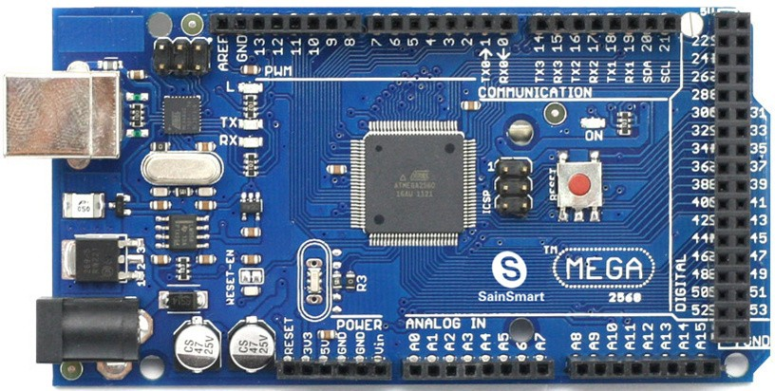
Hardware Tools
Receiver Circuit:
Arduino MEGA 2560
A microcontroller board

Slide 10
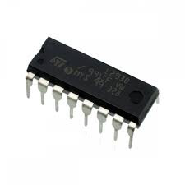
Hardware Tools
Receiver Circuit:
L293D motors driver
Used to control two DC motors at the same time.

Slide 11
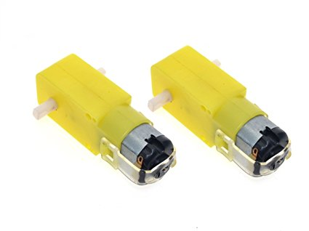
Hardware Tools
Receiver Circuit:
DC motors

Slide 12
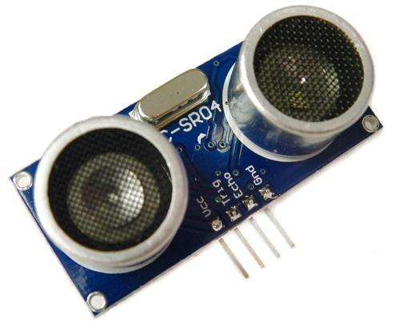
Hardware Tools
Receiver Circuit:
Ultrasonic sensors
A microcontroller board

Slide 13
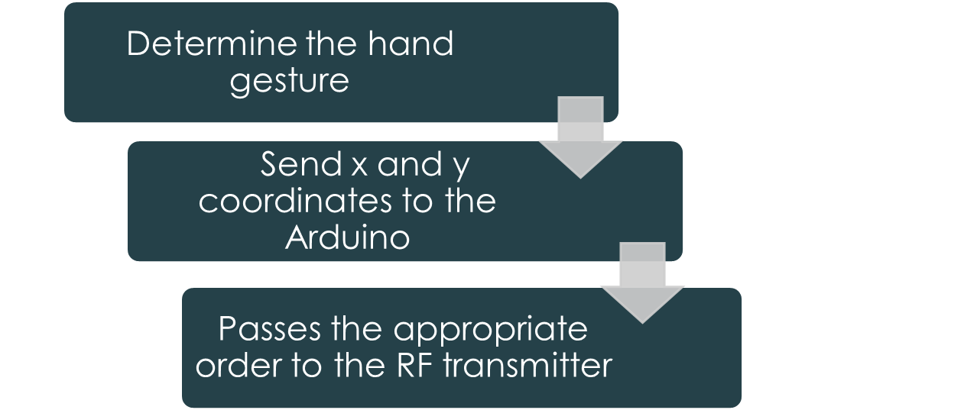
How the project work ?
The transmitter part:

Slide 14
How the project work ?
The receiver part:
Receive the data from transmitter part
Move it to the Arduino
Arduino passes it to the motor driver IC
Motor driver decided how to turn the two motors

Slide 15
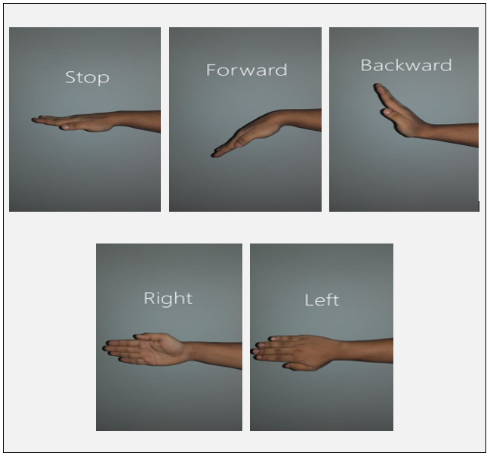
Hand Gestures

Slide 16
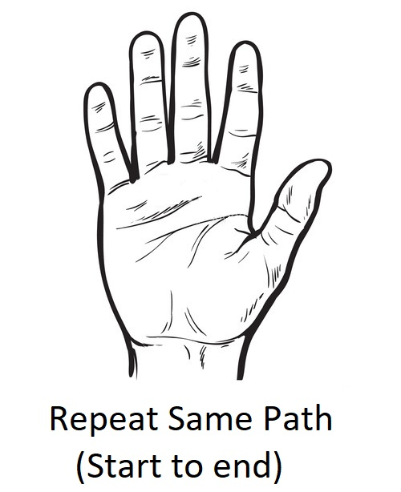
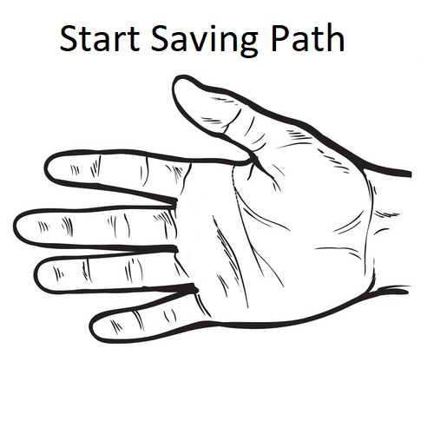
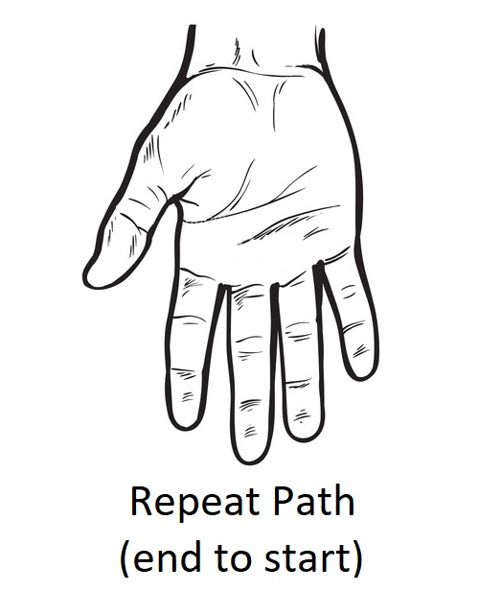
Hand Gestures

Slide 17

Demo

Slide 18
Constraints
Limitation of hand movements
DC Motor inaccuracy in save path

Slide 19
Future work
Game for children that equipped with sensors for educational goals.
Providing a camera and use it to reach small and dangerous places.
Insert robotic-arm to move small things.

Slide 20
Conclusion
To keep up with technological development it was good to design a robot controlled by hand gestures. With the possibility of this robot to save the path it was walked and avoid barriers.

Slide 21


