Slide 1
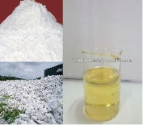
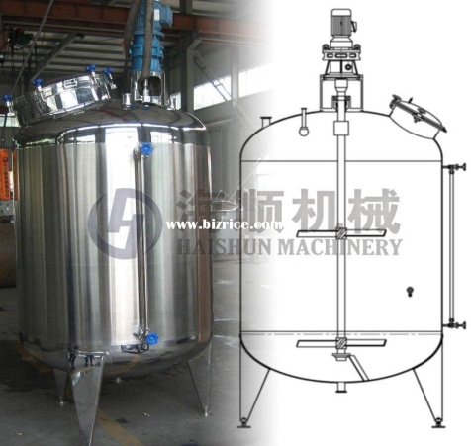
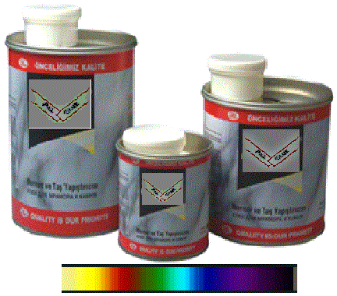

An-Najah National University
Chemical Engineering Department
Production and
Characterization of Marble Glue
Prepared by:-
Asmhan To’meh
Haneen Alama
Submitted to supervisor:-
Eng. Shadi Sawalha.
2012/2013

Slide 2

Table of content:-
Objectives.
Review of last semester.
Main constituents.
Methodology.
Results and Discussion.
Conclusion.

Slide 3
Objectives:-
Marble glue is an adhesive compound used to join parts of marble, granite and other stones in addition to fill holes and cavities that might exist.
The objective of this project is to produce local marble glue according to local and international specifications and with competitive cost. This aim was blossomed from the non-existence of a local product to improve the Palestinian economy.

Slide 4
Review of last semester:-
A survey was distributed to study the monthly consumption of the marble glue, the cost and the predicted Market share of the coming local marble glue.
The raw materials were determined by conducting different primary samples.

Slide 5
Main constituents of Marble Glue:-

Slide 6
1- Polyester:-
A typical polyester system consists of polyester resin and styrene.
The polyester resins are produced by the reaction between terephethalic acid and ethylene glycol to form the ester group which is the repeating unit to form the polyester.

Slide 7
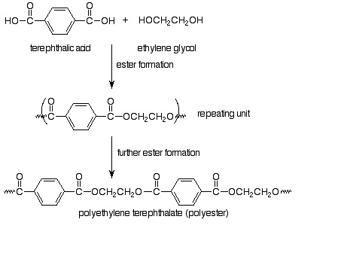
Mechanism of preparation of Polyester.

Slide 8
Properties of polyester:-
The most important properties of the unsaturated polyester are ease of handling, rapid curing with no volatiles evolved, light color, dimensional stability, and good physical and electrical properties.
Polyester doesn’t exhibit a strong chemical reaction with the stone, and it works by establishing a mechanical bond with the stone, therefor polyester
should be restricted to use with pours material like limestone.

Slide 9
2- Fillers:-
Pure CaCO₃
Cheap filler Comes in various sizes.
Ability to improve impact strength.
Cutting Stone
Wide available.
Used to improve impact strength.
Talc
Used to increase ‘bulk’ and reduce exothermic temperature usually in casting applications.
Used where lower shrinkage are desirable.
very cheap filler.
Used to stiffen thermoplastics

Slide 10
3- Additives:-
Castor oil
Lubricants.
Tends to form gums in a short time.
Anti-shrinking
Prevent the shrinkage of the material when using to joint parts of stones.

Slide 11
Plasticizer
Degrade most physical properties.
Increase impact resistance.
Decrease tensile strength and chemical resistance.
Thixotrops
Reduce flow in product.
Improve gap filling.
Reduce settlement of fillers.

Slide 12
Hardener:-
To achieve the function of the marble glue of joining two parts it’s very essential to use the hardener in a suitable percent.
Each type of resin has its suitable hardener, for polyester the suitable hardener is Cycloheaxanone Peroxide. The usage of hardener will achieve the drying of the material, but it’s important to accelerate drying, so an initiator like Zinc Octate was used, as a result the drying time was reduced to 5 minute.

Slide 13

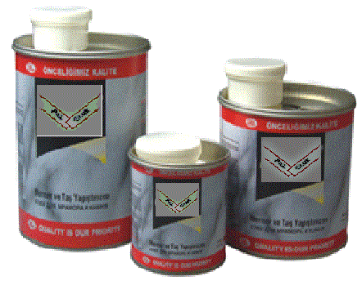
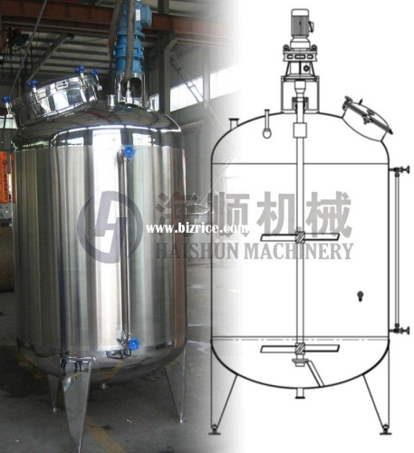

Methodology:-

Slide 14
Methodology:-
Experimental work
Tests
Facility layout
Cost analysis

Slide 15
1- Experimental work:-
1- The cutting stone filler was dried at 80° C.
2- Firstly, 40% of resin and 60% of different fillers were weighted.
3- The second step was mixing by adding the fillers to the resin until the desired texture was reached.
4- During the mixing, anti-shrinking material and lubricant oil were added.

Slide 16
5- The strength of product was tested by joining two pieces of stone with suitable amount of marble glue and hardener.
6- The stone was tested by the flexural test, and the test were analyzed to get the optimum sample.
7- Service life test was applied by soaking joining stones in (water, Citric acid and HCl) for 72 hour

Slide 17
2- Tests:-
A- Flexure Test:-
The flexural strength of a material is defined as its ability to resist deformation under load
The use of flexural tests to determine the mechanical properties of resins and to determine the interlaminar shear strength using a short beam.

Slide 18
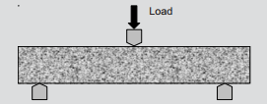
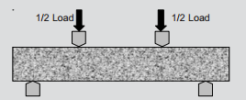
Two test types of Flexure test :-
A- 3-point flexure
B- 4-point flexure

Slide 19
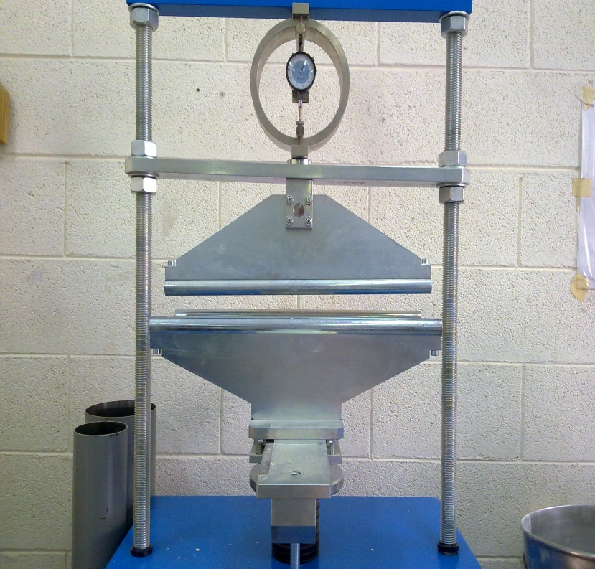
Flexure unit:-

Slide 20
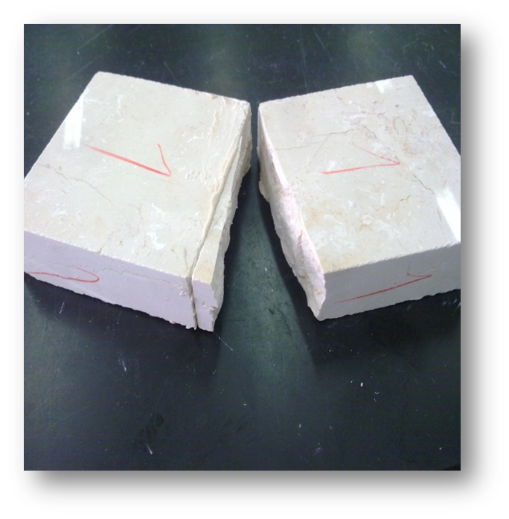
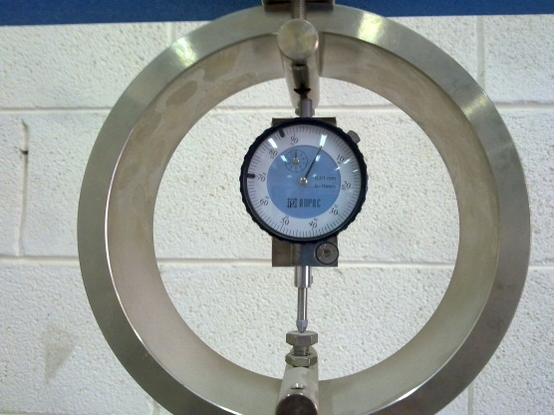
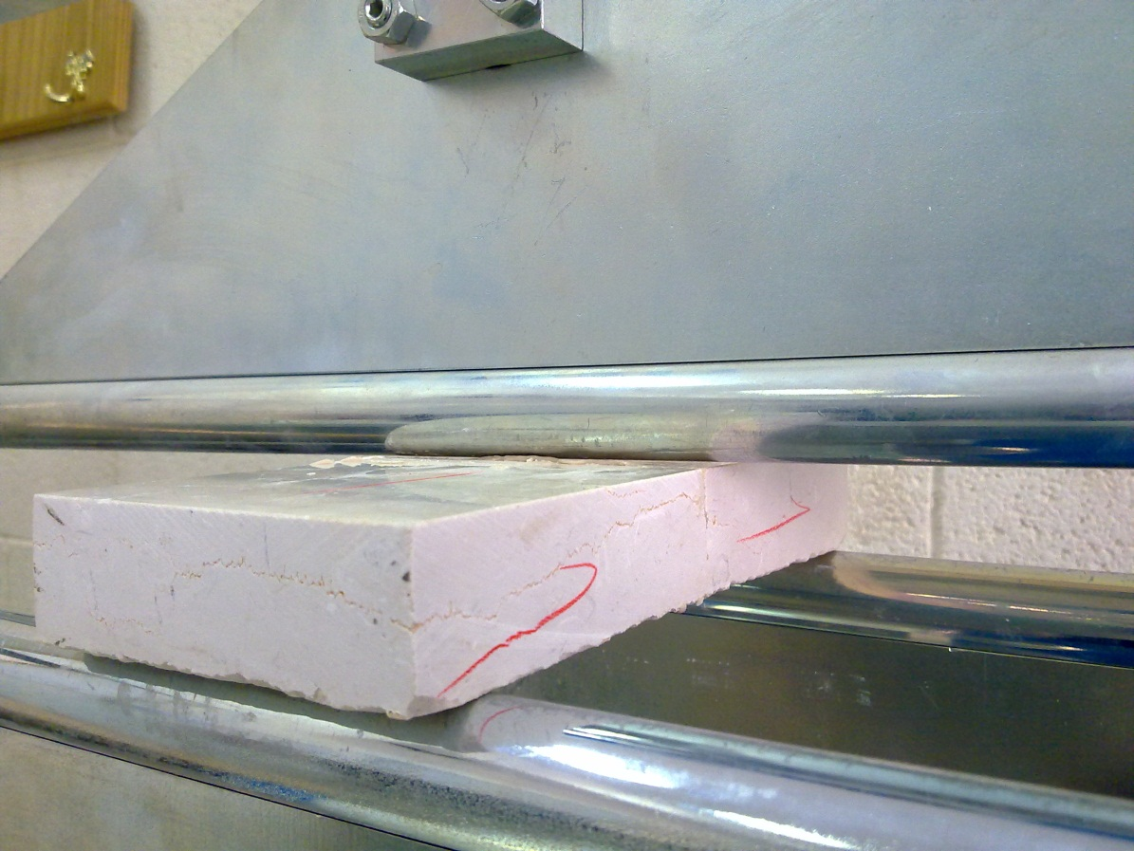
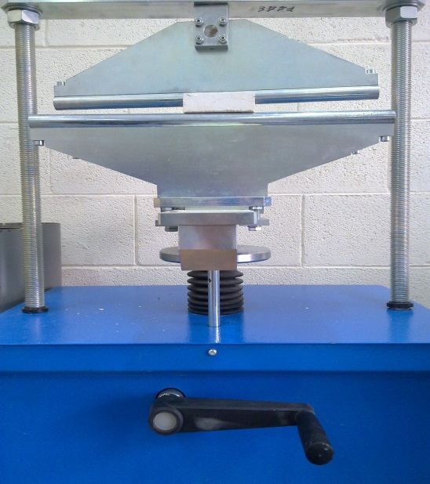
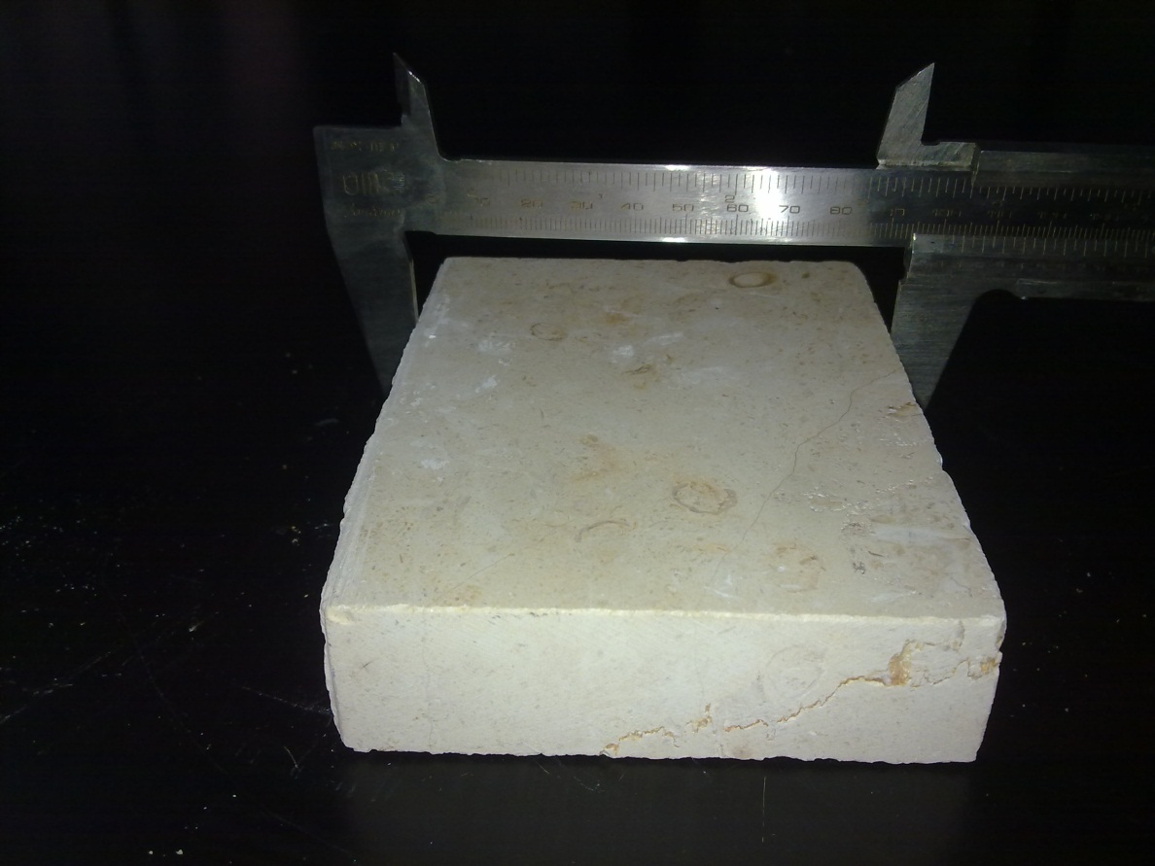
Procedure:-
2
4
3
1

Slide 21
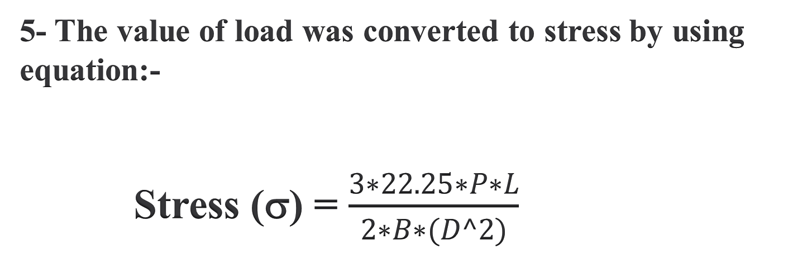
5- The value of load was converted to stress by using equation:-
Stress (σ) = $\frac{3∗22.25∗P∗L}{2∗B∗(D^2)}$

Slide 22
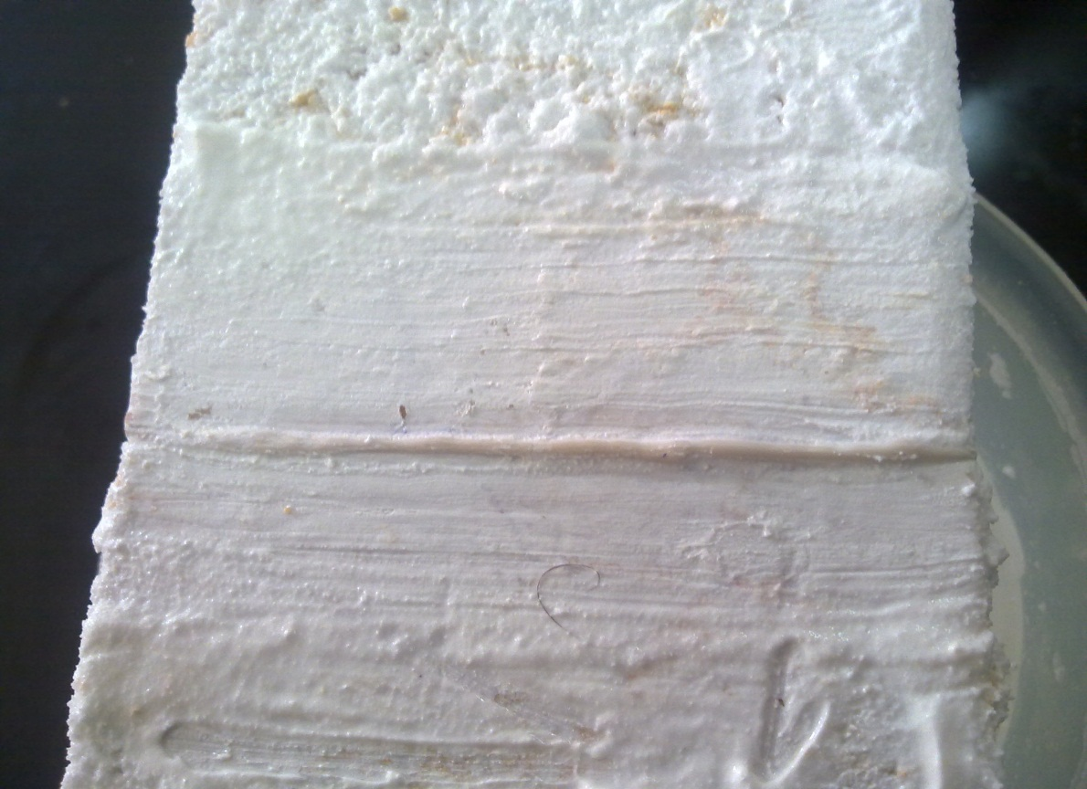
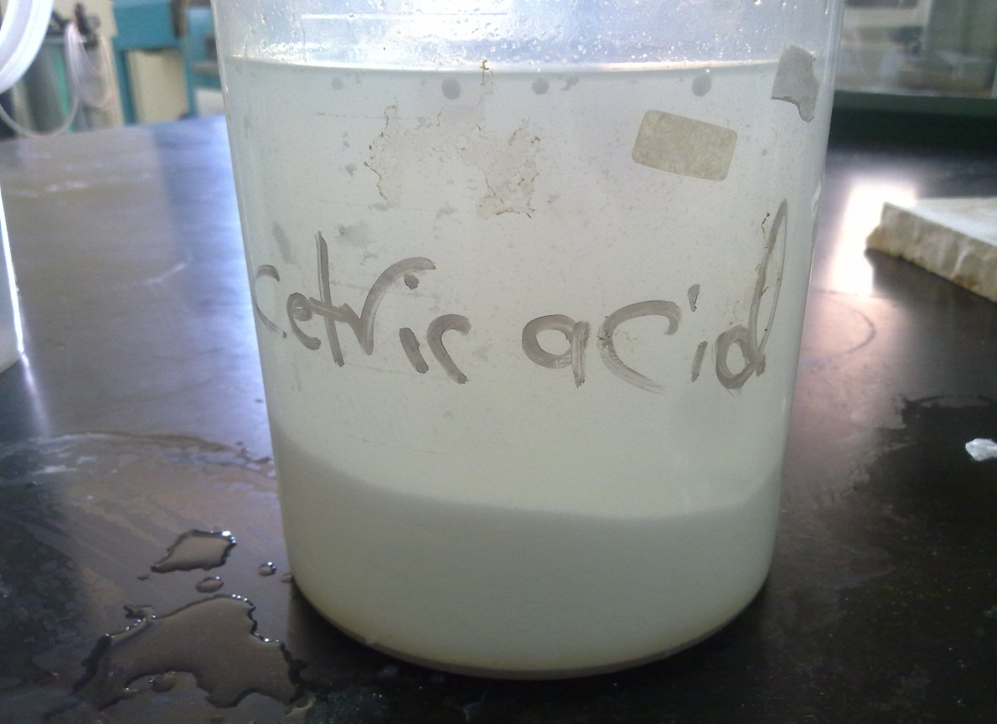
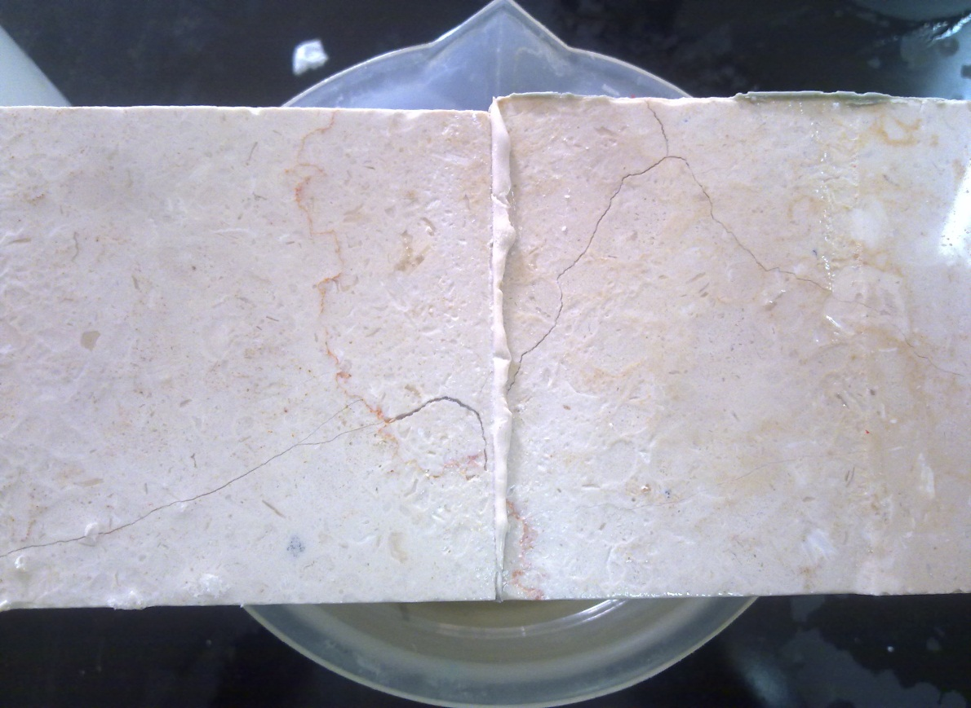
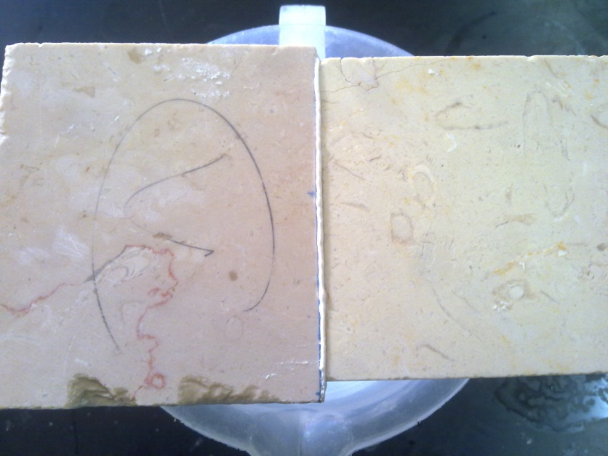
B- Service life Test:-
Service life test was applied by soaking joining stones in (water, Citric acid and HCl) for 72 hour.
5% Citric acid
Water
5% HCl

Slide 23



Results and Discussion:-

Slide 24
The first samples were prepared
Sample number | Resin percent % | Type of filler |  |  | Texture
 |  | Pure CaCO3 | Cutting stone | Talc
1 | 36 | 64 | - | - | Non acceptable
2 | 32 | - | 68 | - | Non acceptable
3 | 58.82 | - | - | 41.18 | Non acceptable
4 | 32 | 34 | 34 | - | Non acceptable
5 | 46 | 27 | - | 27 | Non acceptable
6 | 48 | - | 26 | 26 | Non acceptable
7 | 41 | 19.6 | 19.6 | 19.6 | acceptable

Slide 25
The samples prepared by using three different types of filler.
Sample number | Resin % | Pure CaCO₃ | Cutting stone | Talc
 |  | Ratio/ Grams / Percentage%
1 | 40.486 | 1 | 1 | 1
 |  | 19.8 % | 19.8 % | 19.8 %
2 | 38.835 | 1.5 | 1.5 | 1
 |  | 22.8155 % | 22.8155 % | 15.534 %
3 | 38.835 | 2 | 2 | 1
 |  | 24.272 % | 24.272 % | 12.6213 %
4 | 38.873 | 2.5 | 2.5 | 1
 |  | 25.462 % | 25.462 % | 10.204 %
5 | 42.554 | 9.63 | 9.63 | 1
 |  | 27.305 % | 27.305 % | 2.84 %

Slide 26
Results from the flexure test:-

Slide 27
The stress and the percentage of talc added to the samples:-

Slide 28
3- Cost analysis:-
Equipment cost:-
Equipment | Cost (NIS)
Sieve trays (Mish) | 19500
Mixer | 585000
Filling machine | 273000
Total | 877500

Slide 29
Infrastructure cost.
Infrastructure |  | cost (NIS)
Land | 500 m²= 10000 JD | 50000
Building |  | 75000
Transportation | Cars | 40000
Total |  | 165000

Slide 30
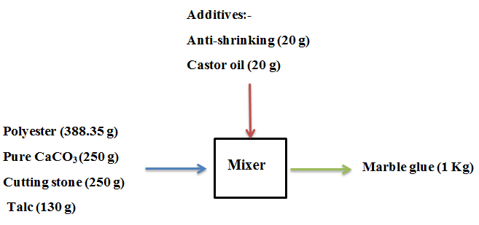
Flow diagram of raw material:-

Slide 31
Price of (1 Kg) of local marble glue:-
Factor | Cost (NIS/Kg)
Raw materials | 15.01
Electricity | 0.3
Labor | 0.66
Maintenance | 0.2
Depreciation | 2.01
Total | 18.18

Slide 32
The annual cash flow of the plant:-

Slide 33
The payback period of the project:-

Slide 34
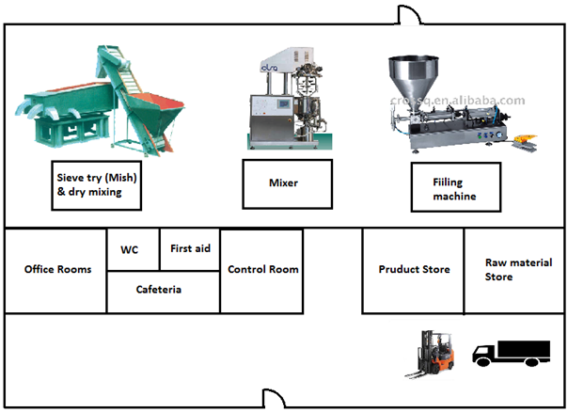
The lay out of the plant:-

Slide 35
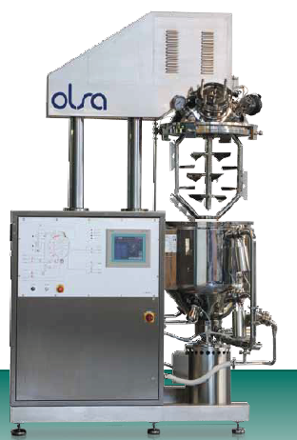
Speedy mix Vacuum mixer homogenizer is used for semi-solid products.
The designs of this mixer including three types of impeller:
Two slow agitators: coaxial execution with outer anchor.
Fast agitator: rotor and stator type installed in a mixing chamber.

Slide 36
Conclusion:-
1- The optimum sample which gives the best performance was composed from (38.835 % Polyester, 24.272% Pure CaCO3, 24.272% Cutting stone, and 12.6213% Talc).
2- The average stress of the optimum sample was 9.3015 (MPa).

Slide 37
3- The price of 1 Kg of local marble glue was 19.998 NIS with expenses cost of 18.18 NIS, the profit percentage was 10%.
4- The payback period of the project was 4 years with 12 years project life.

Slide 38
Thank You

