Slide 1
PAL EVENT
LEDS , LIGHT, Dance floor
Supervisor name:
Amjad hawash
student :
motasem kharouf
subhi Eid
Abdallah abu asbah

Slide 2
INTRODUCTION and purpose of system
The software specified in this document aims to streamline the party organization process for Pal Event. Its purpose is to provide a robust platform for efficiently managing and coordinating LED screens, lighting setups, dance floors, and corridors. The software facilitates automation of tasks related to party planning and execution, ensuring a seamless and memorable experience for both clients and attendees.

Slide 3
problem and solution
The large number of details of the party for which the services you provide can result in any of the customer’s requests being lost, so the system provided him with a space to review who was requested and another service the system provides through us is to reserve the hall through us.
Facilitating the reservation process with all the details on one site instead of going to more than one site.
Adding a restriction to prevent the data base from being filled with unimportant information or empty requests

Slide 4
OUR TOOLS And programming language
phpMyAdmin
SQL Server
MYSQL
JAVASCRIPT
PHP
HTML
CSS

Slide 5
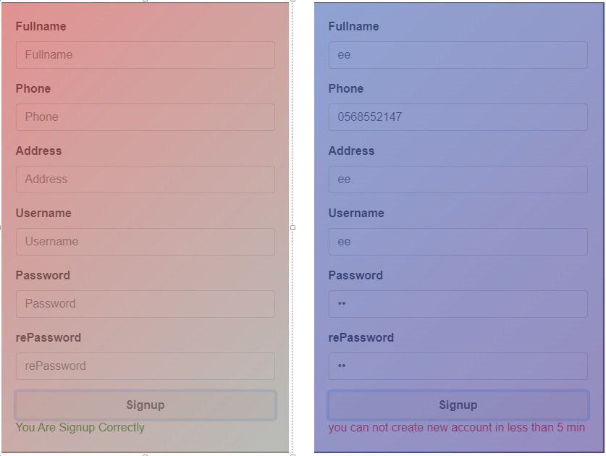
Sign up & Replies

Slide 6
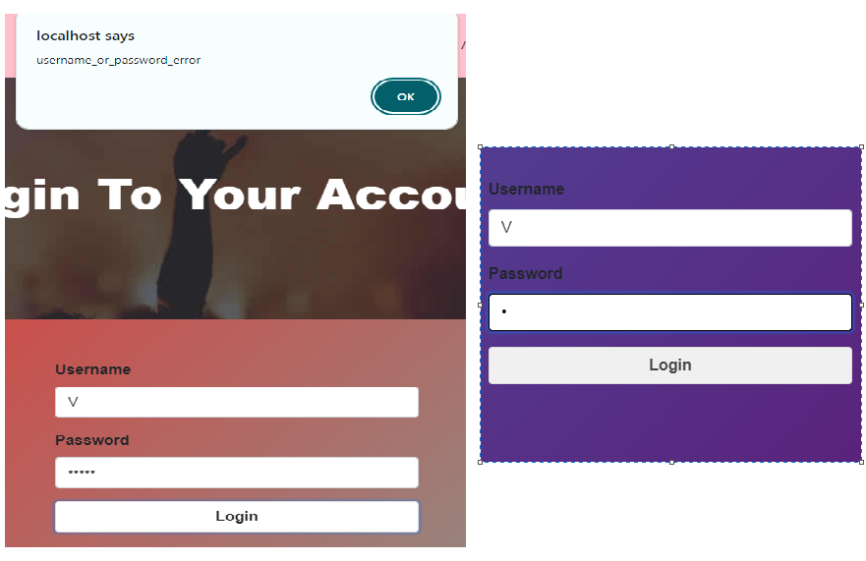
Sign in & Replies

Slide 7


Cutomer account

Slide 8
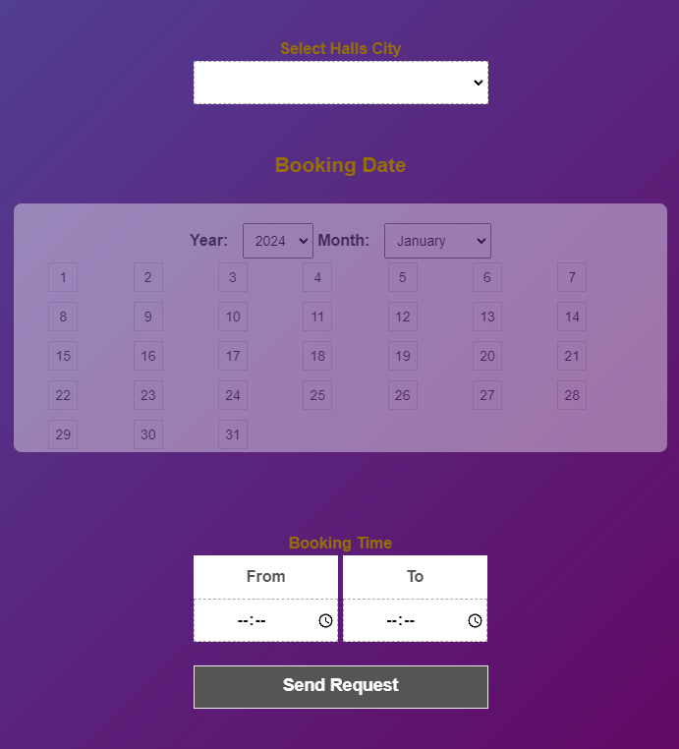
Request Hall

Slide 9
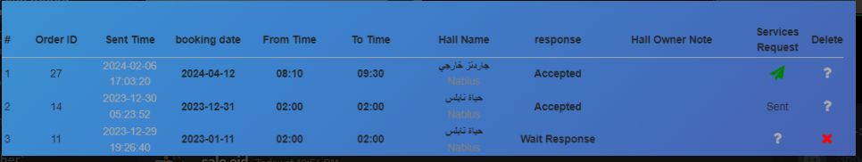
Orders to hall owner

Slide 10
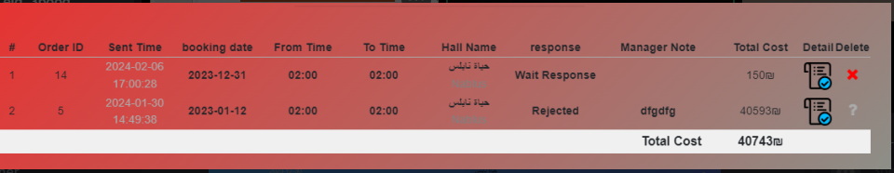
Order a services

Slide 11
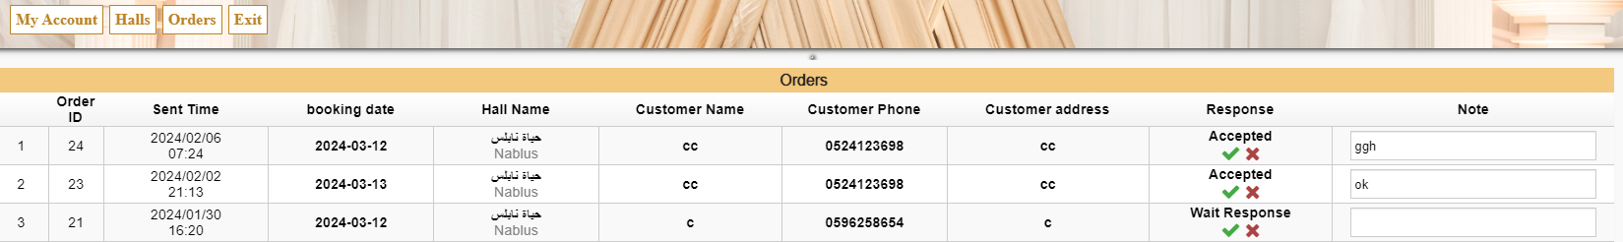
Hall owner account

Slide 12
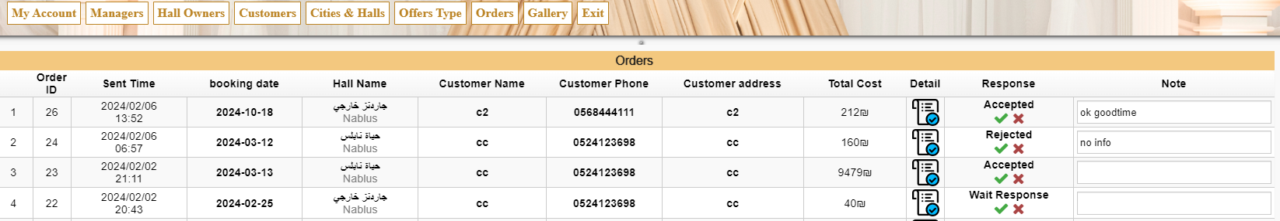
Manager account

Slide 13
Future Work
Linking the program to the field of artificial intelligence, email confirmation service, paid SMS service to customers’ phone numbers, adding a payment gateway such as PayPal and Credit Card, and designing the screens’ shape through a painter so that they can draw them themselves.

