Slide 1

An-Najah National University
Facility of Engineering and Information Technology
Civil Engineering department
Apple Media Center-Structural Design
Prepared by: Haya Khalil Ataire
Baraha Omar Saleh
Supervised by: Dr. Mohammad Sammaneh

Slide 2
Content
01
Introduction
02
Seismic Design
03
Seismic Design Check
04
Concrete Design
05
Steel Design

Slide 3
Introduction
Project description
Apple Media center Located in Nablus City, near the Nablus commercial complex
The building is composed of 21 stories and is wrapped to 120 degrees with two typical type of plane area, one consists of 560m² and the other one repeated after each five stories with an area 812m².

Slide 4
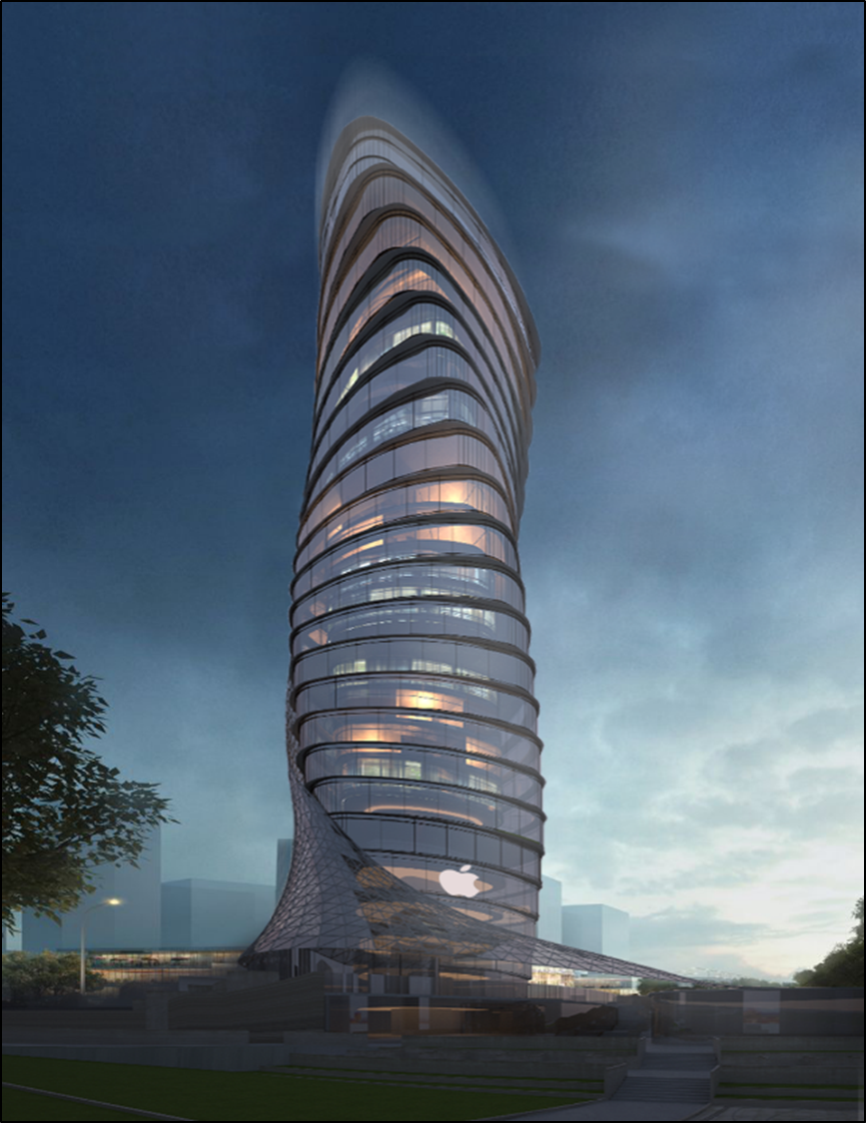
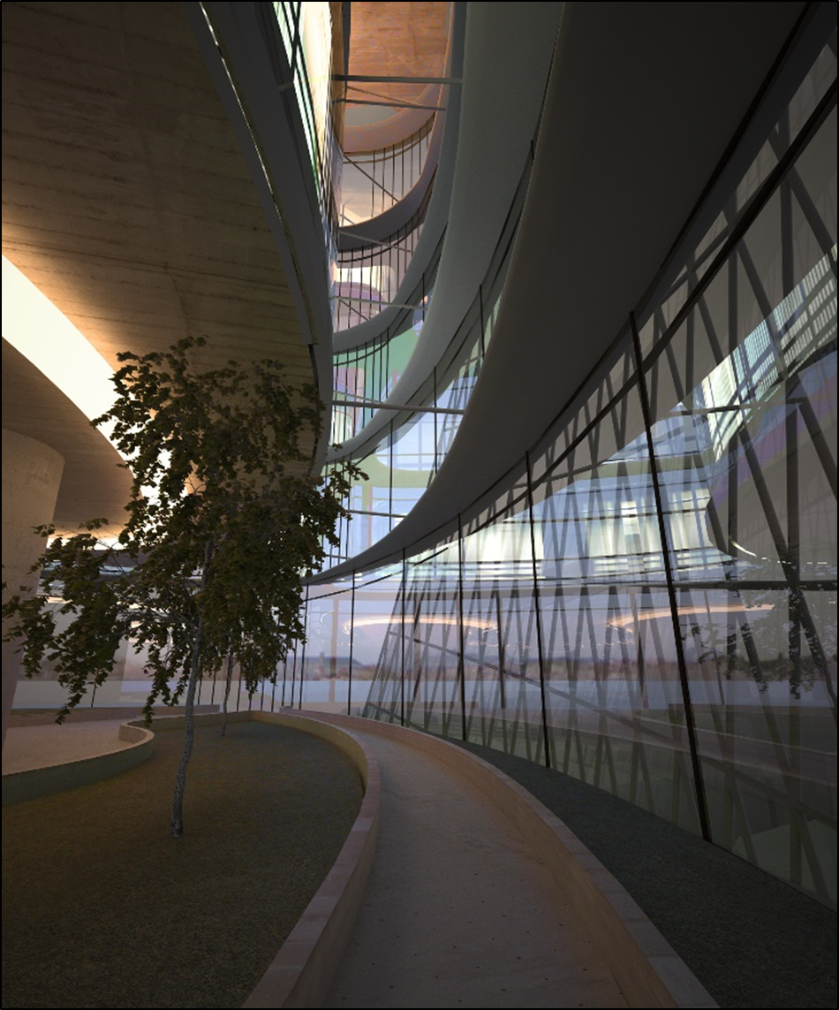
Apple Media Tower

Slide 5
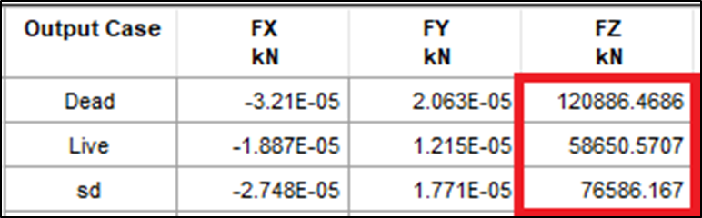
Checks
Model check
Equilibrium check
ETABS result
load | Manually (kN) | Program(kN) | Error %
Dead | 122961.34 | 120886.5 | 1.7%
live | 60060 | 58650.6 | 2.3%
SD | 77836.4 | 7686.2 | 1.6%
The errors is less than 5% so the result is acceptable

Slide 6
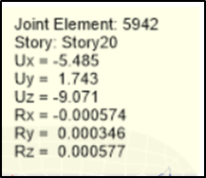
Checks
Deflection check
Check the deflection from live load only
Max deflection ≤L/180
→9.071mm >166.67mm
→Ok

Slide 7
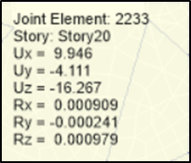
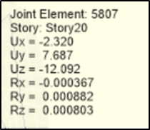
Checks
Deflection check
Check the long-term deflection
Maximum deflection from dead load
Maximum deflection from
superimposed load
ΔL= 9.071mm
ΔD= 16.267mm
ΔLS= 12.092mm
Using equation:
ΔLT= ΔL + λ∞ ΔD + λ t ΔLS
ΔLT= 61.5mm
Max deflection ≤L/480
→61.5mm > 62.5mm
→Ok

Slide 8
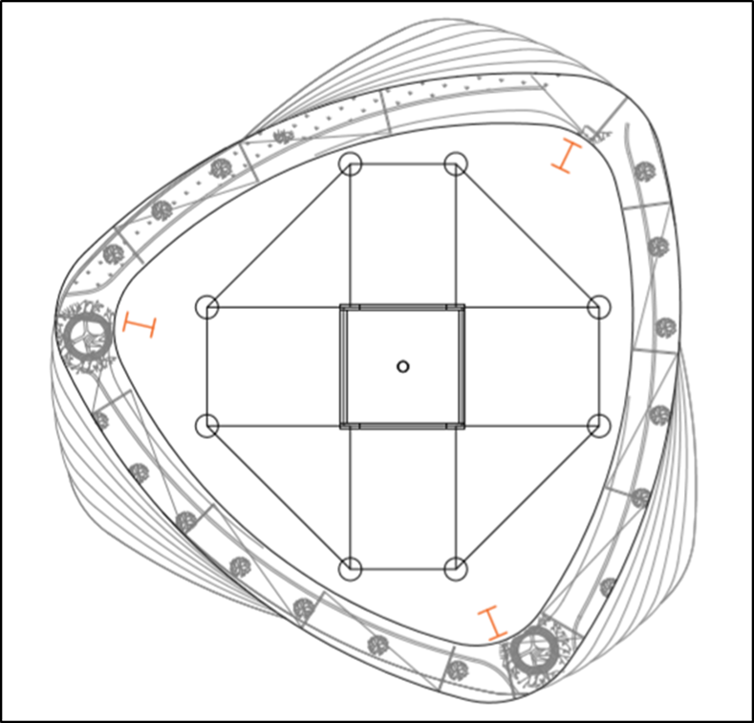
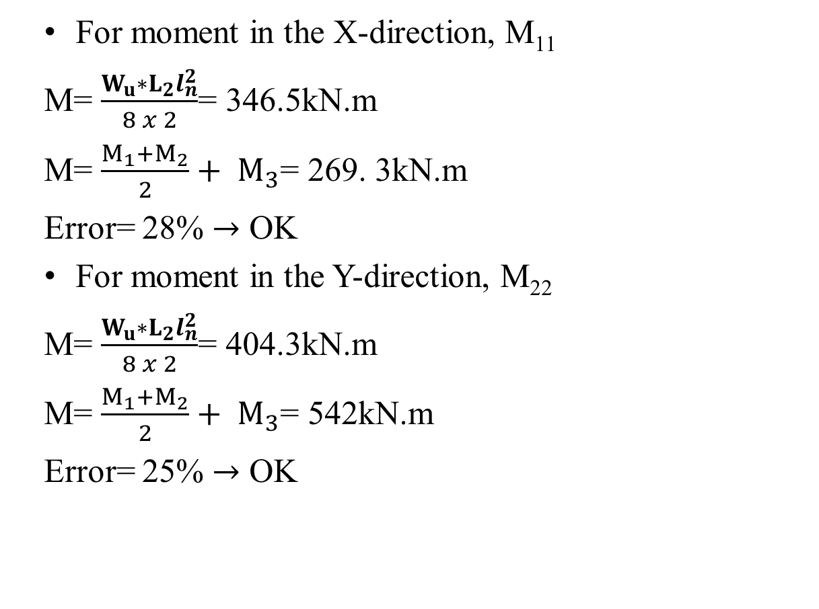
Checks
Stress-Strain Check
For moment in the X-direction, M₁₁
M= $\frac{W_{u}∗L_{2}l_{n}^{2}}{8 x 2}$= 346.5kN.m
M= $\frac{M_{1}+M_{2}}{2}+ M_{3}$= 269. 3kN.m
Error= 28% $→$ OK
For moment in the Y-direction, M₂₂
M= $\frac{W_{u}∗L_{2}l_{n}^{2}}{8 x 2}$= 404.3kN.m
M= $\frac{M_{1}+M_{2}}{2}+ M_{3}$= 542kN.m
Error= 25% $→$ OK

Slide 9
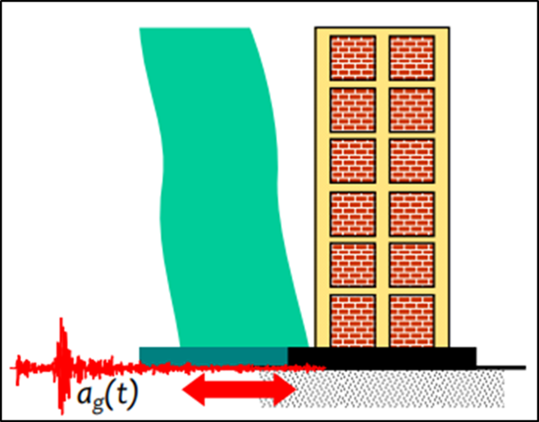
Seismic Design
Introduction
An earthquake is the shaking of the surface of the Earth resulting from a sudden release of energy in the Earth's lithosphere that creates seismic waves. In earthquake design, the building is subjected to random motion of the ground at its base, which induces inertia forces in the building that in turn cause stresses, this is displacement-type loading.

Slide 10
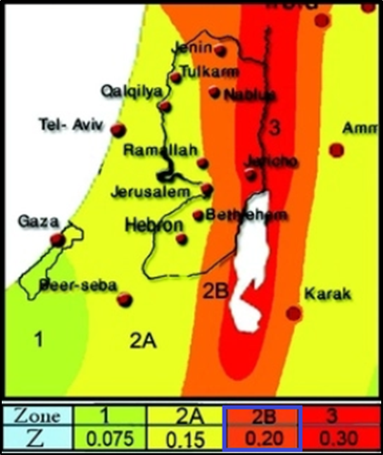
Seismic Design
Criteria Selection
Site Classification
(D) stiff soil
Risk Categorization
III (Buildings and other structures, the failure of which could pose a substantial risk to human life).
The importance factor (I_{e}) is equal to 1.25.
Site Seismic Characteristics
Seismic Zone Factor (Z) in Palestine
range from 0.075 to 0.30.
In Nablus Z is equal to 0.20.

Slide 11
Seismic Design
Criteria Selection
Structural System
From ETABS find out that columns and other frames
carry out 83889.4946kN, from 120886.4686kN, so the frames resist 30% of the base shear and it is more
than 25%.
so the structure is dual system with moment frames capable of resisting at least 25% of prescribed seismic forces.
and it is special reinforced concrete shear walls since the height of the structure is 63m.

Slide 12
Seismic Design
Procedure Used in the Calculations
Response Modification Coefficient (R)
R is equal to 7.
Deflection Amplification Factor C_{d})
C_{d} is equal to 5.50.
Over Strength Factor (Ω₀)
Ω₀ is equal to 2.50.
Mapped Acceleration Parameters, S₁ and S_{s}
S₁ = 0.375.
S_{s} = 0.75.

Slide 13
Seismic Design
Procedure Used in the Calculations
Site Coefficient, F_{a} and F_{v}
F_{a} is equal to 1.2.
F_{v} is equal to 1.9.
Maximum considered earthquake spectral response acceleration adjusted for site class effects, S_{MS} and S_{M1}
S_{MS}= 0.90.
S_{M1}= 0.7125.

Slide 14
Seismic Design
Procedure Used in the Calculations
Design Spectral Acceleration Parameters, S_{DS} and S_{D1}
S_{DS}= 0.60.
S_{D1}= 0.475.
Seismic Design Category
The seismic design category is D.

Slide 15
Seismic Design
Base Shear Calculation Using ELF Procedure
The calculation of C_{S}
C_{S}= 10.71%
C_{S}= 10.71% ≥ C_{S, min}= 3.3% …. OK
C_{S}= 10.71% ≥ C_{S, max}= 7.8%
C_{S}= 7.8%

Slide 16
Seismic Design
Base Shear Calculation Using ELF Procedure
The calculation of W
W= 212135.2783kN.
The manual value of base shear (V_{Manual})= 16465.52kN
Load Pattern | Weight (Manual) (kN)
Dead | 120886.4676
0.25 Live | 14662.64268
SD | 76586.167
Total Weight (W) | 212135.2783

Slide 17
Seismic Design
Methods of Design
We have three methods of design:
Equivalent lateral force analysis.
Modal response spectrum analysis.
History analysis.
In the project will use Equivalent lateral force & Modal response spectrum analysis.

Slide 18
Seismic Design
Methods of Design
Equivalent lateral force
In seismic analysis loads, are historically taken as equivalent static accelerations modified by certain factors depending on the seismicity of the location, soil properties and the natural frequencies of the structure and the intended use.
The idea of equivalent lateral force method is to distribute part of the seismic force (base shear) to every floor, which are able to transfer lateral loads.

Slide 19
Seismic Design
Methods of Design
Modal response spectrum analysis
In this method, structures are modeled as multiple degree of freedom systems where the resulting frequencies and mode shapes are extracted. For each mode, the spectral forces and displacements are found and then combined. The combined forces are then divided by the response modification factor (R).
In the calculation of response for each horizontal direction, the combined number of modes is taken to include at least 90% of the participating mass of the structure.

Slide 20
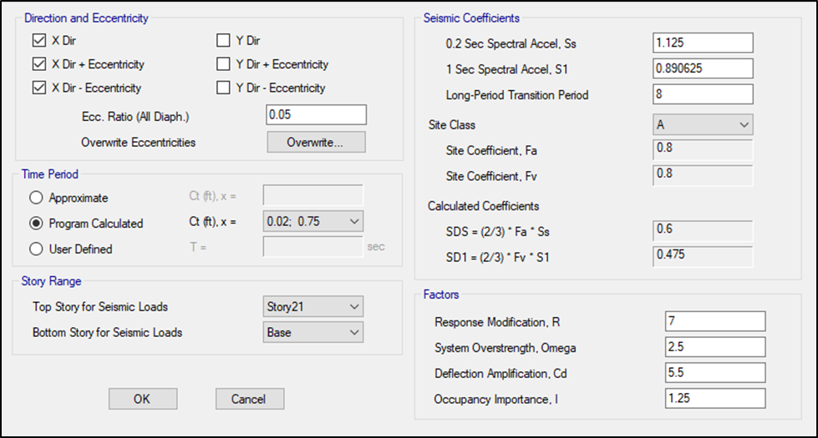
Seismic Design
ETABS Procedures
Equivalent Lateral Force (ELF) Procedures

Slide 21
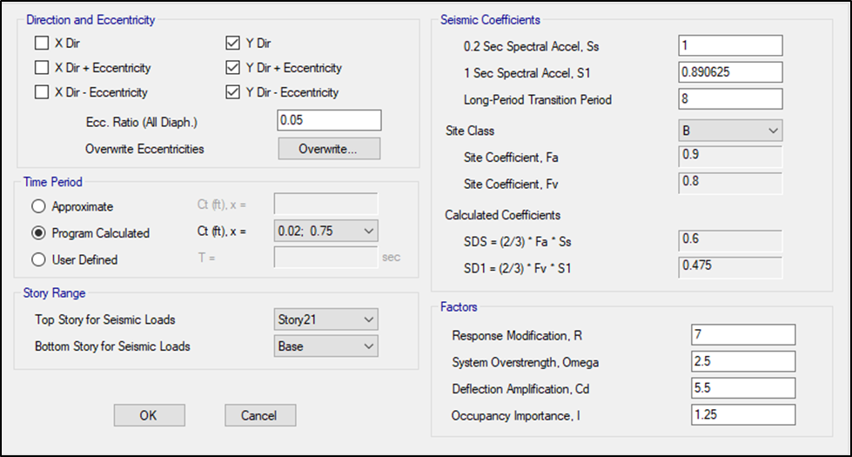
Seismic Design
ETABS Procedures
Equivalent Lateral Force (ELF) Procedures

Slide 22
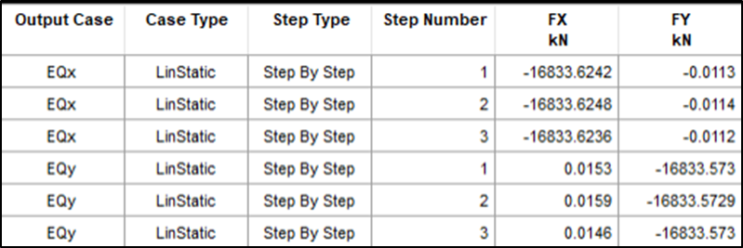
Seismic Design
ETABS Procedures
Equivalent Lateral Force (ELF) Procedures
The value of base shear from ETABS, in both directions X
and Y and considering 0.05 eccentricities of the diaphragms.
Manual Base Shear (kN) | 16465.52 | Error% 2.24% > 5% OK
ETABS Base Shear (kN) | 16833.6236

Slide 23
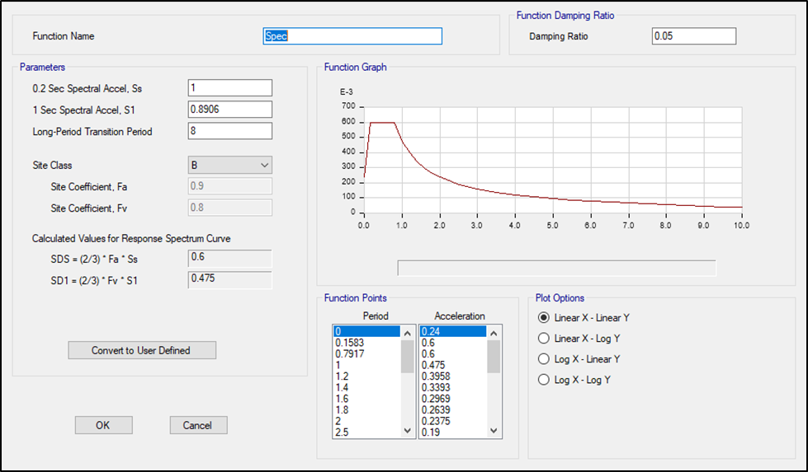
Seismic Design
ETABS Procedures
Response Spectrum Analysis

Slide 24
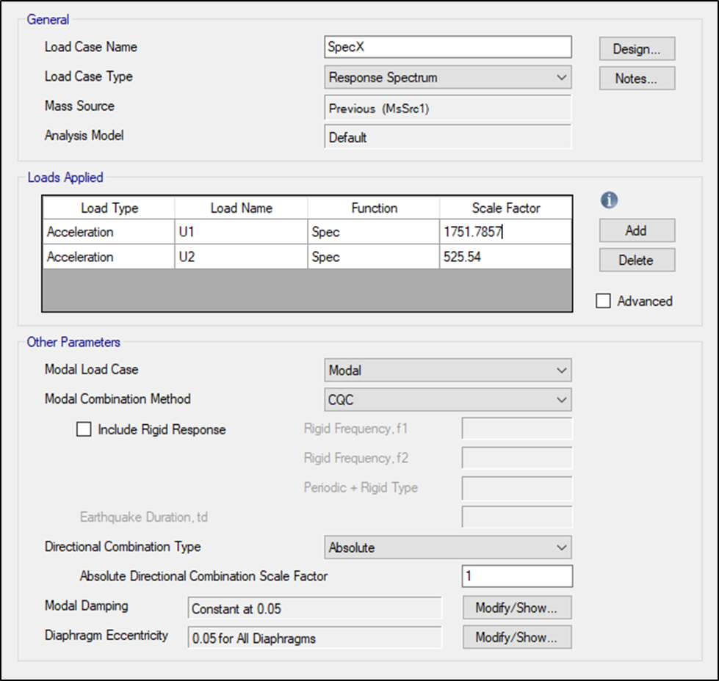
Seismic Design
ETABS Procedures
Response Spectrum Analysis

Slide 25
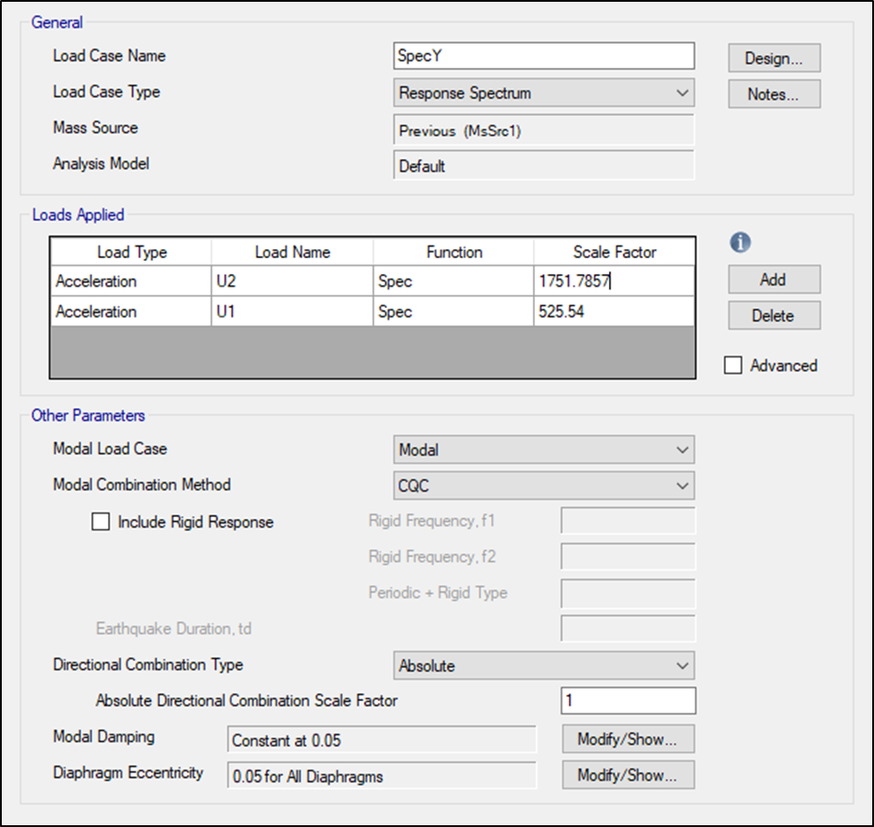
Seismic Design
ETABS Procedures
Response Spectrum Analysis

Slide 26
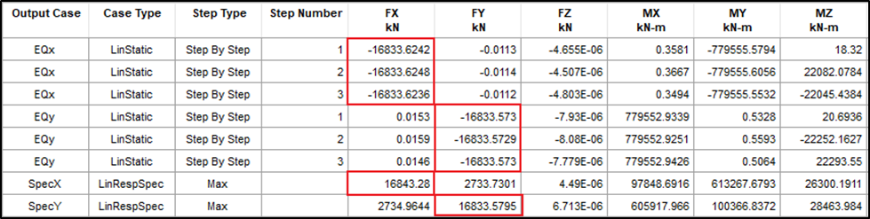

Seismic Design
ETABS Procedures
Response Spectrum Analysis
Base Shear Response Spectrum Procedure
Scale factor= $\frac{I_{e}xg}{R}$ x $\frac{V_{ELF}}{V_{R}}$

Slide 27
Seismic Design
Design Checks
Period Check
T_{model}= T_{n}= 2.17 seconds from ETABS.
T_{a}= 1.09 seconds.
C_{u} x T_{a}= 1.526
T_{n} < C_{u} x T_{a} OK

Slide 28
Seismic Design
Design Checks
Story Drift Check
Δ_{a}= 0.045
Story | Elastic Drift (X) | Inelastic Drift (X) | Comparison with code limit (< 0.045)
Story21 | 0.068023 | 0.20951084 | FALSE
Story20 | 0.064101 | 0.19743108 | FALSE
Story19 | 0.004084 | 0.01257872 | TRUE
Story18 | 0.004111 | 0.01266188 | TRUE
Story17 | 0.004106 | 0.01264648 | TRUE
Story16 | 0.047687 | 0.14687596 | FALSE
Story15 | 0.004126 | 0.01270808 | TRUE
Story14 | 0.004072 | 0.01254176 | TRUE
Story13 | 0.004025 | 0.012397 | TRUE
Story12 | 0.003955 | 0.0121814 | TRUE
Story11 | 0.028235 | 0.0869638 | FALSE
Story10 | 0.003756 | 0.01156848 | TRUE
Story9 | 0.003603 | 0.01109724 | TRUE
Story8 | 0.003394 | 0.01045352 | TRUE
Story7 | 0.003112 | 0.00958496 | TRUE
Story6 | 0.010769 | 0.03316852 | TRUE
Story5 | 0.007958 | 0.02451064 | TRUE
Story4 | 0.002083 | 0.00641564 | TRUE
Story3 | 0.001657 | 0.00510356 | TRUE
Story2 | 0.001184 | 0.00364672 | TRUE
Story2 | 0.000146 | 0.00044968 | TRUE
Story1 | 0.000607 | 0.00186956 | TRUE

Slide 29
Seismic Design
Design Checks
Story Drift Check
Δ_{a}= 0.045
Story | Elastic Drift (Y) | Inelastic Drift (Y) | Comparison with code limit (< 0.045)
Story21 | 0.069117 | 0.21288036 | FALSE
Story20 | 0.065175 | 0.200739 | FALSE
Story19 | 0.004229 | 0.01302532 | TRUE
Story18 | 0.004256 | 0.01310848 | TRUE
Story17 | 0.004299 | 0.01324092 | TRUE
Story16 | 0.049546 | 0.15260168 | FALSE
Story15 | 0.004334 | 0.01334872 | TRUE
Story14 | 0.004291 | 0.01321628 | TRUE
Story13 | 0.004235 | 0.0130438 | TRUE
Story12 | 0.004116 | 0.01267728 | TRUE
Story11 | 0.02868 | 0.0883344 | FALSE
Story10 | 0.003785 | 0.0116578 | TRUE
Story9 | 0.003615 | 0.0111342 | TRUE
Story8 | 0.003406 | 0.01049048 | TRUE
Story7 | 0.003141 | 0.00967428 | TRUE
Story6 | 0.011053 | 0.03404324 | TRUE
Story5 | 0.008186 | 0.02521288 | TRUE
Story4 | 0.00217 | 0.0066836 | TRUE
Story3 | 0.001728 | 0.00532224 | TRUE
Story2 | 0.000156 | 0.00048048 | TRUE
Story2 | 0.001226 | 0.00377608 | TRUE
Story1 | 0.00062 | 0.0019096 | TRUE

Slide 30
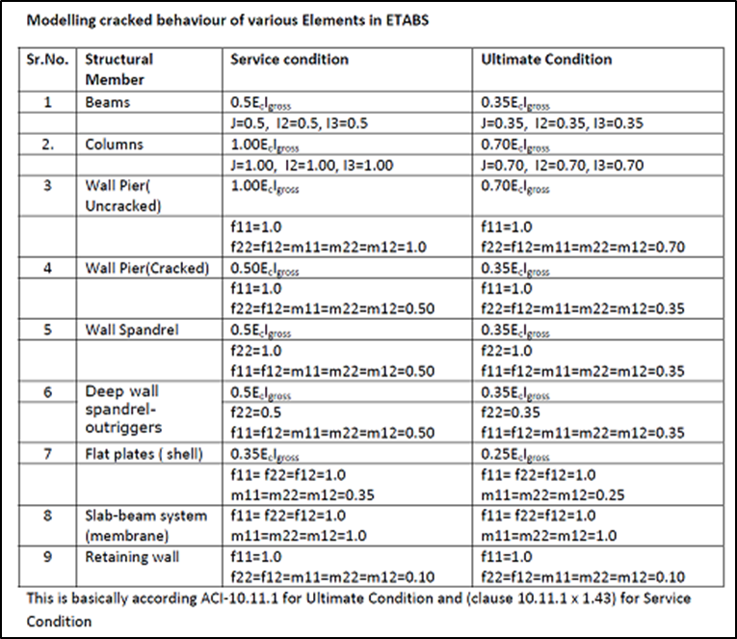
Seismic Design
Design Checks
P-Delta Check
Load combination equal to Dead Load + Live Load + Superimposed Live Load.

Slide 31
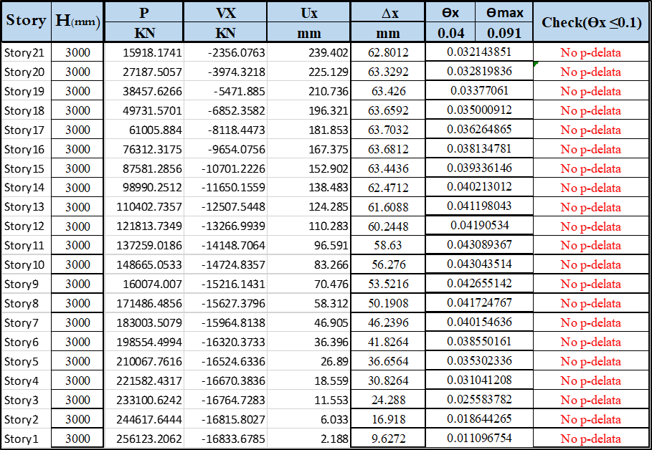
Seismic Design
Design Checks
P-Delta Check

Slide 32
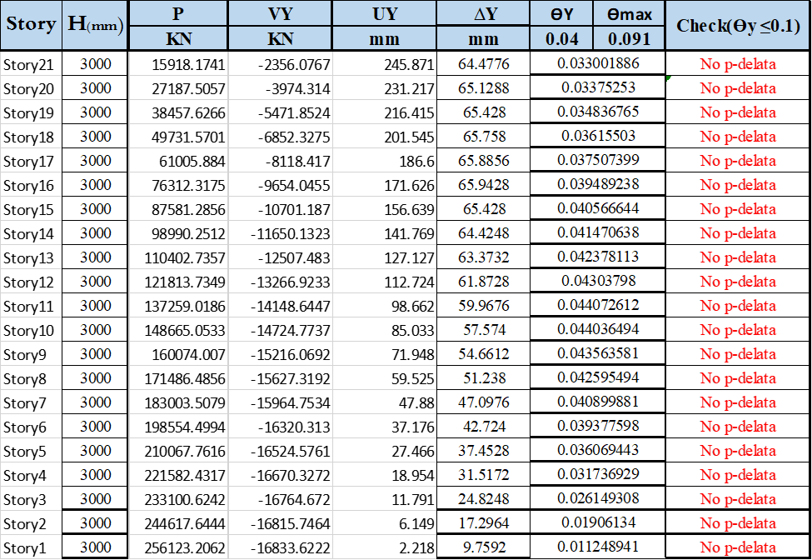
Seismic Design
Design Checks
P-Delta Check

Slide 33
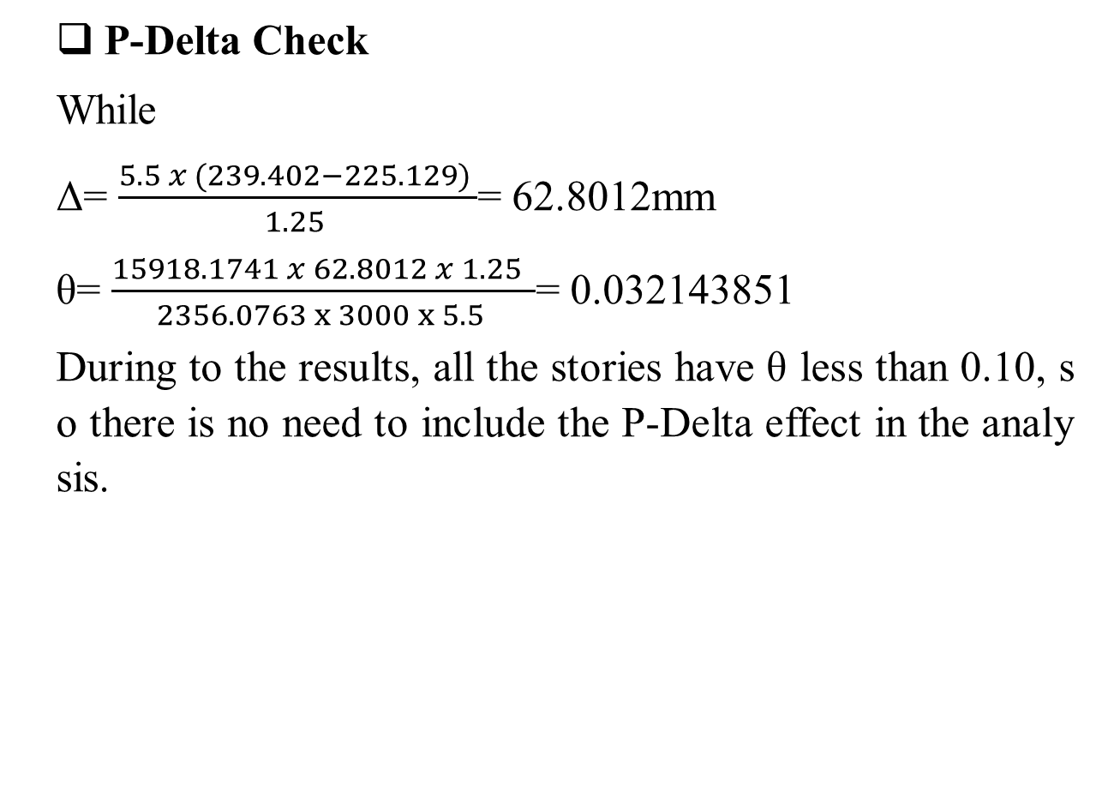
Seismic Design
Design Checks
P-Delta Check
While
Δ= $\frac{5.5 x (239.402−225.129) }{1.25 }$= 62.8012mm
θ= $\frac{15918.1741 x 62.8012 x 1.25 }{2356.0763 x 3000 x 5.5 }$= 0.032143851
During to the results, all the stories have θ less than 0.10, so there is no need to include the P-Delta effect in the analysis.

Slide 34
Seismic Design
Design Checks
Torsional Irregularity Check
Torsional Irregularity Check in X-Direction

Slide 35
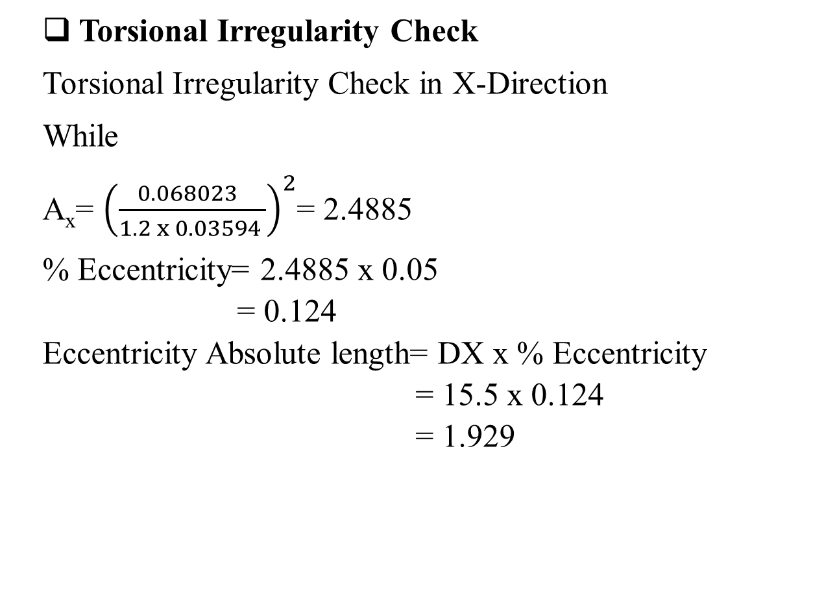
Seismic Design
Design Checks
Torsional Irregularity Check
Torsional Irregularity Check in X-Direction
While
A_{x}= ${\left(\frac{0.068023 }{1.2 x 0.03594 }\right)}^{2}$= 2.4885
% Eccentricity= 2.4885 x 0.05
= 0.124
Eccentricity Absolute length= DX x % Eccentricity
= 15.5 x 0.124
= 1.929

Slide 36
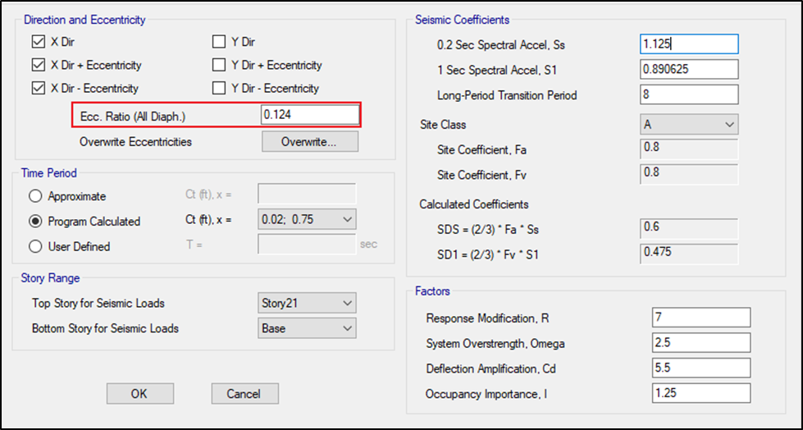
Seismic Design
Design Checks
Torsional Irregularity Check
Torsional Irregularity Check in X-Direction

Slide 37
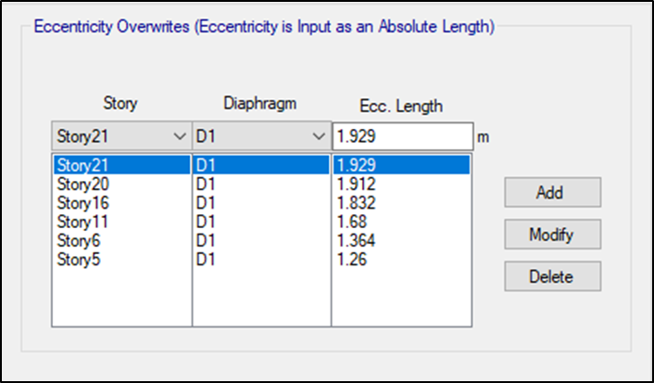
Seismic Design
Design Checks
Torsional Irregularity Check
Torsional Irregularity Check in X-Direction

Slide 38
Seismic Design
Design Checks
Torsional Irregularity Check
Torsional Irregularity Check in Y-Direction

Slide 39
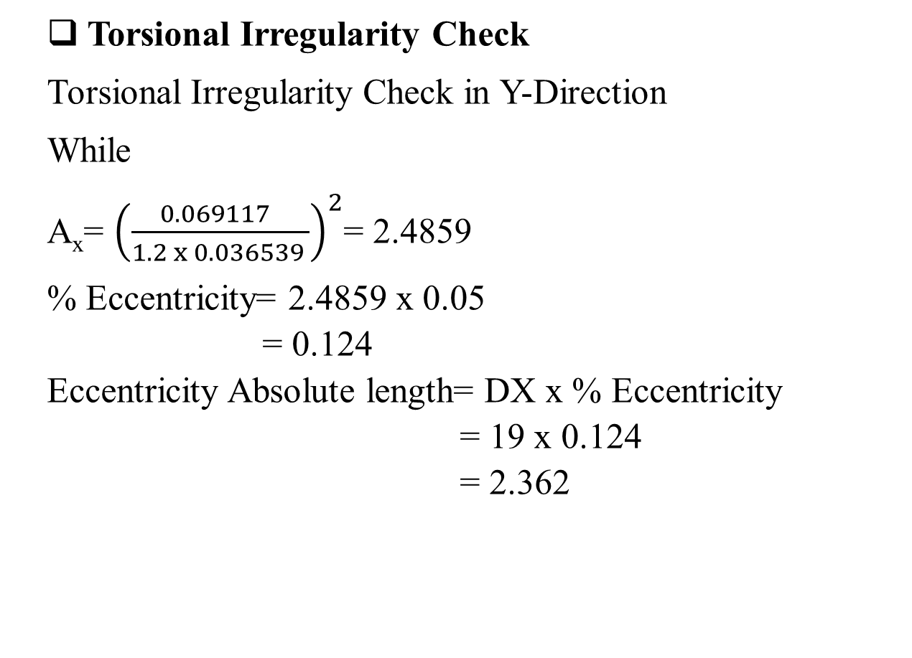
Seismic Design
Design Checks
Torsional Irregularity Check
Torsional Irregularity Check in Y-Direction
While
A_{x}= ${\left(\frac{0.069117 }{1.2 x 0.036539 }\right)}^{2}$= 2.4859
% Eccentricity= 2.4859 x 0.05
= 0.124
Eccentricity Absolute length= DX x % Eccentricity
= 19 x 0.124
= 2.362

Slide 40
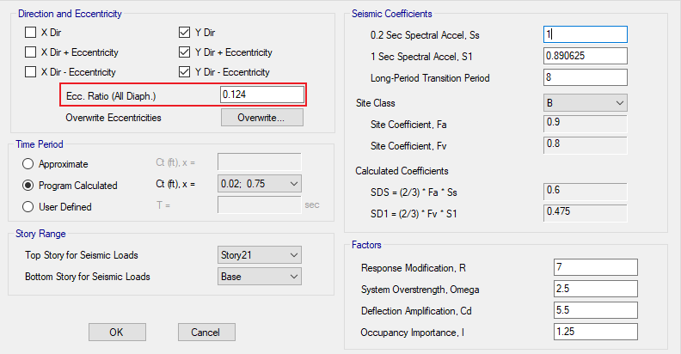
Seismic Design
Design Checks
Torsional Irregularity Check
Torsional Irregularity Check in Y-Direction

Slide 41
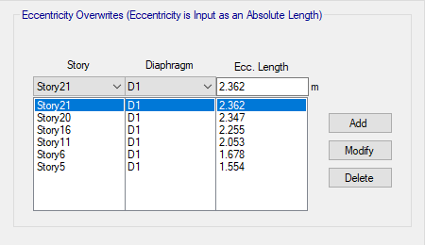
Seismic Design
Design Checks
Torsional Irregularity Check
Torsional Irregularity Check in Y-Direction

Slide 42
Seismic Design
Design Checks
Stiffness Irregularity Check
Stiffness Irregularity Check in X-Direction

Slide 43
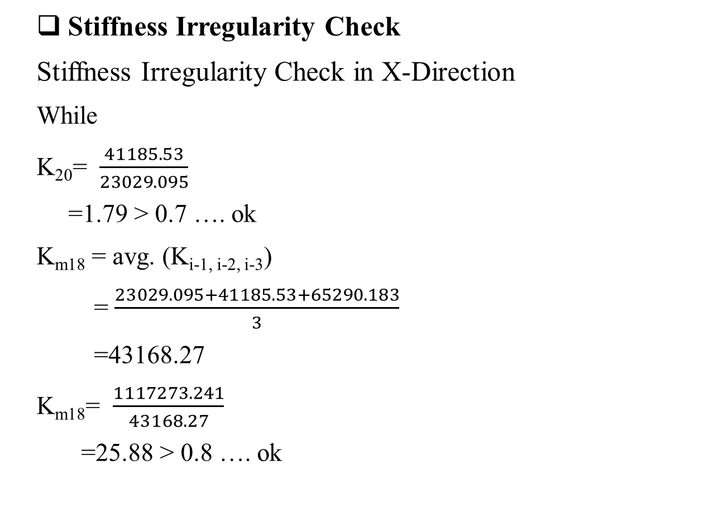
Seismic Design
Design Checks
Stiffness Irregularity Check
Stiffness Irregularity Check in X-Direction
While
K₂₀= $\frac{41185.53}{23029.095}$
=1.79 > 0.7 …. ok
K_{m18} = avg. (K_{i-1, i-2, i-3})
= $\frac{23029.095+41185.53+65290.183}{3}$
=43168.27
K_{m18}= $\frac{1117273.241}{43168.27}$
=25.88 > 0.8 …. ok

Slide 44
Seismic Design
Design Checks
Stiffness Irregularity Check
Stiffness Irregularity Check in Y-Direction

Slide 45
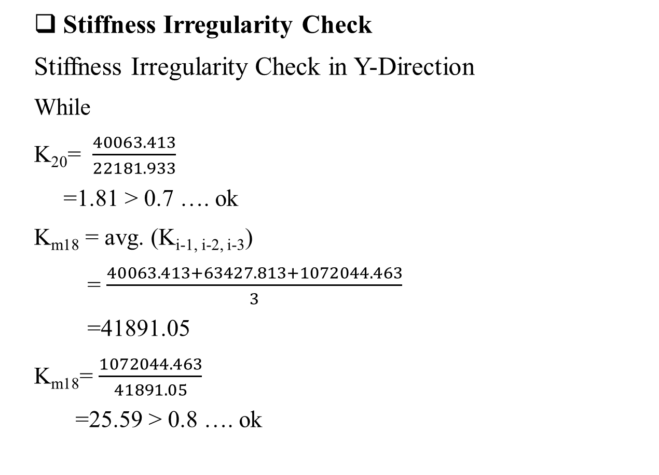
Seismic Design
Design Checks
Stiffness Irregularity Check
Stiffness Irregularity Check in Y-Direction
While
K₂₀= $\frac{40063.413}{22181.933}$
=1.81 > 0.7 …. ok
K_{m18} = avg. (K_{i-1, i-2, i-3})
= $\frac{40063.413+63427.813+1072044.463}{3}$
=41891.05
K_{m18}= $\frac{1072044.463}{41891.05}$
=25.59 > 0.8 …. ok

Slide 46

Seismic Design
Design Checks
Mass-Weight Irregularity Check
Mass-Weight Irregularity in X-Direction
While
M₁₉= $\frac{871494.92}{871604.71}$
=1 < 1.5 …. Ok

Slide 47

Seismic Design
Design Checks
Mass-Weight Irregularity Check
Mass-Weight Irregularity in Y-Direction
While
M₁₉= $\frac{871494.92}{871604.71}$
=1 < 1.5 …. Ok

Slide 48

Design
Introduction
The primary purpose of a structure is to transmit or support loads. If the structure is improperly designed or fabricated, or if the actual applied loads exceed the design specifications, the device will probably fail to perform its intended
function, with possible serious consequences.
A well-engineered structure greatly
minimizes the possibility of costly failures.

Slide 49
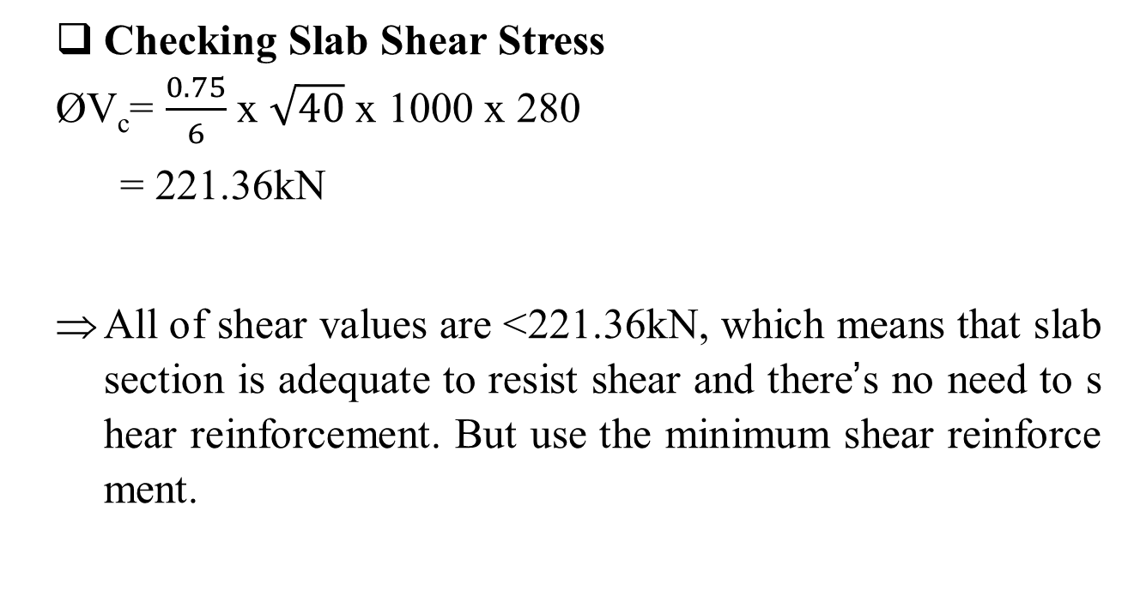
Design
Final Design for Gravity and Lateral Loads
Slabs
Checking Slab Shear Stress
ØV_{c}= $\frac{0.75}{6}$ x $\sqrt{40}$ x 1000 x 280
= 221.36kN
All of shear values are >221.36kN, which means that slab section is adequate to resist shear and there’s no need to shear reinforcement. But use the minimum shear reinforcement.

Slide 50
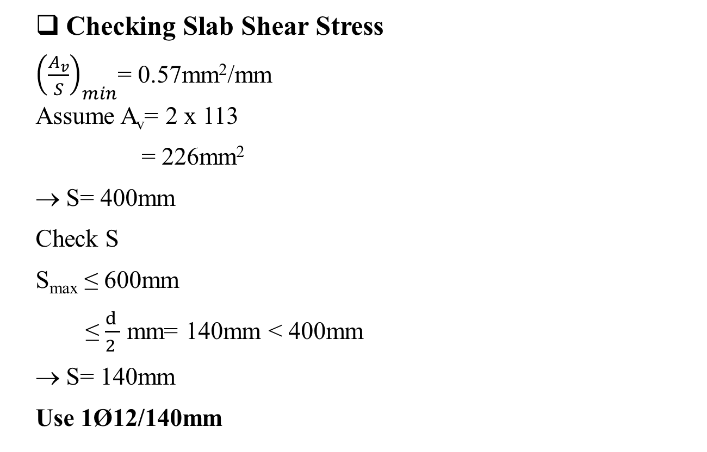
Design
Final Design for Gravity and Lateral Loads
Slabs
Checking Slab Shear Stress
${\left(\frac{A_{v}}{S}\right)}_{min}$= 0.57mm²/mm
Assume A_{v}= 2 x 113
= 226mm²
S= 400mm
Check S
S_{max} ≤ 600mm
≤ $\frac{d }{2 }$ mm= 140mm < 400mm
S= 140mm
Use 1Ø12/140mm

Slide 51
Design
Final Design for Gravity and Lateral Loads
Slabs
Slab Reinforcement for Moments
 | A_{s}(mm²/m) |  | Main Slabs | Extended Slabs
 | Main Slabs | Extended Slabs
Top Steel in X-D | 1400 | 2000 | 10Ø14/m | 10Ø16/m
Bottom Steel in X-D | 800 | 1200 | 8Ø12/m | 8Ø14/m
Top Steel in Y-D | 1900 | 1000 | 10Ø16/m | 10Ø18/m
Bottom Steel in Y-D | 2500 | 1200 | 9Ø12/m | 8Ø14/m

Slide 52
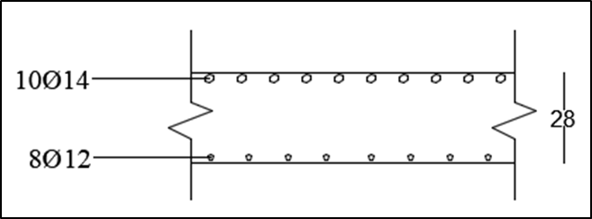
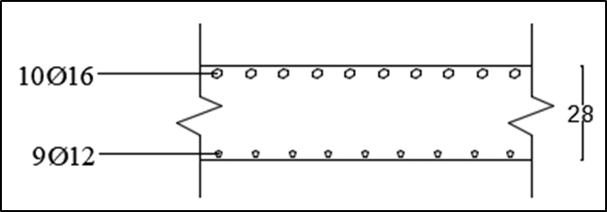
Design
Final Design for Gravity and Lateral Loads
Slabs
Slabs Sections
Main Slabs
X-Direction
Y-Direction

Slide 53
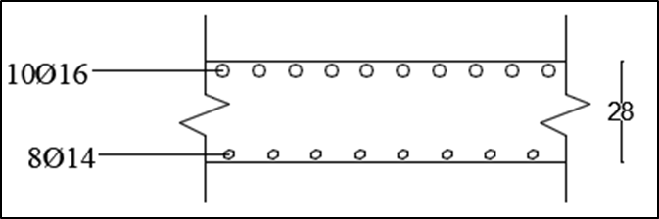
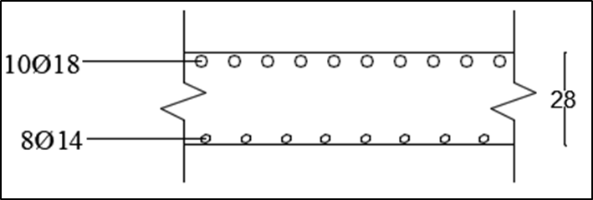
Design
Final Design for Gravity and Lateral Loads
Slabs
Slabs Sections
Extended Slabs
X-Direction
Y-Direction

Slide 54
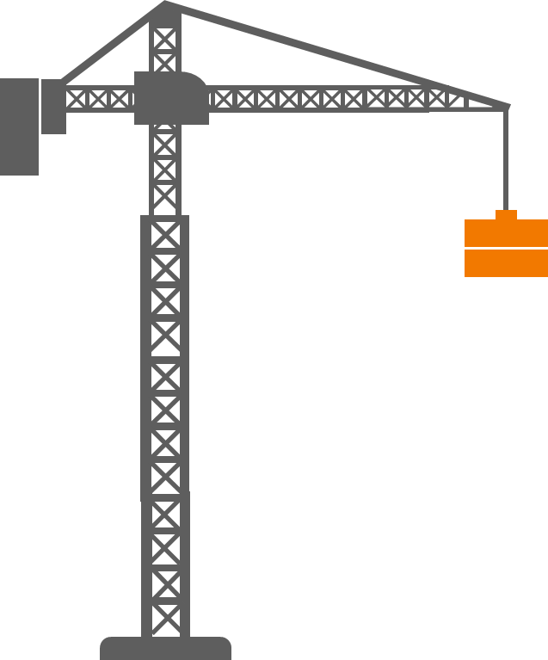
Design
Final Design for Gravity and Lateral Loads
Beams
Beams Steel Reinforcement
Main Beams:
A_{s, Bottom}= 1672mm²
4Ø25
A_{s, Top}= 3932mm²
8Ø25
Shear Walls Beams:
A_{s, Bottom}= 530mm²
3Ø18
A_{s, Top}= 545mm²
3Ø18

Slide 55
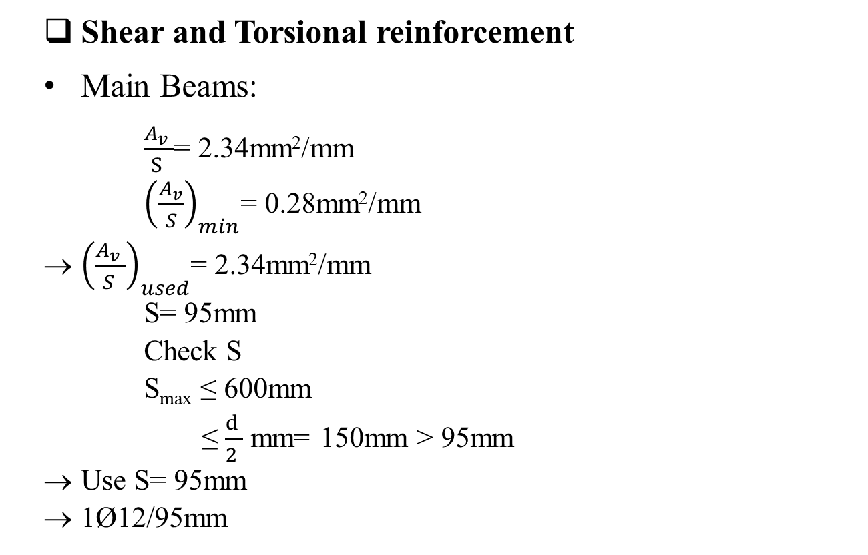
Design
Final Design for Gravity and Lateral Loads
Beams
Shear and Torsional reinforcement
Main Beams:
$\frac{A_{v} }{S }$= 2.34mm²/mm
${\left(\frac{A_{v}}{S}\right)}_{min}$= 0.28mm²/mm
${\left(\frac{A_{v} }{S }\right)}_{used}$= 2.34mm²/mm
S= 95mm
Check S
S_{max} ≤ 600mm
≤ $\frac{d }{2 }$ mm= 150mm > 95mm
Use S= 95mm
1Ø12/95mm

Slide 56
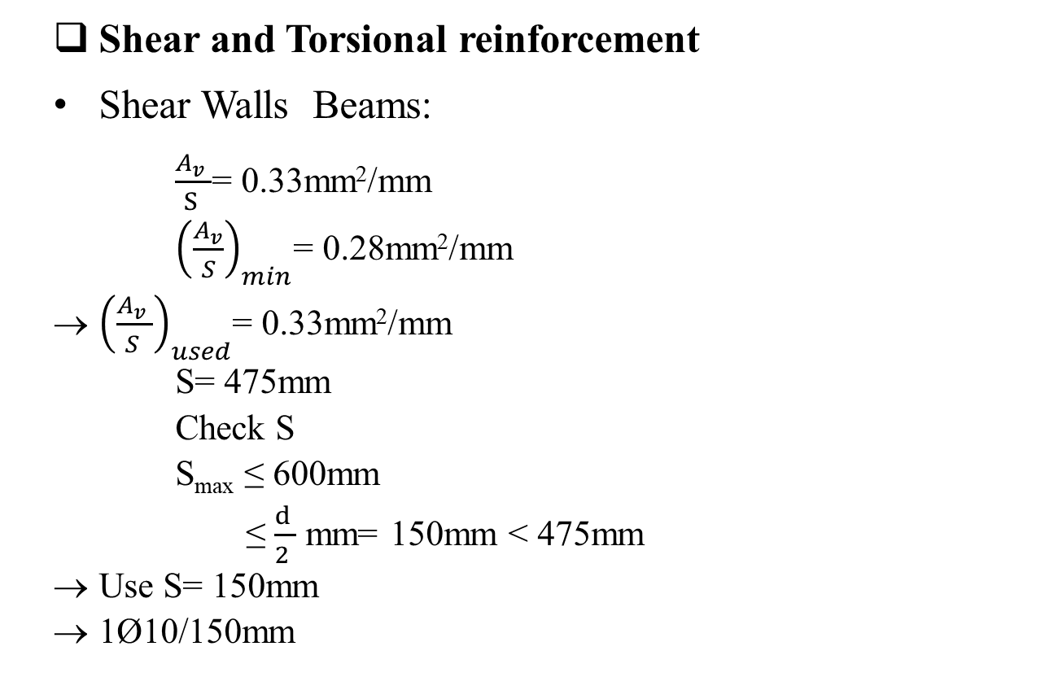
Design
Final Design for Gravity and Lateral Loads
Beams
Shear and Torsional reinforcement
Shear Walls Beams:
$\frac{A_{v} }{S }$= 0.33mm²/mm
${\left(\frac{A_{v}}{S}\right)}_{min}$= 0.28mm²/mm
${\left(\frac{A_{v} }{S }\right)}_{used}$= 0.33mm²/mm
S= 475mm
Check S
S_{max} ≤ 600mm
≤ $\frac{d }{2 }$ mm= 150mm < 475mm
Use S= 150mm
1Ø10/150mm

Slide 57
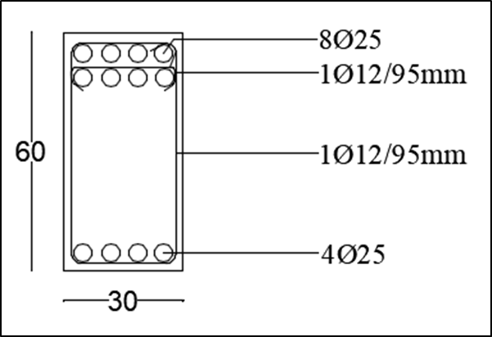
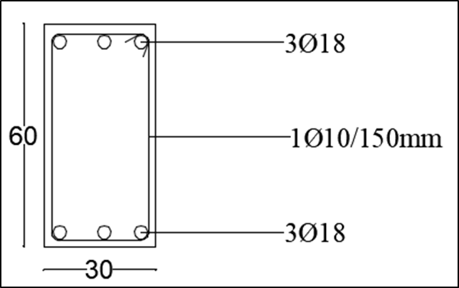
Design
Final Design for Gravity and Lateral Loads
Beams
Beams Sections
Shear Walls Beams
Main Beams

Slide 58
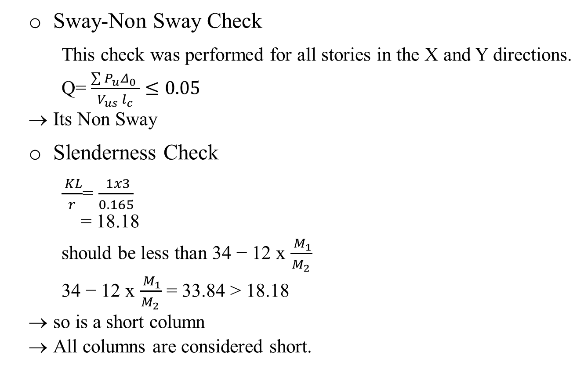
Design
Final Design for Gravity and Lateral Loads
Columns
Sway-Non Sway Check
This check was performed for all stories in the X and Y directions.
Q= $\frac{\sum{P_{u}}Δ_{0} }{V_{us} l_{c}}≤0.05$
Its Non Sway
Slenderness Check
$\frac{ KL}{r}$= $\frac{ 1x3}{0.165}$
= 18.18
should be less than 34 − 12 x $\frac{ M_{1}}{M_{2}}$
34 − 12 x $\frac{ M_{1}}{M_{2}}$ = 33.84 > 18.18
so is a short column
All columns are considered short.

Slide 59
Design
Final Design for Gravity and Lateral Loads
Columns
Columns Steel Reinforcement
Columns Group Number | Columns Diameter (mm) |  | A_{s} Required (mm²) | A_{s} of the Columns
1 | 1100 |  | 34027 | 43Ø32
2 | 950 |  | 23794 | 30Ø32
3 | 700 |  | 16643 | 21Ø32
 | Depth (mm) | Width (mm)
Shear Walls Columns | 1000 | 300 | 13189 | 17Ø32

Slide 60
Design
Final Design for Gravity and Lateral Loads
Columns
Shear reinforcement
Main Columns
A_{sp}= 154mm² (Ø14)
All the distance between the rings for all columns is less than 75mm.
Use spirals: Ø14/50mm.
Columns Group Number | Columns Diameter (mm) | D_{c} (mm) | A_{g} (mm²) | A_{ch} (mm²) | ρ_{s} | S (mm)
1 | 1100 | 968 | 950332 | 735937 | 0.01249 | 50
2 | 950 | 818 | 708822 | 525529 | .014948 | 50
3 | 700 | 568 | 384845 | 253388 | 0.02223 | 50

Slide 61
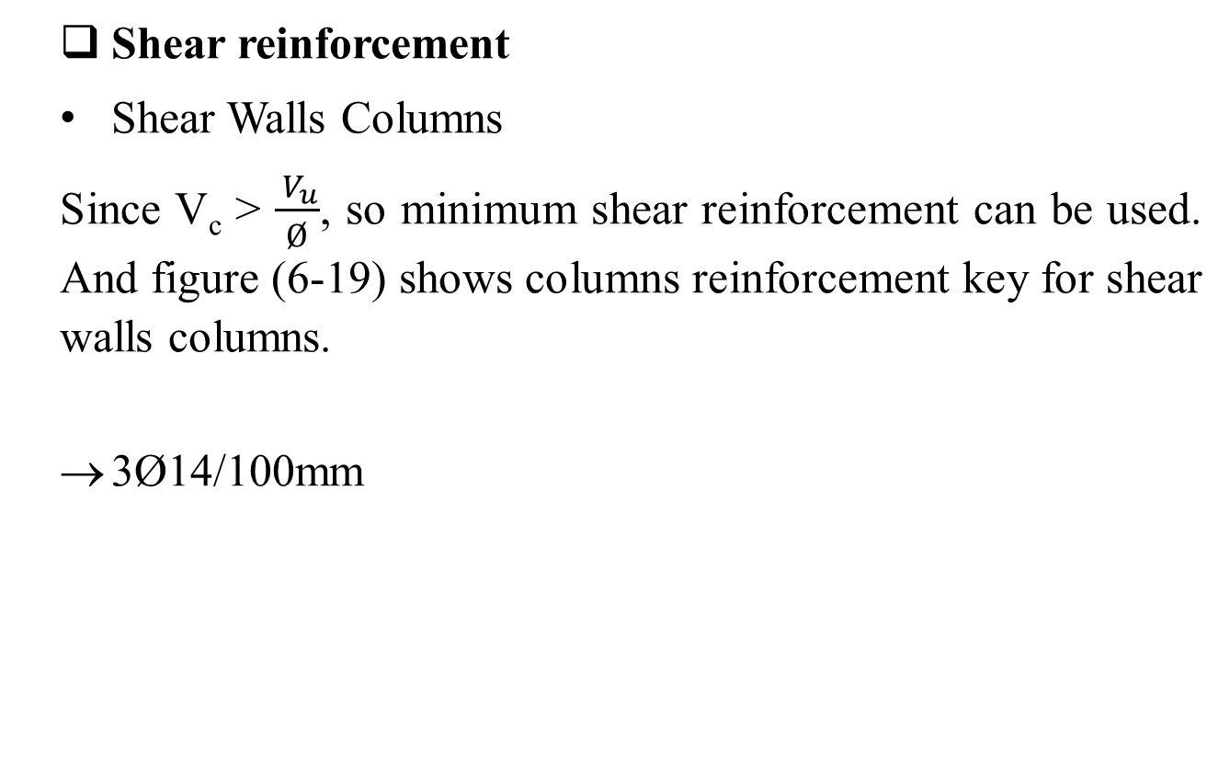
Design
Final Design for Gravity and Lateral Loads
Columns
Shear reinforcement
Shear Walls Columns
Since V_{c} > $\frac{ V_{u}}{Ø}$, so minimum shear reinforcement can be used. And figure (6-19) shows columns reinforcement key for shear walls columns.
3Ø14/100mm

Slide 62
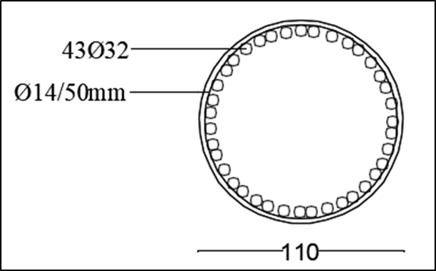
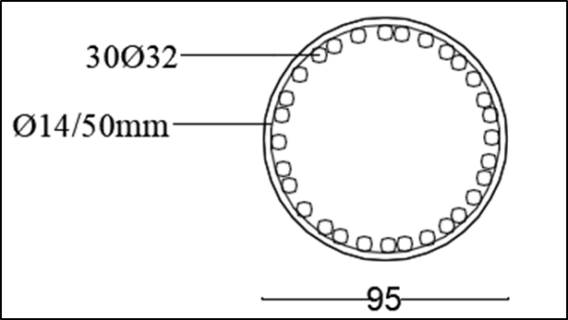
Design
Final Design for Gravity and Lateral Loads
Columns
Columns Sections
0.95m-Diameter Columns
1.1m-Diameter Columns

Slide 63
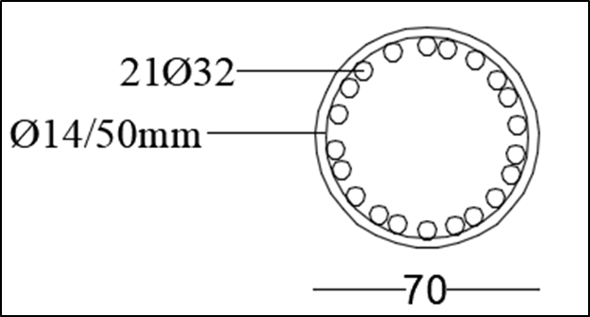
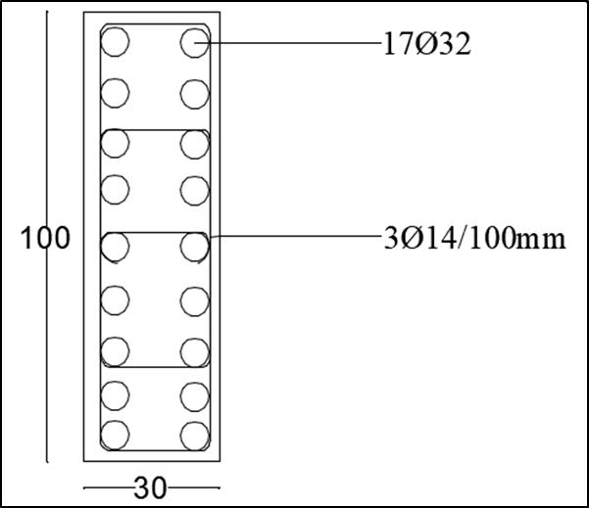
Design
Final Design for Gravity and Lateral Loads
Columns
Columns Sections
Shear Walls Columns
0.70m-Diameter Columns

Slide 64
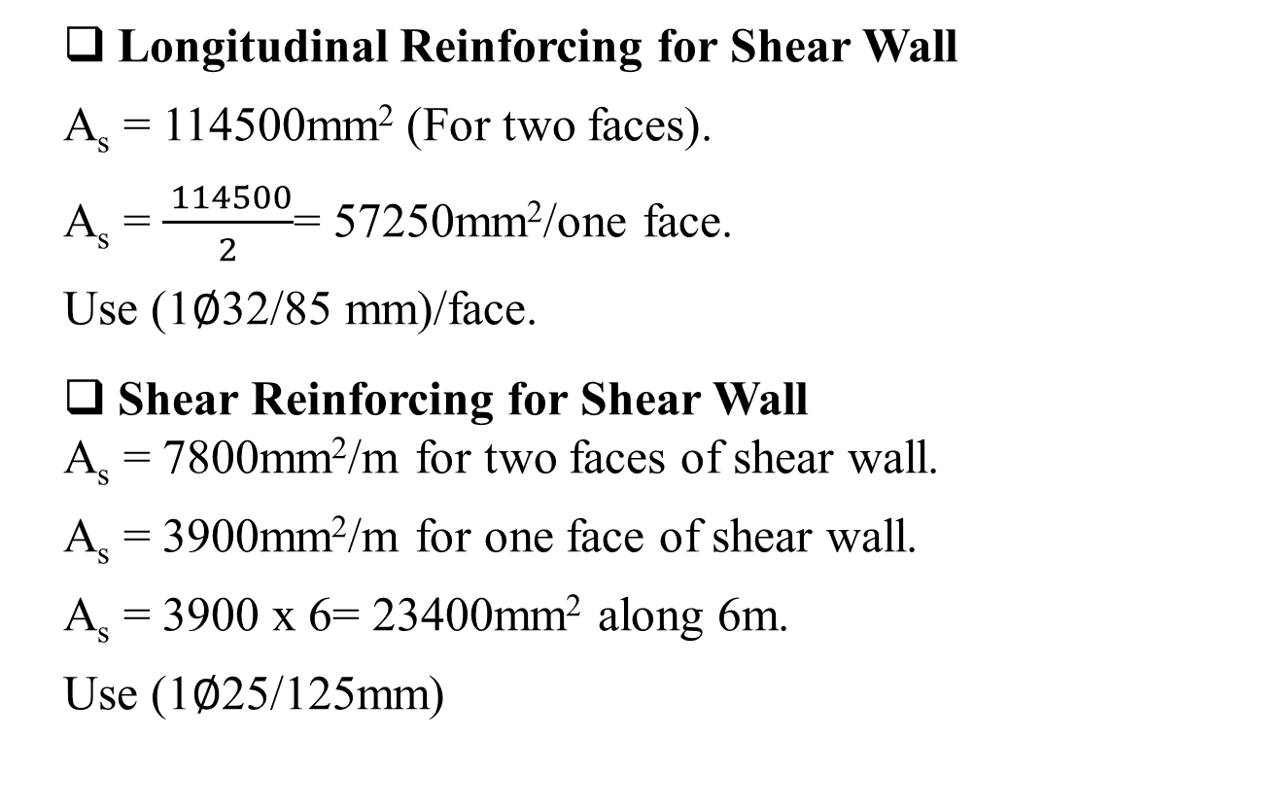
Design
Final Design for Gravity and Lateral Loads
Shear Walls
Longitudinal Reinforcing for Shear Wall
A_{s} = 114500mm² (For two faces).
A_{s} = $\frac{ 114500}{2}$= 57250mm²/one face.
Use (1∅32/85 mm)/face.
Shear Reinforcing for Shear Wall
A_{s} = 7800mm²/m for two faces of shear wall.
A_{s} = 3900mm²/m for one face of shear wall.
A_{s} = 3900 x 6= 23400mm² along 6m.
Use (1∅25/125mm)

Slide 65

Design
Final Design for Gravity and Lateral Loads
Shear Walls
Shear Wall Section

Slide 66
Design
Steel Connections
Introduction
To connect the element of steel structure we use connection, connection is structure element used for joining different member of a structure steel frame work.
The connection type will be used:
• Bolts.
• Plate.
The connected member:
• Steel Column-Steel Column.
• Steel Beam-Steel Column.
• Steel Beam-Concrete Column.

Slide 67

Design
Steel Connection
Using RAM Connection program.
• Customize Connection Design

Slide 68

Design
Steel Connection
• Load Condition and Load Combination

Slide 69

Design
Column-Steel Connection
Joint Data

Slide 70


Design
Column-Steel Connection
Load

Slide 71

Design
Column-Steel Connection
The Shape of Designed Column
After using the RAM connection program get this shape of
connection for columns.

Slide 72
Design
Column-Steel Connection
Details of Connection
For Shear
Details of Connection for Shear
Family: Column splice (CS).
Type: Shear web plate(s).

Slide 73

Design
Column-Steel Connection
For Shear
General Information
The Connector

Slide 74
Design
Column-Steel Connection
For Shear
General Information
Members
Material: A36
Top column
Top column section: EN_HE 1000 M
Bottom column
Bottom column section: EN_HE 1000 M
Connector
Section: PL 7x632.4x292.1
t_{p} (Plate thickness): 7mm

Slide 75

Design
Column-Steel Connection
For Shear
General Information
Members
Material: A36
Top side column
Bolts: 3/4" A325 N
n_{c} (Bolt columns): 4
n_{r} (Rows of Bolts): 3
s (Transverse bolt spacing): 76.2mm
g (bolts spacing): 120mm

Slide 76

Design
Column-Steel Connection
The Result of Shear Connection
Design Check

Slide 77

Design
Column-Steel Connection
The Result of Shear Connection
Design Check

Slide 78
Design
Column-Steel Connection
Details of Connection
For Moment
• Details of Connection for Moment
Family: Column splice (CS).
Type: Flange-plated.

Slide 79


Design
Column-Steel Connection
For Moment
General Information
Members
Material: A36
Flange Plate
Connector
Plate: PL 25x376x786
Consider interior plate: Yes
b (Plate width): 376mm
t_{p} (Plate thickness): 25mm
Material: A36
Bolts: 1" A325 N

Slide 80

Design
Column-Steel Connection
For Moment
General Information
Bolts: 1" A325 N
Connection type: Bolted
Top side column
L_{s} (Top part length): 393mm
n_{c} (Bolt columns): 4
n_{t} (Rows of bolts): 5
Bottom side column
L_{i} (Bottom part length): 393mm
n_{c} (Bolt columns): 4
n_{t} (Rows of bolts): 5

Slide 81

Design
Column-Steel Connection
The Result of Moment Connection
Design Check

Slide 82

Design
Column-Steel Connection
The Result of Moment Connection
Design Check

Slide 83

Design
Beam-Column Steel Connection
Using RAM Connection program
Joint Data

Slide 84


Design
Beam-Column Steel Connection
Load

Slide 85

Design
Beam-Column Steel Connection
The Shape of Designed Column
After using the RAM connection program get this shape of connection for beam-columns.

Slide 86
Design
Beam-Column Steel Connection
Details of Connection
For shear
Details of Connection for Shear
Family: Column splice (CS)
Type: Shear web plate(s)

Slide 87

Design
Beam-Column Steel Connection
For shear
• General Information
Members
Material: A36
End Plate
Connector
Section: PL 8x165.1x304.8
L (Plate length): 304.8mm
B (Plate width): 165.1mm
t_{p} (Plate thickness): 8mm
Material: A36

Slide 88

Design
Beam-Column Steel Connection
For shear
• General Information
Beam side
Plate position on beam: Center
Welding electrode to beam: E70XX
Support side
Connection type: Bolted
Bolts: 3/4" A325 N 140
nc (Bolt columns): 2
nr (Rows of Bolts):4

Slide 89

Design
Beam-Column Steel Connection
The Result of Shear Connection
Design Check

Slide 90

Design
Beam-Column Steel Connection
The Result of Shear Connection
Design Check

Slide 91
Design
Beam-Column Steel Connection
Details of Connection
For Moment
Details of Connection for Moment
Family: Beam - Column web (BCW).
Type: Flange-plated.

Slide 92

Design
Beam-Column Steel Connection
For Moment
• General Information
Members
Material: A36
Flange Plate
Connector
L (Top plate length): 502.7mm
B (Top plate width ): 175mm
tp (Top plate thickness): 20mm
Plate material: A36

Slide 93

Design
Beam-Column Steel Connection
For Moment
• General Information
Beam side
Connection type: Bolted
Bolts: 3/4" A325 N
nc (Bolt columns): 2
nr (Rows of Bolts): 6
Support side
Top and bottom welding electrode to support and column : E70XX
D1 (Top weld size to support (1/16 in) ): 6
D2=D4: 2
D3: 7

Slide 94

Design
Beam-Column Steel Connection
The Result of moment Connection
Design Check

Slide 95

Design
Beam-Column Steel Connection
The Result of Shear Connection
Design Check

Slide 96
Design
Steel Beam-Concrete Column Connection
The idea of designing column-steel connection is using Ramp connection program, that we assume the concrete column is steel column and applied the load on it, to
make sure it’s safe and under specification.
After the concrete column have been design and the area of steel has been determined, which is 43Ø32 for
Column Diameter 1100mm, some of the area steel will be used to connect between the column and the steel
beam.

Slide 97

Design

Slide 98

Design
Steel Beam-Concrete Column Connection
Joint Data

Slide 99


Design
Steel Beam-Concrete Column Connection
Load

Slide 100

Design
Steel Beam-Concrete Column Connection
The Shape of Designed Column
After using the RAM connection program get this shape of connection for steel beam-concrete column.

Slide 101
Design
Steel Beam-Concrete Column Connection
Details of Connection
For Shear
• Details of Connection for Shear
Family: Beam - Column flange (BCF).
Type: End plate

Slide 102

Design
Steel Beam-Concrete Column Connection
For Shear
General Information.
Members
Material: A36
End Plate
Connector
Section: PL 8x165.1x304.8
L (Plate length): 304.8mm
B (Plate width): 165.1mm
tp (Plate thickness): 8mm
Material: A36

Slide 103

Design
Steel Beam-Concrete Column Connection
For Shear
General Information.
Beam side
Plate position on beam: Center
Welding electrode to beam: E70XX
Support side
Connection type: Bolted
Bolts: 3/4" A325 N
nc (Bolt columns): 2
nr (Rows of Bolts): 4

Slide 104

Design
Steel Beam-Concrete Column Connection
The Result of shear Connection
Design Check

Slide 105

Design
Steel Beam-Concrete Column Connection
The Result of shear Connection
Design Check

Slide 106
Design
Steel Beam-Concrete Column Connection
Details of Connection
For Moment
• Details of Connection for Moment
Family: Beam - Column flange (BCF)
Type: Flange Angles/Flange Tees

Slide 107

Design
Steel Beam-Concrete Column Connection
For Moment
General Information.
Members
Material: A36
Angels/Flange Tees
Connector
Is angle/tee: Angle
Angle section: LU 8X6X1
Angle short leg on beam: No
Connection type: Bolted
C (Length): 434mm
Material: A36

Slide 108

Design
Steel Beam-Concrete Column Connection
For Moment
General Information.
Beam side
Bolts: 1" A325 N
nr (Rows of Bolts): 2
nc (Bolt columns): 4
Support side
Bolts: 1" A325 N
nr (Rows of Bolts): 1
nc (Bolt columns): 4

Slide 109

Design
Steel Beam-Concrete Column Connection
The Result of moment Connection
Design Check

Slide 110

Design
Steel Beam-Concrete Column Connection
The Result of moment Connection
Design Check

Slide 111
Thank you

