Slide 1


Slide 2
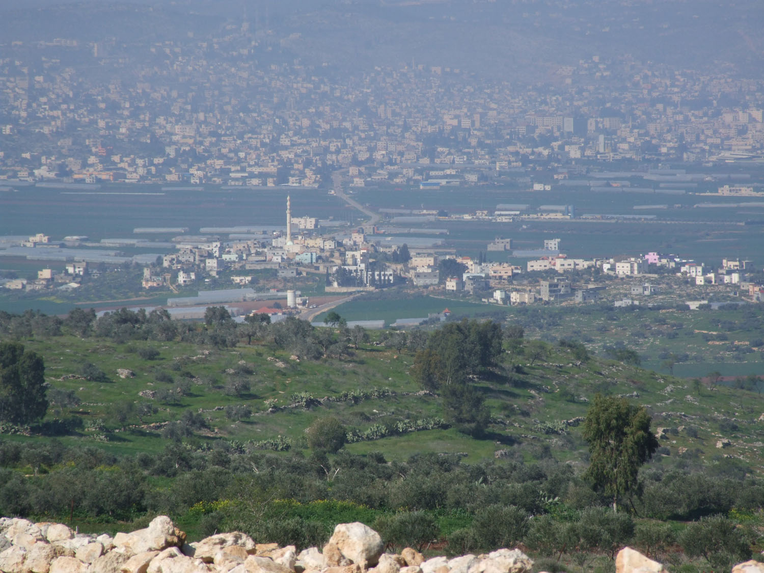
Biet Qad Village

Slide 3
Climate

Slide 4
Relative Humidity

Slide 5
Evaporation

Slide 6
Water Distribution Network
Importance of the system:
Save People Time & Effort.
Grantee Water Quality.

Slide 7
Design inputs :
Watercad is the programme used in design.
population is Predicted depending on the available space for that village after 30 years and found to be 7000 capita
Water consumption rate is 100 l/c .day but if we take into consideration annual increase of about 1.5 l/c.day then it is common sense to use 120 l/c.d
for design process.
Load is distributed on junctions using Thissen polygon method.

Slide 8
Procedure
Building model procedure
1. Determining the area that we want to serve which can be obtained from the master plan.
2. Importing AutoCAD files as a separate layers in Water Cad which includes (Buildings, Roads, Contours and Service area) layers.
.

Slide 9
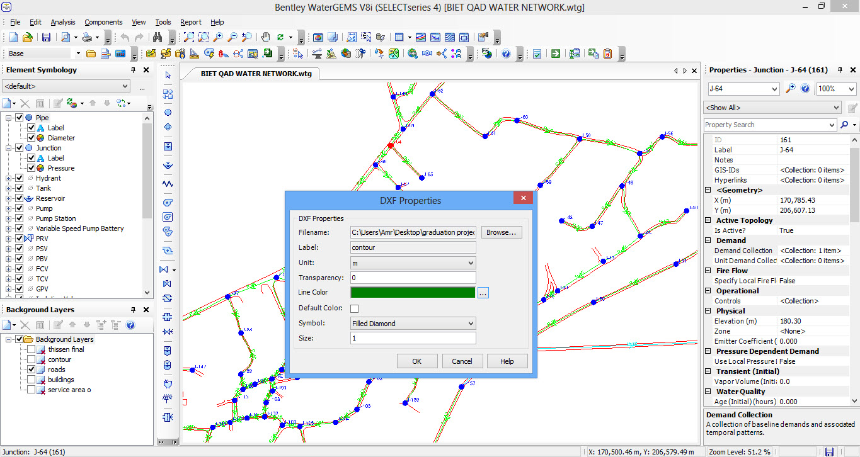
Importing layers

Slide 10
3. Start drawing pipes and junctions on the network.
4. Estimating water consumption and population for that village after 30 years. This is found to be 120 and 7000 respectively.
5.Calculating the area of the service area and defining the total daily demand for that area using GIS.
6.Using load builder to assign water demand to the network

Slide 11
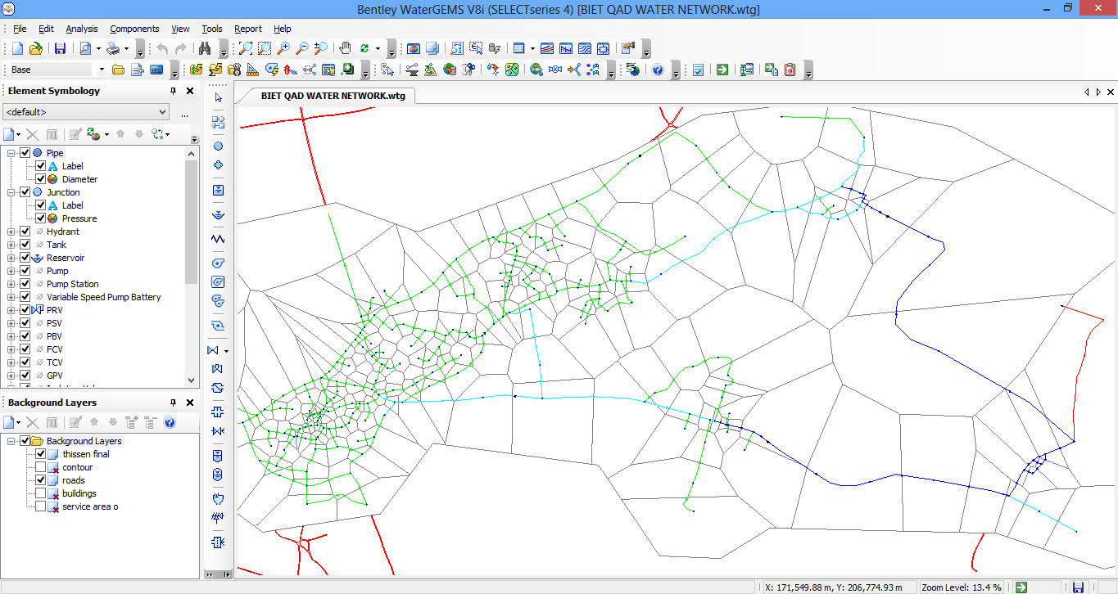
7. Using one of watercad features which is called Theissen polygon to distribute this demand on junctions proportionally with area served by each junction.

Slide 12
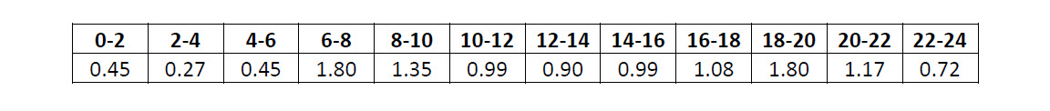
8. Entering the load pattern values as Palestinian Water Authority (PAW) standards.

Slide 13
9. Defining the EPS to be the default base calculation option in order to perform dynamic analysis for the network.
10. Run the model and obtaining pressure and velocity values for junctions and pipes respectively .and starts iterations to find the most suitable pipe diameters to get the values of pressure within ranges of (PAW).
11. Start another cycle of iterations to fit pressure values between maximum and minimum day hours using pressure reducing valves.

Slide 14
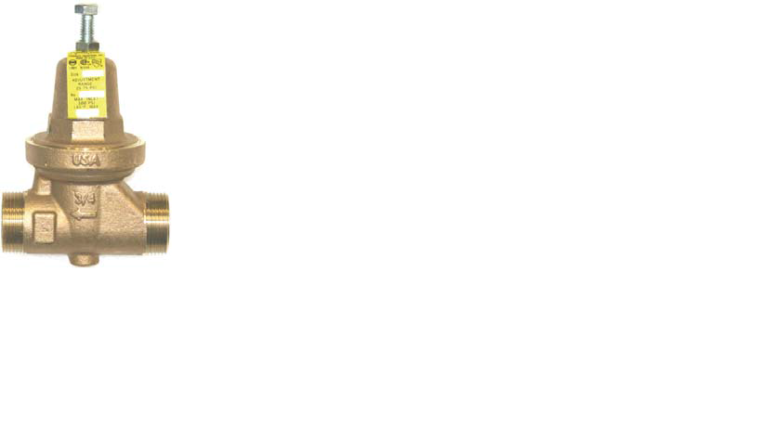
Four (PRV) were used :

Slide 15
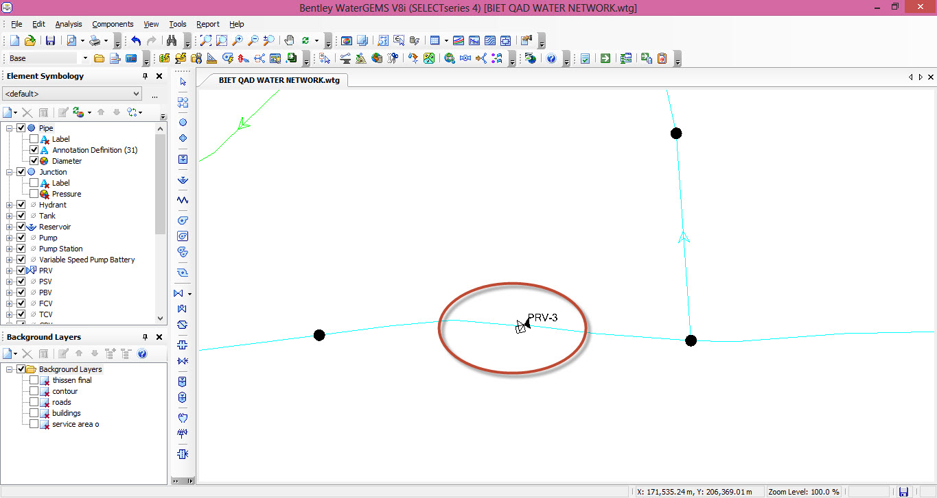
Snapshot For (PRV):

Slide 16
Results

Slide 17
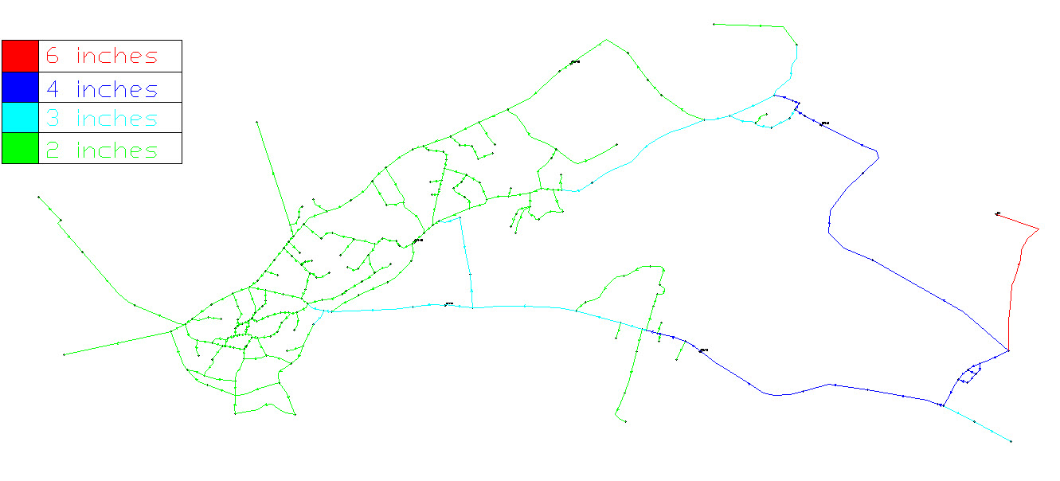
Pipe Diameters:(only 2,3,4and 6)inches

Slide 18
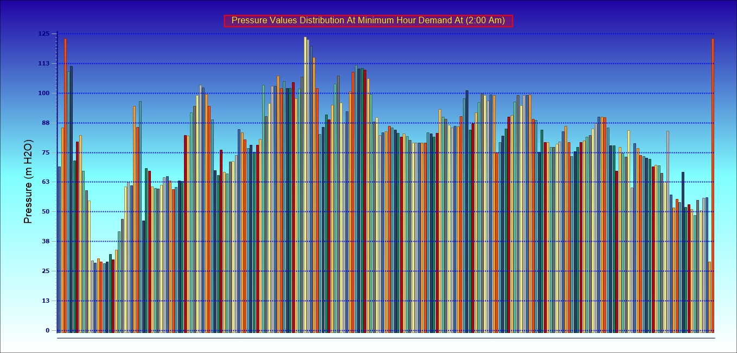

Slide 19
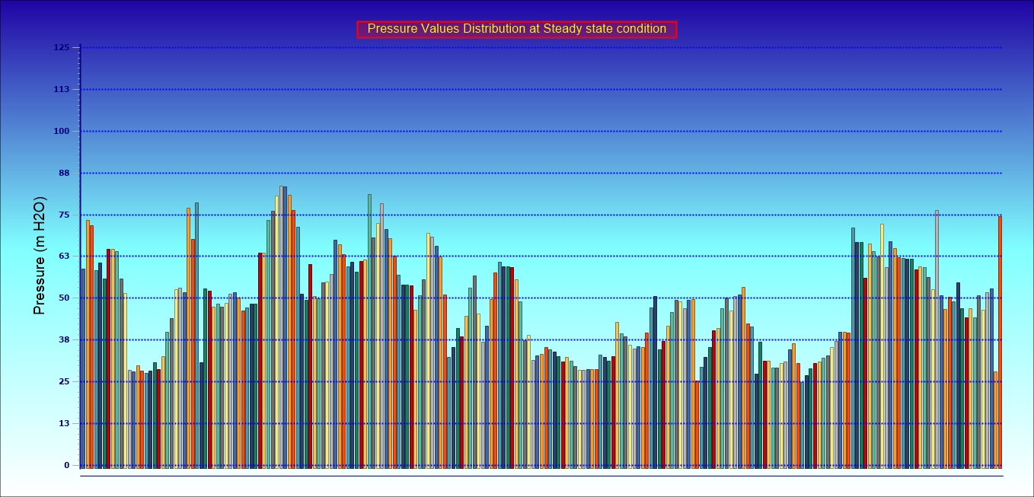

Slide 20
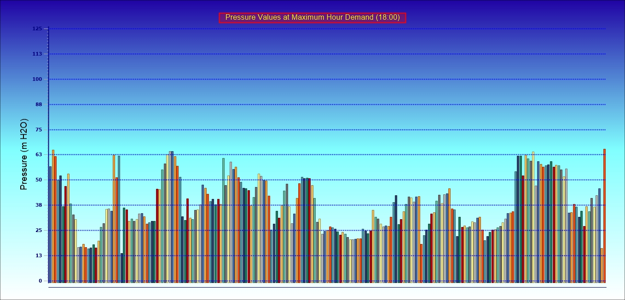

Slide 21
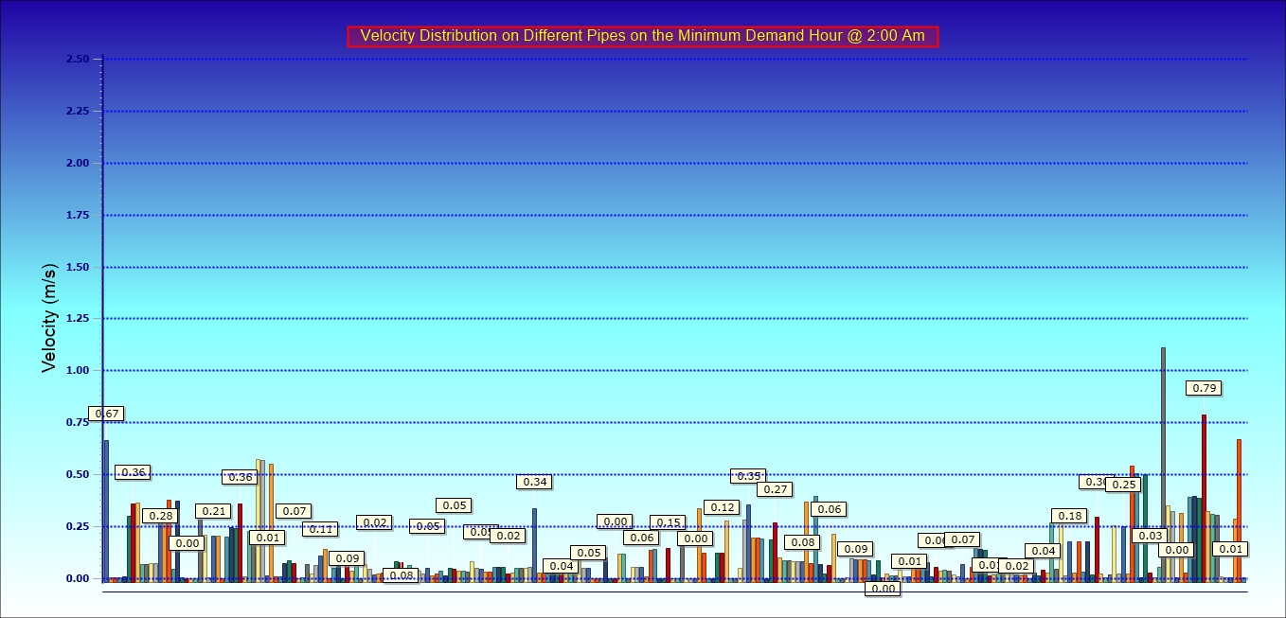

Slide 22
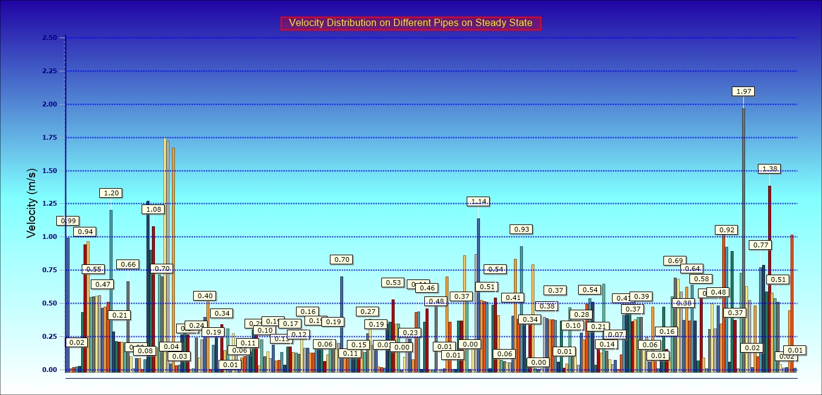

Slide 23
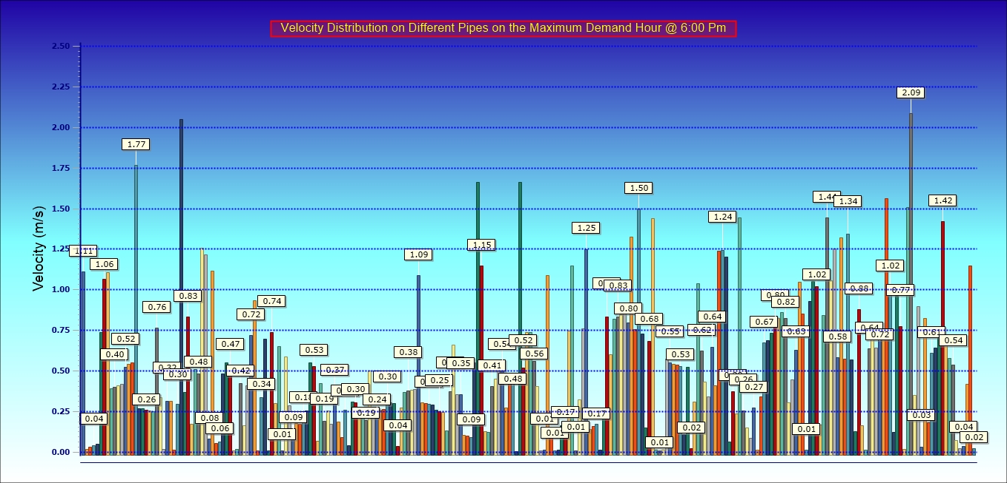

Slide 24
Sewer Collection System

Slide 25
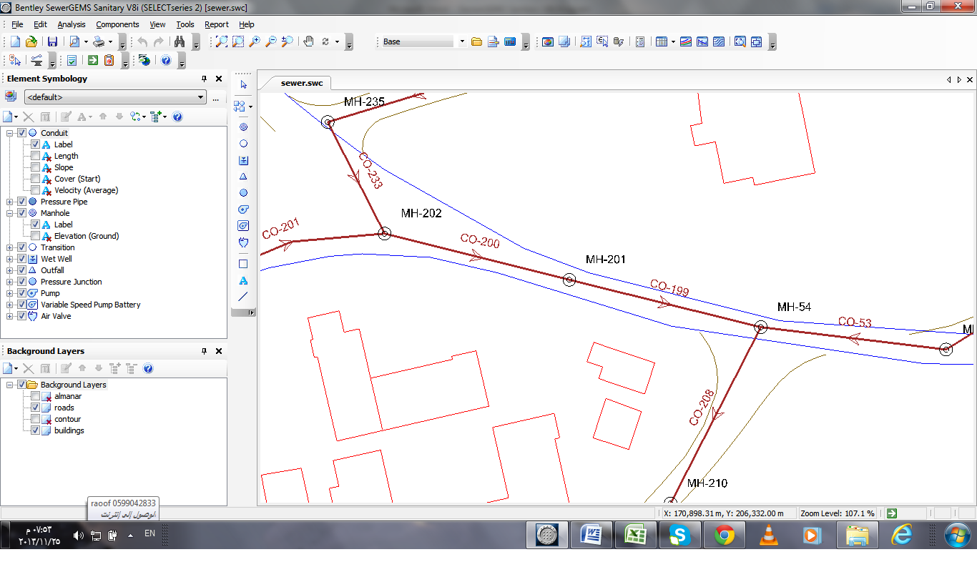
Building the hydraulic model
Draw the network in the street of the village taken into considerations the slops.

Slide 26
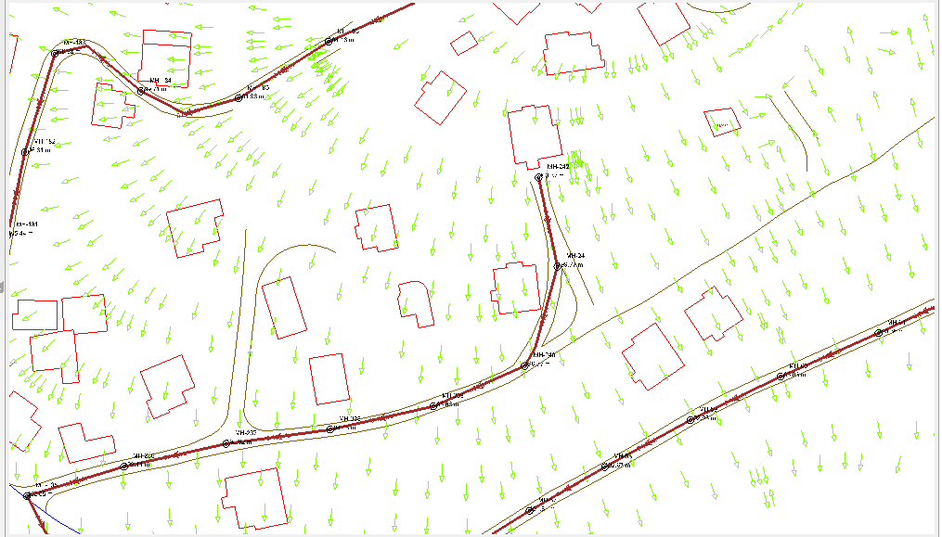

Slide 27
Inter the elevations of the manholes by using TREX
Determine the water generations per person, using this formula
unit load = average daily per capita wastewater flow*return flow percentage*max. hourly factor+ infiltrations
= 120*0.8*3+ (120*0.8)*.2
=307.2 and take it as 320 L.c/d

Slide 28
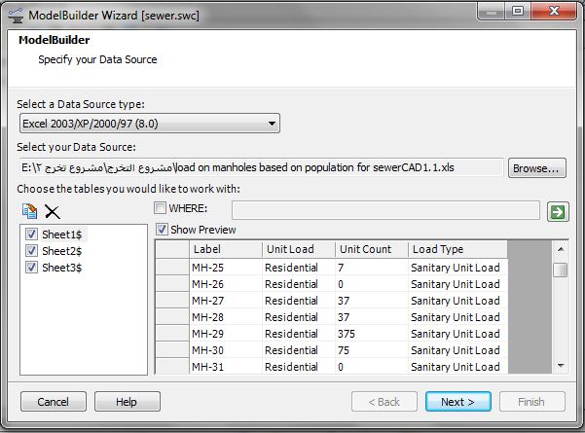
Inter the flow using loadBuilder

Slide 29
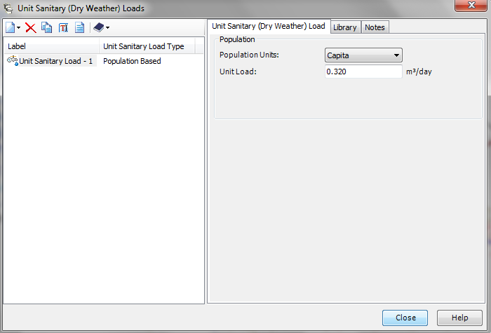

Slide 30
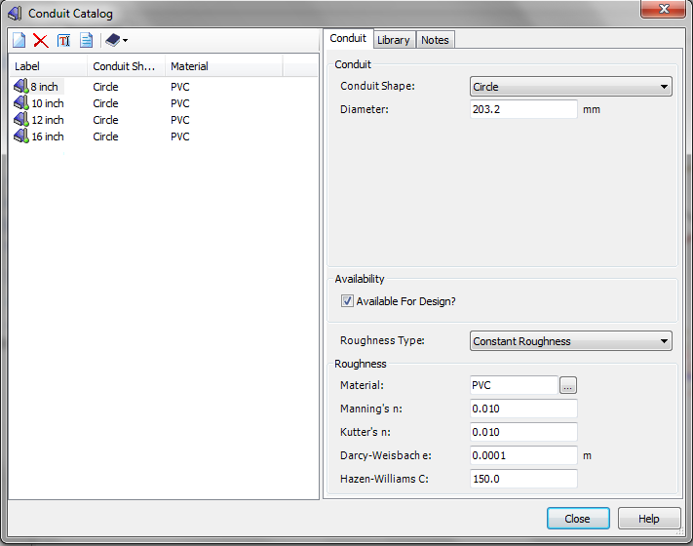
Select the type of pipes which is PVC.

Slide 31
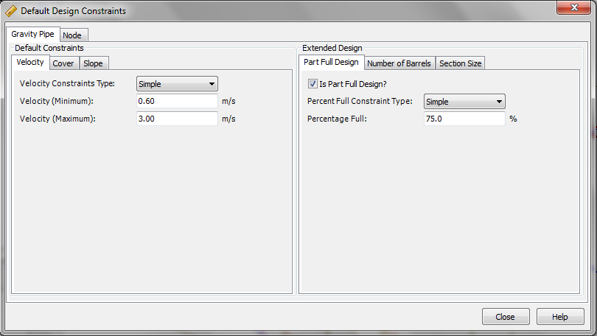
Inter the Default Design Constraints which is velocity, cover and slope.

Slide 32
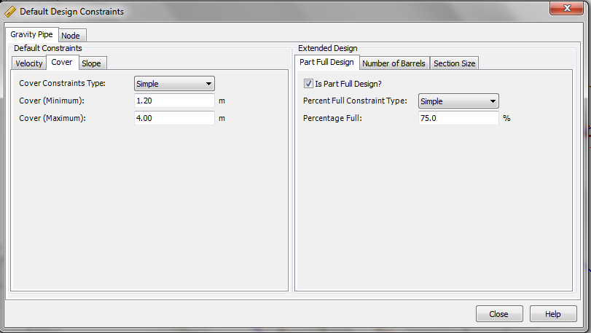
The standard cover of pipes between (1.2 - 4)m, and it is used to protect pips. In other side it is not economic to use more than 4m.

Slide 33
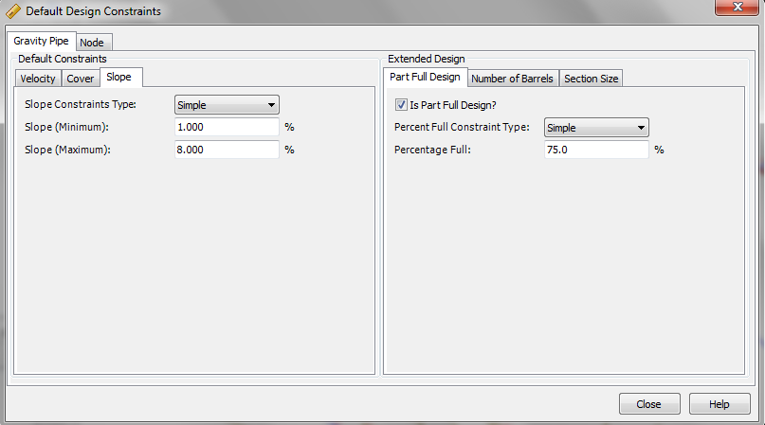

Slide 34
Results
Slope% | cover (m) | Velocity (m/sec)
1 | 1.2 | 0.48 | Minimum
8 | 5.8 | 1.99 | Maximum
About 5.75% of the pipes velocity and found in the beginning of the network less than the minimum constraints.
About 15.1 % not meet the max. cover constraints.

Slide 35
Outfall
Label | Elevation (m) | Flow (m
OF 1 | 165 | 545.6
OF 2 | 160 | 899.22

Slide 36
Profile
From Autocad

Slide 37
Storm drainage system

Slide 38
Storm Drainage System
Importance of the system.

Slide 39
CIA
The Rational Method equation used to calculate peak storm water runoff rate
Q= CIA
Where: Q = design discharge (L³ /T)
C = runoff coefficient (dimensionless)
I = design rainfall intensity (L/T), and
A = watershed drainage area (L²)

Slide 40
Procedure
Building model procedure
Use the GIS program to specify the borders of the total Catchment area.
Import DXF extension of the AutoCAD maps to the StormCAD program, and specify the units and the scale.

Slide 41
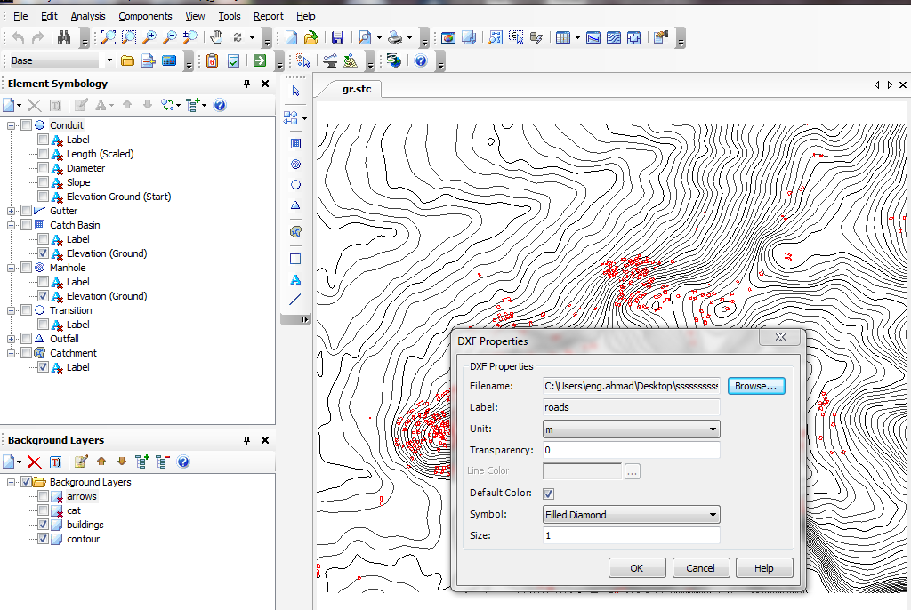

Slide 42

Set the maps as background layers, and enter the default design constrains

Slide 43
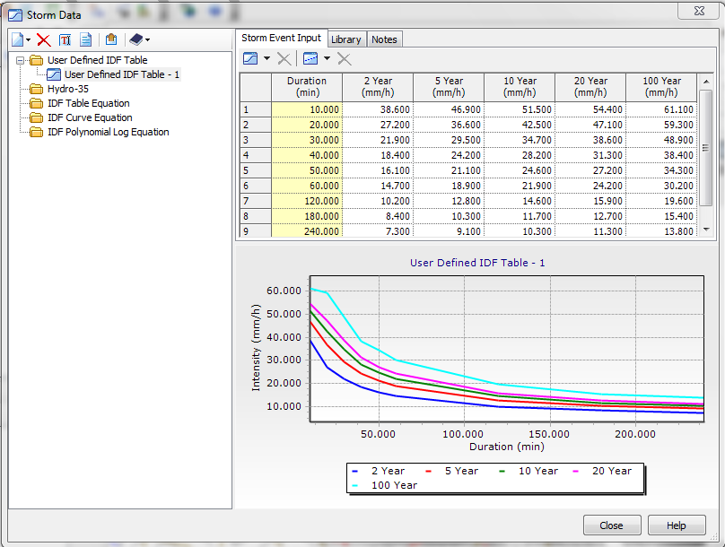
4. Produce the Intensity-duration-frequency (IDF) curves depending on the information from the Palestinian water authority.

Slide 44
Define the inlets and conduits that will be used in the design processes by entering the
available sizes in the market.
Define the catch basins by entering the dimensions of each type.

Slide 45
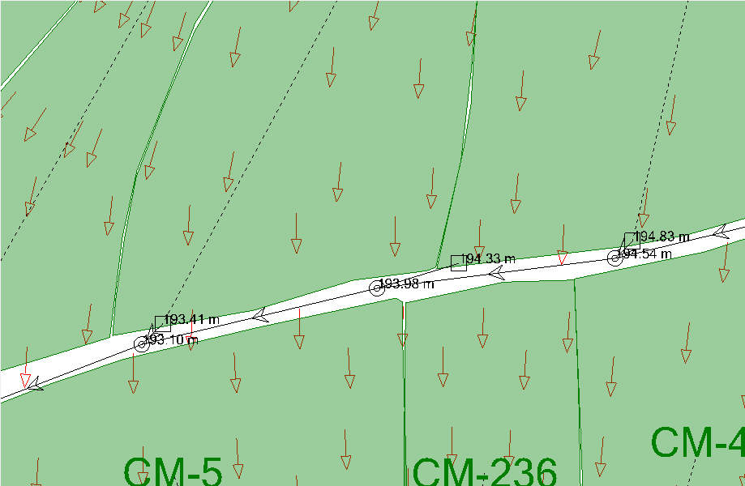
Use (civil 3D) program to obtain slope arrows, and then enter the arrows as a layer into the StormCAD using GIS.

Slide 46
Start drawing the conduits, catch basins, and manholes in the appropriate location.
Obtain the elevation of manholes and catch basins from the contour map by using (Trex).

Slide 47
Use the tables of rational coefficient C to identify the value that represents each catchment area depending on land use and land cover, then use it to calculate the time of concentration.
Run the model and analyze the results.
Detect errors from the given results and correct them.

Slide 48
Results
 | Velocity (m/s) | Cover (m) | Slope (%)
Minimum | 0.6 | 0.8 | 1
Maximum | 6.5 | 4.8 | 15
Velocity : the percent of conduits have more than 4.5m/s is equal to 3%

Slide 49
Profiles
(on Autocad)

Slide 50
Conclusion and Recommendation

Slide 51
Water Distribution Network
According to our calculation and WDN designing .few of nodes have a pressure below 20 m in the maximum hour demand but these nodes have higher pressure values in other day times so the situation could be accepted since we considering fluctuation in demand through the day.
Network leakage not considered in designing the network. But it should be taken into consideration. Since it has a high value in agricultural areas and it might be reach 50 % of water in the network.

Slide 52
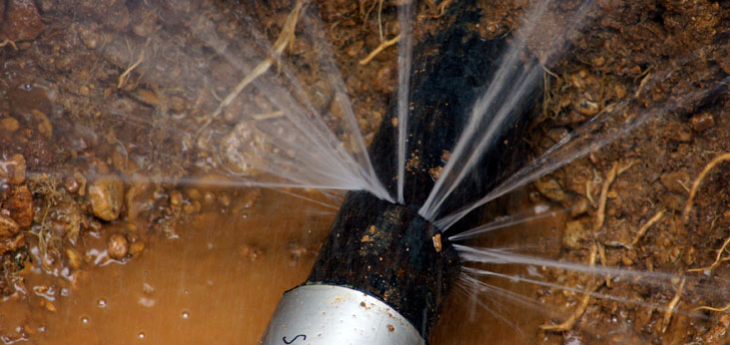

Slide 53
Head loss in pipes and fittings were neglected. And this is not accurate because it can change values of pressure in different nodes. So we recommend take these values into consideration in the future design.

Slide 54
Sewer Collection System
We face some problems in expected the number and the distributions of people in the future, thus we recommend to build a master plan because it is very useful and helpful.

Slide 55
Storm Drainage
The (IDF) curve we use is the curve of Nablus City; since there is no one for Jenin City and its villages. So we should modify this curve to reflect the reality of the villa

Slide 56


