Slide 1

Synthesis of Carbon Nanodots from Smoked Tobacco Molasses via Chemical Oxidation and Extraction
Presented by
Amal Yaseen
Aya Ataya
Leena Rifai
Prepared to
Dr. Shadi Sawalha

Slide 2
Introduction
Sensing Application
Project Objectives
Synthesis of CNDs
Results and Discussion
Summary Of The Project
Content

Slide 3
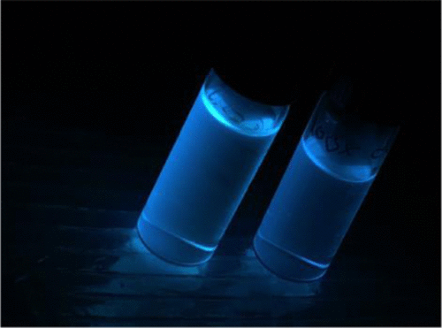
Carbon NanoDots(CNDs)
Over the past decade, carbon dots have received a great deal of attention and extensive research.
CNDs have many important properties such as optical quanta small size uniform shape and composition fluorescence emission, low toxicity and biocompatibility and low cost in preparation.
Resources of CNDs
Natural
Man made
Waste

Slide 4
Synthesis Methods to Prepare CNDs
Top-Down
Chemical Oxidation
Laser ablation
Electrochemical oxidation
Sonication
Bottom-Up
Thermal Carbonization
Plasma Treatment
Hydrothermal Treatment
Microwave

Slide 5
Using CNDs In Sensing
CNDs are suitable for use in Nano sensors due to a variety of their characteristics .
Adjustable Fluorescence
Superior Stability
Strong Water Solubility

Slide 6
Project Objectives
.
.
Synthesis of carbon nanodots from tobacco molasses waste by two methods extraction and chemical oxidation, to use them in sensing based on fluorescence metals mainly iron ions in the water will be an optimal solution for the problem of water pollutants, especially that CNDs are synthesized from tobacco molasses waste, which is available and recycle for the waste.

Slide 7
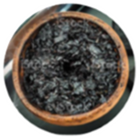
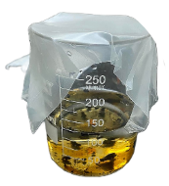
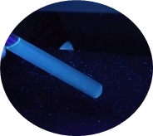
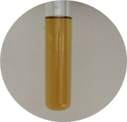
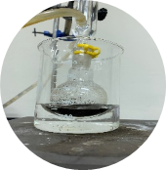
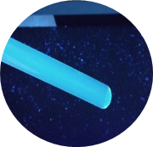
Smoked Tobacco Molasses (STM)
Residual of STM $H_{2}O_{2}+$Water
Residual of STM 𝐇_𝟐 𝐎_𝟐+Water
5g STM soaked in 120 ml water
D-CNDs
Florescence D-CNDs
O-CNDs
Oxidation
90 min
Florescence O-CNDs
Synthesis of CNDs

Slide 8
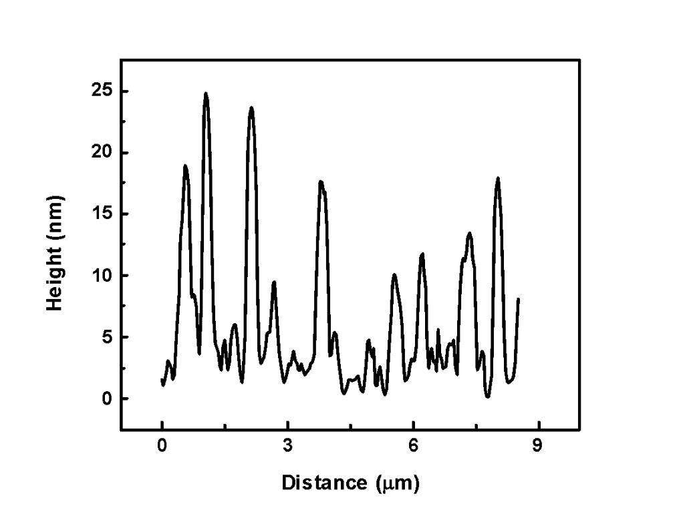
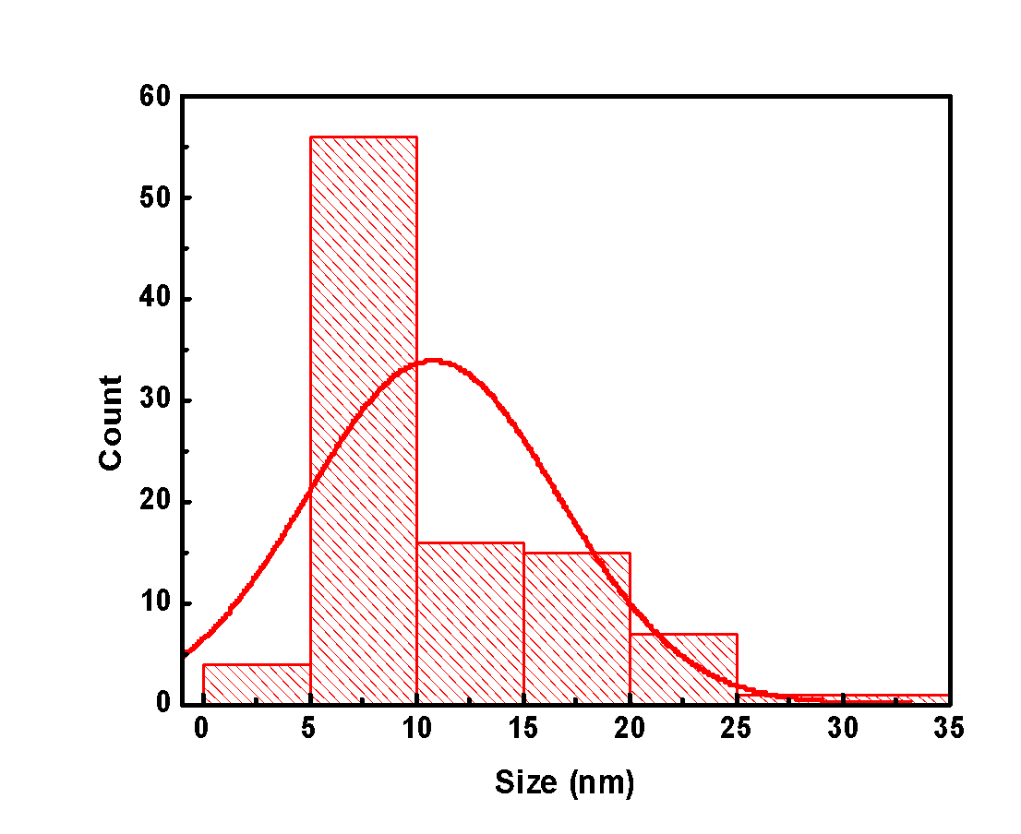
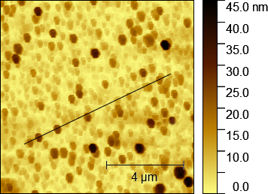
Characterizations of CNDs
Morphology and Chemical Composition
D-CNDs show a wide range of particle size from 2.9 to 33 nm with an average of 10.7 nm
AFM Image
Height Profile
Distribution Histogram

Slide 9
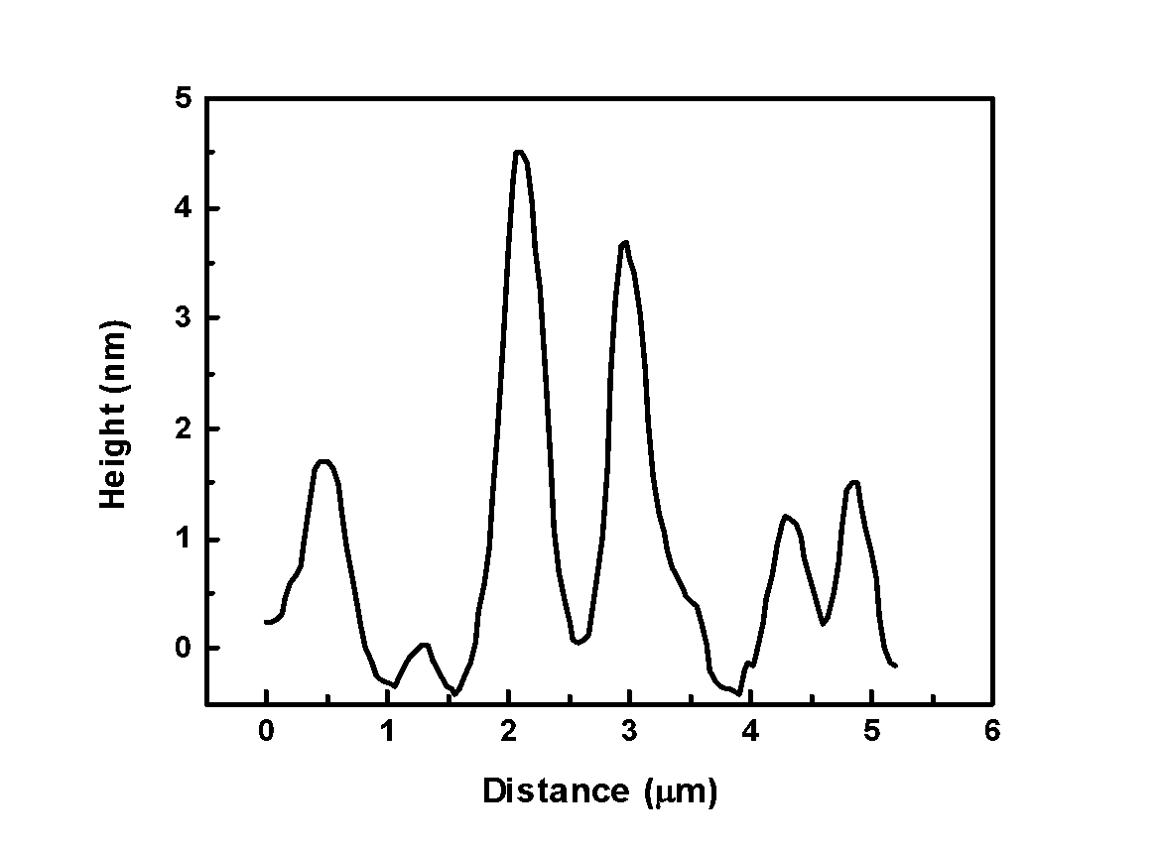
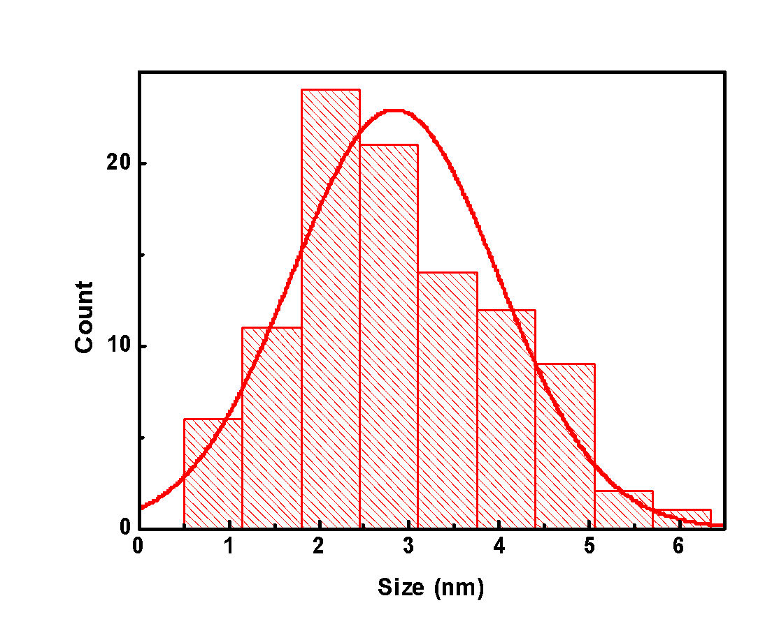
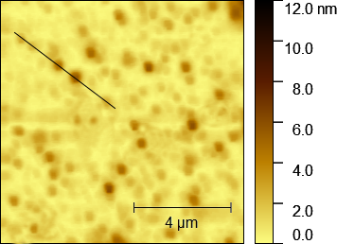
Morphology and Chemical Composition
O-CNDs show narrow range of particle size from 0.93 to 5.9 with an average of 2.7 nm
AFM Image
Height Profile
Distribution Histogram

Slide 10
FTIR Spectra of Synthesized CNDs
The existence of oxygen group in both CNDs (O-CNDs and D-CNDs) was confirmed by PAIS 𝜀-Potential measurement illustrating higher negative value for O-CNDs (-15.2) than D-CNDs (-10.24).

Slide 11
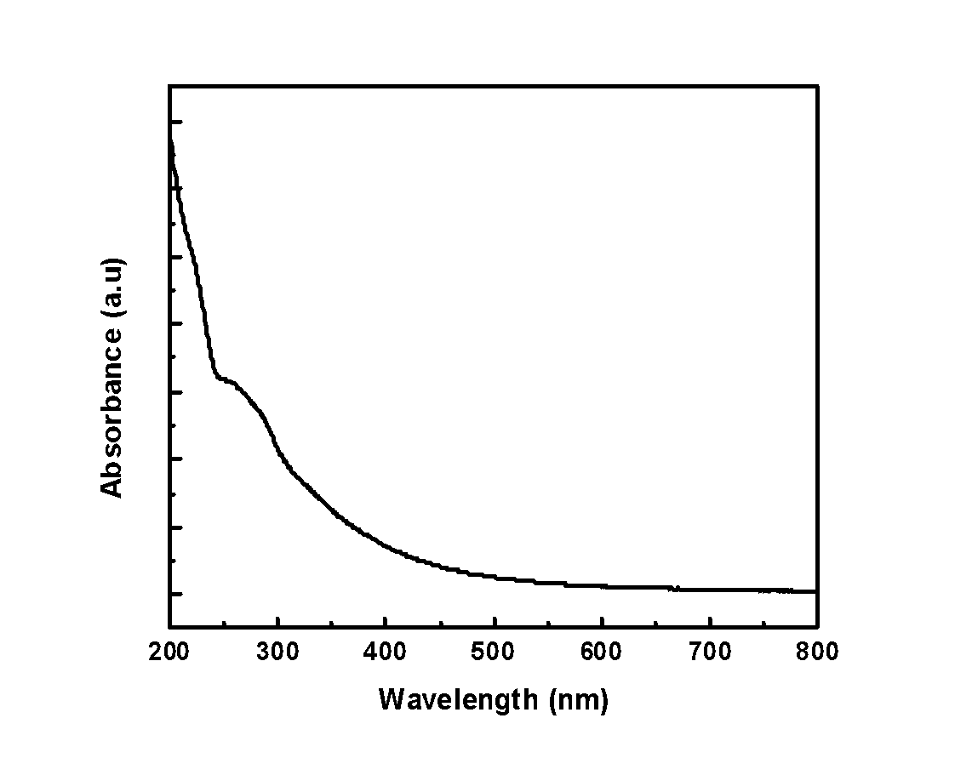
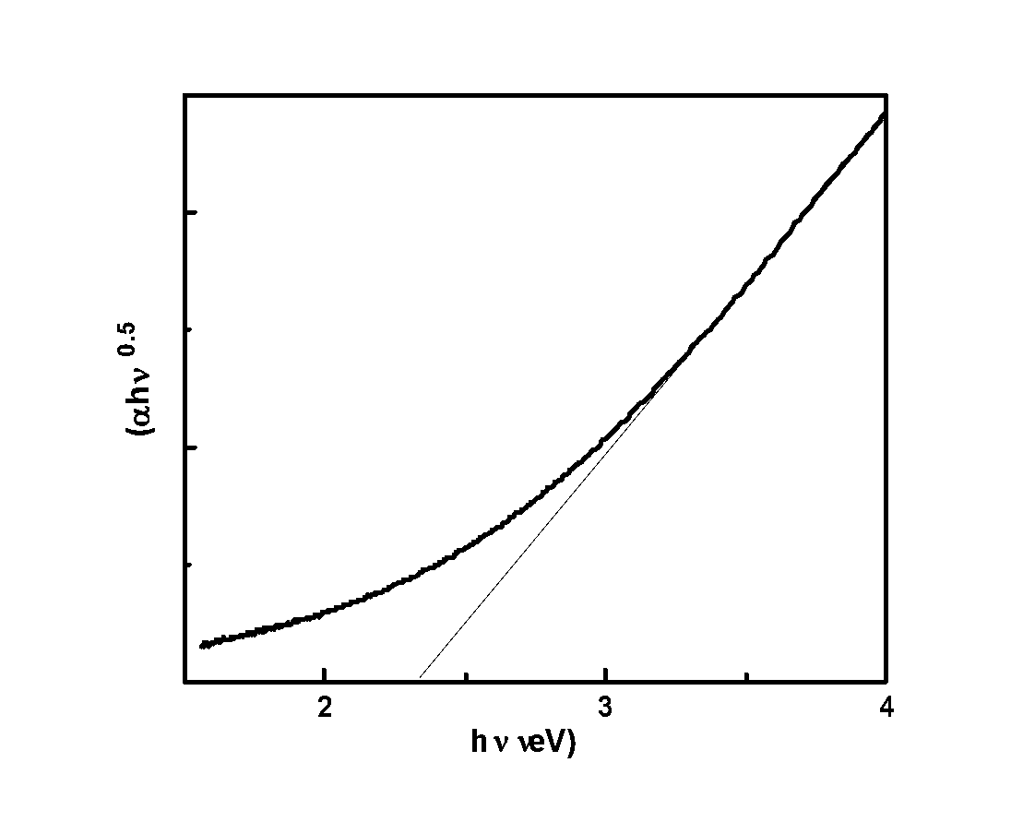
Optical properties
Band gap of D-CNDs has been calculated and giving a value of (2.25 eV)
The absorption spectra of prepared D-CNDs
Tauc plot of D-CNDs

Slide 12
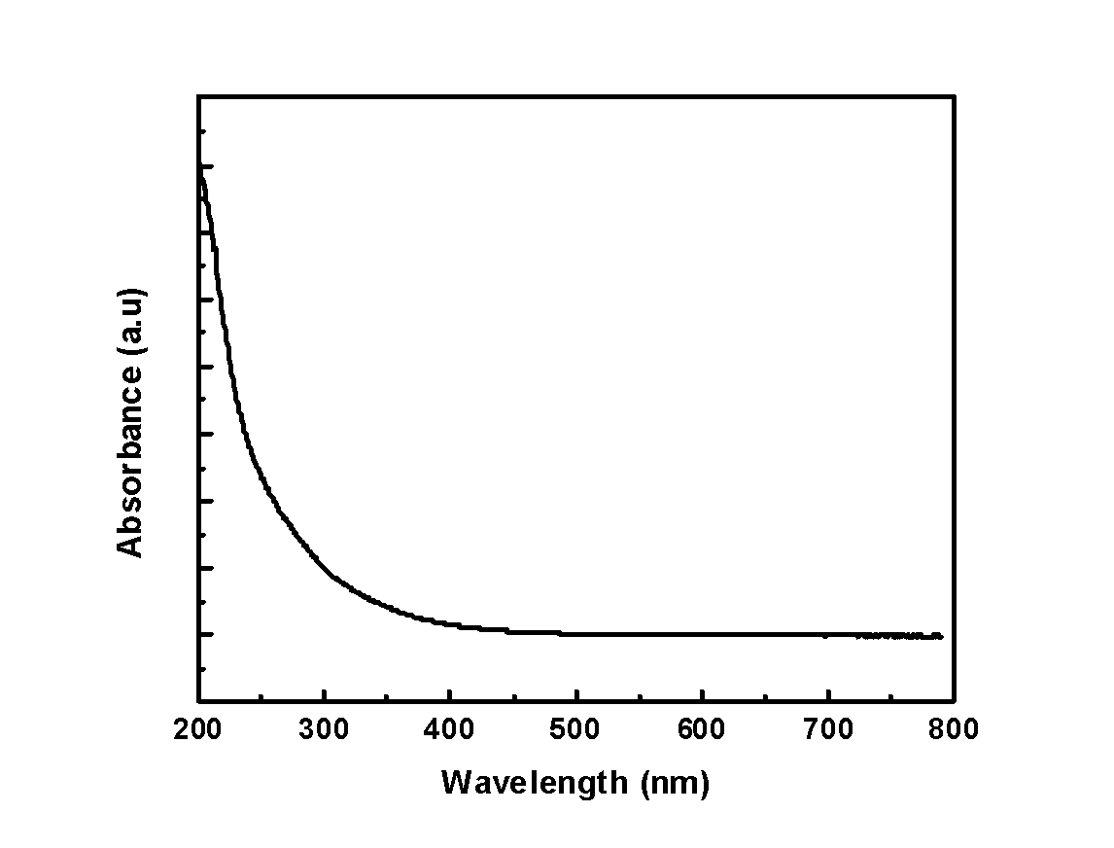
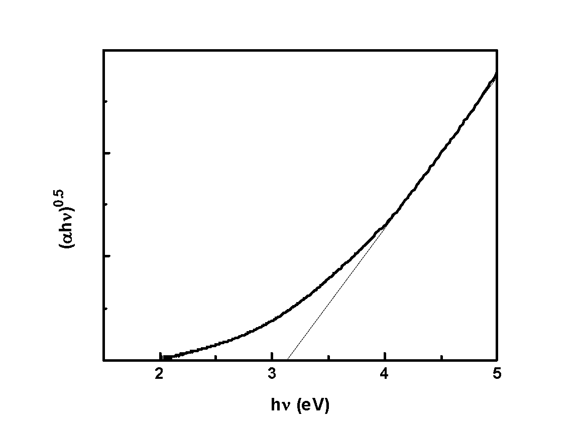
Optical properties
Band gap of O-CNDs has been calculated and giving a value of (3 eV)
The absorption spectra of prepared O-CNDs
Tauc plot of O-CNDs

Slide 13
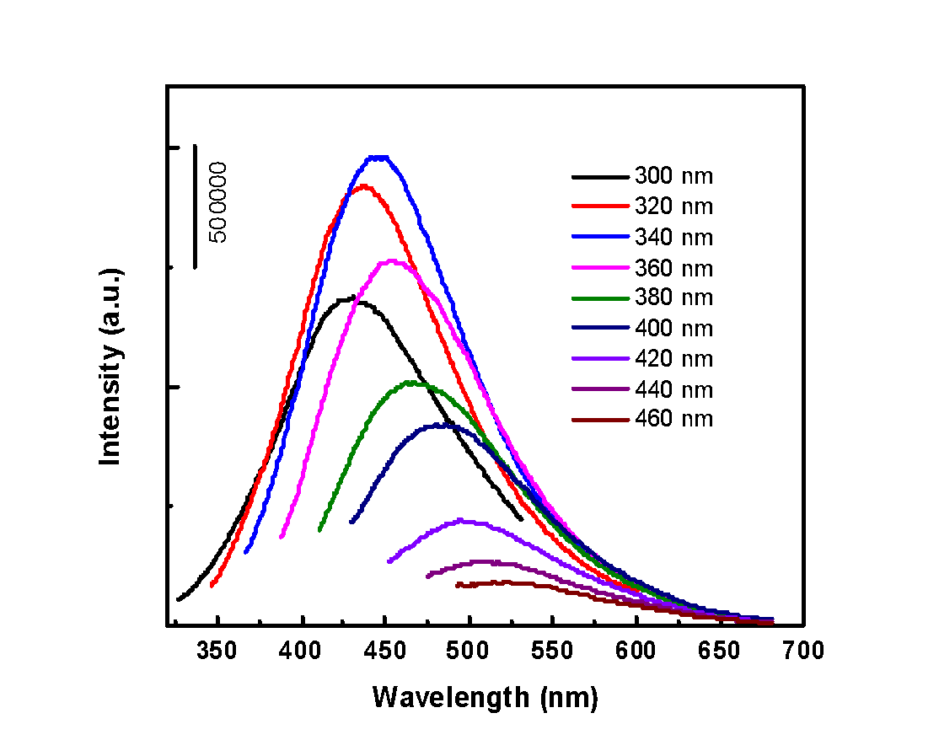
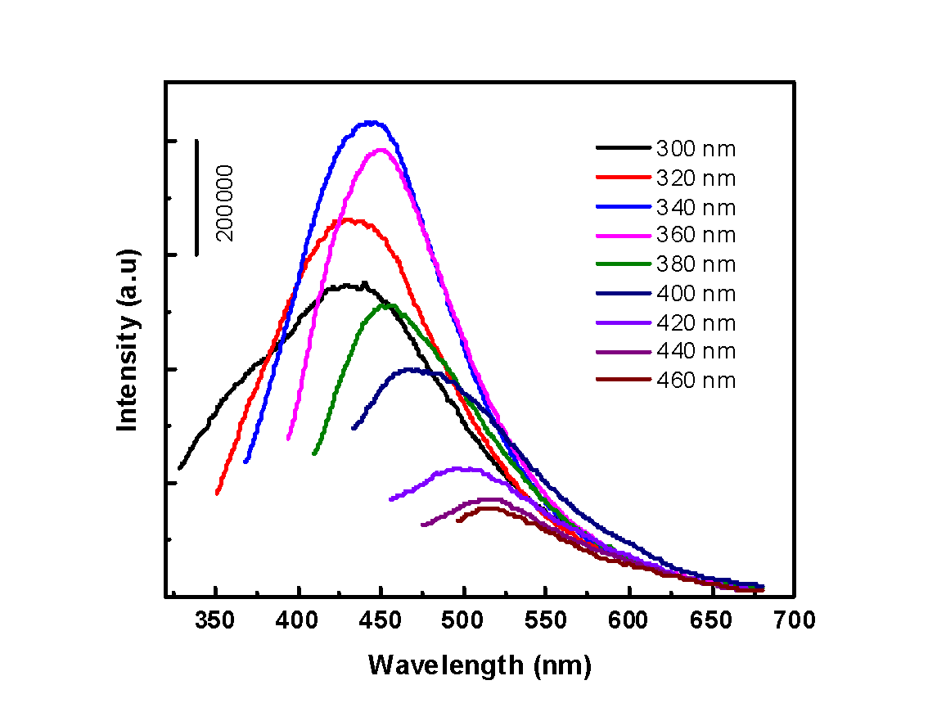
Photoluminescence (PL) Intensity
O-CNDs exhibit a higher Q.Y which was 3.1% while D-CNDs have a quantum yield of 1.55%
O-CNDs
D-CNDs

Slide 14
Selectivity Test
Metal Ions Solution
Sample
CNDs
Deionized Water

Slide 15
Metal Salts
$${FeCl}_{3}$$
〖𝐹𝑒𝐶𝑙〗_3
$${MnCl}_{2}$$
〖𝑀𝑛𝐶𝑙〗_2
$${HgCl}_{2}$$
〖𝐻𝑔𝐶𝑙〗_2
$${Ni(PO_{3})}_{2}$$
〖𝑁𝑖(𝑃𝑂_3)〗_2
$${FeCl}_{2}$$
〖𝐹𝑒𝐶𝑙〗_2
$$Pb(NO3)2$$
𝑃𝑏(𝑁𝑂3)2
$$CuCl2.2H2O$$
𝐶𝑢𝐶𝑙2.2𝐻2𝑂

Slide 16
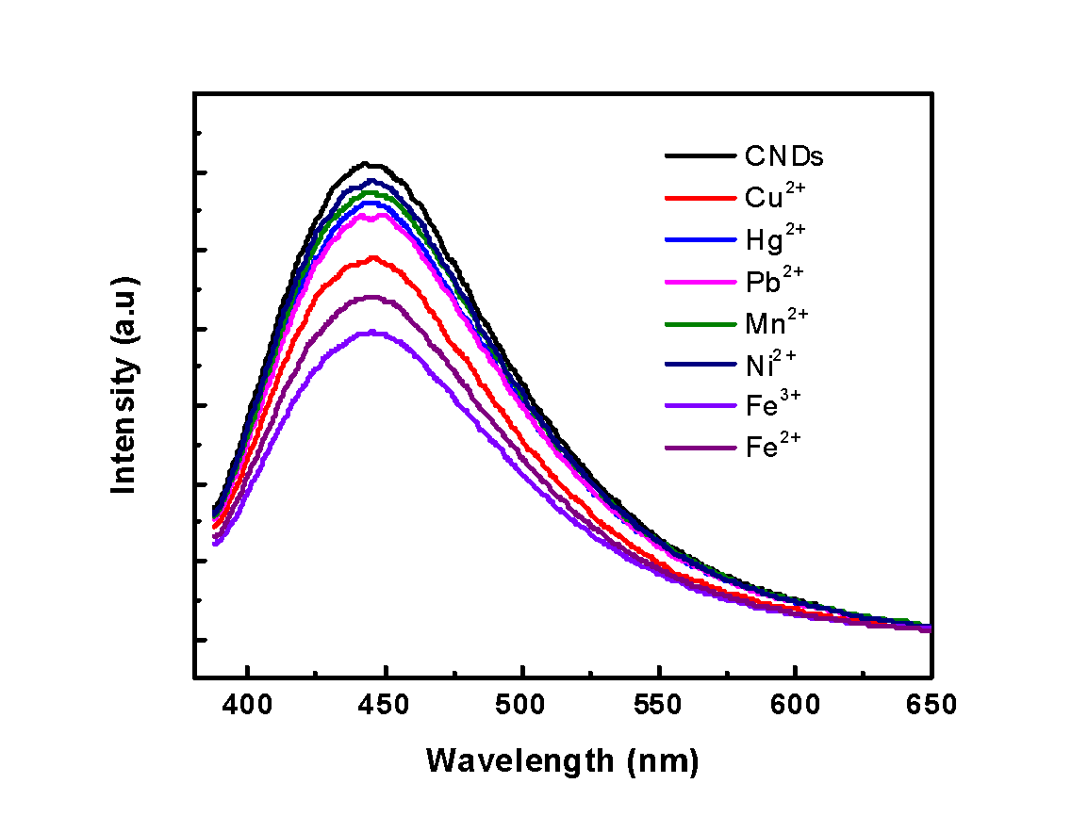
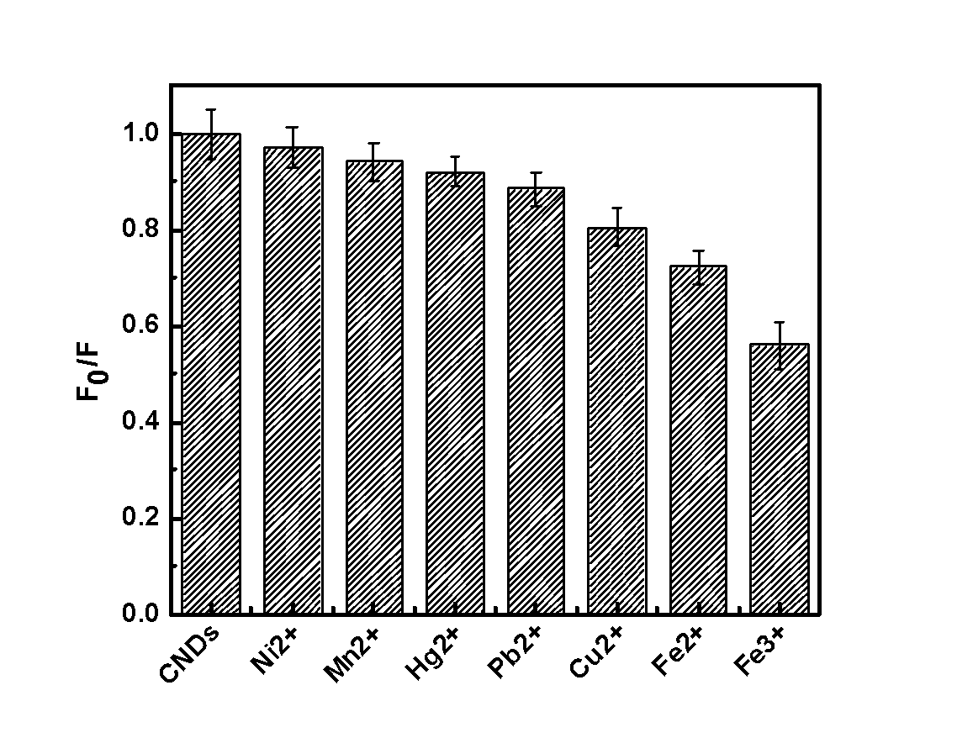
Results of Selectivity Test for D-CNDs
D-CNDs Fluorescence Quenching Upon Cation Ions Spiking
D-CNDs Selectivity of Different Cations

Slide 17
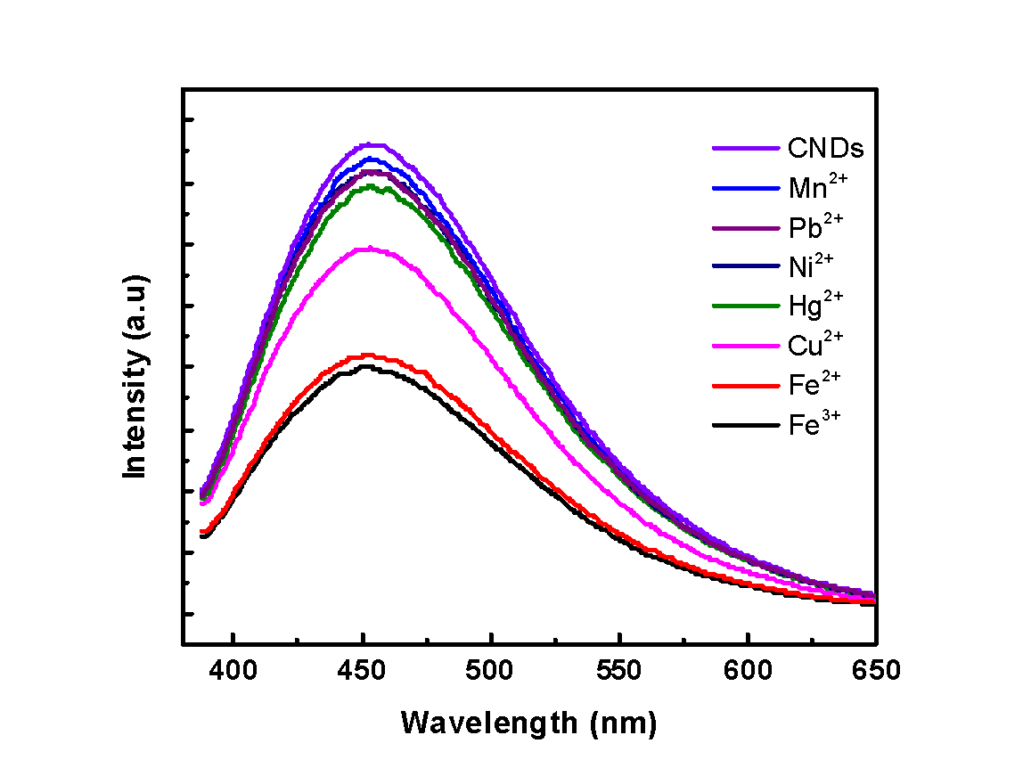
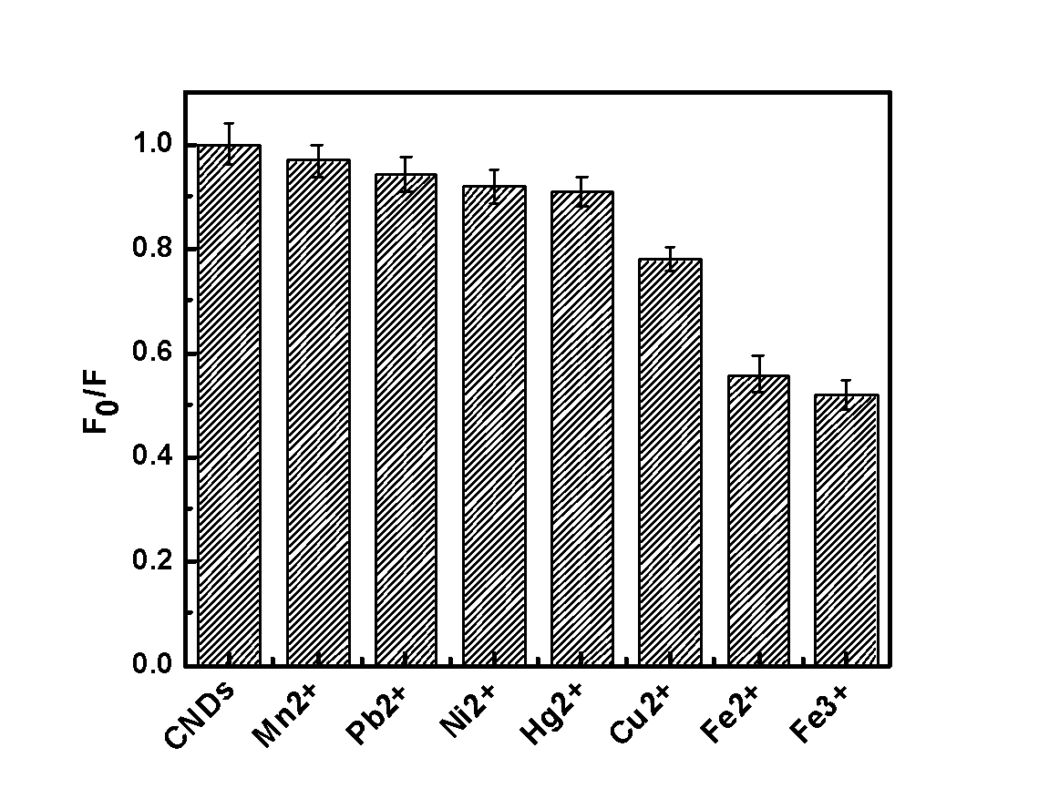
Results of Selectivity Test for O-CNDs
O-CNDs Fluorescence Quenching Upon Cation Ions Spiking
O-CNDs Selectivity of Different Cations

Slide 18
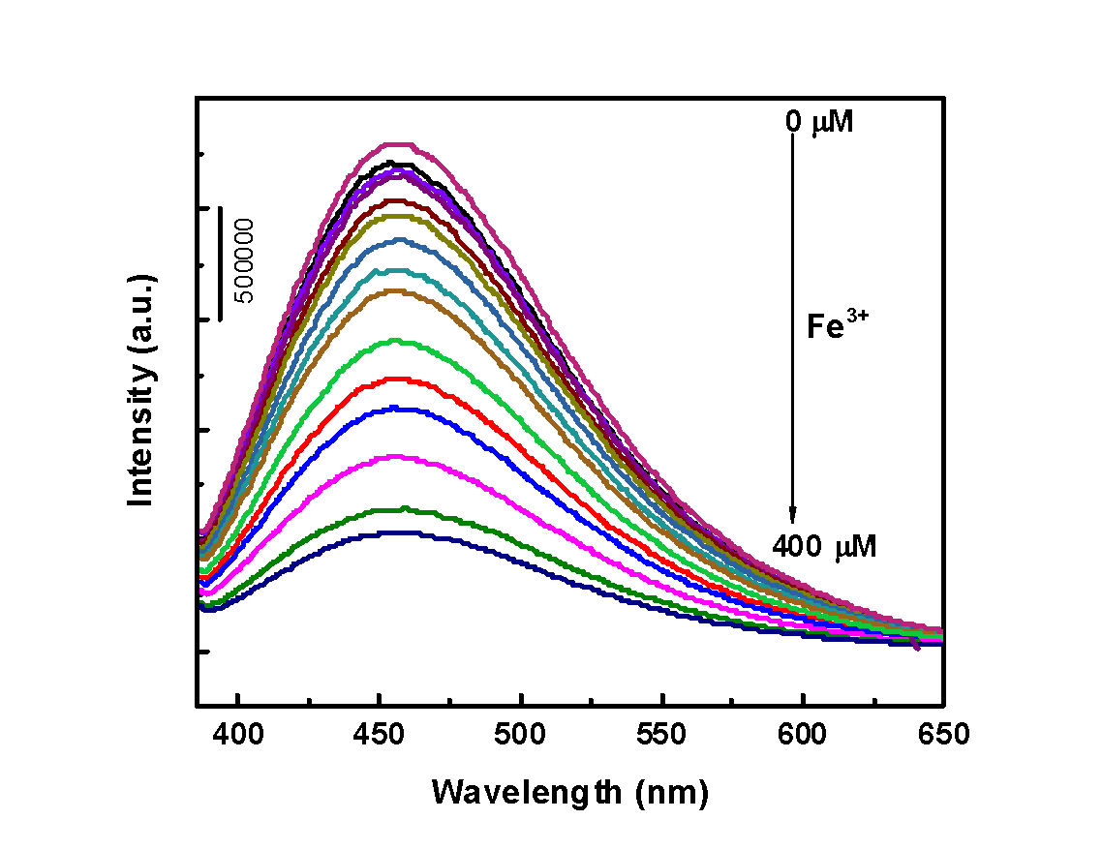
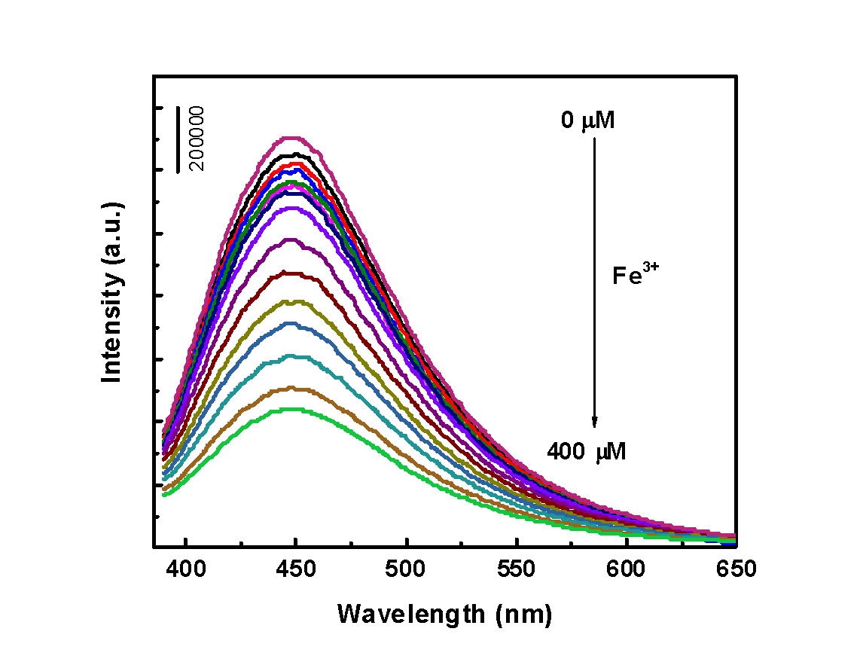
PL Intensity at Different Excitation Wavelengths
O-CNDs
D-CNDs

Slide 19
Comparing The Sensing Parameter For Both CNDs
CNDs | Linear Range (μM) | Sensitivity (μM⁻¹) | LOD (μM) | LOQ (μM) | Efficiency @ 400 μM
D-CNDs | 0 - 50 | 0.0029 | 7.2 | 24 | 65%
O-CNDs | 0 - 50 | 0.0045 | 3.9 | 13 | 76.6%

Slide 20
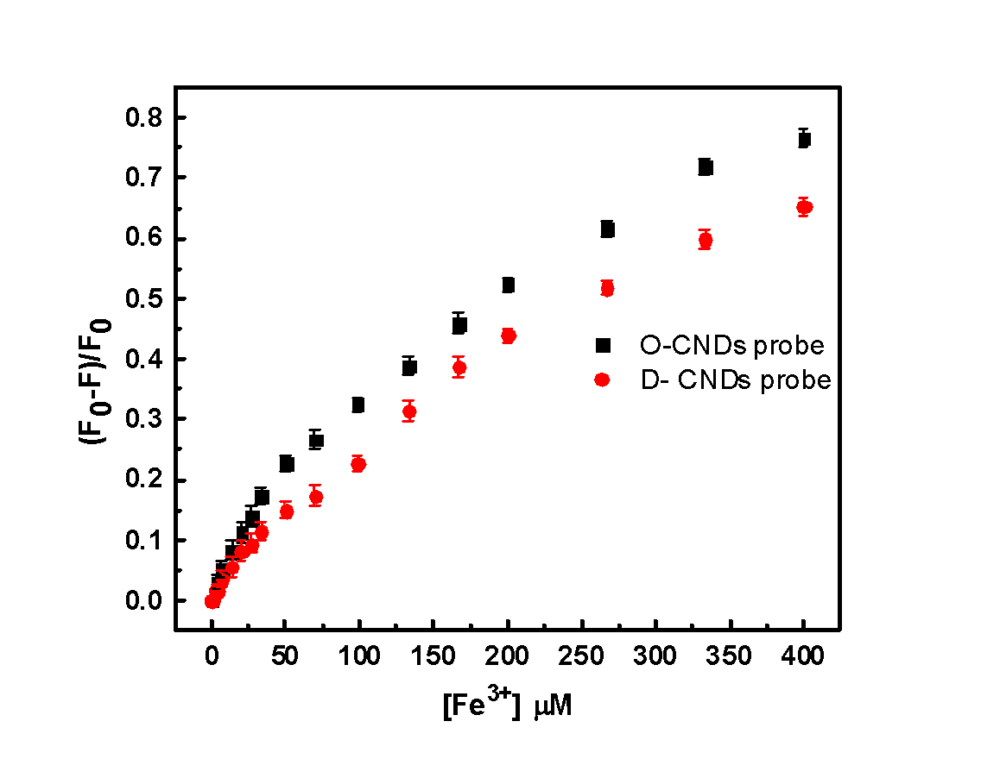
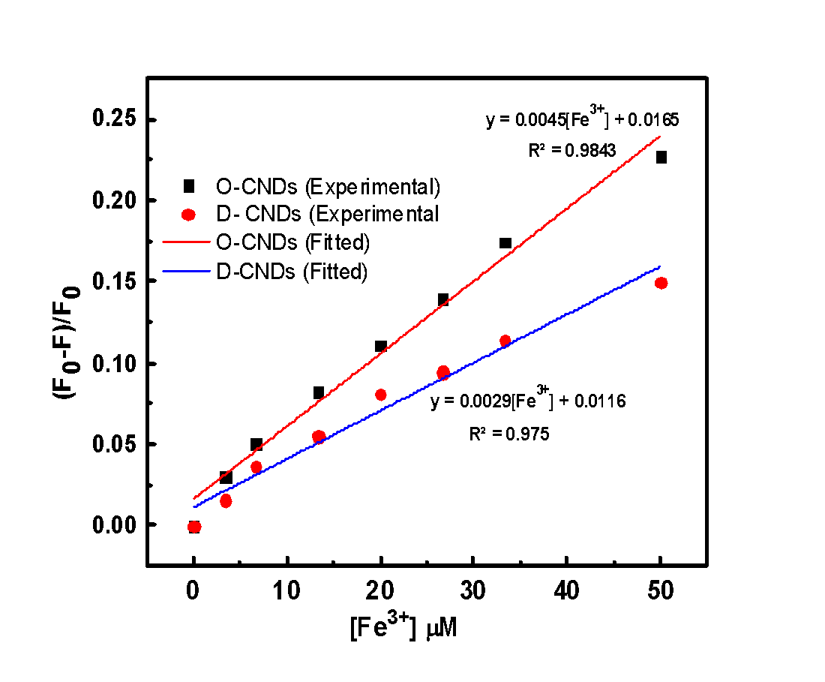
Quenching Efficiency Curves for D-CNDs and O-CNDs
Fitted Calibration Curves

Slide 21
Fe⁺³ Sensing With CNDs In Real Water Samples
Sample | CNDs Type | Spiked (µM) | Measured (µM) (n=3) | %RSD | Recovery %
Tap water | D-CNDs | 50 | 49.42 | 0.615 | 98.84
 |  | 20 | 18.53 | 2.73 | 92.66
 | O-CNDs | 50 | 49.51 | 3.34 | 99.03
 |  | 20 | 20.89 | 1.93 | 104.48
Rain Water | D-CNDs | 50 | 51.84 | 1.060 | 103.68
 |  | 20 | 20.48 | 2.58 | 102.43
 | O-CNDs | 50 | 51.05 | 2.48 | 102.10
 |  | 20 | 20.50 | 0.418 | 102.50
Drink Water | D-CNDs | 50 | 47.85 | 0.232 | 95.70
 |  | 20 | 18.88 | 0.264 | 94.41
 | O-CNDs | 50 | 52.42 | 6.819 | 104.8
 |  | 20 | 19.56 | 2.075 | 97.80

Slide 22
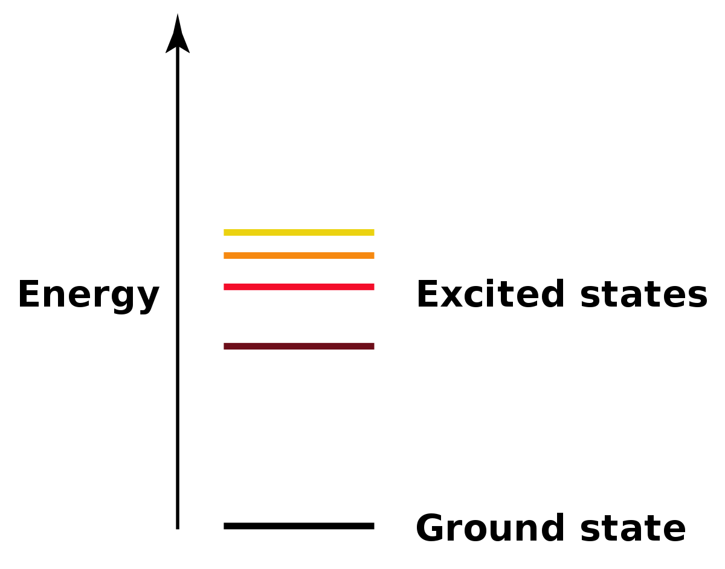
Fluorescence Quenching Mechanism
Static
Dynamic
Combined
Stern Volmer Plot

Slide 23
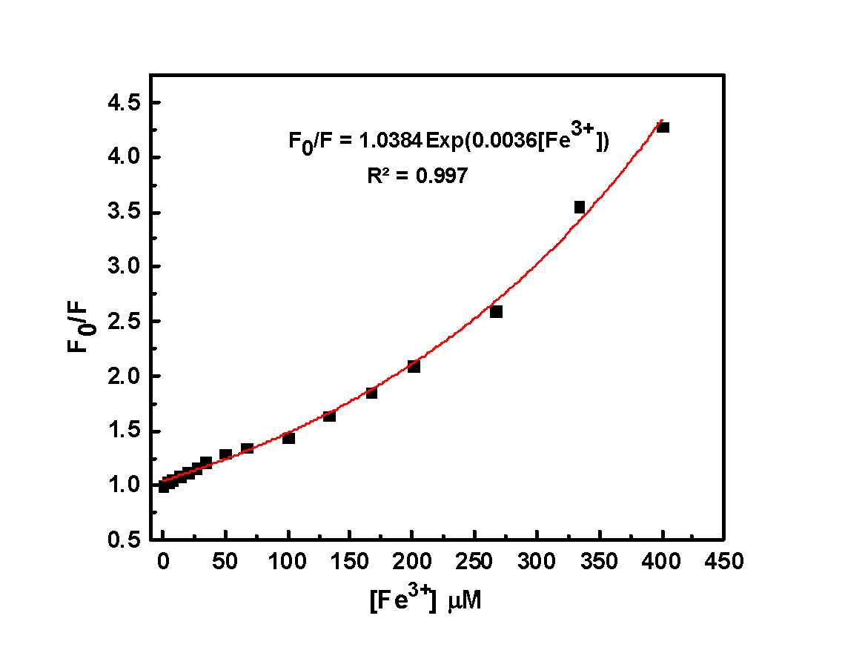
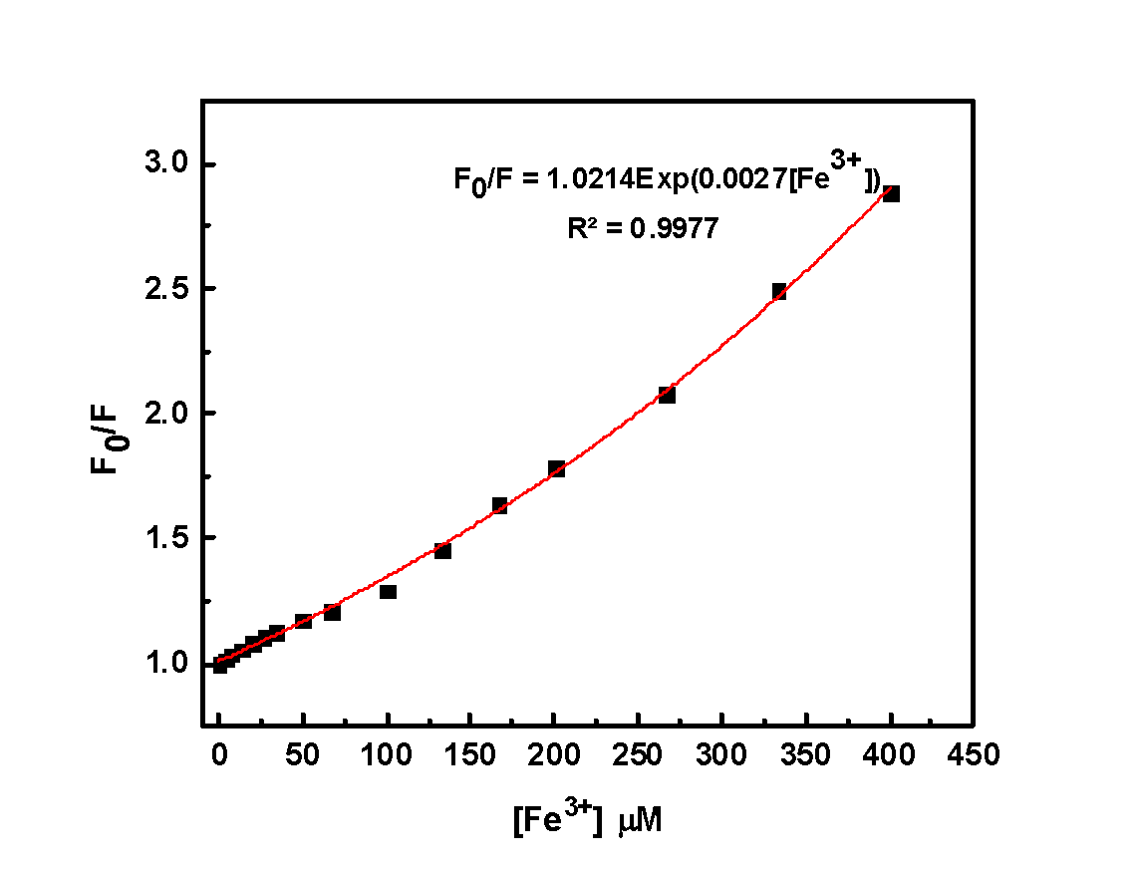
Quenching Mechanism of CNDs with Fe⁺³ (Stern Volmer Plot)
O- CNDs
D-CNDs

Slide 24
Summary
Of The
Project
Pollutants Found In Water Cause Different Types of Diseases
Water Sensors are Expansive & Needs Complicated Instrumental Techniques
Sensing Application Using O-CNDs and D-CNDS
Synthesis of Carbon Nanodots From Tobacco Molasses Waste
Based on Fluorescence Metals Iron Ions ${Fe}^{3+}$
Based on Fluorescence Metals Iron Ions 〖𝐹𝑒〗^(3+)
An Available Feasible Solution!

Slide 25
Thank You For Your Attention!

