Slide 1
Graduation Project II
Design and cost estimation of the wastewater collection network for Bidya Village and a study of the water consumption at schools
Prepared by :
Mohamad Mousa
Mohammad Al sadi
Sanad Qashoa
Under the supervision of Dr. Mohammad N. Almasri

Slide 2
Introduction:
Bidya Village lies in the north west of Salfit City in Palestine, Bidya has a total area of about 13,428 donums .
Elevations in the village vary significantly from one place to another with maximum and minimum values of 390 m and 215 m AMSL.

Slide 3
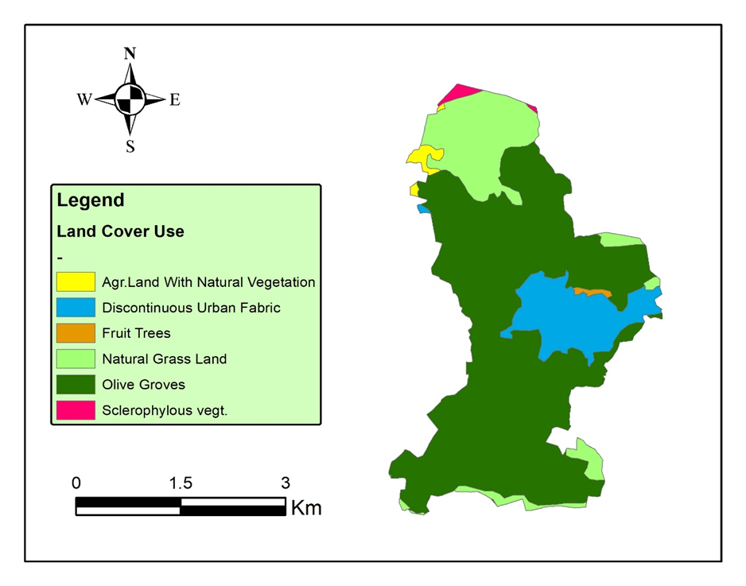
Bidya has an overall area of 13,428 dounms.
1,633 donums is residential areas have a blue color.

Slide 4
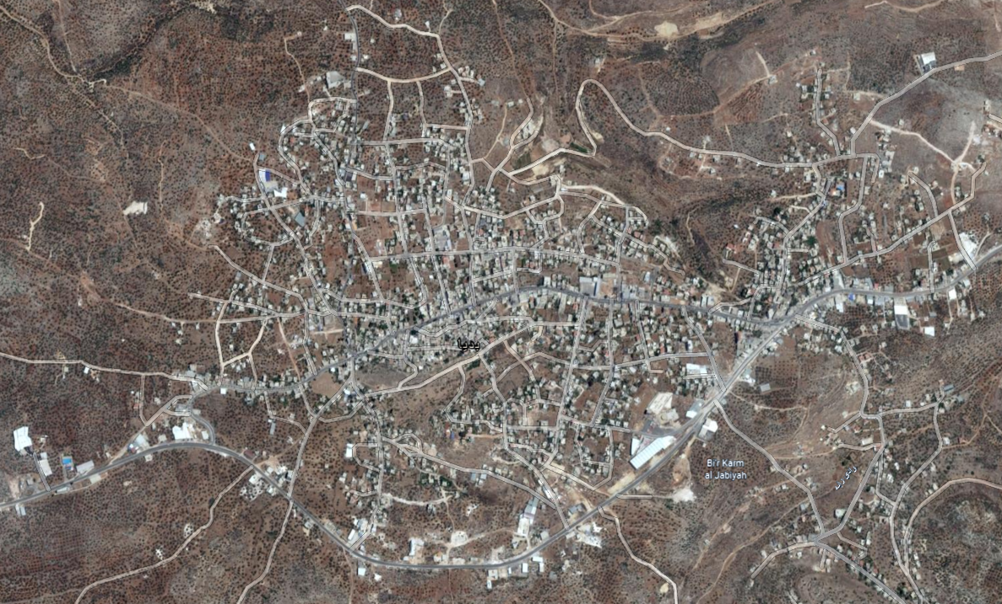
STUDY AREA

Slide 5
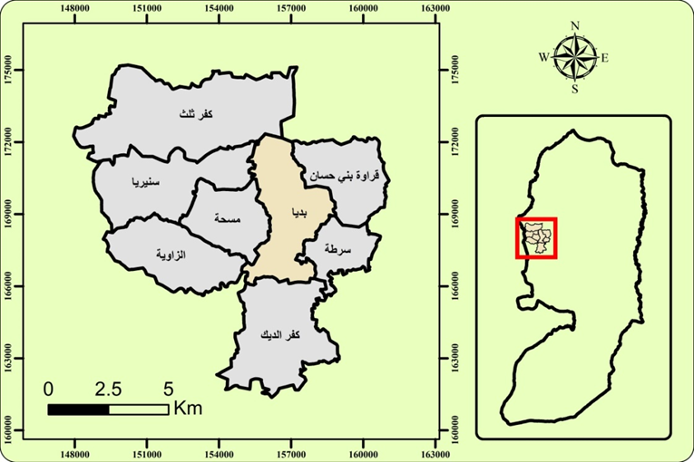
LOCATION

Slide 6
OBJECTIVES
To design the wastewater collection network for Bidya using SewerCAD.
To estimate the cost of the network.
To compare the consumption of water at schools between Jenin and Qalqilya.

Slide 7
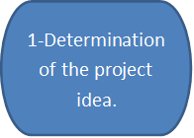
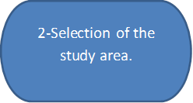
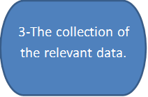
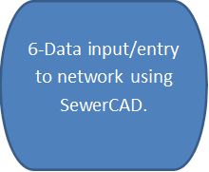
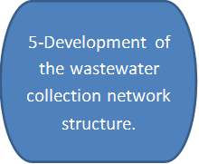
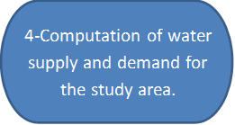
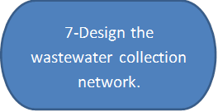
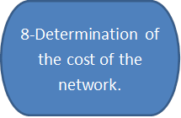
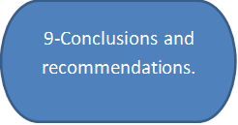
METHODOLOGY OF DESIGN THE NETWORK

Slide 8
LIMITATION
Hard terrain is big challenge.
The network must be in street because it public ownership.
We need 1m contour map to know more details about elevations.

Slide 9
DATA COLLECTION
Road network.
Contour map.
Boundary of study area.
Population number.
House distribution.

Slide 10
TOPOGRAPHIC NATURE
Due to the topography nature in Bidya we divided the network into three parts north, middle and south in terms of the location of each part in the town, the outfall direction in each part is north, west and south respectively

Slide 11
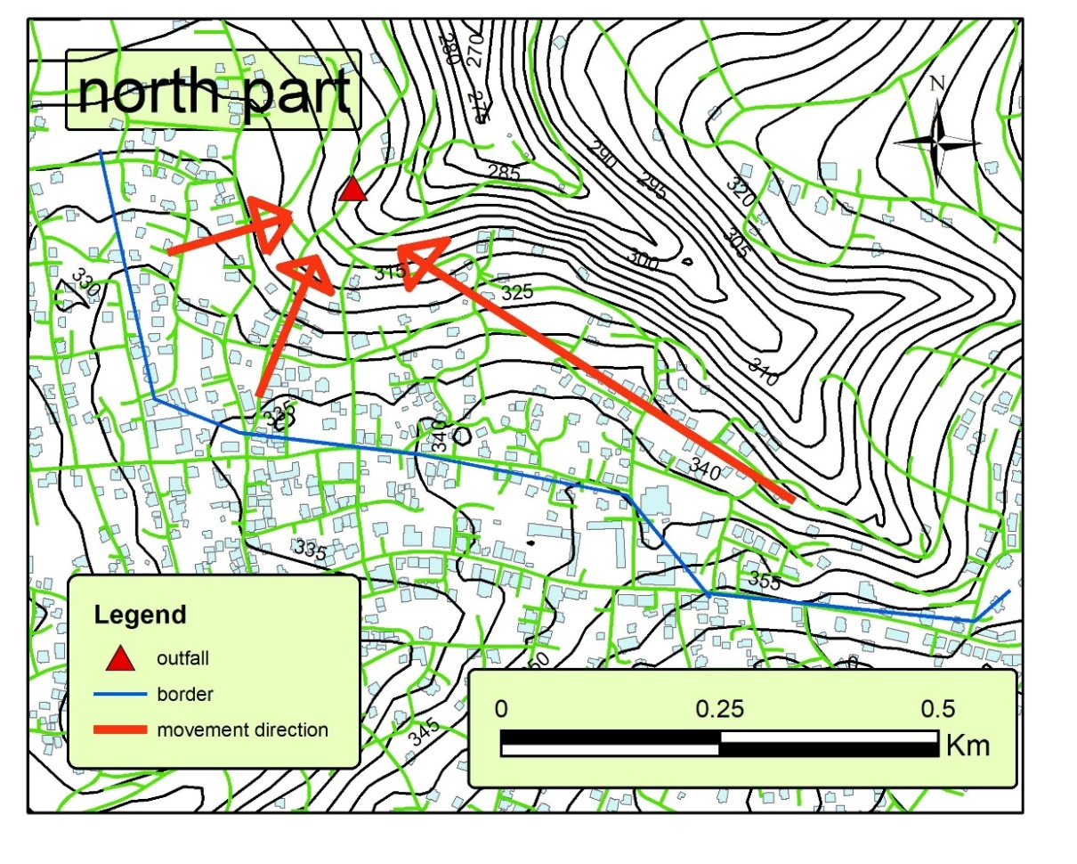
North part

Slide 12
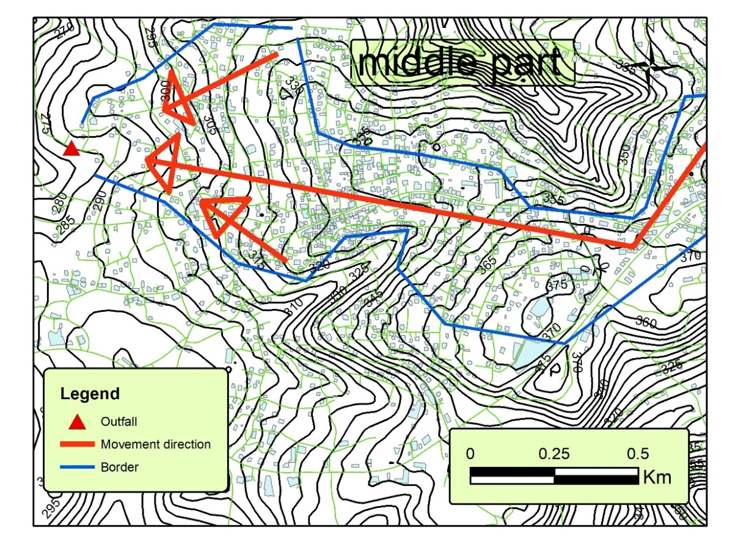
Middle part

Slide 13
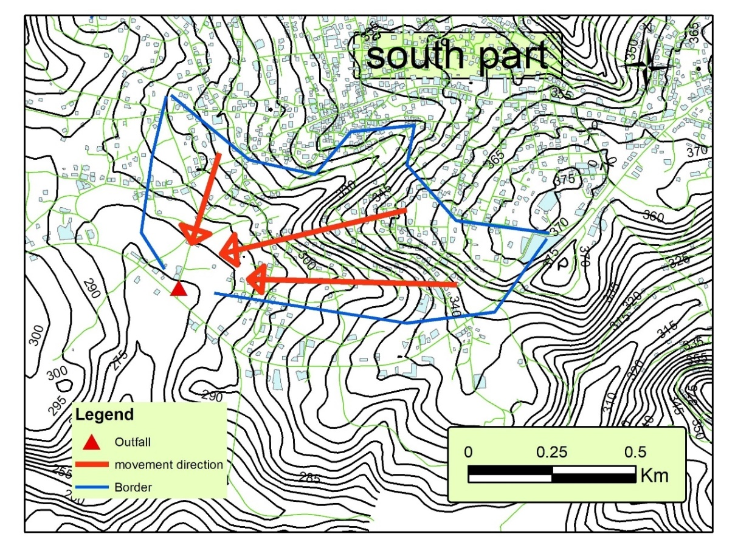
South part

Slide 14
Standards and specifications
Water consumption is 120 l/c. d.
Return flow of 80% of the consumption.
Infiltration rate of 5% of the flow.
Length of conduit: 30-50 m.
Material: PVC pipes.
Pipe sizes: minimum 8 inches (200 mm).
Full flow: 75% of the cross section.
(MHF): The peak factor used is 4.
Velocity: 0.6 - 3 m/s.
Cover: 1 - 4 m.
Slope: 1-12%.

Slide 15
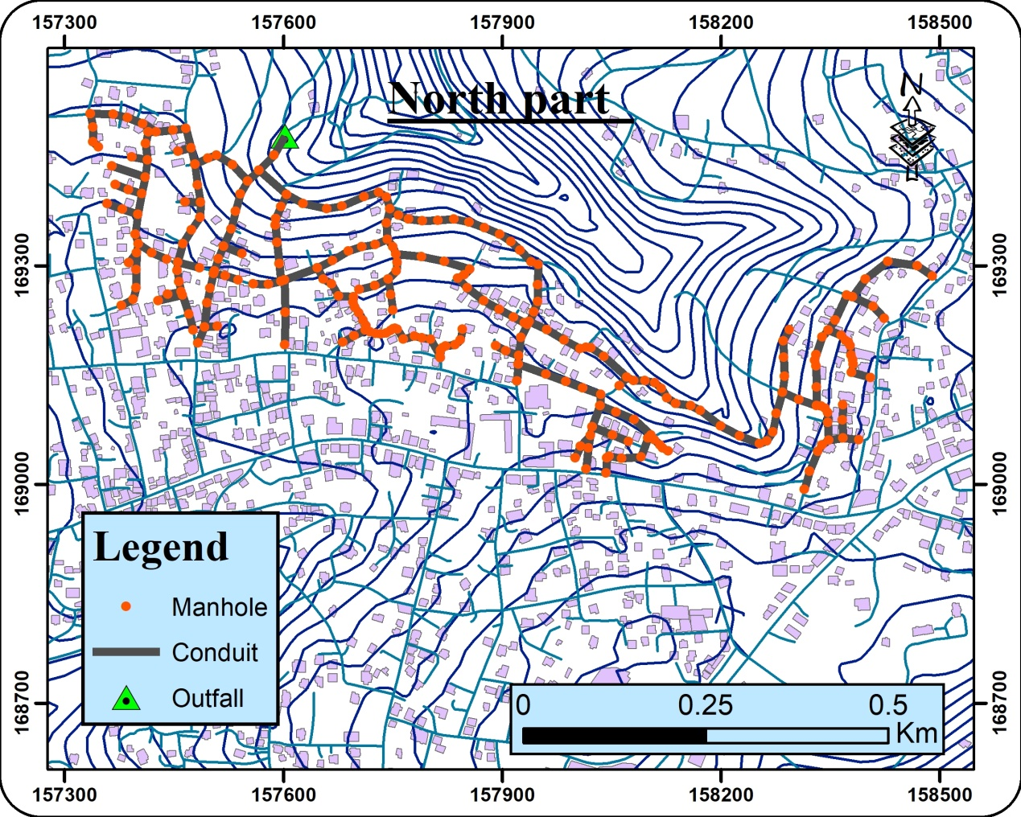
Design
After drawing the manholes on ArcMap, the final model for three parts has 1316 manholes.

Slide 16
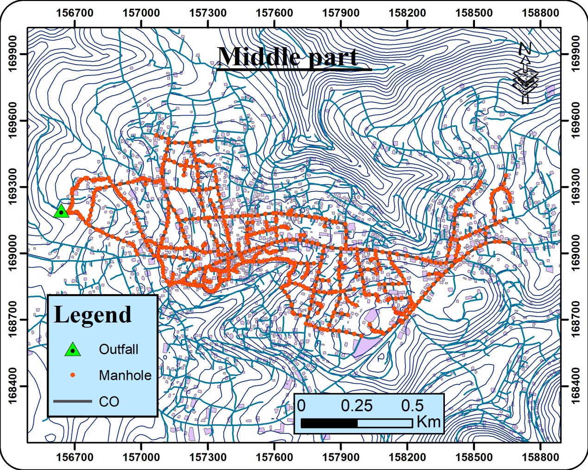

Slide 17
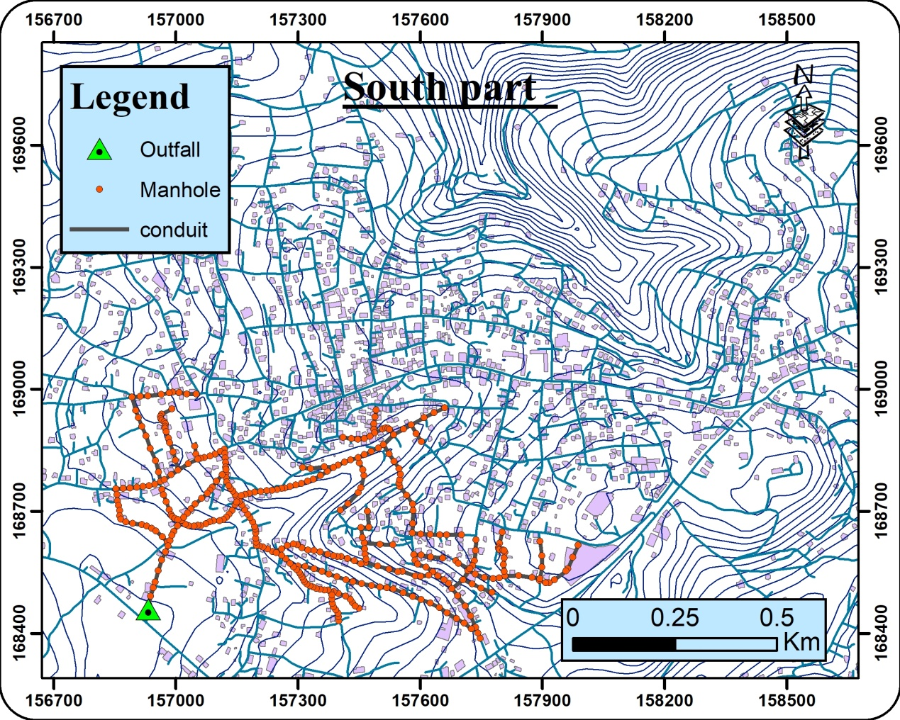

Slide 18
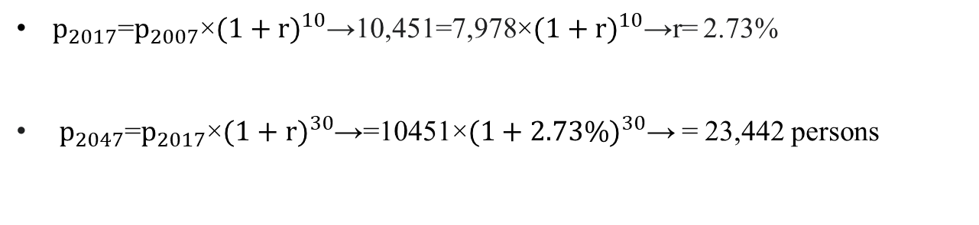
Population Prediction
Year | 2007 | 2017
Population | 7,978 | 10,451
$p_{2017}$=$p_{2007}$×${(1+r)}^{10}$→10,451=7,978×${(1+r)}^{10}$→r= 2.73%
$p_{2047}$=$p_{2017}$×${(1+r)}^{30}$→=10451×${(1+2.73\%)}^{30}$→ = 23,442 persons

Slide 19
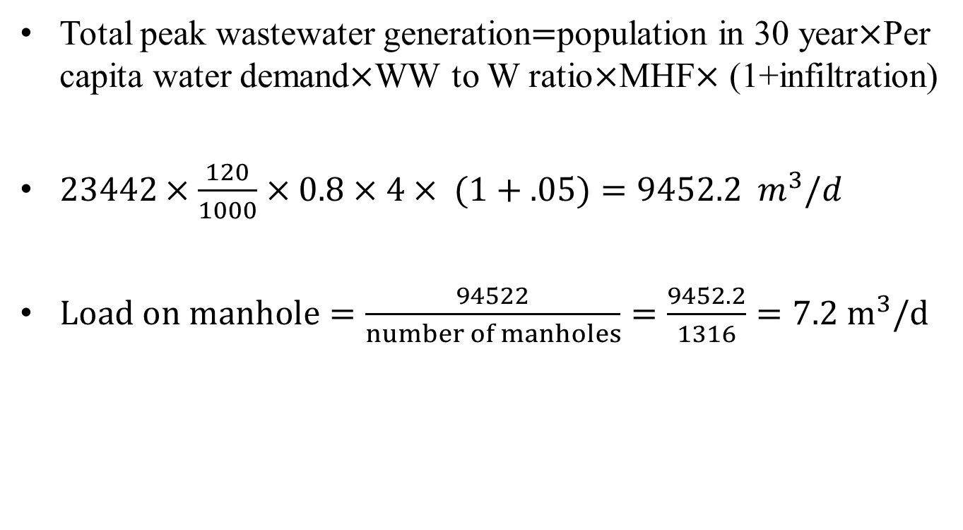
Load on manhole
Total peak wastewater generation$=$population in 30 year$×$Per capita water demand$×$WW to W ratio$×$MHF$×$ (1+infiltration)
$23442×\frac{120}{1000}×0.8×4× (1+.05)=9452.2 m^{3}/d$
$Load on manhole=\frac{94522}{number of manholes}=\frac{9452.2}{1316}=7.2 m^{3}/d$

Slide 20
First attempt in SewerCAD
When put the manhole and conduits shapefiles for three zones in SewerCAD some results of velocity and cover depth was out of criteria range.

Slide 21
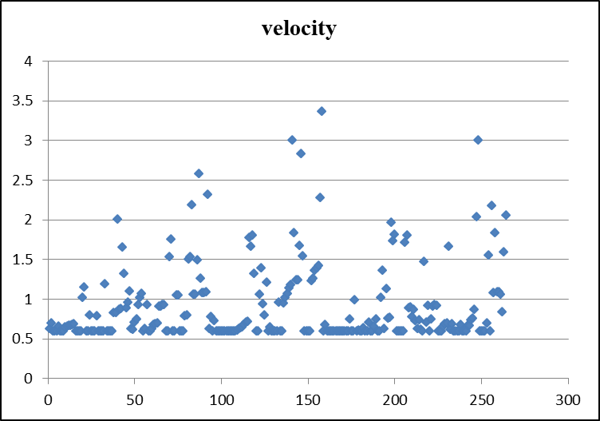
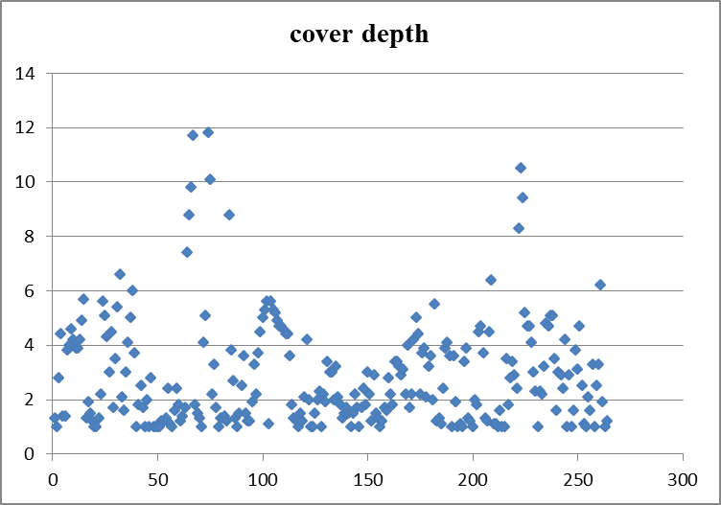
Velocity and cover depth in north part

Slide 22
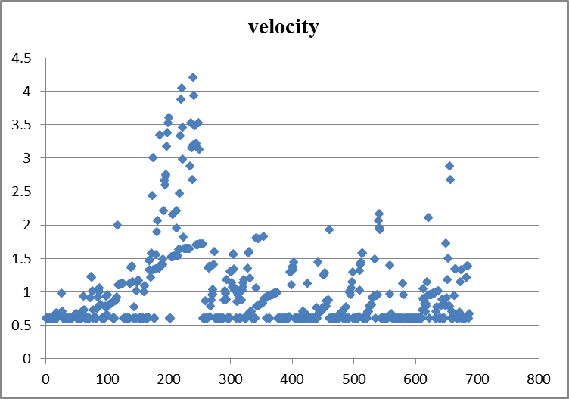
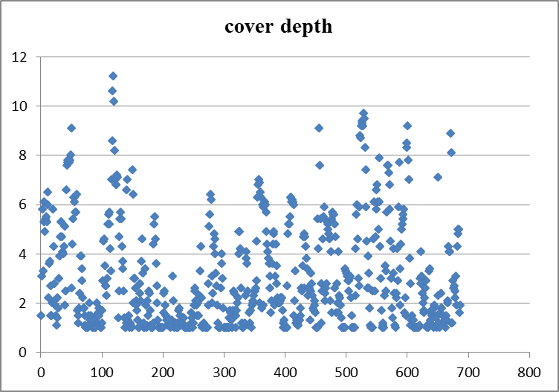
Velocity and cover depth in middle part

Slide 23
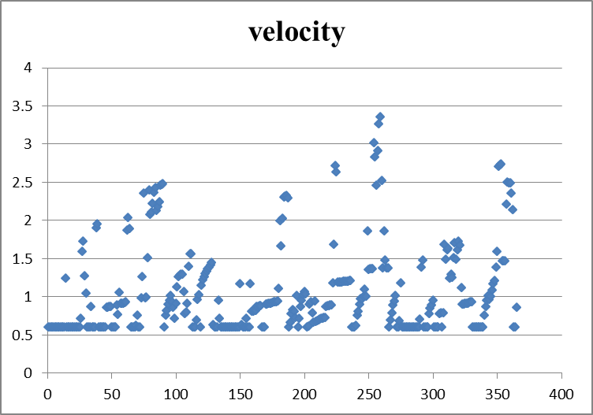
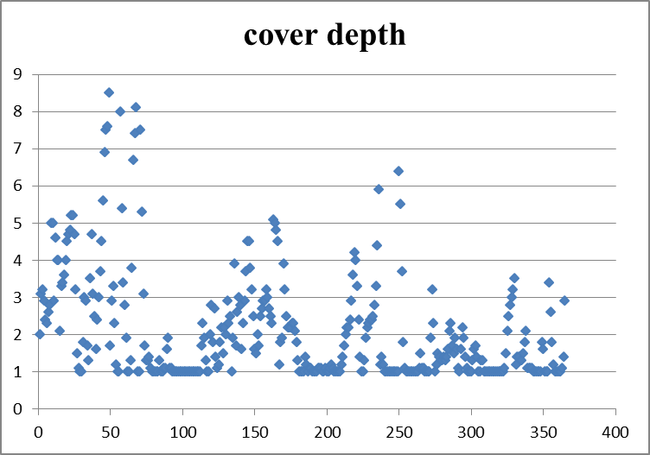
Velocity and cover depth in south part

Slide 24
    Second attempt in SewerCAD
We did edit in
The range of design criteria for the minimum velocity form 0.6 m/s to 0.45 m/s
Network connectivity.

Slide 25
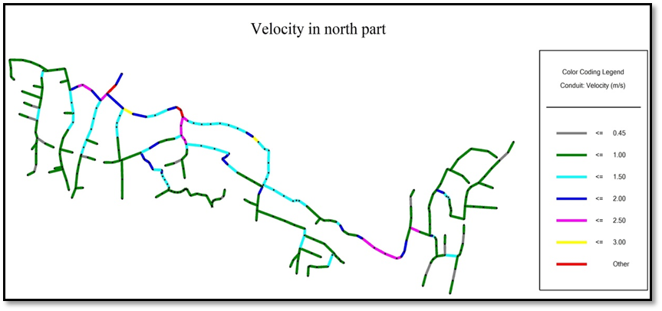
Velocity values in north part

Slide 26
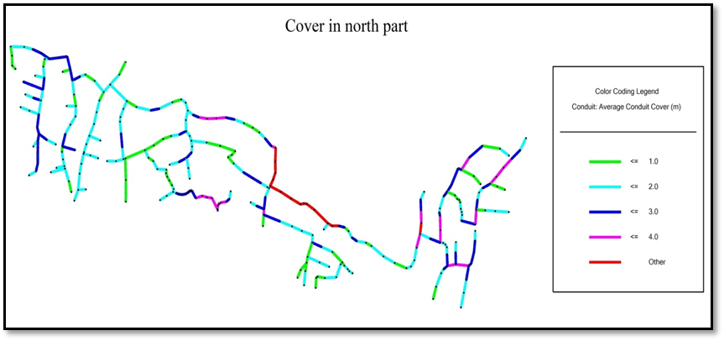
Cover values in north part

Slide 27
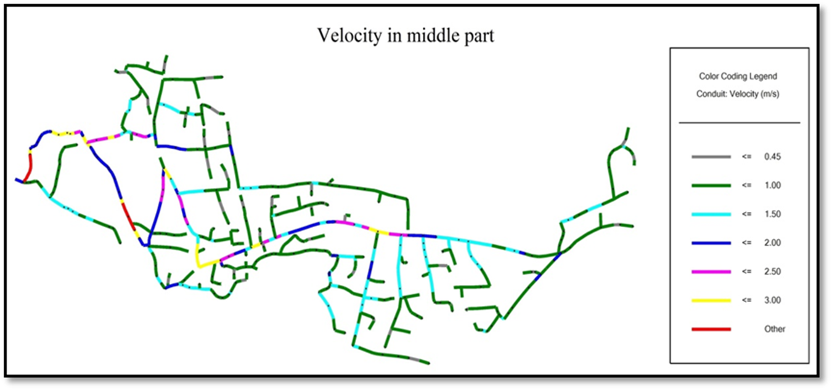
Velocity values in middle part

Slide 28
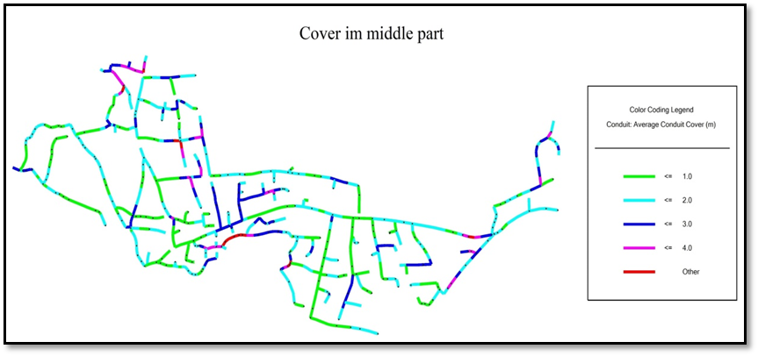
Cover values in middle part

Slide 29
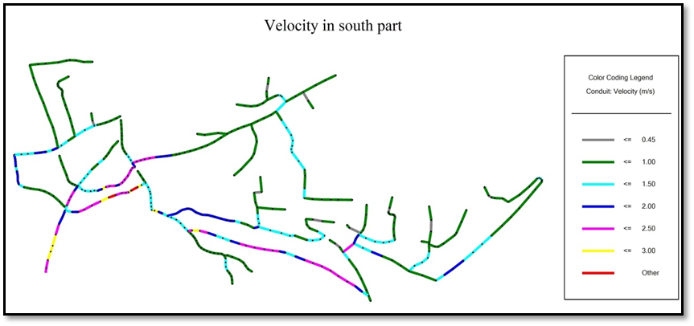
Velocity values in south part

Slide 30
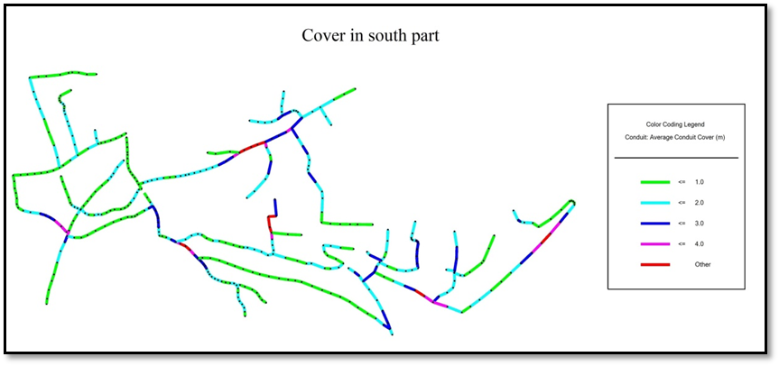
Cover values in south part

Slide 31
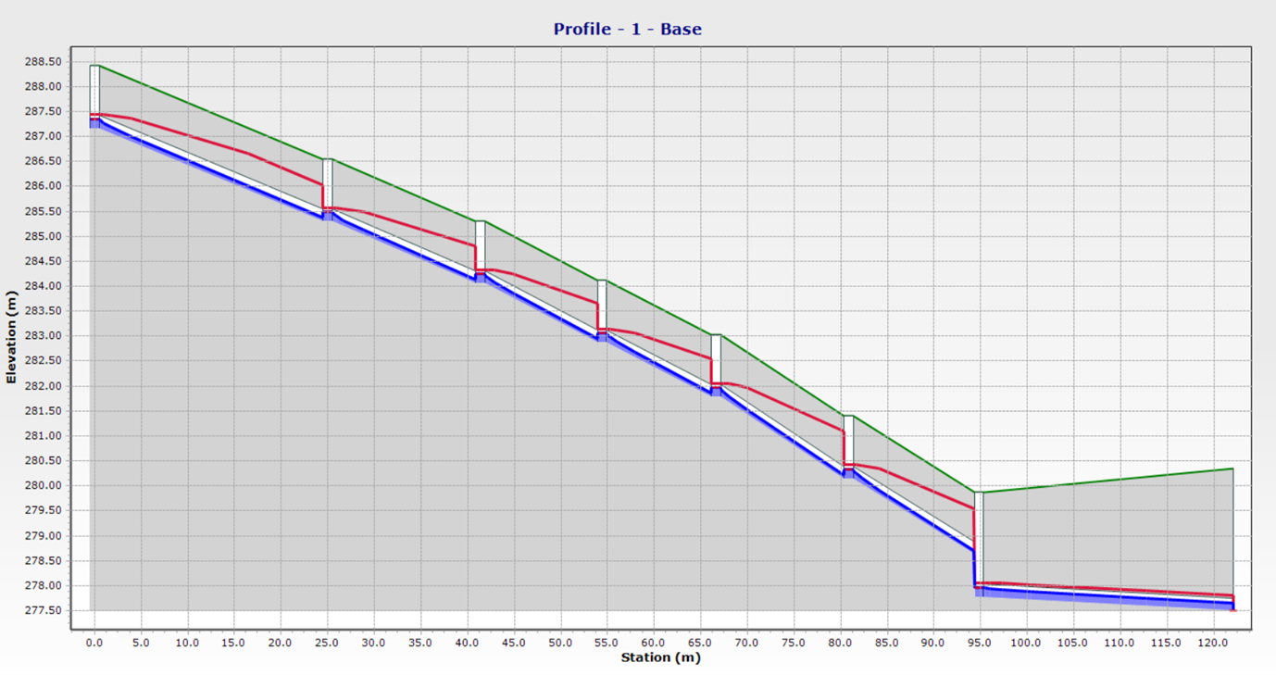
Profiles:

Slide 32
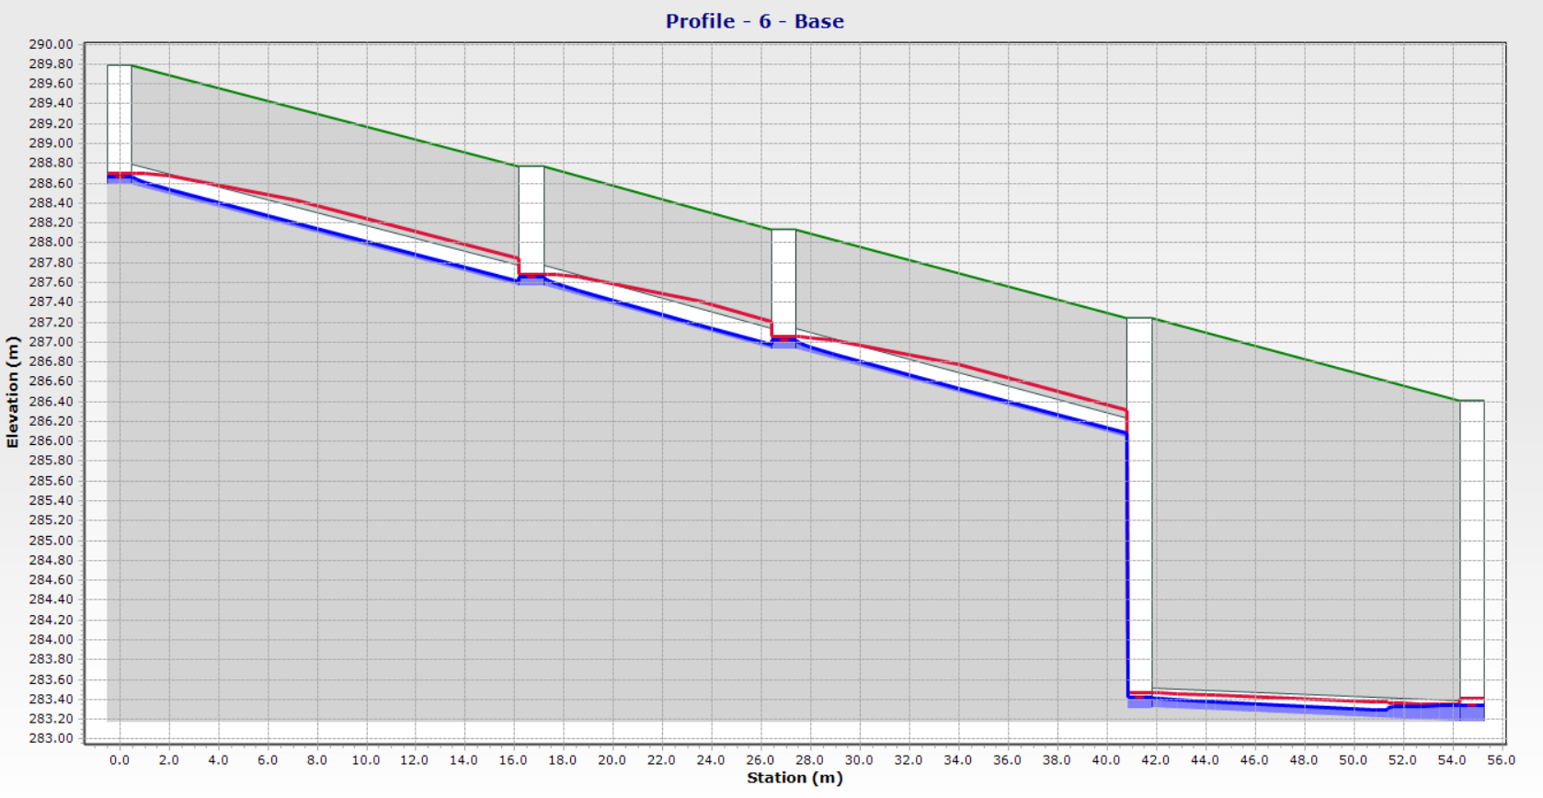

Slide 33
  Discussion
Problems in cover on many conduits appeared,
this is due to three reasons:
Prioritizing velocity constrains in SewerCAD rather than the cover constrains.
Is the small flow at the beginnings of the networks.
Existence of quite level ground elevation that conduits go along below it.

Slide 34
Conclusions
There are three outfalls of the study area.
The final model for three zones has conduits 1372 and 1316 manholes.
The Network has an 8,10 inch pipe diameter.
All slopes for conduits lie between (1% -12%)
Some conduits have a velocity greater than 3 m/s because they have big slopes.

Slide 35
Recommendations
The wastewater should be treated to avoid pollution, illness and other problems of wastewater gathering so wastewater treatment plant must be constructed.
The Joint Service Council must implement the same project for all the neighbour villages to collected wastewater from all to reach one outfall somewhere in the west.

Slide 36
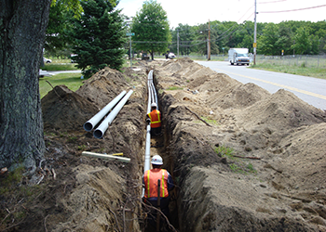
Cost estimation of the network
The main cost drivers for wastewater collection network:
Conduits.
Manholes.
Excavation depth.

Slide 37
Result of the cost estimation
cost ($) | Description | #
1,203,334 | South part | 1
885,944 | North part | 2
2,193,115 | Middle part | 3
15,625 | Mobilization | 4
4,688 | Testing | 5
4,302,705 | Total cost ($)
164 | Total cost/m ($)
369 | Total cost per capita ($)
we compared our result with the costs of a new project similar in Bidya approved on 10/2021 has a cost equal to 159$/m but in our project the cost equal to 164$/m.

Slide 38

Water consumption at schools
$Student water consumption (\frac{L}{d})=\frac{The total annual consumption}{365∗(number of students in this school)}$
The student's water consumption (L/d) for year 2017 at Al khansaa school
Student's daily water consumption rate (L/d) | Number of students | The sum | The consumption | The mounth
3.88 | 481 | 681 | 101 | 1
 |  |  | 30 | 2
 |  |  | 20 | 3
 |  |  | 81 | 4
 |  |  | 13 | 5
 |  |  | 192 | 6
 |  |  | 23 | 7
 |  |  | 87 | 8
 |  |  | 13 | 9
 |  |  | 25 | 10
 |  |  | 27 | 11
 |  |  | 69 | 12

Slide 39
Results of consumption rates in Jenin villages

Slide 40
Results of consumption rates in Jenin city

Slide 41
Results of consumption rates in Qalqilya city

Slide 42
Results of consumption rates
The consumption rate in Jenin villages (L/d)
min | max | avg
0.75 | 16.01 | 4.44 | 2017
0.76 | 18.61 | 4.31 | 2018
0.32 | 22.15 | 4.16 | 2019
The consumption rate in Jenin city (L/d)
min | max | avg
0.30 | 7.77 | 2.63 | 2017
0.25 | 5.63 | 1.90 | 2018
0.60 | 8.93 | 2.89 | 2019
The consumption rate in Qalqilya city (L/d)
min | max | avg
1.40 | 17.53 | 6.42 | 2017
1.72 | 29.58 | 5.98 | 2018
2.31 | 21.98 | 7.15 | 2019

Slide 43
Comparison between schools’ categories in Jenin and Qalqilya Cities
(Females > males) in elementary and secondary schools.
Secondary schools > elementary schools.

Slide 44
References
Bidya Municipality.
Palestinian Central Bureau of Statistics.
Dr. Mohammad N. Almasri website(https ://sites.google.com/site/mohammadnablus/Home).
https ://geomolg.ps/ .

Slide 45
THANK YOU

