Slide 1

بسم الله الرحمن الرحيم
Water and Wastewater Distribution network for ajram area
Prepared by
SAlman Khatib Ghaleb awada
Mohammad ZaqQa Bara Salah
Supervisor
Dr. Sameer shadeed

Slide 2
Outline
Objectives and significance of the project
Methodology
Study Area
Design a New WDN
Design Sewer Network System
Model Analysis Results
Conclusion and Recommendations
1

Slide 3
Objectives
Design a reliable water and wastewater network.
Meet the PWA design standards
Make sure that the networks performance are acceptable for the required design period.
2

Slide 4
Study Area
Location
Topography
Study area
Water resources
Population
5

Slide 5
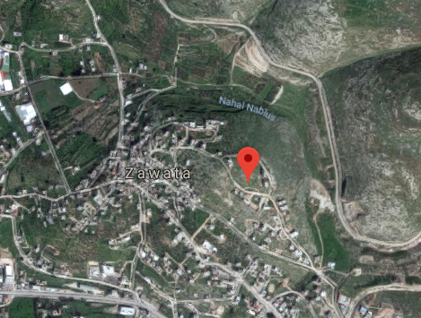
Location :
Ajram area located in Nablus city in the northern of west bank, approximately 49 kilometers north of Jerusalem. With a population of 2275 (PCBS,2016) located Near Zowata village
6

Slide 6
TOPOGRAPHY
Maximum elevation = 530 m above MSL
Minimum elevation =365m above MSL
Mean elevation = 445m above MSL

Slide 7
Climate
The relatively temperate Mediterranean climate brings hot, dry summers and cool, rainy winters to Nablus. Spring arrives around March–April and the hottest months in Nablus are July and August with the average high being 29.6 °C. The coldest month is January with temperatures usually at 6.2 °C. Rain generally falls between October and March, with annual precipitation rates being approximately 680 mm.

Slide 8
Rainfall readings
Rainfall in Nablus city is limited to the winter and spring months; From October to May. Table 2.5 shows the Annual rainfall quantity (mm) in Palestine by station location and year, 2009-2016 the minimum rainfall quantity was in 2014 reached only 360.8 mm and the maximum rainfall quantity was in 2013 reached 805.9 mm
From Palestinian Metrologic Center :

Slide 9
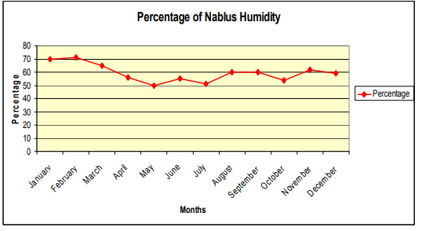
Humidity
The mean annual relative humidity of Nablus city is 59.4%. During Khamaseen period, the relative humidity decreases to reach it minimum value of 50 % in May. Maximum humidity of 71% is registered in January and February so that the value increases gradually at nigh

Slide 10
Water Resources :
The main source of water in Ajram area comes from groundwater, wells and springs the municipality of Nablus city uses this water resources to supply water for Nablus
In summer season the demand increase so additional water will be required, Nablus Municipality bought from private wells
12

Slide 11
Project 1

Slide 12
Equations Used In WaterCAD
Energy Equation
Darcy-Weisbach Equation
Continuity Equation
Hazen-William Equation
Energy conservation

Slide 13
WDN :
Design constraints:
Pressure at junction between (20-80) m.H₂O.
Velocity in pipe (0.6-3.0) m/s.
19

Slide 14
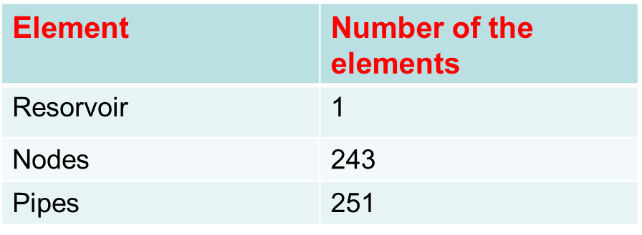
WDN

Slide 15
Pressure Results

Slide 16
Velocity Results

Slide 17
Estimation of population
We estimated population using the following equation:
P_{future}= P₀ (1+i)^{n}
Where,
n = number of years (22 years)
i= growth rate (2.5 %)
P₀= population in 2016 (2275)
P_{future} = 2275*(1+0.025)²²
P_{future}=3,917 people

Slide 18
Estimation of hourly peak factor
In order to be in the safe side in sewerage system design then the flow must be multiplied by a factor to simulate the peaking situation. In Palestine, the peak factor (PF) can be estimated from:
PF = 14P^{–1/6}
Where:
P is the population at the end of the design period.
PF = 14P^{–1/6}
PF = 14(3719 people)^{–1/6}
PF = 3.5

Slide 19
Load Calculations.
Q _{manholes} (m³/day)= (No. of Homes in the zone) * (No. of capita per house) * (Per capita water demand) (L/c.d) * (% of produced wastewater to consumed water) * (PF_{h}) * (1/1000)+.2 (No. of Homes in the zone) * (No. of capita per house) * (Per capita water demand) (L/c.d) * (% of produced wastewater to consumed water) *(1/1000)

Slide 20
● No. of Homes: expected number of houses connected at that manhole in the selected zones.
● No. of capita per house: number of capita at each house, assume = 7
Capita/house.
● Per capita water demand =120 L/c.d.
● % of produced wastewater to consumed water = 90%
● PFh: Hourly Peaking Factor = 3.55

Slide 21
Sewer Drainage system Design for Ajram and Zawata Town.
.

Slide 22
Methodology
Doing calculations to find the expected population of the town in the future
Finding the expected produced waste water in the future
Preparing data as layers of the town
Using sewer cad to design the network depending on layers of (contour, building, road)
Checking the design to achieve the criteria of velocity and cover.

Slide 23
Criteria of the Design.
Natural water consumption (L/capita/day) | 120
Growth rate (%) | 2.5
Design period(years) | 20
% product waste | 90%
Maximum velocity in conduits(m/sec) | 3
Minimum velocity in conduits (m/sec) | 0.6
Maximum allowable cover (m) | 6
Minimum allowable cover(m) | 1
Minimum allowable slope (%) | 1
Maximum allowable slope (%) | 12
Infiltration (%) | 20
Conduit Material | PVC

Slide 24
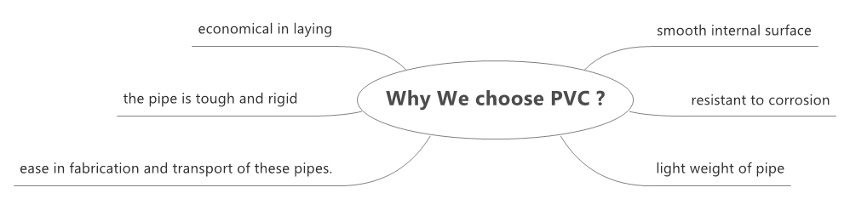
Choosing the PVC conduits
45

Slide 25
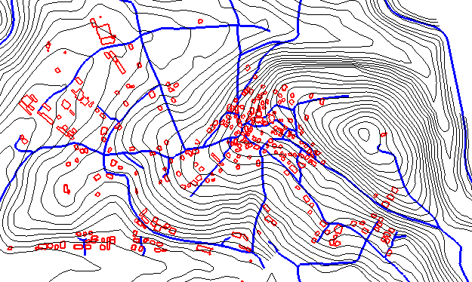
Steps
Adding Data

Slide 26
Location & Connecting Manhole
Before starting the design we should consider that the manholes must be located at the roads networks wherever there is:
An intersection.
Change in slop.
Change in direction.
Change in Diameter
Maximum distance of (30) m.
44

Slide 27
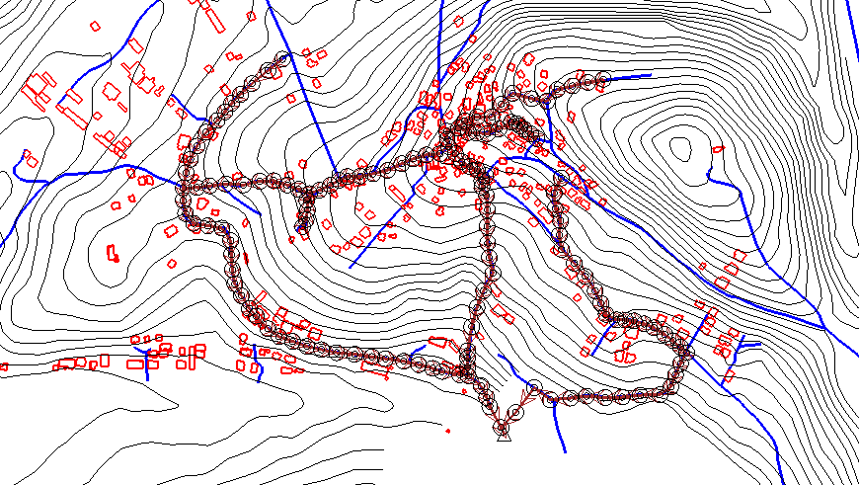
Drawing Manholes

Slide 28
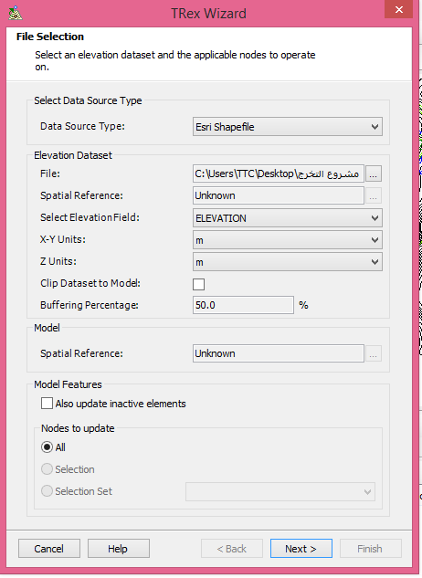
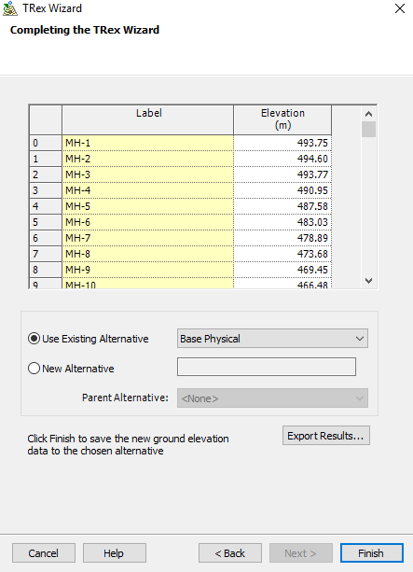
Elevation of Manholes
43

Slide 29
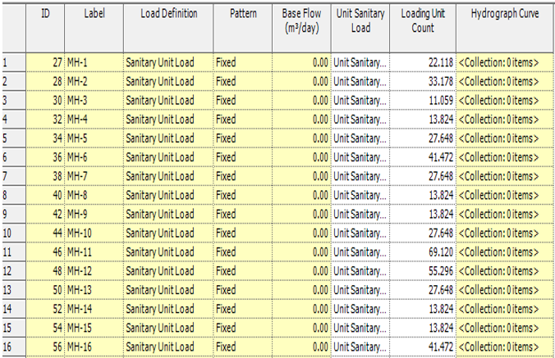
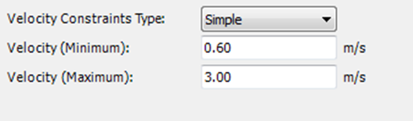
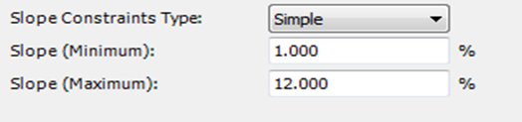
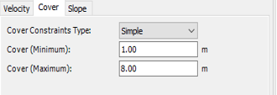
Inserting Loads and constrains

Slide 30
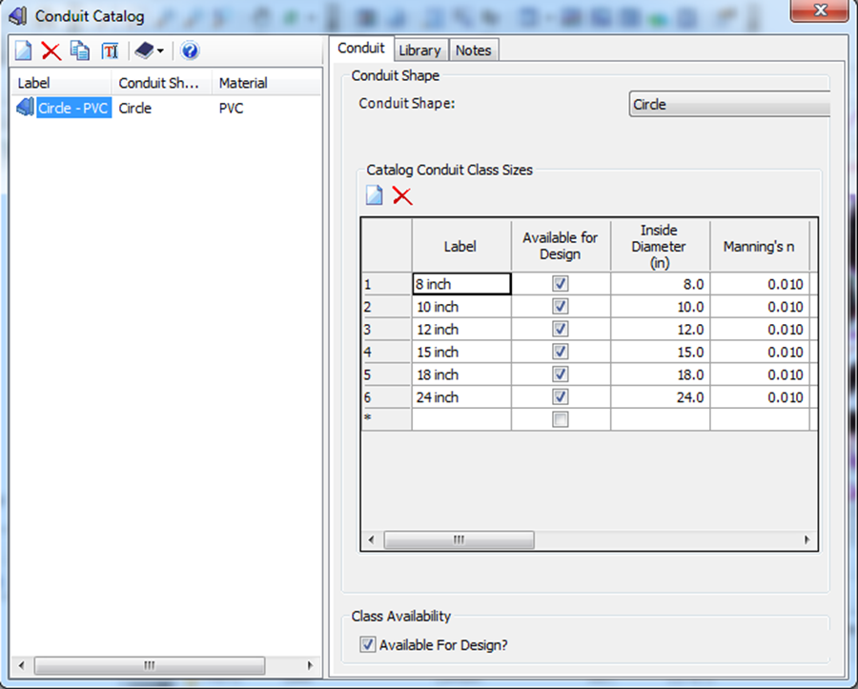
Conduit Catalog

Slide 31
Results
Velocity (m/sec)

Slide 32
Cover Start

Slide 33
slope

Slide 34
Conduit Diameters.
Almost all diameters has 8 Inch diameter.
Lengths between each manhole and the other is less than 30 m.

Slide 35
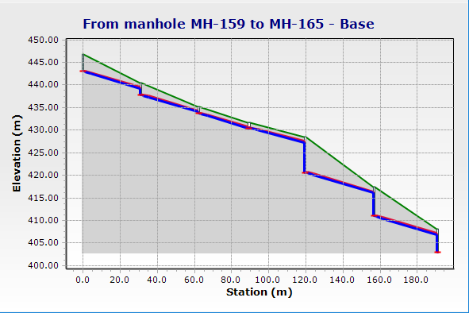
Sample Profile

Slide 36
Conclusion and Recommendations

Slide 37
CONCLUSION
All constraints are achieved and there are no problems in the model, and all the results are in the ranges as specifications and criteria
We used 8 inch diameters for almost all conduits and PVC material, So the network its economical .

Slide 38
Recommendation
We recommend to use a pump to flush the wastewater in the entire network
Connect the outfall with a trunk line driving the wastewater into a treatment wastewater treatment plant before throwing it freely
This wastewater network should be checked by municipality engineer before starting the project

Slide 39


