Slide 1
TheVet
Supervisor :
Dr.Samer Alarandi
participants :
Mahde Souqi
Mohammed Ziad

Slide 2
The Problem

Slide 3
The problem cont.
How to find a veterinary?
Are they any good?
How to book an appointment and communicate with them

Slide 4
The solution

Slide 5
The Solution cont.
An application which you can :
Know where to find a vet.
Know how much good is he.
Also you can book an appointment and communicate with him.

Slide 6
The Main Functionality

Slide 7
The main Functionality cont.
Book an appointment with a Vet
know more about bets by reading articles
Ask question in a bets community

Slide 8
The Architecture

Slide 9
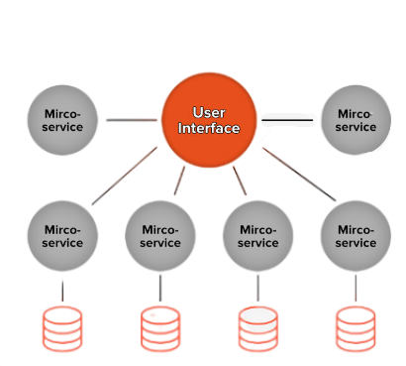
The Architecture cont.
We use Microservices Architecture to implement our app :

Slide 10
The Architecture cont.
The communication between UI and each service done by REST verbs .
Each service built by MVC pattern .

Slide 11
The Technology Used

Slide 12





The Technology Used cont.

Slide 13
The Challenges

Slide 14
The Challenges cont.
Lack in experience of building a projects .
Learn a new framework in a short period of time and the ability to deal with problems within the code .

Slide 15
Future Work

Slide 16
Future Work cont.
Make some update on the Architecture
Make some updates on the UI
Add more luxure feature

Slide 17
Thanks For Listening

