Slide 1
بسم الله الرحمن الرحيم
AN Najah National University
Web based smart bus
passenger counting System
Dr. Raed jaber
Prepared by:
Ayman AL- far
Abdalruhman shushi
Nader Abo Diab

Slide 2
Content
Definition and objective of the system
Problem Specifications
Design Approach
Principle of work
Hardware
Project milestones covered

Slide 3
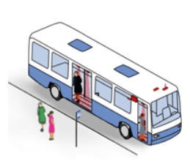
Definition
This system will count the number of passengers in each bus, find the location of it and find the income of the company by each bus .

Slide 4
Objectives
Due to the less trust between the company and the employees in it specially some drivers.
Know the income for each bus.
Location and speed of the bus.
Trips made ​​by each bus

Slide 5
Problem Specification
The Driver in/out not to be counted.
Types of Passengers (extra, cards….etc.).
Employees from the company (not to be counted).
Sensors and detectors fault detection and reporting
Someone enter the bus and does not get out and wants to continue to other station.
Loading the bus aisle with boxes and packages.

Slide 6
Solutions for the system
Image Processing
RFID (Radio Frequency Identification )
Weight sensor
Digital counter using the Laser beam.

Slide 7
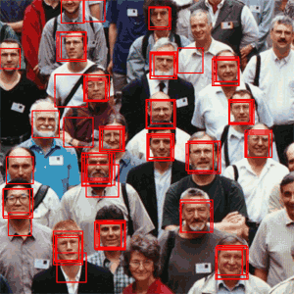
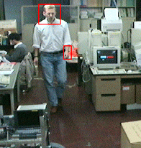
Image processing
Special equipment's(DSP-PIC),
Not accurate enough

Slide 8
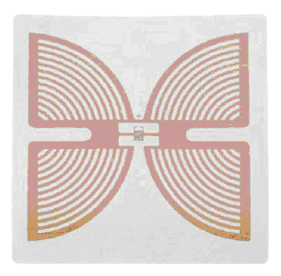
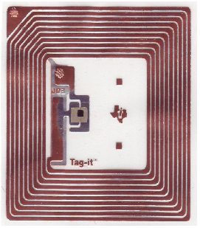
RFID & Weight
RFID :
Not trust for counting , not suitable for all people
Weight :
Not accurate , and it is difficult to be done, more hardware

Slide 9
Digital counting using the laser beam
Simplicity
More Accurate
Easy to install in the bus
Less hardware equipment
Suitable for more features

Slide 10
Comparison according the cost
 | Image Processing | RFID | Weight sensor | Laser beam
Microcontroller | DSP-PIC (75$+125$) | 30$ | 30$ | 30$
GSM-Modem | 100$ | 100$ | 100$ | 100$
Detectors | Cameras (6-7)*3$=21$ | 100$ | 50*5$ | 12*12$
Additional cost | 100$ | 100$ | 100$ | 100$
Total cost | 420$ | 330 | 450$ | 280$
Comments |  | Cards
Visibility | No | No | No | Yes

Slide 11
  Principle of work
Counting sensors are installed in doors and passageways.
Data-Loggers receive sensor signals and store the data to memory.
Data transfer devices take your data from the Data-Loggers to the office computer.
Analysis software turns huge amounts of data into useful, usable information.

Slide 12
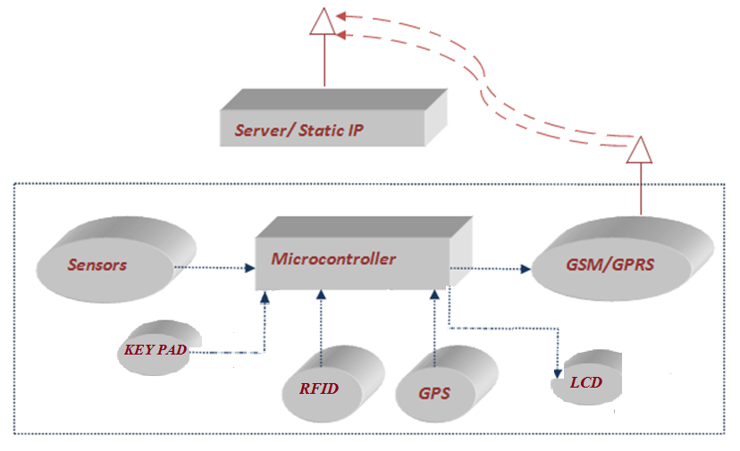
Principle of work In block diagram

Slide 13
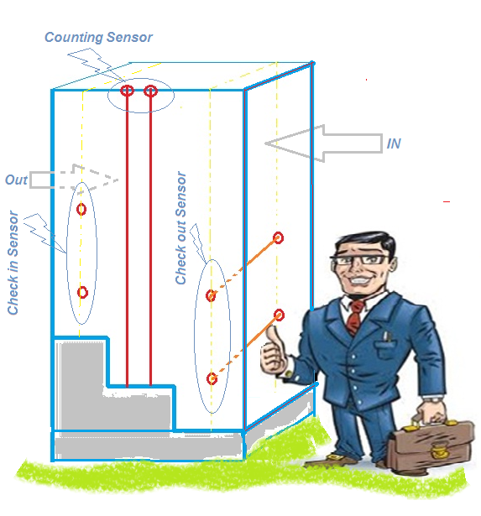
Principle of work

Slide 14
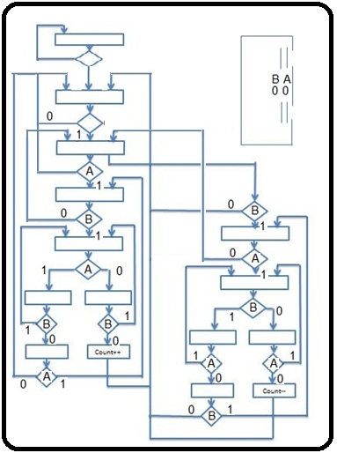
Principle of work
Count algorithm

Slide 15
Principle of work
Data transfer
The controller start checking the changes in the sensors status counting the numbers of passengers in the bus using previous algorithm.
When the doors are closed the controller of the system will decide to send the data if the speed of the bus reaches to specific speed(according to distance with time).
Then send a packet of data to the server

Slide 16
Principle of work
Server
  The packet will contains
  Positions where the bus is stopped
  The number of the passengers
  An ID for the bus
  RFID numbers if there
Server will analyze it and there will be software(C# program) to view the data for each bus and the position of it at any sending and count the total income that will be taken from each bus.

Slide 17
Solution of the Problems in our System
The Driver (not affect )
Passengers (extra, cards….etc.) .(RFID)
Employees from the company.(Keypad)
Detector counting will closed directly by some thing.(closed the bus doors)
Throw something to the bus.(The check sensors)
Someone enter the bus and does not get out and wants to continue to other station.(warning to the driver using Geo fence )

Slide 18
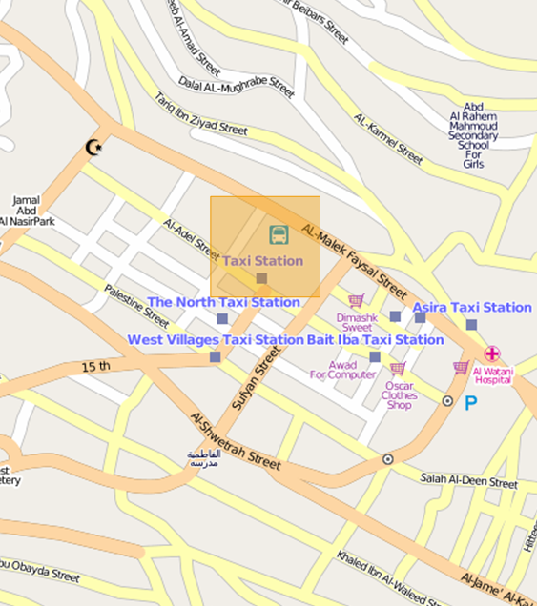
Geo-Fence

Slide 19
Hardware (Cutting edge)
The sensors :
Count and check using the laser beam sensor to do the job.
Speed sensor using GPS.(Distance accumulator)
Check the status of the door using limit switch.

Slide 20
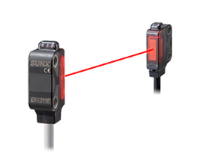
Hardware

Slide 21
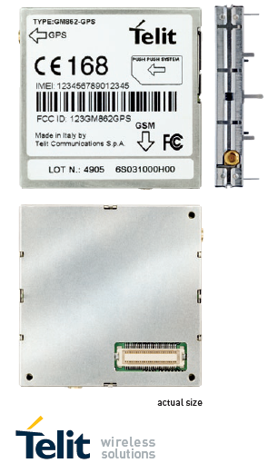
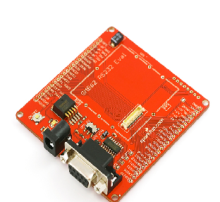
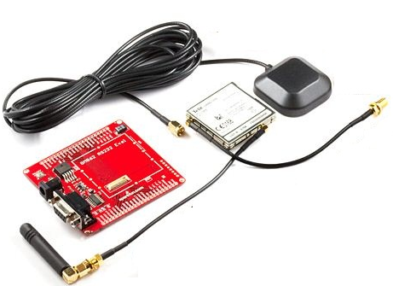
Hardware
The GSM & GPS
Telit GM862-GPS

Slide 22
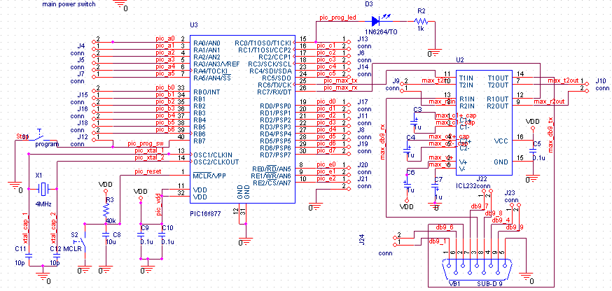
Hardware
Microcontroller

Slide 23
What have we done so far
The algorithm –has been developed
The code of the PIC for counting and the basic circuit –has been developed and tested
Test the Sensors- –has been tested
Some tests have been done on the GSM module (GM-862 module)

Slide 24
What to do next????
Interfacing the Telit GSM-GPS module with the microcontroller.
The ability to use GPRS between the microcontroller and the server.
Will install it and in a bus in order to test it .

Slide 25
PIC_C
Image possessing in Matlab
AT_command for Tilet module
Will start learning C# for web application

Slide 26
Refrances
PhD .Samer Mayaleh
Tamemi Transportation company
Telit company for data sheets
http://www.openstreetmap.org
http://www.infodev.ca/vehicles.html

Slide 27


