Slide 1

Department of Chemical Engineering
Department of Civil Engineering
Production and Utilization of Biochar from Municipal Solid Waste
Supervisors:
Dr. Abdelrahim Abusafa
Dr. Abdelhaleem Khader

Slide 2
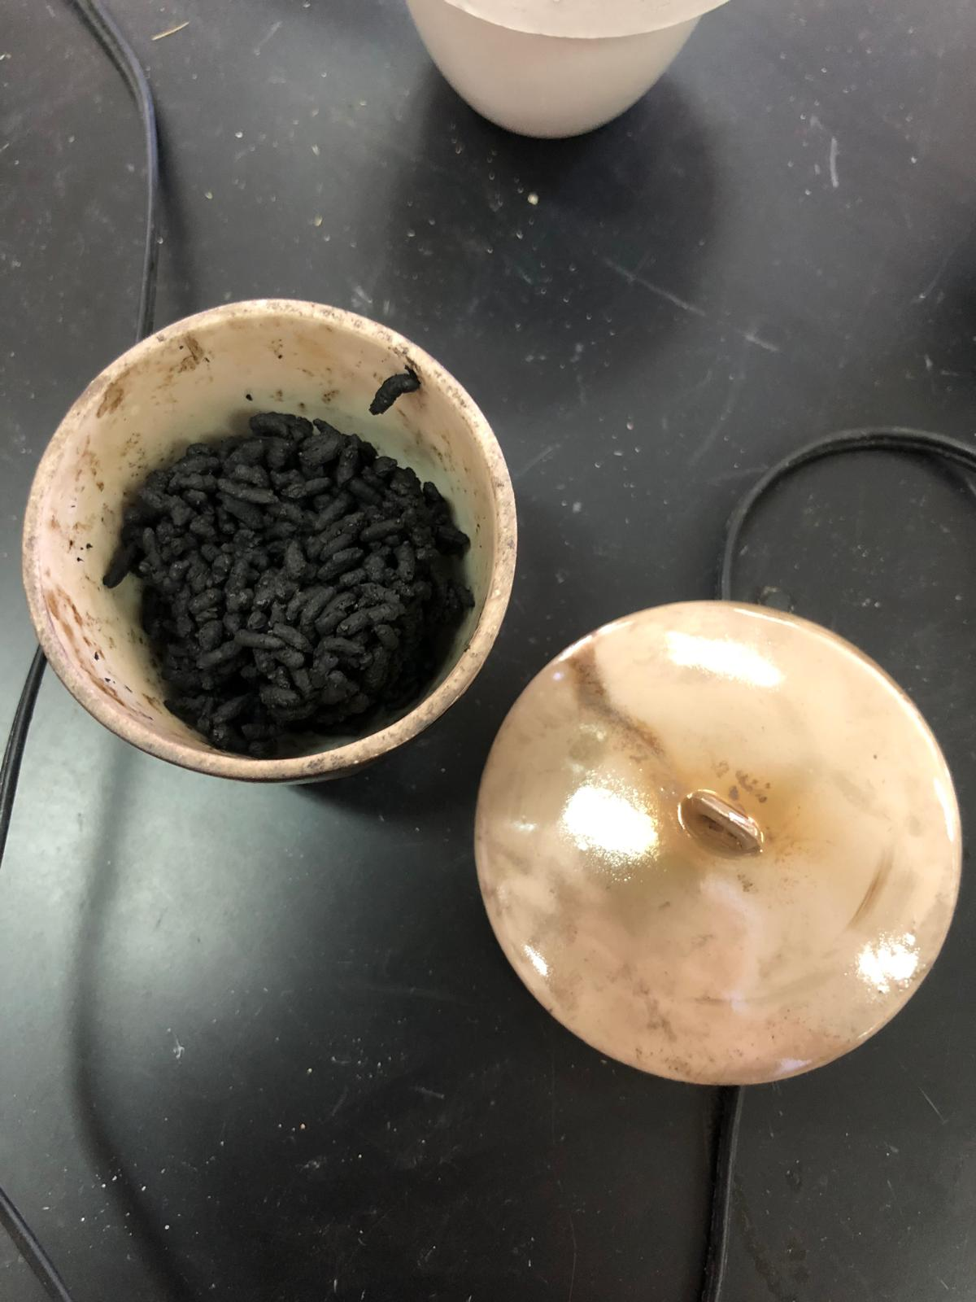
Content
01
INTRODUCTION
02
Municipal Solid Waste Disposal Methods
03
BIOCHAR
04
METHODOLOGY
05
Rustle & Discussion
06
CONCLUSION & Recommendation

Slide 3

INTRODUCTION
01
The Problem statements
Objective
02

Slide 4

The Problem statements
Solid waste management is a significant concern in Palestine, posing environmental and health challenges due to the accumulation of waste. One potential solution involves converting municipal solid waste into biochar through pyrolysis.

Slide 5


Objectives
Reviewing the Literature regrading biochar production.
Investigate the pyrolysis process of biochar using cooked rice as the feedstock.
Explore the impact of varying pyrolysis temperatures and residence times on biochar yield and quality.
Analyze the physical and chemical properties of the produced biochar.
Study the adsorption capacity of biochar for methylene blue (MB) dye.

Slide 6

Municipal Solid Waste Disposal Methods
01
02
03
04
LANDFILLING
Composting
Incineration
Pyrolysis

Slide 7
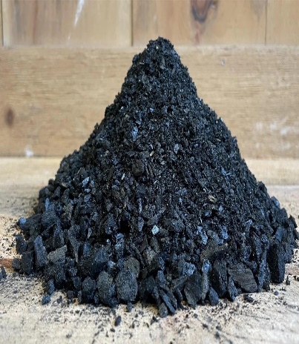


Pyrolysis
Pyrolysis is the heating of an organic material in the absence of oxygen.
Biomass pyrolysis is usually conducted at 400°C and 450 °C .
pyrolysis of produces three products:
  BIOCHAR
  BIO-OIL
  syngas

Slide 8


Biochar Objectives
Production
Characterization
Applications

Slide 9
BIOCHAR
Biochar is a charcoal-like material that is produced by burning organic waste through a process called pyrolysis.
Production
Collect &Separate Solid Waste
Pre-drying
Place Biochar in Special Bags
Steps
Chop Dried
Materials
Post Pyrolysis Cooling in Biochar Production
Prepare the Reactor
Enter Biomass into the Oxygen-Free Reactor

Slide 10
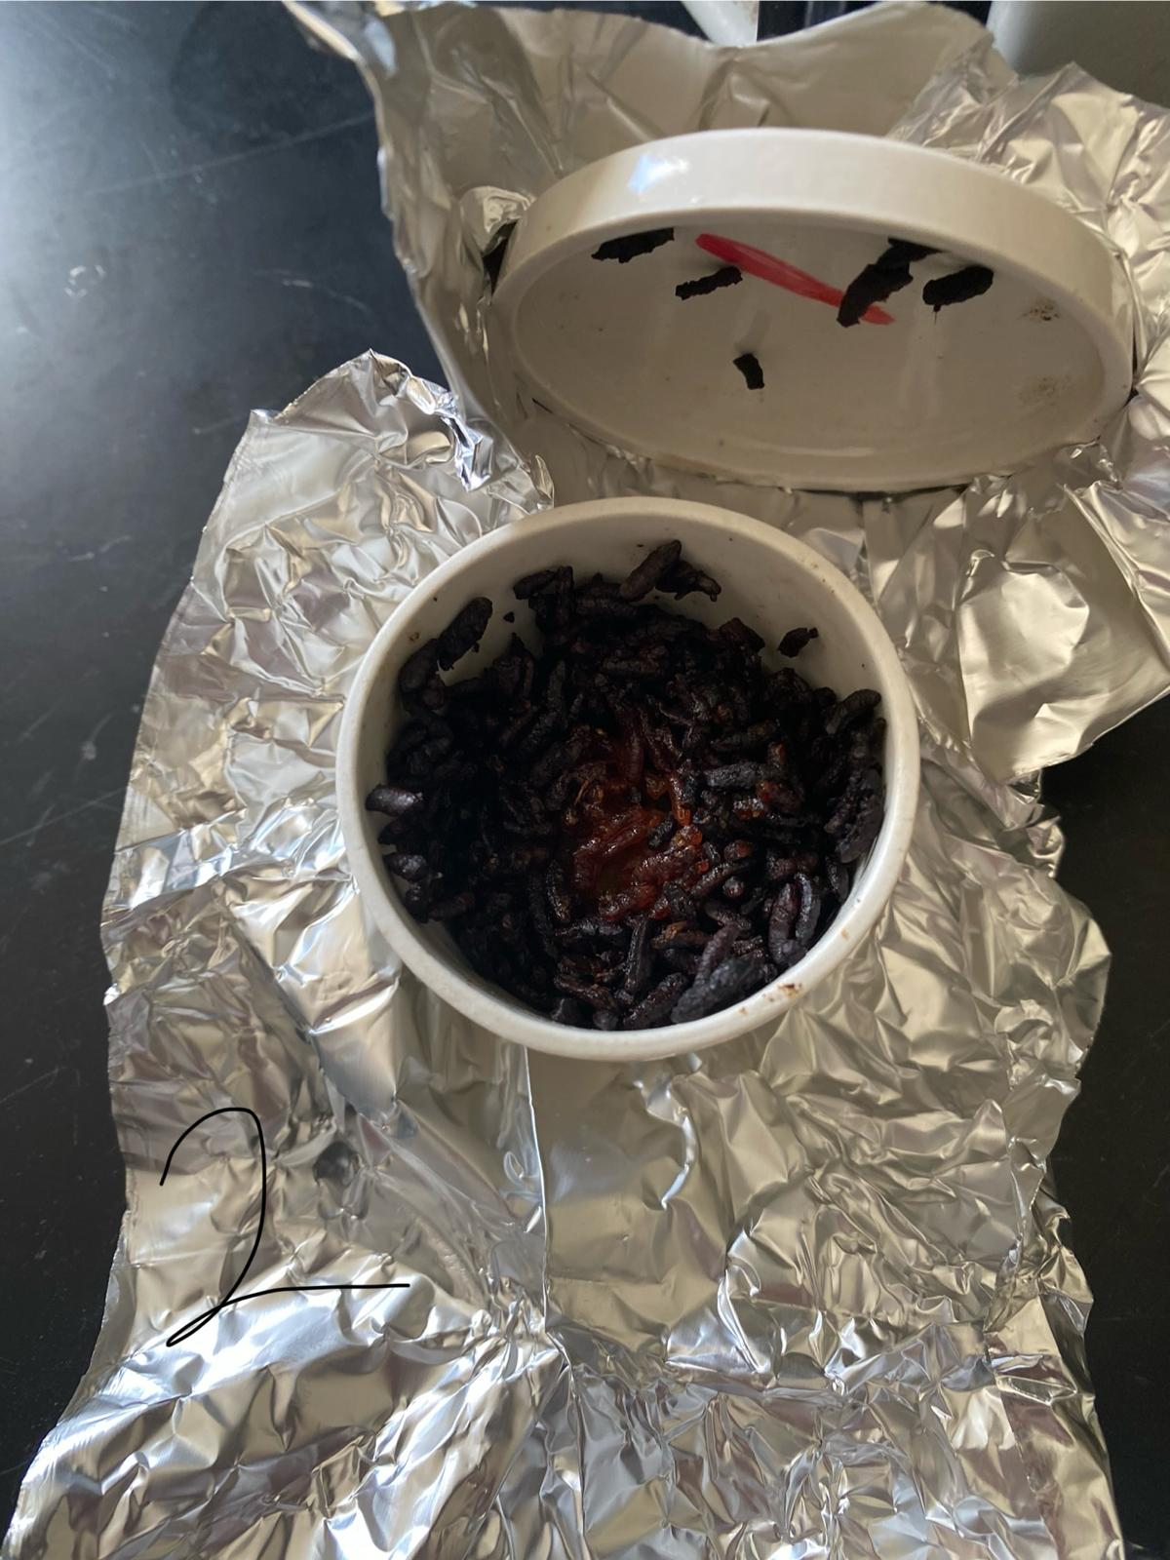
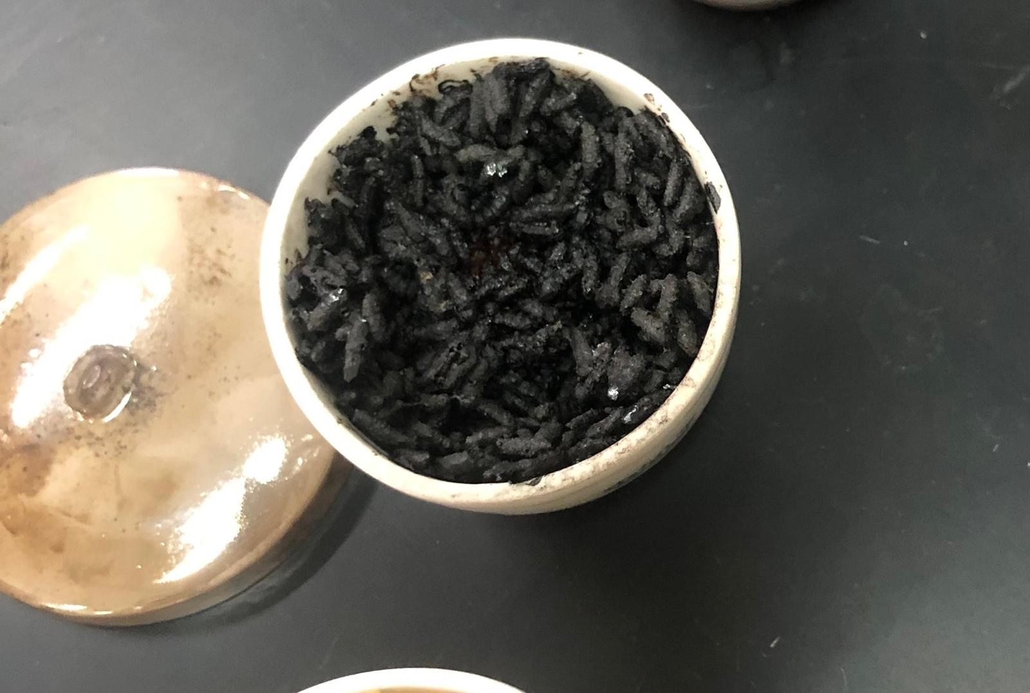
BIOCHAR
In this project, rice was used to produce biochar It is a carbon-rich product that is manufactured at temperatures ranging from 350 to 700 ° C.
300 ° C
400 ° C
450 ° C

Slide 11
Characterization
Chemical
Physical
  PH
Surface Area:
  Biochar pH varies from slightly acidic to alkaline, influenced by factors like organic material source, initial acidity, and pyrolysis conditions.
The surface area property of biochar refers to the total area of the external and internal surfaces within its structure.
  Adsorption
indicating its ability to adsorb pollutants, is influenced by factors like biomass type, pyrolysis temperature, activation method, solution pH, and adsorbate properties. while higher pyrolysis temperatures and activation methods increase surface area and porosity.
Ash Content:
The ash content and composition of biochar are critical factors, often expressed on a dry basis, excluding water. Understanding biochar's ash content is vital as it influences potential applications.
  Water Holding Capacity
Water Holding Capacity (WHC) is a key property of biochar that impacts soil moisture, irrigation needs, and plant growth.

Slide 12
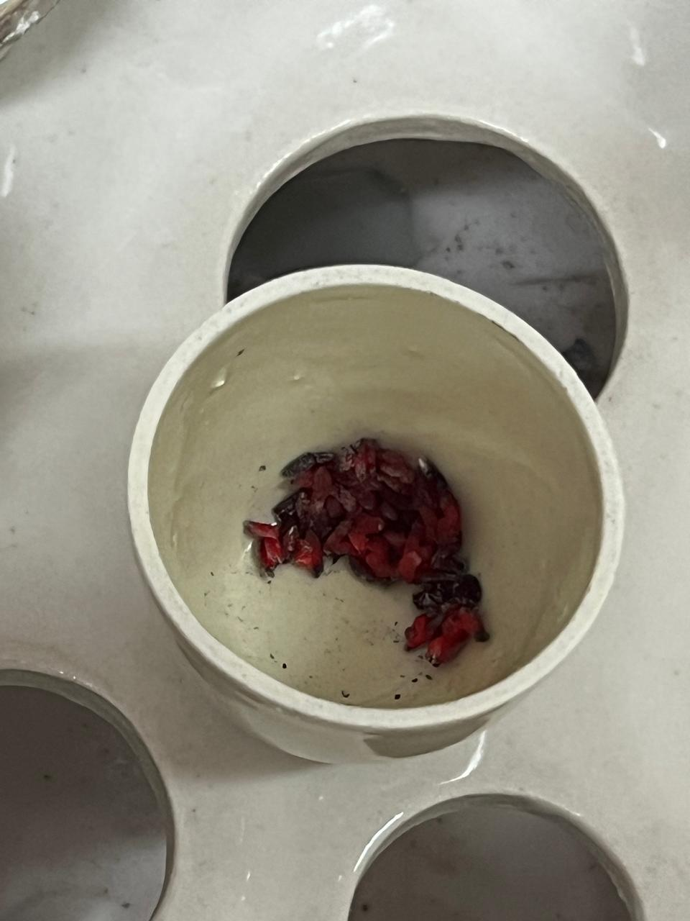
Methodology
Ash content:
prepare the samples 1 g by drying and grinding the original materials
place them in a high-temperature furnace 750c for the incineration process for 7-10 min
Once cooled, measure the weight of the remaining ash using a precision balance.

Slide 13
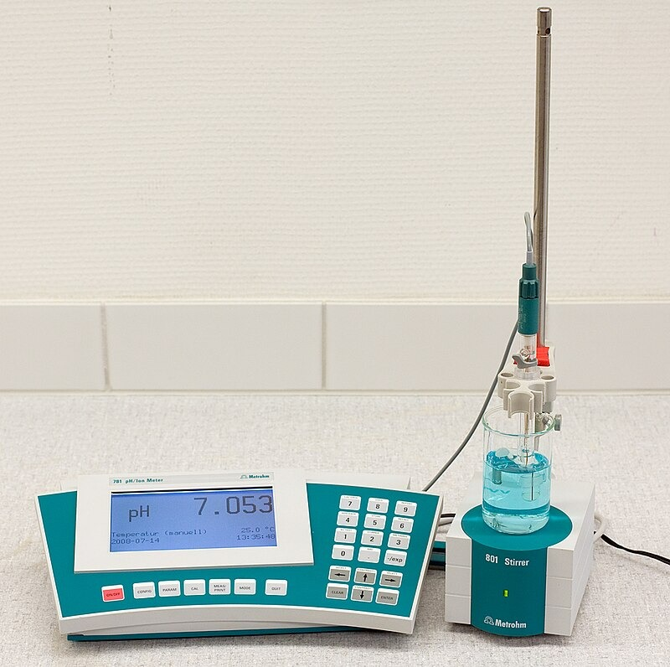
Methodology
PH:
2 g of the sample were added to 50 ml distilled water then the pH was measured using a pH meter.

Slide 14
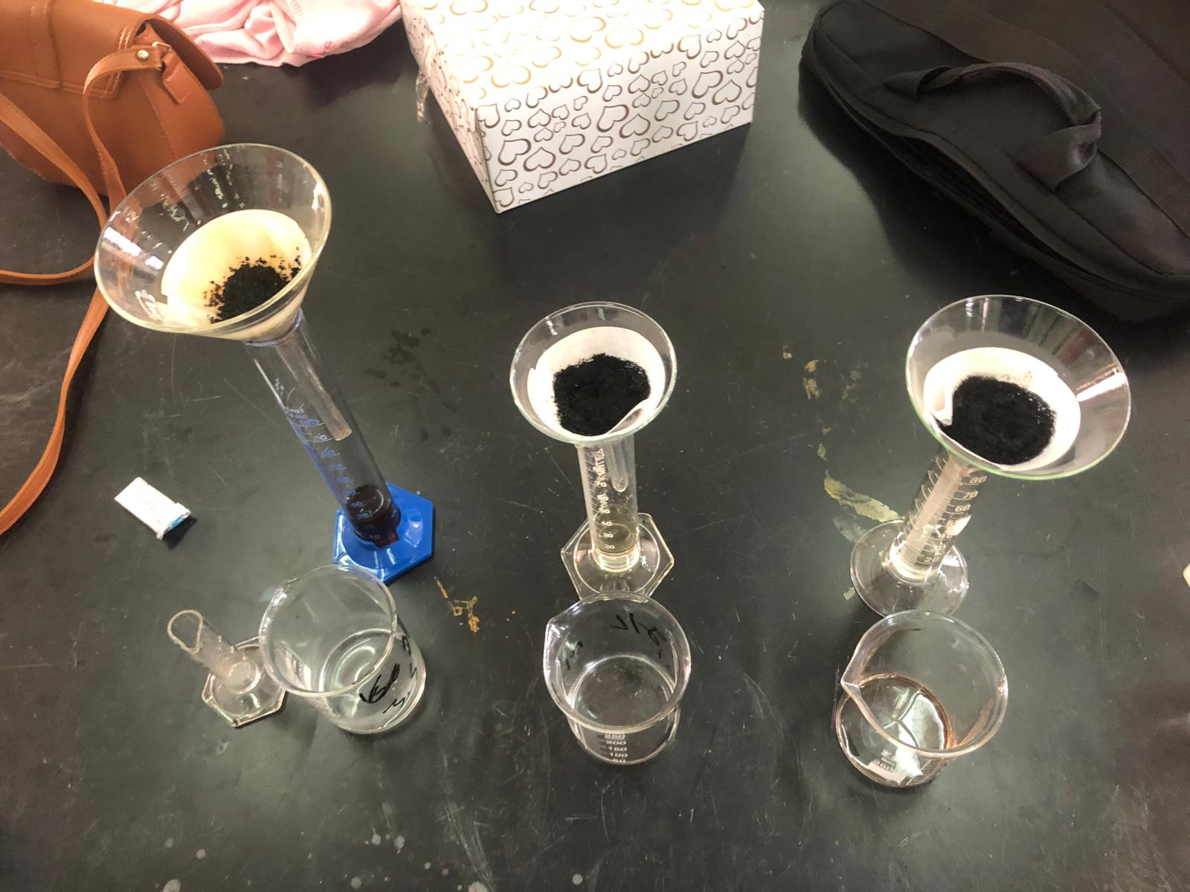
Methodology
Water Holding Capacity:
A 5-gram from crushed biochar was placed in a funnel
addition of 30 milliliters of water.
Test Method:
Percolation

Slide 15
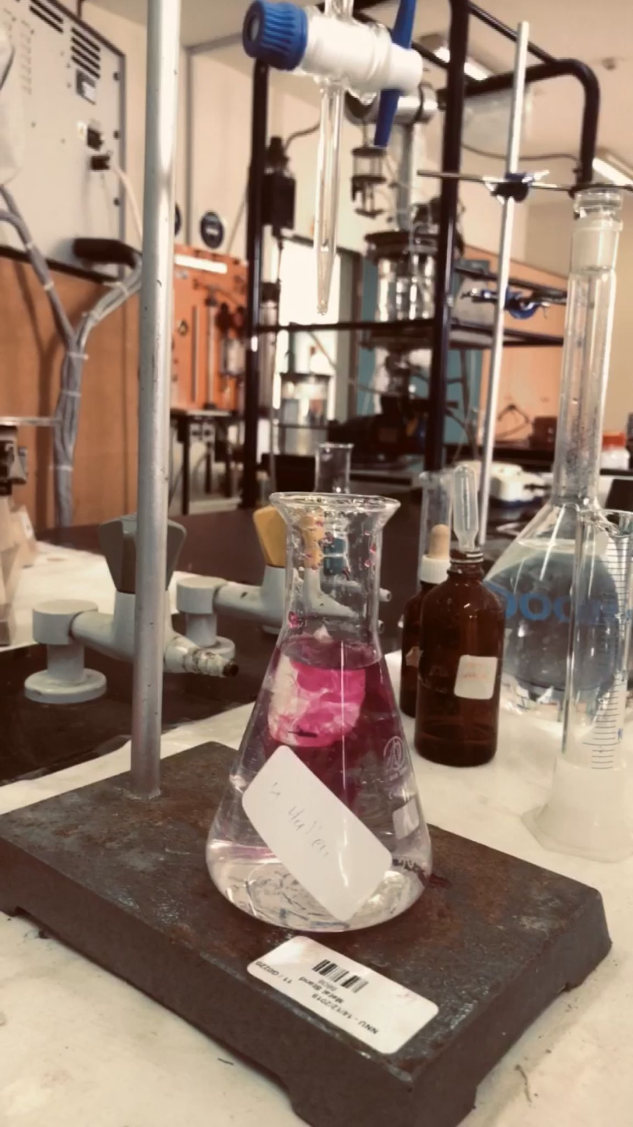
Methodology
Surface area:
The biochar was dried in the oven at 105 C for one-hour
acetic acid solution (0.1 M) was prepared with known concentration and NaOH solution (0.1 M) for titration was prepared
1 g of biochar was weighted and 50 mL of the acetic acid solution were moved to the flask
The 1 g biochar was moved to the flask and left in the solution for 24 hours closed in the shaker
After 24 hours the acetic acid solution was filtered and titrated with NaOH prepared solution (0.1 M)

Slide 16
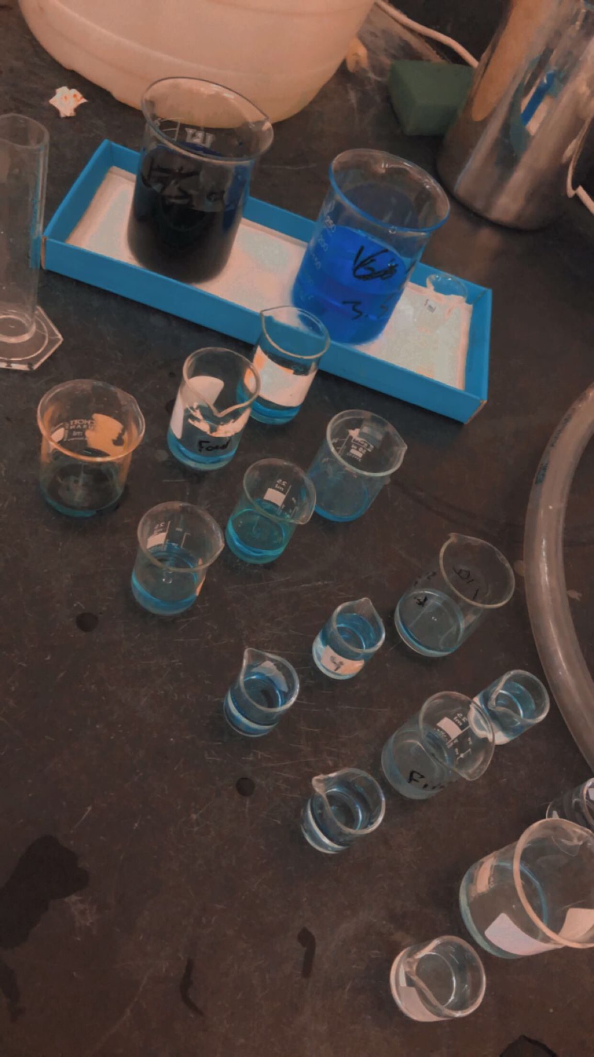
Methodology
Adsorption:
A stock solution of methylene blue (200 mg/L) was prepared and diluted to concentrations of 5, 10, 15, 20, and 25 mg/L.
0.2 gram of crushed biochar was weighed using a sieve and placed in a 10 ml tube containing a solution (distilled water with methylene blue dye) for all concentrations that were diluted.
The solutions were centrifuged at 200 rpm for 24 h in a shaker.

Slide 17

  Results and Discussion

Slide 18
Production
Results Production Biochar
Sample | Temperature (°C) | Duration (h) | Initial weight(g) | Final weight(g) | Difference
1 | 300 | 1 | 109.81 | 93.63 | 16.18
2 | 300 | 2 | 104.69 | 78.68 | 26.01
3 | 400 | 1 | 97.53 | 79.75 | 17.78
4 | 400 | 2 | 99.53 | 68.82 | 30.71
5 | 400 | 3 | 104.02 | 72.69 | 31.33
6 | 450 | 1 | 113.13 | 81.88 | 31.25
7 | 450 | 2 | 110.44 | 73.51 | 36.89
8 | 450 | 1.5 | 108.21 | 72.06 | 36.15
The samples at 300°C did not undergo complete pyrolysis and were therefore completely disregarded
Temperatures of 400°C and 450°C were used to obtain the best sample for studying its characterization and application.

Slide 19
PH
Ash Content
The results range between 7.36−5.46 for biochar samples and 9.72 for the commercial activated carbon.
The samples were weighted before and after incinerating and no ash had appeared.
Sample | PH
2 hr-400c | 7.09
1hr-450c | 5.46
2hr-450c | 7.28
3hr-400c | 7.28
1.5hr-450c | 7.36
Activated | 9.72

Slide 20
WHC
Surface Area
Sample | Weight(g) | Volume 1 | volume 2 | v2-v1 | WHC%
1 hr-450c | 5 | 30 | 21 | 9 | 180
1.5hr-450c | 5 | 30 | 25 | 5 | 100
2hr -450c | 5 | 30 | 26 | 4 | 80
Activated carbon | 5 | 30 | 22 | 8 | 160
Sample name | surface area(m2)
2h (400) | 109.79
3h (400) | 307.40
1.5h (450) | 219.57
2h (450) | 285.45
activated carbon | 1,317.45

Slide 21
Adsorption
calibration curve

Slide 22
Adsorption

Slide 23
Isothermal Adsorption
to select the best biochar sample, it is essential to perform Isothermal Adsorption calculations
Freundlich

Slide 24
Isothermal Adsorption
Langmuir

Slide 25
Data Analysis
Following our characterization study, the biochar was selected to be chemically and physically activated at 450°C for 2 hours.
Physical activation The prepared biochar samples were heated at 450 °C for 2 h using an oven at 750 °C for 1 h.
The biochar's surface area increased from 285.45 m² to 807.47 m² after physical activation.
Chemical activation Phosphoric acid was used to activate biochar prepared at 450°C for 2 hours. Two grams of biochar were immersed in 50 mL of 0.1 M phosphoric acid solution and stirred for 24 hours. The biochar was then washed to adjust the pH to 5.73 and dried at 105°C for 2 hours to remove residual moisture.
The biochar's surface area increased from 285.45 m² to 346.06 m² after chemical activation.

Slide 26
  APPLICATION

Slide 27
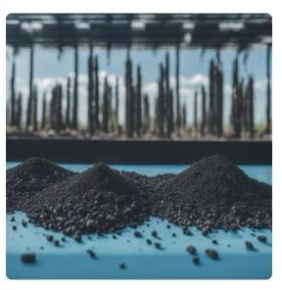
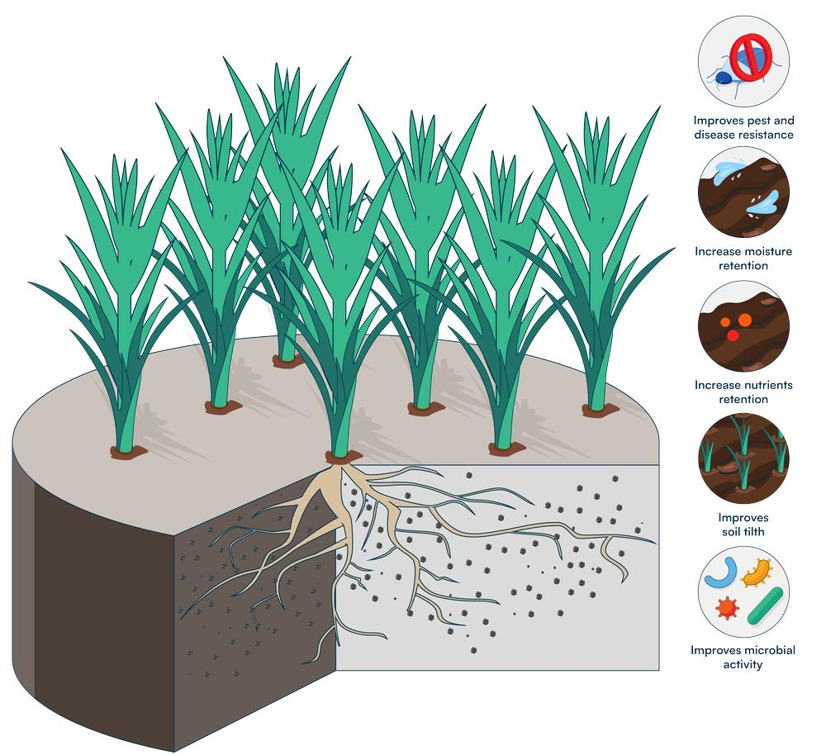
1.Water Purification
2.Soil:
Biochar, derived from biomass pyrolysis, enhances soil by:
Improving physical properties and aeration.
Retaining nutrients and preventing water contamination.
Providing habitat for microorganisms, enhancing soil quality.
Adjusting pH and increasing Cation Exchange Capacity.
Removing heavy metals, contributing to soil remediation.
Sequestering carbon, reducing greenhouse gas emissions.
Increasing water retention, nutrient availability, and reducing soil erosion

Slide 28
Recommendation
Experiments may have errors due to using a single sample; at least three are needed for reliability.
Higher pyrolysis temperatures (e.g., 800°C) improve biochar's water holding capacity (WHC).
Physical activation significantly increases surface area compared to chemical activation and is recommended for better adsorbent and catalyst performance.
Further studies should examine the effect of pyrolysis temperature on pH.
Explore alternative chemical activation agents (e.g., KOH, NaOH, ZnCl2, H2SO4) and control activation parameters.
Applying biochar to soil can enhance soil health and crop yield.

Slide 29
Conclusion

Slide 30



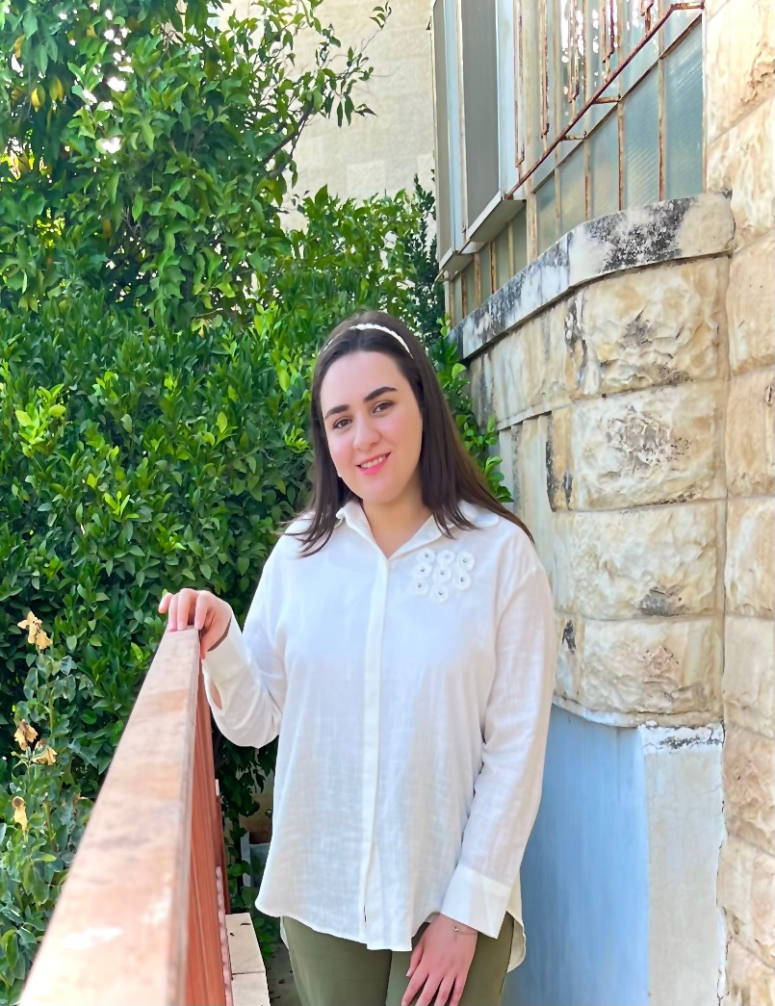
Team Members
Thank you
Eng.Fatima Abujash
Eng.Suzan Shnity
Eng.Dima Shnity
Eng.Dana Qamhiyeh

