Slide 1
Feed your PET
By: Yara A. Abuamsha & Israa N. Ihbiesheh.
Supervisor: Dr. Loai Malhis with Dr. Alaedeen Masri & Dr. Hanal AbuZant.

Slide 2
Outline & Main Idea.
What is Feed Your PET Project? Problem & Solution.
Overview.
Motivation.
Components.
Methodology.
Constraints and Future Work.
Demo.

Slide 3
What is Feed Your PET Project? Problem & Solution.
Problem: Alone PETs in home when their owners are away onboard and can’t take care of their food.
Solution: using our car robot that can take responsibility of feeding that poor PET and keep the owner updated with the feeding times.

Slide 4
Overview..
“Feed the pet” System is a Hardware system, which is able to take care of anyone's pet especially when they are away from home. Second bullet point here
It is specialized in looking after their food and feed them at scheduled time given by the owner, and with a certain amount.
The system is considered as a car robot. A “line-follower” car. This line leads the car to the location of the pet.
The system also supports a feed-back service. More clearly, it communicates with the owner via a GSM system .Each time the meal is provided to each pet, the system sends an SMS message to the owner to inform him about the delivering.

Slide 5
Motivations
PET care
LineFollower
Steppers
Feeders
GSM
Taking care of the PET when it’s home alone.
Keep the owner updated.

Slide 6
Components..
And Cause.

Slide 7
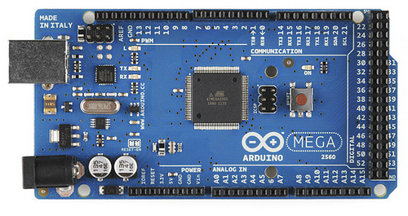
Components.
1) Arduino Mega 2500.
Motive.
Since the Arduino Mega has the most number of inputs.
For controlling all the needed operations and all other components were connected to and communicated with it.

Slide 8
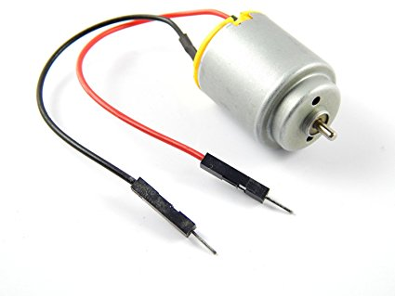
Components.
2) 12v DC Motor.
Motive.
It was connected to Arduino in order to control the rotation of the feeder's wheel in the operation of FEEDING.
The amount/period of rotation is limited by a degree given to the motor. ( AMOUNT DETECTION)

Slide 9
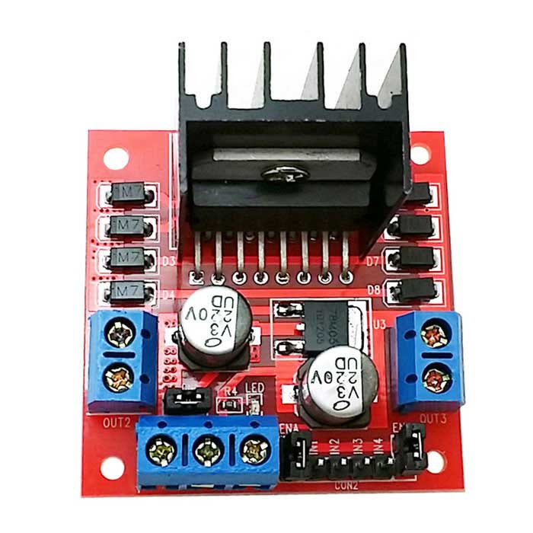
Components.
3) H-Bridge Driver.
Motive.
For interfacing the DC Motor with the Arduino, an H-Bridge driver was used.

Slide 10
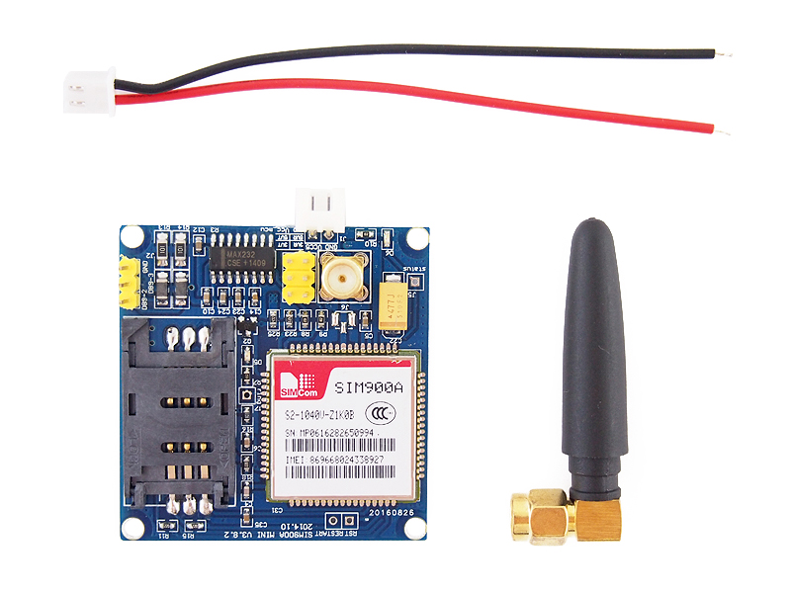
Components.
4) GSM sim 900A Module.
Motive.
In order to send the owners a message each time the feeding operation was achieved , or if the robot faced any problem.

Slide 11
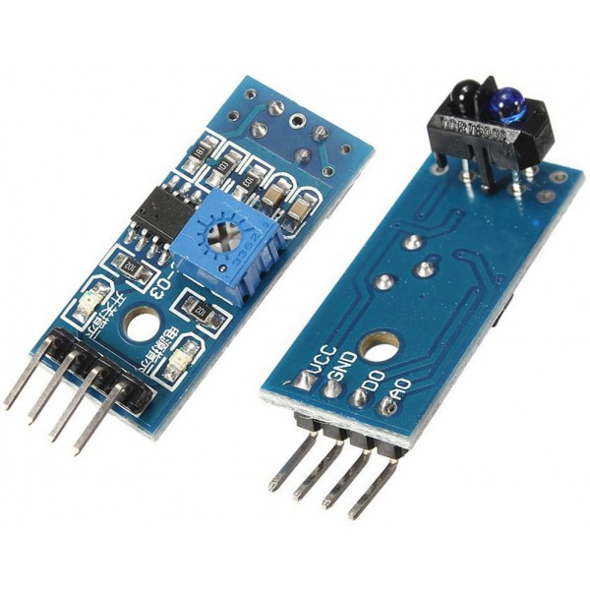
Components.
5) MH Sensors.
Motive.
For purpose of knowing the pets location.
Directions and rotations was controlled by programming them.

Slide 12
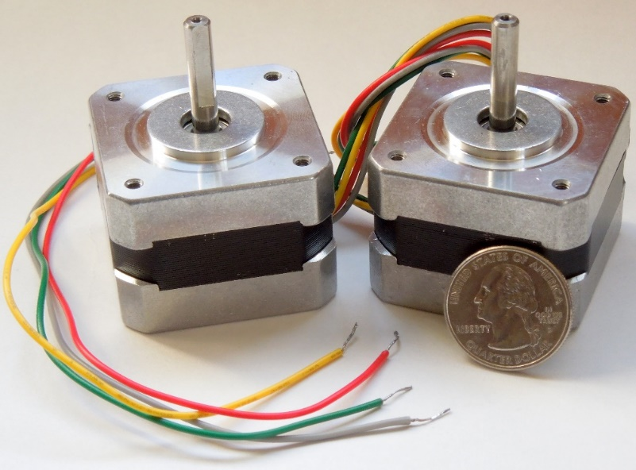
Components.
6) Pair of stepper motors.
Motive.
A pair of Stepper Motors was used to help the robot in its movement.

Slide 13
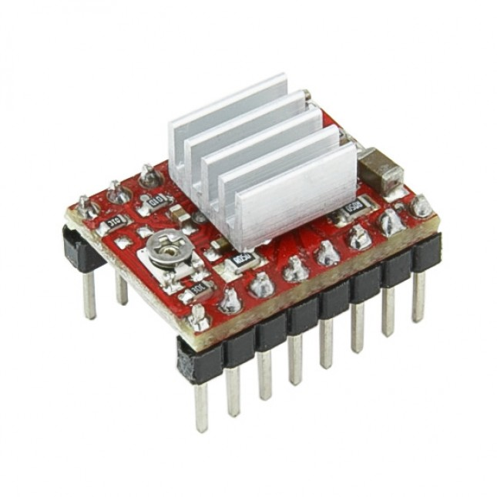
Components.
7) 2 DRV8825 stepper drivers.
Motive.
In order to interface the steppers with the Arduino.
They have step and direction pins to control the speed and direction of the steppers.

Slide 14
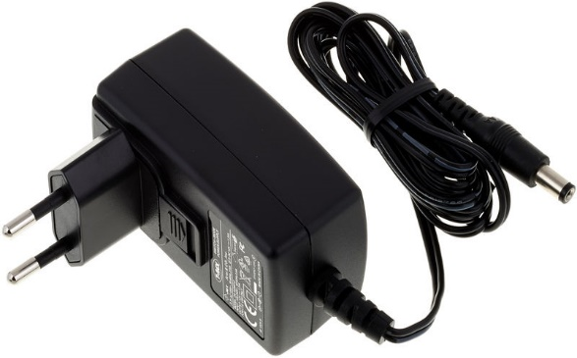
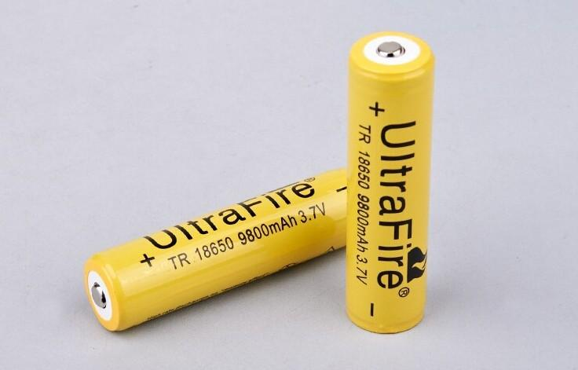
Components.
8) 12v Power Supply and batteries.
Motive.
To power the Steppers and the Motor Feeder.

Slide 15
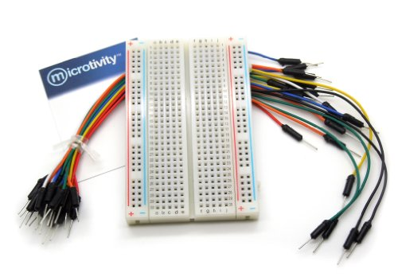
Components.
9) Wires and Breadboard.
Motive.
Connect pins together.

Slide 16
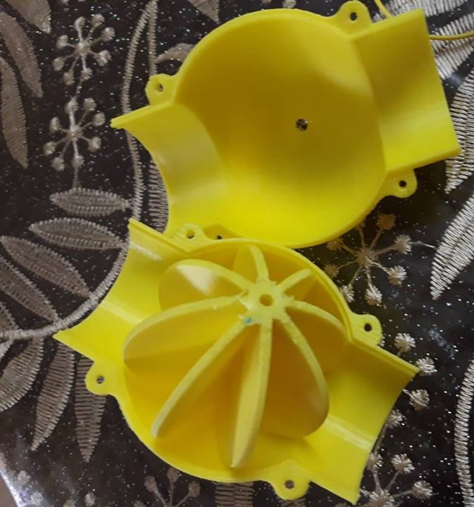
Components.
10) 3D Printing – Feeders internal design.
Motive.
The wheel used to evaluate the food amount, each wing of it is considered to give a specific amount of the food.

Slide 17
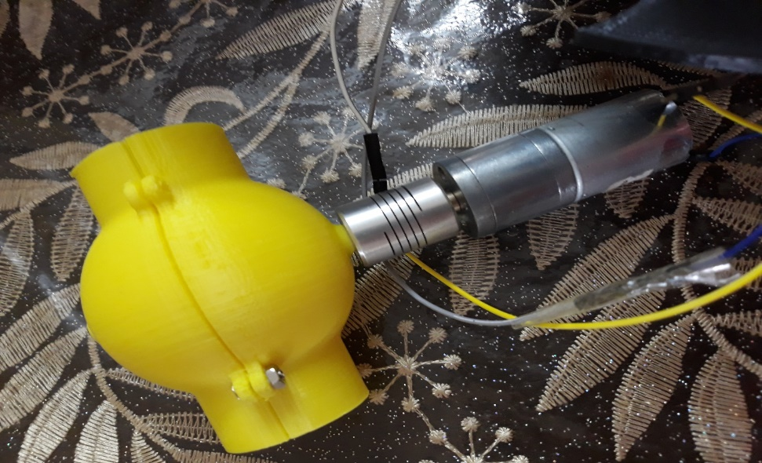
Components.
10) 3D Printing – Feeders external design.
Motive.
Used to feed the pets.

Slide 18
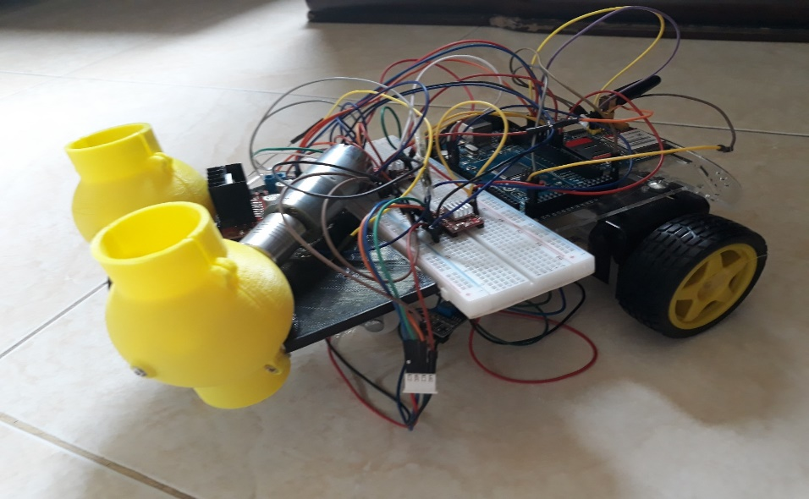
Components.
10) 3D Printing – Car and Robot Wheels.
Motive.
The whole design of the Robot Car.

Slide 19
Methodology.

Slide 20
Constrains.
Interfacing the stepper motors with its drivers to Arduino was a challenge that we had to replace the drivers twice for internal problem in the wires.
The wheels were not moving in a smooth way while rotating, because of the silicon was attached wrongly to the wheel.
As our project required to have many components, the chosen of the structure of the car robot was insufficient, so we had to add an extra plate.
Another problem in using the batteries as an alternative of the wired power supply.

Slide 21
Future Work.
This project can be used for any other similar operation, such as medical field, or any other field that requires a moving car robot to achieve it.
Also, this current project can be used for both feeding and watering PETs. One of the feeders can be replaced by a bottle of water that can support rotating and pouring water to the PET.
Adding a Camera to supply the owner with a picture of the PET in order to comfy the owner of the PETs status.

Slide 22
Demo.

