Slide 1
Laqini
Done By: Isra Sabri
Supervised By: Dr.Sufyan Samara

Slide 2
Table of Contents
01
04
02
05
03
06
Challenges
Motivations
The Idea
Demo
Features
Conclusion

Slide 3
Motivations
Free time
Events
Facebook

Slide 4
Laqini

Slide 5
Idea
Application
Events
Find friends

Slide 6
Features

Slide 7
Profile
User’s data
Edit Profile

Slide 8
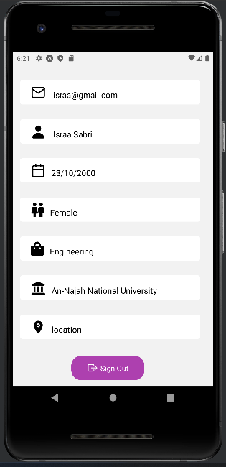
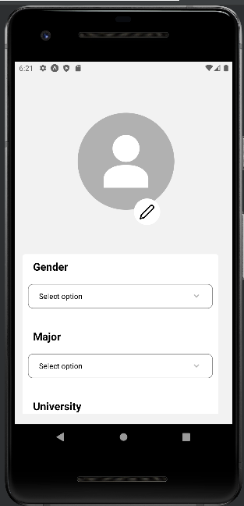
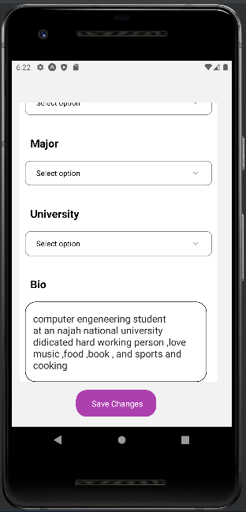

Slide 9
Interstes
Act
Paint
Music
Photography
Bodcast
Filming

Slide 10
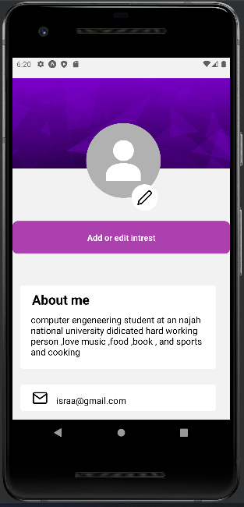
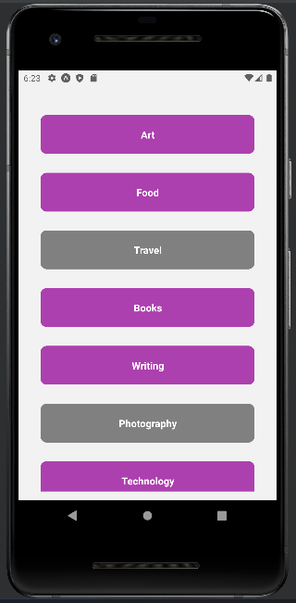

Slide 11
Map

Slide 12
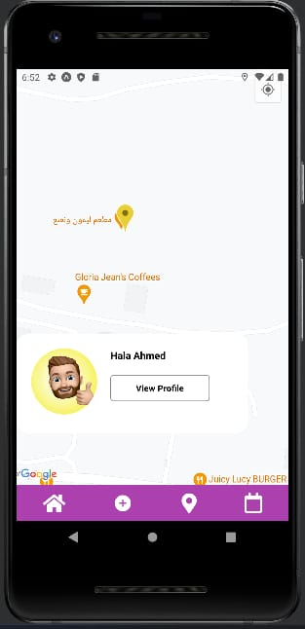
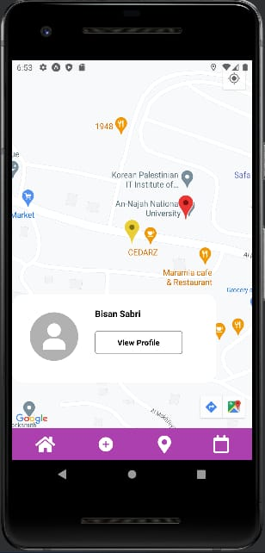
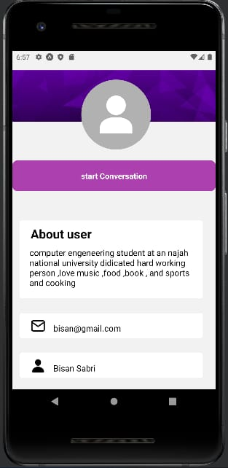

Slide 13
Chat
Discuses
Agreement

Slide 14
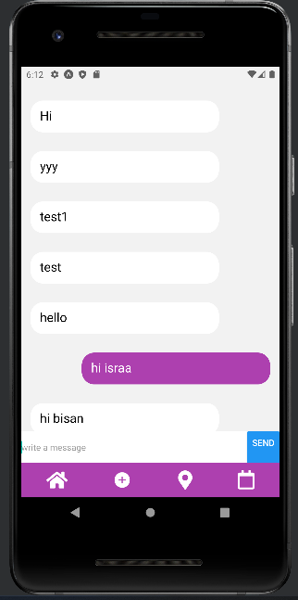
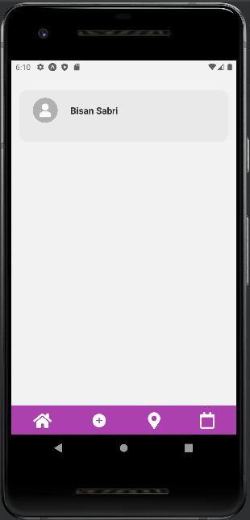
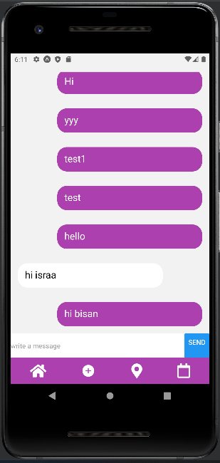

Slide 15
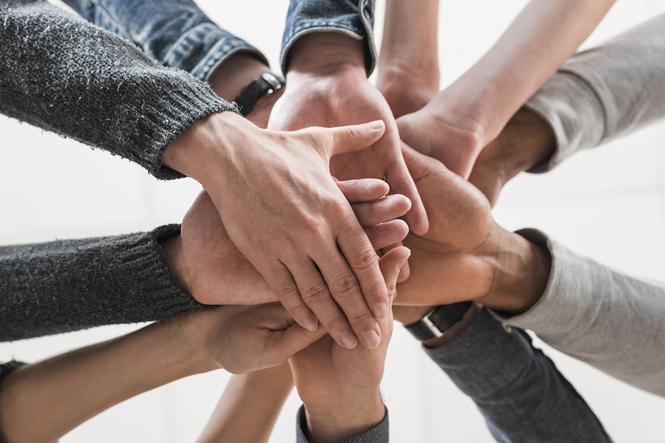
Home page
Event posts
Event filter

Slide 16
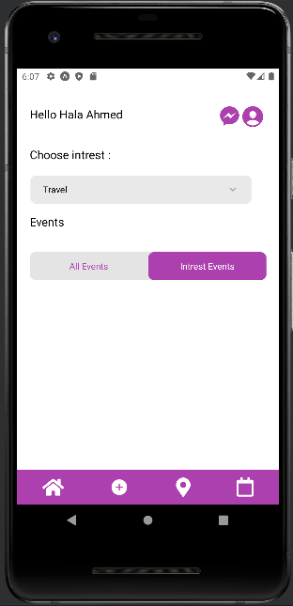
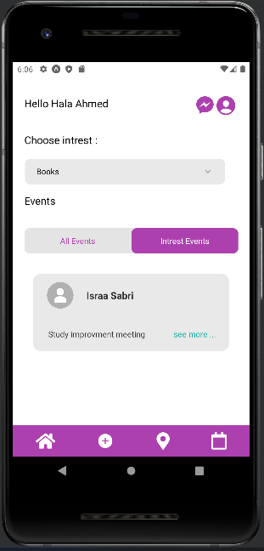
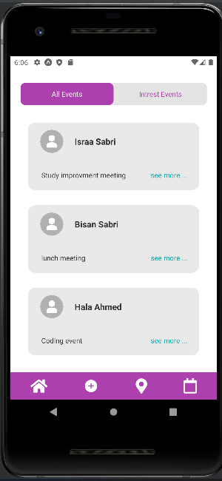

Slide 17
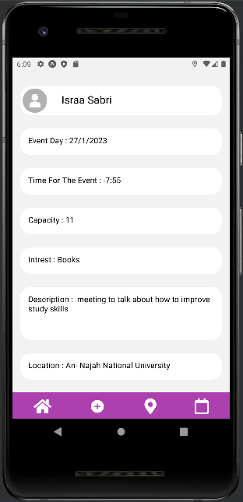
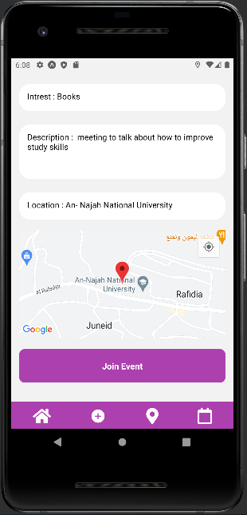
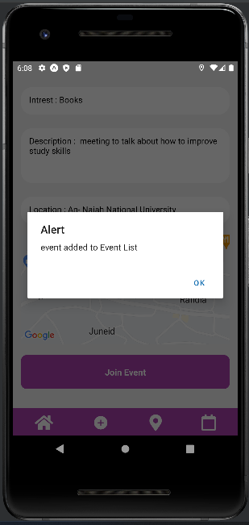

Slide 18
Event
Event
Time
Date
Location
interest
Tittle
Description
# of participants

Slide 19
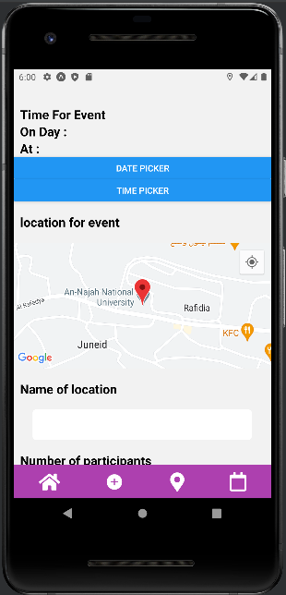
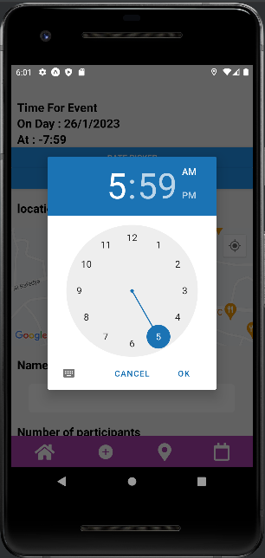
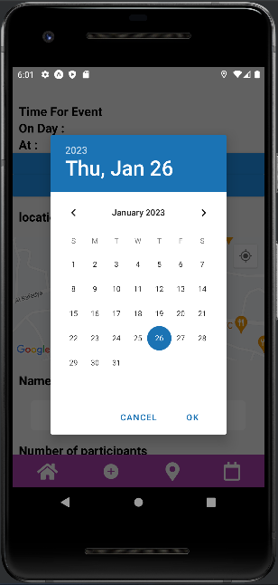

Slide 20
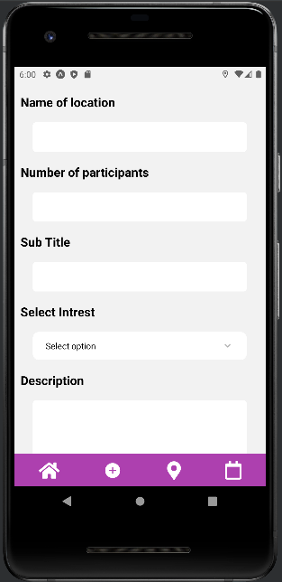
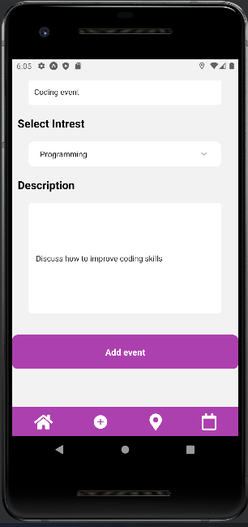

Slide 21
Calendar
Event

Slide 22
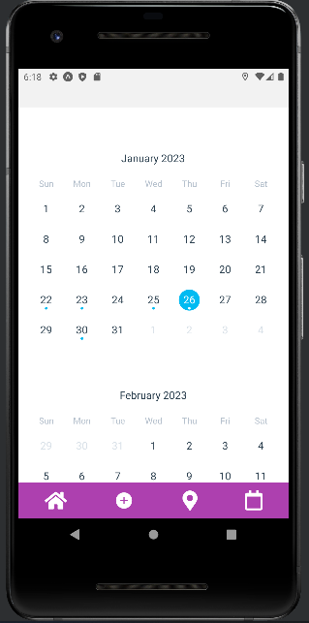
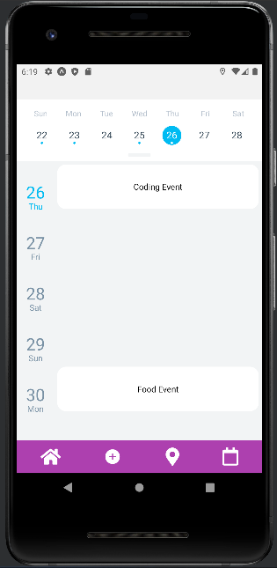

Slide 23
Tools and Technology :
Backend
Mobile
Web
Nodejs , MySQl
React native
HTML , CSS ,
Js, php

Slide 24
Frontend
Android studio
Simulation
React native & Expo
Web
HTML , CSS , PHP, JavaScript
Frontend
framework

Slide 25
Backend
DataBase
Node.Js
Test Endpoint
MySql
Backend framework
Postman

Slide 26
Challenges
Learning new freamworks
Heavy editors and simulators
Limiting time
Working with map is hard

Slide 27
Thanks
Do you have any questions?

