Slide 1

Graduation Project 2
Design and manufacture of a lensed-glass surface for concentrating solar radiation

Slide 2
Objective
We are continuing the work done by Adnan Hilal and Hanan Isleem which by improving the efficiency of the solar heaters by using a specifically manufactured lensed surface

Slide 3
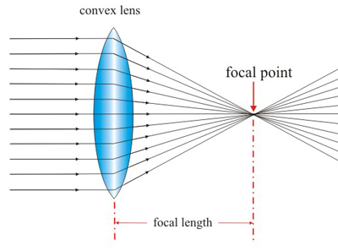
Convex lenses

Slide 4
Glass types
Glass type | SiO₂ % | Na₂O% | CaO% | Al₂O₃% | B₂O₃% | Other | Characteristics and Applications
Fused silica | More than 99.5% | - | - | - | - | - | High melting temperature, very low coefficient of expansion (thermally shock resistant)
VycorTM | 96% | - | - | - | 4% | - | Thermally shock and chemically resistant (laboratory ware)
Borosilicate | 81% | 3.5% | - | 2.5% | 13% | - | Thermally shock and chemically resistant (ovenware)
Container (soda-lime) | 74% | 16% | 5% | 1% | - | 4% MgO | Low melting temperature, easily worked, also durable
Fiberglass | 55% | - | 16% | 15% | 10% | 4%MgO | Easily drawn into fibers(glass–resin composites)
Optical flint | 54% | 1% | - | - | - | 37%PbO 8%K₂O | High density and high index for reflection (optical lenses)

Slide 5
processes Lenses manufacturing
Generation:
Grinding:
Polishing
Centering and Edging.
Coating

Slide 6
glassomer
The problem in glass manufacturing in Palestine is that during the molten glass solidification there will be a shrinkage due to a volume loss
The best approach in this case is adding additional melt to compensate the loss in volume b y using a compensation channel (Vent)

Slide 7
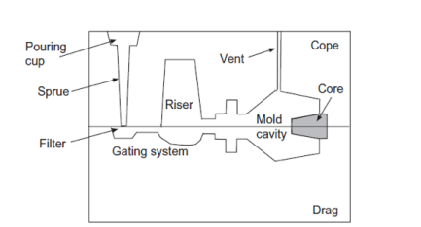
Glass melting oven with Vent tube that produce glass product with the desired dimensions

Slide 8
Unfortunately there is no oven in Palestine that is equipped with a Vent channel
However, even by using a compensation tube there will be defects on the glass surface where it will be rough topography.

Slide 9
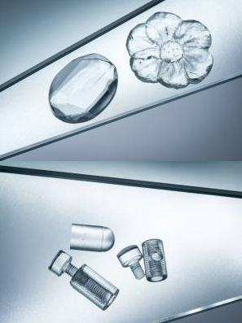
Glassomer

Slide 10
glassomer
A revolutionary technique in glass manufacturing
Using thermoplastic polymeric melt and nano-glass particles
The 40 nanometer diameter quartz particles are dispersed in a molten polymer and continue to stir it until the glass particles are uniformly distributed in the melt
This polymeric liquid that contains nano-glass is called glassomer.

Slide 11
Glassomer
The polymer is casted to obtain and retain the desired shape of the mold
Once its solidifies the polymer is burned into carbon dioxide gas leaving the glass which has obtained the shape of the moled with the exact dimensions
Sintering is applied at 1300 C to remove the gaps on the surface and to increase its density.

Slide 12
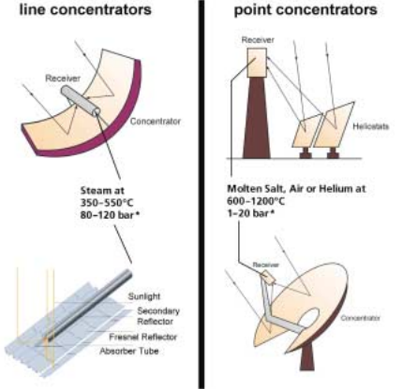
Power concentrator

Slide 13
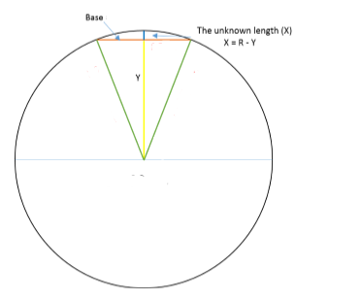
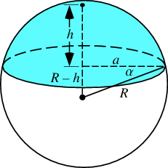
Designing the lenses

Slide 14
Designing lenses
As shown above the lens is a hemisphere part where the focal point is half the radius.
In other words the focal length is a two parameter function of the lens diameter and height.
the following tables shows the height for each diameter and focal length

Slide 15
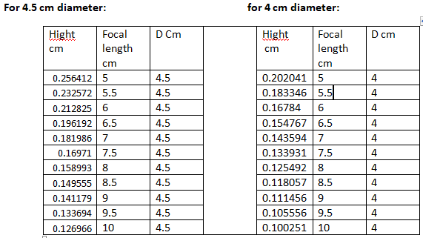
4 and 4.5 cm diameter

Slide 16
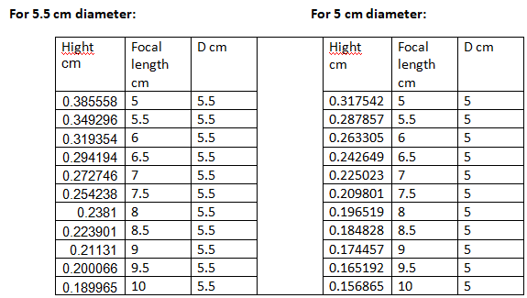
5 and 5.5 cm diameter

Slide 17
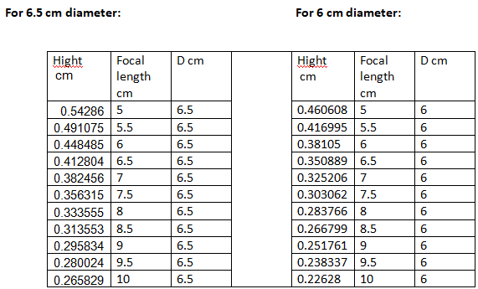
6 and 6.5 cm diameter

Slide 18
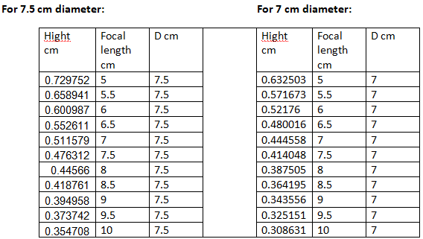
for 7 and 7.5 cm diameter

Slide 19
As the focal length for the lens decrease, the manufacturing cost will increase due to the centering process in which it will require to be longer and more accurate. So in order to obtain a reasonable cost with a relatively large quantity of the lenses we chose the lens with the dimensions of 5 cm diameter and a height of 0.225023 cm which means the focal length is set to be 7 cm.

Slide 20
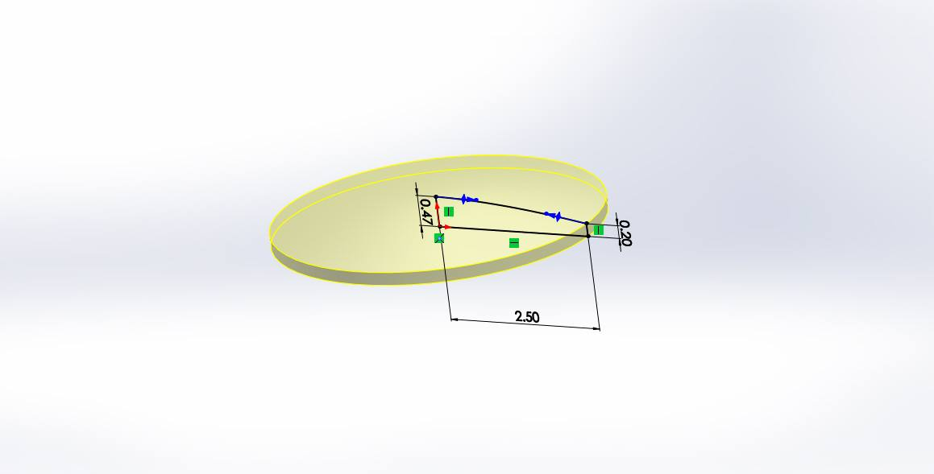
Chosen lens

Slide 21
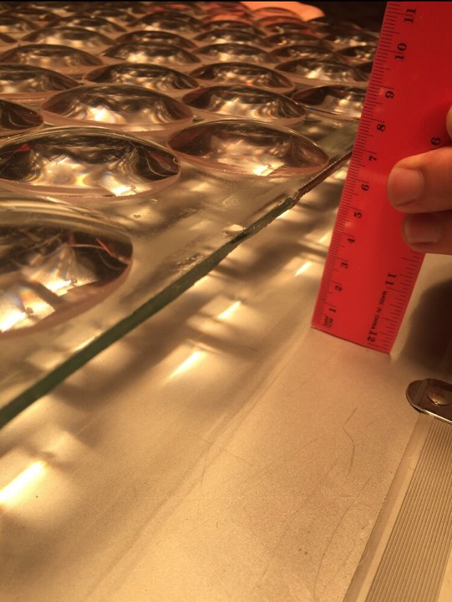

Slide 22
Lenses manufacturing
The first step is the Generation process: removing material from a bulk glass by CNC machine leaving the lenses desired dimensions
However, it doesn’t have any good optical properties yet

Slide 23
centering
Prior lenses manufacturing process the lenses had to go through a mechanical centering in order to make the vertical plane from the lens peak and the horizontal plane from the plane surface perpendicular.

Slide 24

Manufacturing process

Slide 25
plate Lensed surface
A lensed surface plate (flat plate with lenses on it), the lenses were oriented in closed-pack configuration where they occupy 67.3% of the total area due to the plate sides are not covered and there is a small variation in the lenses sizes.

Slide 26
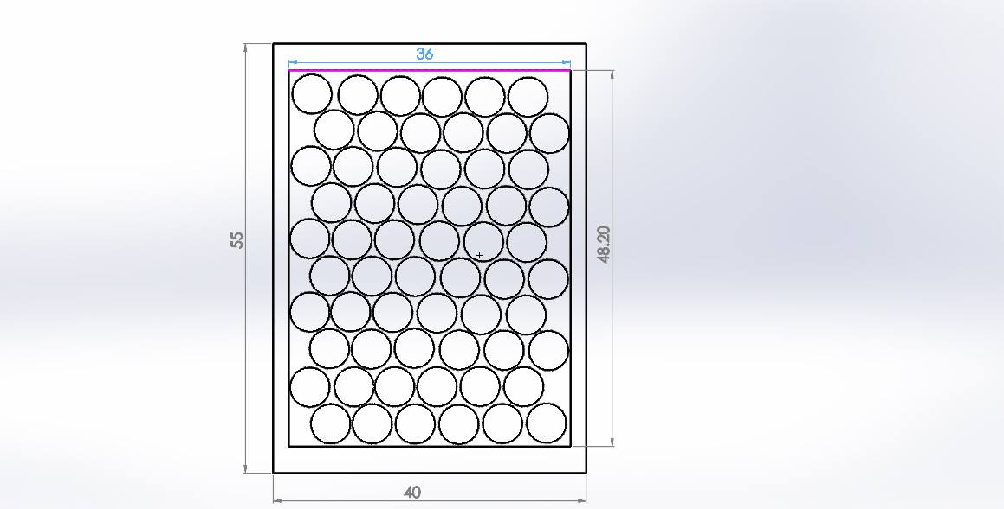

Slide 27
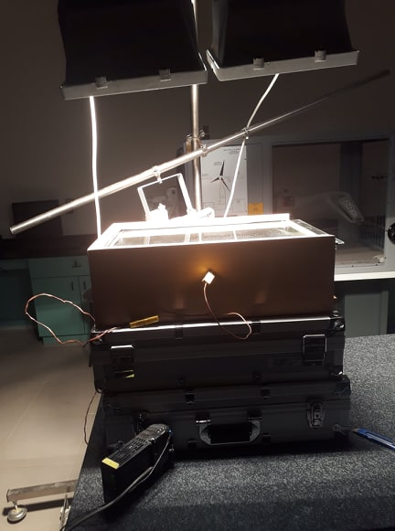
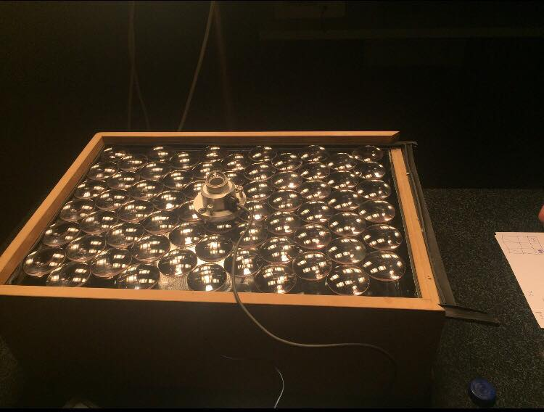
Open system experiments

Slide 28
The first and second experiment
The first experiment was conducted by using 3 litres of water but it was cut off because there was an error with the thermometer (it didn’t record values above 40 C)
The second experiment was conducted at the exact same conditions but it was cut off because the flashes (light source) was not properly aligned to the box surface

Slide 29
The third and fourth experiment
Those experiments were conducted by using 3 litres of water and an average radiation
intensity value of 2302 W/m² for both times, and with the exact starting temperature value 14 C.
The third experiment we used a lensed surface plate, where in the fourth one we used a flat surface plate

Slide 30
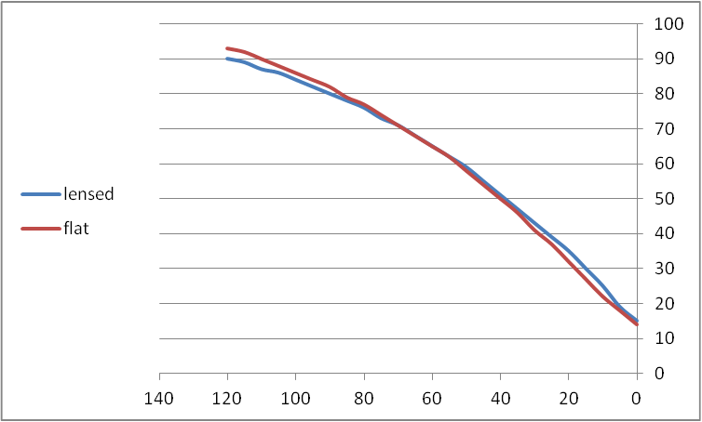
The third and fourth

Slide 31
The fifth and sixth exps
At first we thought that the lenses were not efficient because the water level in the box was not high enough to reach the focal point of the lenses, so we added more water (additional 7 litres) so that the water level raised to reach 5.5 cm where the focal points lays beneath it
So we conducted the experiments using 10 litres of water and The average radiation intensity value was 2382 W/m². for both exp

Slide 32
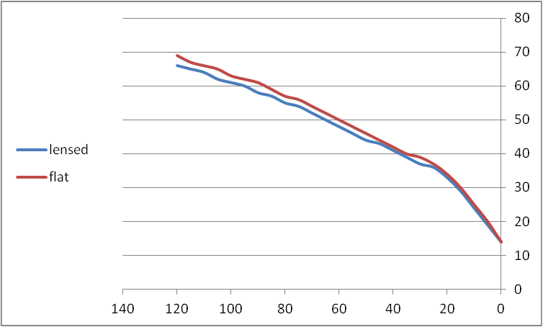
The fifth and sixth exps

Slide 33
efficiencies
The lenses has no effect on the efficiency for an open system which contadict the results obtained by Adnan Hilal and Hanan Isleem in their previous GP

Slide 34
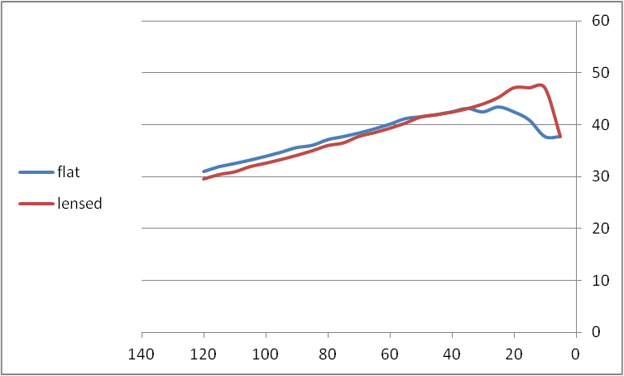
Efficiency of the open system

Slide 35
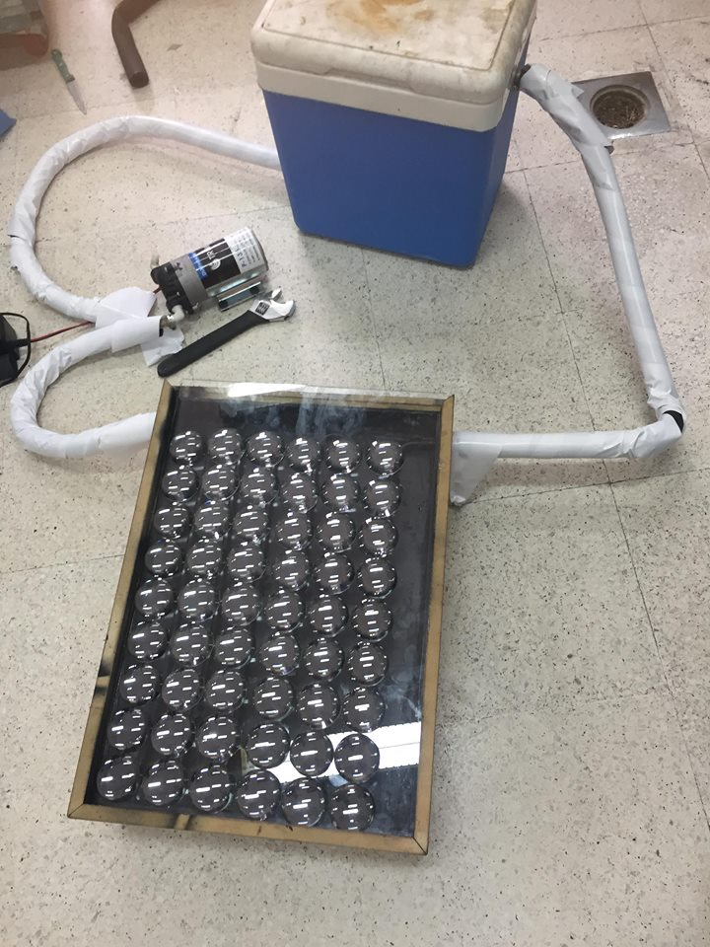
Closed system solar heater

Slide 36
manufacturing the solar plate
We transformed the wooden box to a solar plate by tying a copper pipe to be shaped like a rotator and inserting it in the box
However before that we had to adjust the depth so that the pipe is placed right at the lenses focal points
So we sprayed foam under the inner base of the box so the height became 5 cm and the distance between the plate and the pipes is 7cm

Slide 37
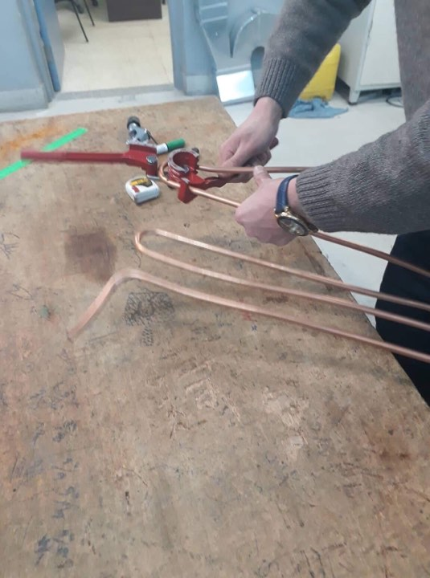
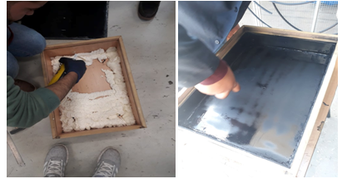
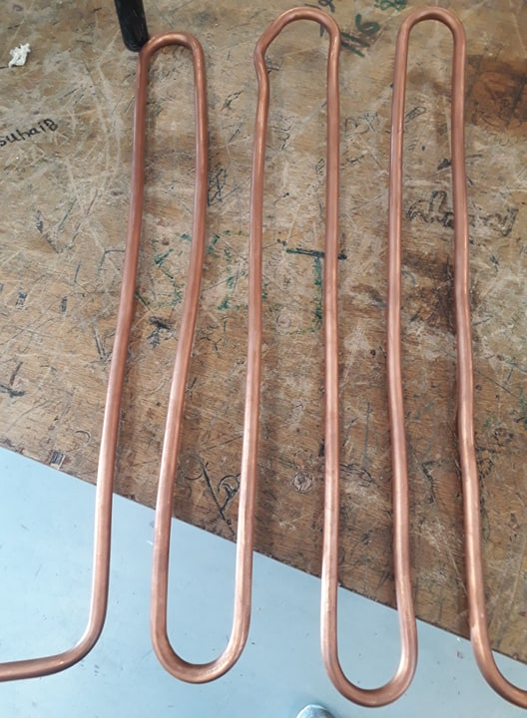
manufacturing the solar plate

Slide 38
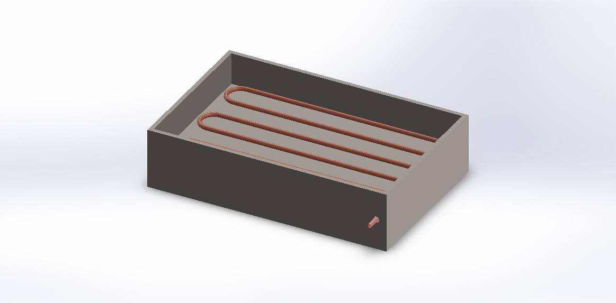
manufacturing the solar plate

Slide 39
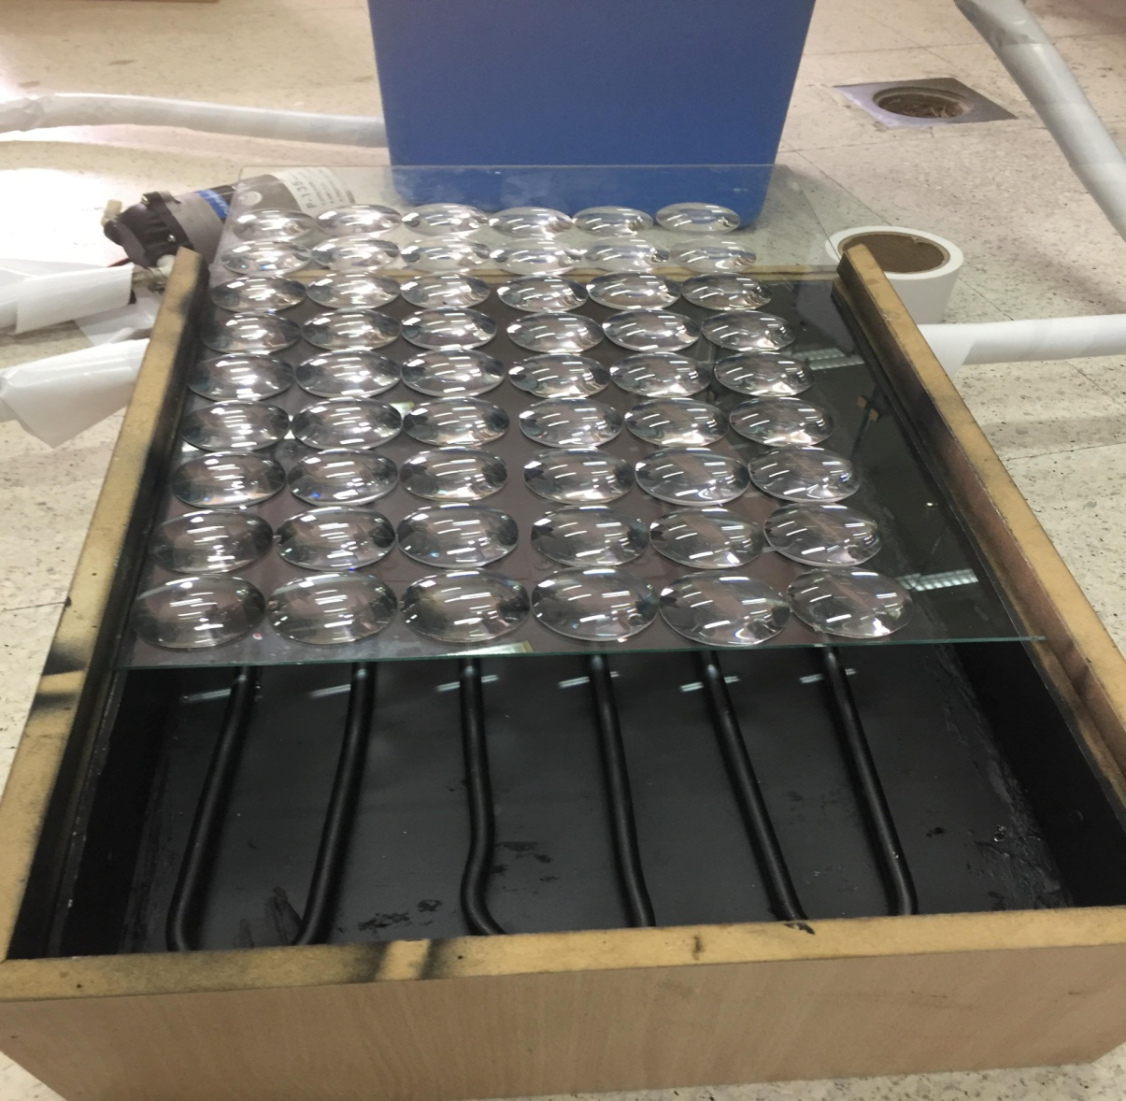

Slide 40
Solar plate experiments
We conducted the solar plate exp in the exact same conditions for both surfaces : 1 atm, 18 Cº starting temperature, 1.35 L/minute pump
The average radiation intensity was 2308 W/m² for the flat surface and 2360 W/m² for the lensed surface, the water mass was 4.5 kg.

Slide 41
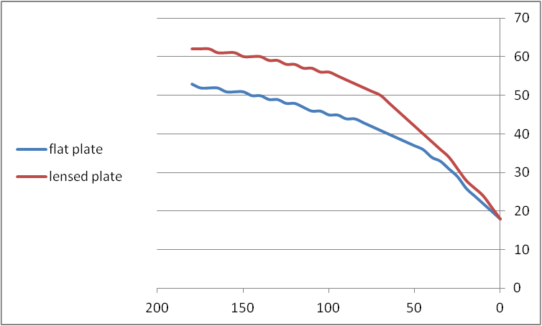
Solar plate results

Slide 42
Solar plate exp
After 3 hours the highest the water temperature raised from 18 to 62 C by using the lensed surface and to 53 using the flat surface.
There is an improvement in the system efficiency when using a lensed surface.

Slide 43
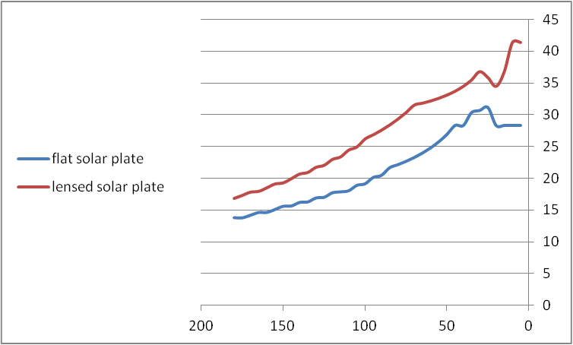
efficiencies

Slide 44
Conclusions and recommendations
The lenses do not improve the efficiency for an open system but slightly reduce it but it improve the efficiency for the closed system.
The results that were obtained by Adnan Hilal and Hanan Isleem by performing the open system experiment contradicts our results so we recommend redoing their experiments to make sure that the results they reported are reproducible

Slide 45
Conclusions and recommendations
Glassomer method can be used to manufacture a high accurate dimension's lenses if a 40 nm diameter powder are available.
Using the acrylic polymer material as a starting material for lenses manufacturing due to its flexibility and accuracy.

Slide 46
Conclusions and recommendations
Higher power lenses require a well-equipped manufacturing institutions with a special techniques for each step in lenses manufacturing such as CNC instead of molding for the lens dimensions, CVD for coating and a highly accuracy centering machine.
Manufacturing a larger lensed plate to be suitable for the commercial solar heater, in order to see if there is availability to improve their efficiencies.

