Slide 1

" Deep Learning-Based Real-Time AI Virtual Mouse System Using Computer Vision"
Submitted by: Rawan Abu Ali Arwa Ahmad
Supervisor: Dr. Falah Hasan
An-Najah National University
Faculty of Engineering and Information Technology
Electrical Engineering Department

Slide 2
Outline
Introduction.
Project idea.
Methodology.
Conclusion.

Slide 3
Introduction
-The AI virtual mouse system was created using the Python programming language, as well as OpenCV, a computer vision library.
-The model in AI virtual mouse MediaPipe package for tracking the hands and the tip of the hands, the Pynput, Autopy, and PyAutoGUI packages for moving around the computer's window screen and performing functions like left click, right click, and scrolling.

Slide 4
Project idea
-AI virtual mouse system is to create an alternative to the regular and traditional mouse system to perform and control the functions of a mouse.
-Using a webcam that captures hand gestures and then manipulates these frames to perform certain mouse functions such as left click, right click ,scrolling , Double Click and so on .

Slide 5
Methodology.
1-Paython
:2-OpenCV
-Computer vision package that includes object detection picture processing techniques.
-Library is used to process images and videos.

Slide 6
Cont:
:3-Mediapipe
-Open source framework
-Cross platform
-Applying in a machine learning pipeline
landmark -Do detection for the face, hands and body and draw &pipeline
-Apply it to videos in real time

Slide 7
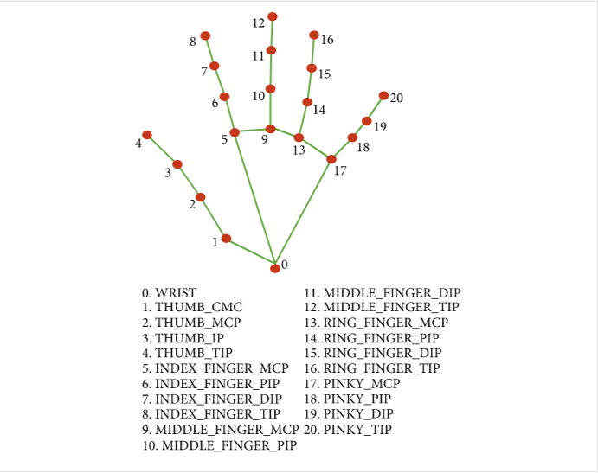
Single-shot detector
Detecting and recognizing a hand
or palm in real time.
Hand landmark consists of locating 21 joint or knuckle co-ordinates in the hand region

Slide 8
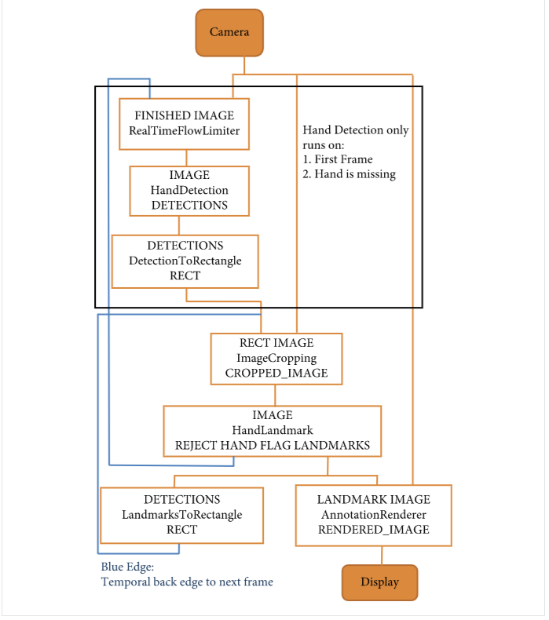

Slide 9
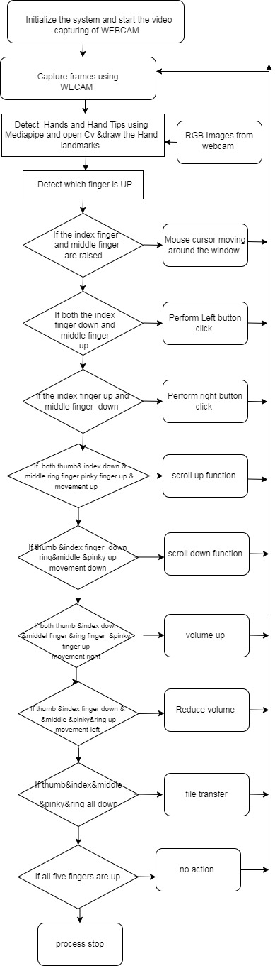
System Flowchart

Slide 10
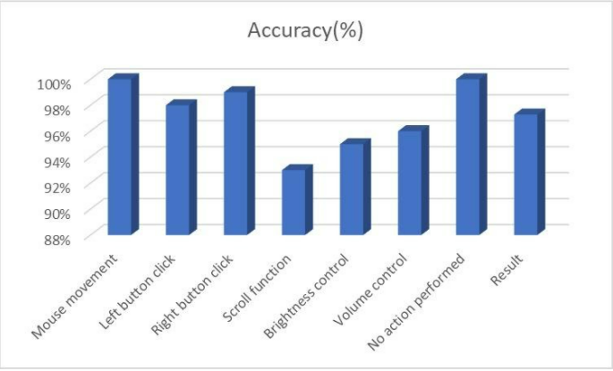
:result

Slide 11
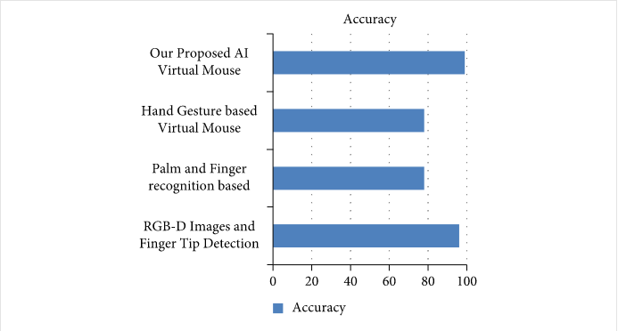
Comparison with existing models

Slide 12
Conclusion
-Smart Movement: Because the existing recognition process is limited to a 25cm radius
-Better Accuracy & Performance: The response time is significantly reliant on the machine's hardware,

Slide 13
Application:
-AI virtual mouse can be used to play virtual reality- and augmented reality-based games without the wireless or wired mouse devices
-The field of robotics, the proposed system like HCI can be used for controlling robots

Slide 14
The End
Any question ?
Ask China ☺

