Slide 1
Improving Service Quality at Al-Zaytona Company
Prepared by :
Aisha Batta
Ro’a Qadous
Rawand Abu Ghannam
Supervisor :
Dr. Mohammad Othman

Slide 2
Agenda
1
General Introduction
2
Objectives
3
Case study
4
Methodology
5
Results and Analysis
6
Recommendation and Conclusion

Slide 3
Introduction
Al-Zaytona is a telecommunication company which provides Internet services in the West Bank.
Like other companies Al-Zaytona endeavors to improve the quality of its services, increase of customer satisfaction, and increase their numbers, thus enhancing the company’s image and reputation, which requires us to make a whole analysis for the company; which in terms could help to achieve the goals of the company

Slide 4
Objectives
1
Find rooms for improvement through the use of quality, marketing, and other improvement and management tools
.
Increase market share of the company and enhance its image in front of customers through increasing quality
2
Provide tips for the employees to have good soft skills which in turn involves having a competitive advantage over competitors
3

Slide 5
SOWT Analysis
SWOT analysis is a method used to evaluate (Strengths, Weaknesses, Opportunities, and Threats) not only identifies what your business is doing right and wrong, but can also helps you formulate an action plan to achieve your company’s short and long term goals
Opportunities
Weaknesses
Threats
strengths

Slide 6
SOWT Analysis
strengths
There is no sequence of administrative reform that could delay error
Continued existence of specialized personnel for the maintenance of the field
Widespread because it has many branches in Palestine, ( Nablus , Bethlehem, Ramallah , and Hebron)
there are usual customer lists, these lists contain the name of the client, the date of calling to provide the complaint, and date of fixing the problem
The company provides outstanding trial period for new customers
According to the site, Al- Zaytona company is located in the city center, making it easier to access

Slide 7
Communicating and delivering value to customers and managing relationships with customers in ways that benefit the organization and its stakeholder
Al-Zaytona is considered to be the third largest company in Palestine

Slide 8
Weaknesses
There is no experience of direct marketing which leads to reduce market share
There are some villages where the technical possibility of high speeds is not available
Customer lists do not take into account the quality of service that is provided to each customer, and this may affect their ability to increase profitability

Slide 9
Threats
A critical threat for the company comes from Al-Zaytona competitors; (e.g. Hadra company)
Sometimes poor services
Don’t provide competitive offers in different times of the year.

Slide 10
OPPORTINITIES
Having periodic maintenance on all tools for all users.
Making sure that speed meets customer requirements.
Holding awareness campaign on how to use the Internet
Increasing the market share
Developing a new service that could be competitive with other companies

Slide 11
Methodology
What we are trying to do is to search in these three areas and try to find rooms for improvements
Quality
Soft Skills
Marketing

Slide 12
Methodology
1
Quality
2
Soft skills
Seven Management tools
Seven improvement tools
Effective soft skills
Hypothesis testing
2
3
Marketing
Market metrics

Slide 13

Quality
First : Quality Control
Apply control charts; to monitor discrete data that were given by Al-Zaytona (data from 1/9/2012 to 1/11/2013) in the first semester. And (data from 1/11/2013 to 1/4/2014) in the second semester. We are taking into consideration the number and the fraction of the complaints.
.

Slide 14
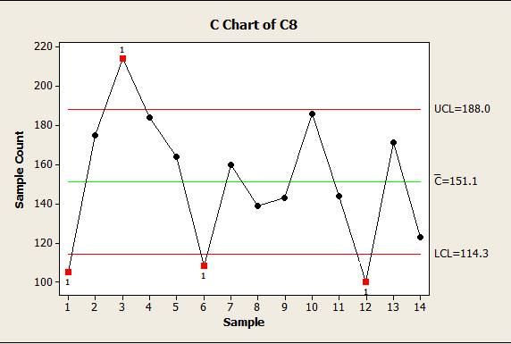
Quality
First : Quality Control
The quality chart shows that the process is out of control and there is high variability in the process.

Slide 15
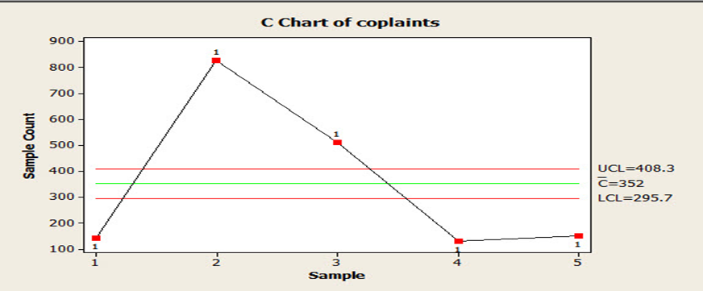
Quality
First : Quality Control
This sample was taken ( from 11/2013 to 3/2014 )
The chart indicates out of control points specially in 12th month because the weather was too cold and snowy

Slide 16
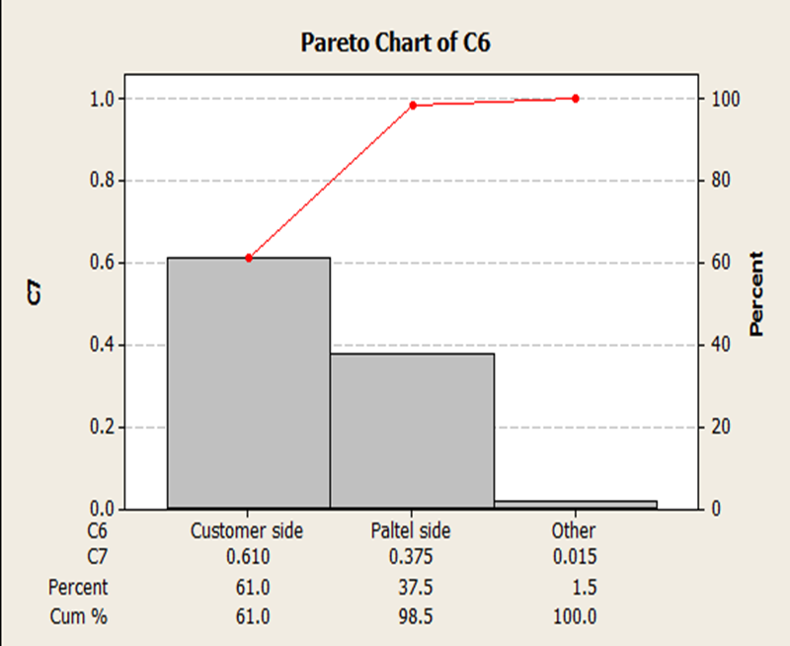
Quality
Second: improvement tools
Pareto charts are often used in quality control to display the most common reasons for failures, and customer complaints.
So we use Pareto chart to know the percentages of the complaints sources. 61% of the
the complaints comes from customer side.

Slide 17
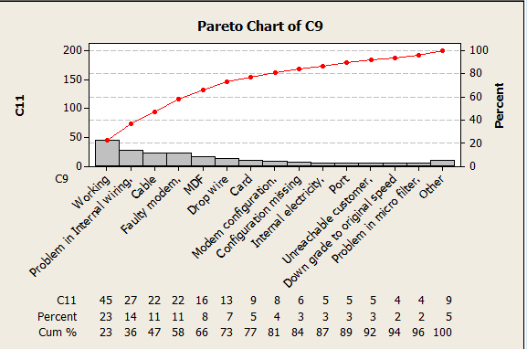
Quality
Second: improvement tools

Slide 18
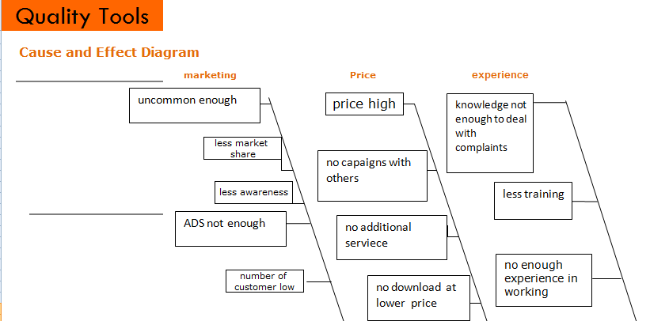
Quality
Second: improvement tools

Slide 19
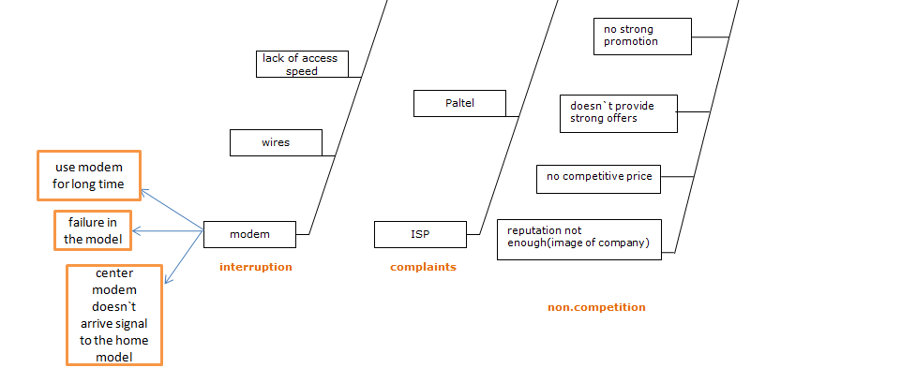

Slide 20
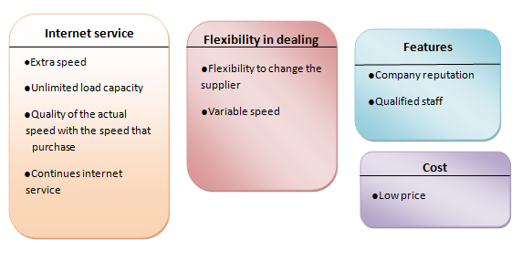
Quality
Third : Seven Management tools
First : Affinity Diagram :

Slide 21
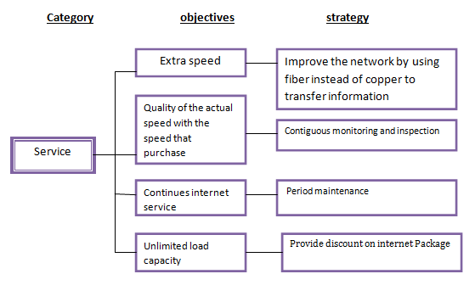
Quality
Third : Seven Management tools
Second :Tree Diagram:

Slide 22
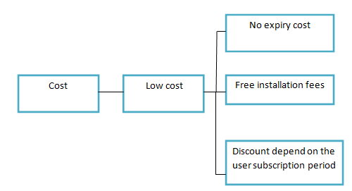
Quality
Third : Seven Management tools

Slide 23
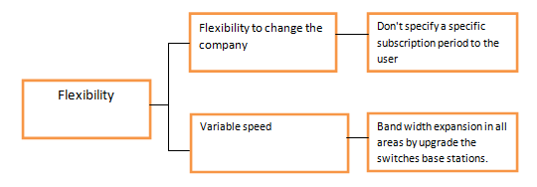
Quality
Third : Seven Management tools

Slide 24
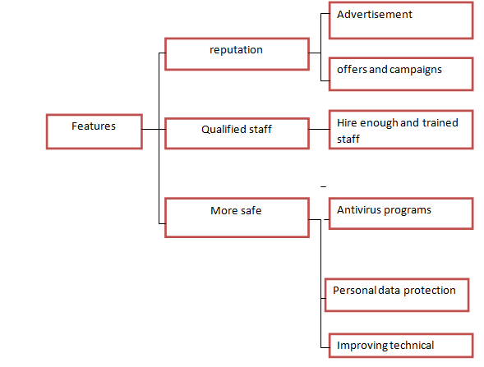
Quality
Third : Seven Management tools

Slide 25
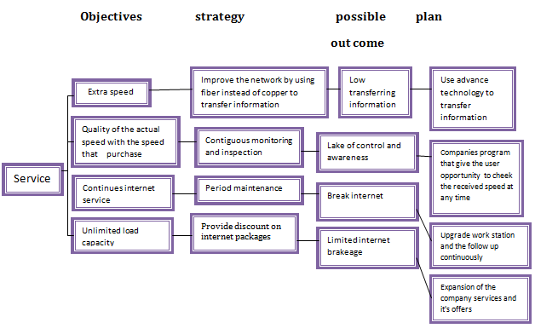
Quality
Third : Seven Management tools
Third :Process Decision Program Chart:

Slide 26
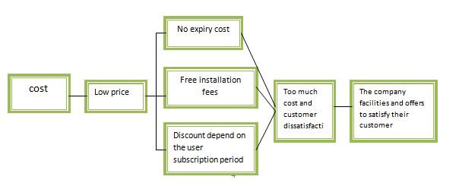
Quality
Third : Seven Management tools

Slide 27
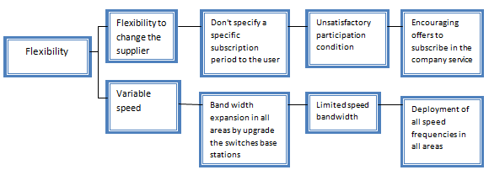
Quality
Third : Seven Management tools

Slide 28
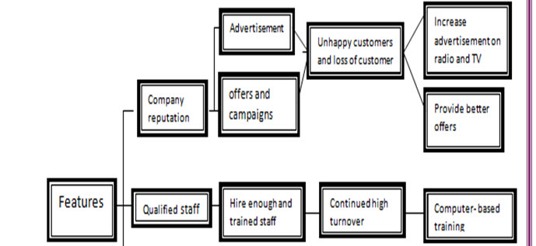
Quality
Third : Seven Management tools

Slide 29
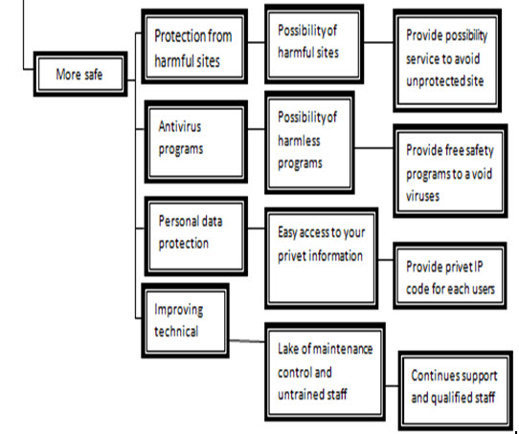

Slide 30
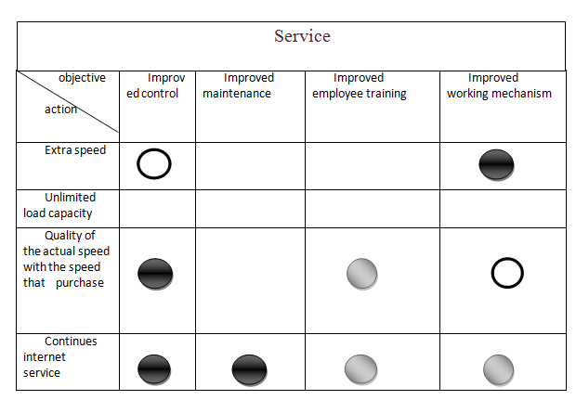
Quality
Third : Seven Management tools
Fourth : Matrix Diagram:

Slide 31
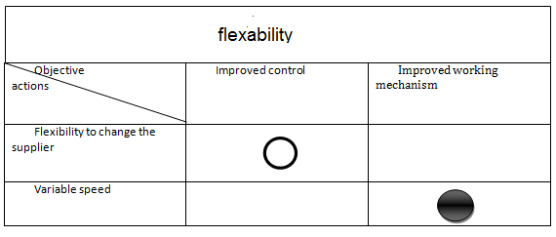
Quality
Third : Seven Management tools

Slide 32
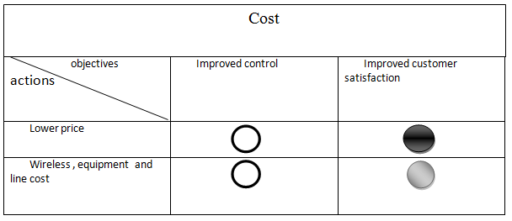
Quality
Third : Seven Management tools

Slide 33
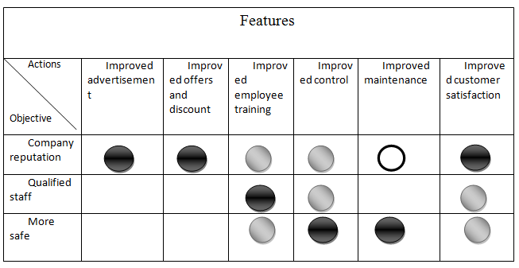
Quality
Third : Seven Management tools

Slide 34
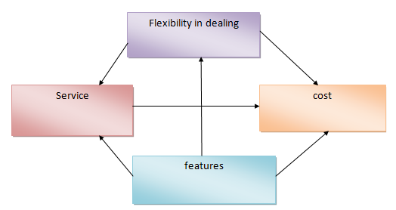
Quality
Third : Seven Management tools
Fifth :Interrelationship Diagram:

Slide 35
Quality
Third : Seven Management tools
Sixth :Prioritization Matrix:
categoy | Weigt | Zaytona score | Zaytondwtd. score | Hadara score | Hadarawtd. score | Mada score | Madawtd.score | Diff1 | Diff2
Sevice | 0.35 | 6 | 2.1 | 8 | 2.8 | 6 | 2.1 | -0.7 | 0
Cost | 0.25 | 7 | 1.75 | 8 | 2 | 7 | 1.75 | -0.25 | 0
Adjustable | 0.20 | 7 | 1.4 | 8 | 1.6 | 7 | 1.4 | -0.2 | 0
feature | 0.20 | 5 | 1 | 7 | 1.4 | 6 | 1.2 | -0.4 | -0.2
Total | 1 |  | 6.25 |  | 7.8 |  | 6.45

Slide 36
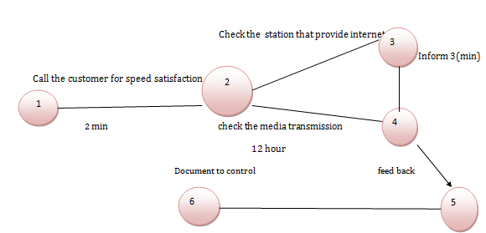
Quality
Third : Seven Management tools
Seventh :Activity Network Diagram:

Slide 37
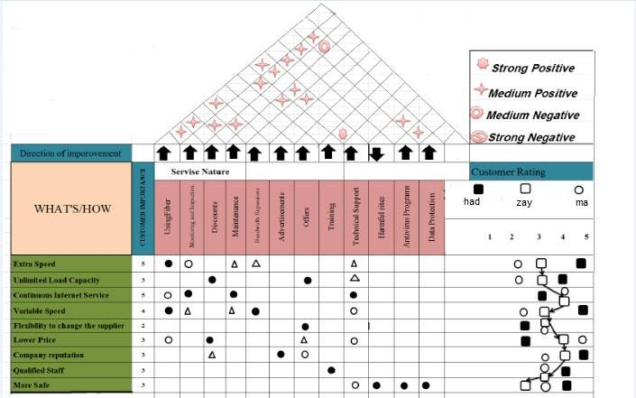
Quality function deployment

Slide 38
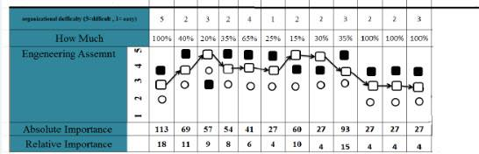

Slide 39

Soft Skills
Fist : effectiveness of soft skills
important dimensions to achieve success on the work.
help the organization use its technical expertise to full advantage.
soft skills are connected to the personality and the way an employee could deal with client
Lack of soft skills of workers affect negatively the work performance and the customer satisfaction.
Notes:
And it’s quite important to recognize the vital role of the existing of soft skills to the worker

Slide 40

10 major tips provided to yield a happy client:
Quick thinking
Observe and take note
Make an apology
Be composed
Be positive
Think of your business
Communicate regularly
Own the problem
Discover the reasons
Serious complaints

Slide 41

Second :Soft skills Survey
In order to make sure that the soft skills of the employees are at the right standards, we made a survey, asking these following questions
The extent of welcoming the client
Welcoming the customer with a smile
The extent of listening from employees and understanding what a client has demanded
The extent of understanding what a customer need from the first time
The extent of giving the customer true and accurate information
The extent of taking emotional side into consideration when the client is being needed
Ability to apologize when a mistake happens
Following the client order until it is finished
Ensuring that the problem has been resolved
Ability to give alternative solution if the original one didn’t work

Slide 47
Hypothesis Testing
Based on analysis of the hypotheses, the good-to-excellent soft skills influence customer satisfaction.

Slide 48
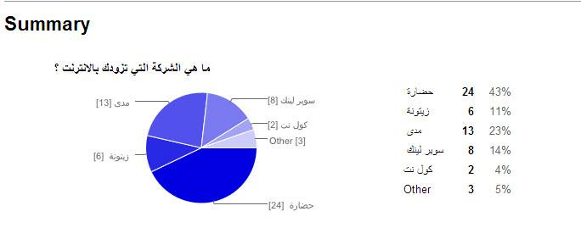
Market Survey
we’ve made a survey about Al-Zaytona company and their competitors, asking people about Al-Zaytona competitors

Slide 49
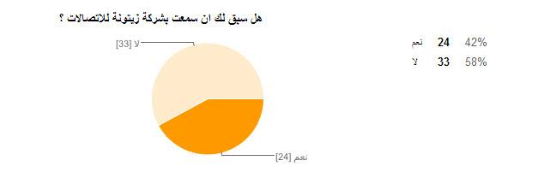
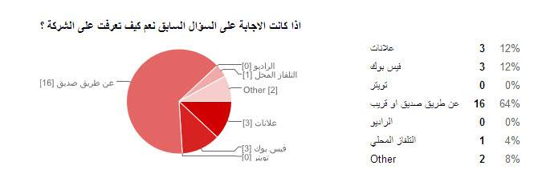

Slide 50

Marketing
Marketing metrics are the set of measures that helps to quantify, compare, and interpret their marketing performance
So the main question is why these campaigns and advertisings don’t reach people! This question will be answered after measuring the marketing productivity

Slide 51
Market Survey results
Trying to solve the awareness which is the vital market metric that affects Al-Zaytona improvement.
We have four levels of awareness
Negative recognition
Non recognition
recognition
loyalty

Slide 52
Type of advertising:
Informative advertising : gives general information to the sector that the company wishes to attract.
Persuasive advertising : happens when the client need to choose among the competitors and Al-Zaytona company.
Reminder advertising : targets the current subscribers who have loyalty towards the company.

Slide 53

Conclusions
All companies strive to get the nearest level to perfection!
Improving service quality is one of the most important goals for service companies

Slide 54
Focus on what do the customer needs, by designing quality that satisfies the customer’s needs; this is achieved by conducting the seven management tools and quality function deployment (QFD).
Also when talking about quality it is important for the internet service to provide high speed and less or almost zero interruptions. This is done by conducting the quality control charts

Slide 55
Soft skills are not less important than technical skills, so we interviewed the company’s employees on how to have and get a good soft skills when dealing with customers
We addressed the marketing strategy in the company, and set basic measures to the effectiveness or productivity of a successful marketing, by taking into account the awareness toward the company.

Slide 56

Recommendations
Al-Zaytona should adopt instructions provided about soft skills of employees
the company should devote more efforts to marketing
Applying control charts to monitor the process.
We also recommend to make use of Benchmarking concept

