Slide 1

Automated Plastic Recycling for 3D-Printing
FACULTY OF ENGINEERING
DEPARTMENT OF MECHANICAL & MECHATRONICS ENGINEERING
Supervisor:
Dr.Bashir Nouri
Group Members:
Karem Rashed (12011598)
Badee Al-salameen (11925004)
Ahmad Al-Abed (12010958)

Slide 2
TABLE OF CONTENTS
01
04
02
05
03
Introduction
MANUFACTURING AND ASSMEBLY
REVIEW OF AUTOMATED PLASTIC RECYCLING FOR 3D-PRINTING
TESTING & IMPLEMNTATION
MECHINICAL DESIGN OF PLASTIC SHREDDER & CALCULATIONS
06
CONCLUSIONS AND FUTURE WORK

Slide 3
01
Introduction
General Background.
Project Motivation.
Project Scope and Description.
Significance of the Project.

Slide 4
02
REVIEW OF AUTOMATED PLASTIC RECYCLING FOR 3D-PRINTING
Plastic Used in 3D Printing:
Thermoplastics, which can be melted and reshaped multiple times and are suitable for recycling.
Thermosetting plastics, which cannot be remelted after curing.
Common FDM Materials:
ABS, which is strong and suitable for recycling.
PLA, which is easy to print but loses some of its properties after recycling.
PET and HDPE, which are widely used but require precise thermal control during melting.

Slide 5
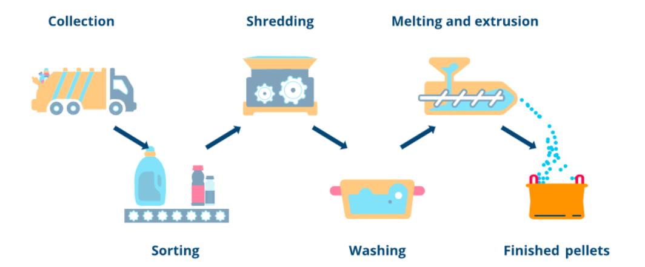
Plastic Recycling Process for 3D Printing Filament:
Collection and sorting.
Washing and drying.
Shredding.
Melting and extrusion.
Cooling and spooling.
Challenges in Recycled Filament Production:
Inconsistent filament diameter.
Degradation of mechanical properties after recycling.
Moisture and temperature sensitivity during melting.

Slide 6
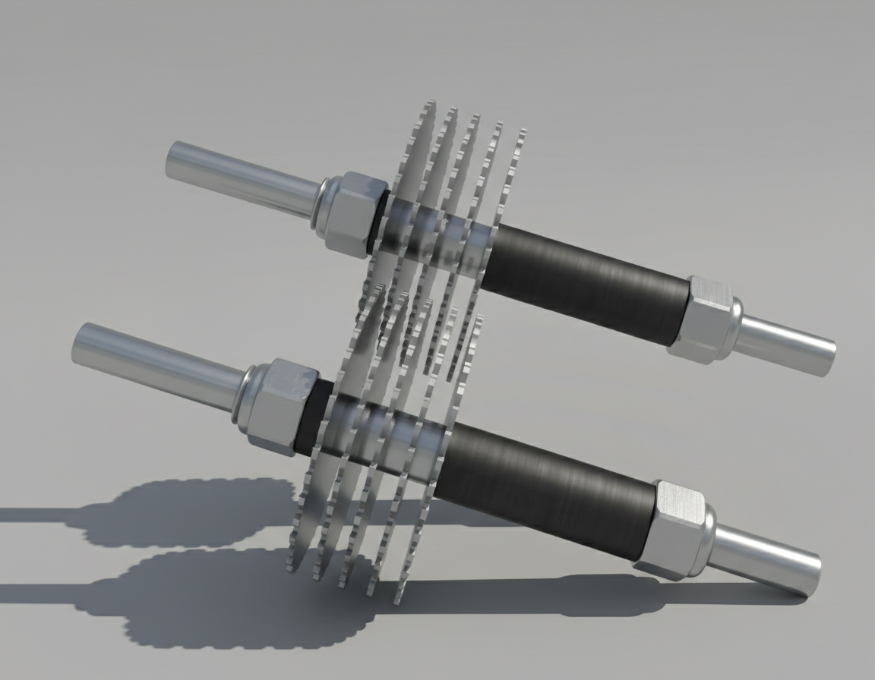
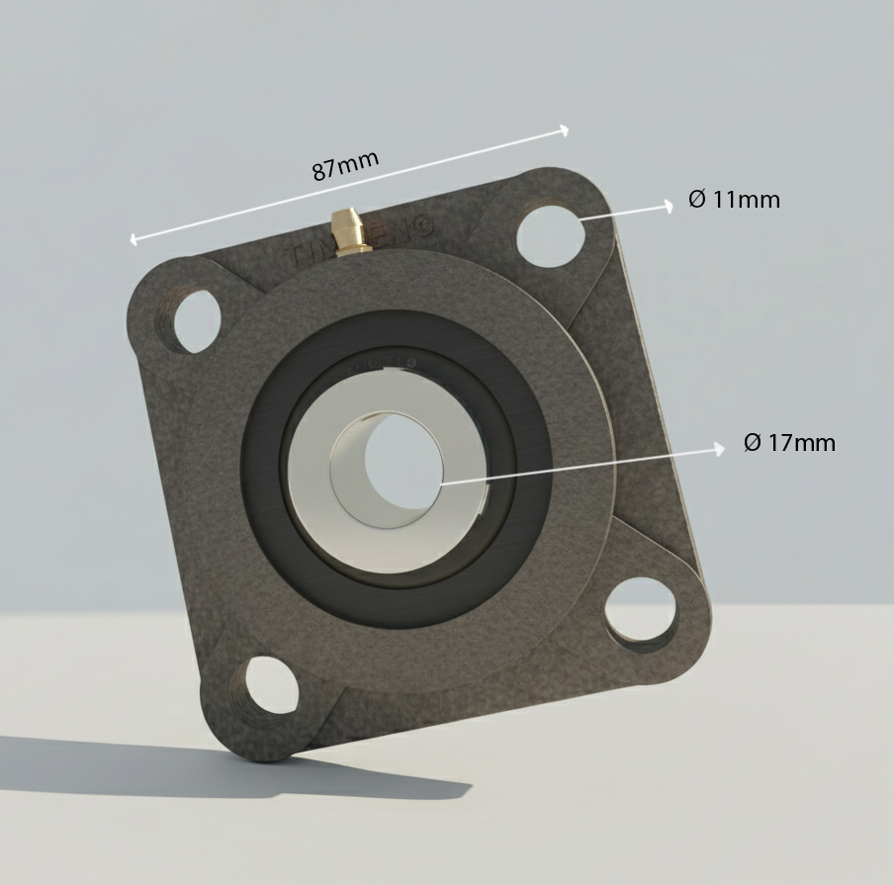
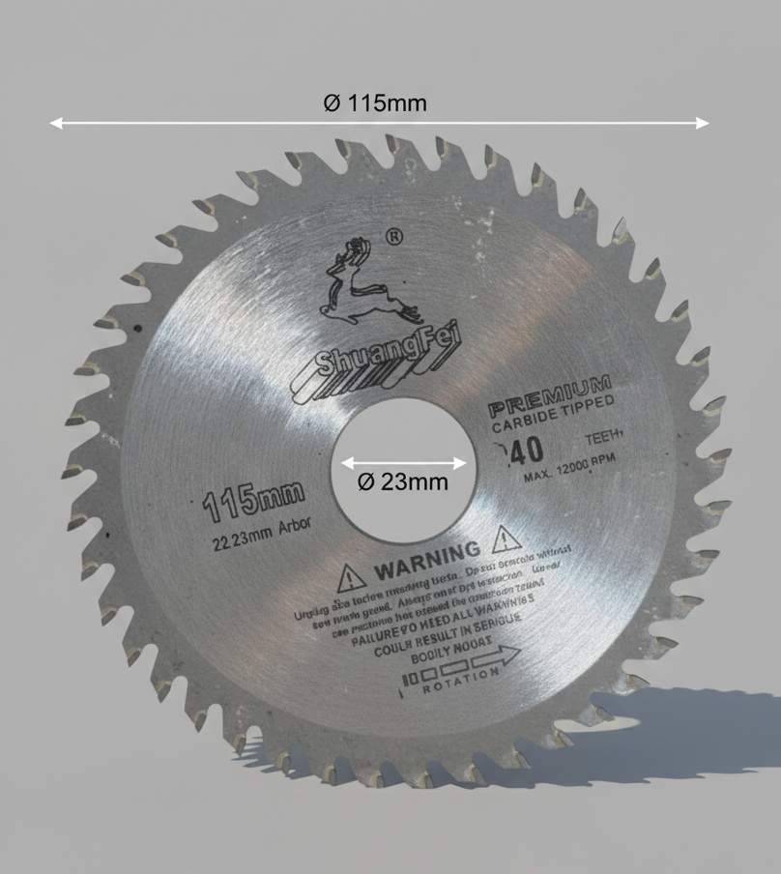
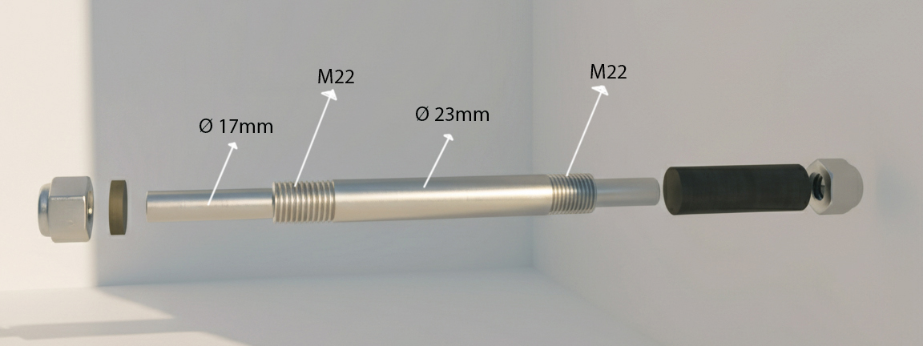
03
MECHINICAL DESIGN OF PLASTIC SHREDDER & CALCULATIONS
Mechanical Design Concept and Working
Principle:
The plastic shredder is designed as a dual-shaft, low-power machine.
Two parallel shafts rotate in opposite directions, pulling plastic material between them and shredding it through tearing and shredding action.
Main Mechanical Components and Power Transmission:
The cutting system consists of circular steel blades mounted on two solid steel shafts. The shafts are supported by standard pillow block bearings to ensure smooth and stable rotation.
Two parallel shafts
Bearing unit
Cutting blade
Shaft design

Slide 7
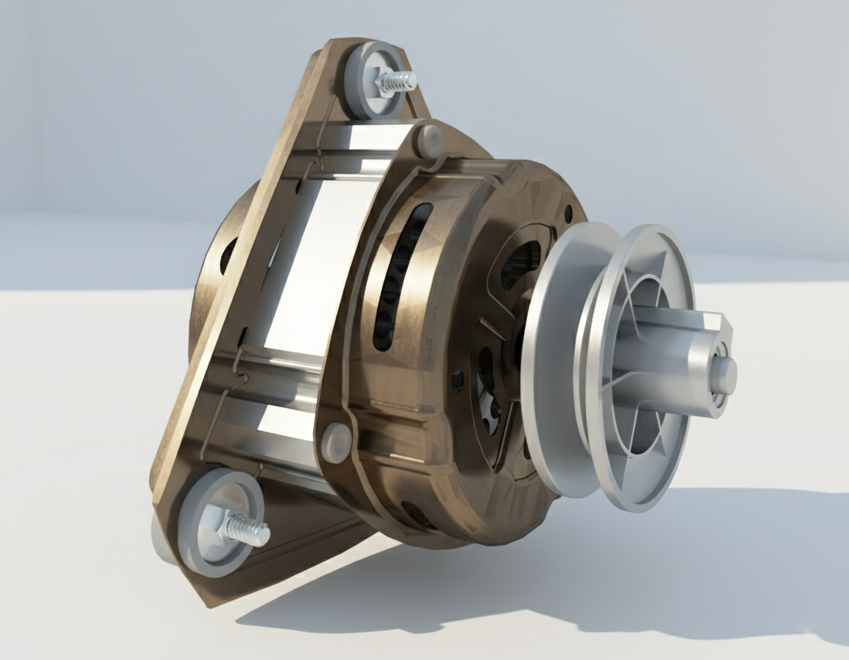
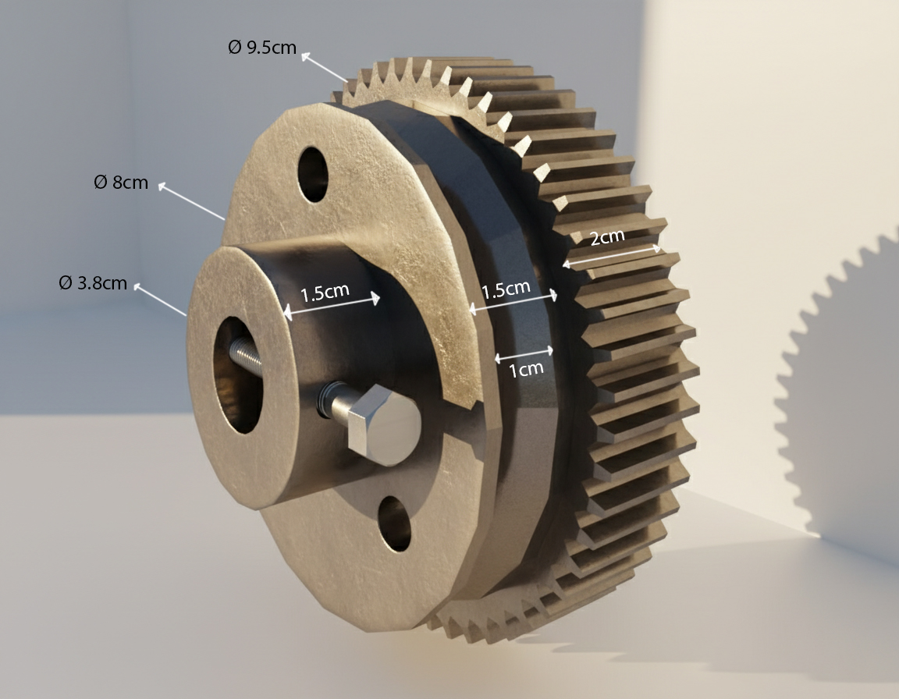
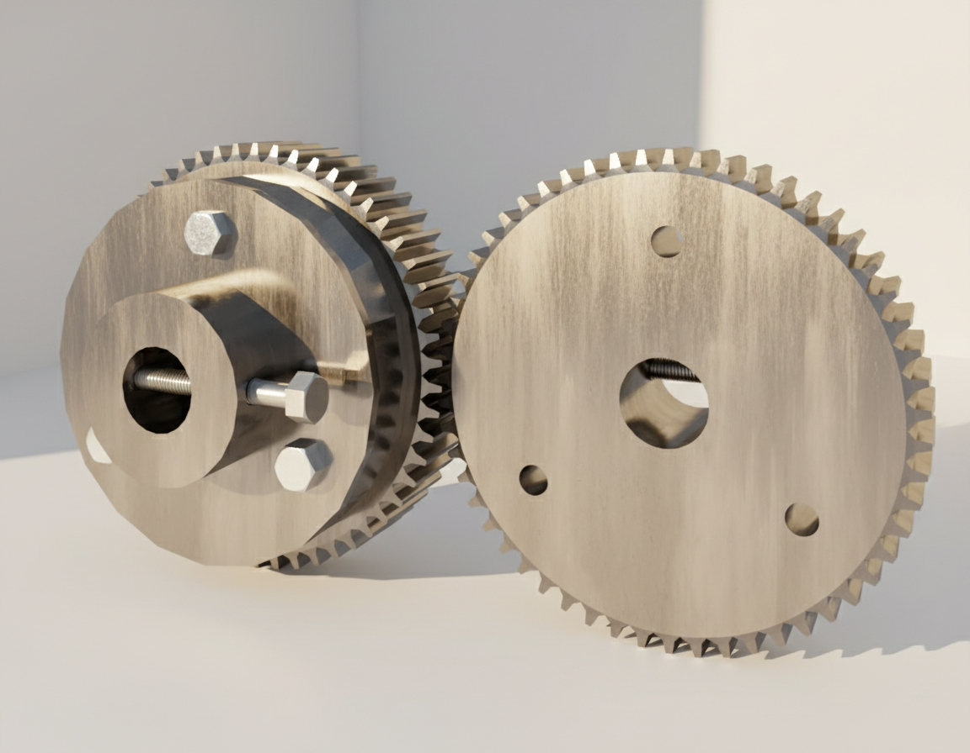
Washing machine motor
Power is provided by a 120 W single-phase electric motor, and motion is transmitted using a belt drive system to absorb shocks.
A pair of spur gears with a 1:1 gear ratio is used to synchronize the shafts and ensure opposite rotation.
Mechanical Calculations:
Mechanical calculations were performed based on the actual measured dimensions of the constructed machine.
These calculations include motor torque, transmitted torque, cutting force at the blades, shaft strength verifications, gear forces, and bearing load analysis.
The main purpose of these calculations is to verify the mechanical safety and reliability of the design rather than optimization.
Spur gear M2 X 46
Gear train 1:1 ratio

Slide 8
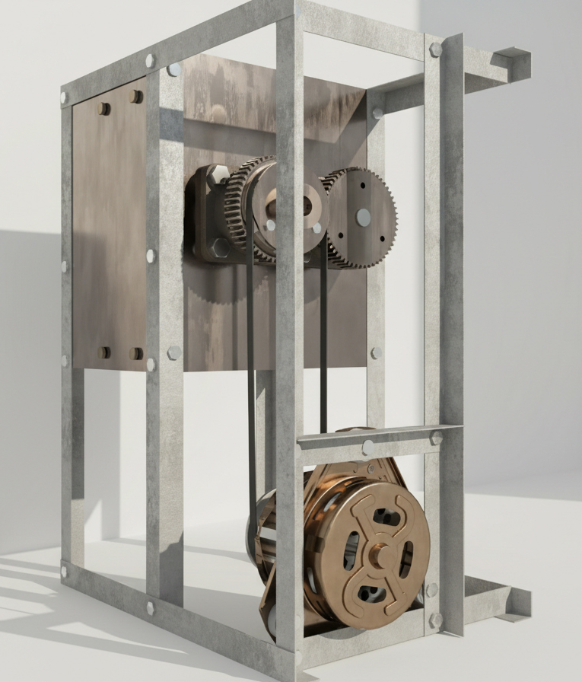
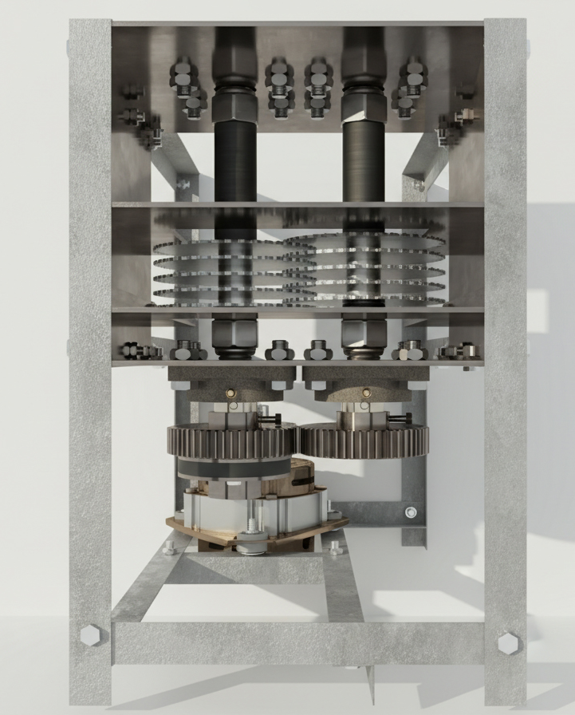
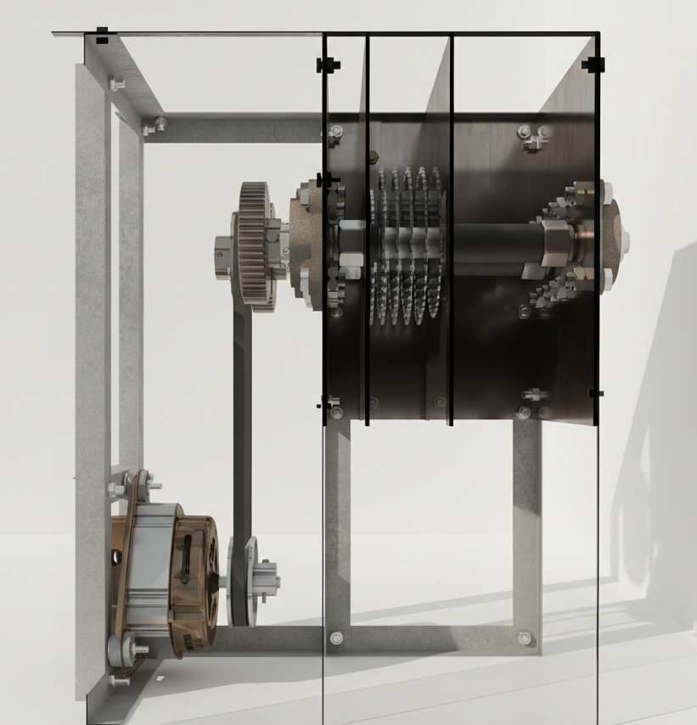
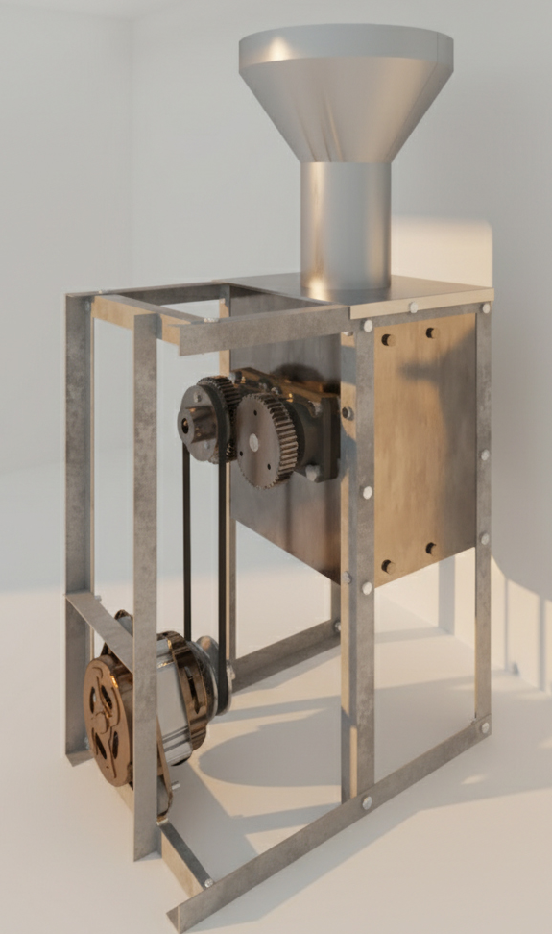
Design Validation and Safety:
The results of the calculations confirm that all components operate within safe mechanical limits.
The selected low-power motor provides sufficient torque to shred thin plastic without overloading the system.
This validates the mechanical design as a safe, reliable, and efficient plastic shredder, suitable for educational and small-scale recycling applications.
Full 3D Model with Hopper
Model Design
Top View of the 3D Model
Side Section

Slide 9
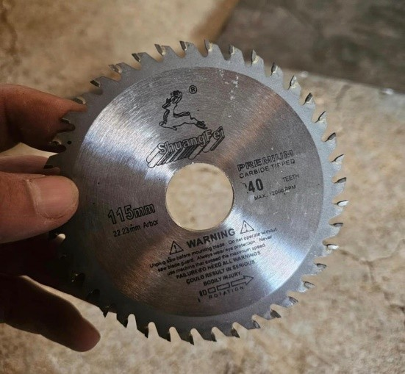
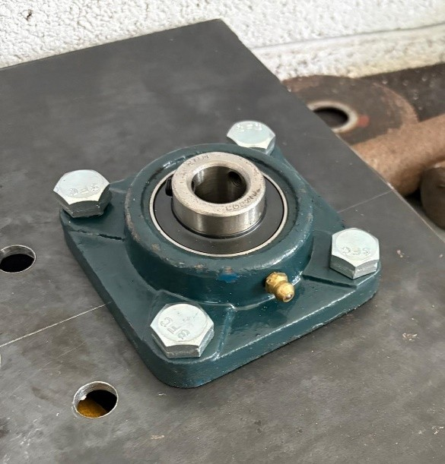
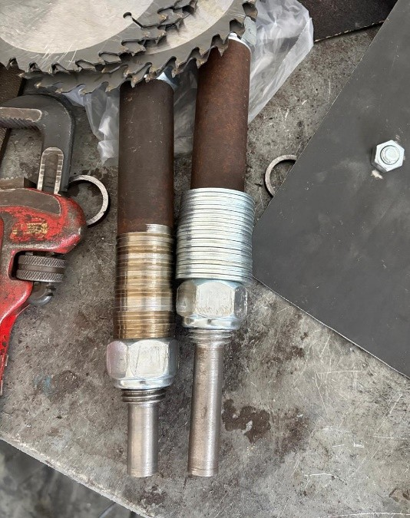
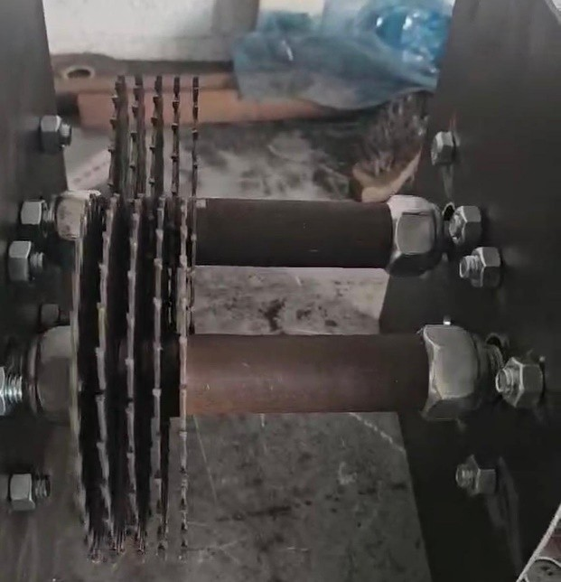
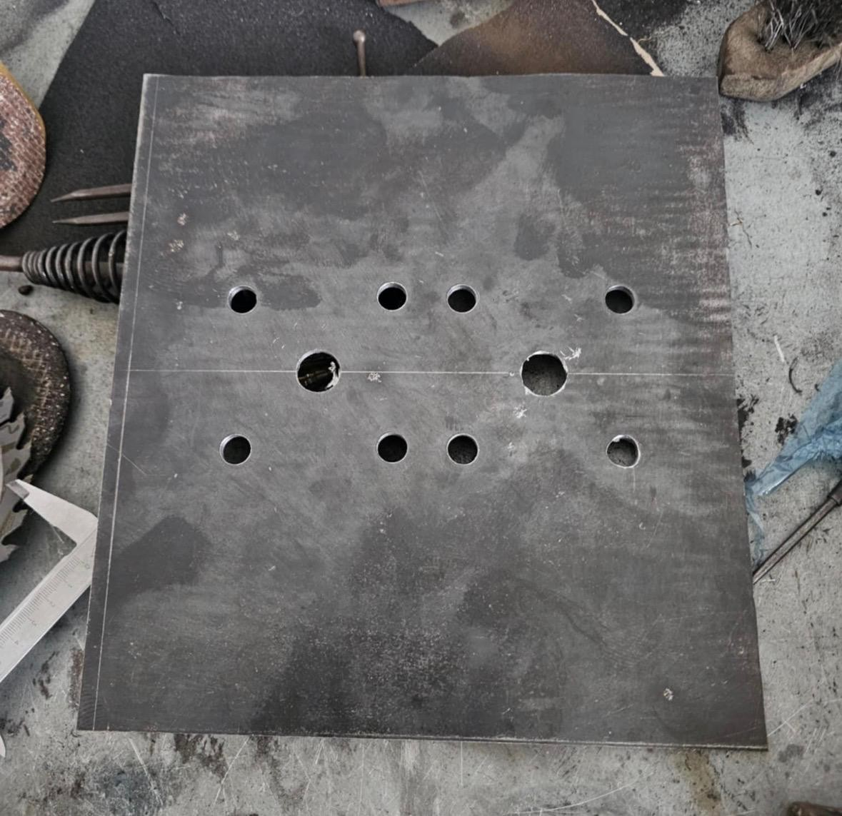
04
MANUFACTURING AND ASSMEBLY
Suitable cutting blades were selected based on their strength and ability to cut thin plastic materials.
After that, the steel shafts were manufactured using lathe machine, with stepped diameters to allow proper blade mounting and bearing installation.
Standard pillow block bearings were mounted on steel side plates to support the shafts and ensure correct alignment.
The cutting blades were then assembled on the shafts with proper spacing to prevent interference during rotation.
Used cutting blade
Bearing unit (RS 750-8775)
The shafts after the manufacturing process
Cutting blades mounted
Side plate

Slide 10
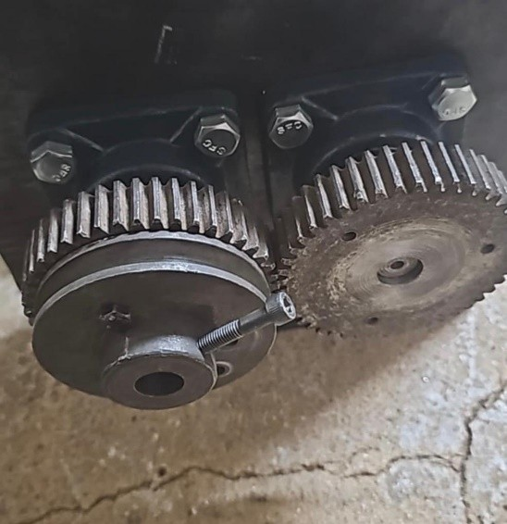
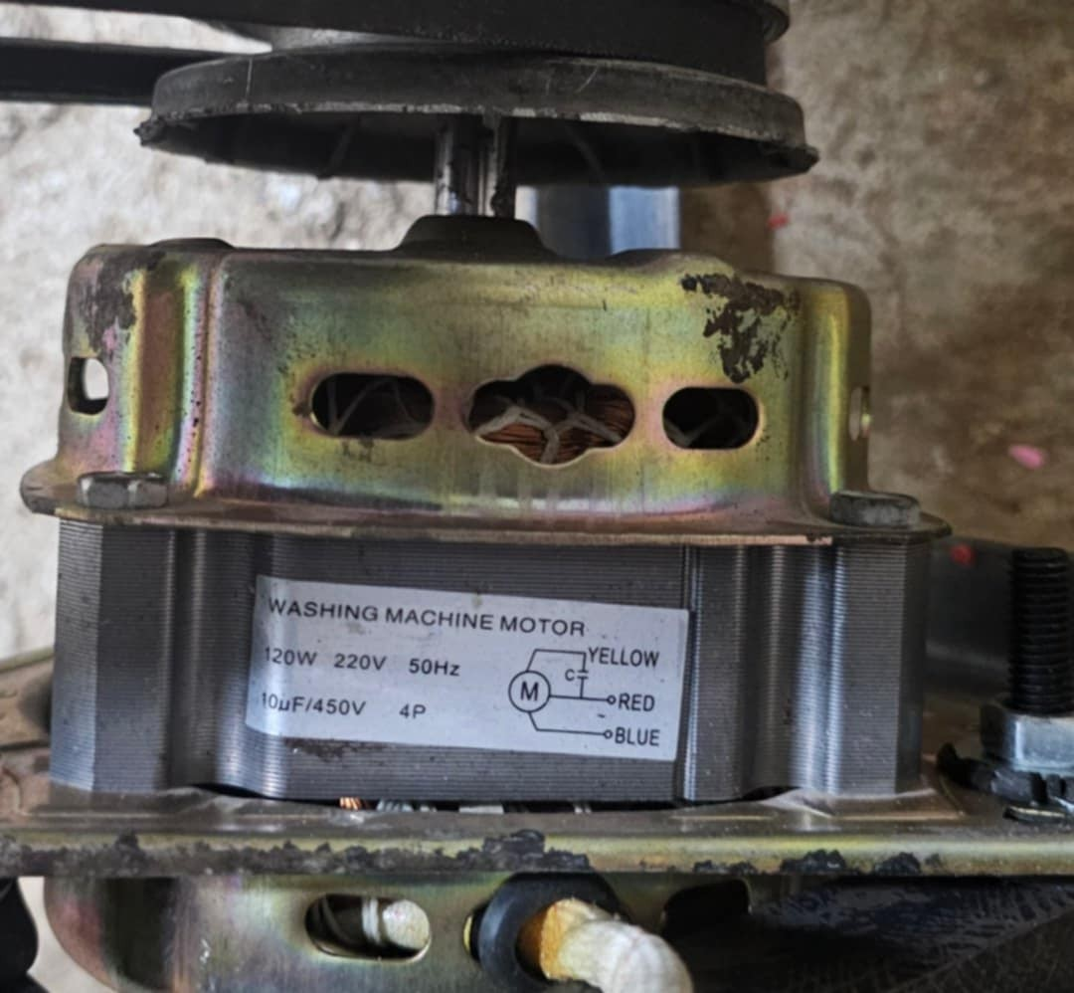
04
MANUFACTURING AND ASSMEBLY
The gears and pulleys were installed to synchronize the shafts and transmit power from the motor.
The electric motor was mounted on the frame, and the full system was assembled and tested under no-load conditions to ensure smooth operation.
Gears and pulley
120w Washing machine motor

Slide 11
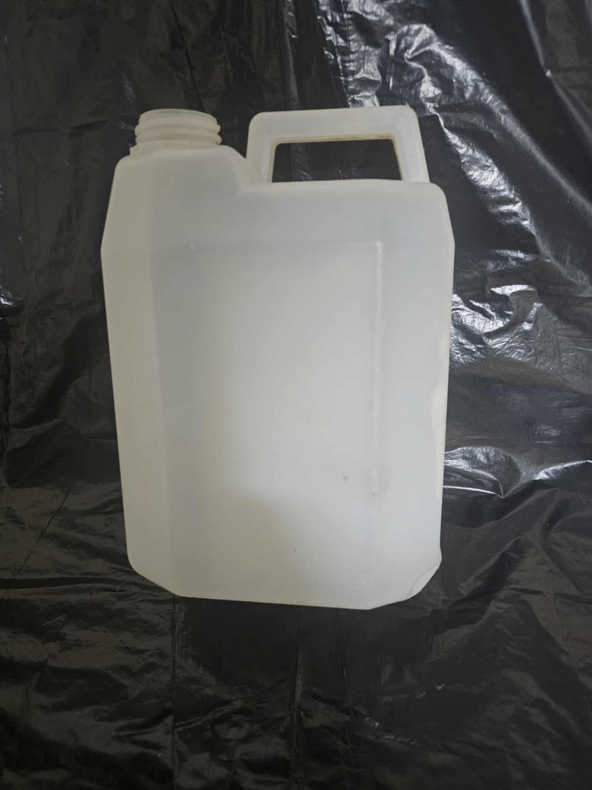
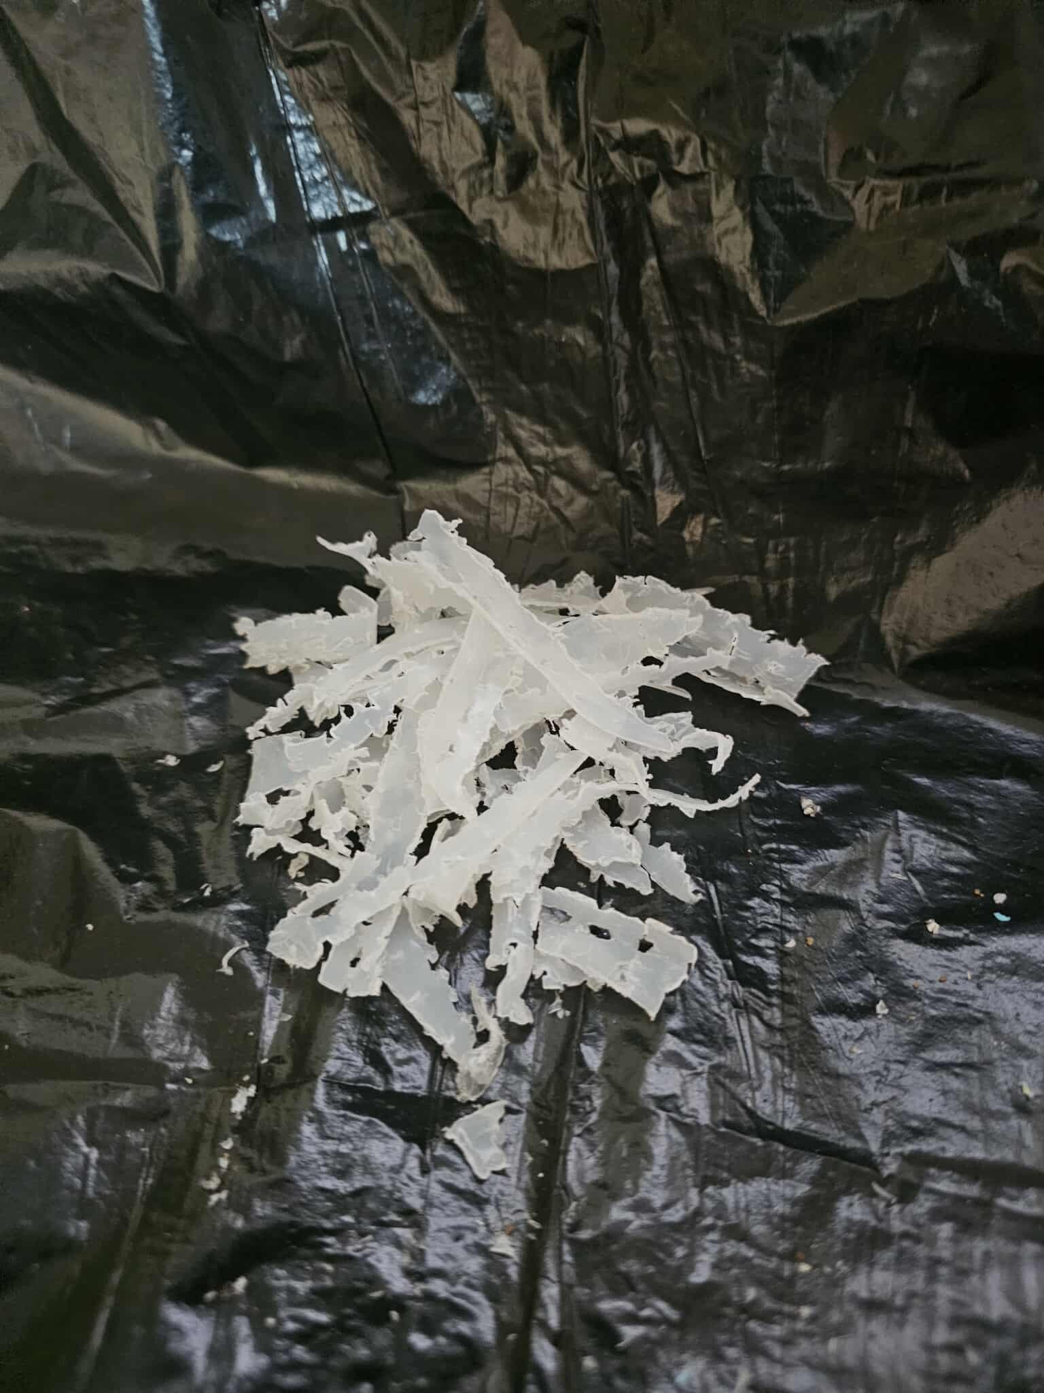
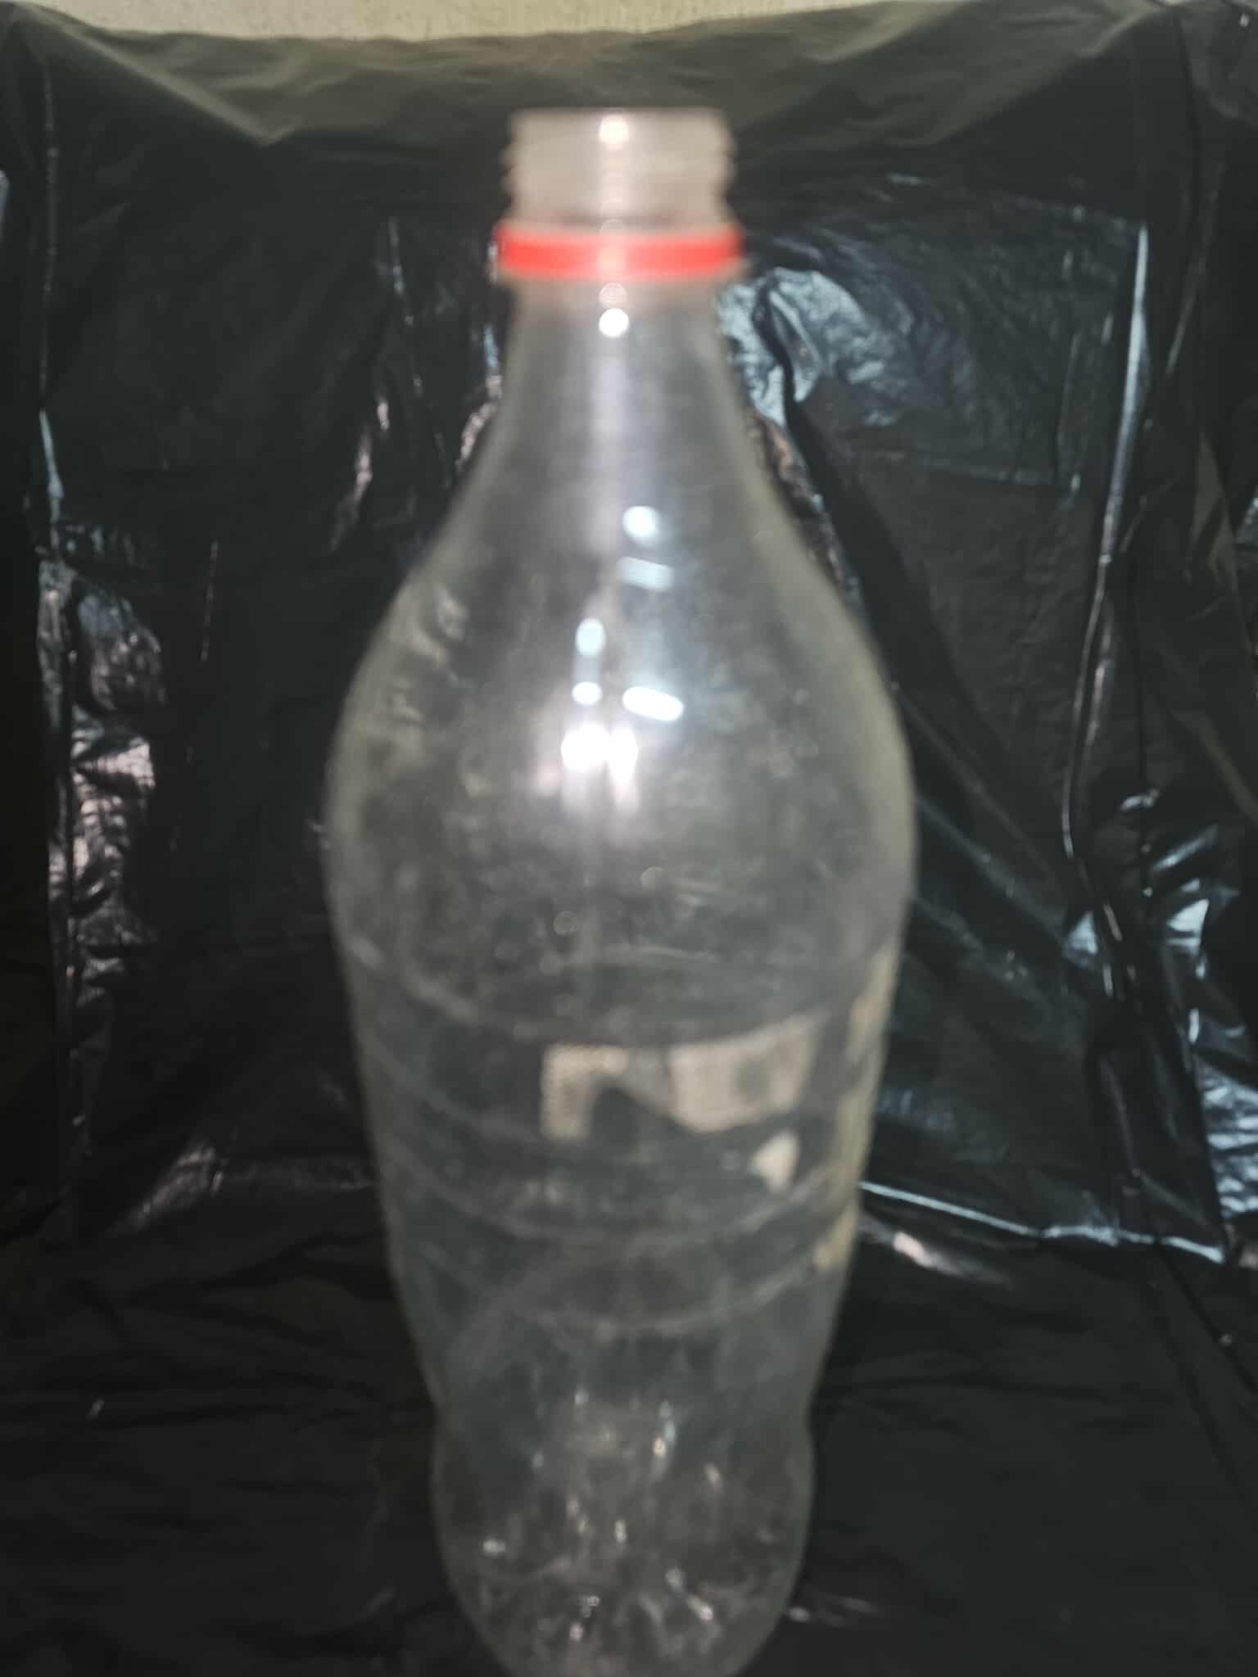
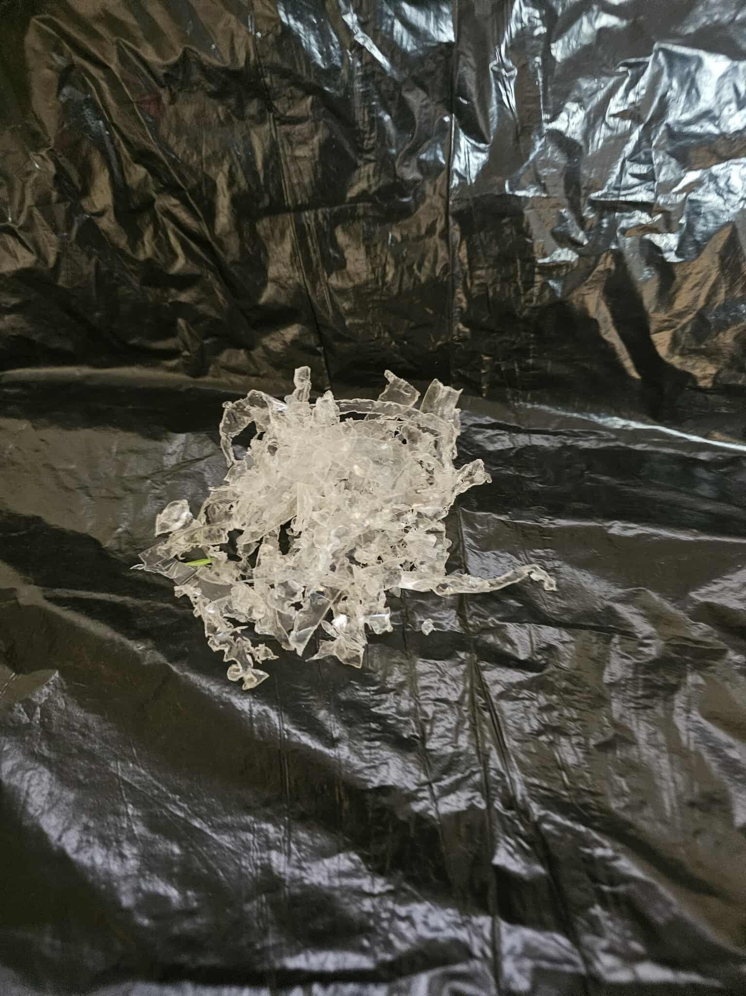
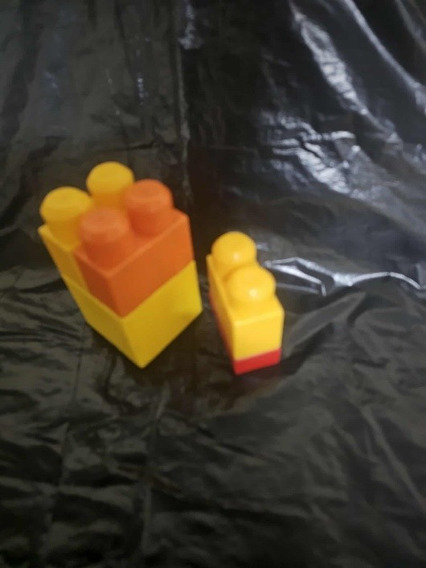
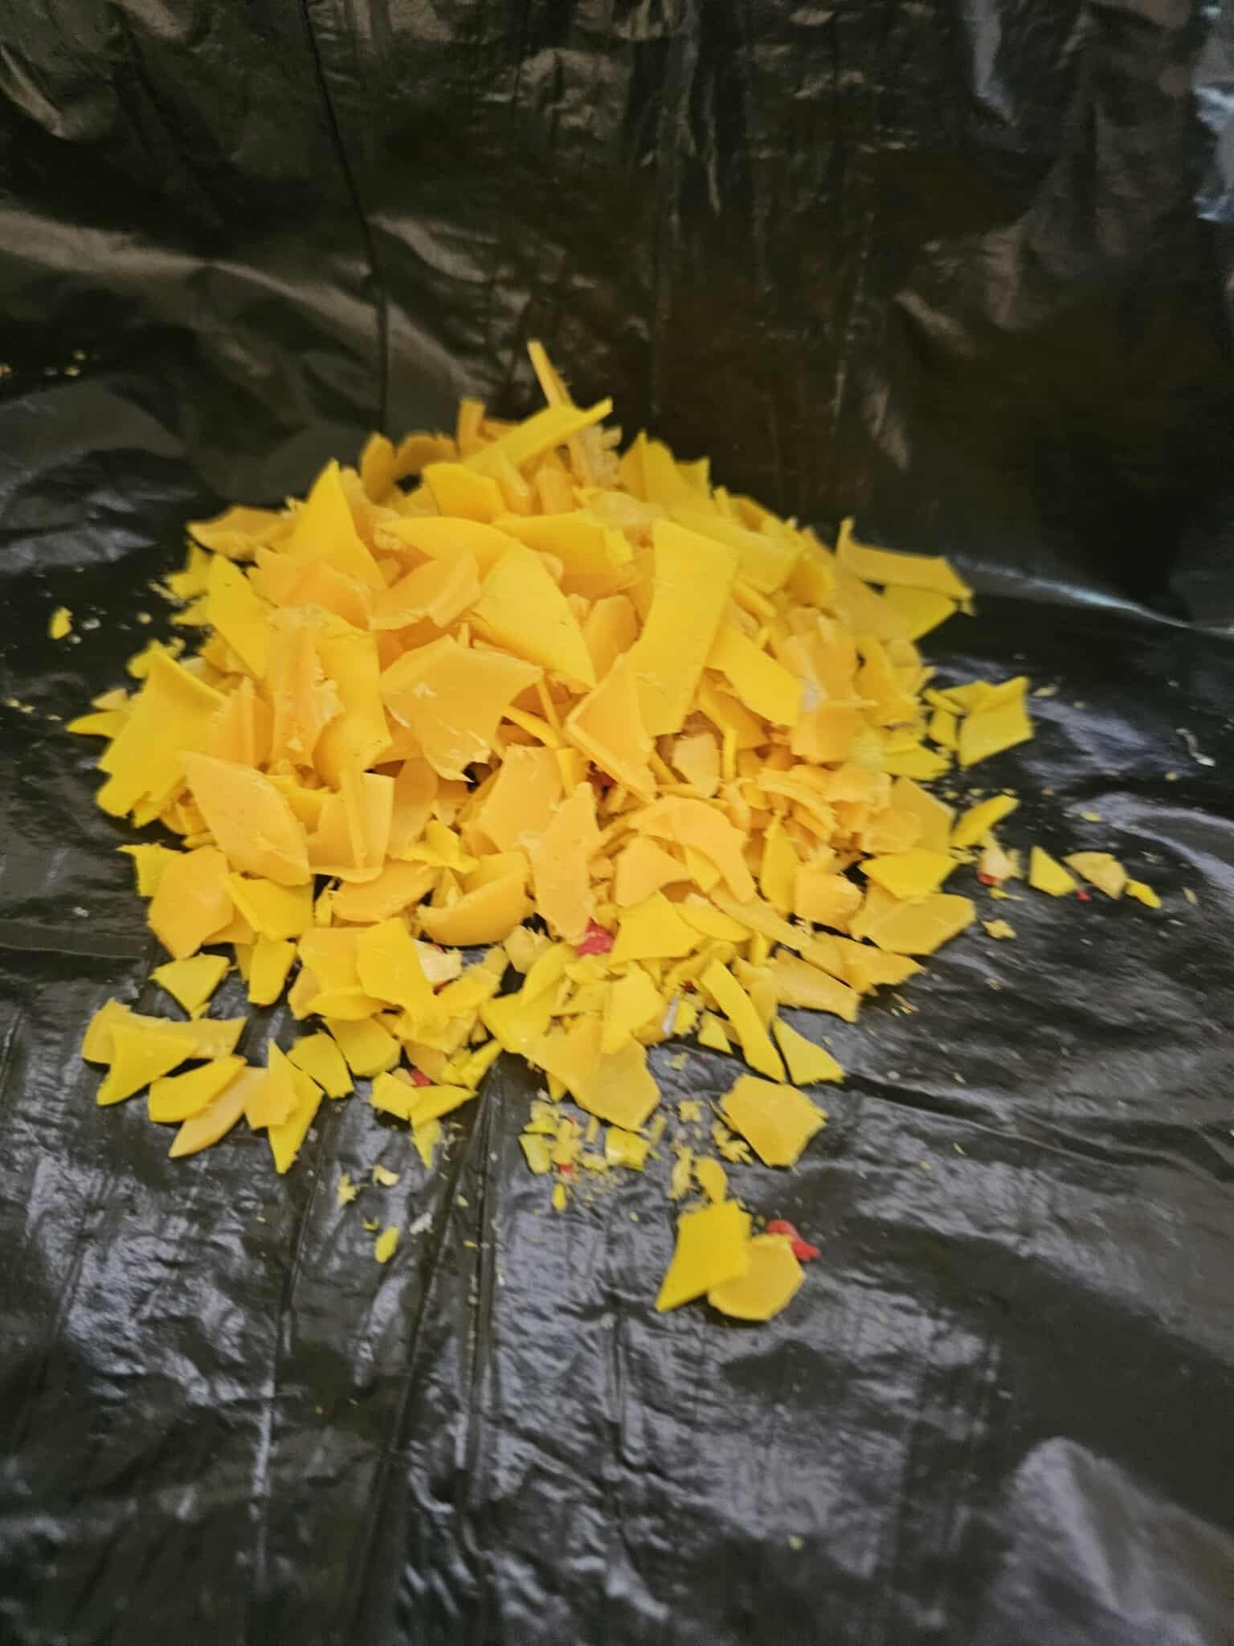
Before shredding
After shredding
05
TESTING & IMPLEMNTATION
The machine was tested using three types of plastic:
HDPE
PET
ABS
The machine successfully shredded all three materials into small and uniform pieces without clogging or mechanical failure.
HDPE plastic
HDPE plastic
PET plastic
PET plastic
ABS plastic
ABS plastic

Slide 12
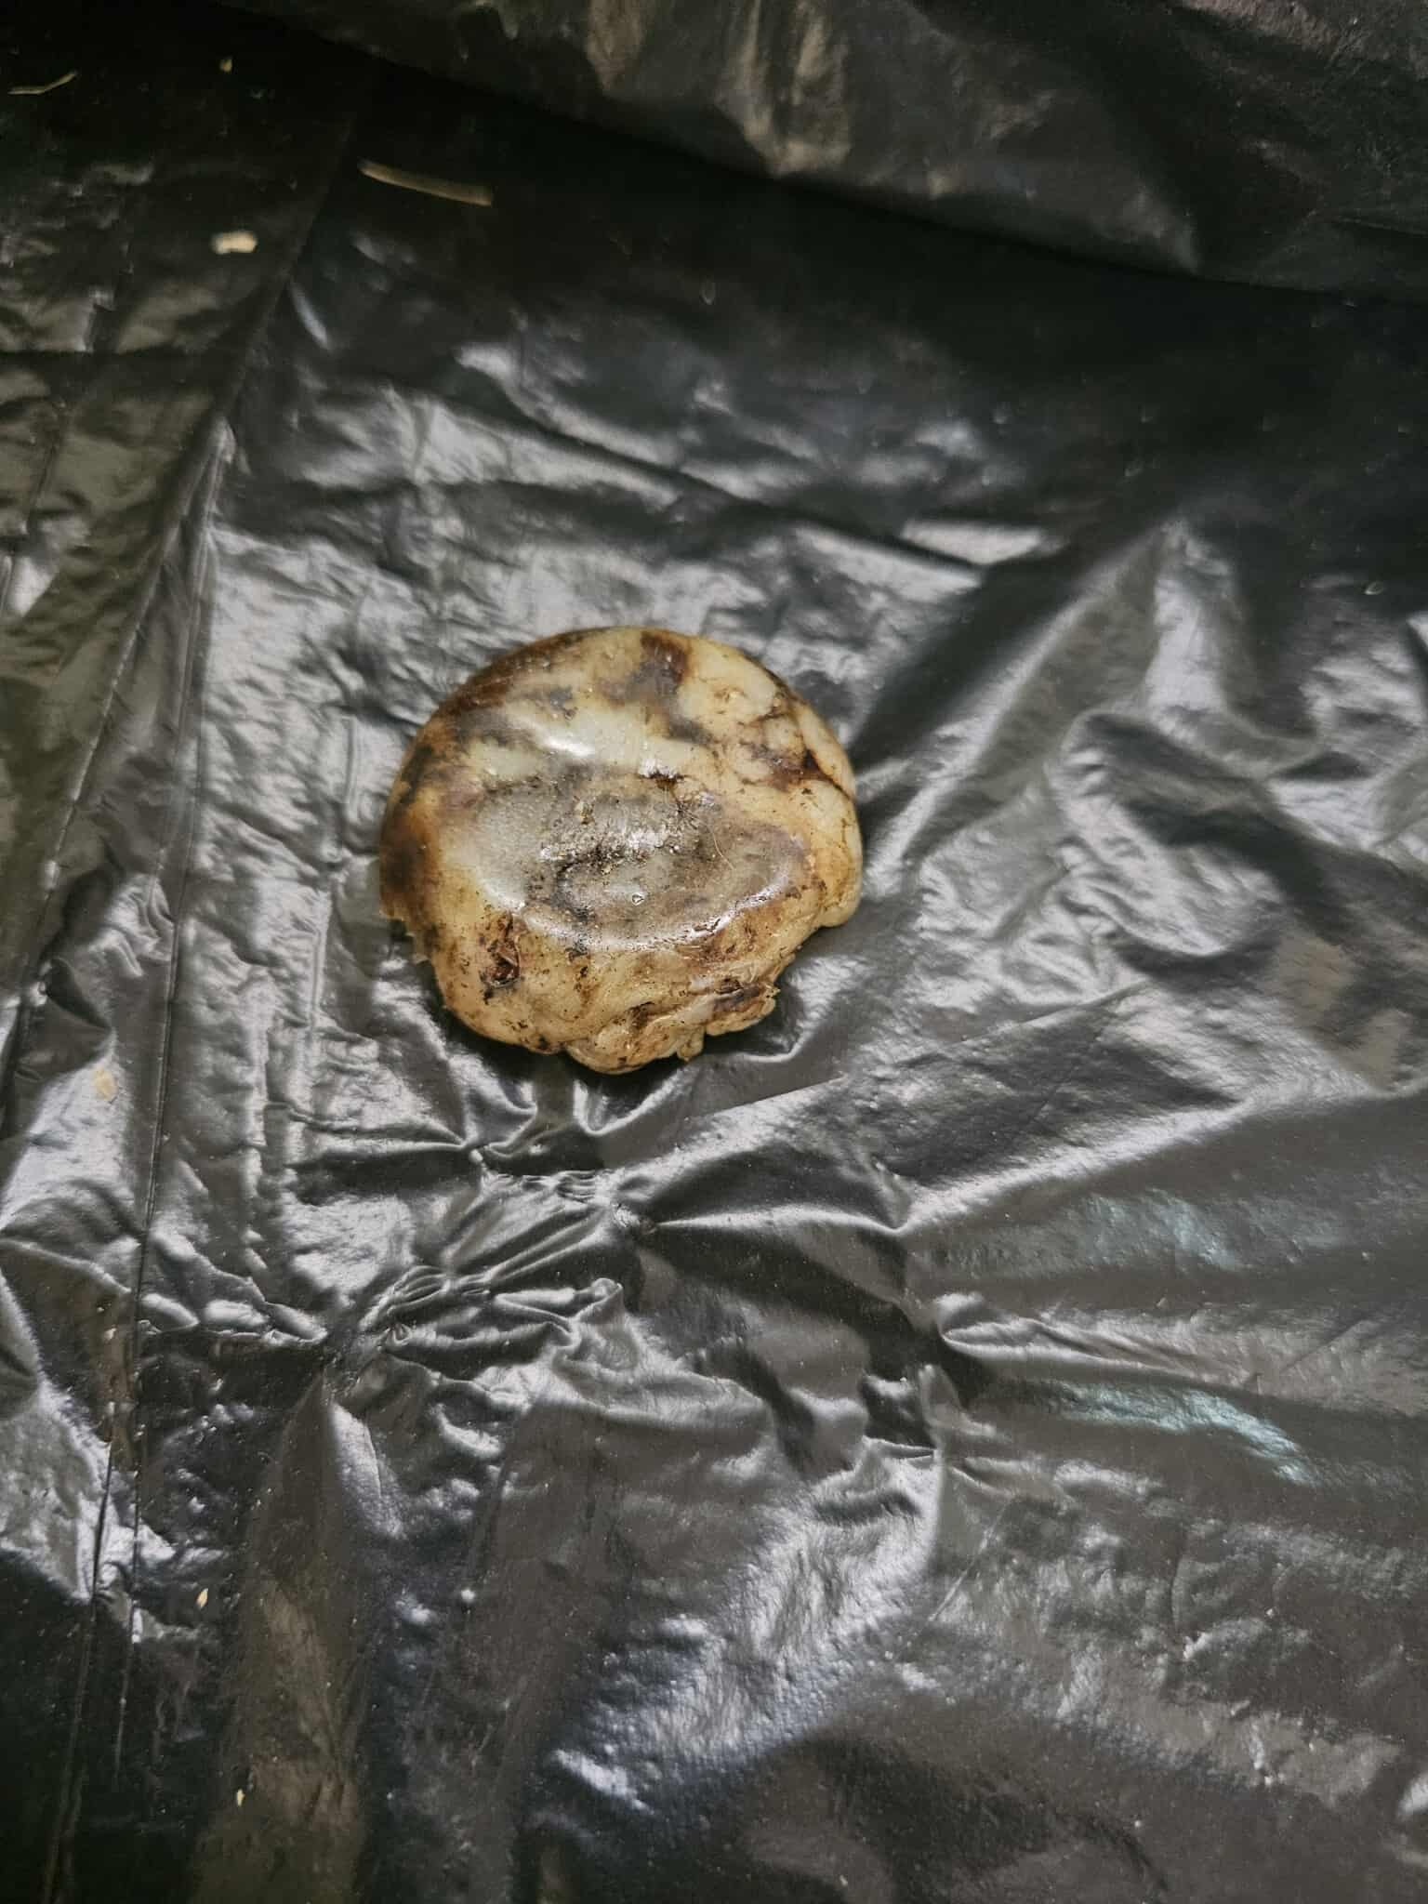
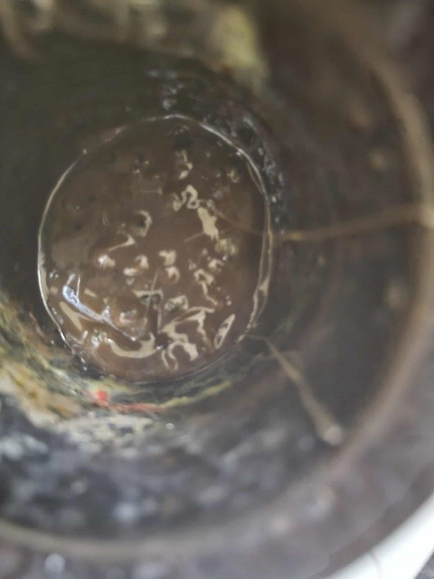
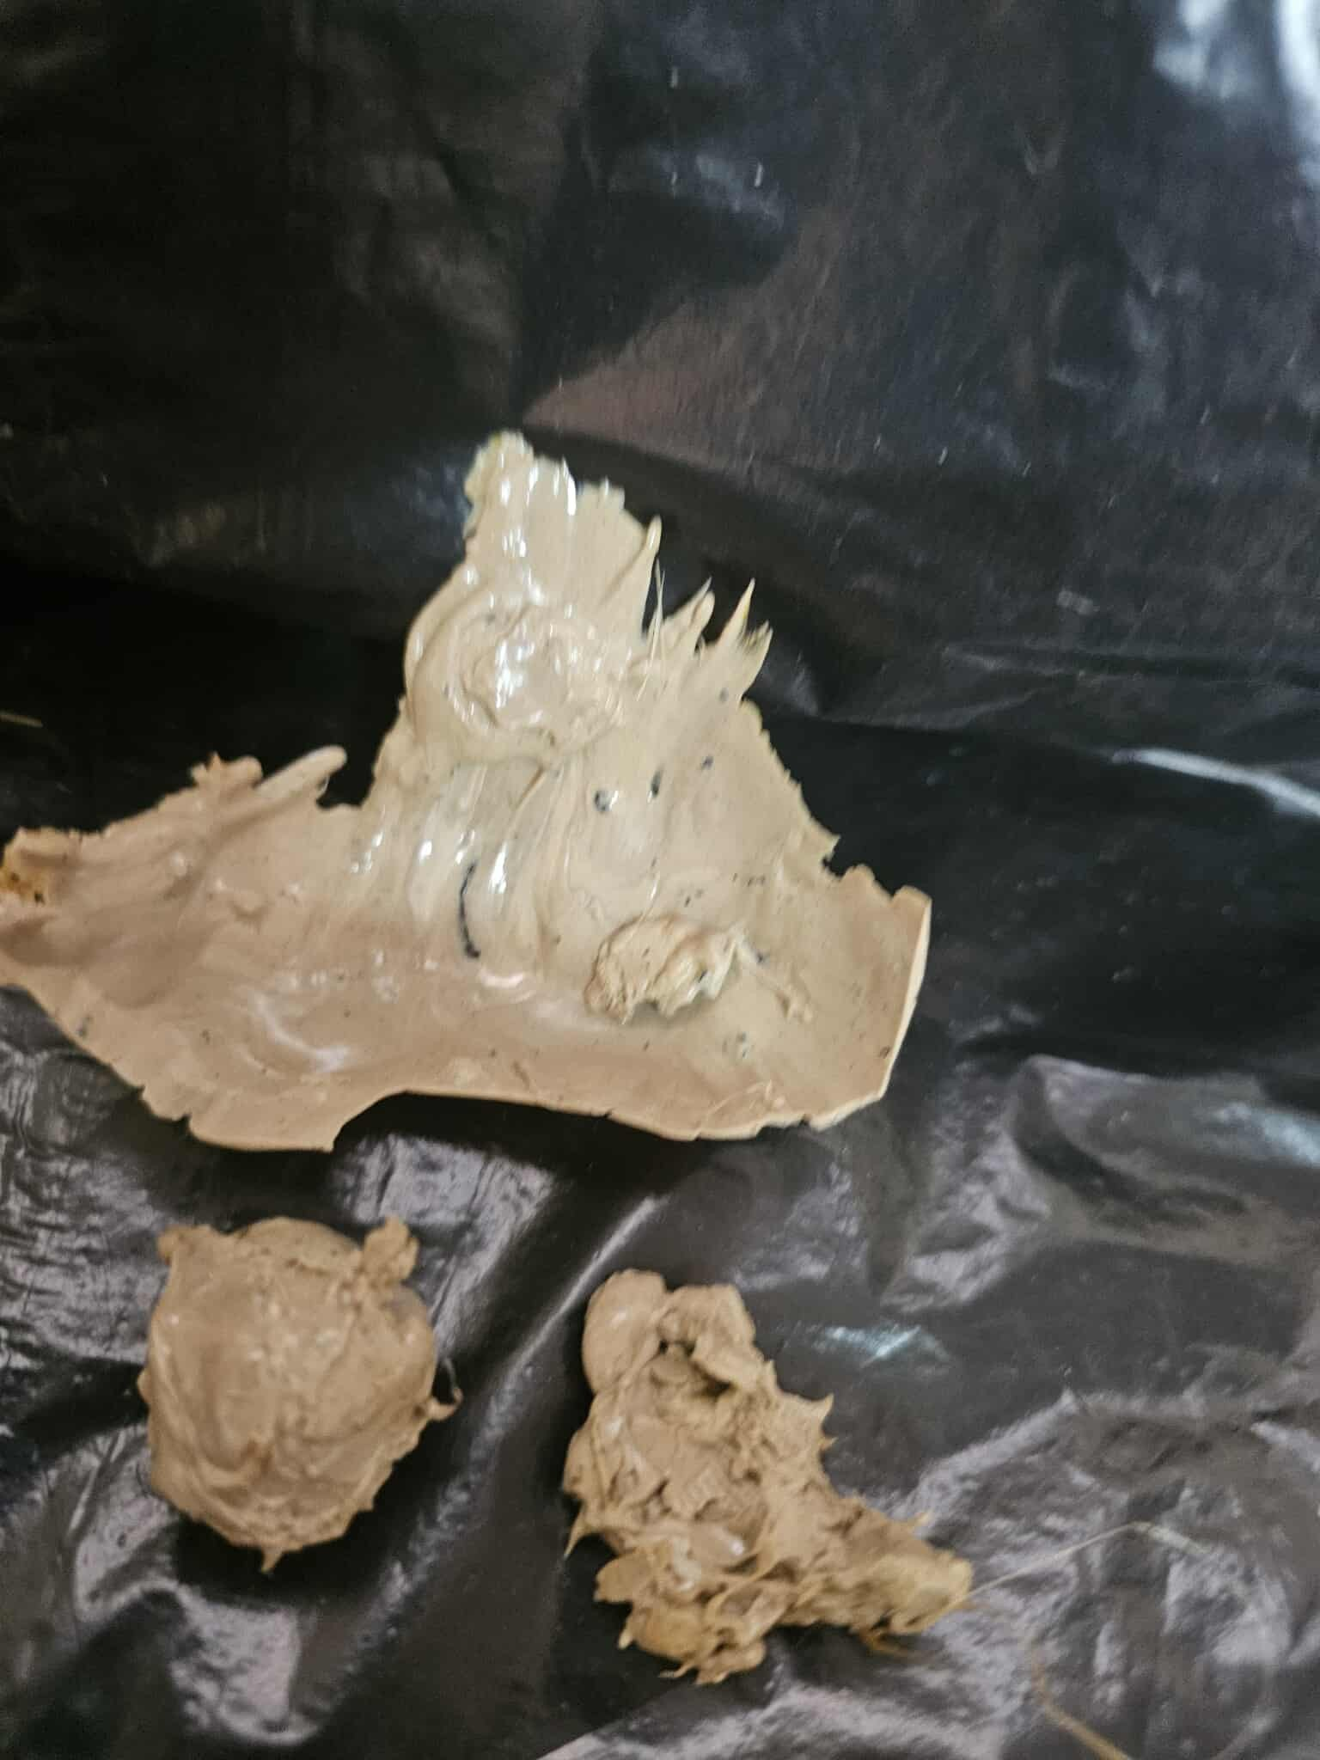
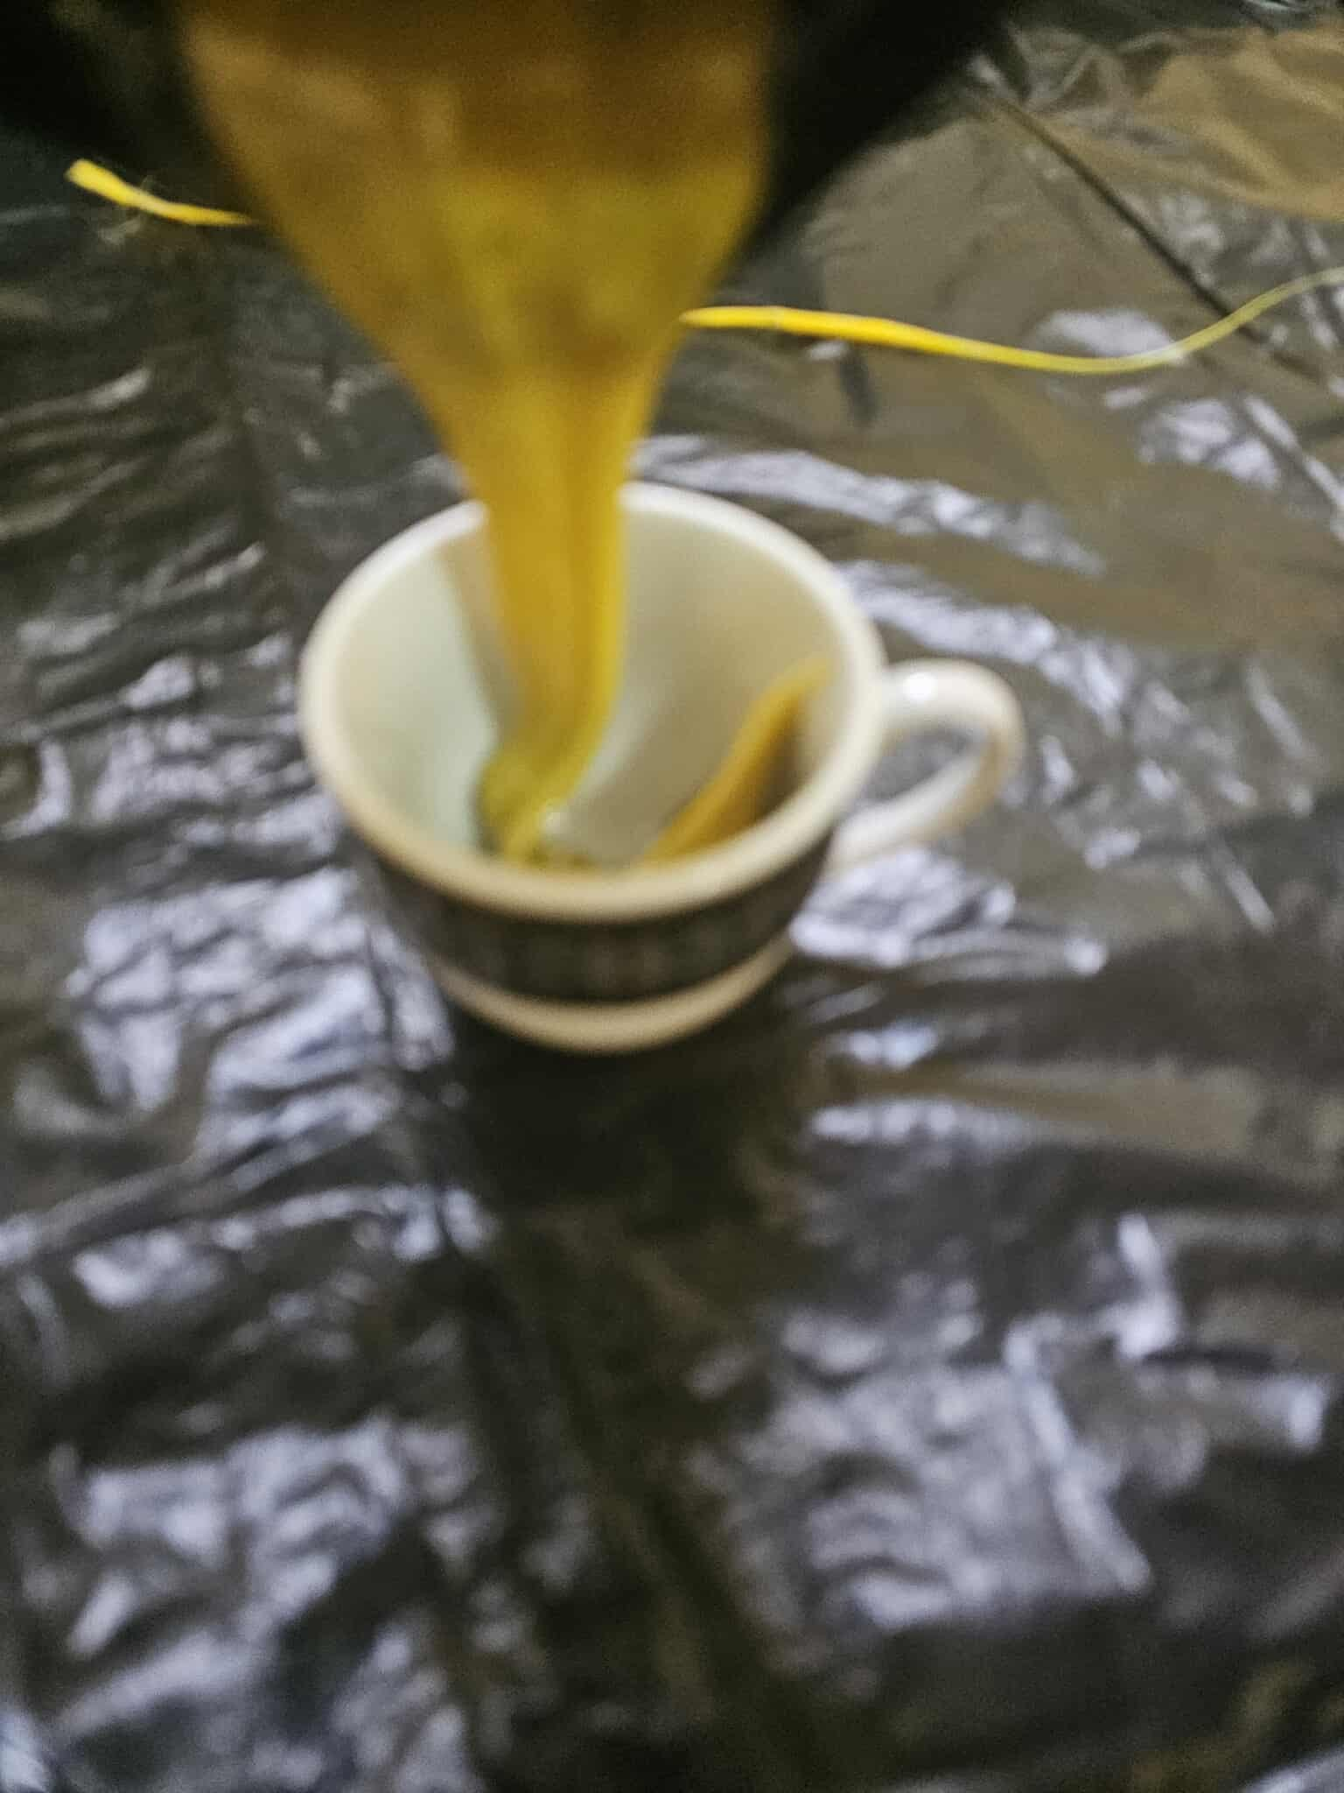
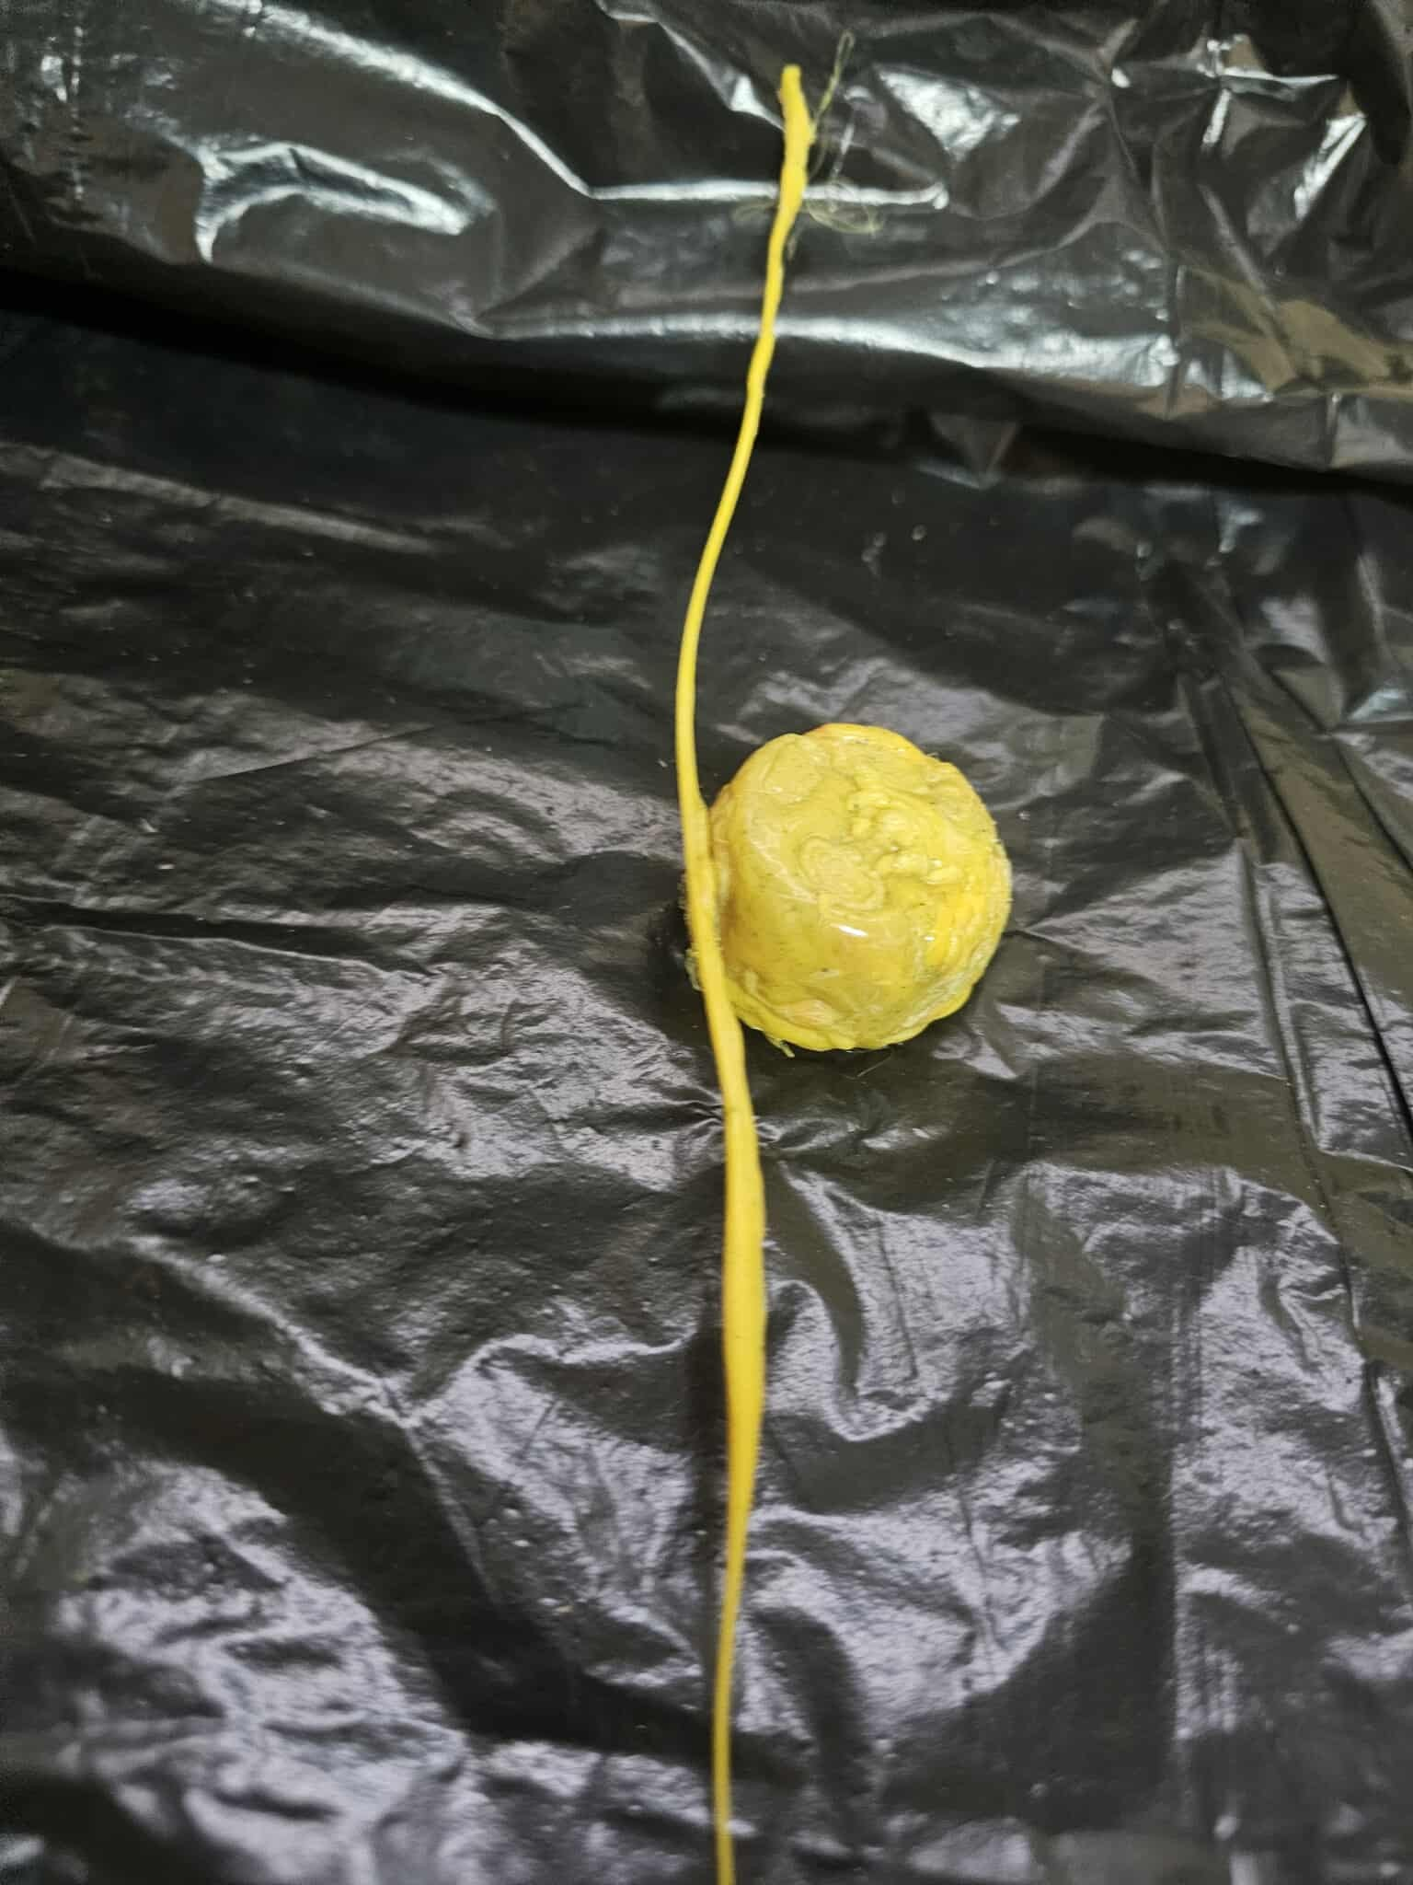
After shredding, manual melting and reshaping tests were conducted:
HDPE: melted but released flammable gases, making manual processing unsafe without controlled heating.
PET: showed poor behaviour during melting and became brittle after cooling.
ABS: showed excellent melting behaviour and was successfully reshaped into a solid filament with a diameter close to 1.75 mm, which is the standard size for 3D printing.
Melted PET plastic before & after molding
Melted HDPE Plastic
Melted ABS plastic before & after molding

Slide 13
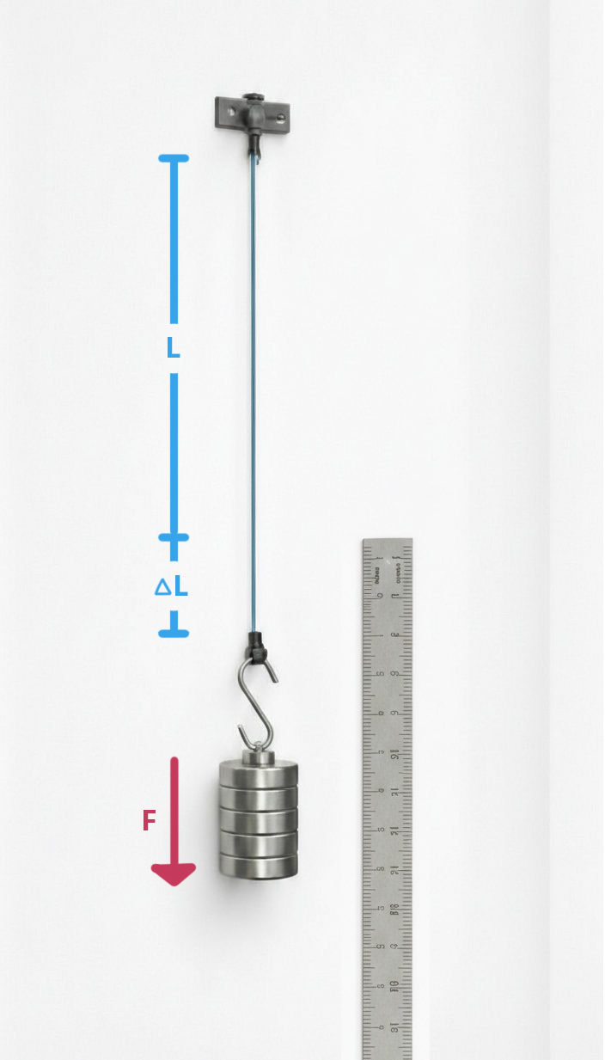
A Tensile Test was performed on the recycled ABS filament to evaluate its mechanical strength.
The results showed that despite diameter irregularities caused by manual extrusion, the filament has sufficient mechanical strength for practical use

Slide 14
06
CONCLUSIONS AND FUTURE WORK
Applications:
Preparation of plastic waste for recycling processes such as melting and extrusion.
Educational laboratories for teaching mechanical design, power transmission, and recycling principles.
Small-scale recycling initiatives in universities, workshops, and research centers.
Experimental setups for future development of recycled 3D-printing filament production systems.
The shredder serves as a foundational unit that can be integrated into a complete plastic recycling line in future projects.

Slide 15
06
CONCLUSIONS AND FUTURE WORK
Recommendations:
Improving blade material and geometry to enhance cutting efficiency and durability.
Implementing noise and vibration reduction techniques for improved user comfort.
Conducting long-term performance testing to evaluate wear and maintenance requirements.

Slide 16
06
CONCLUSIONS AND FUTURE WORK
Future Work and Development:
Integrating a washing and drying unit after shredding.
Adding a plastic extrusion system for producing 3D printing filament.
Automating material feeding and collection processes.
Optimizing blade design for thicker or harder plastic materials.
Incorporating sensors to monitor load, speed, and operational safety.

Slide 17
THANK YOU

