Slide 1

Software tools and libraries
Objective-c
Php
Json
Xcode
Coco pods
WebRTC
quickblox

Slide 2
Login Page
User login with his email and password.
The password is hashed using md5 and SHA1 hash, the same as the Website to ensure security.

Slide 3
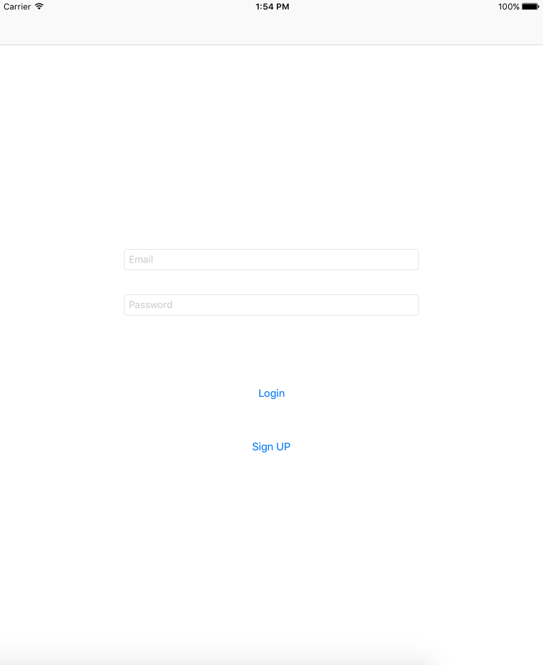

Slide 4
Sign-Up Page
User Sign Up with his name and email , he create a password and a user name that could be used to login to Website beside Email.

Slide 5
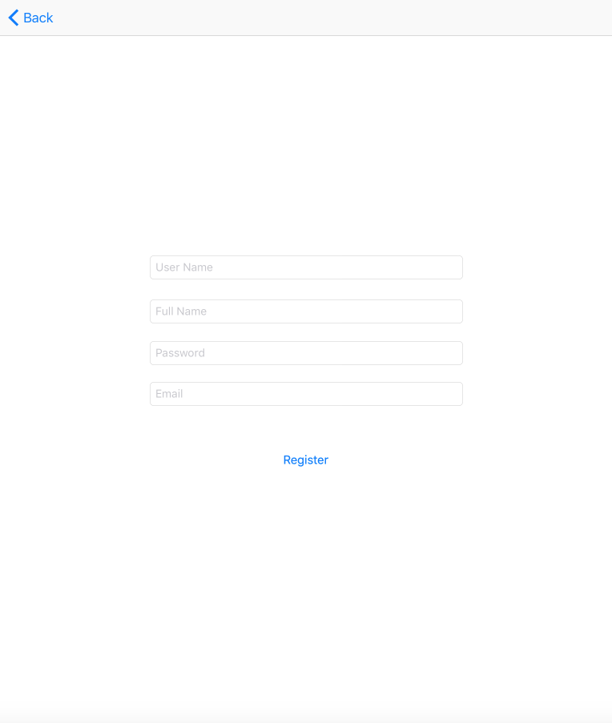

Slide 6
Home Page
In this page user will see all his friends posts, view posts comments and add comments.
Post may contain text and photo.
User can add new post.
It contain chat notifications.
It contain friends Requests Notifications.
User can also search for people he want communicate with hem and send a friend request to them.
The user can from page enter chat page.

Slide 7
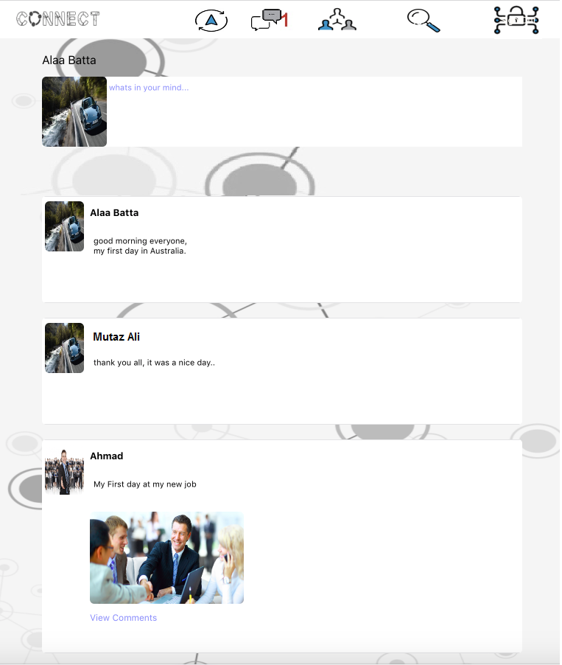
W3

Slide 8
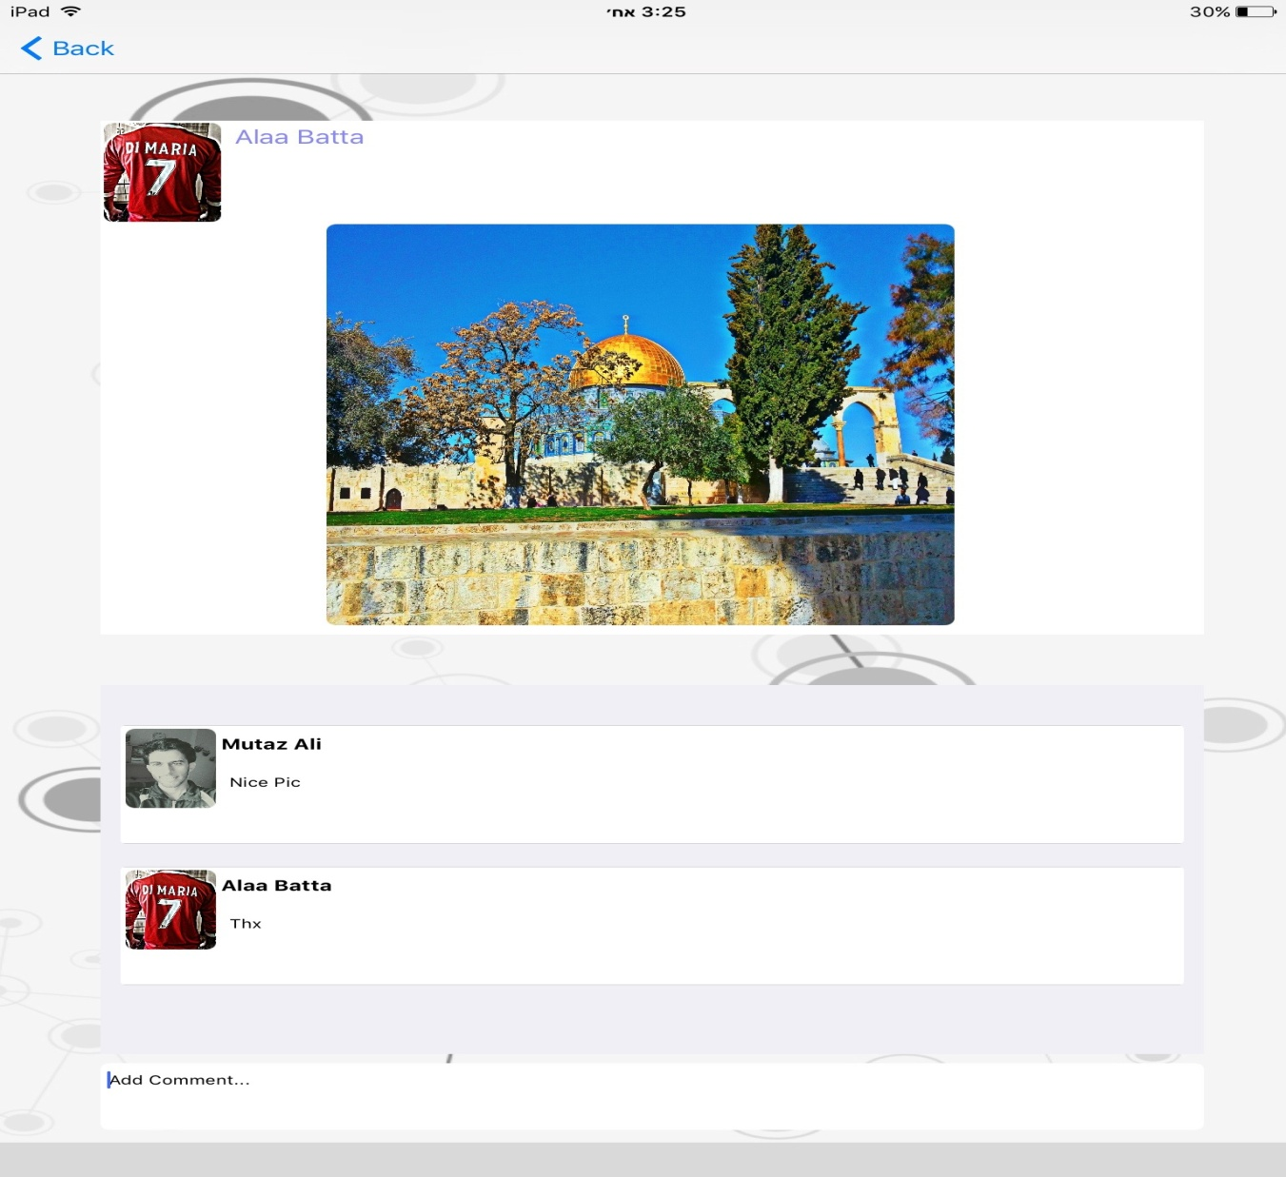
-When user view a post with
picture, the picture will be enlarged , and comments
viewed.

Slide 9
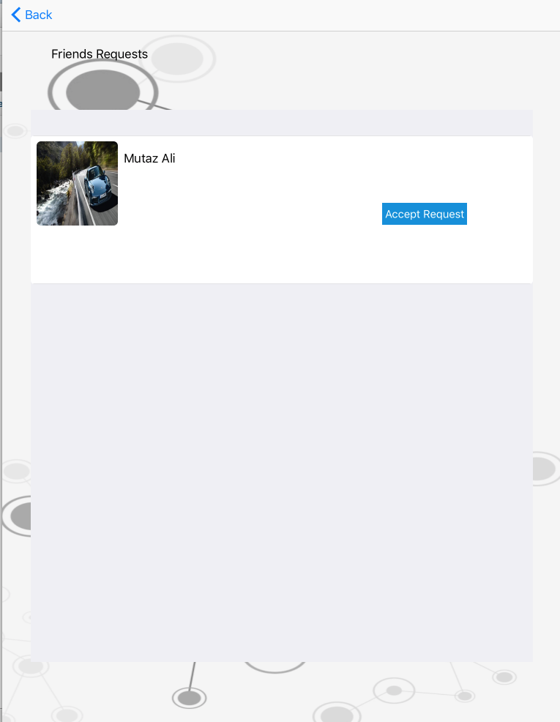
-when a friend send user a friend request.

Slide 10
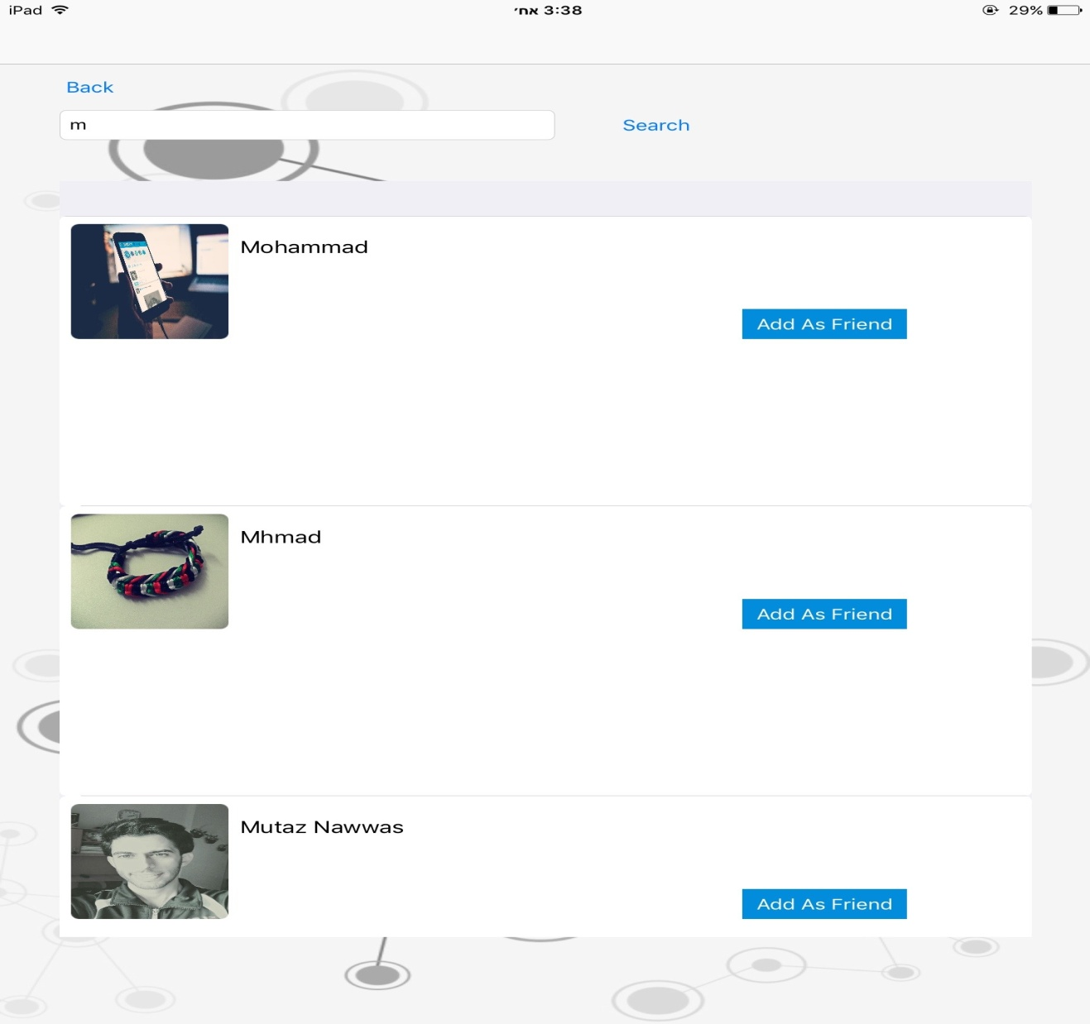
-user can search for people and send friend requests to them.

Slide 11

-Posting new post with text and/or image,
The image can be taken fron photos library ot from device camera directly.

Slide 12
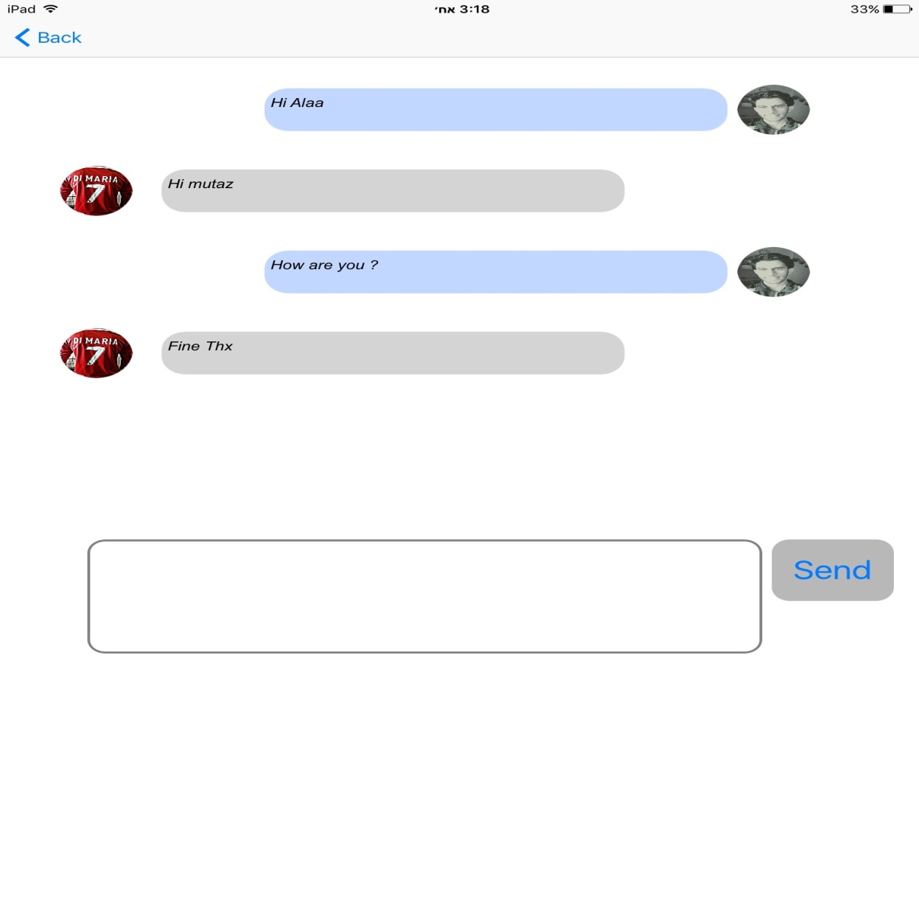
Chatting page: real time chatting connected with the Website chatting system.

