Slide 1

AN-NAJAH NATIONAL UNIVERSITY
FACULTY OF ENGINEERING
DEPARTMENT OF MECHANICAL ENGINEERING
Dough Cutting Machine
supervisor:- Prepared by :-
Dr-Osayd Abdul fattah Yazeed saleh
Abdallah Mahfod
Hakam Koni
Ehab Absi

Slide 2
Project Outline
Introduction
Constrains and Standards/Codes
Literature Review
Design of Soft Dough Cutting Machine
Results and Analysis
Discussion
Conclusion and Recommendation

Slide 3
Introduction
Importance for having DCM:-
  Dough cutting is the main process in the production of bread and bread is widely used in our daily meals.
  The aim of the project is:-
  Design and development of machine able to divide a large amount of dough into pieces, quickly
  and high accuracy.
  The advantage of this machine is:-
  High dividing accuracy and much higher production rates.
  Have an economic and positive impact on national production.

Slide 4
Constrains and Standards/Codes
Mechanical and Electrical Design Constrains
Choosing the right motor option for cut the dough.
Choosing the right Extruder.
  In our project, we will be dealing with some US standards to do the calculations.

Slide 5
Literature Review
  First machine was made around 1918 in Canada by a British man called Thompson.
The dough divider is very user friendly because this machine deals with dough.
This machine is simple as it is easy to repair and clean.
The lubrication system of dough dividers represents an important feature as it has a bearing on the
efficiency of their operation.

Slide 6
Design of Dough cutting machine
  Machine parts
  1. Single Screw Extruder
  it is a rod with a helical thread (groove) around its outside Surface.

Slide 7
Design of Dough cutting machine
2. Conveyor Belt
  It used to transfer pieces from the Dough cutter to the other station.
  We designed a belt with a width of 500mm and length of 3m and height of one meter, and transport 30kg per hour.

Slide 8
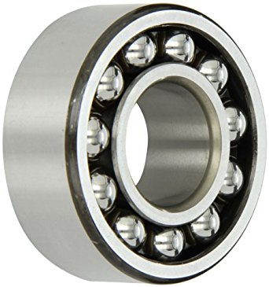
Design of Dough cutting machine
3. Bearings
  it is a machine element that reduces friction between moving parts and transmit motion and
  forces and we use ball bearing.

Slide 9
Design of Dough cutting machine
4. Roller Chains
  Transmission systems that mechanisms or devices transferring the rotary motion of the motor
  shaft to the equipment using the motive power.

Slide 10
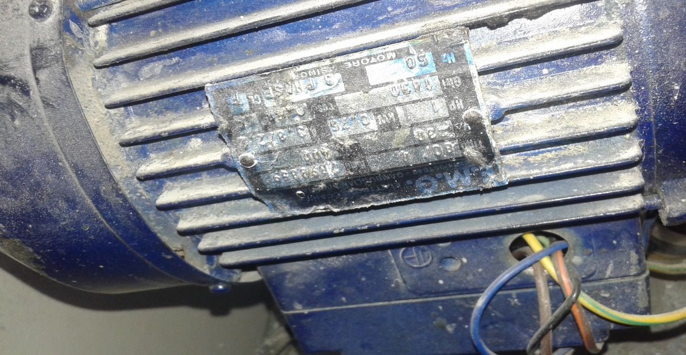
Design of Dough cutting machine
5. Motor
We have three motors. First two motors moves the screw and coverage belt (1hp) and the last one
(1/2hp) cuts the dough .

Slide 11
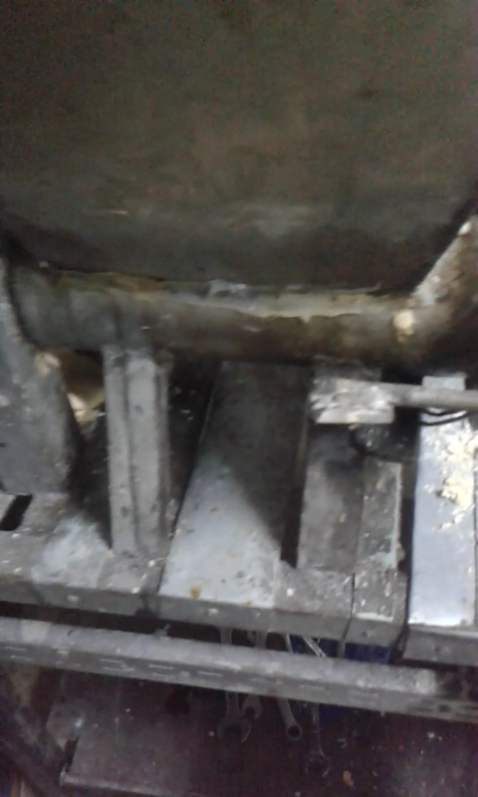
Design of Dough cutting machine
Parts Description & Methodology
  1. The Steel Base
  A steel base (95 * 50) cm was brought and allocate the machine over it using Stainless Steel Welding.

Slide 12
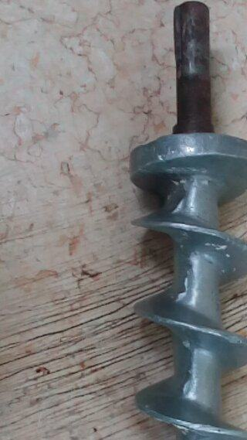
Design of Dough cutting machine
2. Screw Extruder Selection
A selection for the screw was made according to the requirements needed and the ability of the
  engine that we have (1HP). and we choose (TDD30A) from Technical datasheet .

Slide 13
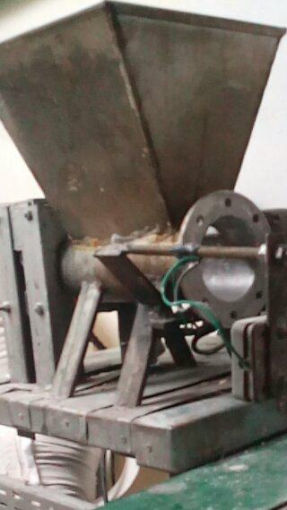
Design of Dough cutting machine
3. Cylinder & Head & Hopper
We brought empty cylinder of Stainless Steel. This cylinder covered the screw. The cylinder
diameter is 15cm and height is 25cm.

Slide 14
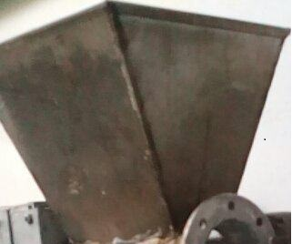
Design of Dough cutting machine
Hopper
Is the conical bowl made of stainless steel, had smooth texture to avoid adhesion dough and
to make cleaning process easily. Hopper size equal 5kg of dough.

Slide 15
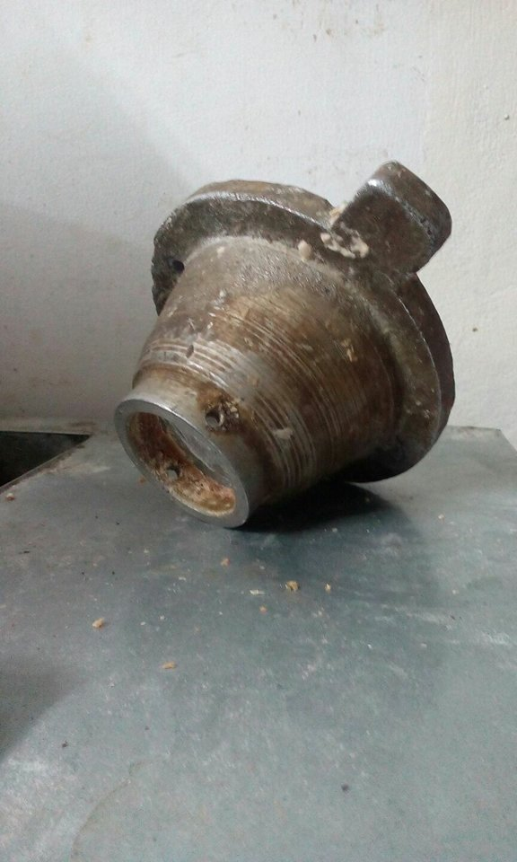
Design of Dough cutting machine
Head of Cylinder
We linked a piece to the head of the cylinder. This piece is responsible for cutting the dough
though a hole founded on the other end of the cylinder. This piece is about 15cm tall.

Slide 16
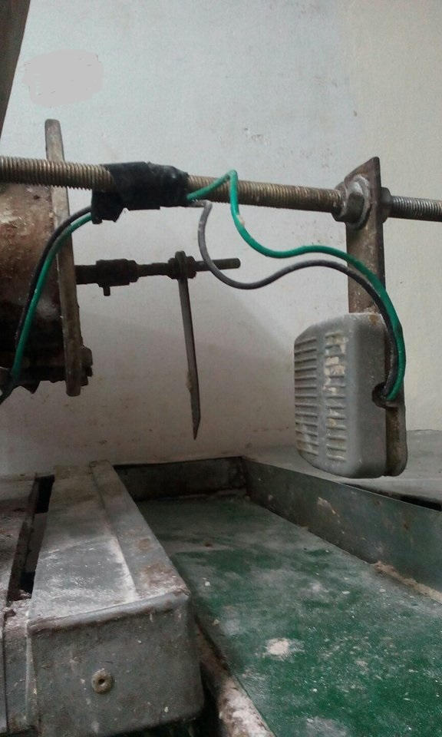
Design of Dough cutting machine
4. Sensor and Motors
We have three motors in our project , A one (1/2hp) cuts the dough This motor cuts the dough
by using the sensor which sends signals to motor to move axis with the knife.

Slide 17
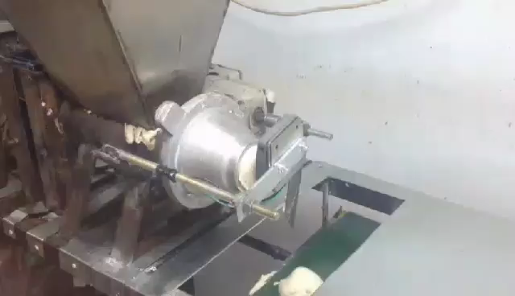
Dough Cutting Machine )DCM)

Slide 18
Calculations
Selection Single screw Extruder
In this project we don’t design extruder, because density of dough is low (Less than other materials which
designed for them), then we selected from catalog based on Requirements.
We choose the model TDD30A that has a 30-mm diameter, working on max power equal 2.5 HP and gives
(10-40) kg/hr.

Slide 19
Calculations
Bolt design
bolt diameter =8 mm
The plate that holds motor diminutions are 200*200*8 mm
The motor mass is 8 kg
The plate material is HR G A1018 steel
The load will be critical @ C &D bolts

Slide 20
Calculations
Bearing design
The axial force &the radial force are 0.69N & 98.1N respectively
Motor speed is 250 rpm
Designed life will be two years that gives Ld = 1456000 rev
Single row radial ball bearing is to be selected
Using tables and calculations show that the bearing No.6006
The bore =30 mm

Slide 21
Calculations
Roller Chain design
Single strand chain is selected with
Roller No.40
Roller pitch =0.5 inch
Motor speed =300rpm
This speed gives 1.85 hp
The torque = 165.7 ibf.in
The sprocket driving chain diameter =2.7in
The force that will be derived =121.8 ibf

Slide 22
Calculations
Conveyor Belt design
belt with 500mm
conveying speed =1.4m/s
length=3m
Vertical height of the conveyor =1m
The motor power (P_{m})=0.6879kw
The belt breaking strength=8.84N/mm

Slide 23
Discussion
The machine benefits include: saving time, raising production and man power.
The machine dimensions: length 95cm/width 50 cm while the high is 90cm
Using machine can be suitable in: large scale production lines specialized in food industry

Slide 24
Recommendation
The importance of this machine is represented by: increase the efficiency, decrease the
production time, reduce the labor cost and reduce losses in row material.
The improvements aspects include: replace the sensor with (Laser Technology) system

Slide 25
Thank you

