Slide 1

بسم الله الرحمن الرحيم

Slide 2

The Assessment of ERP System on the Performance of Napco Factory
Group Members:
Dalia Halawa
Yasmine Dile’a
Ala’a Hasan
Amera Khalil
Supervised by:
Dr. Yahya Saleh

Slide 3
Agenda
Introduction
Literature Review
Methodology
Results and Discussion
Conclusion
Recommendation

Slide 4

Introduction

Slide 5

Enterprise Resource Planning
History of ERP?
What is ERP?
Why ERP?
Companies have implemented ERP system
Motivation of ERP System?

Slide 6
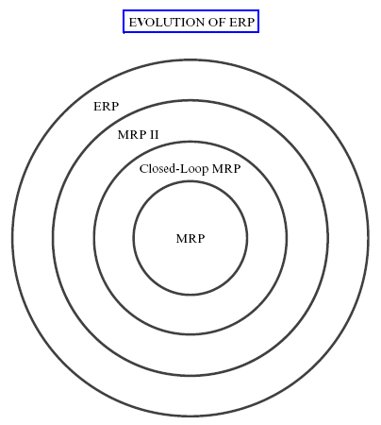
History of ERP?

Slide 7

What is ERP?
ERP stands for Enterprise Resource Planning.
Software that can be used to integrate internal and external information.

Slide 8
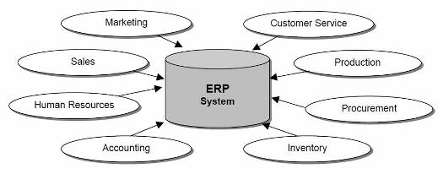

Slide 9

Why ERP ?
Standardization and integration the processes and systems .
Control firms operations.
To enhance companies competitive position.
Information flows constantly .

Slide 10
Statistics Companies that have implemented
ERP system

Slide 11
Motivations for ERP System
Improve the visibility.
Increase Productivity.
Reduce Cost and Improve Control
Enhance the business performance.
Provide a comprehensive view of your company .

Slide 12

Objective of the Study
: The main objectives of this study
To assess the implementation of the ERP system and to assess its impact on Napco departments .
Also to evaluate to what extent the ERP implementation succeeds to alleviate cost, and to improve internal control.

Slide 13
Problem Definition
The project discusses a case study in ‘ Assessment of ERP implementation at Napco factory in Palestine, Nablus.
This study focus on studying and evaluating the impact of the following two hypotheses:
H1: Applying ERP system will increase the internal control in the operation.
H2: Applying ERP system will contribute to cost reduction

Slide 14

Internal Control
Reduce number of errors .
ERP enhance control through standardized and accessible information .
Give more power to employees, greater control relaxation and more job discretion .

Slide 15

2. Cost Reduction
Help reduce overtime ,related labor and payroll expenses .
Increase the production process accuracy .
Help implementing JIT inventory system.
Process automation will help relocating employees

Slide 16

NAPCO ( National Aluminum Profiles Company ) is
Palestinian Aluminum Solutions Company.
NAPCO was established in 1991 in Nablus City – Palestine. It is create more than 250 job opportunities within its production lines

Slide 17

Napco choose Microsoft Dynamic Ax for several reasons mainly because:
1-cost is acceptable compared with other programs
2-it has an authorized dealer in Palestine.
3-it contains all the modulus.

Slide 18
Literature Review

Slide 19
Many previous research related to our project:
Most studies on ERP were new and mostly started in 90s.
Research | Author | Date | about
(ERP) systems for healthcare delivery organizations.) | Godefridus G. van Merodea,Siebren Groothuisb, Arie Hasman | 2004 | Integrated hospitals need a central planning and control system, To determine what the requirements for ERP in hospitals are!, we will discuss the planning and control function in hospitals

Slide 20
Ina global market, companies are exposed to competition from not only traditional or local competitors but also worldwide players in the industry | 2005 | (Chan-Hsing Lo,& other) | Opt-Electronics Industry This study aims to help enterprise successfully implement ERP system
Increase quality and performance requirements, and competitive education environments,, | 2010 | Ahed Abugabah, Louis Sanzogni | Research in ERP system in higher education with a special focus on higher education in Australia.
The relation of ERP and internal Controls concerning the whole elements of internal controls order to reduce time and audit costs | 2012 | Java Moradi | The Impact of Enterprise Resource Planning (ERP) on the Internal Controls in Esfahan Steel Company
Research | Author | Date | about
Opt -Electronics Industry This study aims to help enterprises successfully implement ERP . | (Chan-Hsing Lo,& ther) | 2005 | In a global market, companies are exposed to competition from not only traditional or local competitors but also worldwide players in the industry

Slide 21
Methodology

Slide 22
Gap Analysis
Interviews
Observations
Questionnaires
Analysis

Slide 23
Gap analysis
Gap analysis is a tool that helps companies compare actual performance with potential performance. At its core there are two questions: "Where are we?" and "Where do we want to be?".
NAP.FUNC.0116 | The system should have the ability to specify the scrap quantity and weight at the end of production order. | High | Customization
NAP.FUNC.0108 | The system should have the ability to define labor cost per production order. | High | Std Feature

Slide 24
Data Collection
The method of this research is survey based. The most common ways of collecting data are personal interview and using questionnaires.
In data collection we used two methods:
Qualitative Data Collection
Qualitative data is collected from personal interviews and direct observation

Slide 25
Interviews:
Management
Quality
Sales
Inventory
Manufacturing
Were asked about the benefits and advantages of the new ERP system and several questions.
Early stage
Resistance to change
Optimistic, pessimistic reactions

Slide 26
Observations:
Primary observations before applying ERP system, and watch the regular trend of several departments in the company:
Production
Inventory
Sales
Quality.
Then we made an observations after applying the system to note the difference after than before.

Slide 27
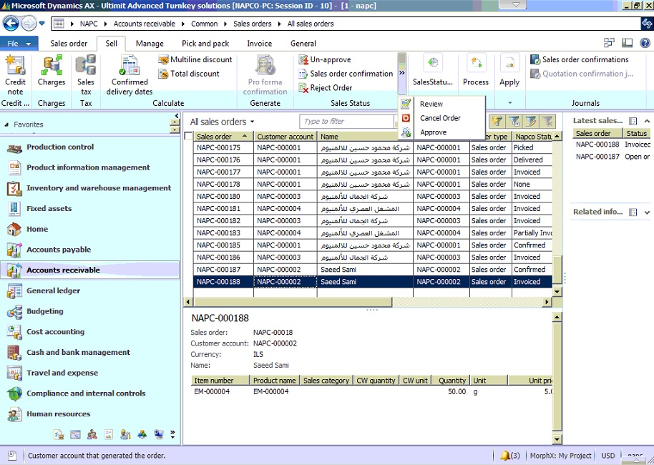
ERP Microsoft Dynamics
.

Slide 28
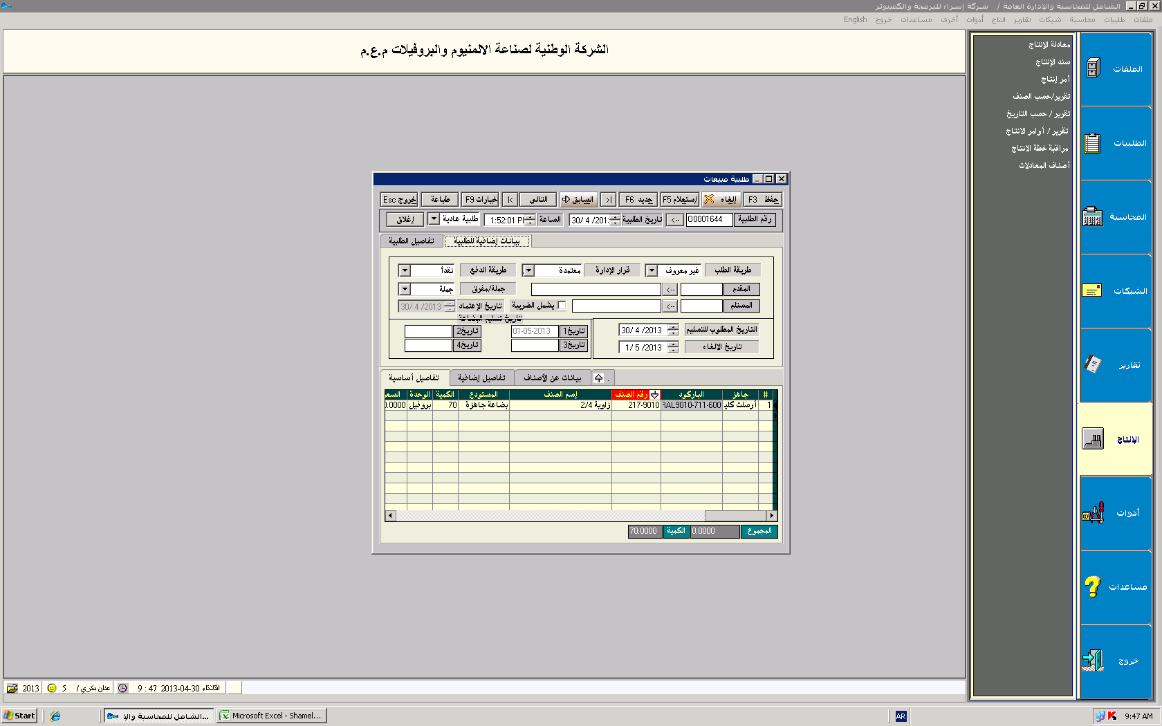
Al- Shamel
.

Slide 29
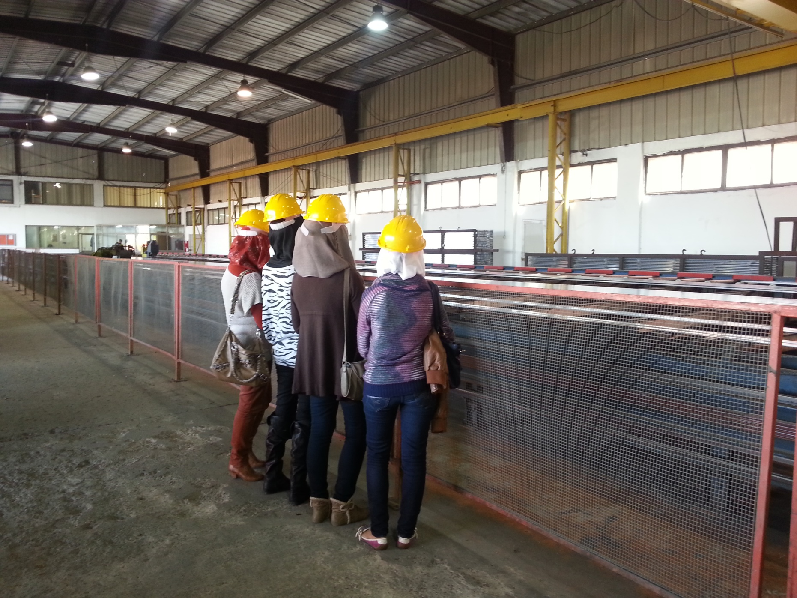
Observing the production line

Slide 30
Quantitative Data Collection
Quantitative data is collected using, for example, questionnaires with fixed answers and correct form.
Questionnaire
The questionnaire that we designe consists of questions dealing with the subjects we need to gain information about .

Slide 31
Internal Control Questionnaire
H1: Applying ERP system will increase the internal control in the Factory?.
Internal Control parts
Risk Management
Organization Structure
Control
Environment
Standard
Operating
Procedure
Control Measuring Tools
Monitoring

Slide 32
Internal Control Parts and its variables:
1. Standard Operating Procedure SOPs
It is a document which describes the regularly recurring operations .
Four main variables to be measured:
Segregation of Duties.
Data entry timing commitment.
SOPs content and structure.
Computerized processes.

Slide 33
2. Risk Management
The identification, analysis, assessment, minimization, or elimination of unacceptable risks.
Four main variables to be measured:
Level of data entry accuracy.
Secured Data.
Clarity of risk factors.
Data validation level.

Slide 34
3. Control Environment
Developing methods to prevent illegal access .
Four main Variables to be measured:
Quality control power level.
Availability of data.
The extent use of benchmarking.
IT-infrastructure .

Slide 35
4. Monitoring
Monitoring is the regular observation and recording of activities .
Two variables to be measured:
Monitoring the movement of material.
The efficiency of monitoring production process.

Slide 36
5. Control Measuring Tools
Policies, procedures, techniques, and mechanisms to reduce risks.
Six main variables to be measured:
Scraps and Defects.
Customer satisfaction.
Inventory safety stock.
Effect of lead time.
Speediness of implementing tasks.
Inspection.

Slide 37
6. Organization structure
Consists of activities such as task allocation, coordination and supervision .
Four main variables to be measured:
Capability to integrate with entities .
Documentation powerful level.
Accuracy of diversity of reporting.
Communication level improvement.

Slide 38
B . Cost Survey
H2: Applying ERP system will contribute to cost reduction
Raw
Material
Labor cost
Overheads
Cost reduction parts
Sales Revenue

Slide 39

C. General ERP Questionnaire
We design a questionnaire which consists of many general questions about the effect of ERP and to know the opinion of the company staff about this system .
The survey is divided into two sections:
First section which have questions about the user's personal data
Second section consists of 15 general questions

Slide 40
The 15 General Questions
General ERP
Productivity
Employs Efficiency
Tool Change
Tasks Change
Communication Methods
Difficulty of ERP Program Use
Work Efforts

Slide 41
Cont ....
General ERP
Performance Improves
Task Time
Sufficient Training Courses
Support the Use of ERP System
Decision-Making
Daily Routine Tasks
Report Generation
Accurate Information

Slide 42
Results
&
Discussion

Slide 43

Internal Control Questionnaire Results and Discussion
It consists of two sections:
Employee Personal Data.
The main variables of internal control parts.
It is distributed to ten different department managers.
Using SPSS and Minitab Programs to Analyze the Collected Data

Slide 44
Personal Data Analysis
Using SPSS:
1. Gender
2. Age

Slide 45
3. Education
4.Specialization

Slide 46
5. Departments
6. Years of Experience

Slide 47
Control Parts Data Analysis
Using Minitab, Paired t -test:
Paired t-test:
The observations on the two populations of interest are collected in pairs.
Dj=Xbef j – Xaft j, j=1, 2…, 10.
The Dj are assumed to be normally distributed with mean
µD = µbef- µaft.
H0: µD= 0 and H1: µD ≠ 0 and α=.05.
Reject H0 if: the P-value is < .05

Slide 48
SOPs Normality Test:
SOPs probability plot not normal

Slide 49
Sign Test for SOPs Paired Samples:
Manager | before | after | Difference, Dj | Sign
1 | 7.2 | 8.4 | -1.2 | -
2 | 4.6 | 7.2 | -2.6 | -
3 | 6.8 | 9 | -2.2 | -
4 | 4.6 | 7.8 | -3.2 | -
5 | 7 | 9.2 | -2.2 | -
6 | 6.2 | 9.4 | -3.2 | -
7 | 7 | 9 | -2 | -
8 | 5.2 | 7.6 | -2.4 | -
9 | 6.4 | 8.8 | -2.4 | -
10 | 6.6 | 8.8 | -2.2 | -

Slide 50
SOP:
Paired T-Test and CI: SOP before; SOP after:
Paired T for SOP bef - SOP aft
Paired t-test results for SOPs
N Mean StDev SE Mean
SOP bef 10 6.16000 0.99688 0.31524
SOP aft 10 8.52000 0.74356 0.23514
Difference 10 -2.36000 0.57966 0.18330
95% CI for mean difference: (-2.77466; -1.94534)
T-Test of mean difference = 0 (vs not = 0): T-Value = -12.87 P-Value = 0.000

Slide 51
Risk Normality Test:
Risk Management probability plot is normal

Slide 52
Risk Management:
Paired T-Test and CI: Risk before; Risk after:
Paired T for Risk before - Risk after
Paired t-test results for Risk Management
N Mean StDev SE Mean
Risk bef 10 6.74000 0.86436 0.27333
Risk aft 10 8.46000 0.55817 0.17651
Difference 10 -1.72000 0.61065 0.19310
95% CI for mean difference: (-2.15683; -1.28317)
T-Test of mean difference = 0 (vs not = 0): T-Value = -8.91 P-Value = 0.000

Slide 53
Control Envoi Normality Test:
Control Environment probability plot is normal

Slide 54
Control Environment:
Paired T-Test and CI: control before; control after
Paired T for cont bef - cont aft
Paired t-test results for Control Environment
N Mean StDev SE Mean
cont bef 10 6.40000 0.75719 0.23944
cont aft 10 8.70000 0.42426 0.13416
Difference 10 -2.30000 0.50332 0.15916
95% CI for mean difference: (-2.66006; -1.93994)
T-Test of mean difference = 0 (vs not = 0): T-Value = -14.45 P-Value = 0.000

Slide 55
Monitoring Normality Test:
Monitoring probability plot is normal

Slide 56
Monitoring:
Paired T-Test and CI: monitoring before; monitoring after
Paired T for Mont bef - Mont aft
Paired t-test results for Monitoring
N Mean StDev SE Mean
Mont bef 10 6.15000 0.70907 0.22423
Mont aft 10 9.05000 0.49721 0.15723
Difference 10 -2.90000 0.65828 0.20817
95% CI for mean difference: (-2.91342; -2.88658)
T-Test of mean difference = 0 (vs not = 0): T-Value = -13.93 P-Value = 0.000

Slide 57
Control Tool Normality Test:
Control Tools probability plot is normal

Slide 58
Control Measuring Tool:
Paired T-Test and CI: Control tool before; Control tool after
Paired T for tool bef - tool aft
Paired t-test results for Control Tool
N Mean StDev SE Mean
tool bef 10 6.73000 0.61833 0.19553
tool aft 10 8.52000 0.47329 0.14967
Difference 10 -1.79000 0.51737 0.16361
95% CI for mean difference: (-1.80055; -1.77945)
T-Test of mean difference = 0 (vs not = 0): T-Value = -10.94 P-Value = 0.000

Slide 59
Organization Structure Normality Test:
Org Structure probability plot is normal

Slide 60
Organization Structure:
Paired T-Test and CI: org before; org after
Paired T for org bef - org aft
Paired t-test results for Organization Structure
N Mean StDev SE Mean
org bef 10 6.37000 0.92742 0.29328
org aft 10 8.82000 0.38528 0.12184
Difference 10 -2.45000 0.67206 0.21252
95% CI for mean difference: (-2.46370; -2.43630)
T-Test of mean difference = 0 (vs not = 0): T-Value = -11.53 P-Value = 0.000

Slide 61
The effect of ERP on Running Cost
Direct Effect
 |  | Cost Effect
 | Description | 0% |  |  | 25% |  |  | 50% |  |  | 75% |  | 100%
Manpower | Salaries & Wages | 0%
 | Car & Transportation | 0%
 | Employees Overtime Expense |  | 5%
 | Leave Pay Expenses | 0%
 | Other Employee Benefits | 0%

Slide 62
Direct effect … Cont
Manufacturing Overhead | Heat & Water Expense | 1%
 | Electricity Expense | 1%
 | Security Service | 0%
 | Fuel (Diesel) Expense | 0%
 | Telephone & Jawwal | -2%
 | Internet & Leased Lines Expense | 0%
 | Postage & Stationary Expense | -3%
 | Maintenance Expense | 0%
 | Office Supplies | -2%
 | Computer Supplies | -2%
 | Insurance Expense | 0%

Slide 63
Indirect Effect
 |  | Positive Effect Estimates on Sales and Production Performance
 | Description | 0% |  |  | 25% |  |  | 50% |  |  | 75% |  | 100%
Raw Material | Productivity | 2%
 | Workload per worker |  | +-7%
 | Control of Material workflow |  |  |  |  | 30%
 | Reduce Production Errors |  | 5%

Slide 64
Indirect effect … Cont
Sales Revenue | Enhance Forecasting process |  |  | 15%
 | Information Availability |  | 10%
 | Tracing production orders |  |  |  |  |  |  |  | 60%
 | Customers Satifaction Level |  | 10%
 | Enhanced Supply Chain |  |  | 15%
 | Power of Reporting |  |  | 20%

Slide 65
General ERP Questions Questionnaire
Results and Discussion
It is consist of two sections:
Employees personal data.
General questions related to the ERP system.
SPSS program use to analyze the collected
data
Data

Slide 66
Personal Data Analysis
Personal Data
 | Gender |  | Age |  |  |  | Education
 | Male | Female | 25-30 | 30-35 | 35-40 | other | bachelors | other
Frequency (n=24) Percent (%) | 75% | 25% | 62.5% | 25% | 8.3% | 4.2% | 87.5% | 12.5%

Slide 67
Personal Data
 | Specialization
 | engineering | management | accounting | other
Frequency (n=24) Percent (%) | 45.8 | 20.8 | 16.7 | 16.7
Personal Data
Year
 | 1 | 2 | 3 | 4 | 5 | 6 | 7
Frequency (n=24) Percent (%) | 12.5 | 20.8 | 33.3 | 8.3 | 4.2 | 12.5 | 8.3

Slide 68

Departments
 | Quality | Plan Mang | Productin | purchases | Sales | IT | Accounting | Inventory | Maint
Frequency(n=24) Percent (%) | 12.5 | 12.5 | 20.8 | 4.2 | 4.2 | 4.2 | 16.7 | 16.7 | 8.3

Slide 69
The 15 General ERP Questions Analysis
Question | Answer
 | Yes (%) | No (%)
1. Tasks Change | 83.3 | 16.7
2. Work Tools Change | 91.7 | 8.3
3. Difficulty of ERP Program Use | 20.8 | 79.2
4. Sufficient Training Courses | 75.0 | 25.0
5. Support the use of ERP system | 95.8 | 4.2
6. Report Generation | 95.8 | 4.2

Slide 70
Questions | Answers
 | Strongly agree(%) | Agree (%) | I don’t know(%) | Strongly dis agree (%) | Dis agree (%)
1.Employee Efficiency | 16.7 | 66.7 | 16.7 | 0 | 0
2. Productivity | 12.5 | 58.3 | 16.7 | 0 | 12.5
3. Communication Methods | 29.2 | 58.3 | 8.3 | 0 | 4.2
4. Employee Performance | 12.5 | 62.5 | 25.0 | 0 | 0
Task Time | 12.5 | 58.3 | 16.7 | 0 | 12.5

Slide 71
Cont…
Question | Answers
 | Strongly agree(%) | Agree (%) | I don’t know(%) | Strongly dis agree (%) | Dis agree (%)
6. Work Efforts | 20.8 | 45.8 | 16.7 | 0 | 16.7
7. Decision-making as a user | 25.0 | 58.3 | 8.3 | 0 | 8.3
8. Daily Routine Tasks | 16.7 | 54.2 | 16.7 | 0 | 12.5
9. Accurate Information | 12.5 | 83.3 | 4.2 | 0 | 0

Slide 72
Conclusion

Slide 73
We can conclude that ERP system implementation confirming our two conducted hypothesis .
    It was a significant difference after applying the ERP system according to the Minitab Results.
    It has an effect on: increasing the indirect cost and no or decreasing the direct cost.
Also, it has an effect on (productivity , efficiency,) and routine time.
An ERP implementation done right, can build the foundation for future growth.

Slide 74
Recommendation

Slide 75
Several areas for future research seem promising. On area is the education of ERP.
Napco Company need to increase the number of training hours.
ERP staff in NAPCO must listen to the department mangers to know what more options they need in the program.
Also, we recommend for NAPCO to reassessment its new system every 6 months.

Slide 76



