Slide 1






Read
Share
Created by :
Mays ismael and Mujahed hamayel
Supervised by: Manar Qamhieh

Slide 2

Overview
  Introduction
  Methodology
  Features
  Mobile Application
  Web Application
  Challenges
  Future Work

Slide 3


Introduction
ReadShare is an app designed to connect book lovers and foster a vibrant reading community. It enables users to exchange books, engage in meaningful discussions, and access a variety of literature. By encouraging the exchange of physical and digital books, we aim to make literature accessible to all and promote a thriving culture of reading and intellectual discourse.

Slide 4







What did we use?
Flutter
Node js
MongoDB
GitHub
Firebase

Slide 5


Features
Authentication
User Profile
Search
Login, Logout, Sign up
Create and manage comprehensive profiles .
Search for books, post, user
Chatting
Order Management
Book Sharing
Between the user
Easily manage book orders, track their status,
Through the request books button

Slide 6
Features
Notifications
Social Sharing
Reviews
Receive updates and notifications for discussion room activities, and order statuses.
Post a text or image
And interact with like and comment posts
User reviews about books
Rating
Saved Books
Reading Tracker
Book Rating
for easy access and future reading.
Keep track of your reading progress

Slide 7
Features
Discussion Rooms
Add Book
Follow Users
Create and join discussion rooms using integrated tools like Zoom for in-depth book discussions.
Easily add new books to the platform, including details to expand the available library for all users.
Follow other users to stay updated on their book activities, posts, and reviews, fostering a more connected and interactive community.

Slide 8
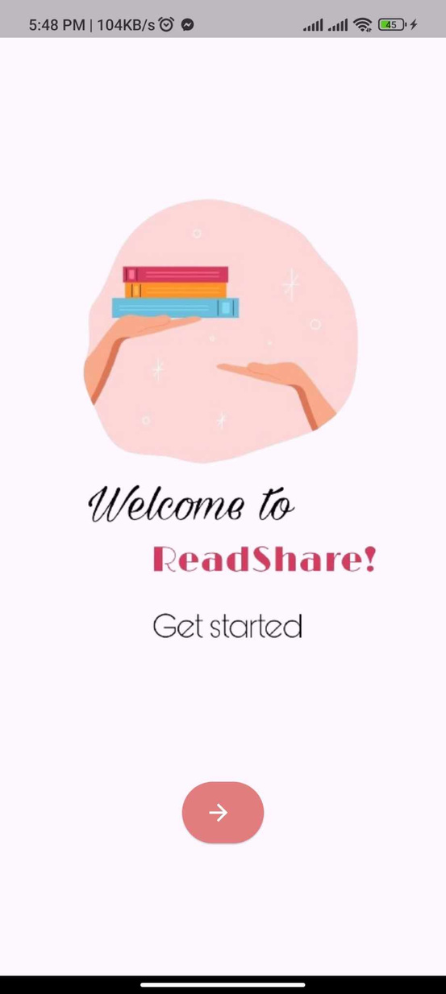



Mobile Application
Welcome Page

Slide 9
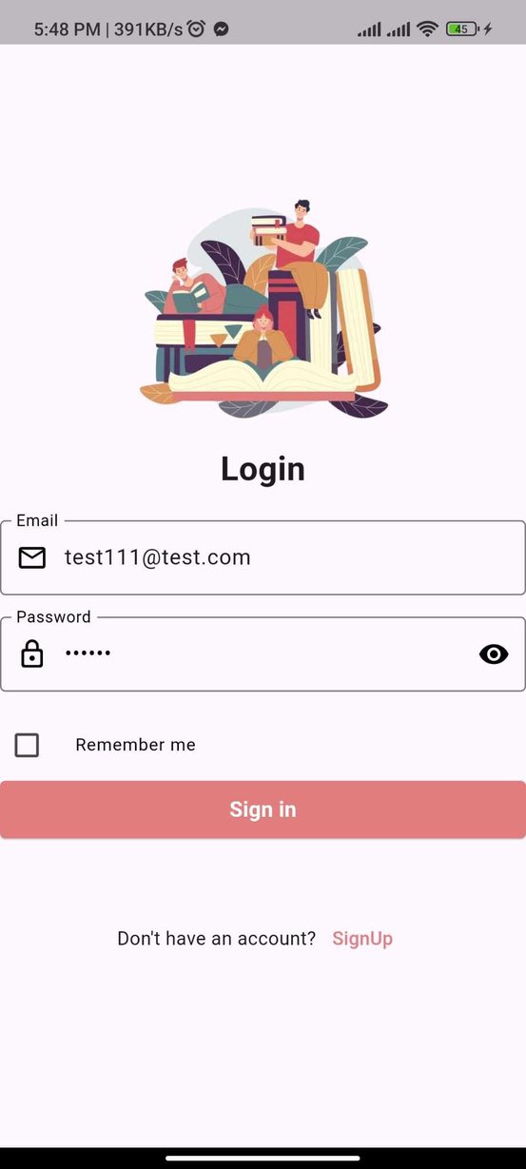
Log In
Page

Slide 10
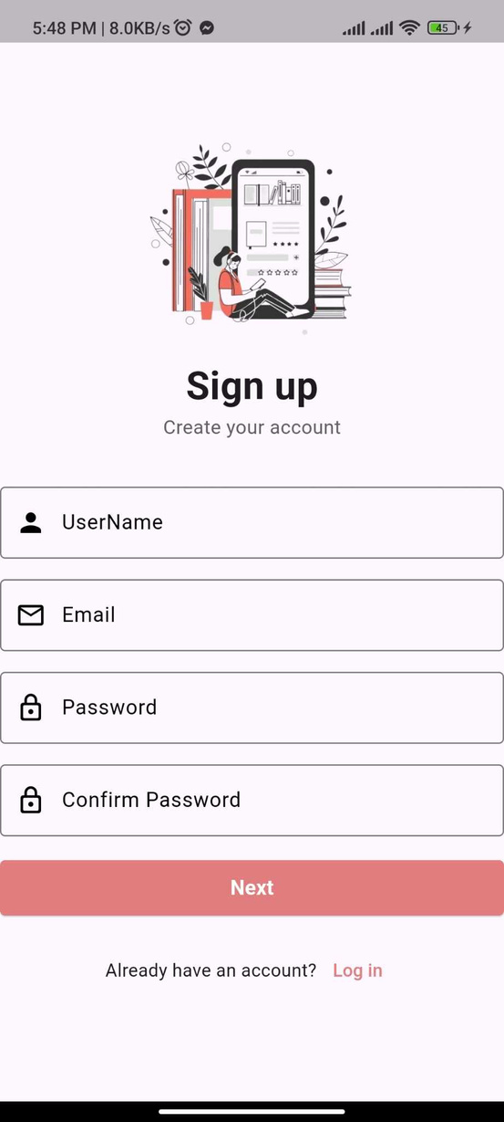
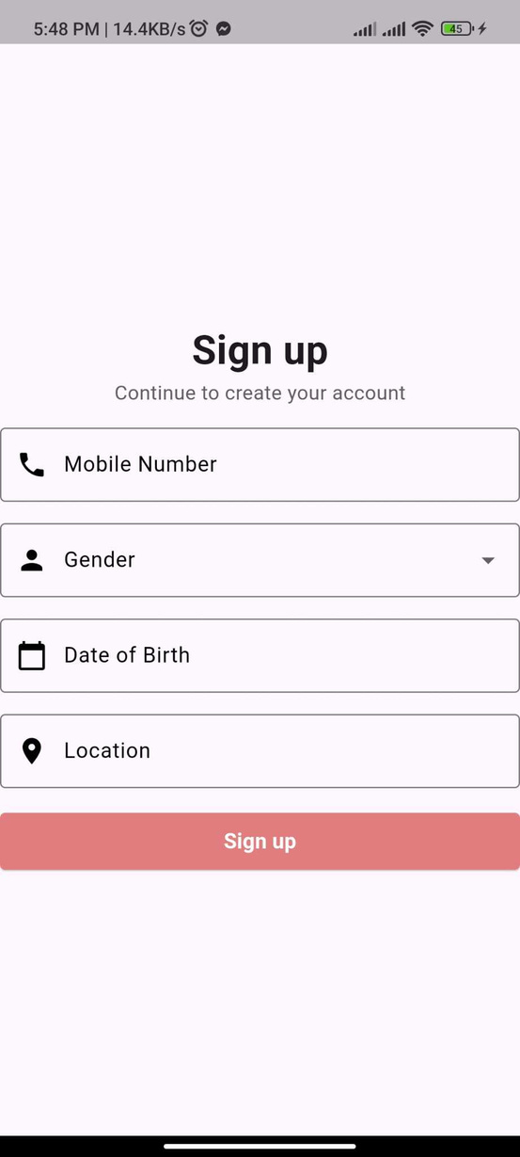
Signup Pages

Slide 11
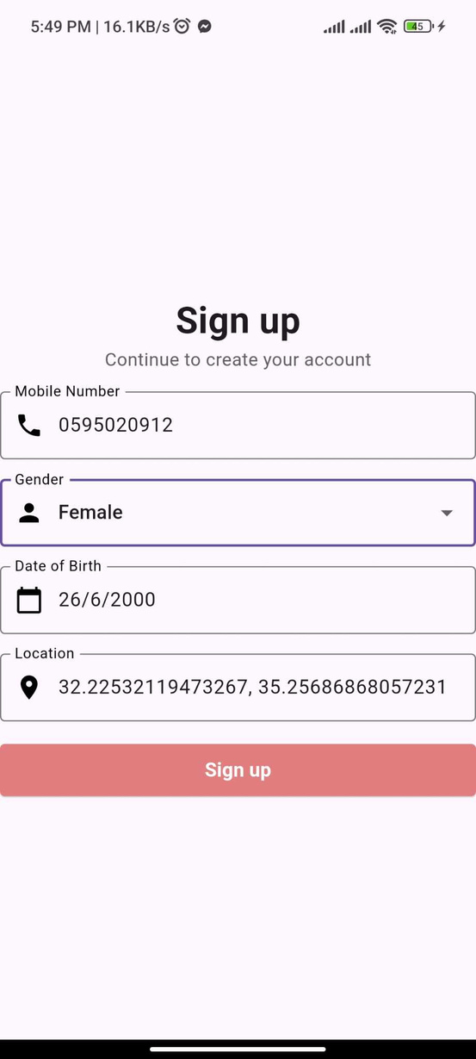
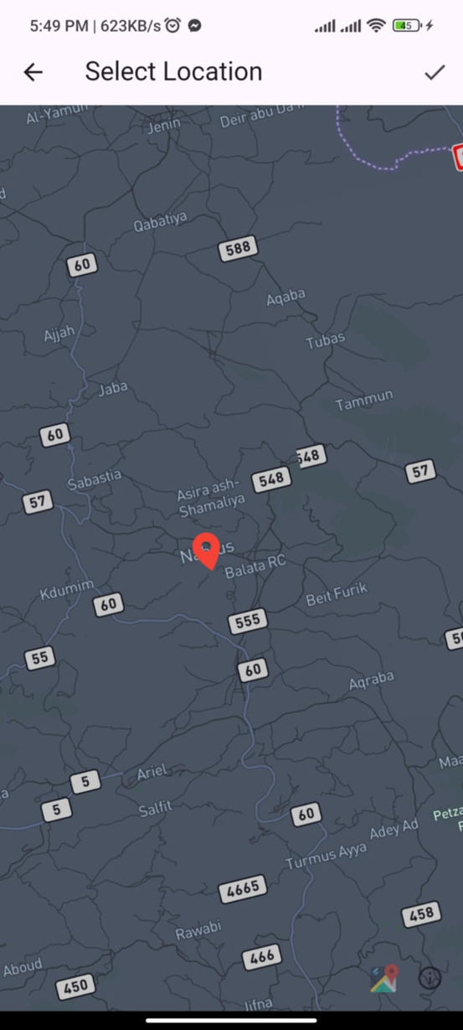
Select location

Slide 12
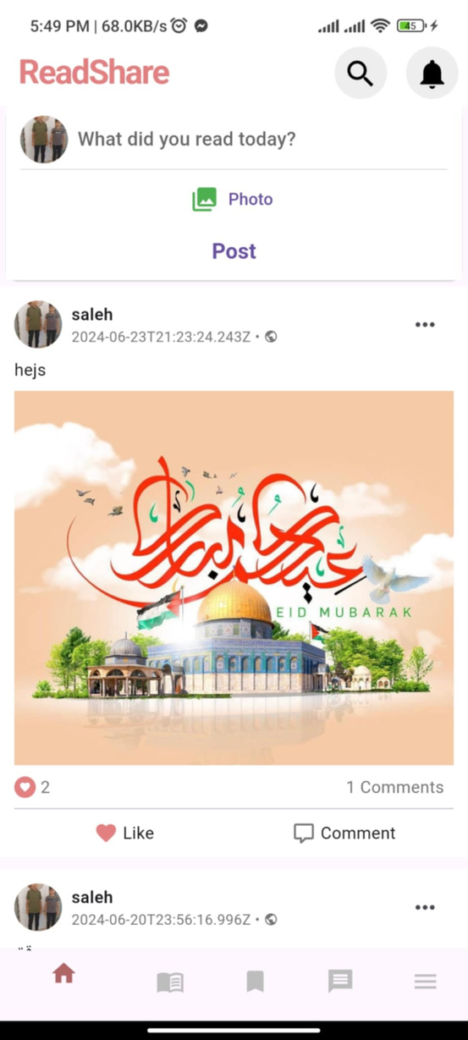
Home
Page

Slide 13
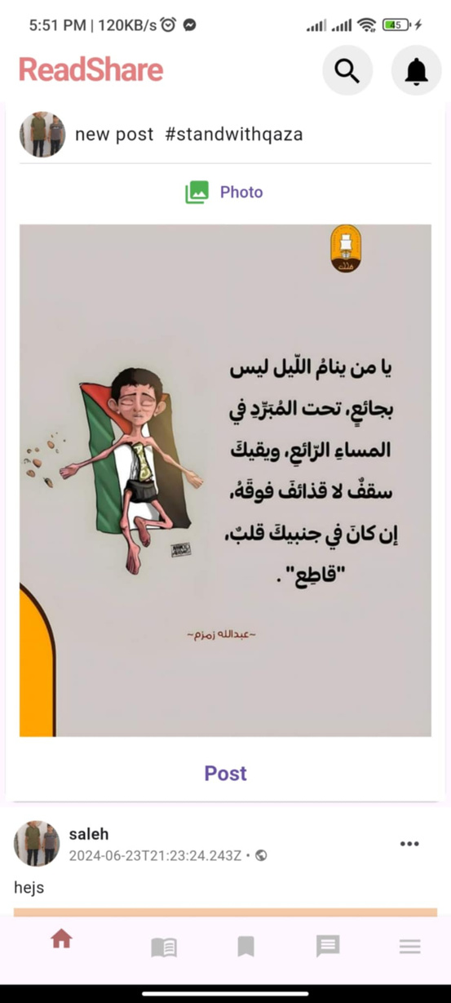
Upload an
Photo

Slide 14
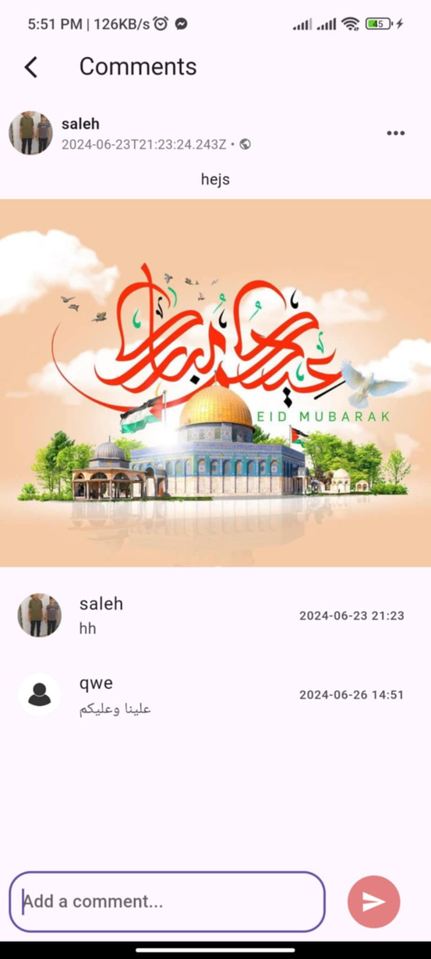
Comment
Page

Slide 15
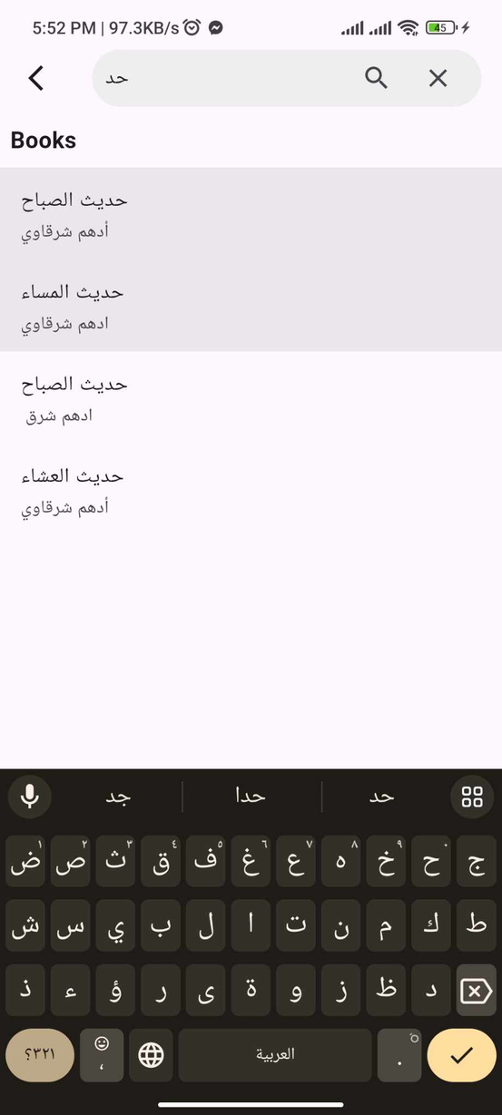
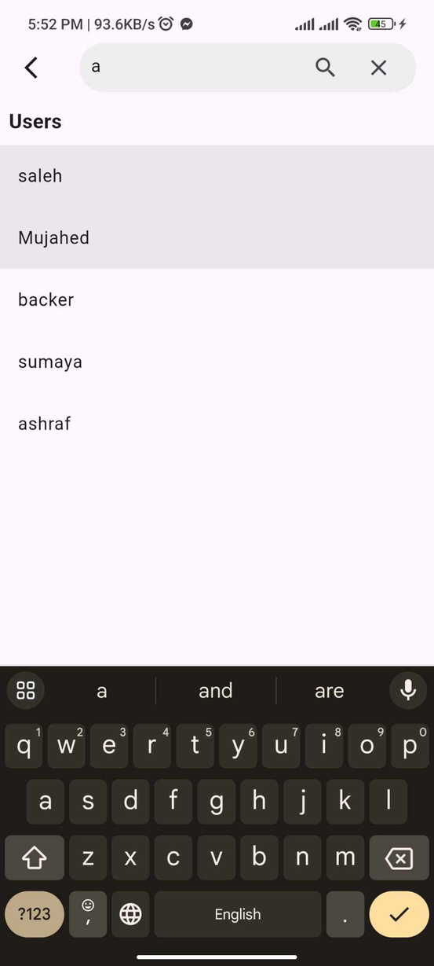
Search Feature

Slide 16
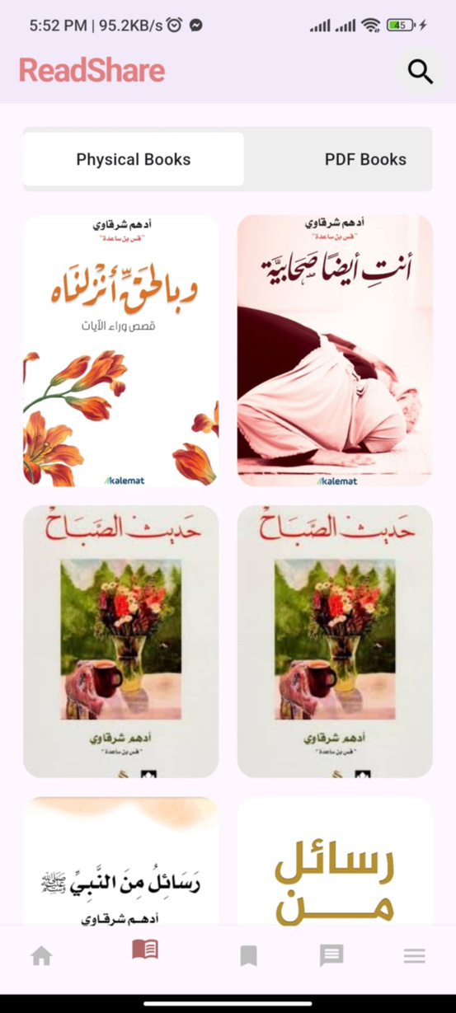
Book
Page

Slide 17
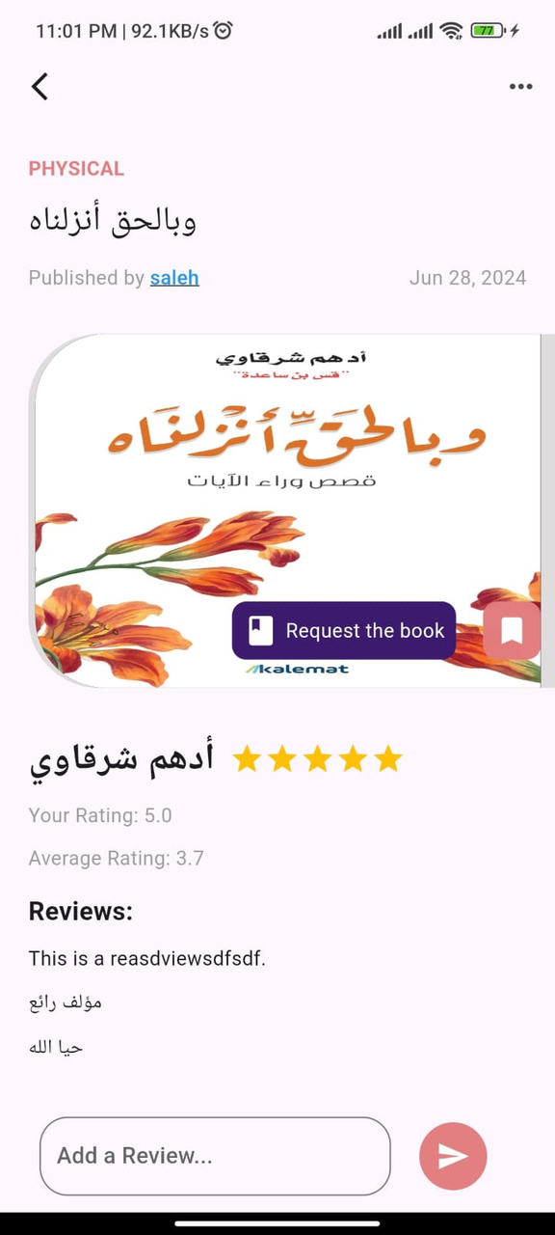
Book
details
page

Slide 18
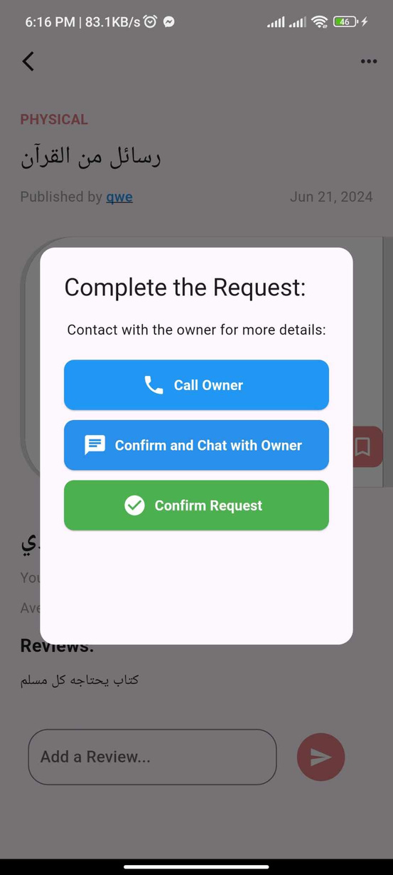
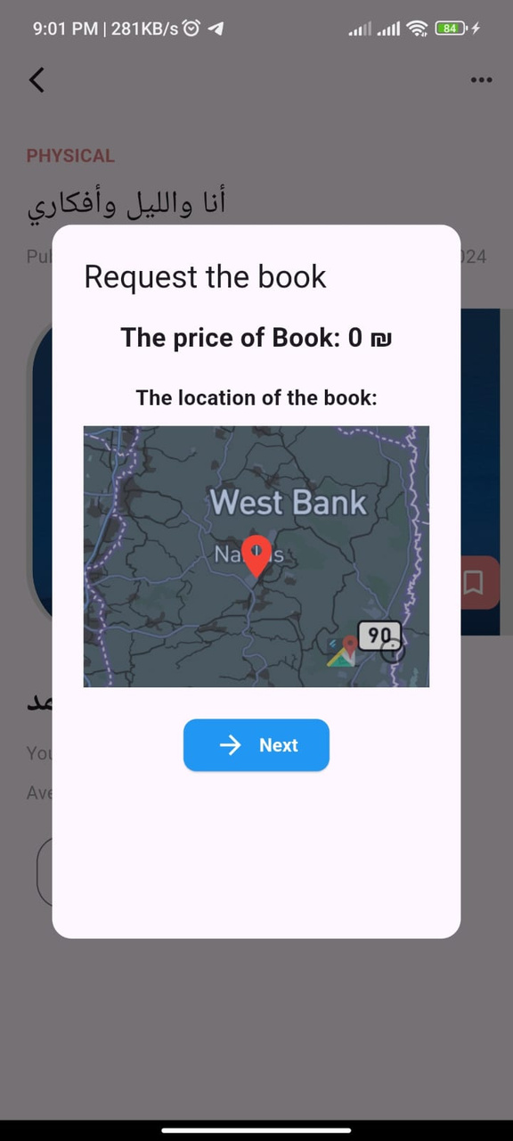
Request Book Feature

Slide 19
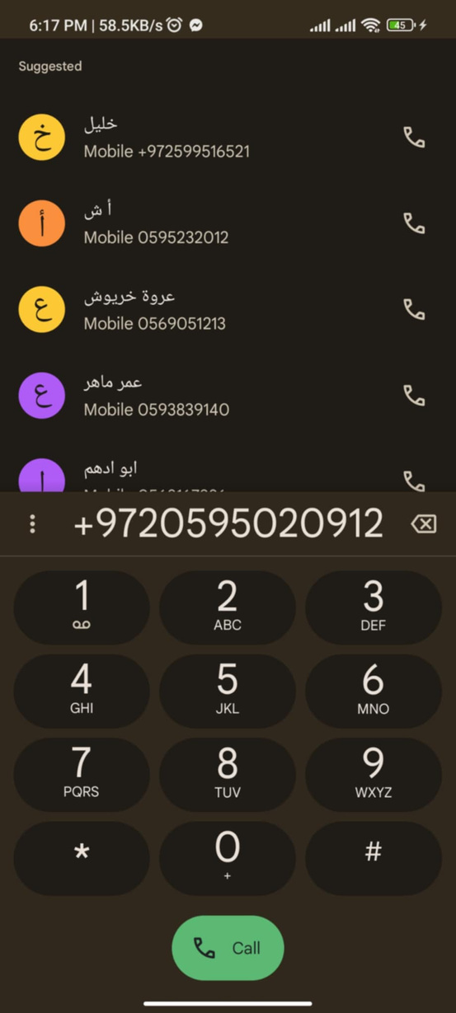
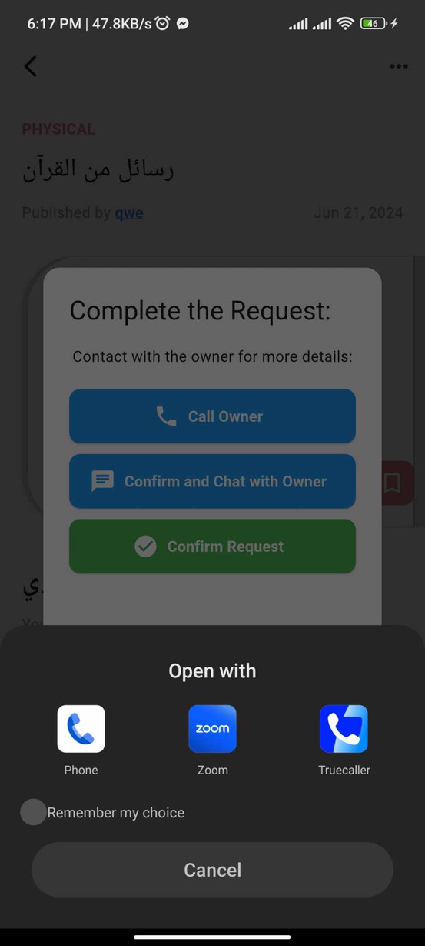
Call Owner
Option

Slide 20
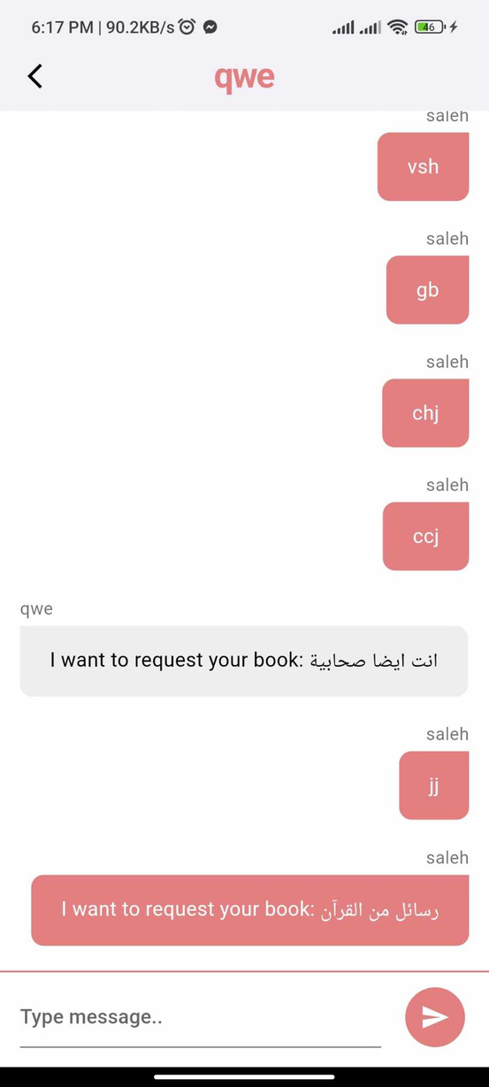
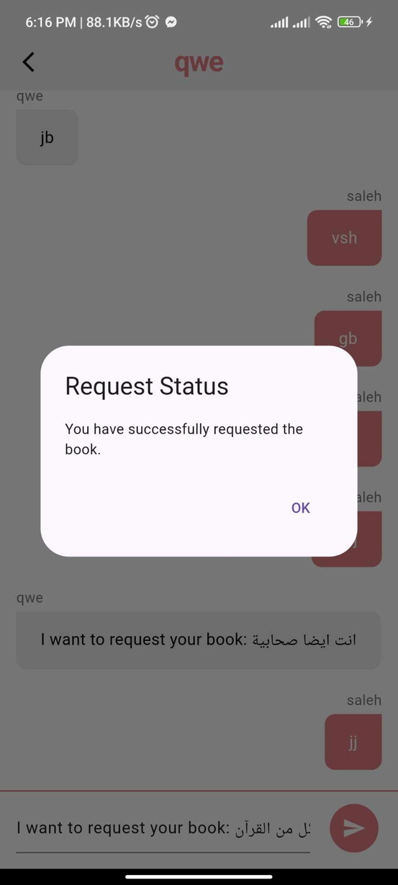
Confirm and Chat with the Owner

Slide 21



Confirm Request
This option sends the request electronically to the owner, who then has the right to accept or reject the request.
All requests made by the user will appear on the "My Requests" page within the
app, enabling the user.

Slide 22
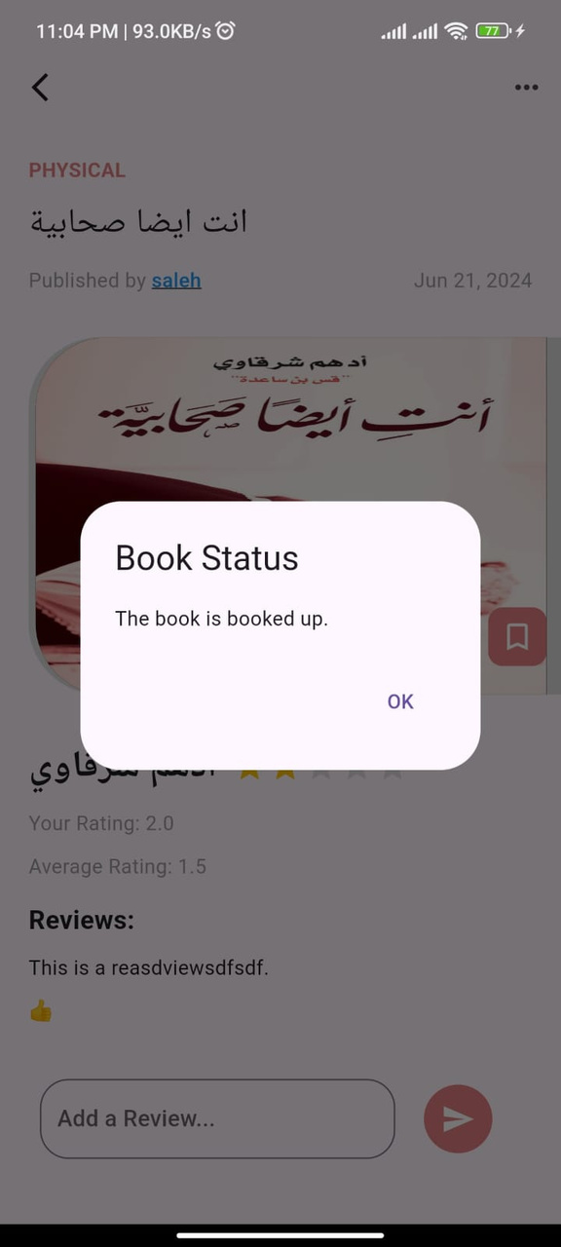
Book
is booked up

Slide 23
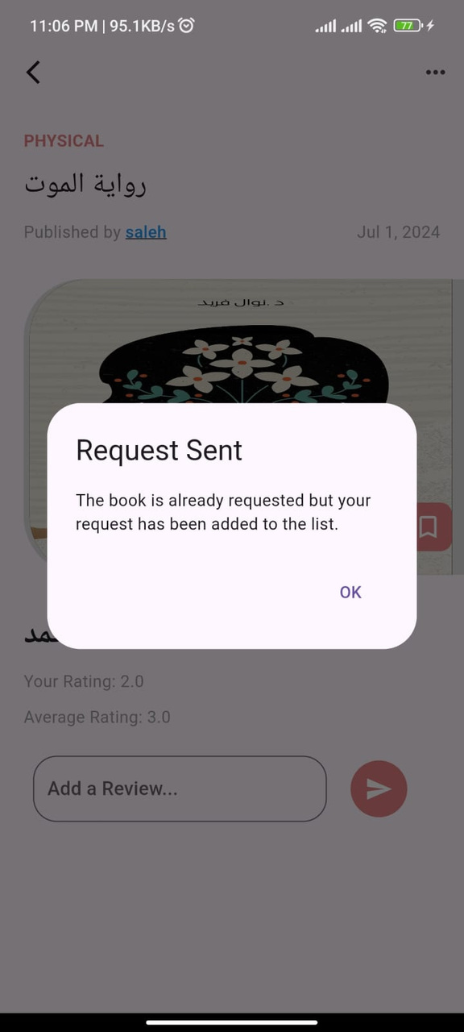
Request
Sent

Slide 24
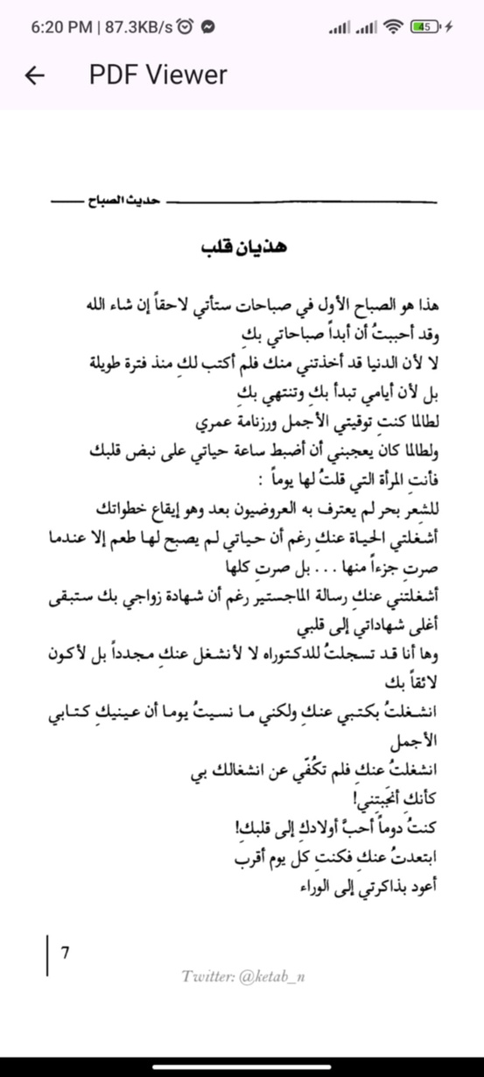
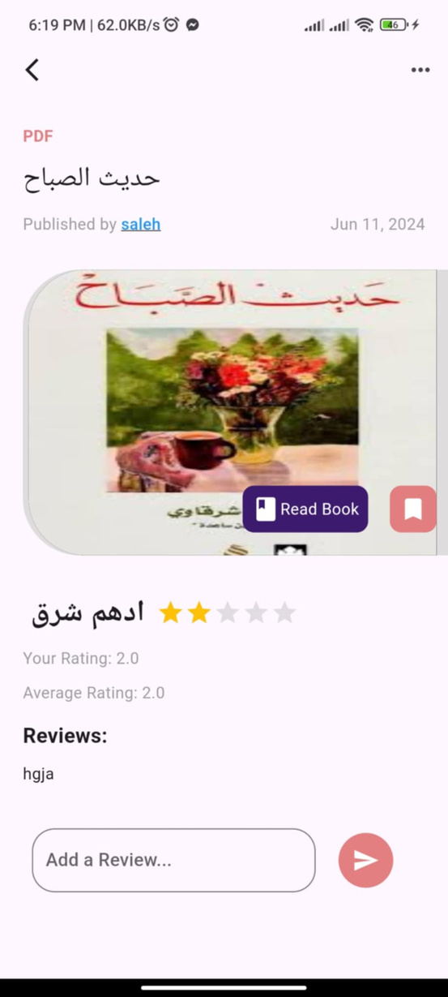
PDF Book Reading Feature

Slide 25
Book preference
The book cover has a “Save” button that enables users to save the book on the “Favorite books” page, whether the book is in physical or PDF format. This feature allows users to save books they want to read later or keep them in their personal library within the app.

Slide 26
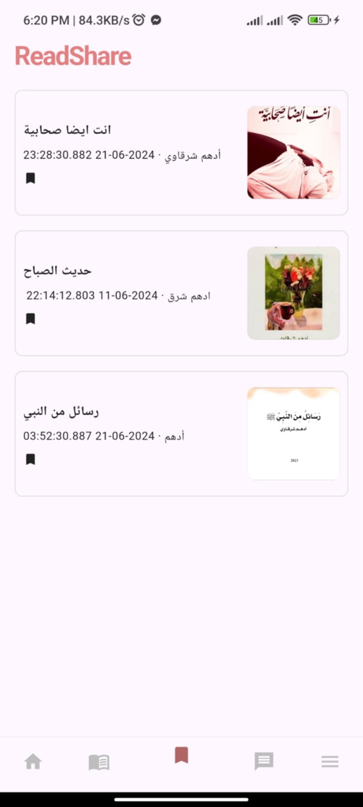
Favorite books
page

Slide 27
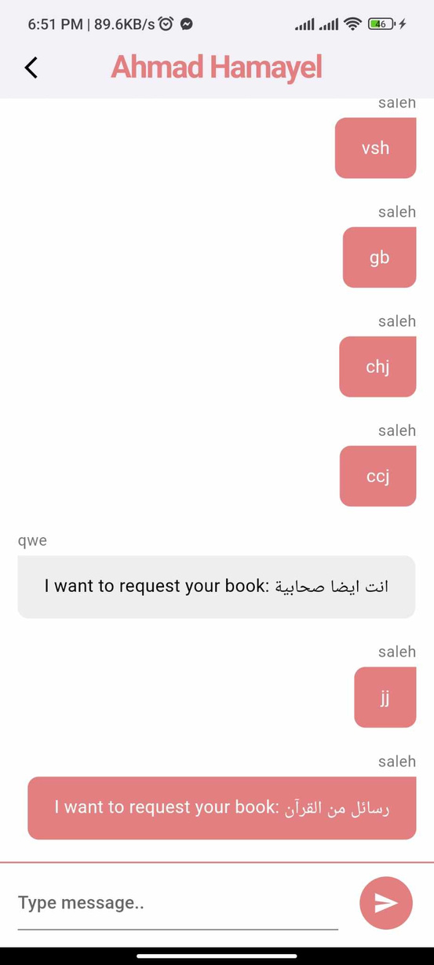
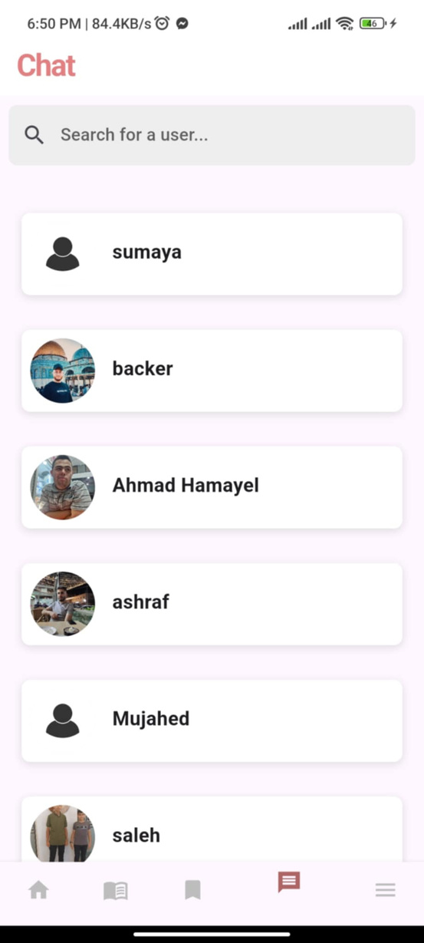
Chat
Page

Slide 28
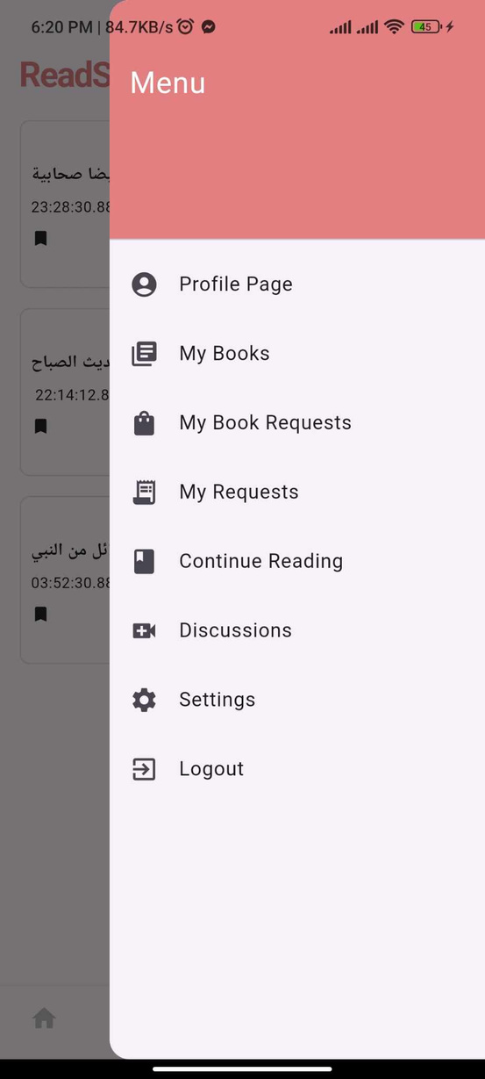
Menu
Page

Slide 29
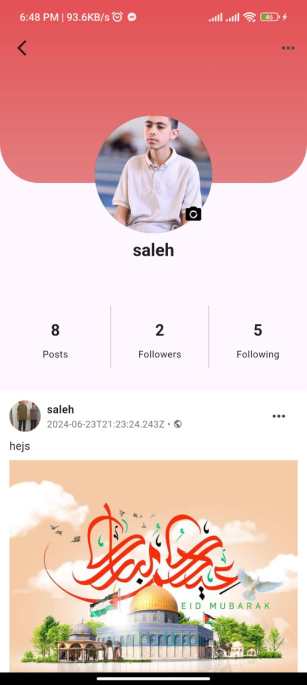
Profile Page

Slide 30
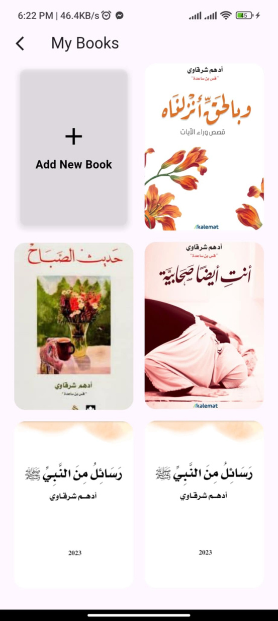
My Books

Slide 31
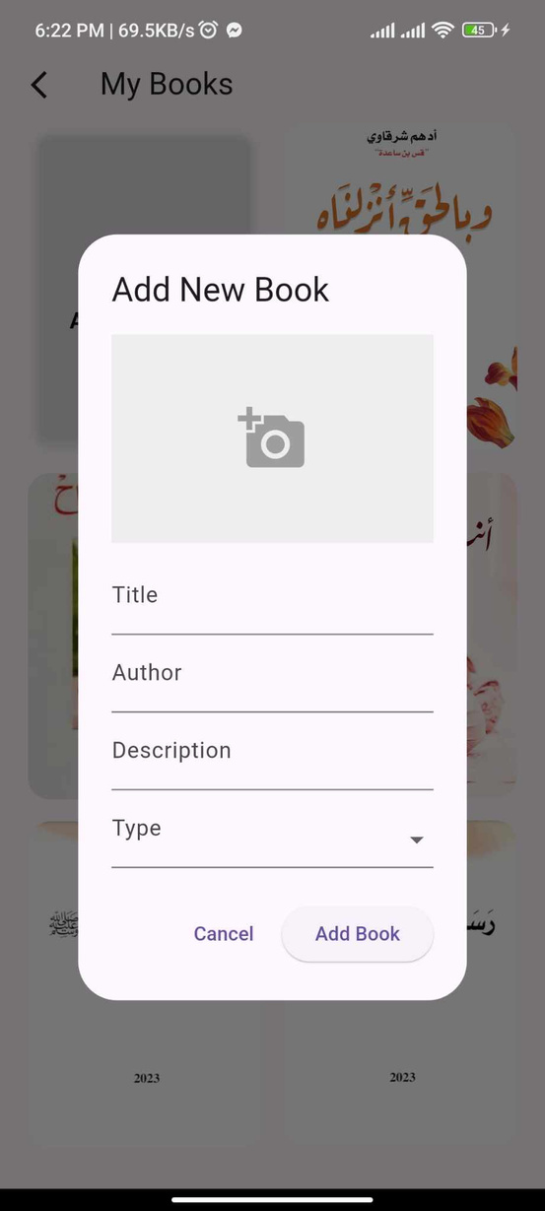
Add a
Book

Slide 32
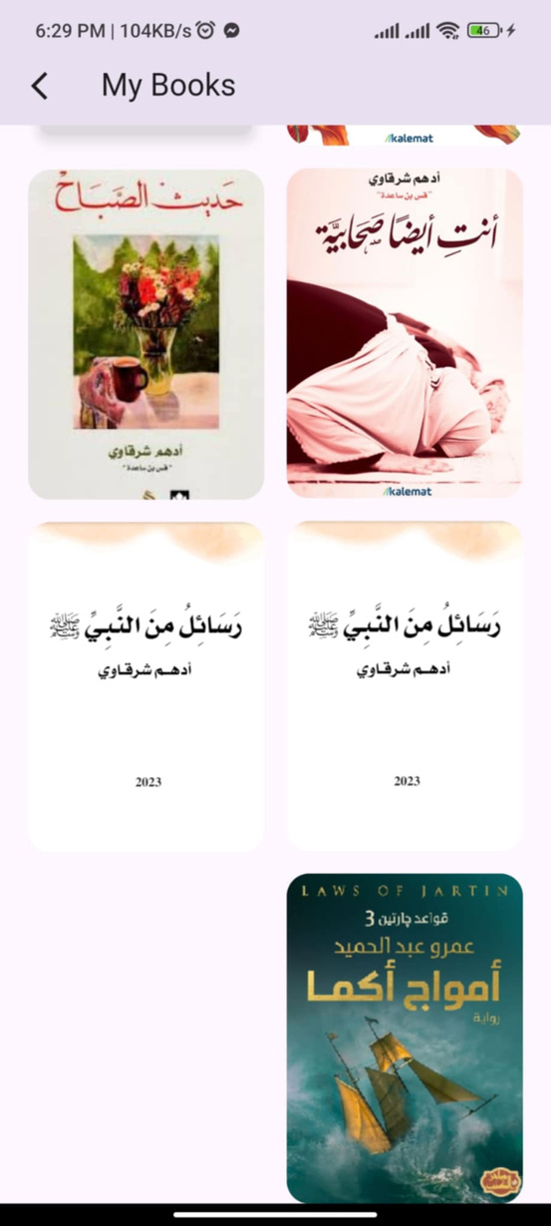
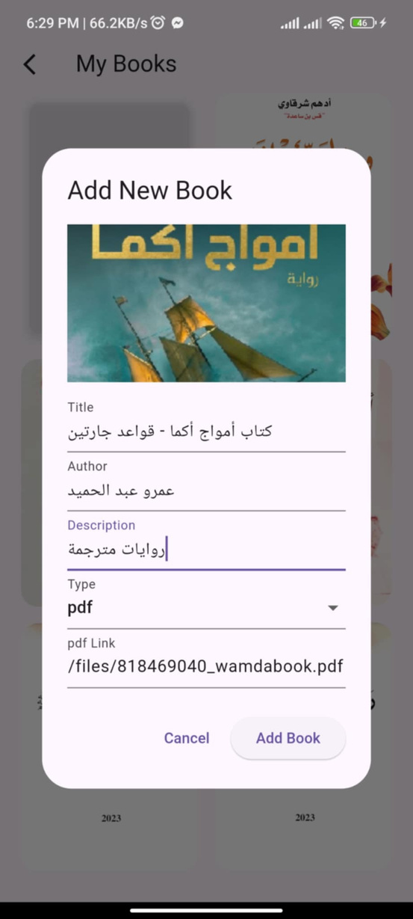
Add a PDF Book

Slide 33
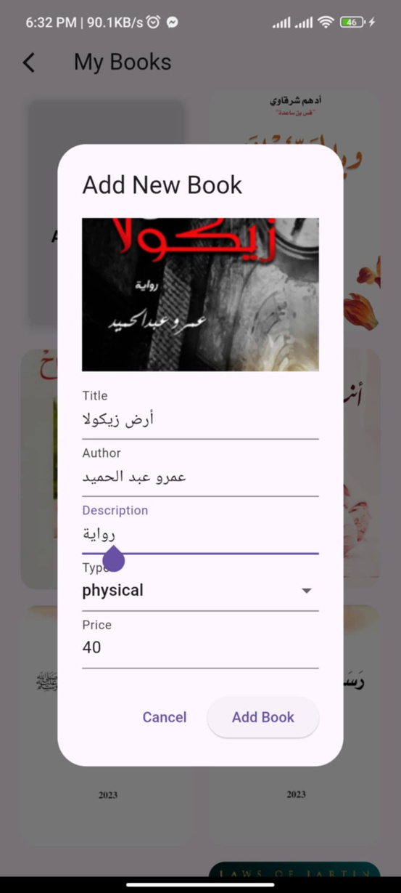
Add a
Physical Book

Slide 34
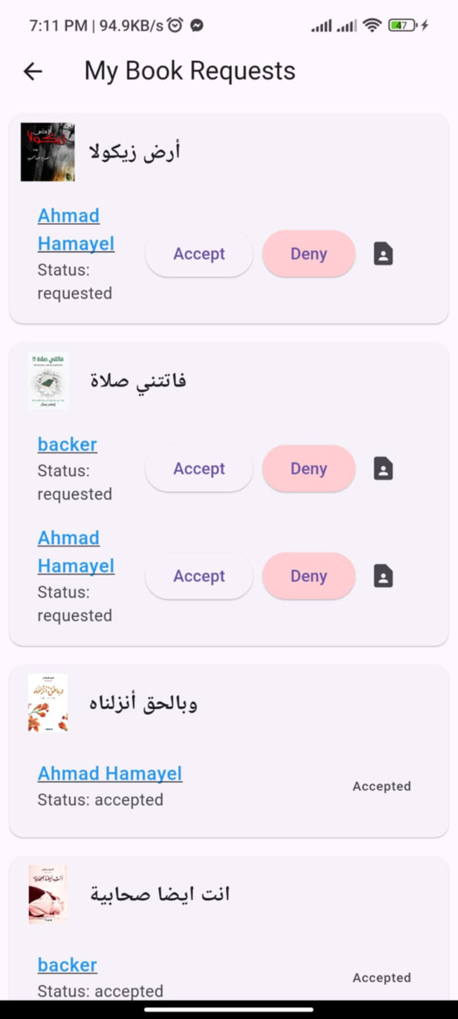
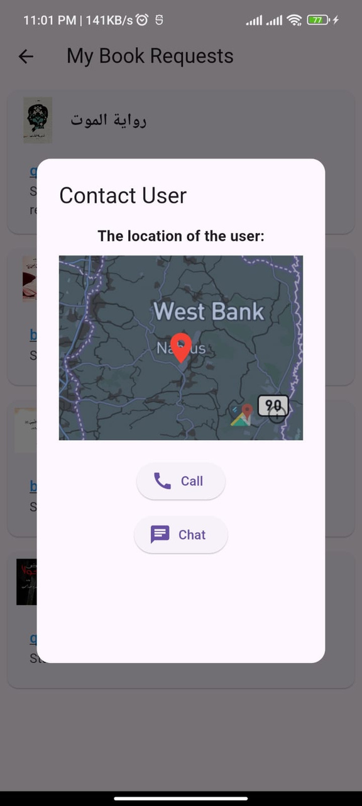
My Book Requests

Slide 35
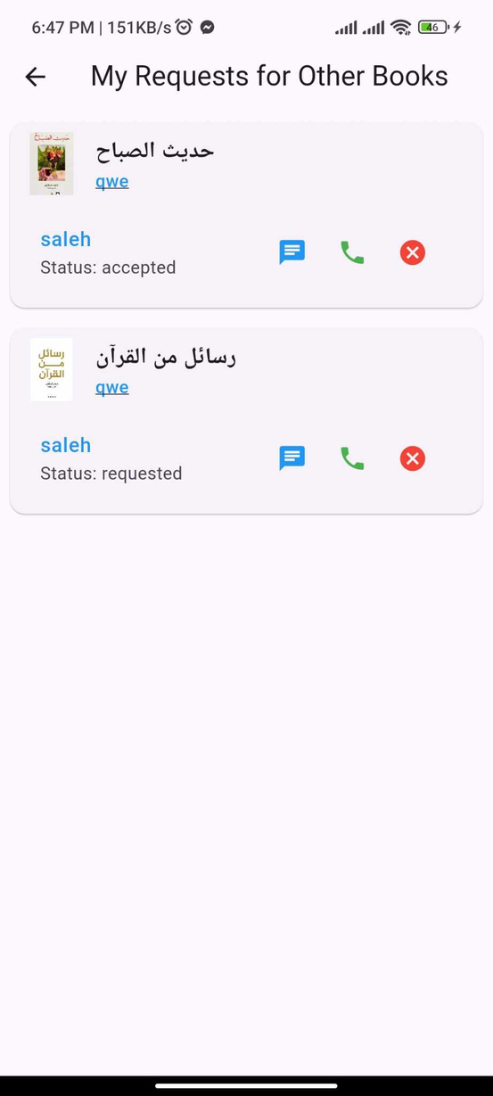
My Requests

Slide 36
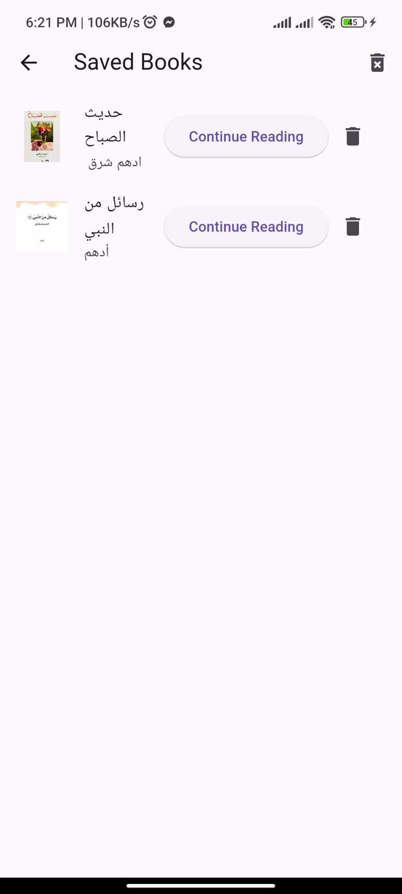
Continue Reading

Slide 37
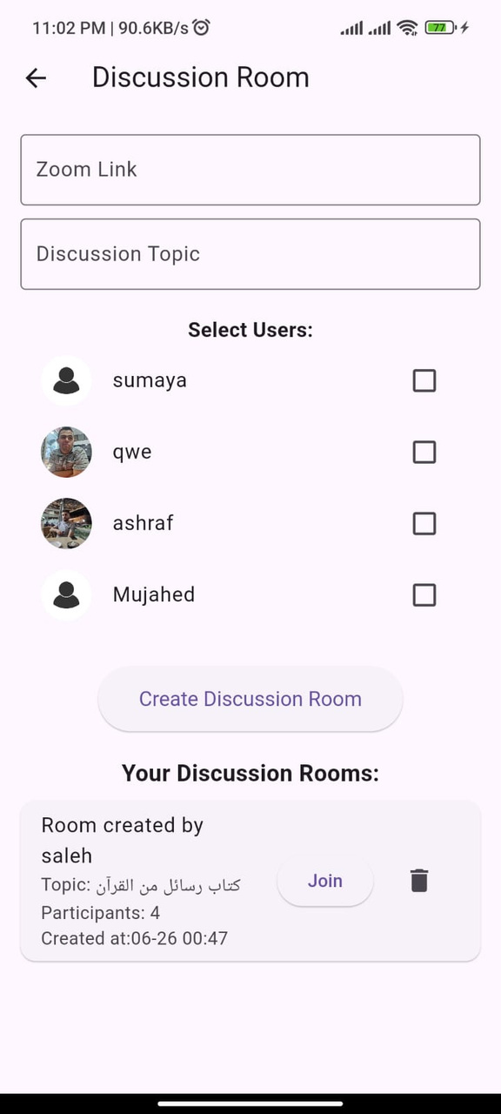
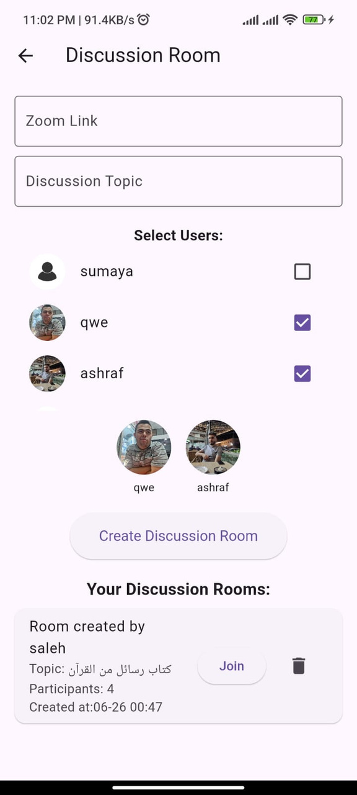
Discussion
Rooms

Slide 38
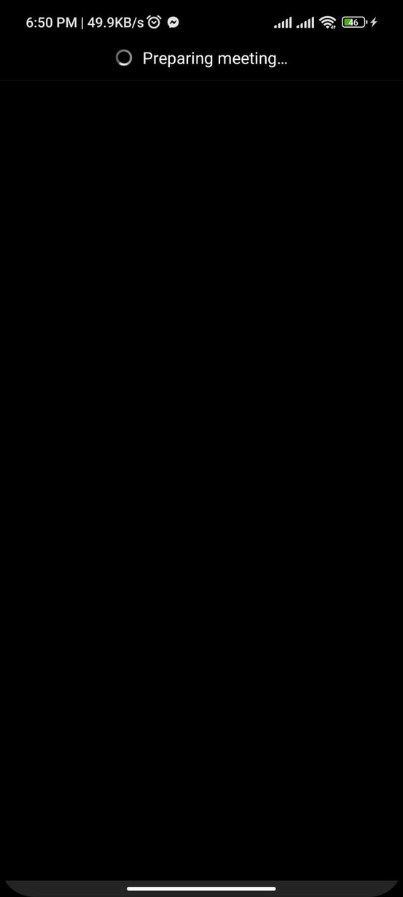
Zoom
Meeting

Slide 39
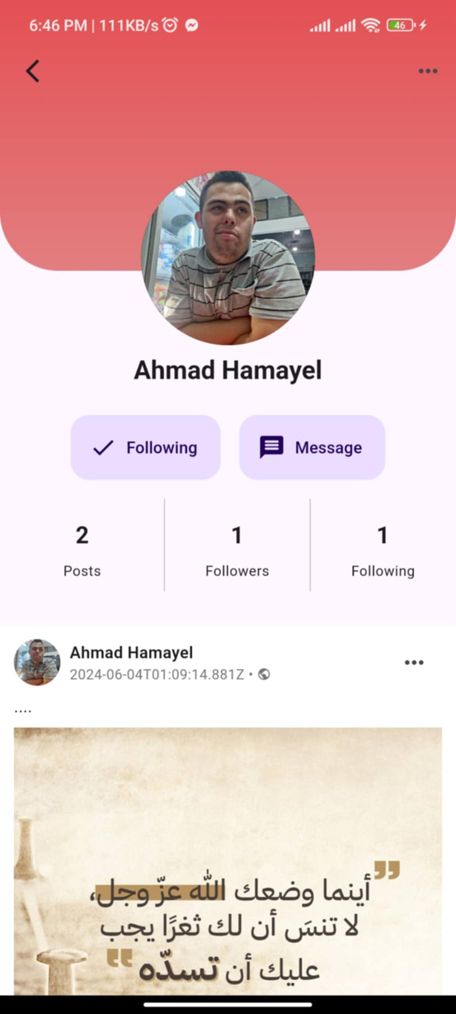
User Profile Page

Slide 40
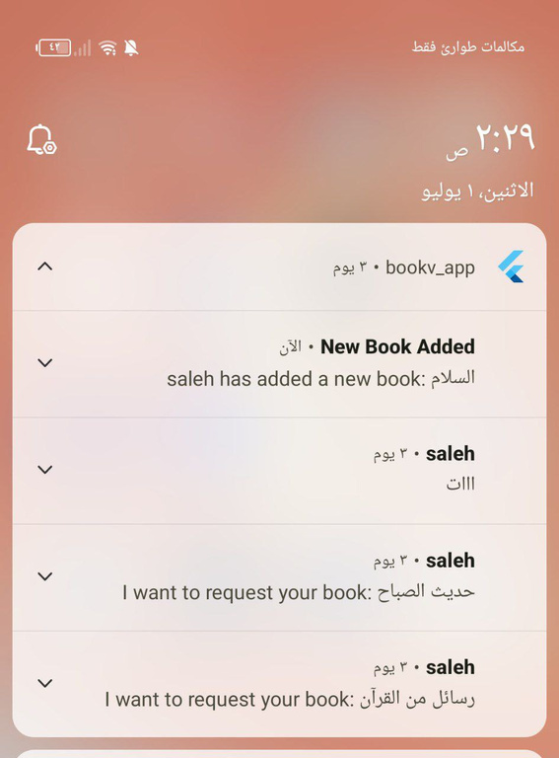
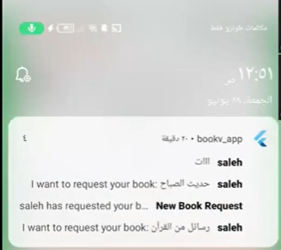
Notifications

Slide 41

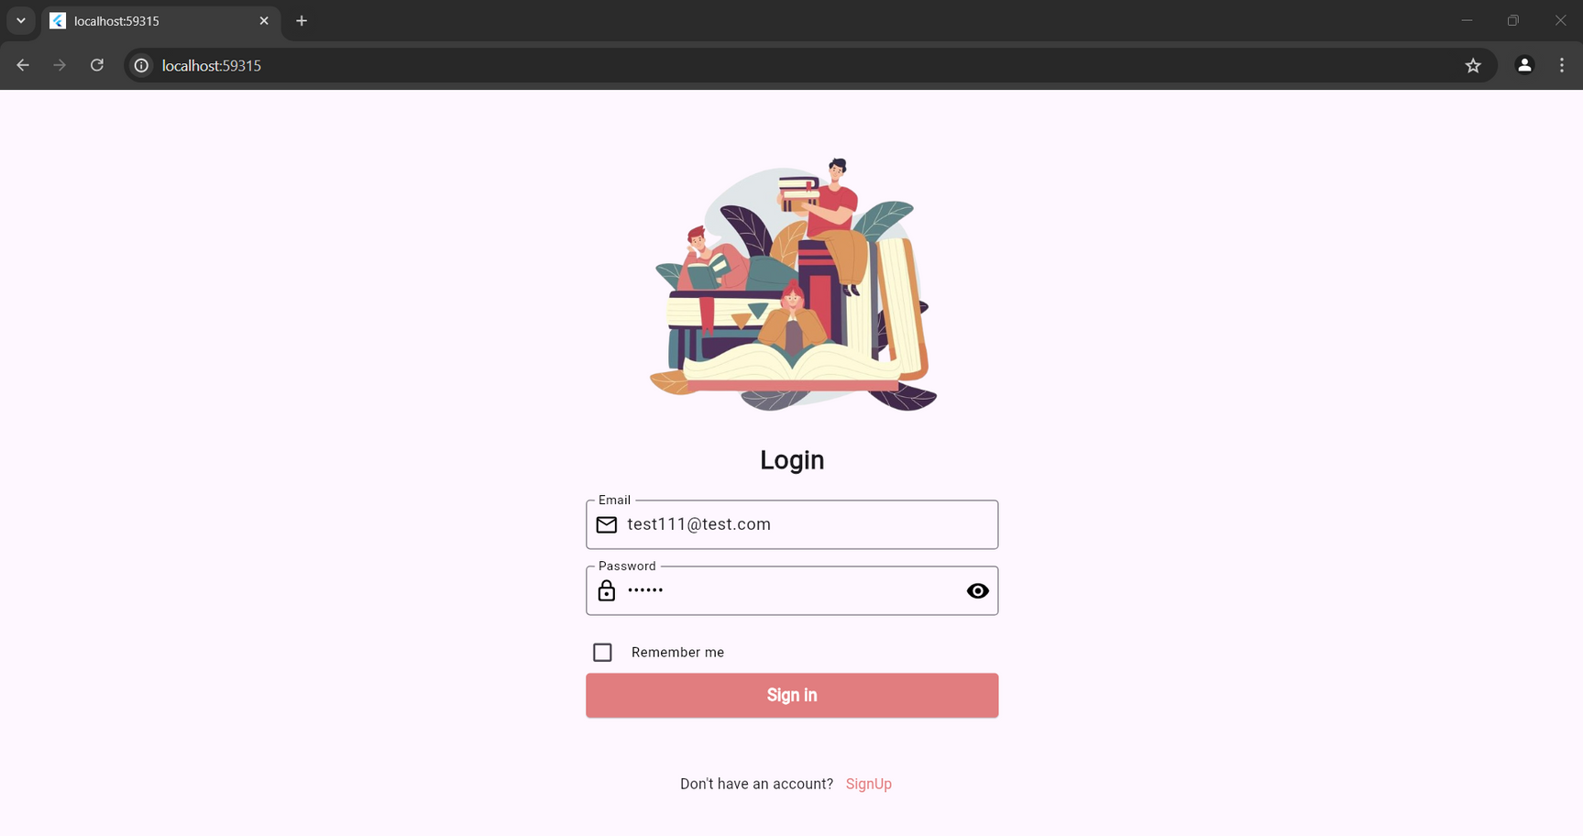


Web Application
Log in page

Slide 42
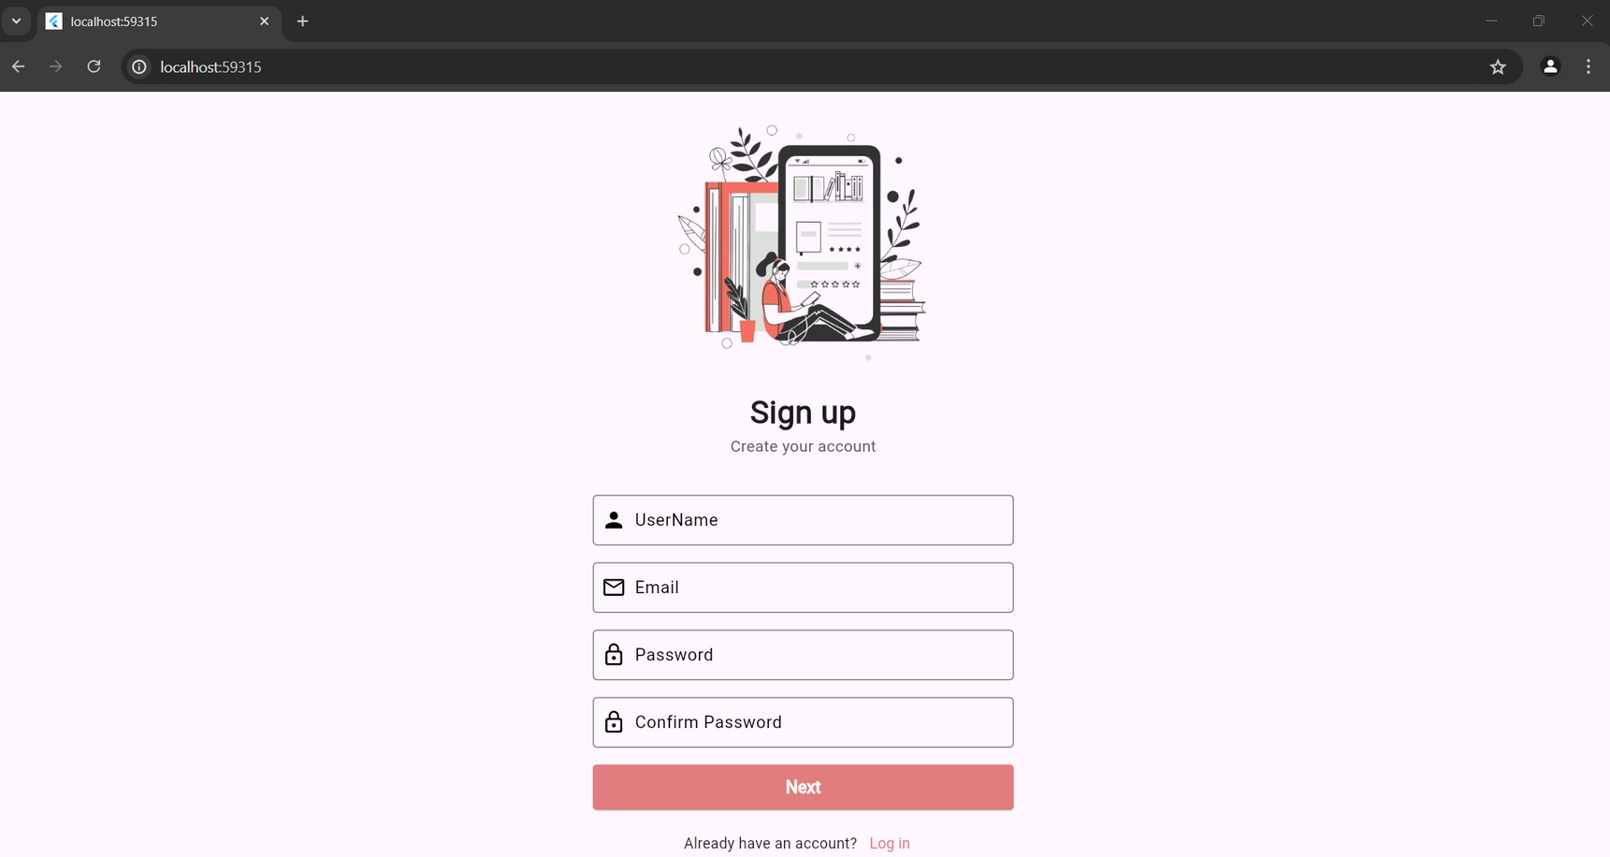
Web Application
Sign Up page

Slide 43
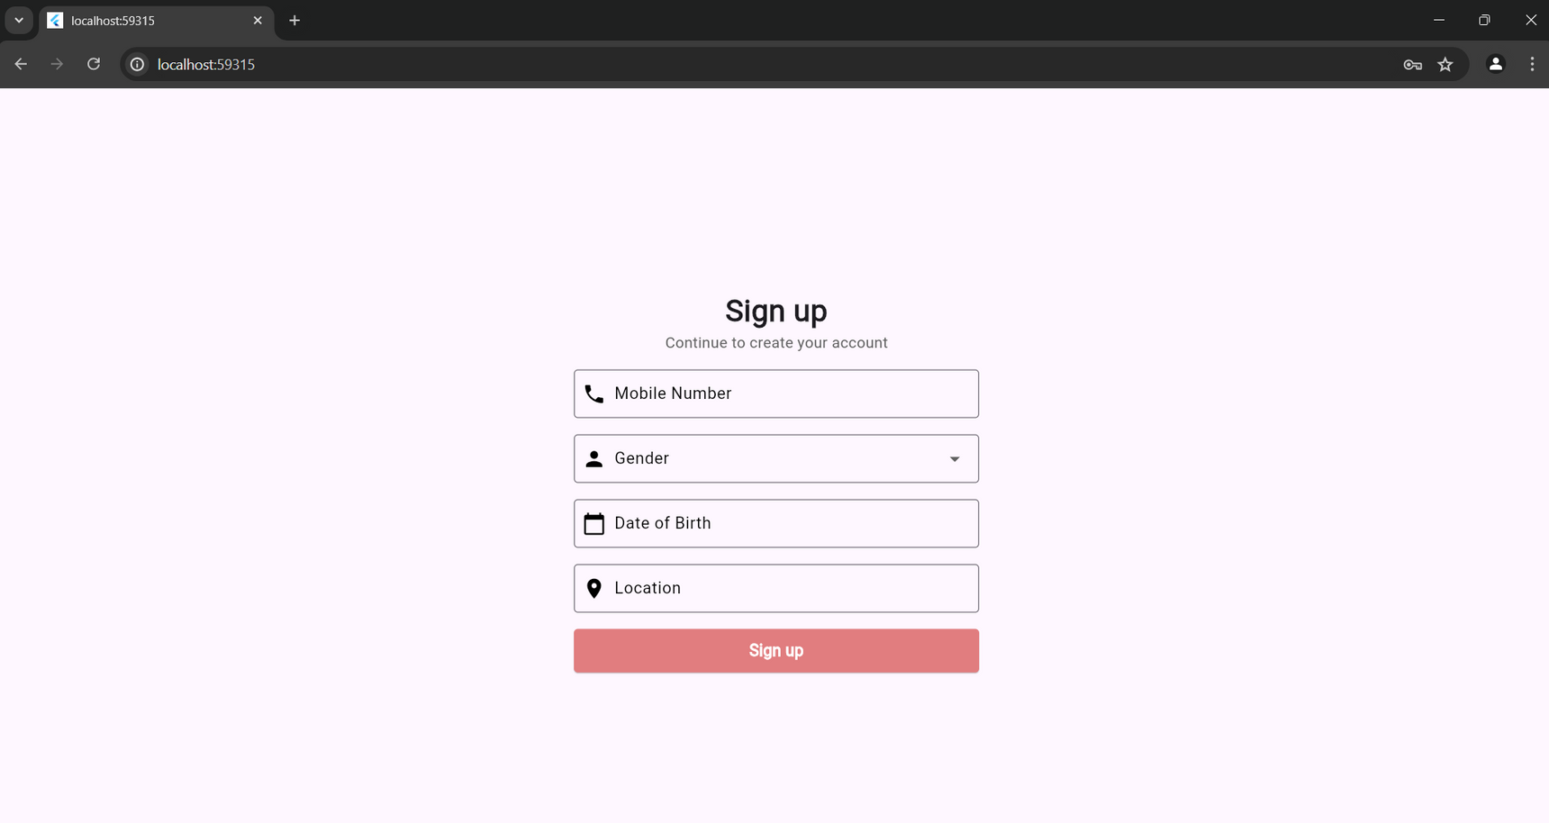
Web Application
Sign Up Page

Slide 44
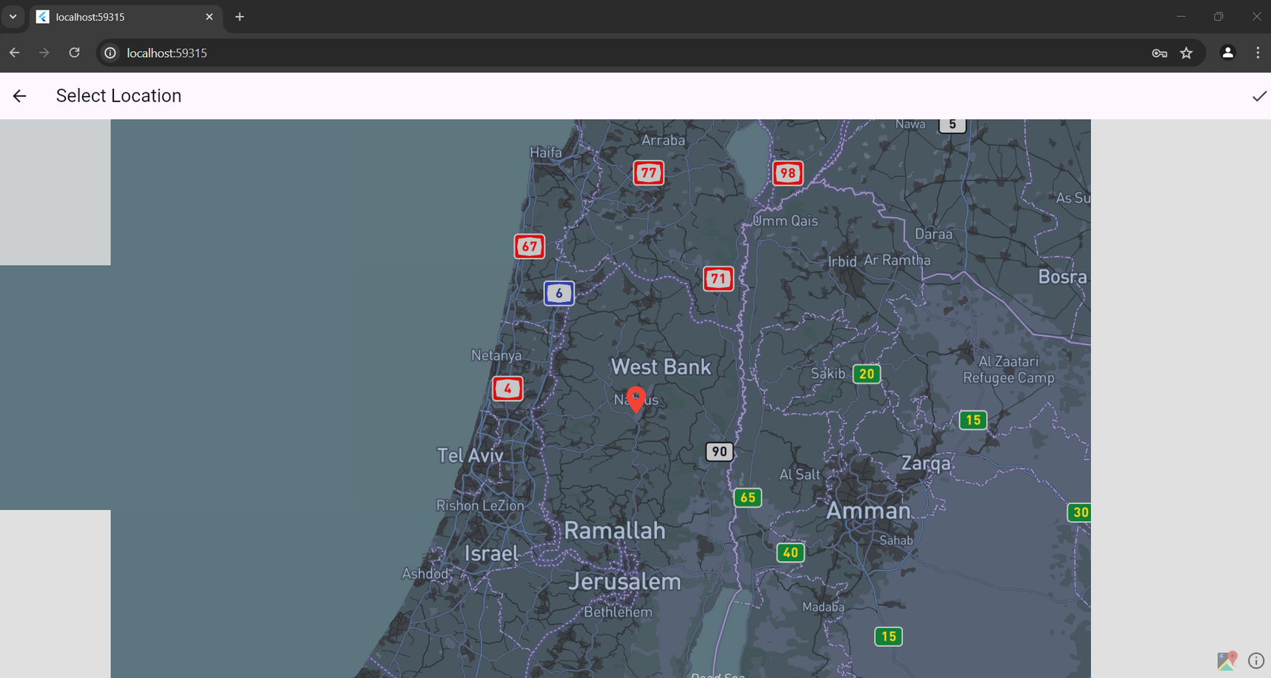
Web Application
Select location

Slide 45
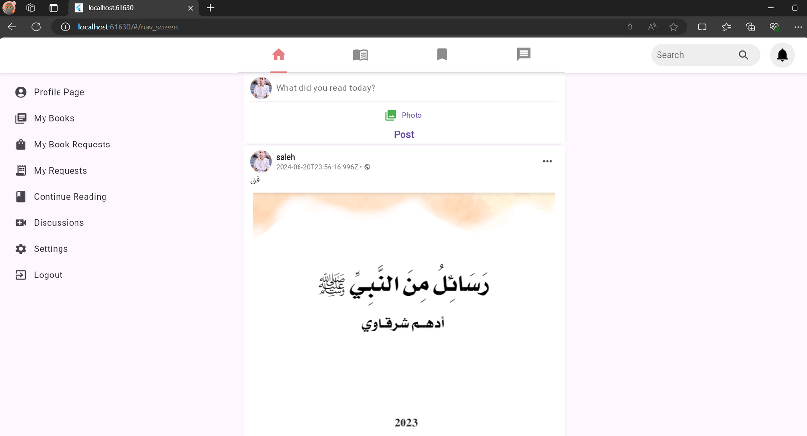
Web Application
Home Page

Slide 46
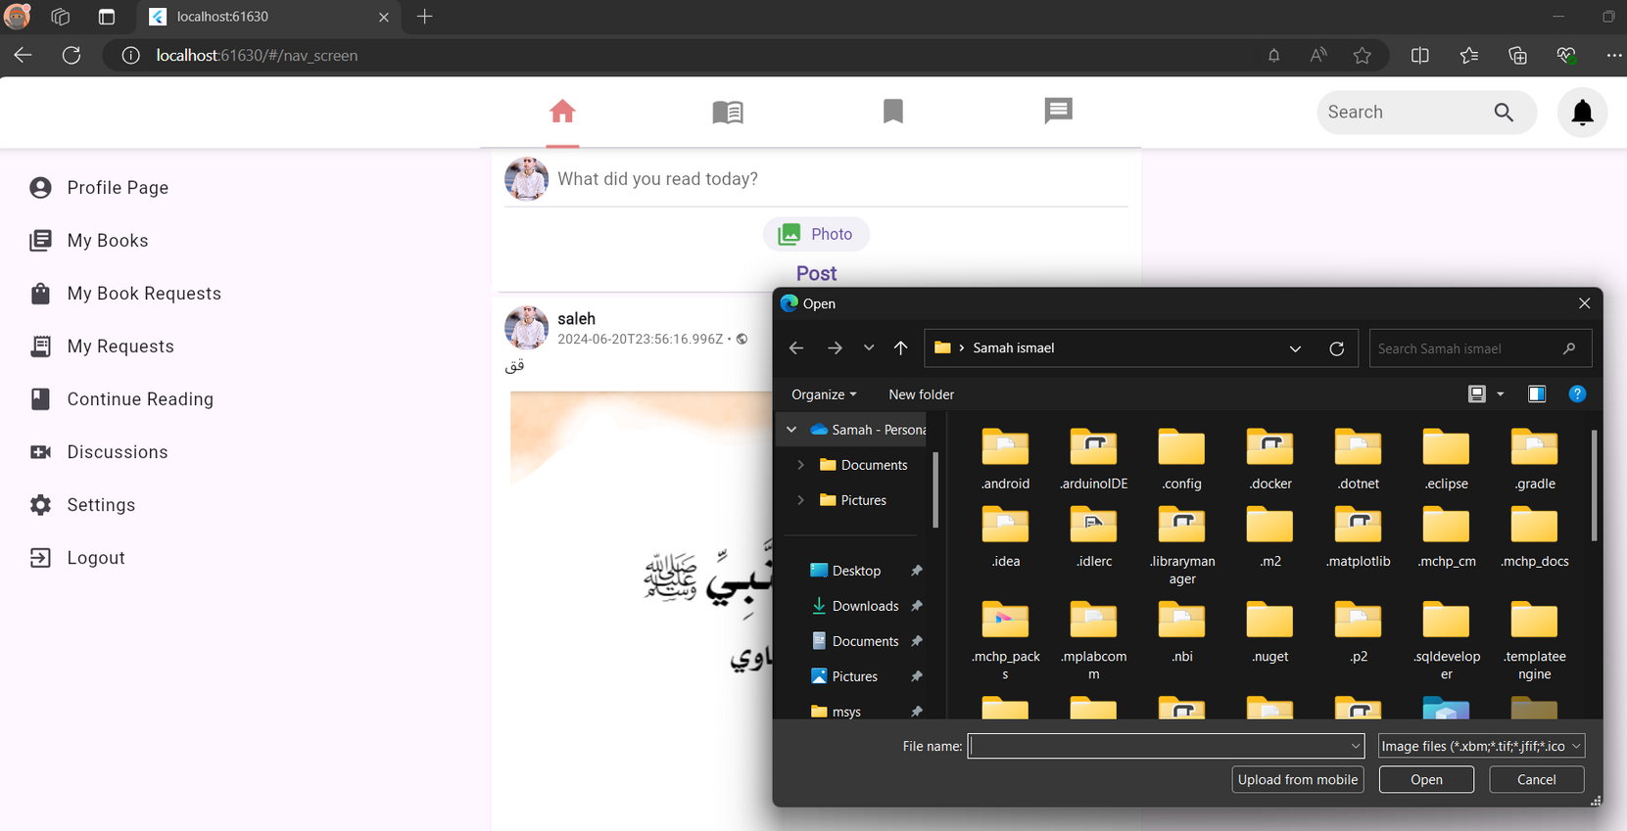
Web Application
Upload an
Photo

Slide 47
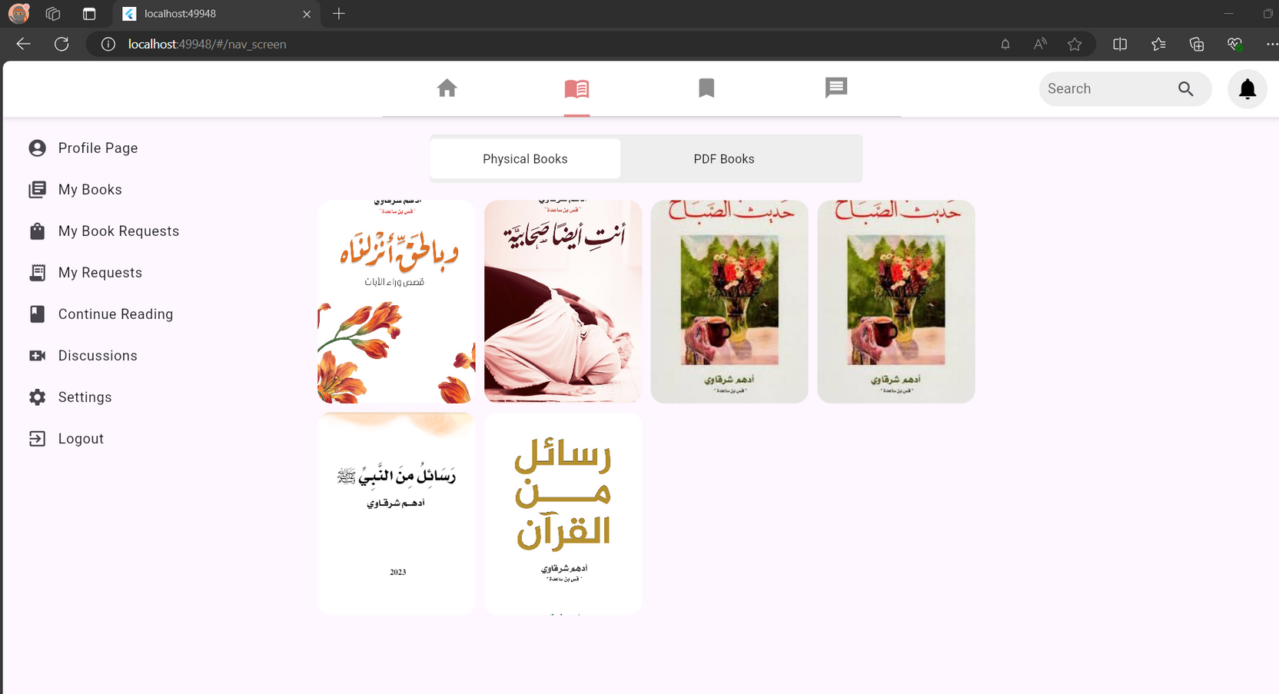
Web Application
Book Page

Slide 48

Web Application
Favorite books

Slide 49

Web Application
Chat Page

Slide 50


Challenges:
Lack of project building experience.
Learn new Framework in short time.
Find good tutorial and community of technologies that we used.
We work remotely, and the distance between us is long, making it difficult for us to meet.

Slide 51
Future Work
Using artificial intelligence to identify the types of books that the user prefers and request to display them first on the books page (recommendation system).
Add more Features to app.

Slide 52

Thank's For Watching

