Slide 1

Tactical Level Business Intelligence.
Presented by : Haya Adli
Marah Bouzia
Supervisor : D. Maher Arafat

Slide 2
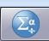
project Idea
1)The idea of our graduation project is to analyze the sales of a business for three months in a row by knowing the volume of sales according to our data
2) After we analyzed the sales using the statistical analysis program SPSS we did not notice a deterioration in the quantity of sales in a particular month during these three months as a total sales total or choose a certain type of sales and find a quantity sold this month

Slide 3
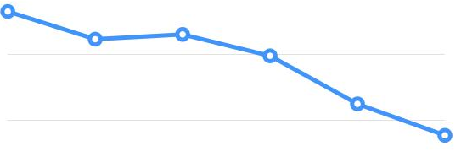
Lower sales volume is a problem for the seller
problem

Slide 4
Our goal as analysts will be after the sales improvement analysis process
Goals:

Slide 5
Using several methods to get rid of this decline
Methods

Slide 6
This decline was detected using a technique called OLAP Cubes
Method

Slide 7
Definition of OLAP Cubes
Online Analytical Processing in SPSS .
Initially it was a technique used by the SPSS program in our project.
The OLAP (Online Analytical Processing) Cubes procedure calculates totals, means, and other univariate statistics for continuous summary variables within categories of one or more categorical grouping variables. A separate layer in the table is created for each category of each grouping variable

Slide 8

OLAP stand for ?
1.Online: Named Online because it is analyzed using the Internet
2. Analytical : An analytical analysis based on multidimensional analysis and the ability to analyze arithmetic
3.Processing: It is called processing because it is based on processing data in different ways

Slide 9
How we used the OLAP Cubes to report sales analysis??
In the beginning, we have brought data, modified, processed, and added deficiencies

Slide 10
Why we use OLAP Cubes in our project
We used it to make analyzes for the previous three months to make comparisons every month on a sales volume basis
Each month consists of the following information:
Sales price
Quantity of sales
Name of item sold
Date of sale
It also consists of periods of sales for each day of the month

Slide 11
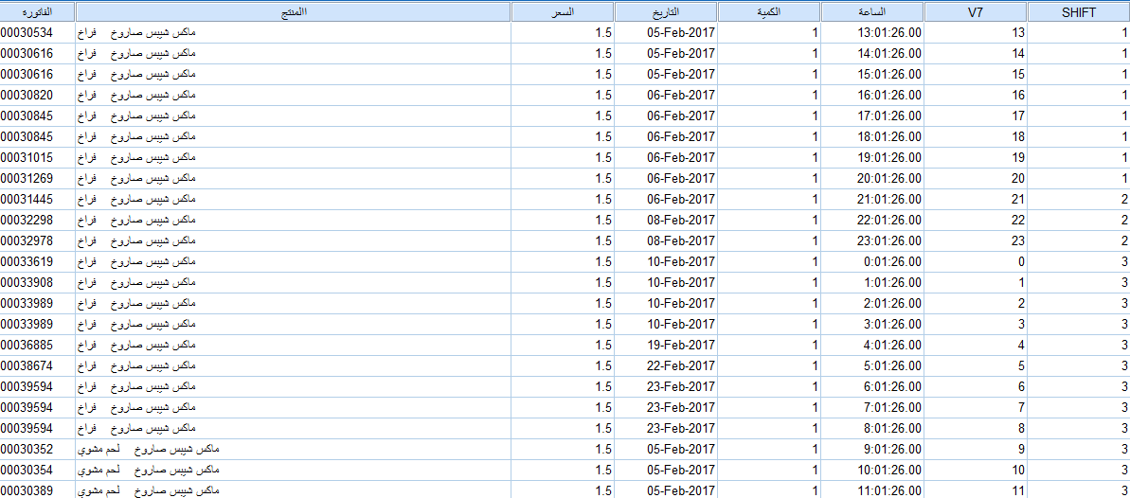
This slide is the form of data in the SPSS interface

Slide 12
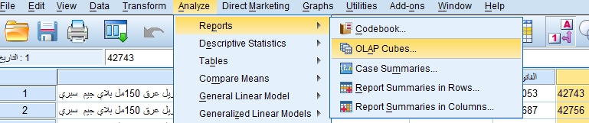
How to create OLAP Cubes using SPSS
1
2
3

Slide 13
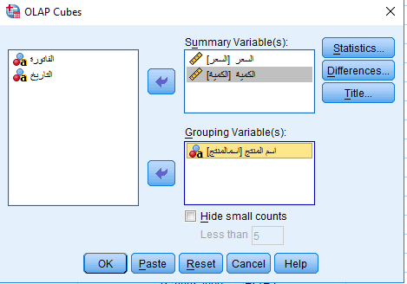
The components of OLAP Cubes in SPSS

Slide 14
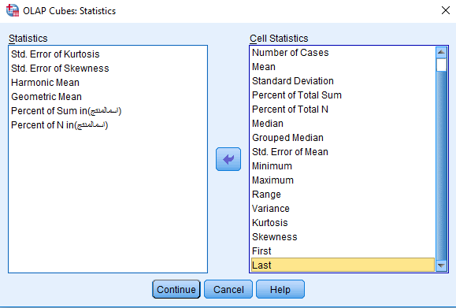

Slide 15
Part one:
We will display the sales quantity for 3 months separately and make comparisons between sales

Slide 16
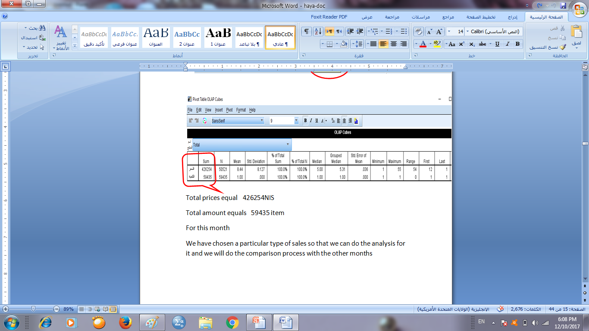
first month
Total amount : 59,435 item

Slide 17
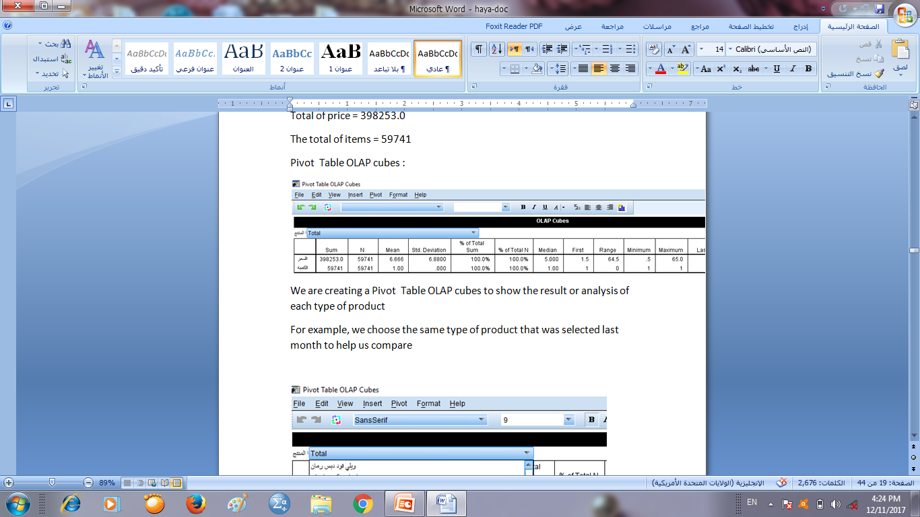
second month
The total of items = 59,741

Slide 18
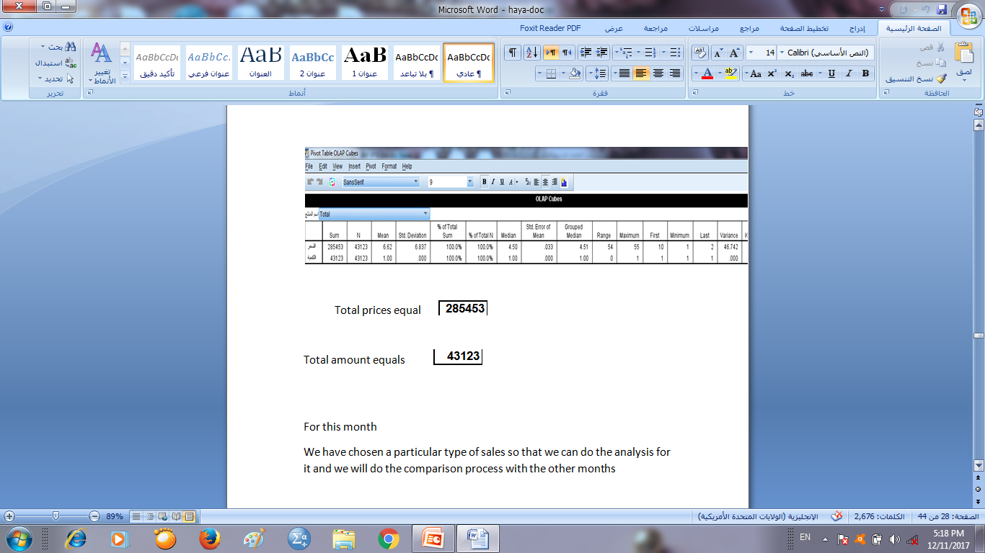
Third month
Total amount : 43,123

Slide 19
1st month
2nd month
3rd month
59,435
59,741
43,123
We noticed that the first and second months were close and high, but in the third month sales were low

Slide 20
We have chosen a particular type of sales called (يوهو كيك) so that we can do the analysis for it and we will do the comparison process with the other months

Slide 21
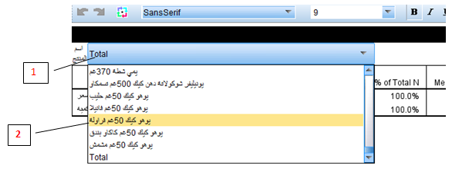
1st month
We select the -< يوهو كيك 20 غم فراولة

Slide 22
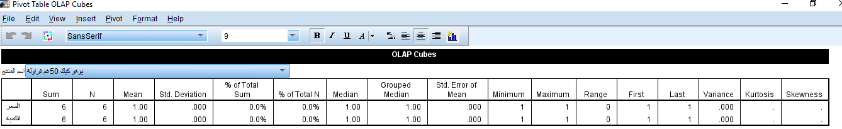
total price 6
total amount 6

Slide 23
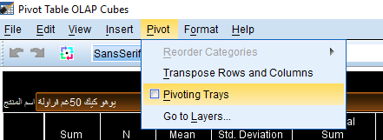
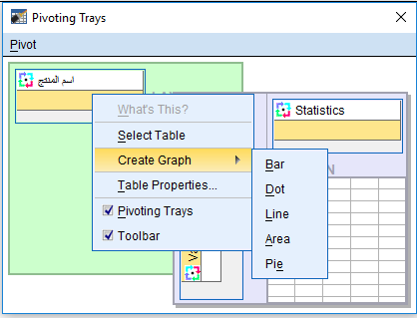
We make the bar chart by using this method
1
3
2

Slide 24
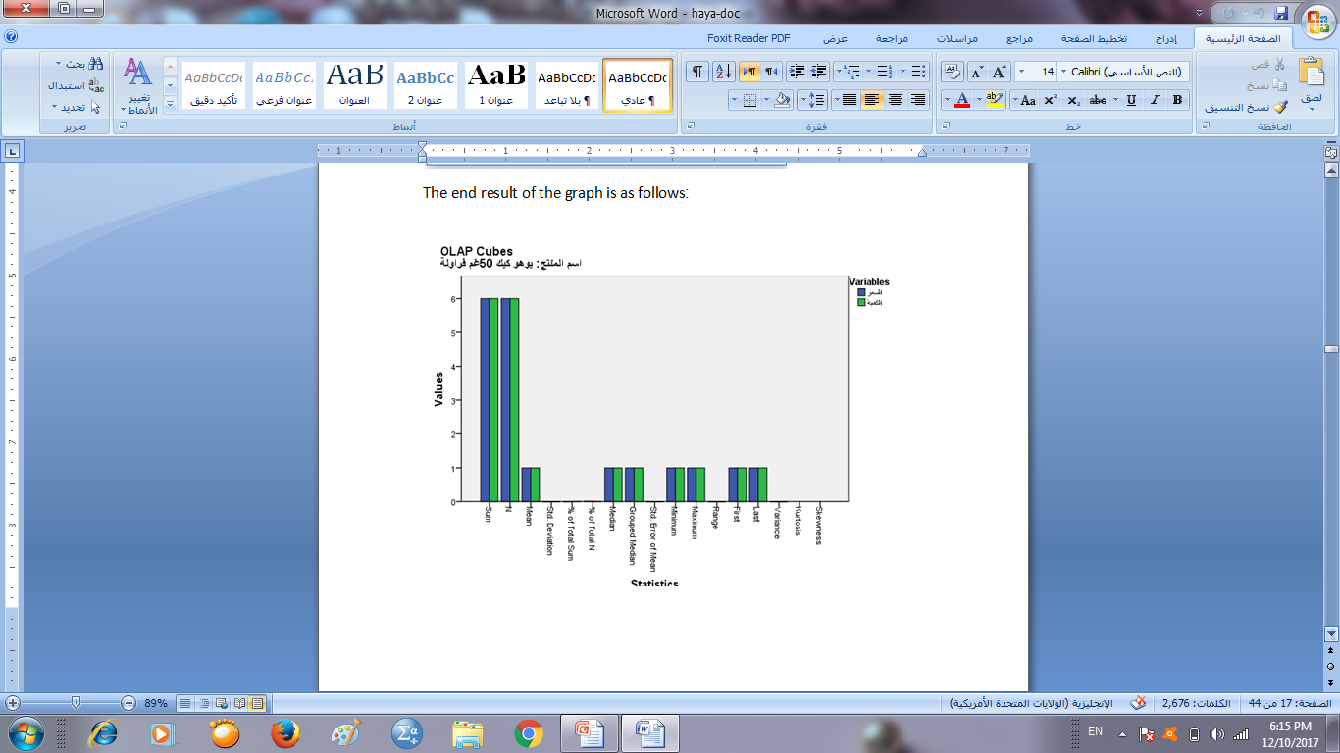
bar chart

Slide 25
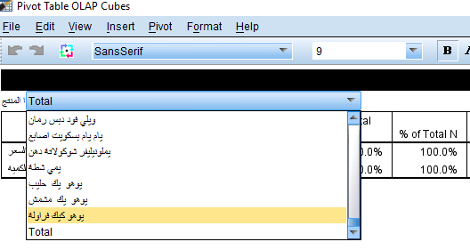
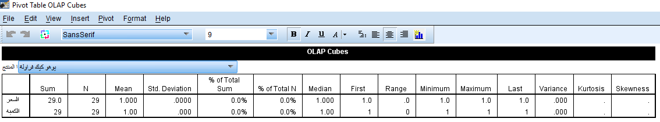
second month
total price 29
total amount 29

Slide 26
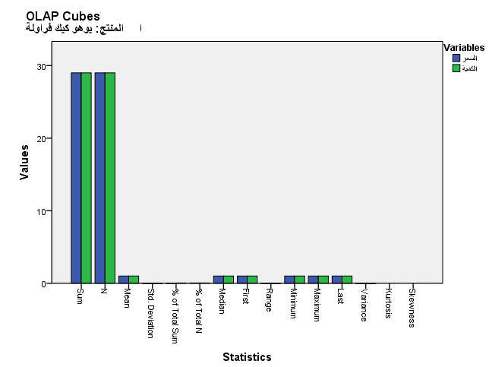
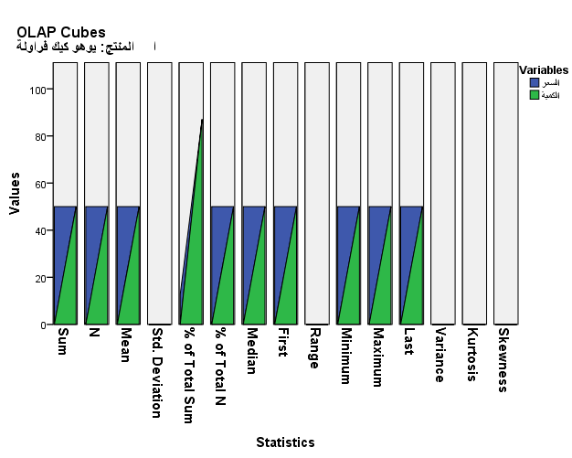
Par chart from pivot table:
Area chart pivot table:

Slide 27
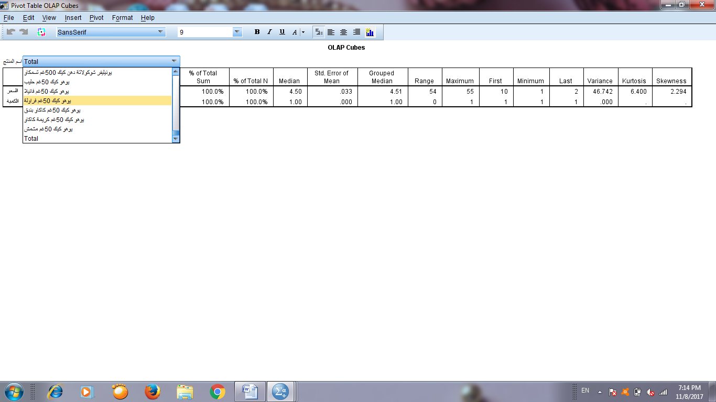
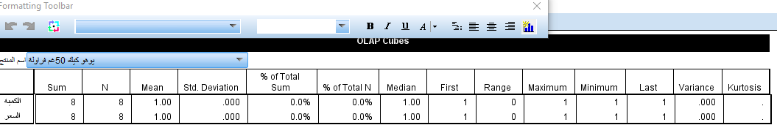
3rd month
Result :
Total price 8
Total amount 8

Slide 28
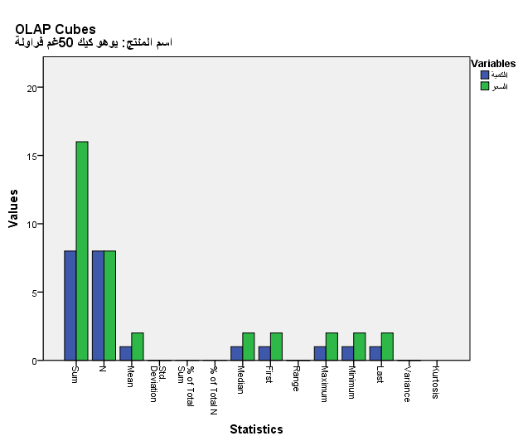
bar chart

Slide 29
We noticed that the sales of this product in the first and third months were close and few but in the second month sales were high

Slide 30
Part two:
There’s three sales periods :Shift A , Shift B & Shift C.
We analyzed the amount of sales , we determined the period in which the quantity of sales were the most important thing that will help us in the work procedures to solve the problems of decrease in sales in the rest of the periods

Slide 32
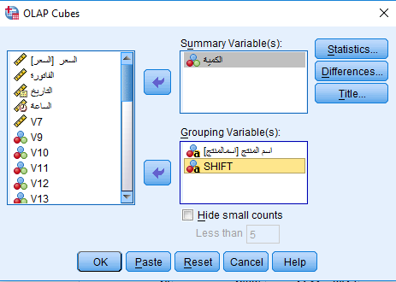

Slide 33
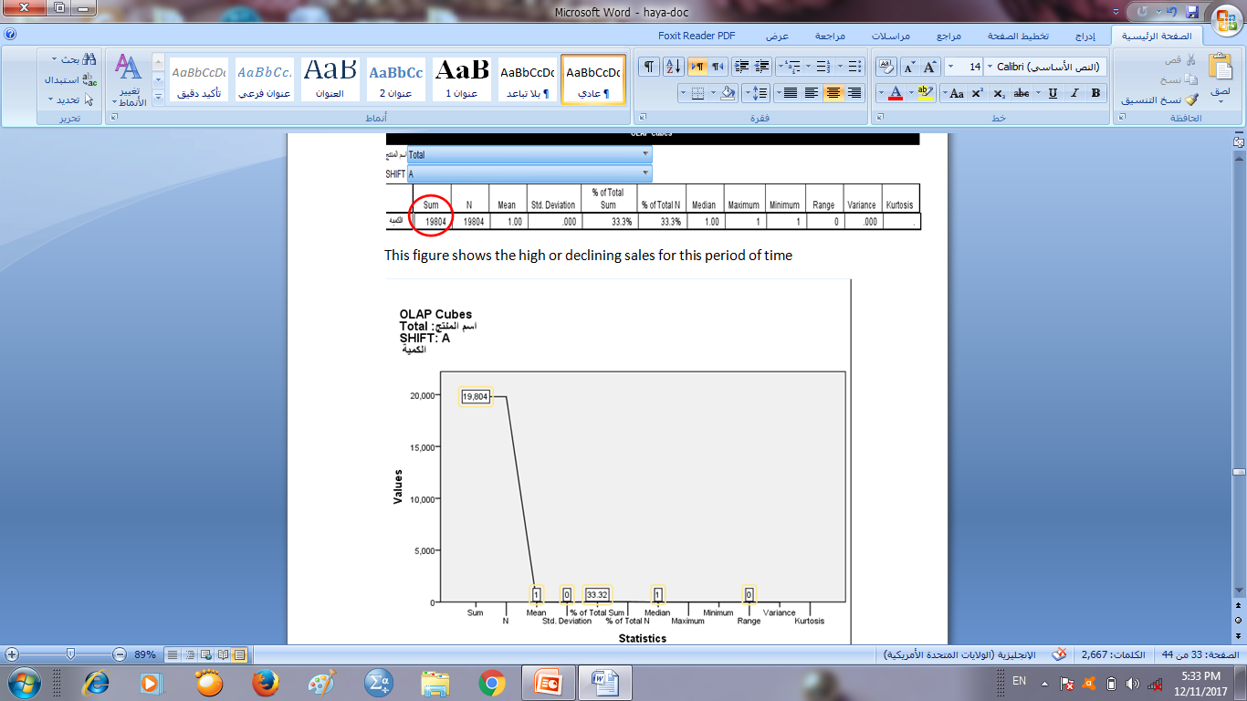
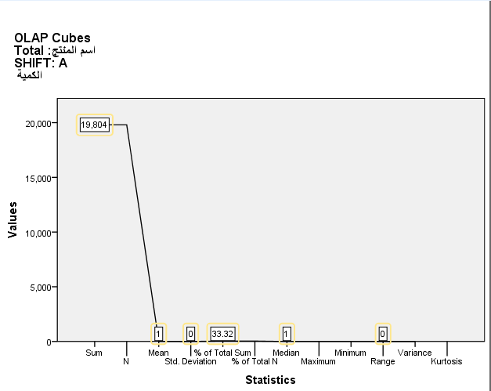
Explanation of the sales situation for the first Month:shift A
This figure shows the high or declining sales for this period of time
Total of sales is 19,804

Slide 34
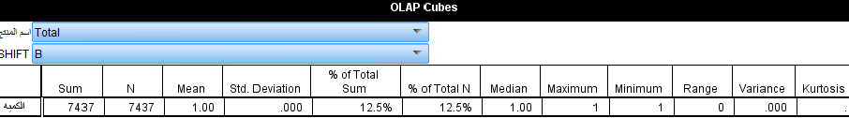
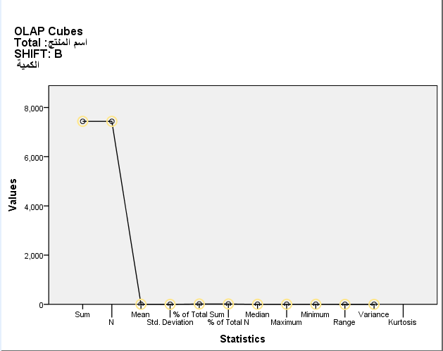
Shift B
Total of sales is 7,437

Slide 35
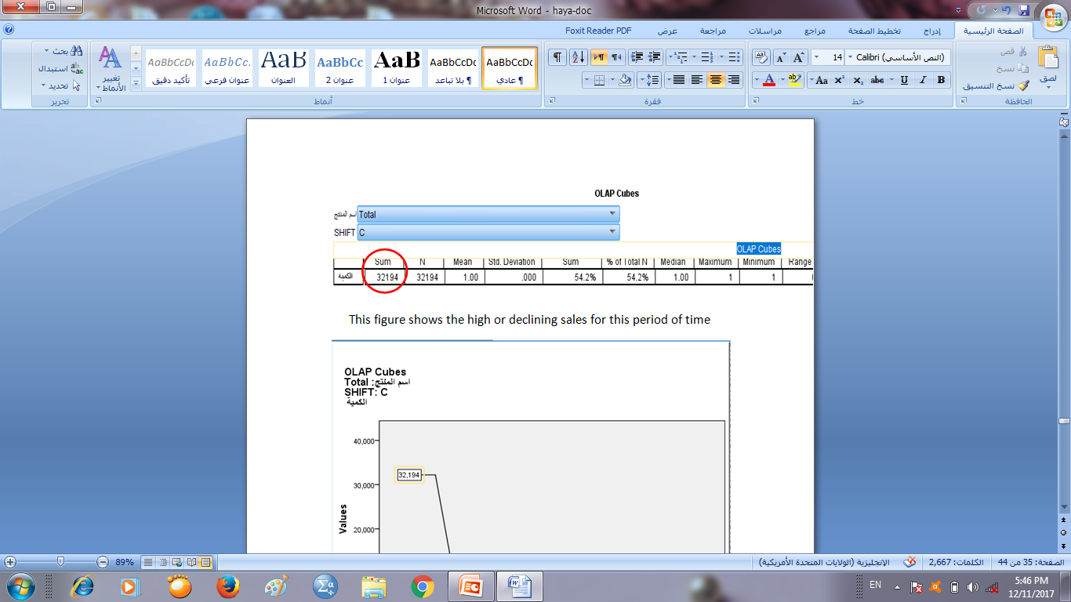
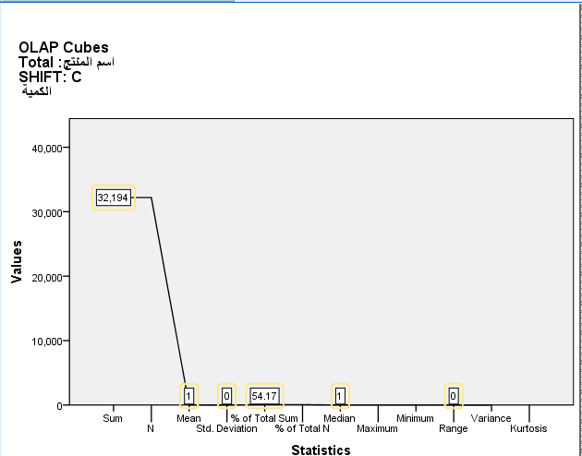
Shift C
Total of sales is 32,194

Slide 36
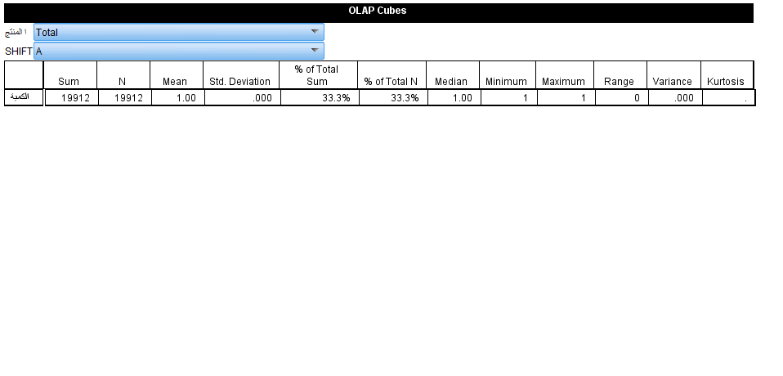
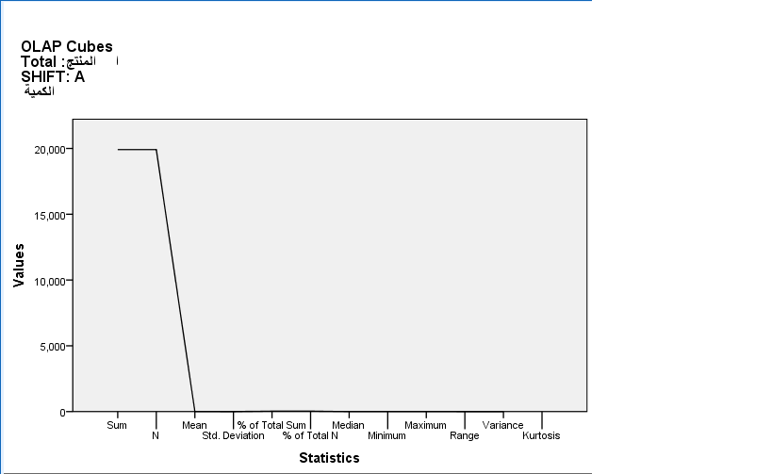
Explanation of the sales situation for the second month :shift A
Total of sales is 19,912

Slide 37

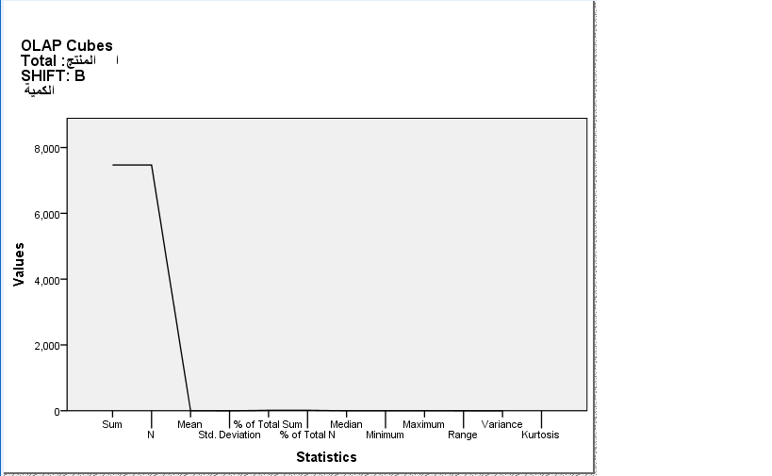
Shift B
Total of sales is 7,469

Slide 38

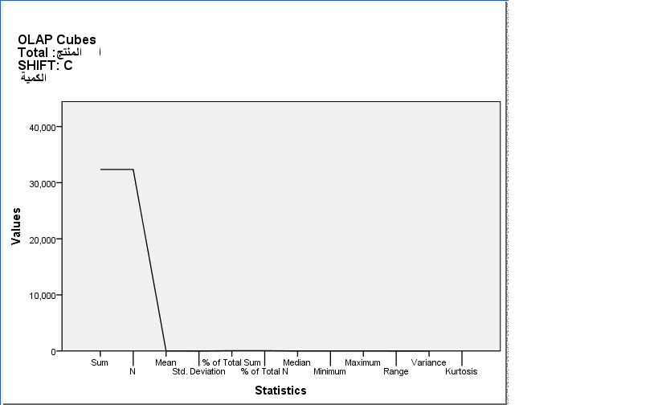
Shift C
Total of sales is 32,360

Slide 39
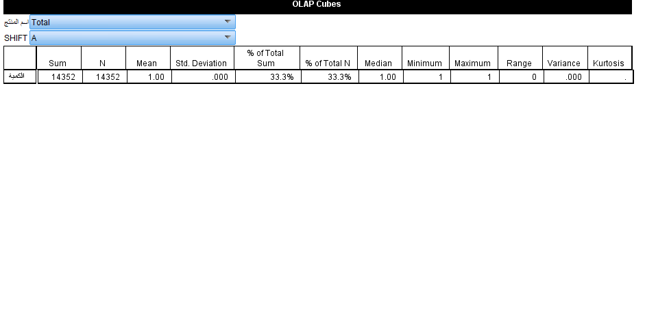
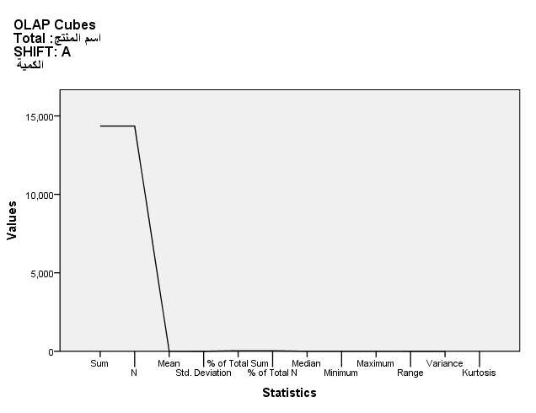
Explanation of the sales situation for the third period :shift A
Total of sales is 14,352

Slide 40
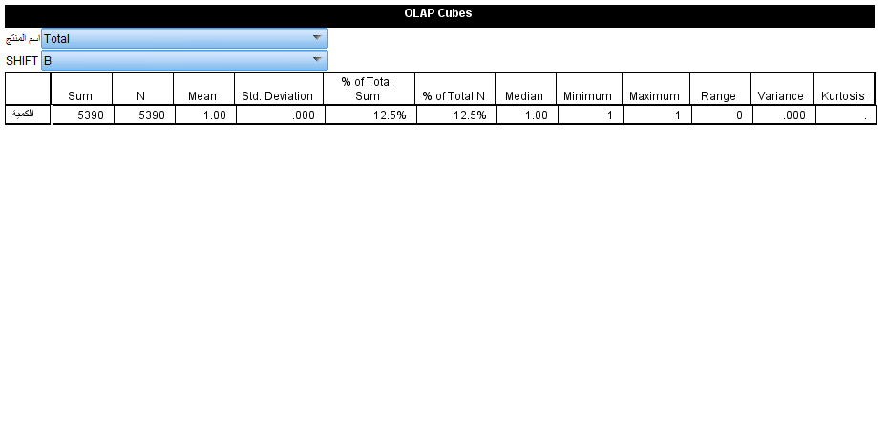
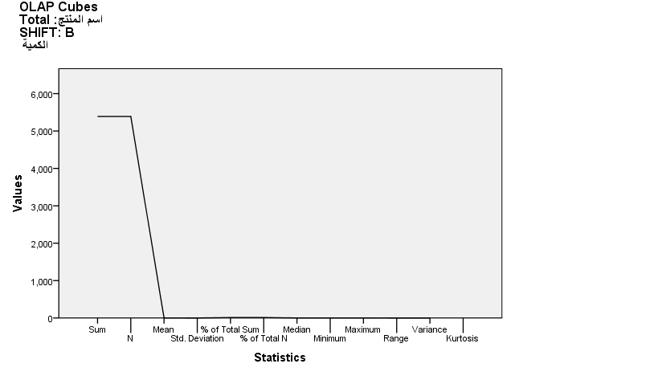
Shift B
Total of sales is 5,390

Slide 41
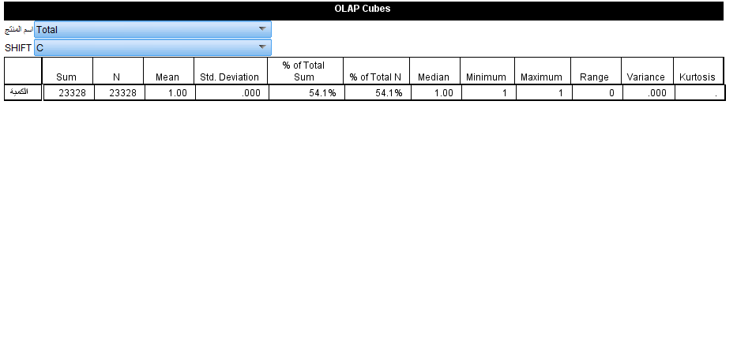
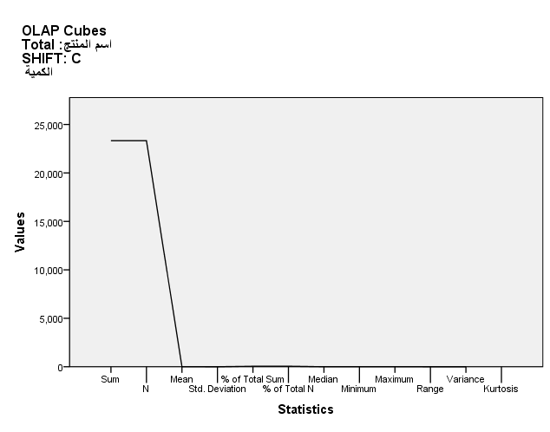
Shift C
Total of sales is 23,328

Slide 42

From this we conclude that the second period in this 3 months was the lowest sales and can be considered a problem for the seller or wrong and must give appropriate solutions to increase the volume of sales does not necessarily be equal to the results of other periods, but fairly close
The second period of sales can be considered a period of stagnation in sales for several reasons. In the afternoon, people go to their homes to take a break after working in the first hours. The seller must do some things and take them into account

Slide 43

Appropriate solutions:
1.QR Code

Slide 44

Happy Hour

Slide 45

flower

Slide 46

Music

Slide 47

Facebook

Slide 48
Conclusion

Slide 49
In the end, we will summarize that the volume of sales and quantities increases and decreases based on specific circumstances and reasons.
This difference can not be found by looking or feeling. We must use statistical methods to show the results to the fullest.
And where the program SPSS is considered the most important program of statistical analysis

Slide 50


