Slide 1

Graduation
Project 2
Project Title:
Al-Ma'ajeen Area-Geometric & Operational Design
Prepared By:
Submitted to:
Lana Hilal
Hiba Abd Al-Fattah
Yahia Jum’aa
Eng. Hussein Abu-zant

Slide 2
Project Outline
Project description
Project objectives.
Sources Of Data Collection
Data Collection & Analysis.
Traffic Design
Geometric Design

Slide 3
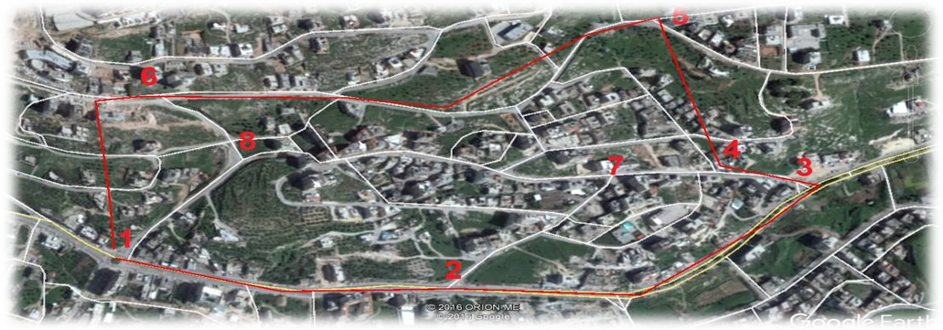
Study Area and Specific Existing Facilities Of interest

Slide 4
The following intersections are considered in this project:
Number | Name
1 | Beit-Eba (alhrmeen) roundabout
2 | Mahmoud Abbas intersection
3 | Al Maajen intersection
4 | Ezz Al-Din mosque intersection
5 | Al-sika (Al-Ain encampment) intersection
6 | AOU intersection
7 | Yameen intersection
8 | Eskan aljam’a intersection

Slide 5
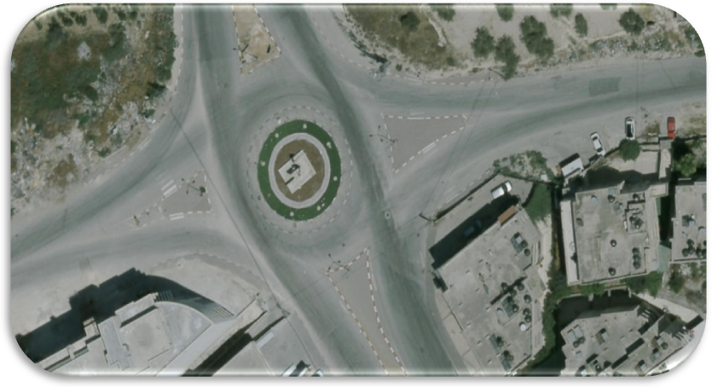
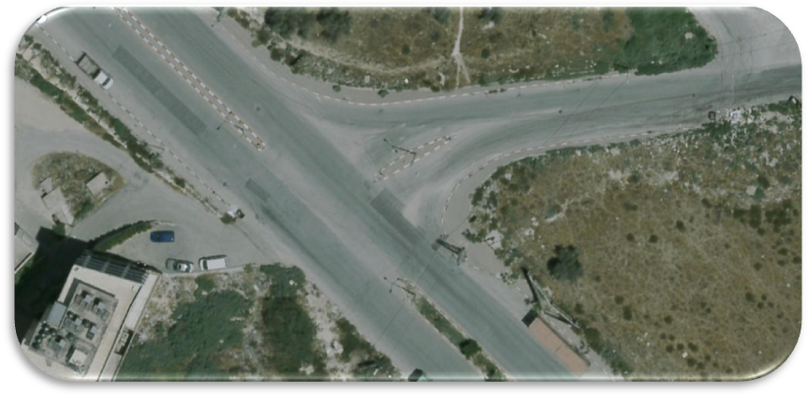
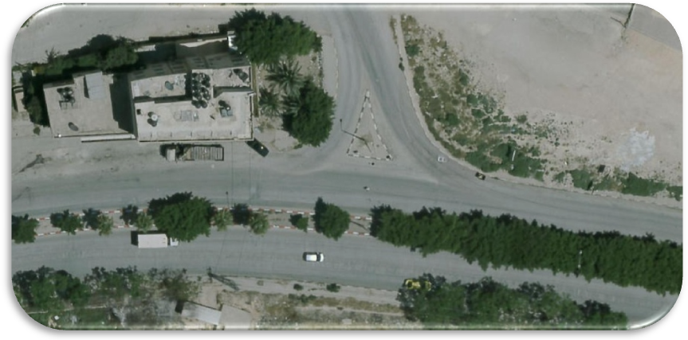
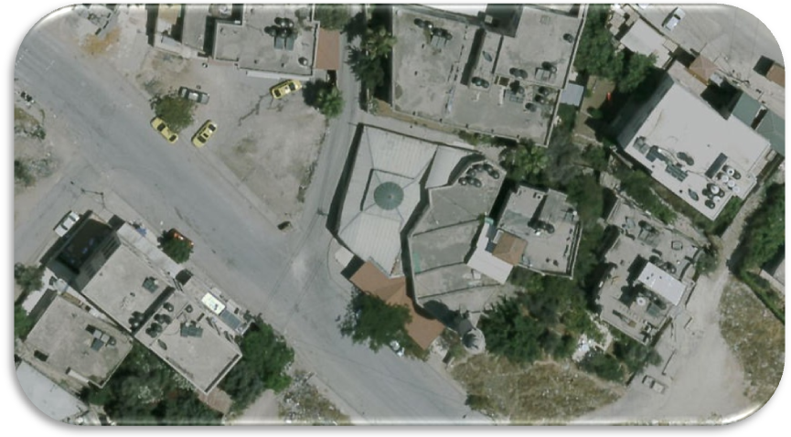
Roundabout
Mahmoud Abbas
Alma’ajeen
Ezz Al-Din

Slide 6
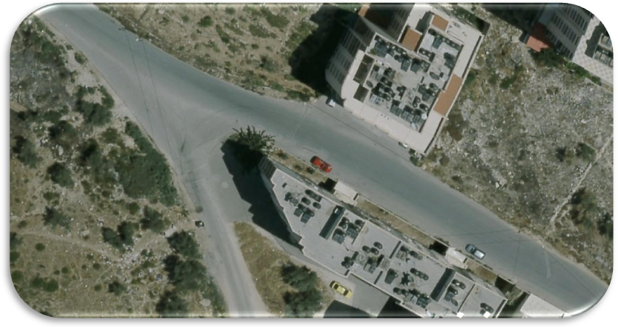
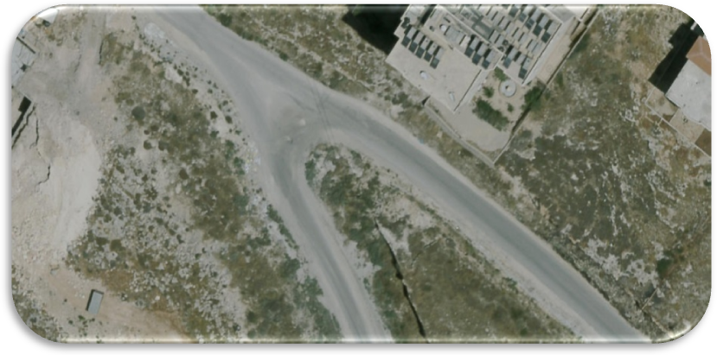
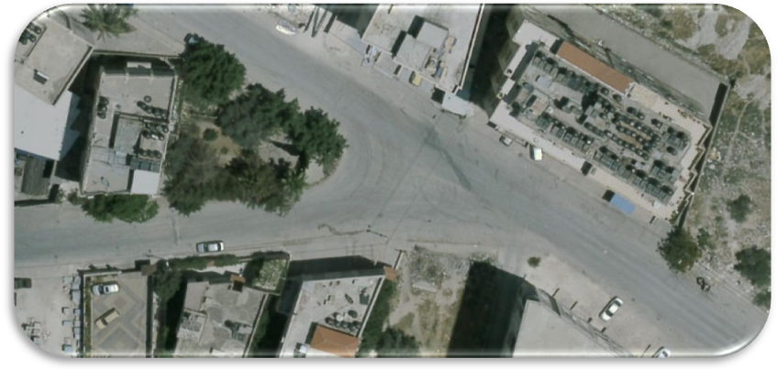
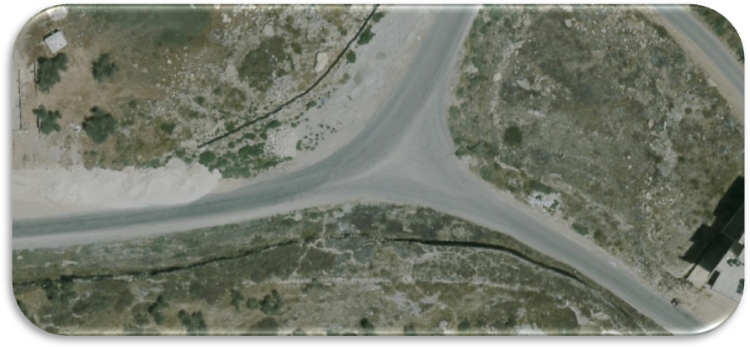
Al-Sika
AOU
Yameen
Eskan aljam’a

Slide 7
Problem Definition
Traffic volume may cause many of problems such as:
Traffic Congestion problem.
High potentiality of accidents especially at intersection
Low level of service (LOS) for the intersections in that area due to noticed traffic delay.
Fuel consumption.
Restricted views at several approaches of intersection.

Slide 8
Objectives Of Project
The main objective of this research is to develop and enhance the efficiency of the recent roads for Al-Ma’ajeen network. This could be achieved through:
Improve safety.
Minimize the travel time.
Improve the LOS.
Develop the operational movement for the roads.

Slide 9
Methodology
Making a clear definition for the problems relating to the specified roadway network.
Visiting area study to gather data about each intersection which is studied at the network.
Gathering data, manual traffic counts should be applied to find the traffic volumes for intersections
Analyzing data to determine: Peak hour, Peak hourly volume and Peak hourly factor to find daily volume and the level of service.
Level of service for each intersection should be determined at the network peak hour, using Synchro software.
According to the results; remedial actions are applied at the intersections which have un-acceptable LOS in order to enhance the efficiency of the network.
Finally detailed plans will be performed for all geometric and operational facilities.

Slide 11
Sources Of Data Collection
Site visit ( inventory study , traffic counting).
Nablus municipality.

Slide 12
Data Collection & analysis
The types of collection data which are studied:
Traffic count studies .
Traffic volume studies.
Geometric studies .

Slide 13
Volume Analysis
Intersection | PH | PHV | PHF
Roundabout | 2:30-3:30 | 1470 | .85
Mahmoud Abbas | 7:15-8:15 | 1786 | .89
Al-Ma’ajeen | 7:15-8:15 | 1480 | .87
Al-Sika | 7:15-8:15 | 451 | .73
Ezz Al-Din Mosque | 7:15-8:15 | 561 | .84
AOU | 7:15-8:15 | 845 | .74
Yameen | 7:15-8:15 | 744 | .89

Slide 14
Analysis Of LOS
Name | LOS
Beit - Eba Roundabout | C
Mahmoud Abbas intersection | C
Al Maajen intersection | C
Ezz Al-Din Mosque intersection | F
Al-sika (Mukhaym Al-Ain) intersection | C
AOU intersection | C
Yameen intersection | C
Eskan Al-jam’a intersection | C

Slide 15
Traffic Control Devices ( TCD)
Warrants number | Satisfied/ Not Satisfied
Warrant 1: Eight-hour vehicular volume(Condition A) | Not Satisfied
Warrant 1: Eight-hour vehicular volume(Condition B) | Not Satisfied
Warrant 2: Four-hour vehicular volume | Not Satisfied
Warrant 3: Peak hour(Condition A) | Not Satisfied
Warrant 3: Peak hour(Condition B) | Not Satisfied
Warrant 4:Pedestrian volume | Not Satisfied
Warrant 5: School crossing | Not Satisfied
Warrant 6: Coordinated signal system | Not Satisfied
Warrant 7: Crash experience | Not Satisfied
Warrant 8: Roadway network | Not Satisfied

Slide 16
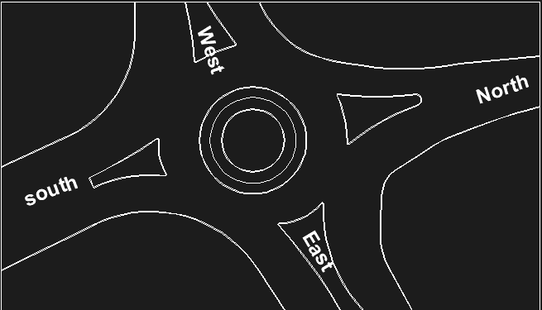
Geometric Studies
1. Beit Eba RoundAbout
 | Pavement with | One or two way | Number of lanes in each direction
East Approach | 25.1 m | Two | 2
West Approach | 27.6 m | Two | 2
South Approach | 19.2 m | Two | 1
North Approach | 13.6 m | Two | 1

Slide 17
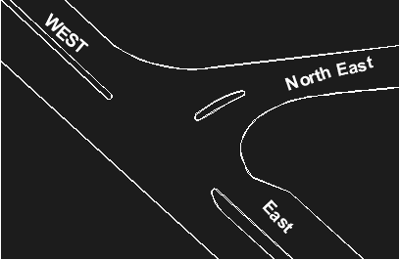
2. Mahmoud Abbas Intersection
 | Pavement width | One or two way | Number of lanes in each direction
East Approach | 30.6 m | Two | 2
West Approach | 22.6 m | Two | 2
North-east Approach | 9.7 m | Two | 1

Slide 18
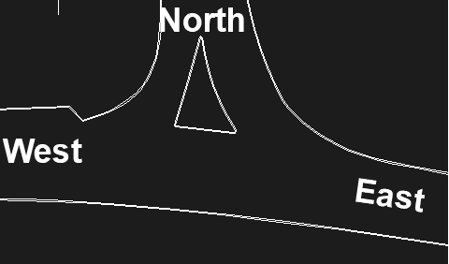
3.Alma'ajeen Intersection
 | Pavement with | One or two way | Number of lanes in each direction
East Approach | 9.9 m | Two | 2
West Approach | 11.9 m | Two | 2
North Approach | 11 m | Two | 1

Slide 19
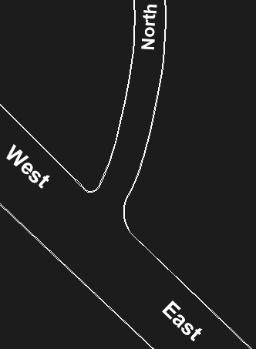
4.Ezz Al-Din Intersection
 | Pavement with | One or two way | Number of lanes in each direction
East Approach | 14.2 m | Two | 2
North Approach | 6.2 m | Two* | 1
West Approach | 15.9 m | Two | 2

Slide 20
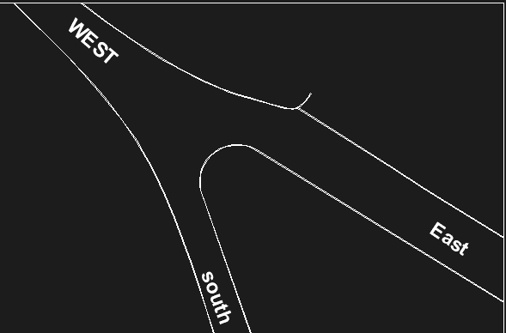
5. Al-Sika Intersection
 | Pavement with | One or two way | Number of lanes in each direction
West Approach | 16.5 m | Two | 2
East Approach | 12.7 m | Two | 2
South Approach | 7.2 m | Two | 2

Slide 21
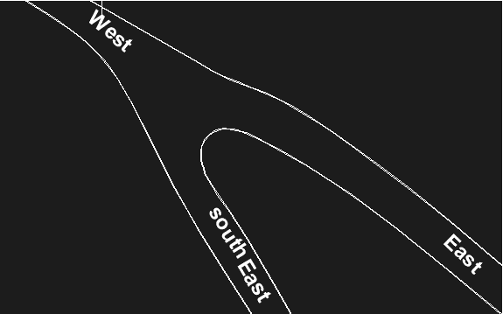
6. AOU Intersection
 | Pavement with | One or two way | Number of lanes in each direction
East Approach | 8.1 m | Two | 1
West Approach | 9.3 m | Two | 1
South-East Approach | 7.2 m | Two | 1

Slide 22
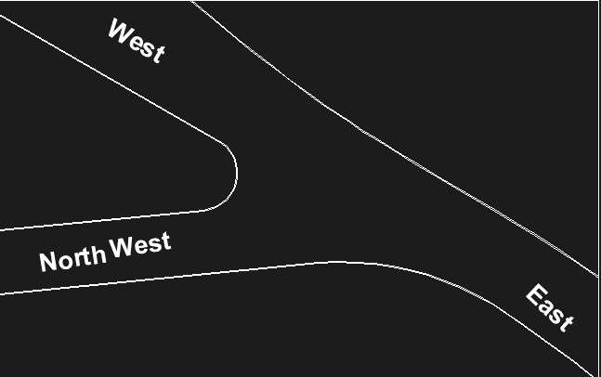
7.Yameen Intersection
 | Pavement with | One or two way | Number of lanes in each direction
East Approach | 13 m | Two | 1
West Approach | 20 m | Two | 1
North-West Approach | 10.5 m | Two | 1

Slide 23
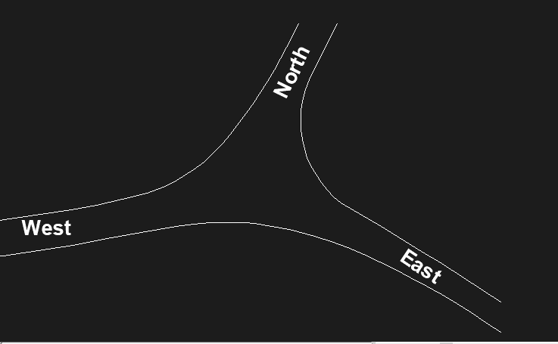
8.Eskan Al-jam’a Intersection
 | Pavement with | One or two way | Number of lanes in each direction
East Approach | 7.2 m | Two | 1
West Approach | 5.3m | Two | 1
North Approach | 7.3 m | Two | 1

Slide 24
Design Of Intersections “ Traffic Design “
Traffic control devices are the signs, signals, markings, and other devices placed on, over, or adjacent to a Network by authority of public body, such as municipality.
Traffic Sign must be :
Fulfill a need
Command attention
Convey a clear, simple meaning
Command the respect of road users
Give adequate time for proper response

Slide 25
Types of Traffic signals
Traffic Marking
Longitudinal Marking
Travers Marking
Words and symbols Marking
Traffic signs
Regulatory signs
Warning signs
Guides sign

Slide 26
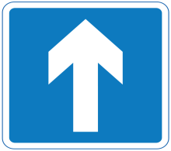
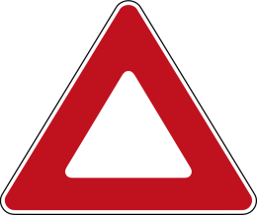
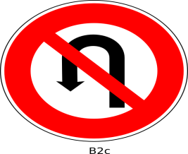

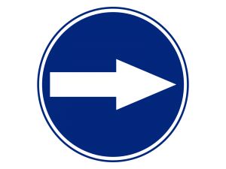



Types Of Traffic Sign

Slide 27
Islands
Objectives Of islands:
Control prohibited turns.
Provide pedestrian refuge.
Restrict the speeds of vehicles
Separate different traffic movements.
Give priority to the predominant movements.
Control the merging, diverging, or crossing angle of vehicles.
Direct the paths of vehicles so that not more than two paths cross at any one point.

Slide 28
Types Of Islands:
Curbed Traffic Islands.
Traffic Islands Formed by Pavement Markings.
Islands Formed by Pavement Edges.
Island function:
Channelized Islands
Divisional Islands
Refuge Islands

Slide 29
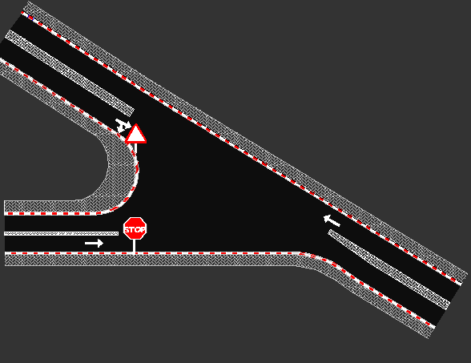
Geometric Design
Yameen intersection

Slide 30
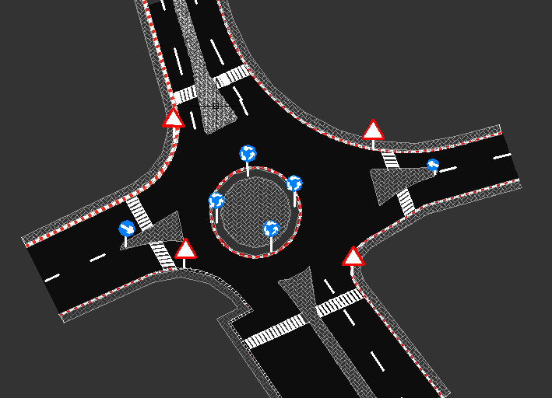
Beit – Eba Roundabout intersection

Slide 31
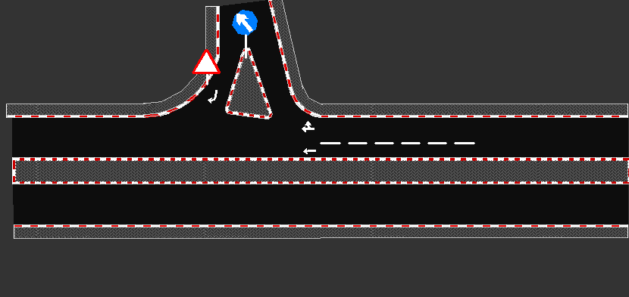
Al-Ma’ajeen intersection

Slide 32
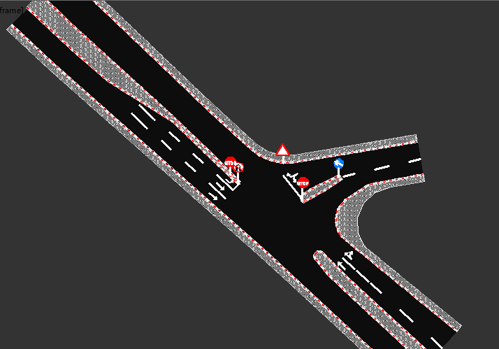
Mahmoud Abbas intersection

Slide 33
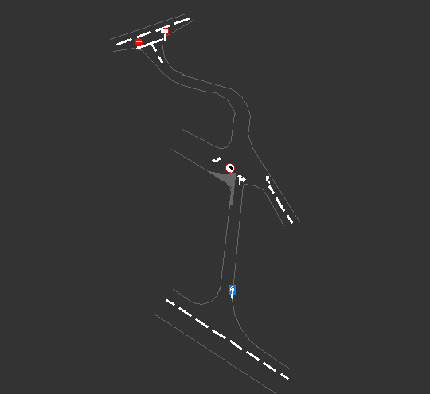
Ezz Al-Din intersection

Slide 34
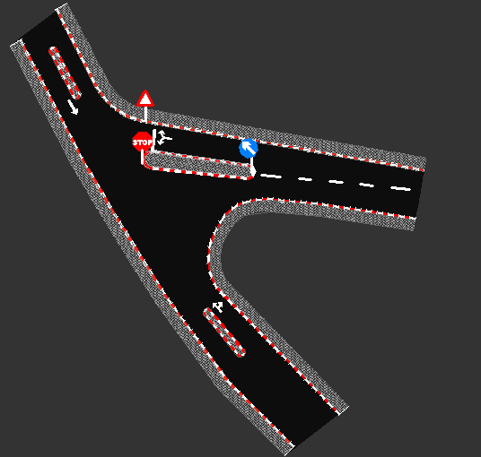
Barakat intersection

Slide 35
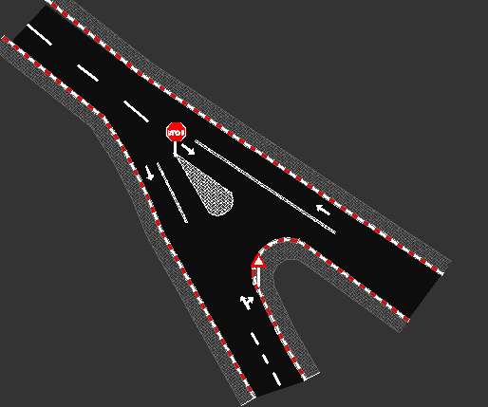
AOU intersection

Slide 36


