Slide 1

Flow Code
Prepared By:
Bara’ Khdier
Saleh Hamayel
Supervisor:
Dr. Mona Nabil Demaidi

Slide 2
Outline
Why Flow Code?
Overview about Flow Code
Methodology and How Flow Code works
Challenges and Problems
Conclusion and future work
Demo

Slide 3
Why?
wrong sequence of learning programming languages
hard to deal with syntax and IDEs in the beginning

Slide 4
Flow Code
Flow Code is a Web application that tries to help the student in learning Python language, by using flow charts.

Slide 5
Flow Code Objectives
Flow Code tries to make students learn programming languages such as Python in easier ways
it provides levels with many problems to solve that have all concepts in Python

Slide 6
Methodology
Two users
  Students
    Can solve problems by drawing flow chart and test the code by providing some inputs
  Teachers
    Can add, modify and delete questions in each level. Also can add other teachers and notify students to new quises

Slide 7
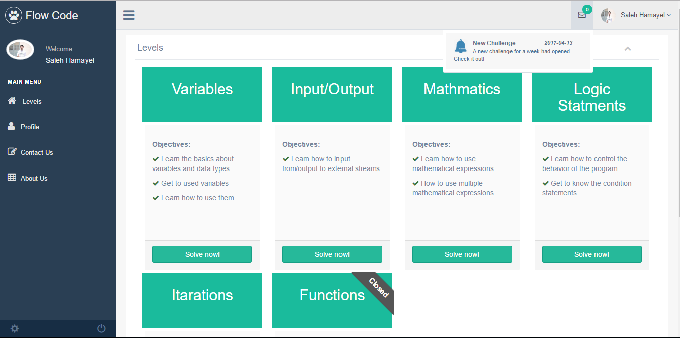
Methodology – user home page

Slide 8
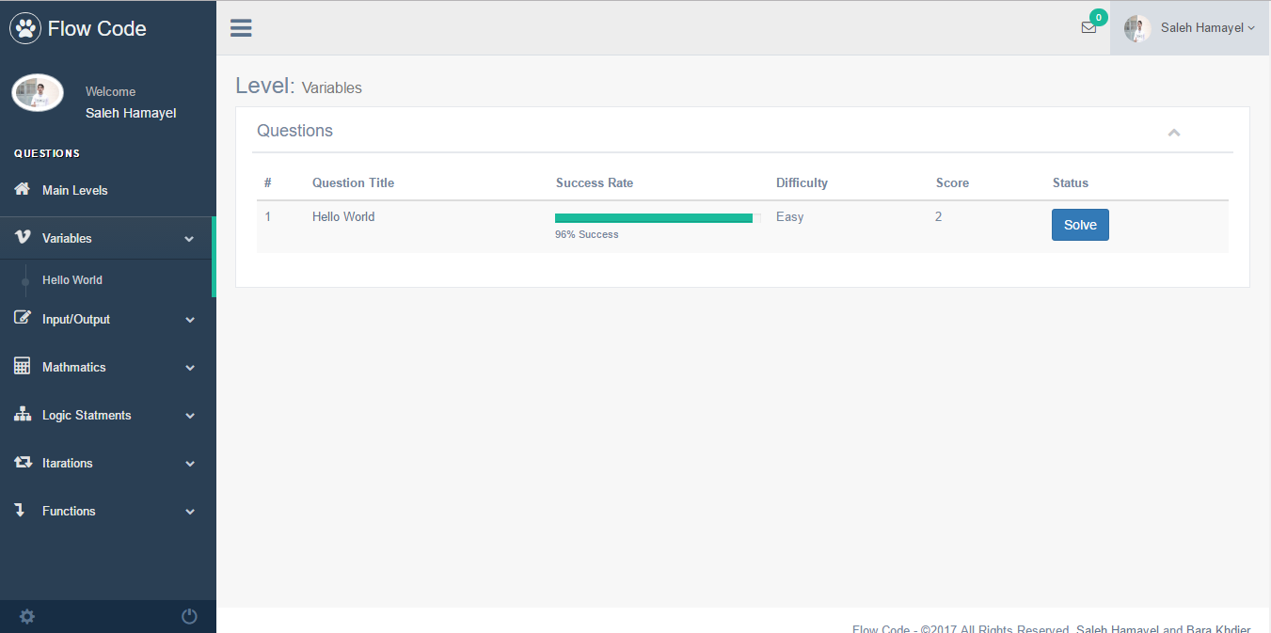
Methodology – questions in a level

Slide 9
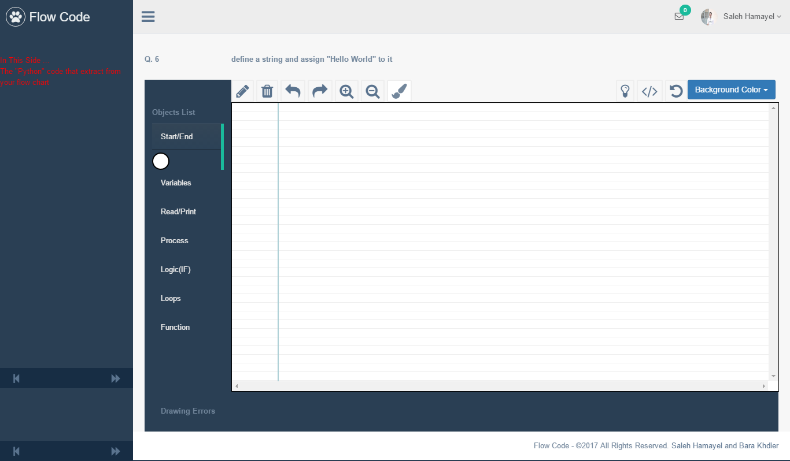
Methodology – the drawing panel

Slide 10
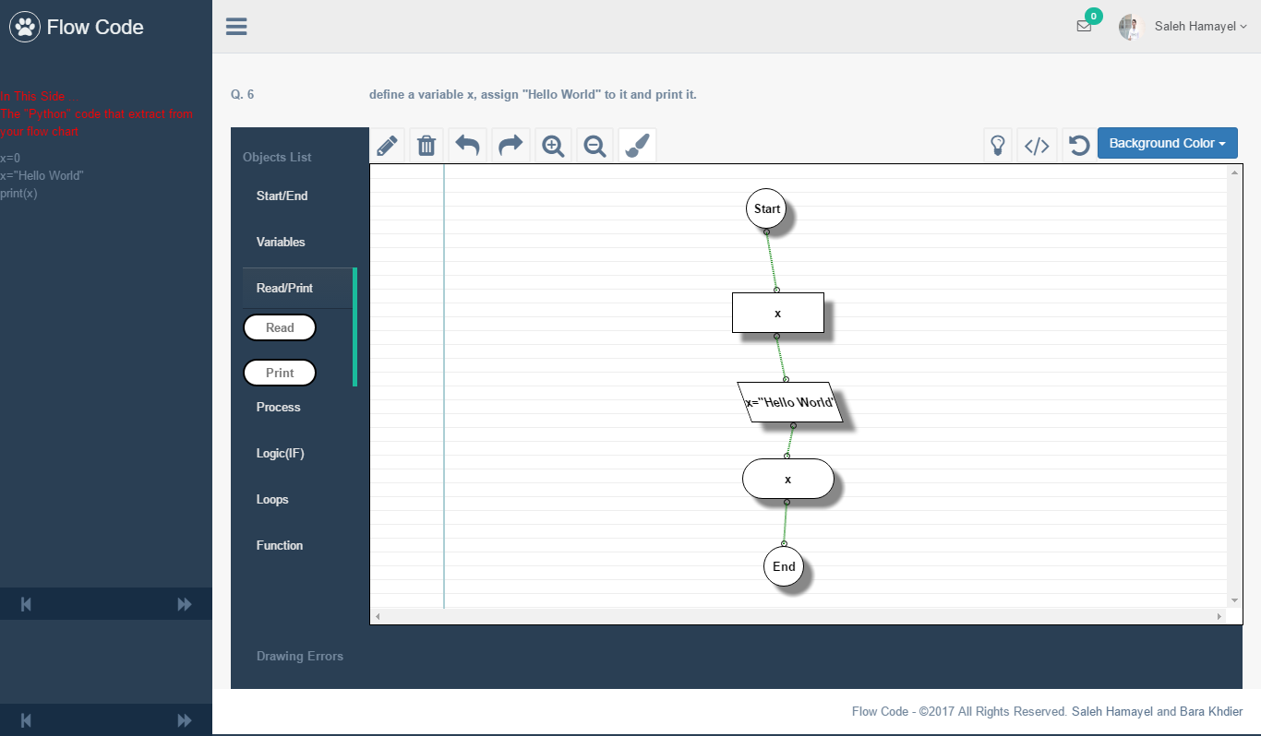
Methodology – drowned flow chart

Slide 11
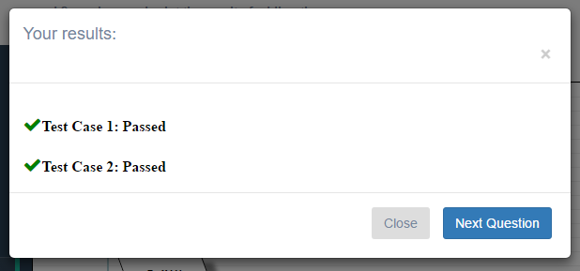

Methodology – code converting from flow chart and esting results

Slide 12
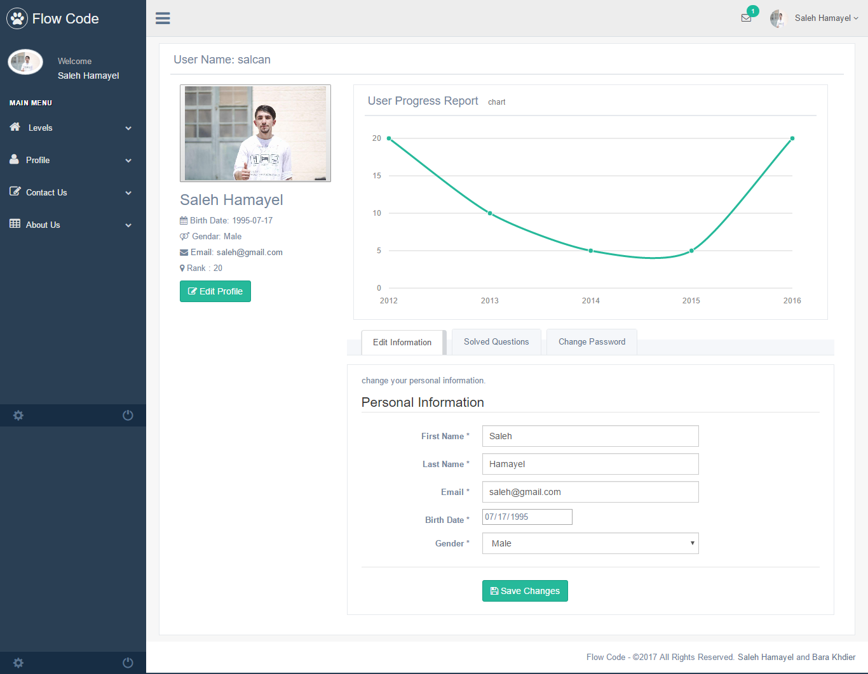
Methodology – student profile

Slide 13
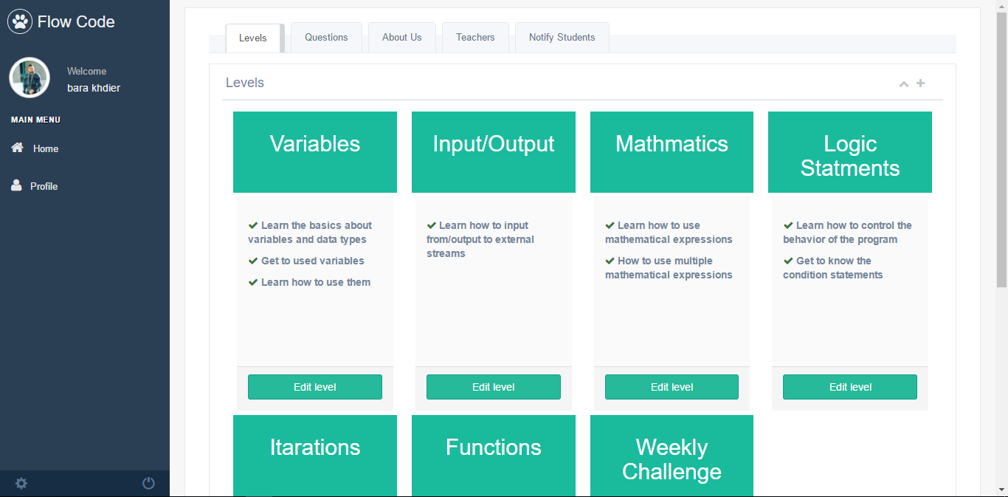
Methodology – teacher control panel

Slide 14
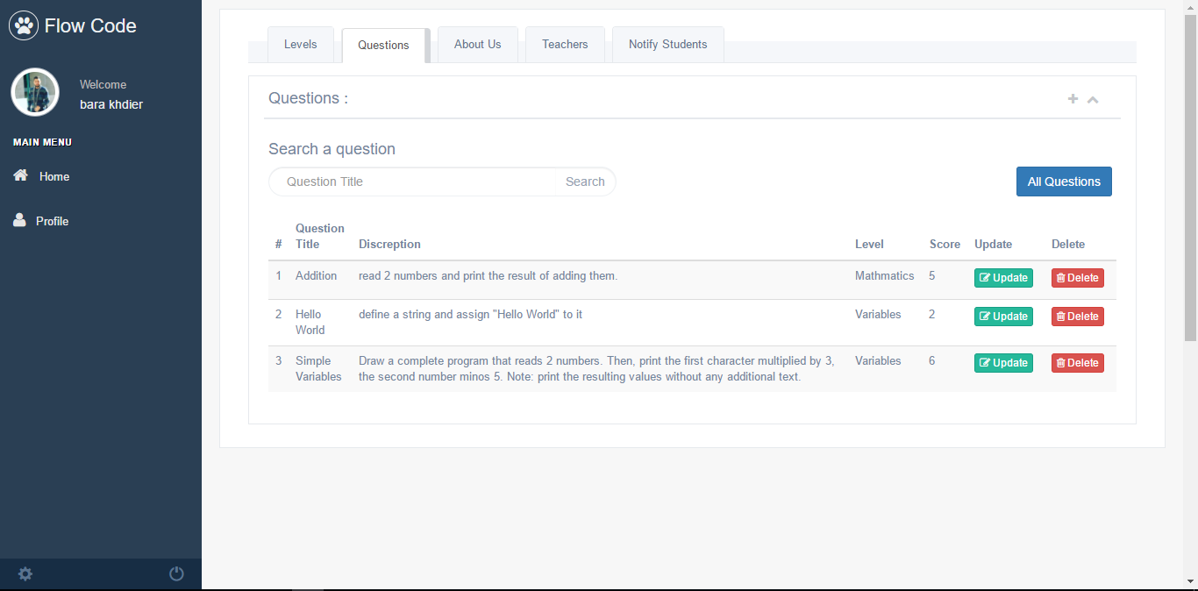
Methodology – questions modification

Slide 15
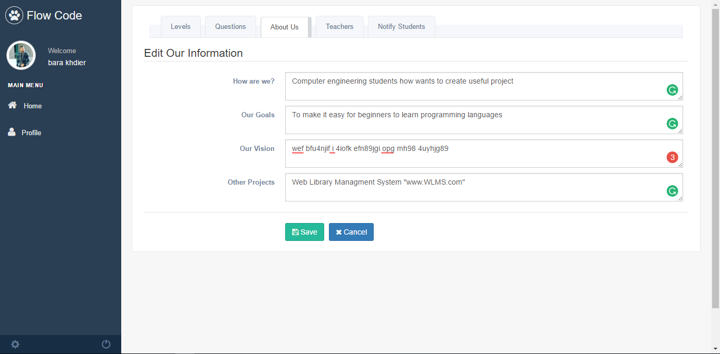
Methodology – abous us

Slide 16
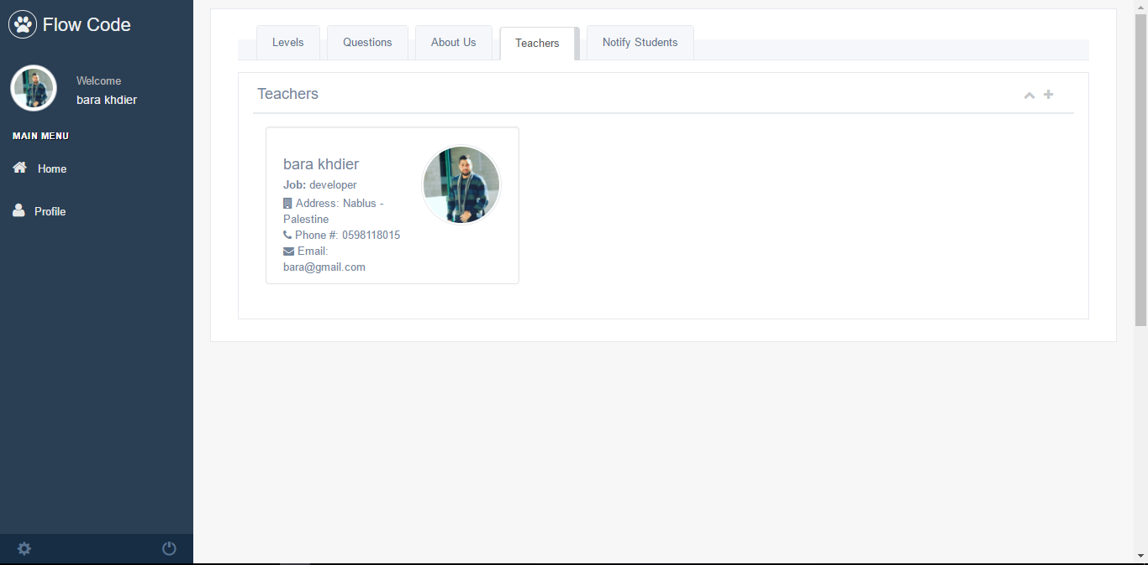
Methodology – teachers panel

Slide 17
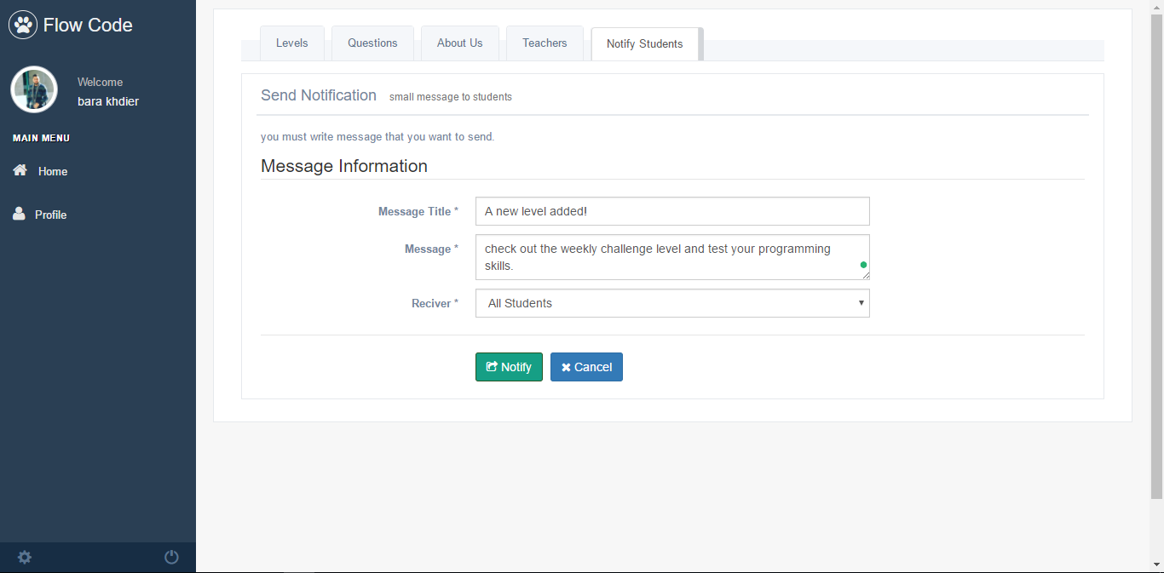
Methodology – notification panel

Slide 18
Challenges and Problems
The graphical drawing panel was hard to deal with due to a lot of special cases
The compilation of the flow chart takes a lot of processing

Slide 19
Future work
Support more than one programming language such as C/C++
Make Flow Code a teaching tool on moodle as a plugin

Slide 20
Flow Code
Thanks for listening
Prepared By:
Bara’ Khdier
Saleh Hamayel
Supervisor:
Dr. Mona Nabil Demaidi

