Slide 1


Graduation Project II
Adsorptive Removal of Cr³⁺ Metal Ions onto
MgO and Silica-Embedded MgO Nanoparticles:
“Comparative Study”
Prepared By:
Hanaa Baniowda
Nada Bitar
Supervisor : Eng. Maryam Hmoudah
Co-supervisor : Dr. Amjad El-Qanni

Slide 2
Outlines
Challenges
Materials and methods
Introduction
Adsorption isotherms
Fourier-transform infrared spectroscopy
Cost estimation
Conclusions
Recommendations

Slide 3

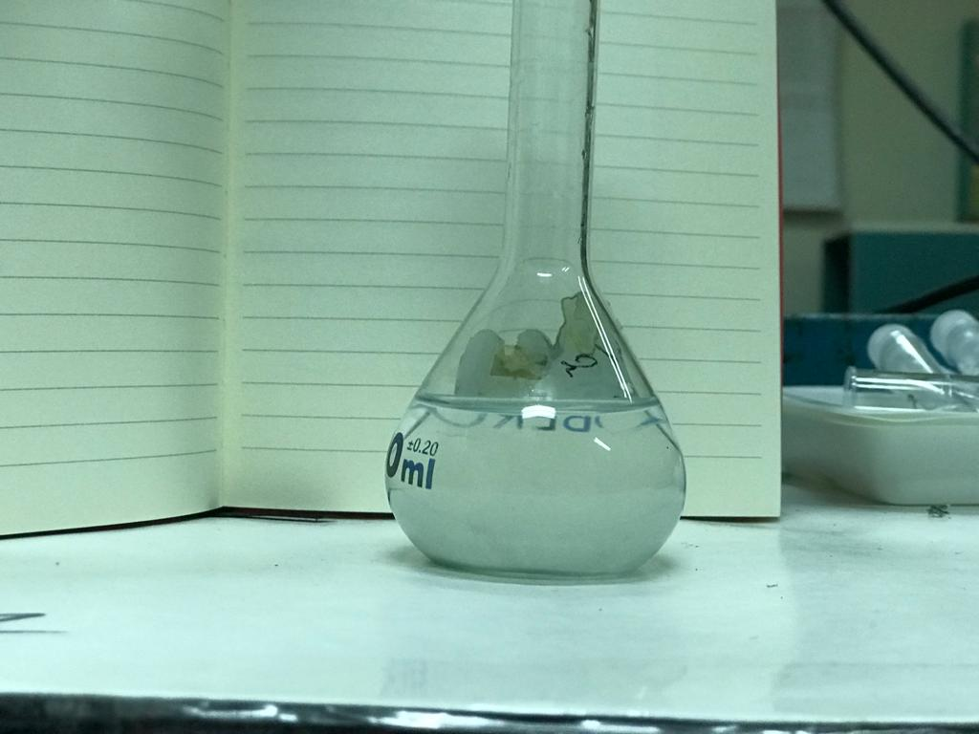
Introduction
Wastewater effluent containing heavy metals negatively affect the environment.
Nanotechnology sector is rapidly growing in the field of wastewater treatment.
Cr³⁺ metal ions can be found in tannery wastewater influents along with other metals.
A concentration higher than particular limit could pose a potential threat to the environment and surroundings.

Slide 4
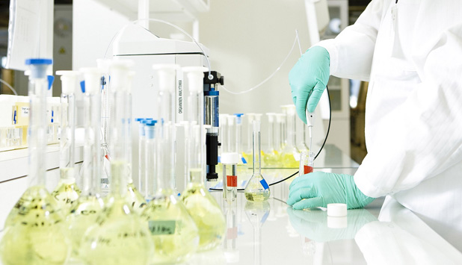
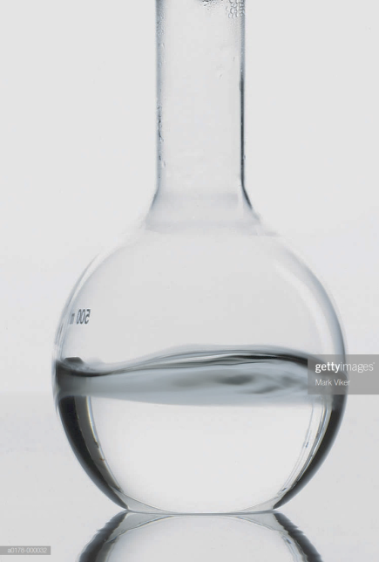
Challenges
Experimental work was designed at the beginning of the semester.
Several experiments were conducted at different pHs.
Adsorption isotherms and kinetics study were conducted before the university shut down.
Thermodynamics and regeneration studies were supposed to be done throughout this study.

Slide 5
Materials
Commercial MgO nanoparticles.
Purchased from Sigma Aldrich, Haifa.
Characterized by XRD.
In-house prepared silica embedded MgO nanoparticles.
Prepared by coprecipitation method.
Materials:
Magnesium nitrate
Colloidal silica
Nitric acid
Sucrose
Deionized water
Ammonia hydroxide (27% (w/w))

Slide 6
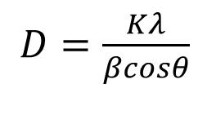
Materials
Crystalline domain size was determined using Scherrer’s equation:
$D=\frac{Kλ}{βcosθ}$
 | Commercial MgO-NPs | MgO-SBNs
Crystalline domain size (nm) | 12.32 | 50 ± 1.6
Reference | This study | Abuhatab et al.
Abuhatab S, El-Qanni A, Al-Qalaq H, Hmoudah M, Al-Zerei W. Effective adsorptive removal of Zn2+, Cu2+, and Cr3+ heavy metals from aqueous solutions using silica-based embedded with NiO and MgO nanoparticles. Journal of Environmental Management. 2020;268:110713.

Slide 7
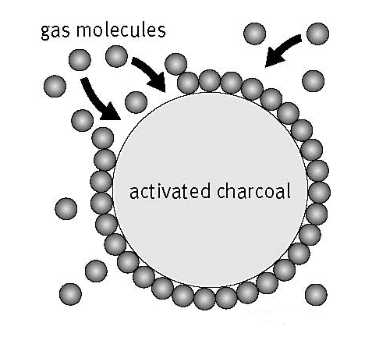
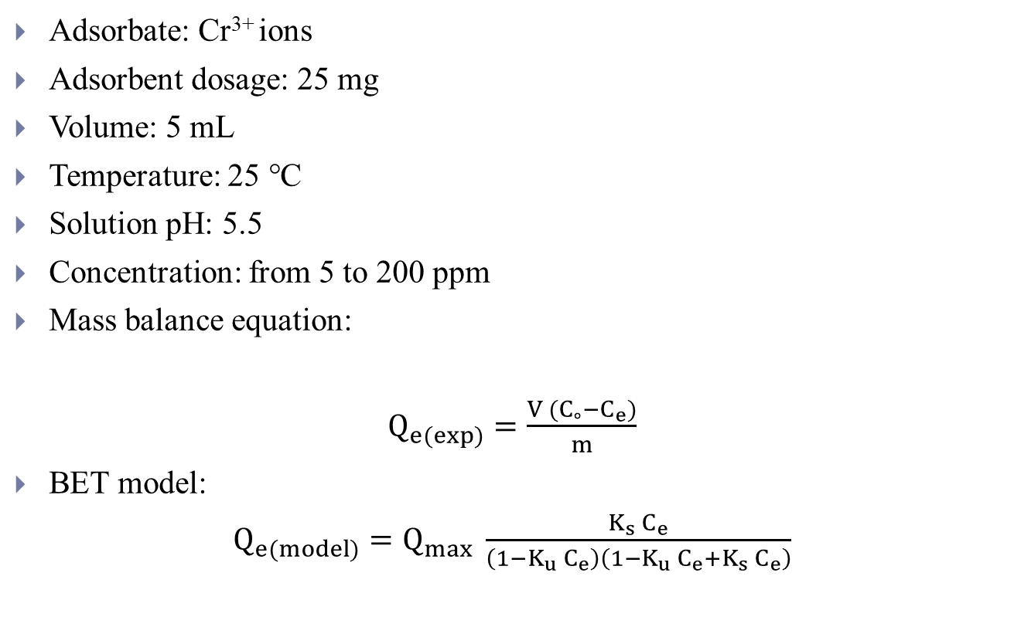
Adsorption isotherms
Adsorbate: Cr³⁺ ions
Adsorbent dosage: 25 mg
Volume: 5 mL
Temperature: 25 ℃
Solution pH: 5.5
Concentration: from 5 to 200 ppm
Mass balance equation:
$Q_{e(exp)}=\frac{V (C_{∘}−C_{e})}{m}$
BET model:
$Q_{e(model)}=Q_{max} \frac{K_{s} C_{e}}{\left(1−K_{u} C_{e}\right)\left(1−K_{u} C_{e}+K_{s} C_{e}\right)}$
Cr³⁺
MgO surface

Slide 8
Adsorption isotherms
MgO_Cr³⁺
MgO-SBNs_Cr³⁺
 | BET model parameters
Adsorbent | Q_{m} (mg/g) | K_{s} (L/mg) | K_{u} (L/mg) | χ²
Commercial MgO-NPs | 69.91 | 0.012 | 0.985 | 1.249
MgO-SBNs | 108.9 | 0.024 | 1.164 | 0.357

Slide 9
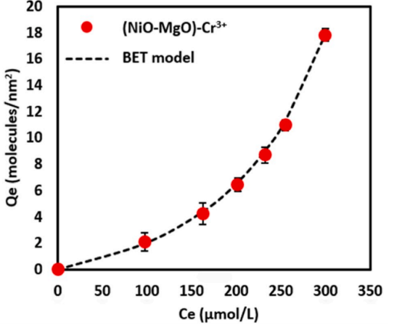
Adsorption Isotherms
From literature:
Adsorbent: NiO-MgO SBNs Adsorbate: Cr³⁺ metal ions
Q_{m} (mg/g)=209.5
NiO-MgO SBNs showed higher adsorption uptake for Cr³⁺ ions, suggesting that the presence of NiO adsorption sites increases the uptake.
Abuhatab S, El-Qanni A, Al-Qalaq H, Hmoudah M, Al-Zerei W. Effective adsorptive removal of Zn2+, Cu2+, and Cr3+ heavy metals from aqueous solutions using silica-based embedded with NiO and MgO nanoparticles. Journal of Environmental Management. 2020;268:110713.

Slide 10
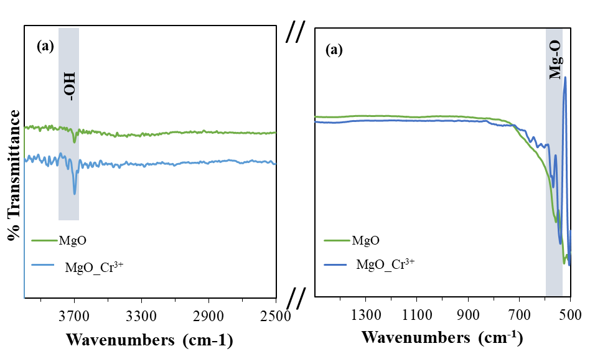
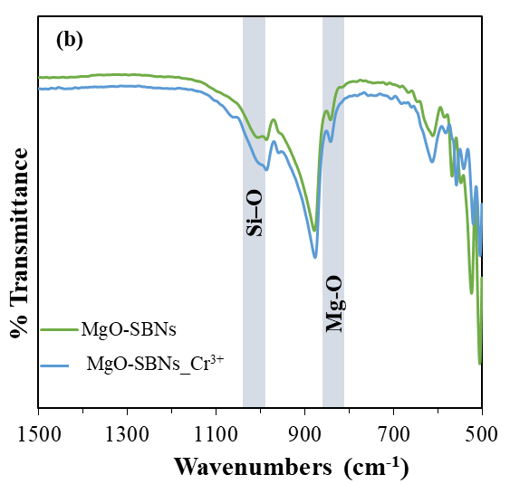
Fourier-transform infrared spectroscopy
FTIR analysis was conducted to confirm the adsorption onto MgO surfaces.
(cm⁻¹)
Dinh V-P, Le HM, Nguyen V-D, Dao V-A, Hung NQ, Tuyen LA, et al. Insight into the adsorption mechanisms of methylene blue and chromium (iii) from aqueous solution onto pomelo fruit peel. RSC advances. 2019;9(44):25847-60.
Fiol N, Escudero C, Villaescusa I. Chromium sorption and Cr (VI) reduction to Cr (III) by grape stalks and yohimbe bark. Bioresource Technology. 2008;99(11):5030-6.

Slide 11
Cost estimation
Adsorbent |  | Price | Cost for 1 gram
Magnesium oxide nanopowder |  | $500.51 per 25 grams | $20
Materials used for synthesizing MgO-SBNs
Material | Amount used for 7 g | Price | Cost for 1 gram ($)
Magnesium nitrate | 24 g | $52 per 100 g | 1.82
Colloidal silica | 4 g | $61.85 per 1 L | 0.036
Nitric acid | 4 L | $148 per 500 L | 0.173
Sucrose | 20 g | $1/kg | 0.003
Total cost |  |  | $2.03

Slide 12
Conclusions
The crystalline domain size of commercial MgO-NPs was calculated, 12.32 nm.
High adsorption uptake were obtained for both adsorbents, 69.9 for commercial MgO-NPs and 108.9 mg/g for MgO-SBNs.
FTIR results confirmed the adsorption occurrence.
Cost analysis showed that the estimated cost of 1 gram MgO-SBNs is much less than commercial MgO-NPs.

Slide 13

Recommendations
Future work:
Thermodynamics and pH study.
Adsorption kinetics.
Apply adsorbents for real wastewater.
Study the MgO-SBNs in continuous adsorption experiments.

Slide 14

Thank you for listening

