Slide 1

An-Najah National University
Building Engineering Department
Redesign of the Nissan Car Showroom in Ramallah
Presented By: Supervisor:
Hamza Nayef Dr. Muhannad Haj Hussein
Mosab Abdulghani
Omar Jamal Ali Date: December 24, 2018
Ihab Aqraa

Slide 2
Presentation Outline
Site Analysis
Architectural Design
Structural Design
Environmental Design
Electro-Mechanical Design
Safety Design
Cost Estimation

Slide 3
Site Analysis

Slide 4
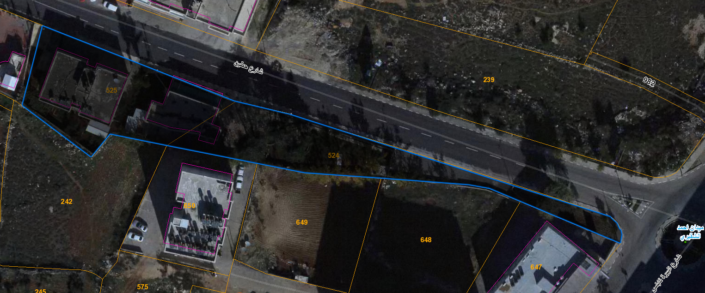
Site Location
The showroom is located at Al-Bireh city, which is a city in the central West Bank.
The area of the site is about 2349 m². This site has one street with 7 m wide.

Slide 5
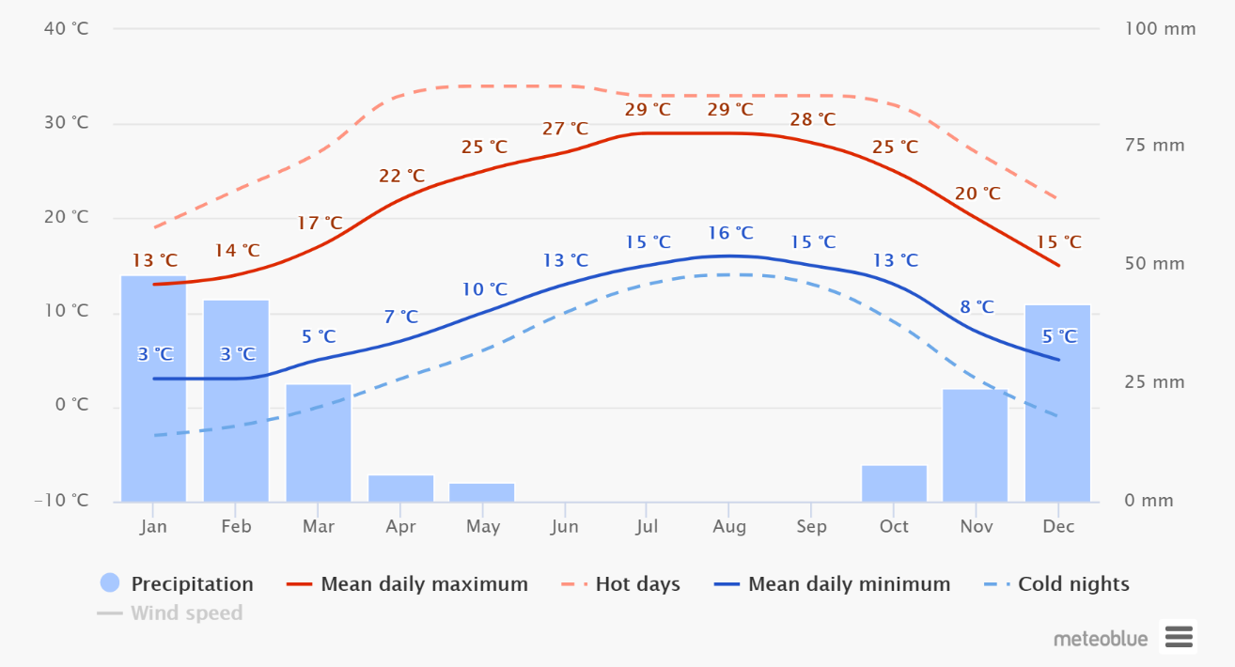
Climate Conditions
Temperature

Slide 6
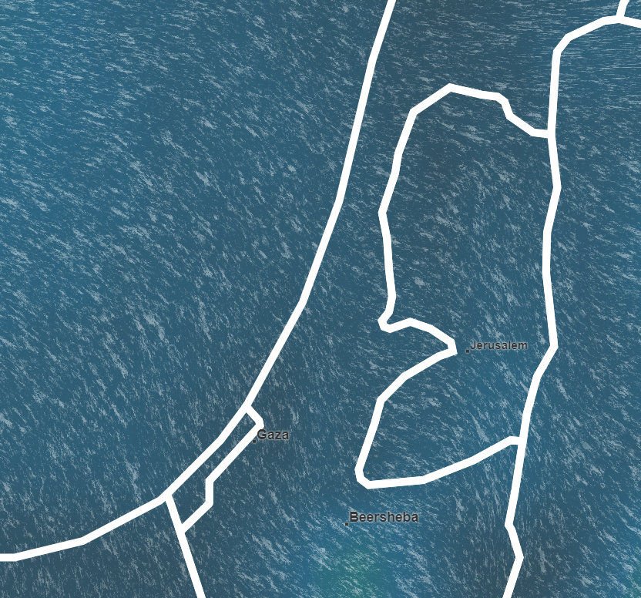
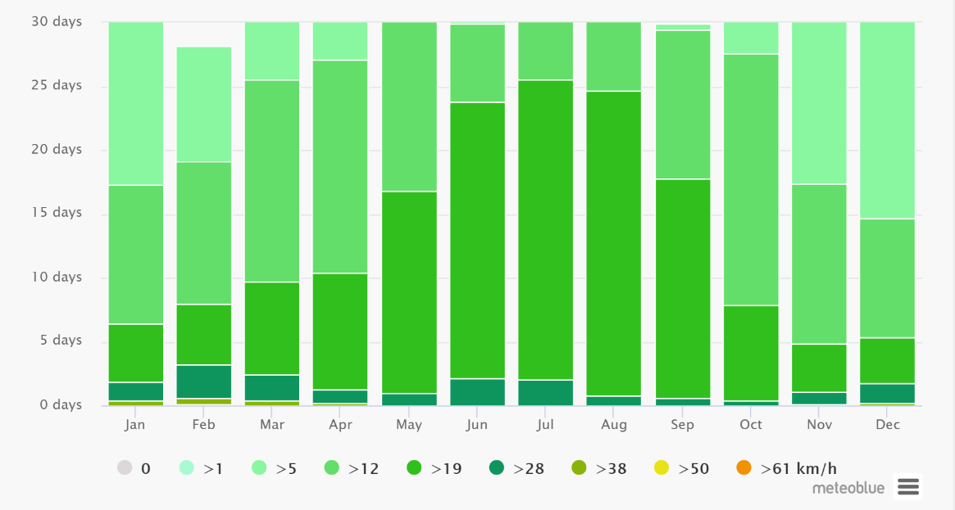
Climate Conditions
Wind Direction & Wind Speed

Slide 7
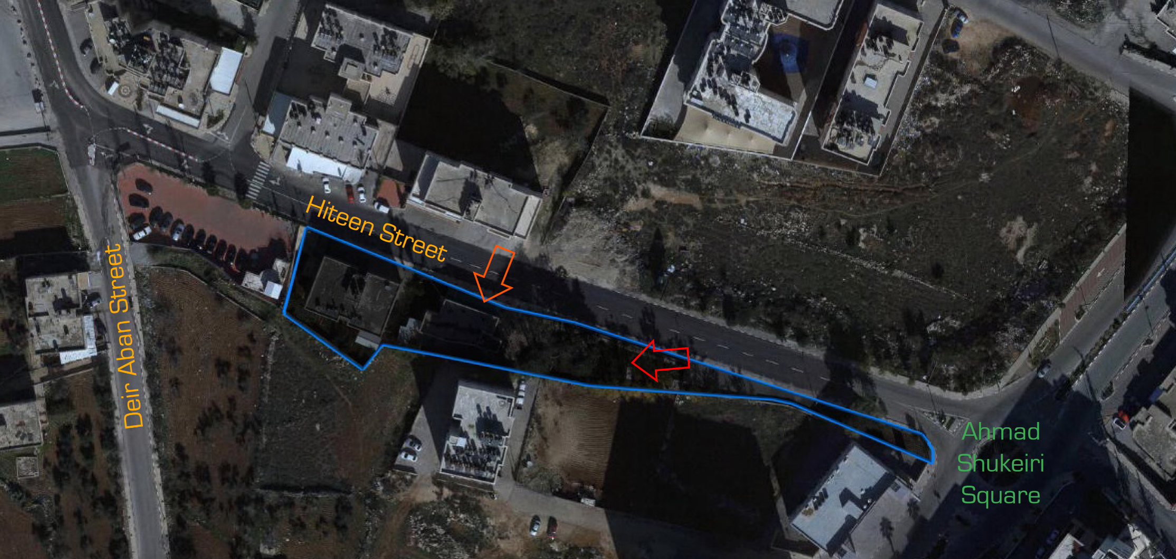
Accessibility and Circulation

Slide 8
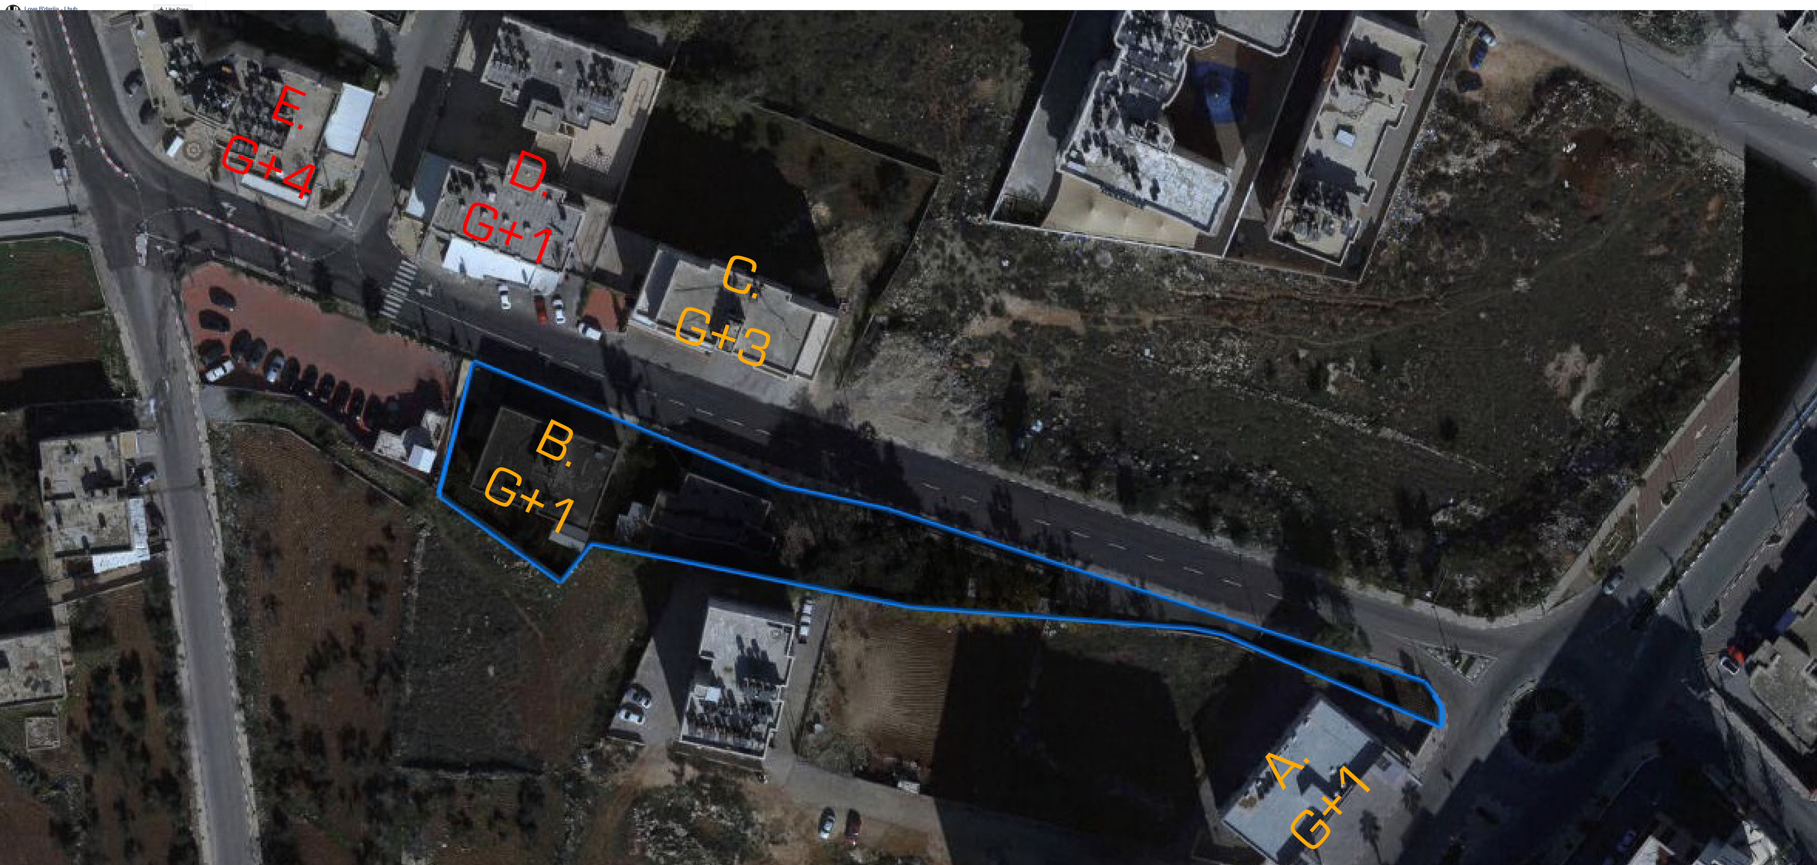
Nearby Buildings and Services

Slide 9
Architectural Design

Slide 10
Architectural Facilities
Main Entrance
Main Showroom
Offices
Maintenance Area
Ramps
Washing and Preparation Station
Painting Station
Body Shop Stations
Storage Space

Slide 11
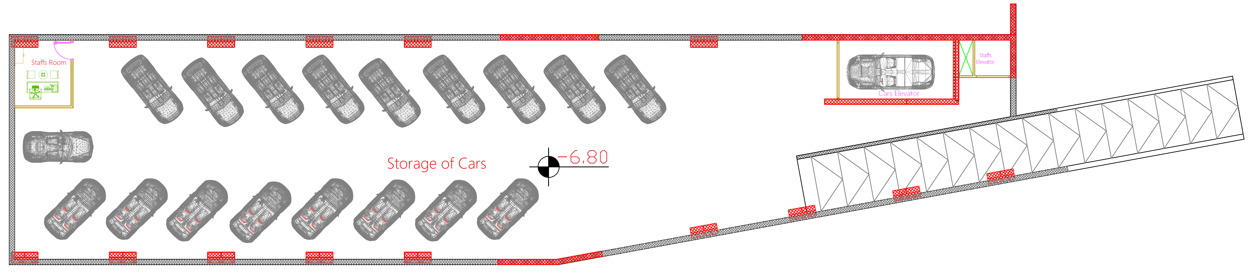
Second Basement Floor

Slide 12
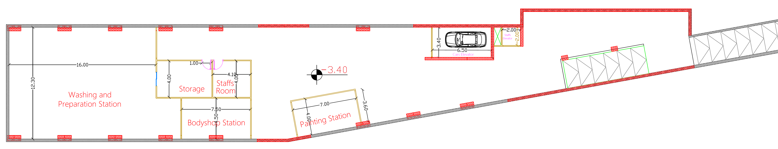
First Basement Floor

Slide 13
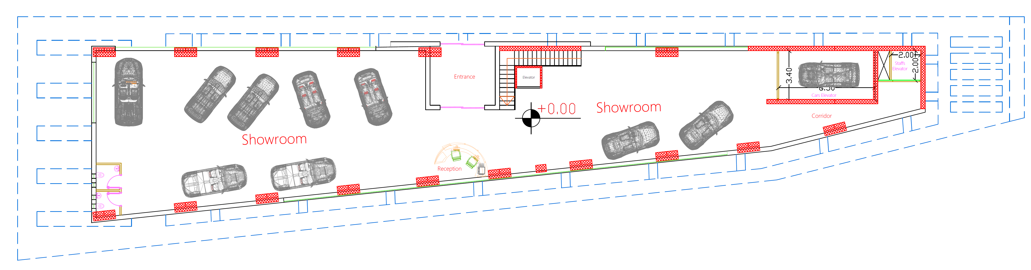
Ground Floor

Slide 14
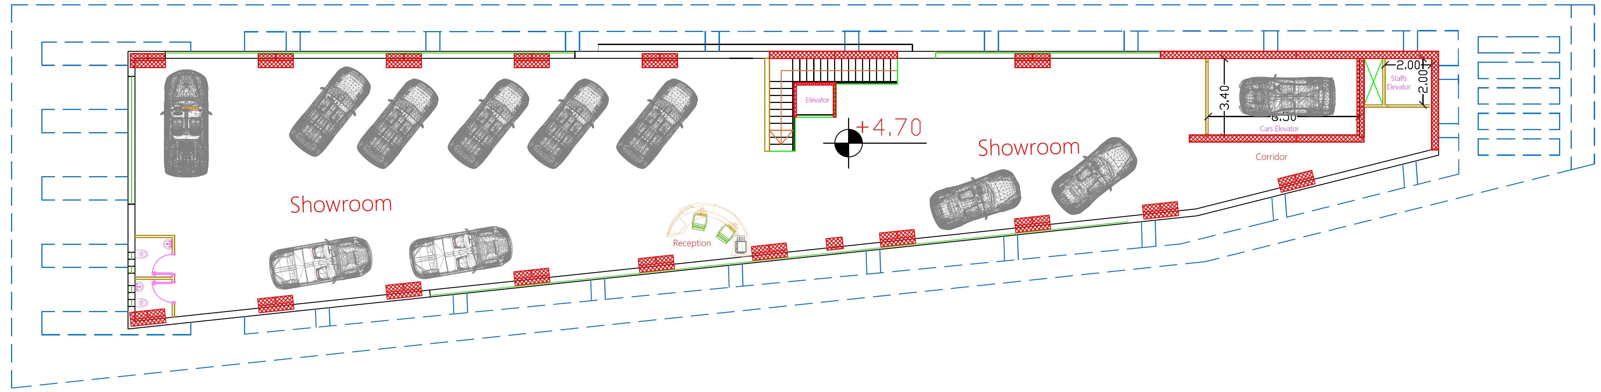
First Floor

Slide 15
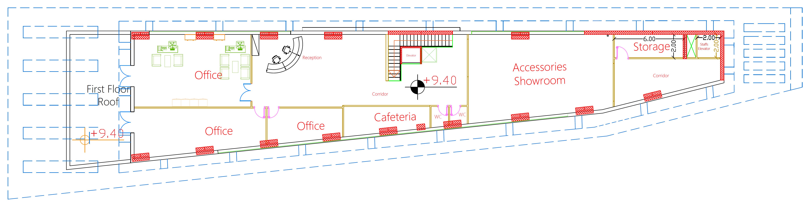
Second Floor

Slide 16
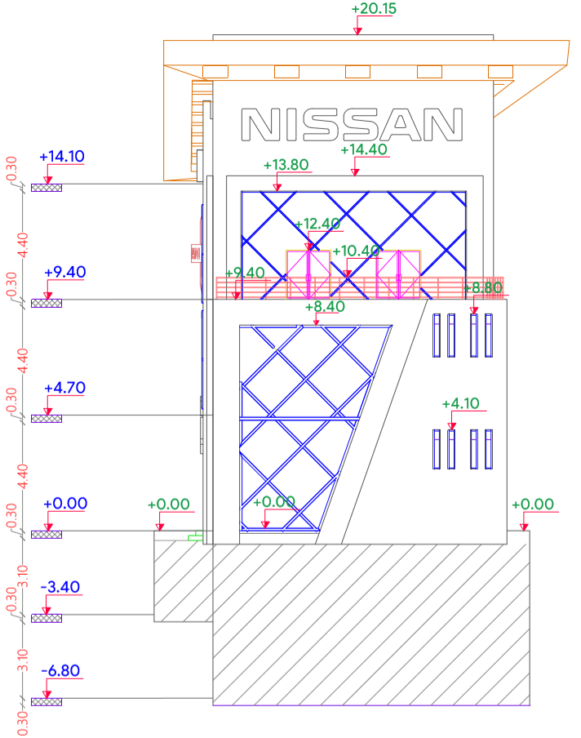
Western Elevation

Slide 17
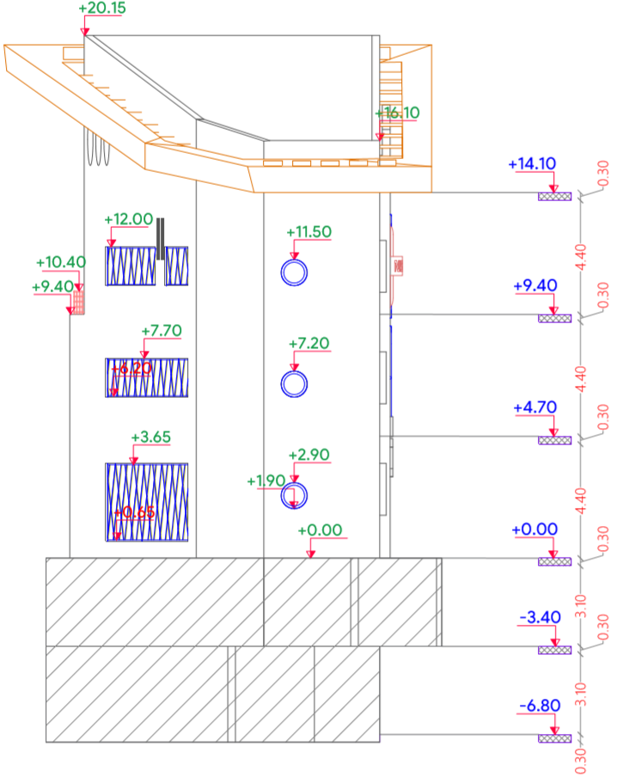
Eastern Elevation

Slide 18
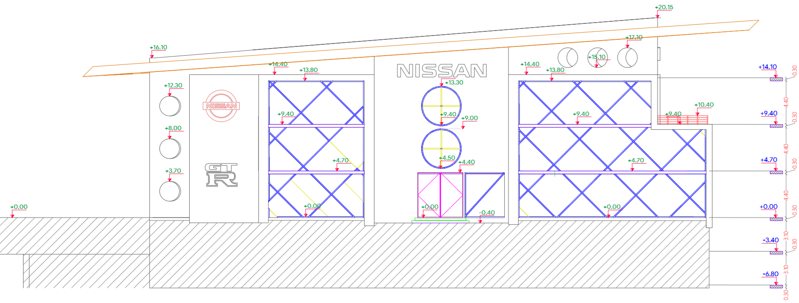
Northern Elevation

Slide 19
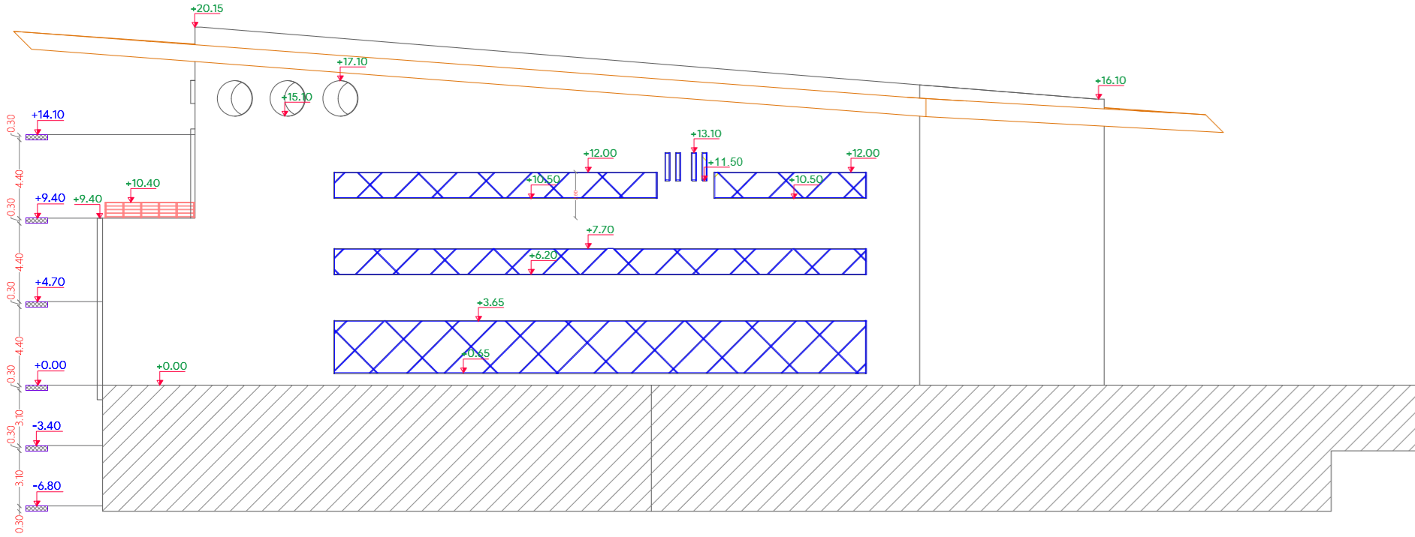
Southern Elevation

Slide 20
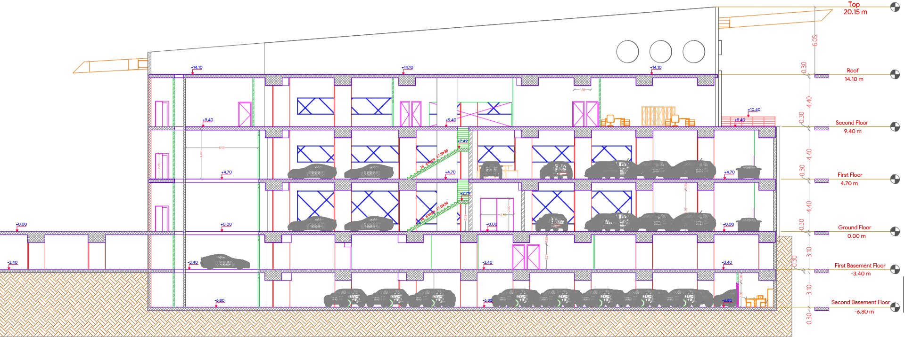
Section A-A

Slide 21
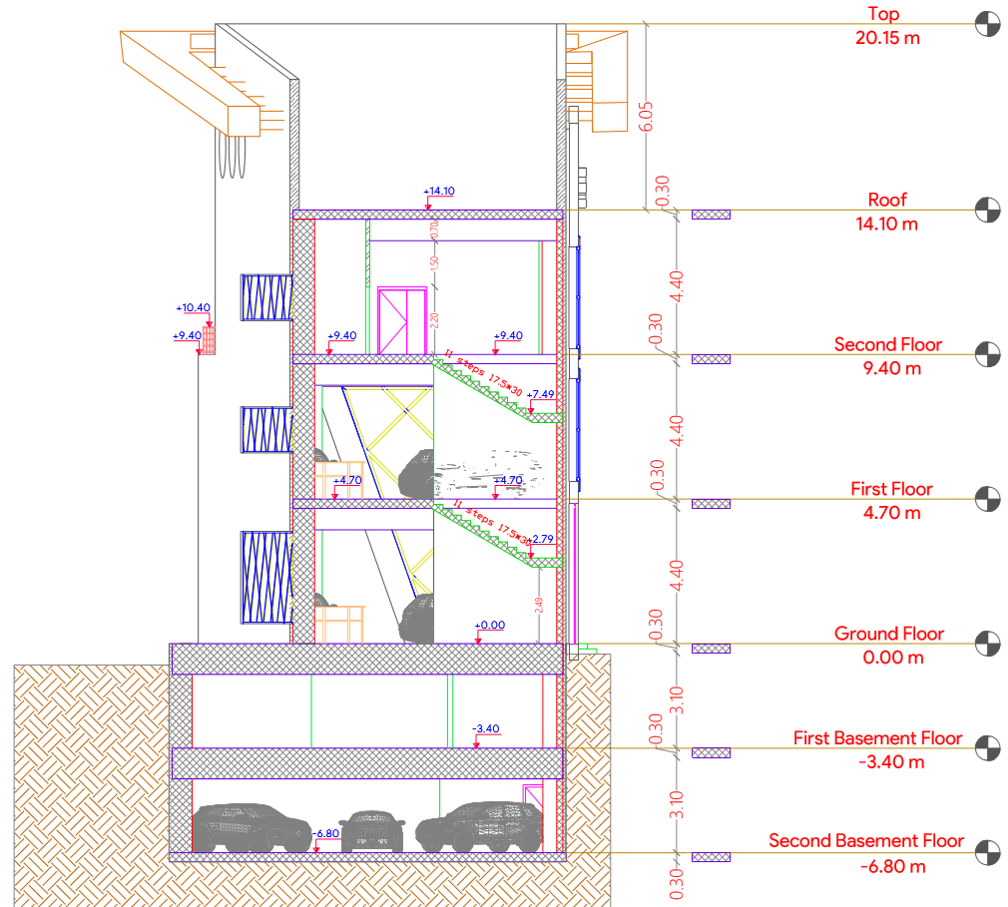
Section B-B

Slide 22
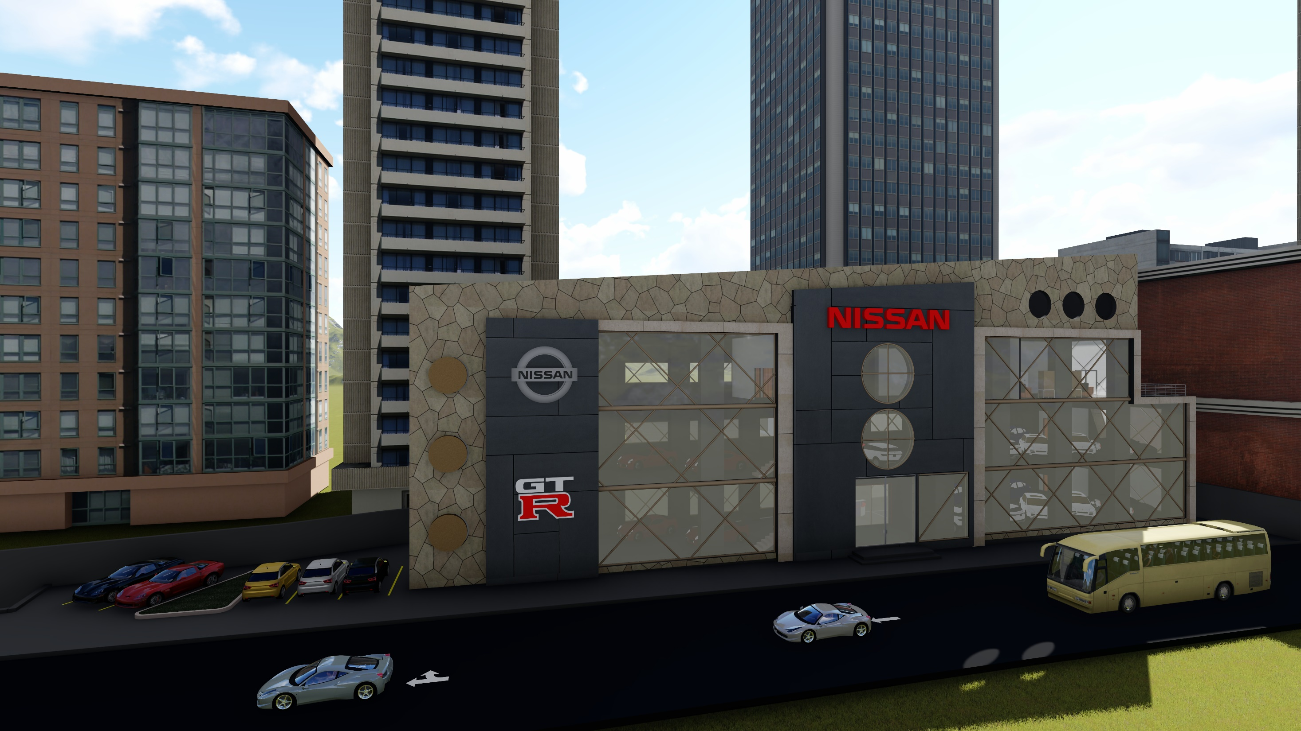

Slide 23
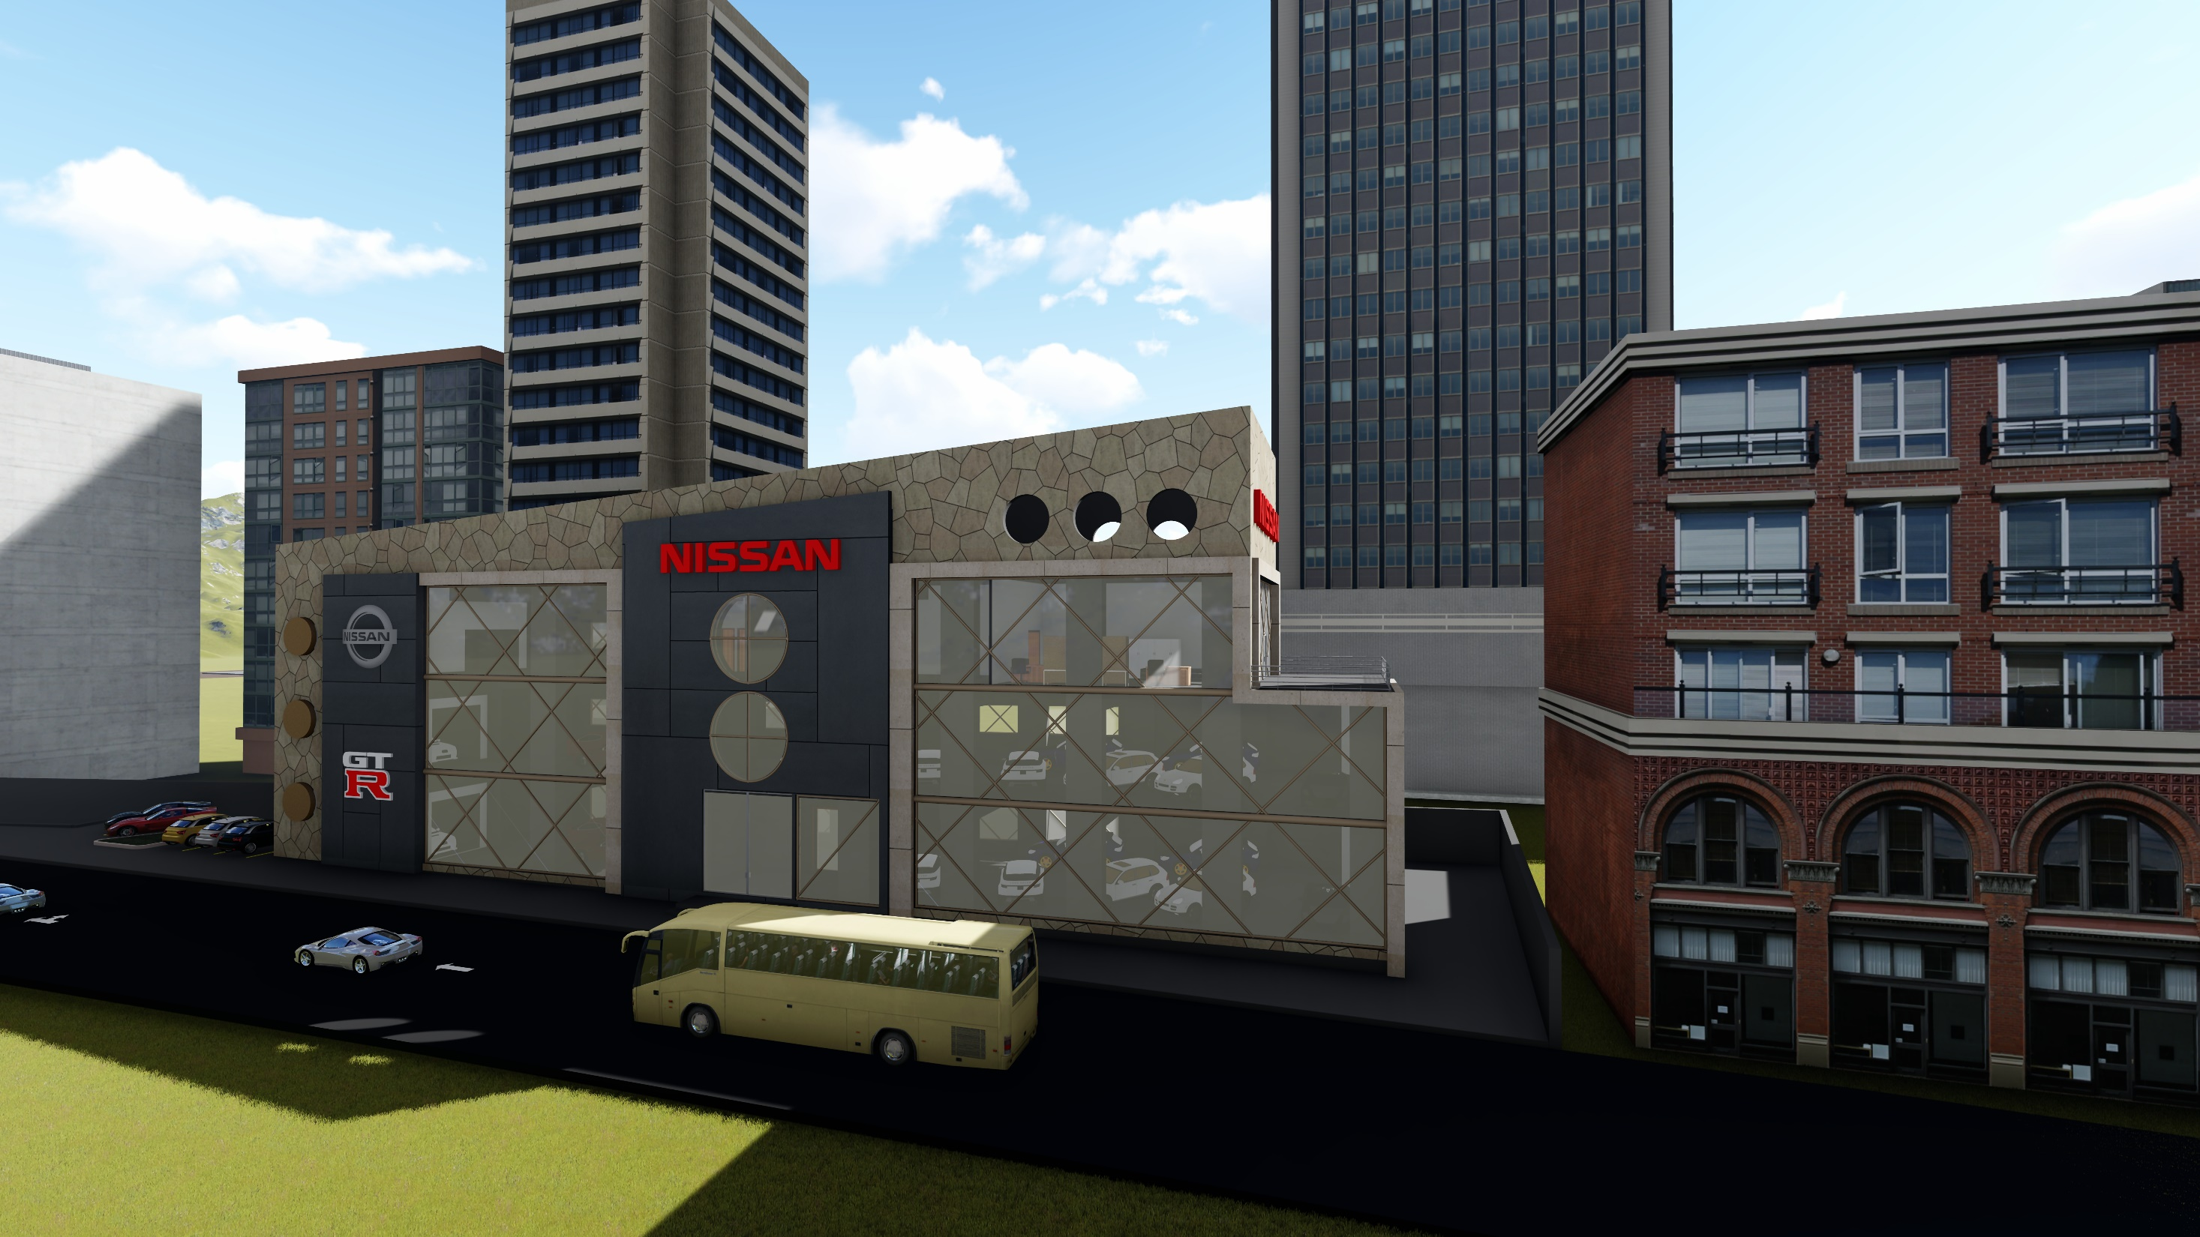

Slide 24
Environmental Design

Slide 25
Thermal Design
U Value for Building Envelope
Component | U-value (W/m².k)
External Wall | 0.444
Internal Wall | 2.032
Floor | 0.434
Roof | 0.363
Windows (In Southern, Eastern and Western Elevations) | 1.493
Windows (In Northern Elevation) | 2.511

Slide 26
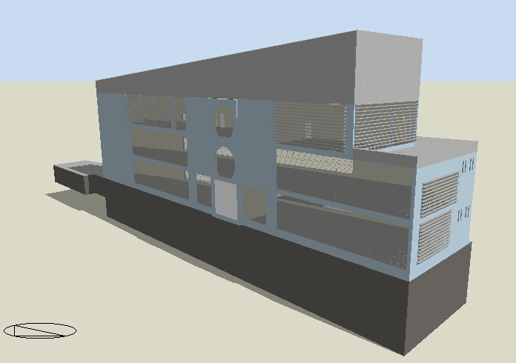
Thermal Design
3D Model in DesignBuilder

Slide 27
Thermal Design
Shading
Louvers System
CNC
Nearby Buildings

Slide 28
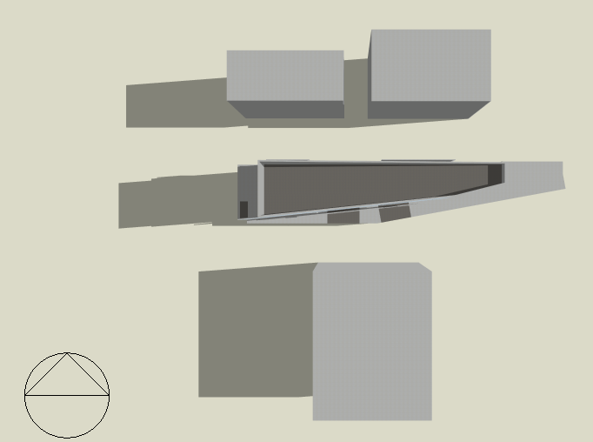
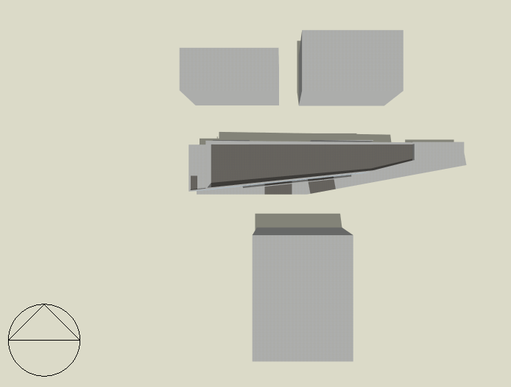
Thermal Design
Shading
In Summer Day
21 July at 8 AM
21 July at 12 PM

Slide 29

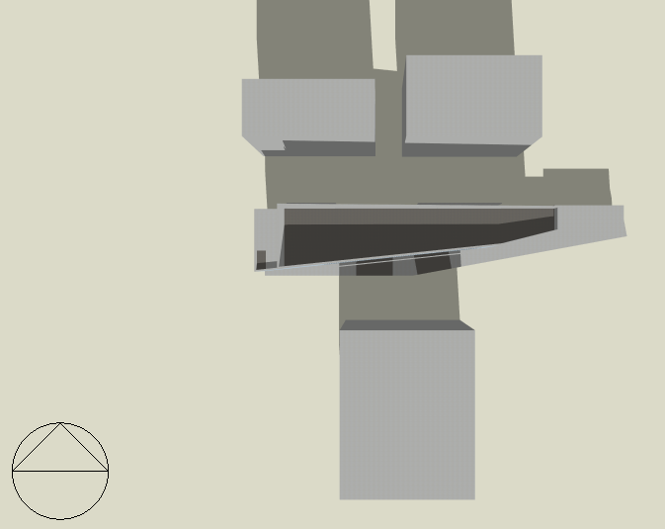
Thermal Design
Shading
In Winter Day
21 January at 8 AM
21 January at 12 PM

Slide 30
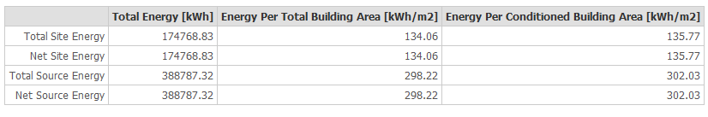
Thermal Design
Heating and Cooling Loads
Cooling Load = 94.61 kW
Heating Load = 76.6 kW
Site and Source Energy

Slide 31
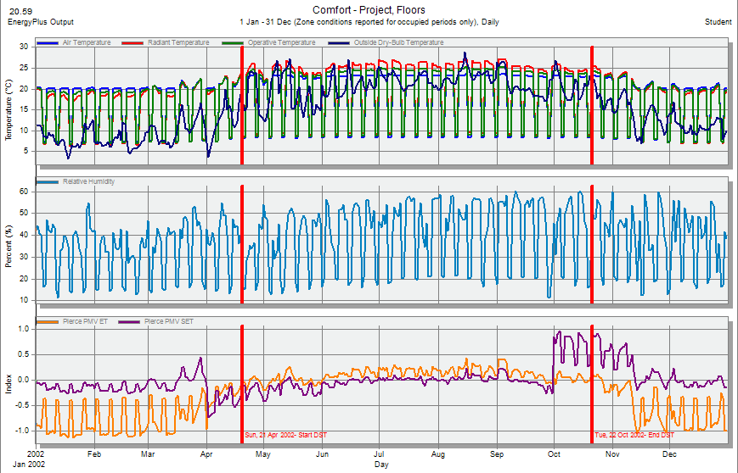
Thermal Design
Comfort PMV-Set

Slide 32
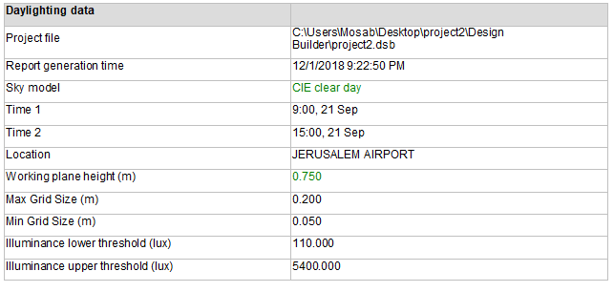
Daylight
Daylighting Data

Slide 33
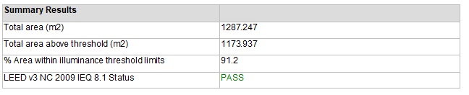
Daylight
Summary Results

Slide 34
Acoustical Design
Absorption Coefficient
Element | Finish Material | Absorption Coefficient (α)
 |  | 63 Hz | 125 Hz | 250 Hz | 500 Hz | 1000 Hz | 2000 Hz | 4000 Hz | 8000 Hz | 16000 Hz
Windows | Double Glaze 6 mm | 0.12 | 0.10 | 0.06 | 0.04 | 0.03 | 0.03 | 0.03 | 0.04 | 0.04
Floor | Tile | 0.01 | 0.02 | 0.06 | 0.14 | 0.37 | 0.6 | 0.65 | 0.6 | 0.7
Walls | Plaster | 0.03 | 0.04 | 0.05 | 0.06 | 0.08 | 0.04 | 0.06 | 0.05 | 0.06
Roof | Plaster Decorative Panels | 0.1 | 0.2 | 0.22 | 0.18 | 0.15 | 0.15 | 0.16 | 0.15 | 0.16
Doors | Hollow Core Plywood | 0.44 | 0.41 | 0.35 | 0.25 | 0.2 | 0.15 | 0.15 | 0.13 | 0.12

Slide 35
Acoustical Design
At 50 % Occupancy
FREQ.. | RT₆₀
63 Hz | 4.75
125 Hz | 4.18
250 Hz | 2.51
500 Hz | 1.04
1 kHz | 0.53
2 kHz | 0.46
4 kHz | 0.49
8 kHz | 0.51
16 kHz | 0.48
RT₆₀ for the Showroom
The Recommended Range (1.0–1.4)

Slide 36
Acoustical Design
At 50 % Occupancy
FREQ.. | RT₆₀
63 Hz | 3.03
125 Hz | 2.67
250 Hz | 1.89
500 Hz | 0.93
1 kHz | 0.50
2 kHz | 0.44
4 kHz | 0.44
8 kHz | 0.42
16 kHz | 0.40
RT₆₀ for the Manager Office
The Recommended Range (0.6–1.2)

Slide 37
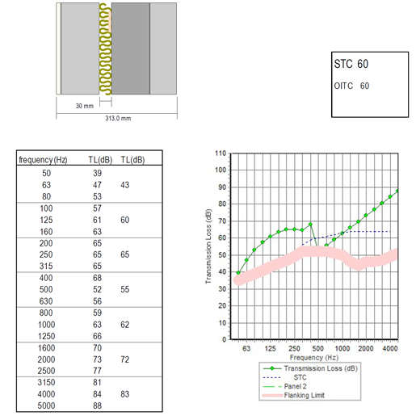
Acoustical Design
STC for the External Wall
The Recommended Range (50 – 60) dB

Slide 38
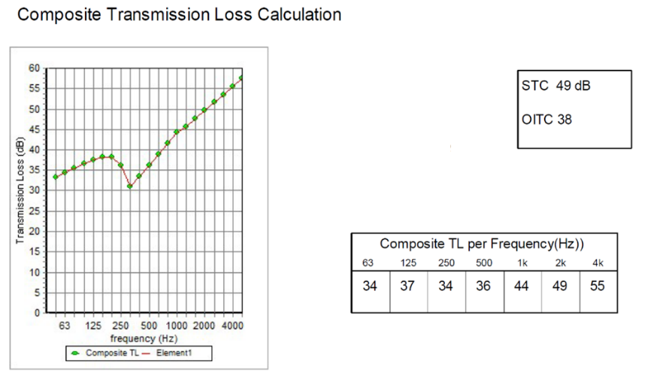
Acoustical Design
STC for the Manager Office adjacent to the next office
The Recommended Value = 45 dB

Slide 39
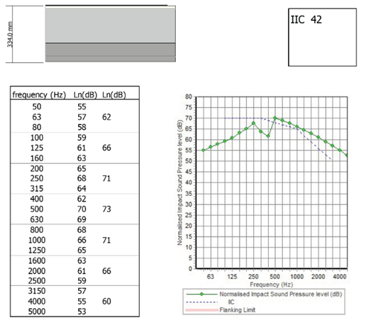
Acoustical Design
IIC for Floor
The Recommended Range (35 – 55) dB

Slide 40
Structural Design

Slide 41
Codes and Loads
Codes
ACI 318-14 for reinforced concrete design
UBC 97 for seismic design and its load combinations
ASCE 7 for load combinations
Loads
Dead Load
Superimposed Load = 4 kN/m²
Live Load = 5 kN/m²

Slide 42
Structural System
Materials
Concrete B350 and B400
Yield Strength of Steel= 420 MPa
Soil Bearing Capacity = 350 kN/m²
Structural System
One Way Solid Slab with Drop Beams

Slide 43
Structural System
Sections Dimensions
Member | Width | Depth
Slab | 30 cm Thickness
Main Beams | 150 cm | 100 cm
Secondary Beams | 60 cm | 30 cm
Column 1 | 160 cm | 70 cm
Column 2 | 70 cm | 50 cm
Shear Wall | 40 cm Thickness

Slide 44
Structural System
Seismic Analysis Parameters
Seismic Zone: 2B (Z=0.2)
Soil Profile: S_{B}
Acceleration Seismic Coefficients C_{a} = 0.2
Velocity Seismic Coefficient C_{v} = 0.2
Importance Factor I = 1.0
Force Reduction Factor R = 5.5

Slide 45
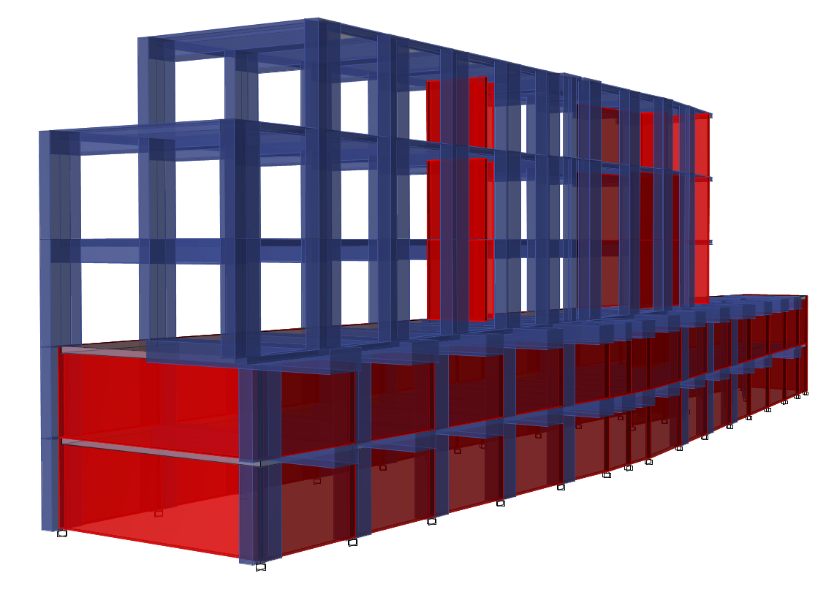
Structural System
Model in ETABS

Slide 46
Model Checks
Equilibrium Check
 | Manual | ETABS | Error % | Assessment
Live Load | 10540.85 | 10475.91 | 0.62 % | OK
Superimposed Load | 18646.64 | 18861.53 | 1.14 % | OK
Dead Load | 66727.13 | 65646.18 | 1.65 % | OK

Slide 47
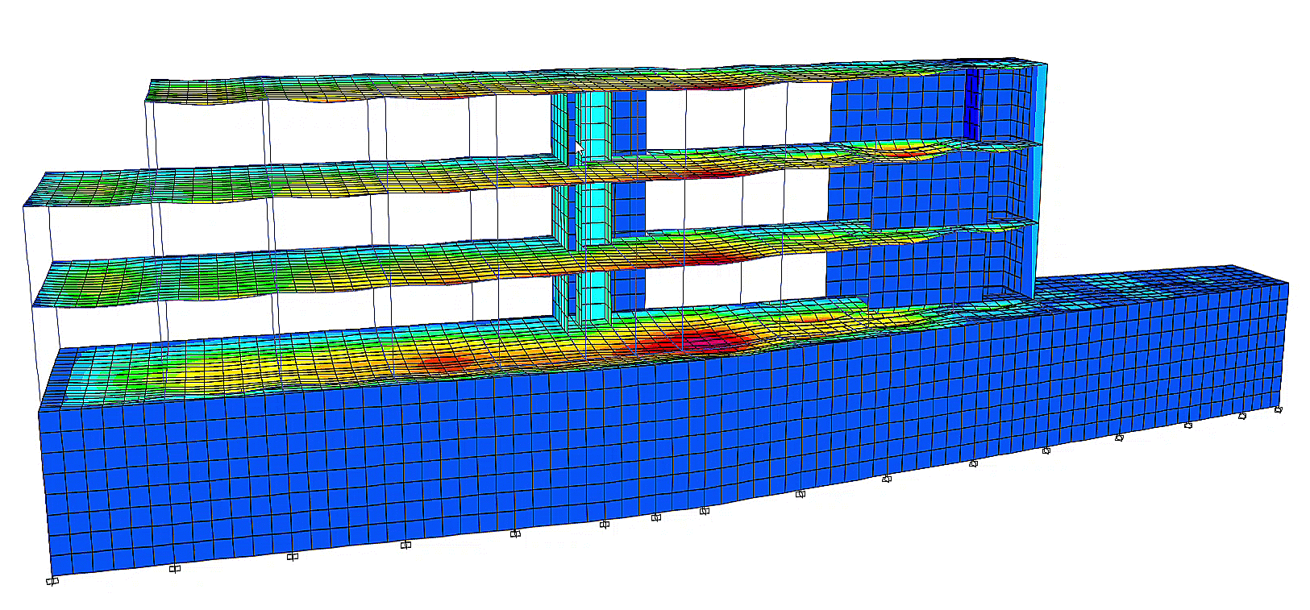
Model Checks
Compatibility Check

Slide 48
Model Checks
Internal Forces Check
All columns, beams and slab that checked, the difference between ETABS and hand calculations was been less than10%.

Slide 49
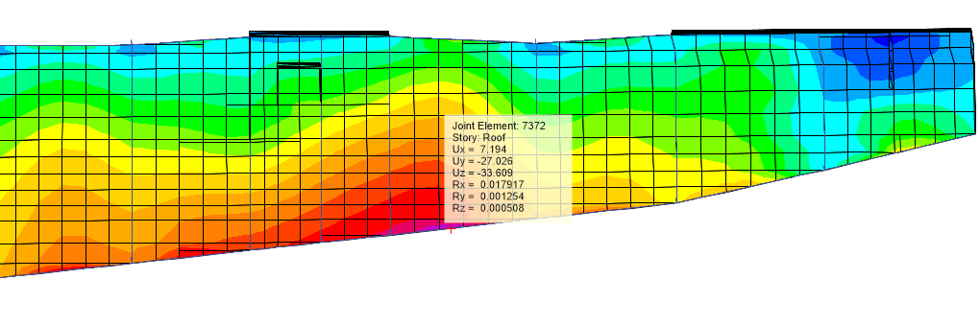
Model Checks
Deflection Check
Maximum Allowable Deflection = L/240 = 12/240 = 50 mm

Slide 50
Model Checks
Period Check
Method A Period = 0.497 sec
Method B Period (From ETABS) = 0.689 sec
Method B Period < 1.4 Method A Period
0.689 sec < 0.696 sec → OK

Slide 51
Model Checks
Base Shear Check
V_{x} Manual = 7920.6 kN
V_{y} Manual = 4598.3 kN
V_{x} ETABS = 7930 kN
V_{y} ETABS = 4599 kN
V Manual < V ETABS → OK

Slide 52
Model Checks
Drift Check
Story | Δm_{x} (mm) | Δm_{y} (mm) | Limitation (mm) | Assessment
BF2 | 0.34265 | 3.7576 | 80 | OK
BF1 | 0.7392 | 11.52305 | 80 | OK
GF | 4.67005 | 5.26295 | 94 | OK
F1 | 7.4921 | 35.13895 | 94 | OK
F2 | 9.2708 | 36.4056 | 94 | OK

Slide 53
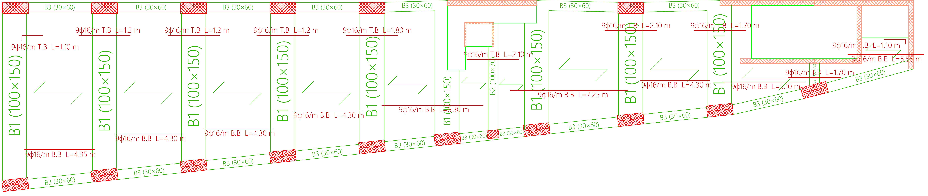
Beams Distribution

Slide 54
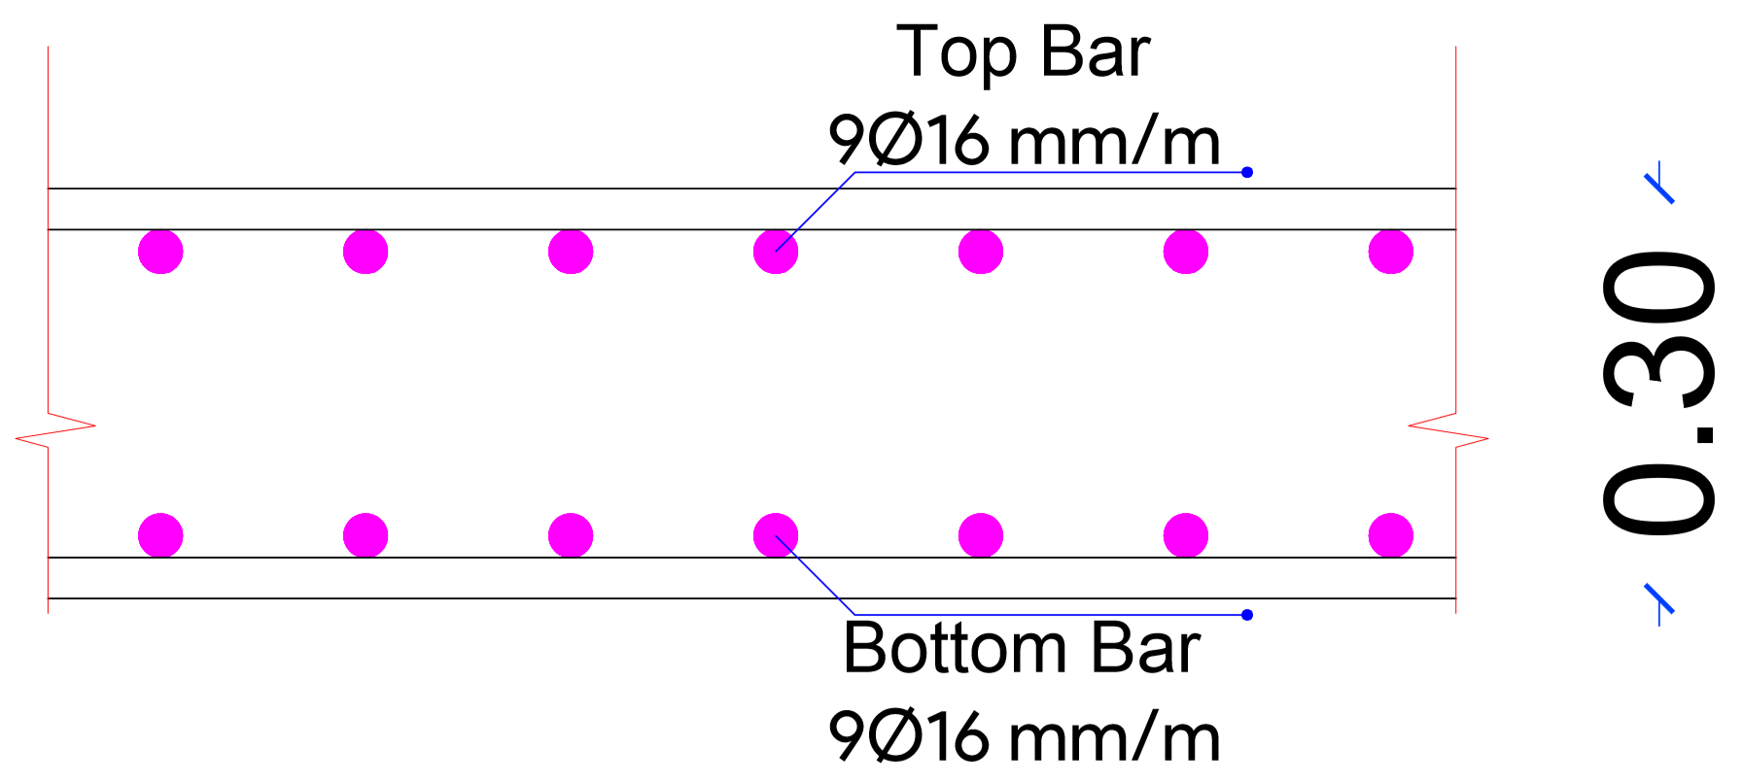
Structural Elements Details
Slab Reinforcement

Slide 55
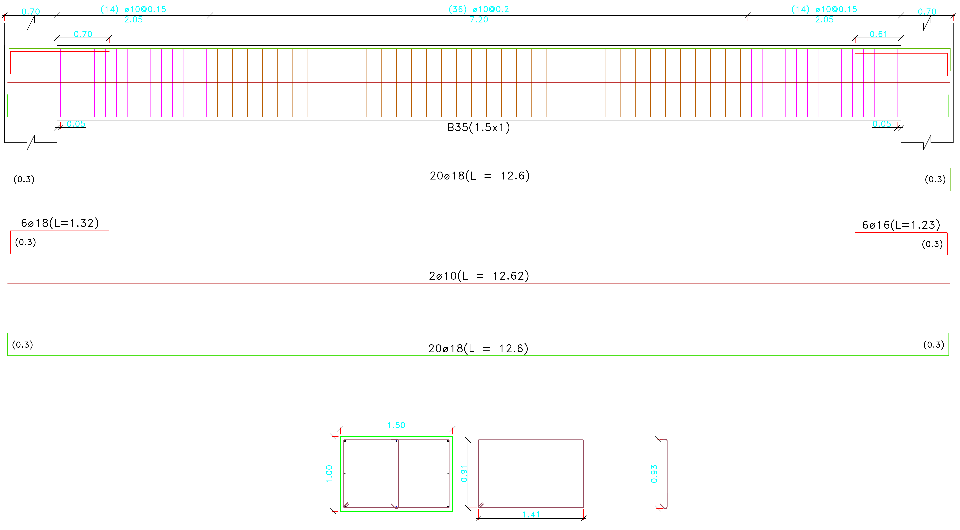
Structural Elements Details
Beams Reinforcement

Slide 56
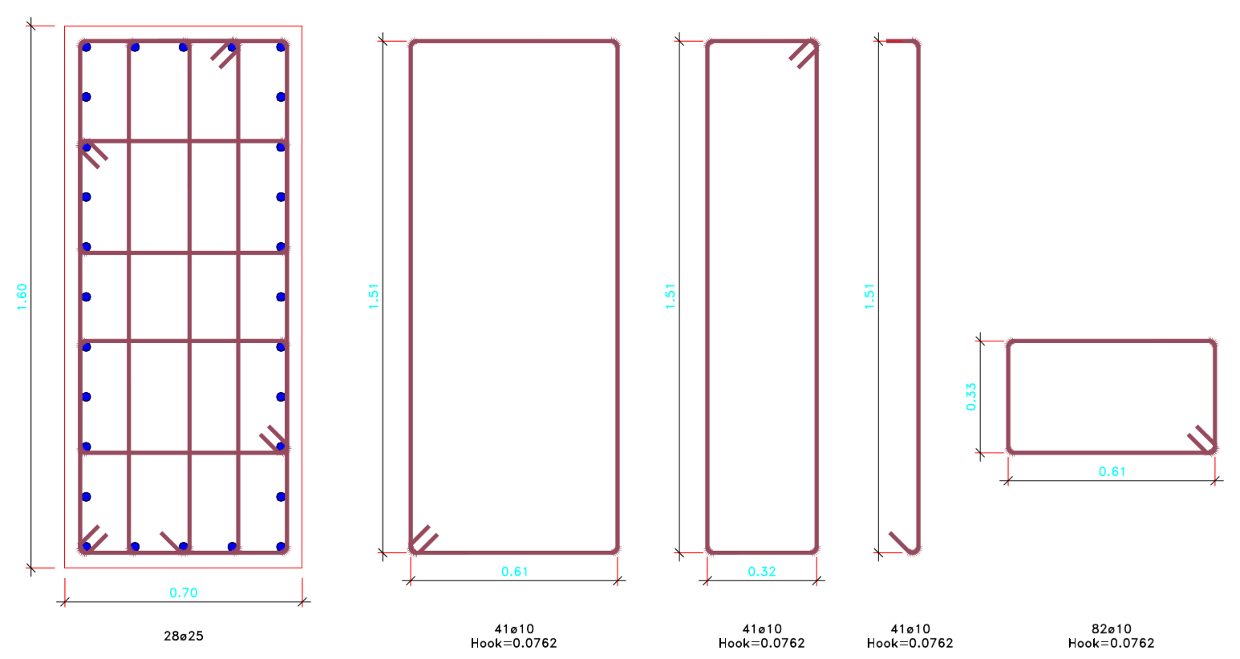
Structural Elements Details
Columns Reinforcement

Slide 57
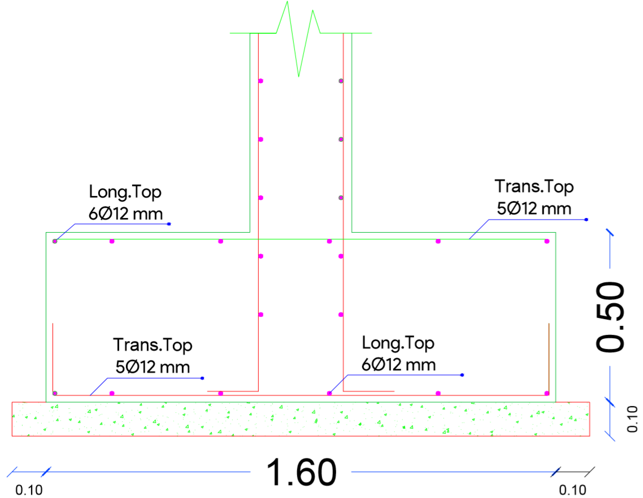
Structural Elements Details
Footings Reinforcement

Slide 58
Electrical Design

Slide 59
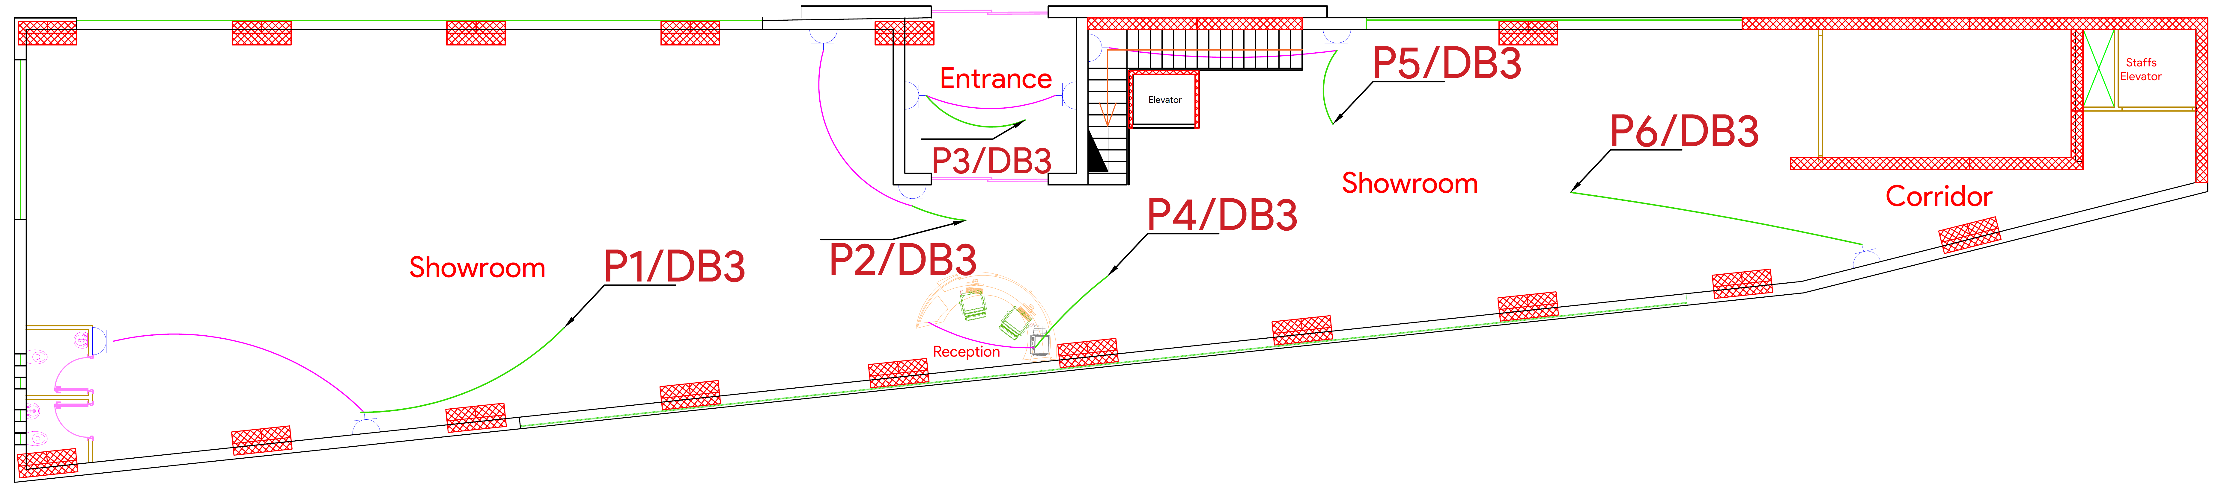
Ground Floor Sockets Plan

Slide 60
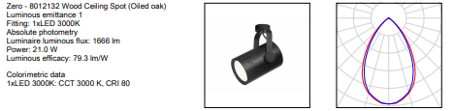
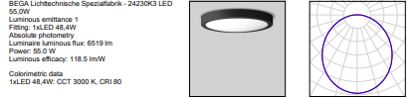
Luminaires Layout

Slide 61
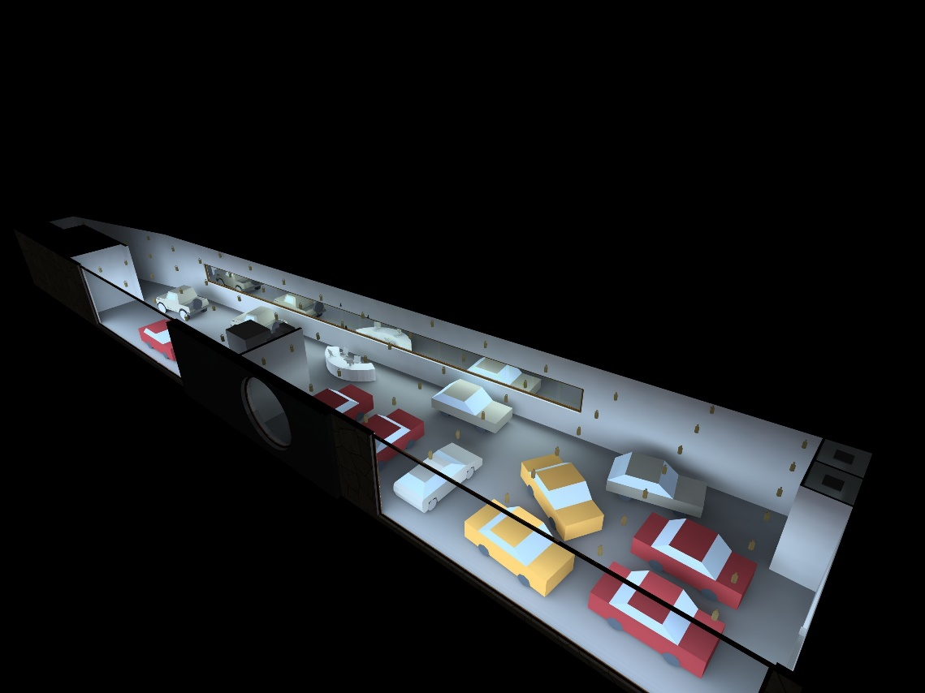
3D Rendering Model (DIALux)
First Floor

Slide 62
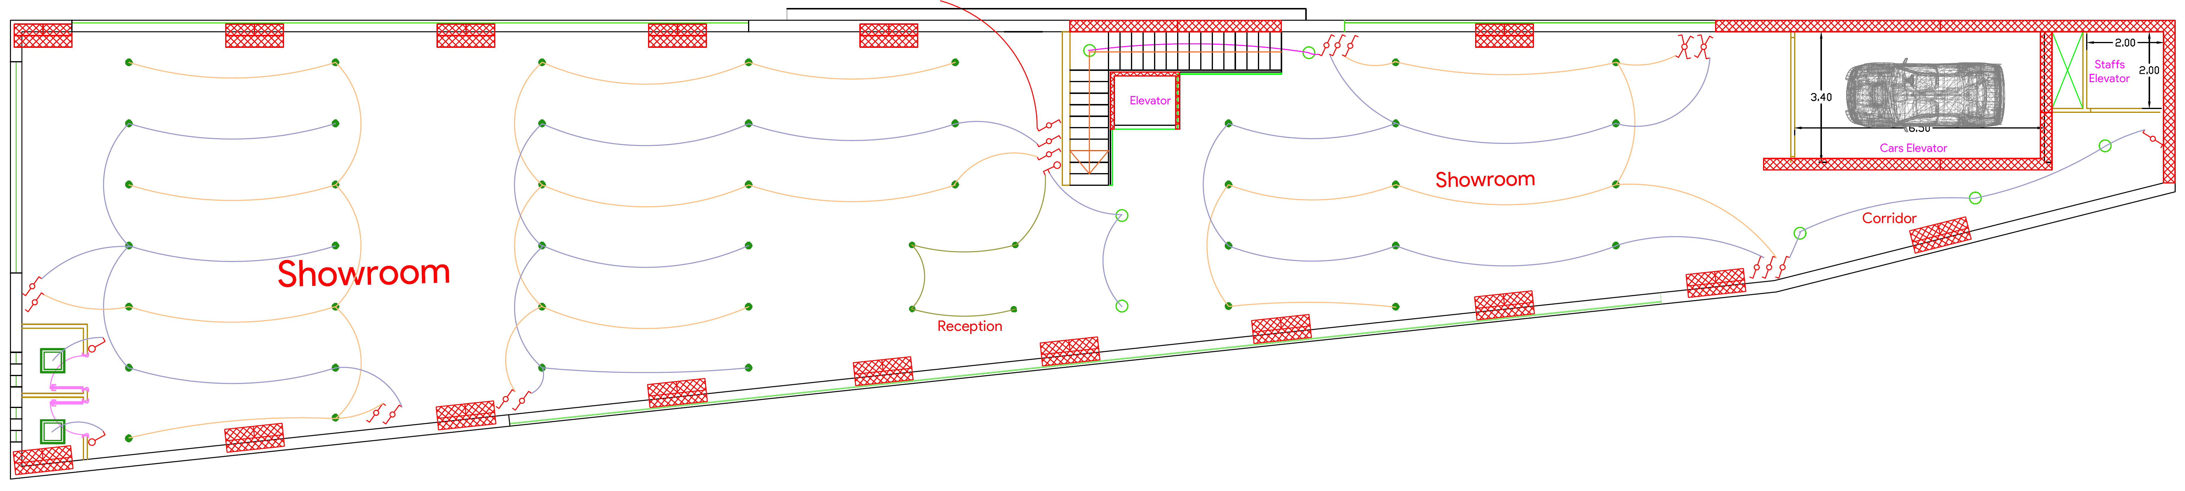
Ground Floor Lighting Plan

Slide 63
Power Consumption Estimation
Type | Consumption (kW/day) | Consumption (kW/month) | Cost (NIS/day) | Cost (NIS/month)
Lighting | 205.31 | 4106.11 | 147.82 | 2956.4
Power | 426.40 | 8528.06 | 307.01 | 6140.2
Total | 632 | 12634 | 455 | 9097

Slide 64
Mechanical
Design

Slide 65
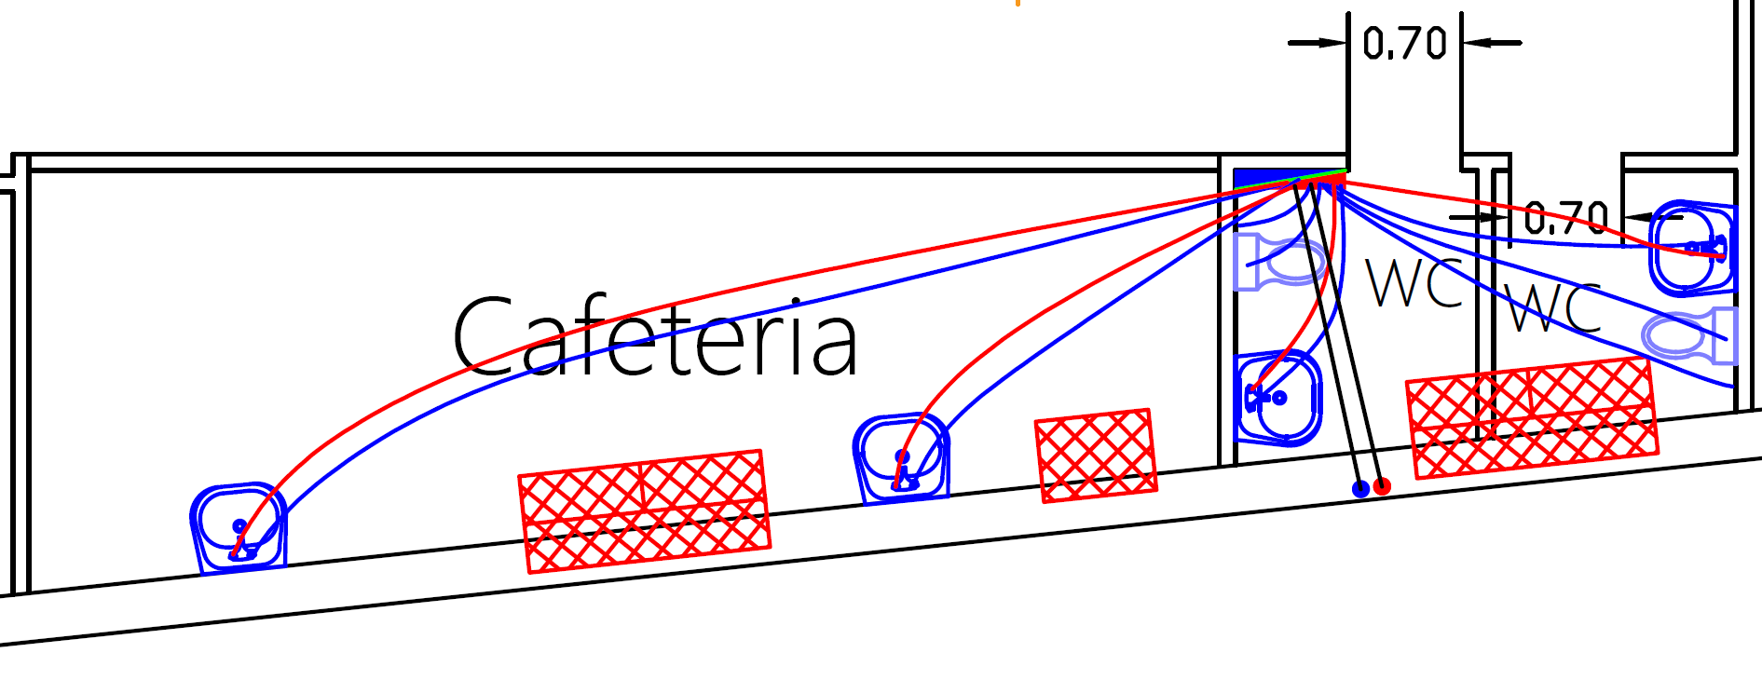
Water Supply System
Number of Tanks = 8 Tanks

Slide 66
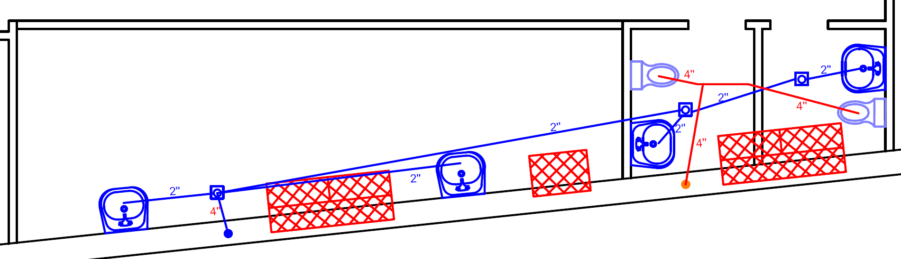
Drainage System

Slide 67
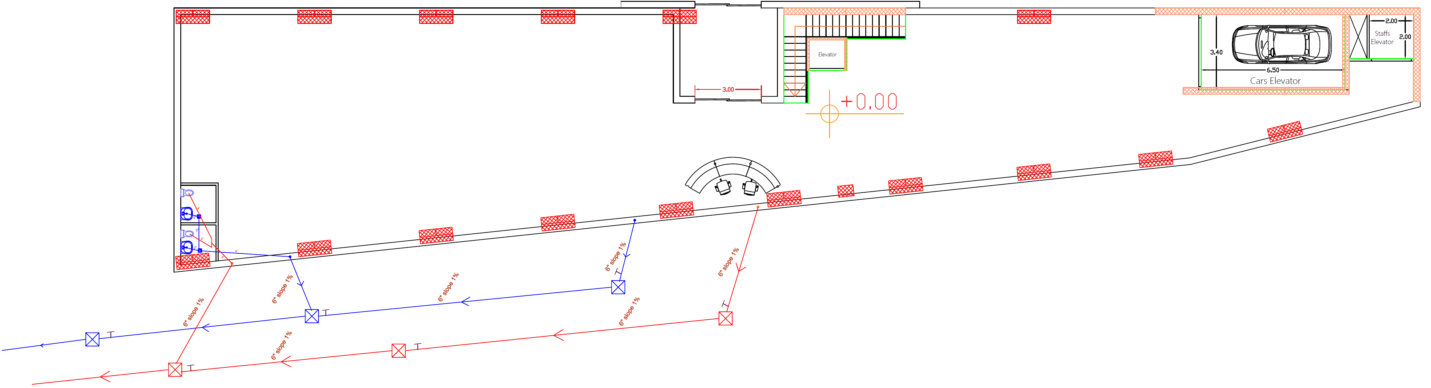
Drainage System

Slide 68
Elevators
Three elevators were designed in the project:
Elevator for Staffs
Elevator for Costumers
Hydraulic Elevator for Cars

Slide 69
HVAC System
VRF System Used
From DesignBuilder
Total Cooling Load = 94.61 kW
Total Heating Load = 76.6 kW

Slide 70
HVAC System
VRF System
Outdoor Unit Selected from TOSHIBA Company with:
Total Cooling Load = 96 kW
(MMY-AP3414FT8-E) Model

Slide 71
HVAC System
VRF System
Fan Coil from Daikin Company with:
Total Cooling Capacity = 16.4 kW
Total Heating Capacity = 19.81 kW
Volumetric flow rate = 0.83 m³/s
(FWD16AT) Model

Slide 72
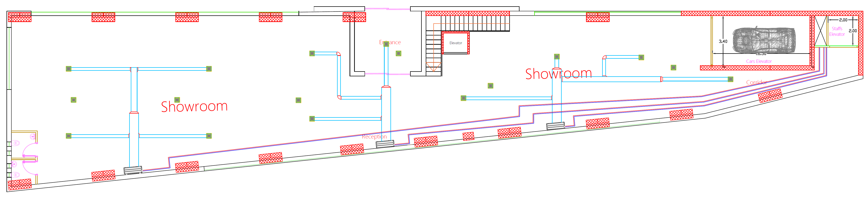
Ground Floor HVAC System Layout

Slide 73
Firefighting and Safety Design

Slide 74
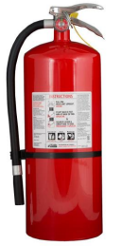
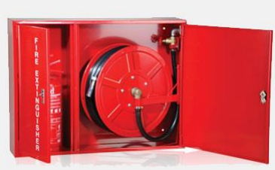
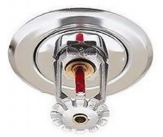

Emergency Fire Protection System
Fire Extinguishers
Hose Stations
Sprinklers
Warning Signs

Slide 75

Emergency Fire Protection System

Slide 76

Heat Detector System

Slide 77
Quantity Surveying and Cost Estimation

Slide 78
Cost Estimation
Total Building Area = 3106 m²
Direct Unit Cost = 5807252/3106
= 1870 NIS/m²
Direct Unit Cost = 361 JOD/m²
Total Direct Project Cost | 5,807,252

Slide 79
Done!
Thanks a Lot

