Slide 1

Design & Implementation of Pick & Place SMT Machine
By: Eng.Muhammad Marmash, Eng. Adel Bni Jaber,Eng.Laith Mousa
Supervisor: Dr. Omar Tamimi

Slide 2
Acknowledgements
We would like to express my deep gratitude and respect to our supervisor, Dr. Omar Tamimi, for his guidance, suggestions and excellent support. We consider ourselves extremely proud and fortunate to work under his supervision with such a dynamic personality.
Also, thanks to all the faculty members in the Electrical Department for their assistance during this work.
We would like to extend our heartfelt thanks to the family and friends who have always helped us with the nature and suggestions that helped us complete this current work We acknowledge our debt to them all.

Slide 3
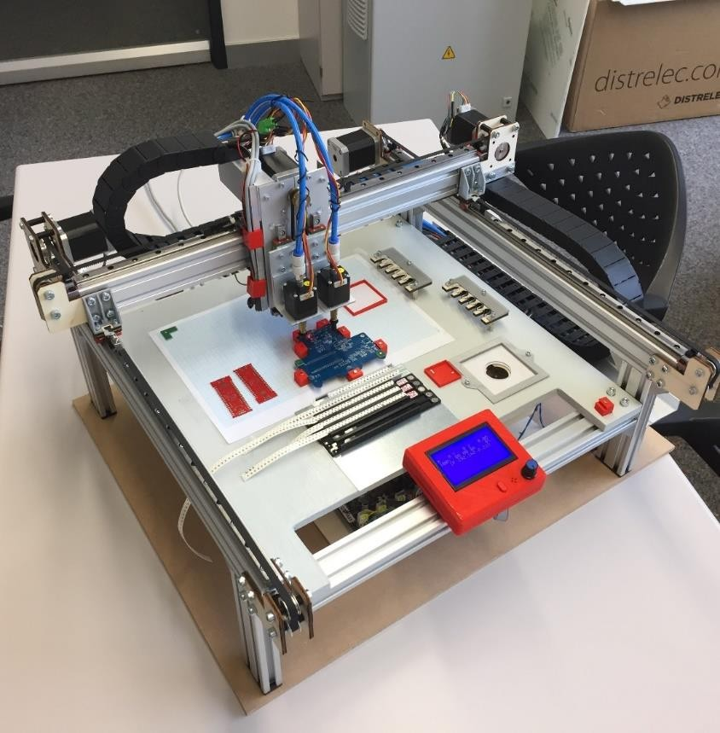
Introduction

Slide 4
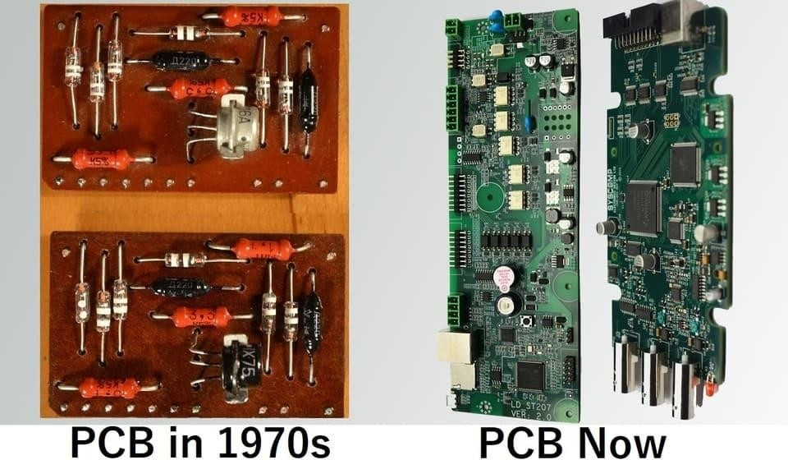
    Surface mount technology and PCB board
SMT the process by which components are mounted directly onto the surface of the PCB. Known originally as “planar mounting,” the method was developed in the 1960s and has grown increasingly popular since the 1980s. Nowadays, virtually all electronic hardware is manufactured using SMT. It has become essential to PCB design and manufacturing, having improved the quality and performance of PCBs overall, and has reduced the costs of processing and handling greatly.
The key differences between SMT and through-hole mounting are (a) SMT does not require holes to be drilled through a PCB, (b) SMT components are much smaller, and (c) SMT components can be mounted on both side of the board. The ability to fit a high number of small components on a PCB has allowed for much denser, higher performing, and smaller PCBs.

Slide 5
Advantages:
SMT allows for smaller PCB size, higher component density, and more real estate to work with. Because fewer drilling holes are required, SMT allows for lower cost and faster production time. During assembly, SMT components can be placed at rates of thousands—even tens of thousands—of placements per hour, versus less than a thousand for THM. Solder joint formation is much more reliable and repeatable using programmed reflow ovens versus through techniques. SMT has proven to be more stable and better performing in shake and vibration conditions.
Disadvantages:
SMT can be unreliable when used as the sole attachment method for components subject to mechanical stress (i.e. external devices that are frequently attached or detached).

Slide 6
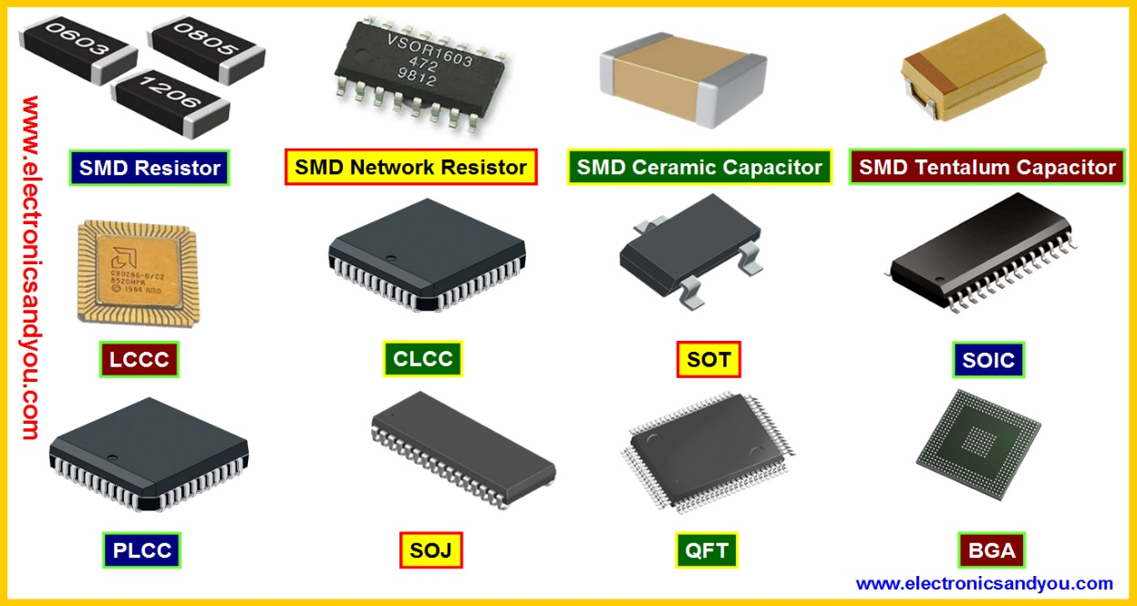
SMD Components – Types of SMD Components
SMD Components or Surface Mount Devices are Electronic Components for SMT. SMD Components for SMT Don’t have Leads Like Thru-Hole Components.
SMD Components or Surface Mount Electronic Components for SMT are no different from through-hole components as far as the electrical function is concerned.
An SMT component is usually smaller than its through-hole counterpart because it has either smaller leads or no leads at all. It may have short pins or leads of various styles, flat contacts, a matrix of solder balls (BGAs), or terminations on the body of the component.

Slide 7
Types of SMD Components
These surface mount components come in a variety of packages, most of which are standardised to make the manufacture of the PCB assemblies using automated equipment much easier.
There are two basic types, active and passive surface mount electronic components:
Passive Surface Mount Electronic Components:
    Surface Mount Resistor
    Capacitors
    Inductors
    Transformers
Active Surface Mount Electronic Components
  Diodes
  Transistors
  Integrated Circuit (IC’s)

Slide 8
    What is SMT Pick and Place Machine?
A PnP machine for SMT, refers to a system used to mount small electronic components (SMDs) such as circuits, capacitors, resistors onto the printed circuit board.
These machines generally contribute to about 50% of the total cost of a complete SMT production line.
Some surface mount placement machine (pick and place machine) are very versatile and are capable of placing many different electronic components used in electronics, while
others are dedicated to a few component types.

Slide 9
Hardware system
1-PCB
2-Smoothie board
3-Sparkfun vacuum pump
4-Solenoid Valve
5-V-Slot Linear Actuator
6-Head and nozzle
7--Camera- PT-0820

Slide 10
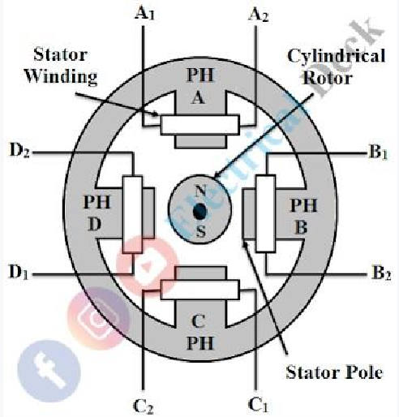
Stepper Motors
Like all motors the stepper motors also have a stator and a rotor, but unlike
a normal DC motor the stator consists of individual sets of coils. The number of coils will differ based on type of stepper motor, a stepper motor the rotor consists of metal poles and each pole will be attracted by a set of coil in the stator.
Types of stepper motors
There are mainly three types of stepper motors based on construction, which are:
1. Variable reluctance stepper motor.
2. Permanent magnet stepper motor.
3. Hybrid synchronous stepper motor.
4. Variable reluctance stepper motor:

Slide 11
Hybrid synchronous stepper motor-Nema-17
This can be used as an adjustable speed drive when the tracker gets large steady-state error, i.e., out of focus with large distance, the driver forces stepper motor with high.
Shaft Size: 5mm
Torque: 76 oz*in
Step Angle: 1.8
Peak Current is 1.68A/phase
4 Wire Bi-Polar
12-24VDC (Recommended)
RoHS Compliant
200 step per revolution
Hypred stepper motor
0.8 in haf step
Open loop system

Slide 12
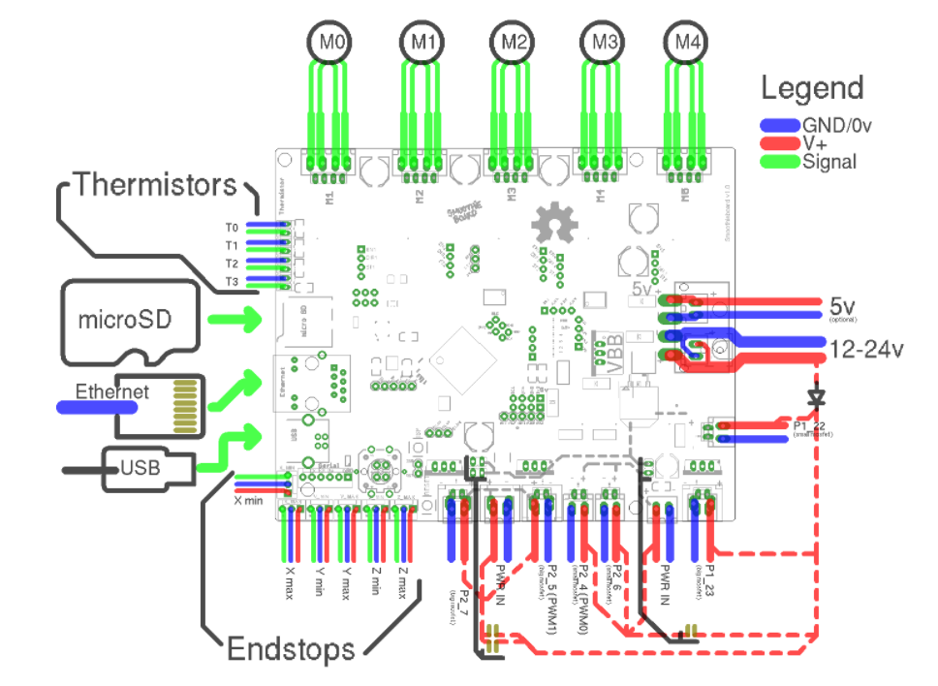
  Smoothie Boards:-
The Smoothie boards are numerical fabrication controllers designed to run the Open-Source Smoothie ware firmware.
the Smoothie project is about creating an open source platform for controlling digital fabrication machines and to make that platform as useful to as many people, projects, and use cases as possible.

Slide 13
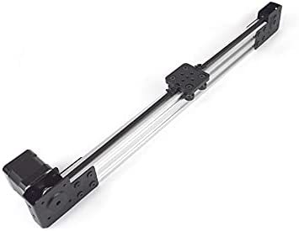
v-slot linear actuator
The V-Slot Linear Actuator is a great component in any linear system.
It’s fast and modular which means it can easily be built into any linear application.
Take advantage of this amazingly affordable linear motion system today!
Linear actuators are used in machine tools and industrial machinery, in computer peripherals such as disk drives and printers, in valves and dampers, and in many other places where linear motion is required. Hydraulic or pneumatic cylinders inherently produce linear motion.

Slide 14
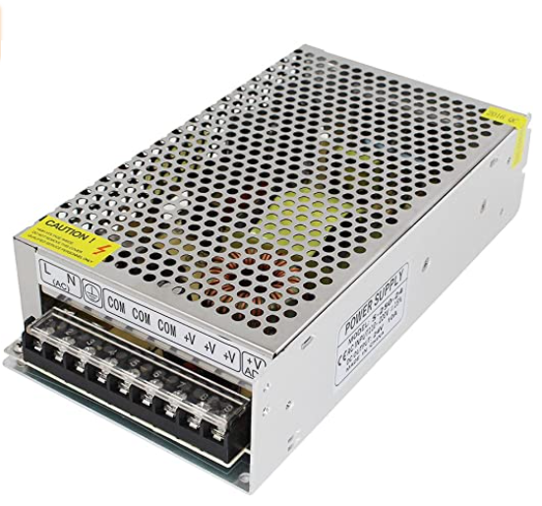
Power Supply
Specifications:
Input Voltage: 100V-120V AC 60HZ, 200-265V AC 50HZ; Output Voltage: 24V DC 10A Output Current: 0~10A Power: 240W Shell Material: Metal case Protection: Shortage Protection. Overload Protection. Over Voltage Protection Safety Compliance: CCC/ FCC / CE Working Temperature: 0~45 degree Storage Temperature: -20~65 degree Ambient Humidity: 0~96% Non-Condensation Package Content : 1 x 24V 10A Switching Power Supply.

Slide 15
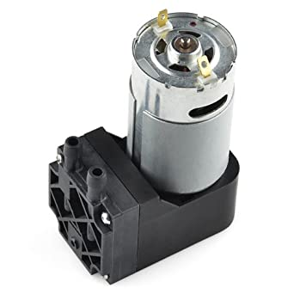
Vaccum pump
The force used to carry the components in this system is the air pressure force generated by the vacuum pump, as it draws air through the pipes and thus generates a reverse force that comes out through a special head that has a narrow enough opening to carry the components.
This vacuum pump really sucks! This pump operates at 12V and has enough suction for most small projects. We even used one to make our very own universal gripper using coffee grounds, balloon and some other parts.
Features:
12V motor
12W operation
1/4" barbs
0-16" Hg vacuum range

Slide 16
smt head
The head is replaced so that its diameter is proportional to the surface area of the other components as needed.
the placement head of the placement machine is an intelligent robot that can pick up components as required and precisely Place it on the preset PCB board. It is most vital part of Pick and Place machine from speed and accuracy prospect. Speed of machine is in direct relation with the speed of head. It is actually speed with which machine can pick and place components and it is usually measured in parts per hours (PPH) or components per hours (CPH).

Slide 17
CONCLUSION

Slide 18
The aim of this project was to design and fabricate SMT (Surface Mount Technology) pick and place machine that could work automatically from the PCB loading up to placement of components on the PCB. As for the mechanical design, all the mechanical parts were ordered online according to the required measurements and specifications, and we will connect this machine with the open pnp program to be able to operate and control the machine

Slide 19
Thank you

