Slide 1
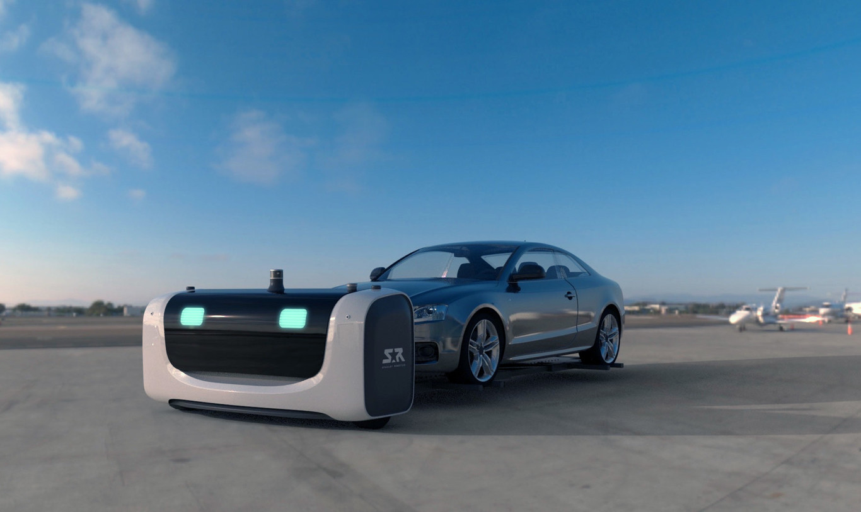
Parking Robot
Under the supervision of Dr. Samer Arandi
Students : Muheeb Hasan & Diaa Sharqawi

Slide 2

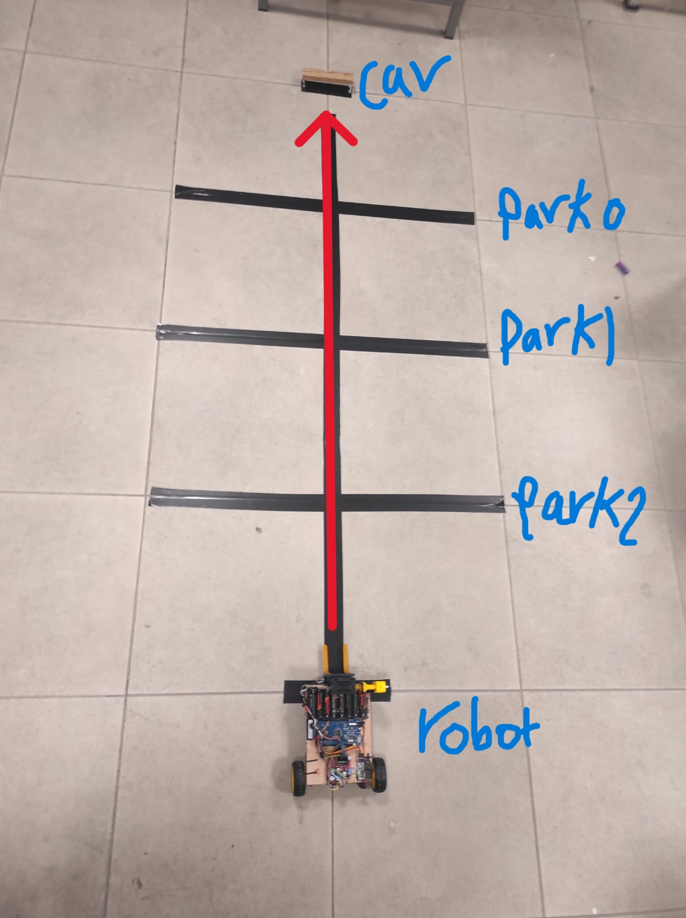
Outline
01
Introduction
Overview of robotic parking system concept and project goals.
02
Constraints
Project limitations, challenges, and technical considerations overview.
03
Equipment's
List of hardware components and their functionality explained.
04
Results and Analysis
Successful implementation and operational efficiency.
05
Future Work
Future enhancements for improved functionality.

Slide 3

Introduction
Robots are used in multiple areas, especially where they can alleviate strenuous.
Tasks or complete missions that are dangerous for a human to undertake.
Many Accidents occur often while parking or reversing cars.
A parking robot is a robot designed to help people to park their cars. They just leave it in the garage entry and the robot parks it for them.
This robot works to lift the car and park it accurately without any human effort.

Slide 4
Our project
In our project, We built a model of parking Robot System. We built the robot and program it to take the car when someone orders him using card .
2- Parking Robot
1- Garage Entry

Slide 5
Constraints
04
03
Raspberry PI
02
Rotate The Robot
01
Robot Movement
Mechanical Parts

Slide 6
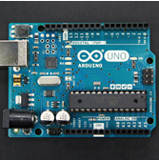
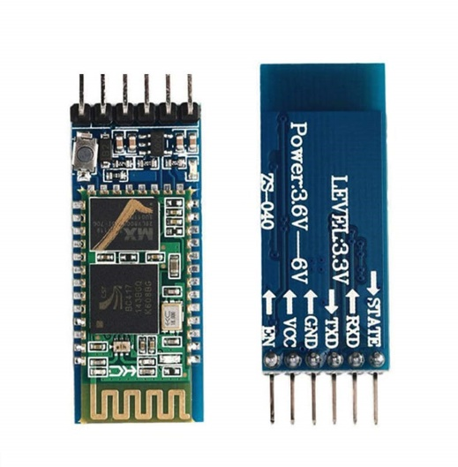
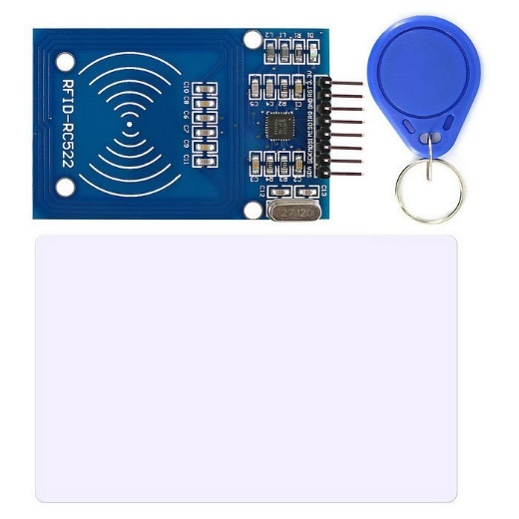
Equipment’s:1- Garage Entry
HC-05 Bluetooth Module
Arduino Uno
RFID

Slide 7
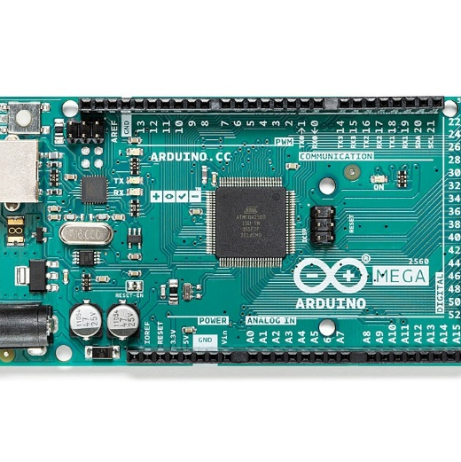
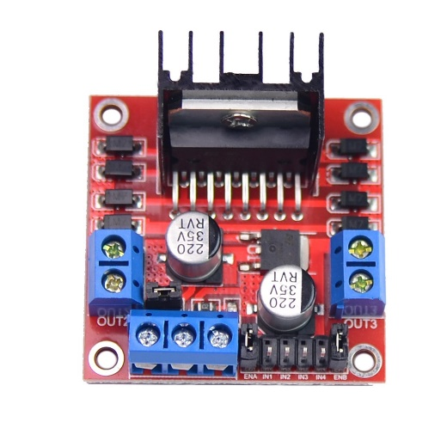
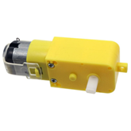
Equipment’s: 2- Parking Robot
Arduino mega
L298N Dual
H Bridge
DC motor

Slide 8
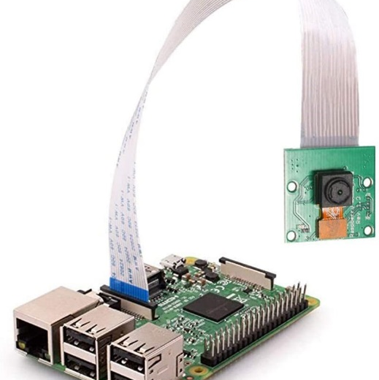
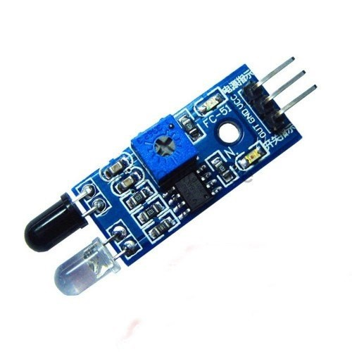
Equipment’s:2- Parking Robot
HC-05 Bluetooth Module
IR
Raspberry pi

Slide 9
Results and Analysis

Slide 10

We compiled the source code for every step and make sure that everything is working well before we move to the next step,
That help us a lot to determine where the errors come from.
In the final stage, our project fulfilled the requirements related to it like:
Reading the user card by the scanner (RFID),
The signal was sent to the robot via Bluetooth to take the car, and the user car was parked in an empty parking space finally,
The robot brings the user car when he scans his card for the second time.

Slide 11
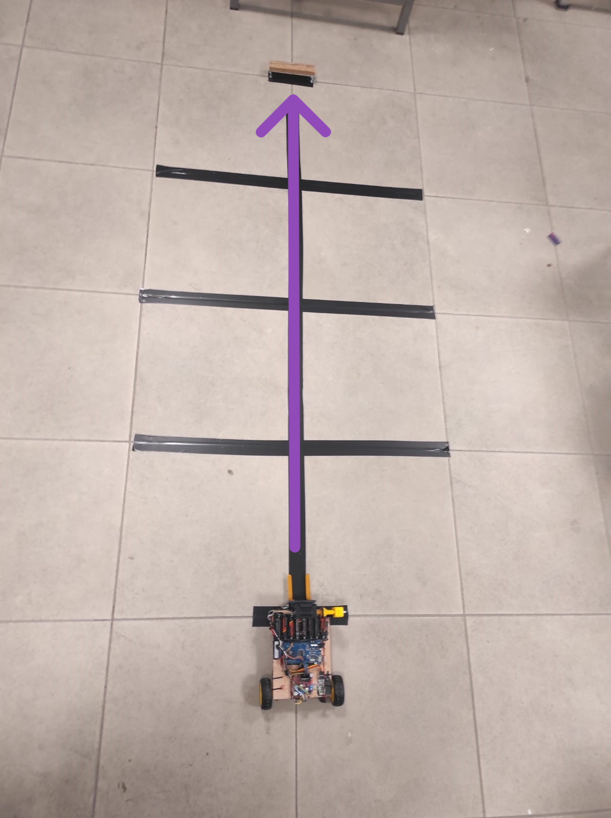
Garage Entry
Step1:
The robot go to the entry of the garage to take the car.

Slide 12
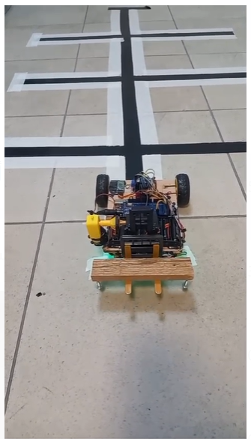
Step2:
Forklift lifts the car from the ground.

Slide 13
Step3:
The robot will read the road to capture a rectangular object with four visible legs, representing a car
If it finds no shape, it indicates that there’s no car present.

Slide 14
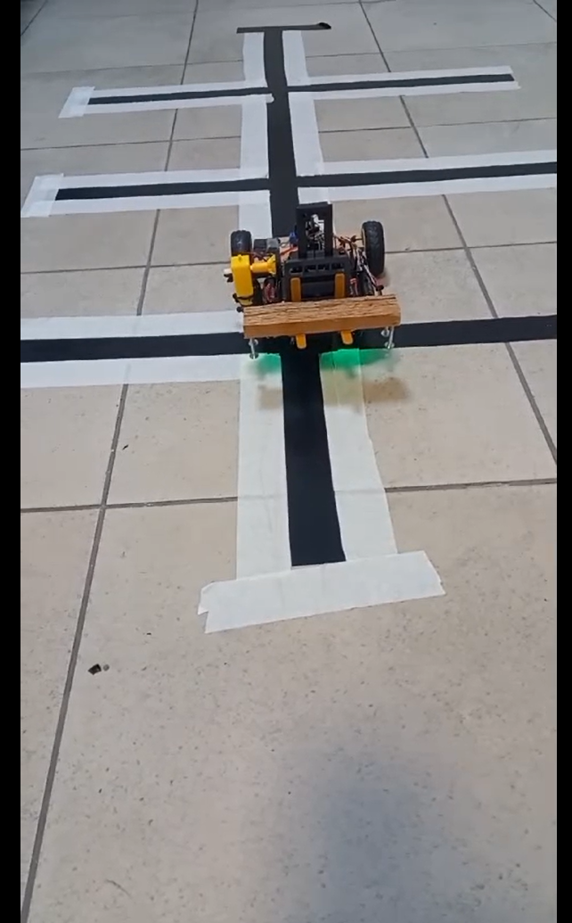
Step4:
After reach to the first parking space the robot check if there is a car in the parking space if not the robot move as shown to directing to the car to an empty parking space.

Slide 15
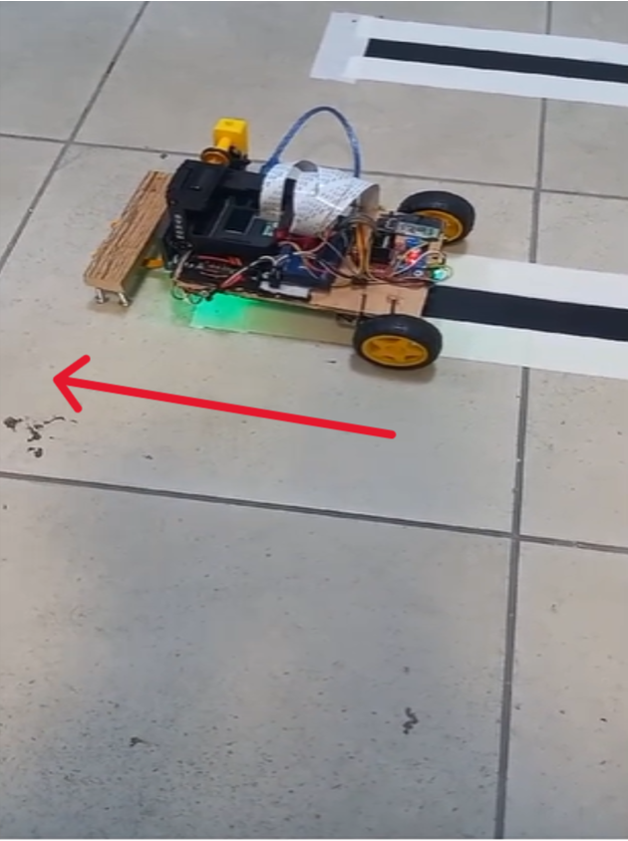
Step5:
Store the garage shape then Park the car

Slide 16
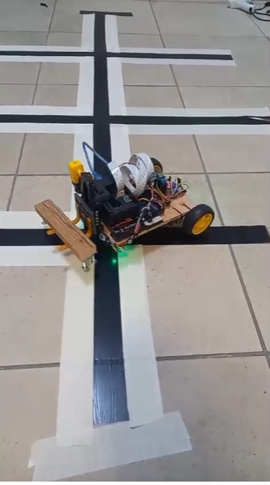
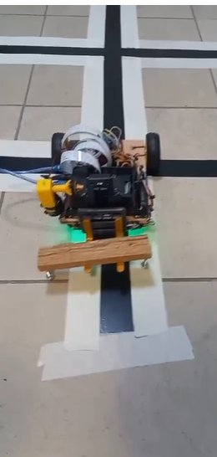
Step6:
When the user order his car again using the same card.
The Robot will pass to each garage and detect the shape again and bring the car (depends on the shape)
car retrieved successfully !

Slide 17
01
02
03
using a mobile application nested of a card
minimize the size of the robot
To park more cars in the garage
contact between
two Arduino by Wi-Fi nested of Bluetooth
Future Work

Slide 18
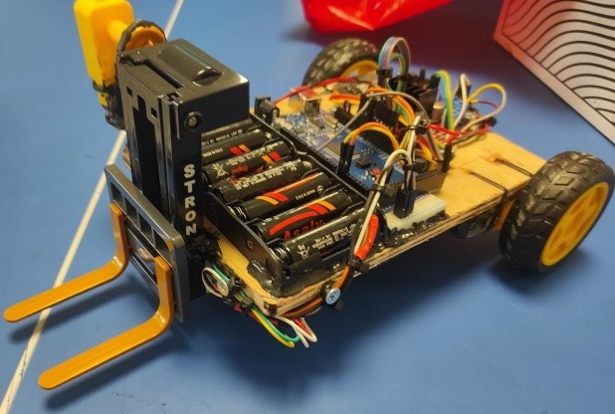
THANK YOU
Any questions ?

