Slide 1

Securing web applications using machine learning

Slide 2
Introduction
Data is the new oil
How to use data to make decision tool

Slide 3
Introduction
Objective: Explain the objective - "To integrate advanced machine learning techniques with network management tools to detect and prevent SQL injections and XSS, vulnerabilities."
Importance: Briefly touch on the increasing importance of cybersecurity.

Slide 4
Project Scope
echnologies Used: List Python, Machine Learning (specific libraries like scikit-learn), pfSense, REST APIs.
Scope: Cover both the detection mechanisms and the response strategies via pfSense.

Slide 5
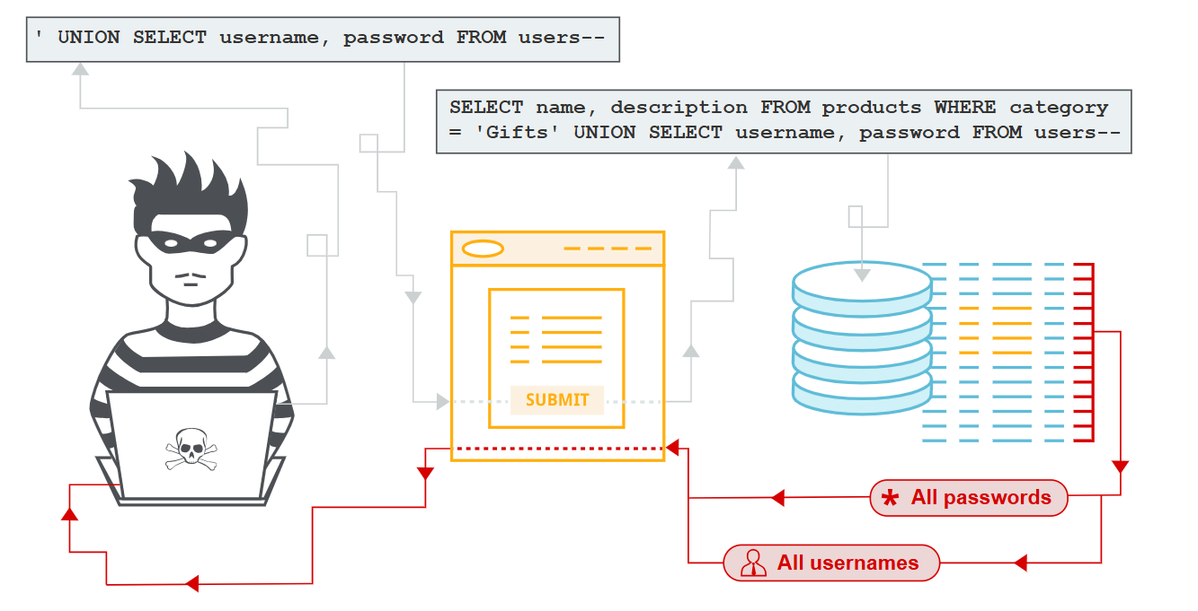
Understanding SQL Injections
How it Works:
An attacker enters malicious SQL code into a form field (e.g., login form or search box).
The web application fails to properly sanitize the input, allowing the code to execute in the backend database.
This can lead to data breaches, unauthorized access, or manipulation of data.
Example: Username: ' OR 1=1 --
Password: [Any]

Slide 6
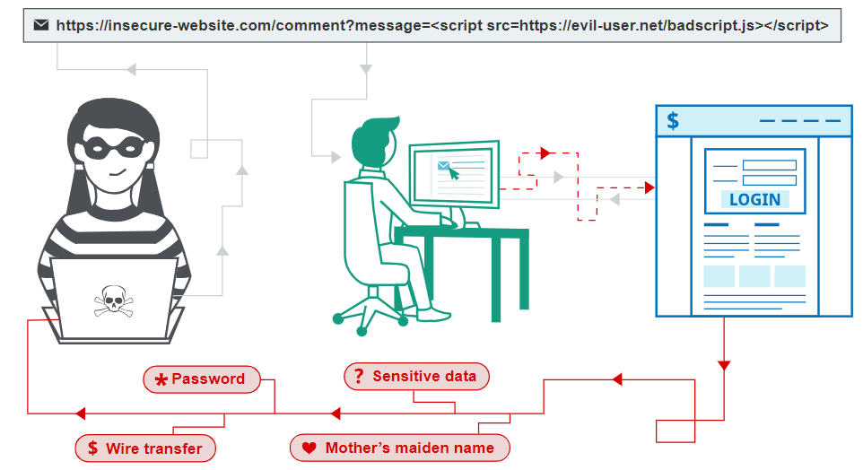
Understanding XSS
How It Works:
User input is echoed by the server and executed immediately in the browser.
Impact:
Can lead to session hijacking and data theft.
Prevention:
Validate inputs and encode outputs.

Slide 7

Traditional Defenses Vs ML
Machine learning boosts security by catching subtle, evolving attack patterns that traditional methods like input validation and output encoding might miss. It learns from large amounts of data to recognize even cleverly hidden or altered threats, providing an extra layer of adaptive protection against attacks.
ML can detect both known and unknown threats more effectively than traditional methods Ex.(IDS).

Slide 8
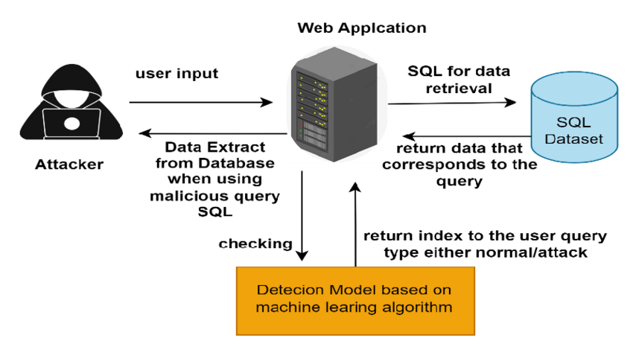

Detect Sql Injection Using Machine Learning

Slide 9

Machine Learning Approach to Detect SQL Injection:
Modeling Approach: Train a machine learning model to identify suspicious patterns that may indicate SQL injection attempts.
Training Data: The model is trained on a dataset containing benign and malicious queries.
Features include:
Frequency of certain characters (e.g., semicolons, single quotes).
Unusual or uncommon SQL functions. Patterns of attack, such as 'OR 1=1', 'UNION SELECT', etc.

Slide 10
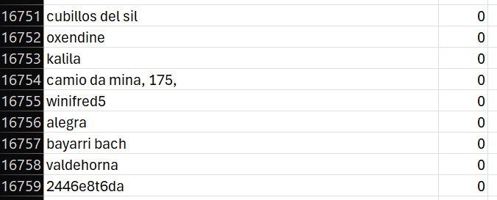
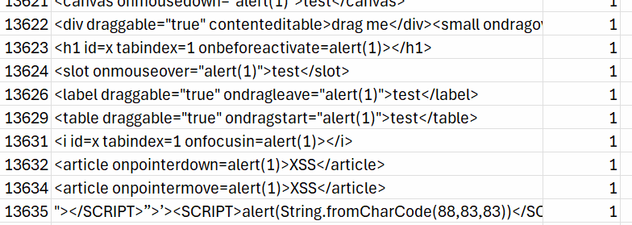
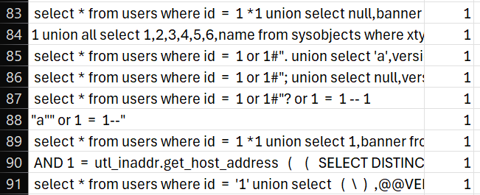
Overview of the Dataset
Benign Inputs
Malicious XSS
Malicious Sqli
It consists of SQL queries, XSS Scripts labeled as 'benign' (0) or 'malicious' (1).

Slide 11
Samples
Benign Queries (Normal User Input):
Query 1:
SELECT * FROM users WHERE username = 'johndoe' AND password = 'pass123';
Query 2:
SELECT * FROM users WHERE username = 'janedoe' AND password = 'secret';
Query 3:
SELECT * FROM users WHERE username = 'alice' AND password = 'alice2025';
Query 4:
SELECT * FROM users WHERE username = 'bob' AND password = 'bobpass';
Query 5:
SELECT * FROM users WHERE username = 'charlie' AND password = 'charlie123';
Malicious Queries (SQL Injection Attempts to Bypass Login):
Query 6:
SELECT * FROM users WHERE username = 'admin' --' AND password = '';
Query 7:
'SELECT * FROM users WHERE username = '' OR 1'='1' AND password = '';
Query 8:
SELECT * FROM users WHERE username = 'admin' OR '1'='1';
Query 9:
SELECT * FROM users WHERE username = '' OR 'a'='a' AND password = '';
Query 10:
SELECT * FROM users WHERE username = 'admin' OR '1'='1' --;

Slide 12
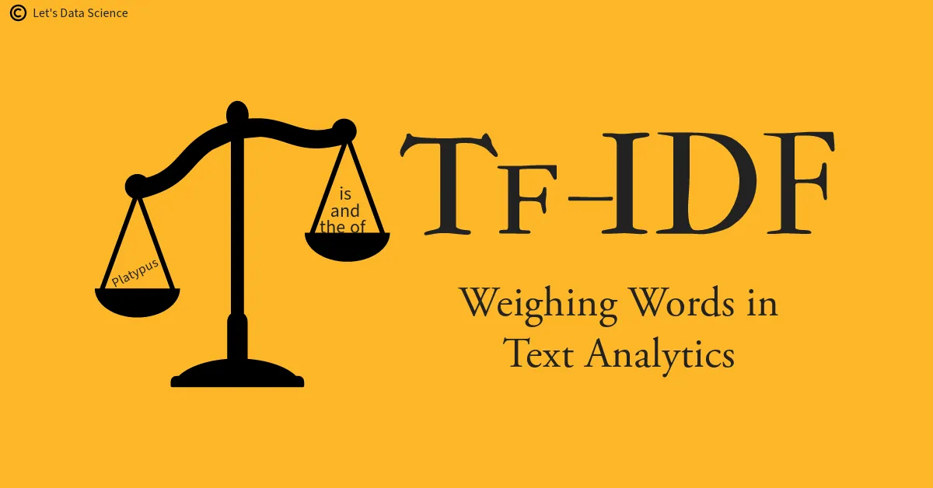
TF-IDF
This helps the machine understand which words are very important and which are ordinary. Words that do not appear frequently are usually important and receive higher numbers.
Statistical Technique

Slide 13

TF-IDF
Term Frequency (TF): Counts the occurrences of key terms (e.g., SELECT, WHERE, OR, --).
Inverse Document Frequency (IDF): Weighs down common terms while emphasizing unique or suspicious tokens (e.g., '1'='1', --).Converts each query into a numerical vector based on word importance.

Slide 14
TF- IDF
TF: is calculated by counting the number of times a term appears in a query divided by the total number of words in that query.
Example:
If the word "or" appears once in a query with 14 words, then:
TF(“OR”) = 1/14 == 0.0714
IDF:Assume we have 10 queries.
If “OR” appears in 4 queries, then:
IDF(“OR”) = log (10/4) == log(2.5) == 0.9163
TF-IDF =TF×IDF
TF-IDF("or")≈0.0714×0.9163≈0.0654

Slide 15
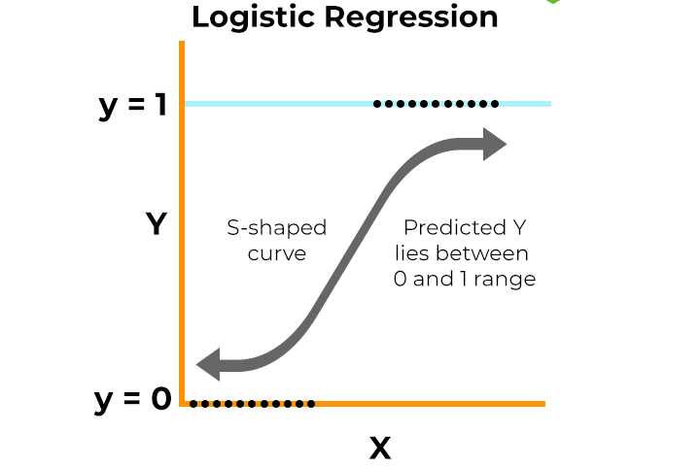
Logistic Regression
To teach the machine how to recognize bad things. We give it many examples that we know are either bad or good, and it learns from these examples.

Slide 16
How Logistic regression works with the TF-IDF matrix
in the context of analyzing SQL queries for potential SQL injection threats:
x - Independent Variables (Features)
In the context of using logistic regression for analyzing SQL queries, the independent variables X are the computed TF-IDF values for each word in a query. Each value in this TF-IDF matrix represents the weight of a specific word within the query, indicating its relative importance in the text compared to the entire dataset of queries. These weights are used as inputs to the model, transforming the words of each query into a series of numerical values.
y - Dependent Variable (Target)
is the dependent variable representing the actual classification of the query, which can be either 0 (non-malicious) or 1 (malicious). This classification is used during the model training process where the model learns to associate the TF-IDF values with their correct classifications.

Slide 17
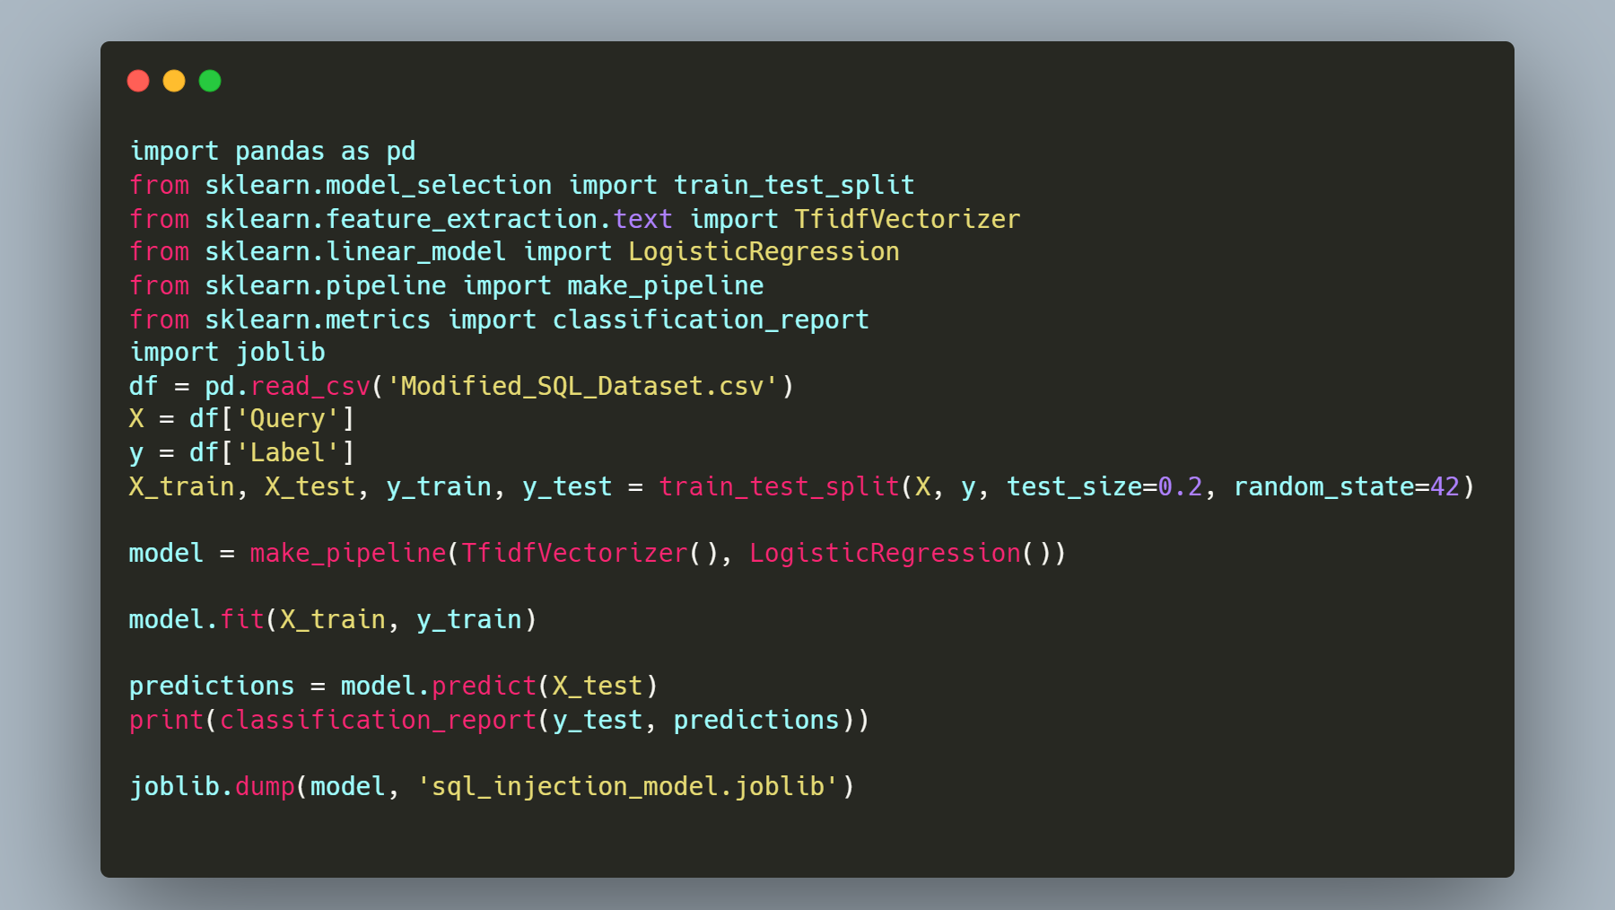

Slide 18
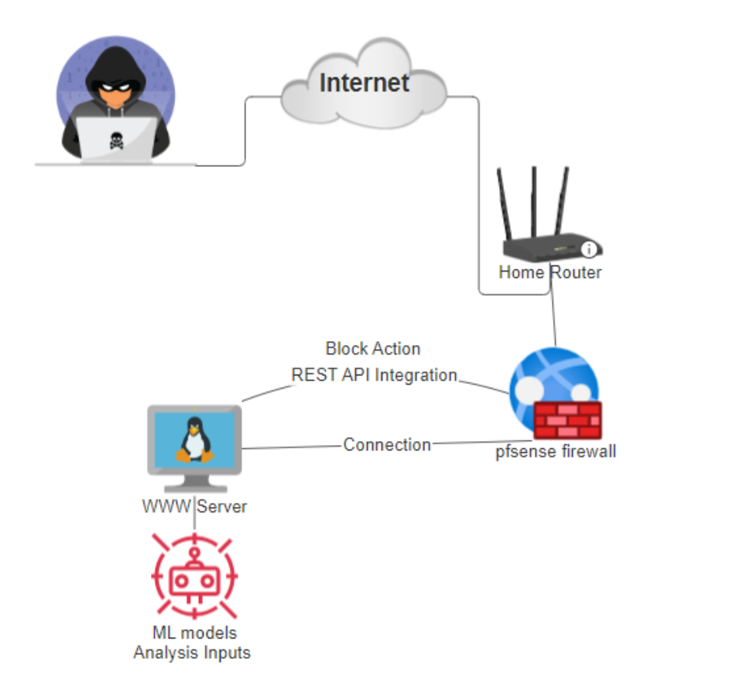
Project Topology

Slide 19
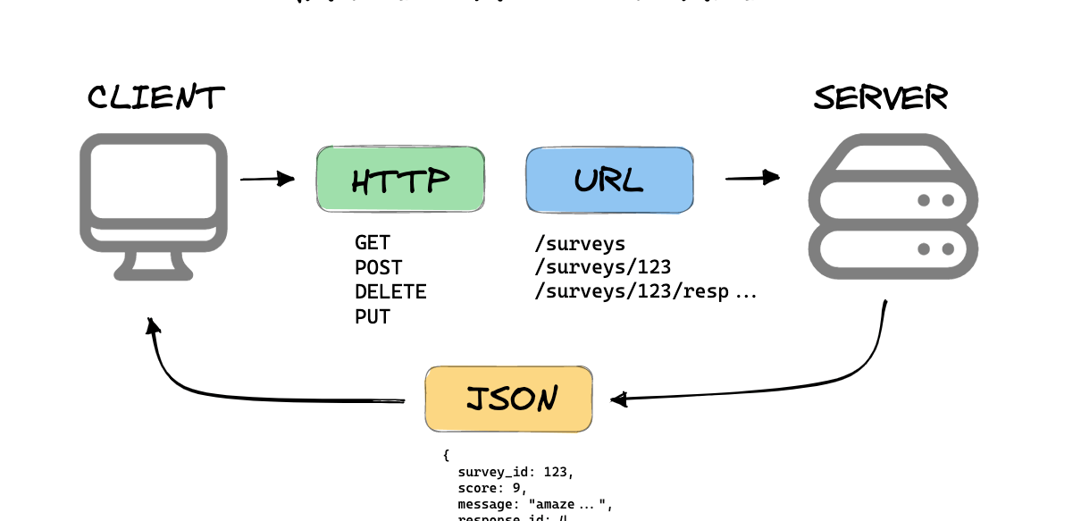
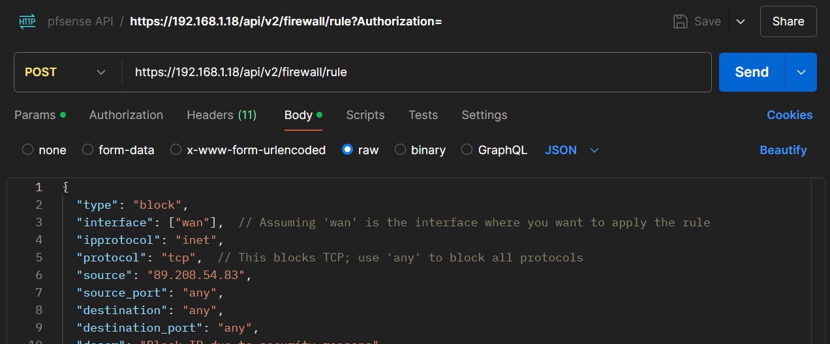
Pfsense API integrated with model

Slide 20
Pfsense API
To prevent SQL injection,XSS attacks from impacting the network, we integrate a firewall solution pfSense.
By using the pfSense API, we can automate responses to detected threats and block attackers in real time.
After identifying a potential SQL injection using the ML model (TF-IDF + Logistic Regression), we trigger an action.

Slide 21
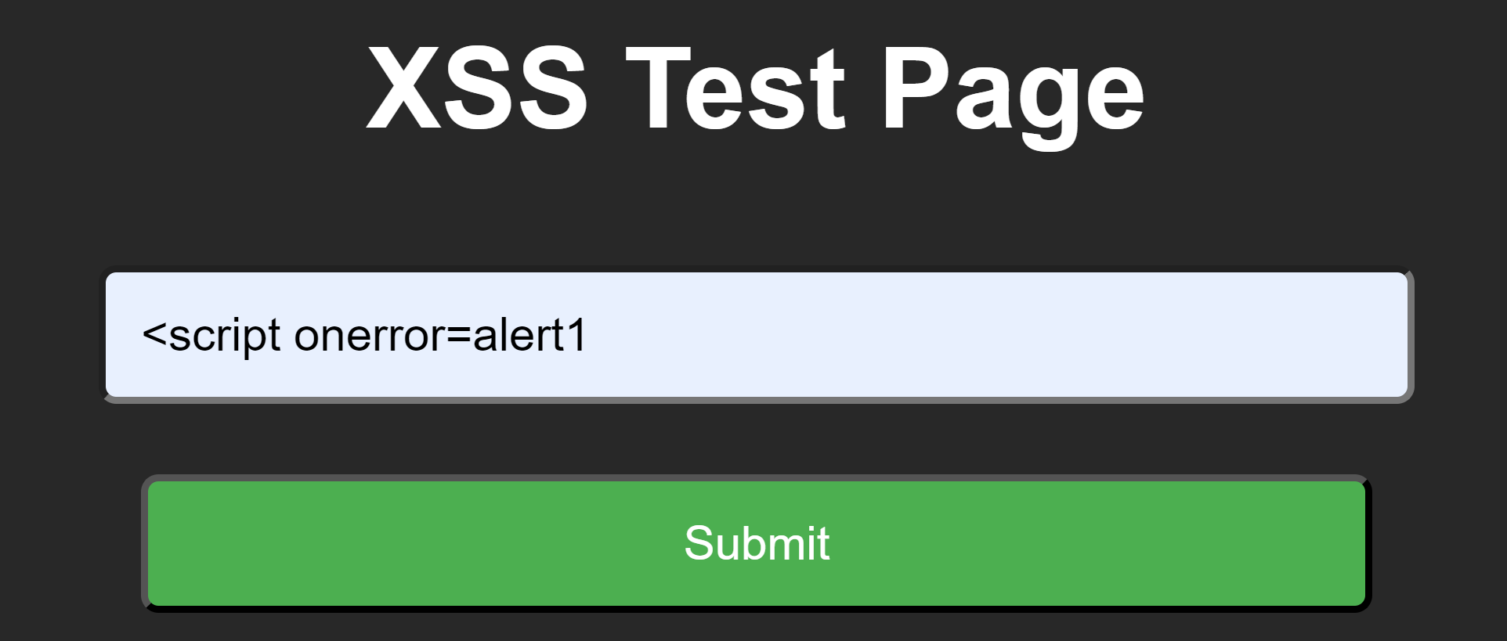
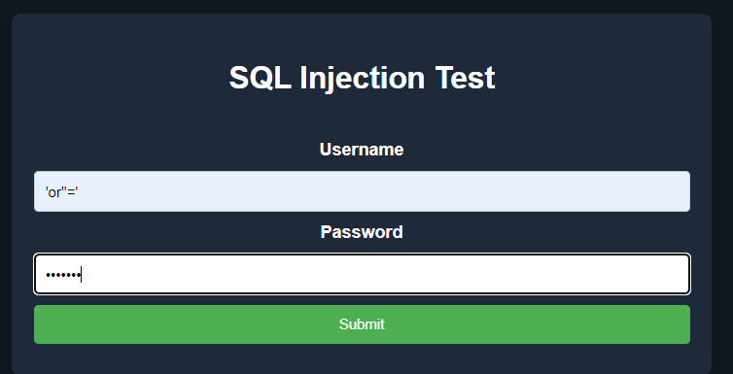
Demo
An attacker is attempting to bypass input validation mechanisms in order to generate a reflected XSS vulnerability, aiming to inject malicious scripts into web pages that are immediately reflected back to the user.

Slide 22
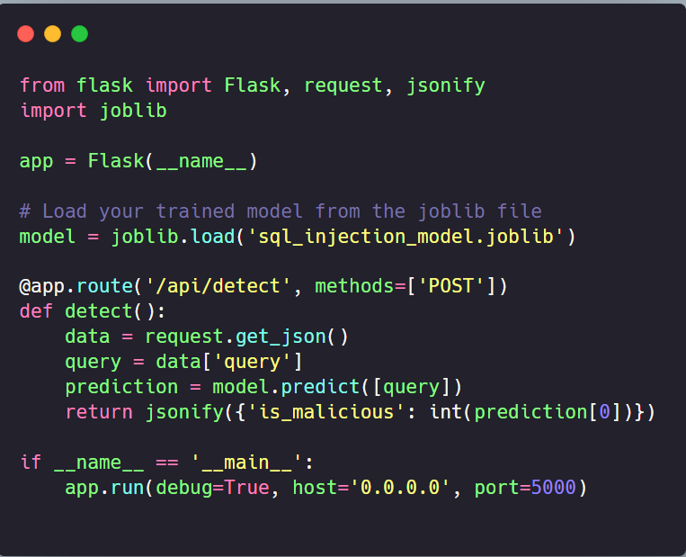
Using Flask framework to publish Model live for request the results

Slide 23
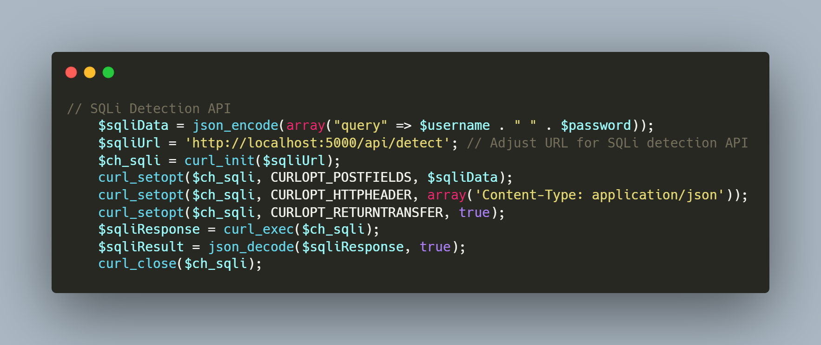
POST query for Sqli Model
Receives the API's response ($sqliResponse) and decodes it ($sqliResult).

Slide 24
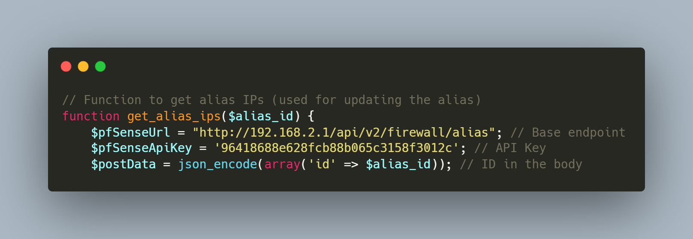
Retrieves alias IPs from a pfSense firewall API

Slide 25
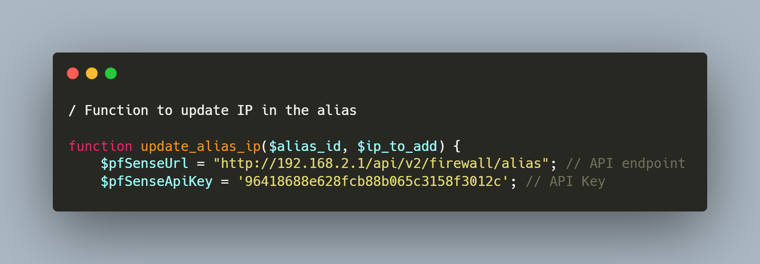
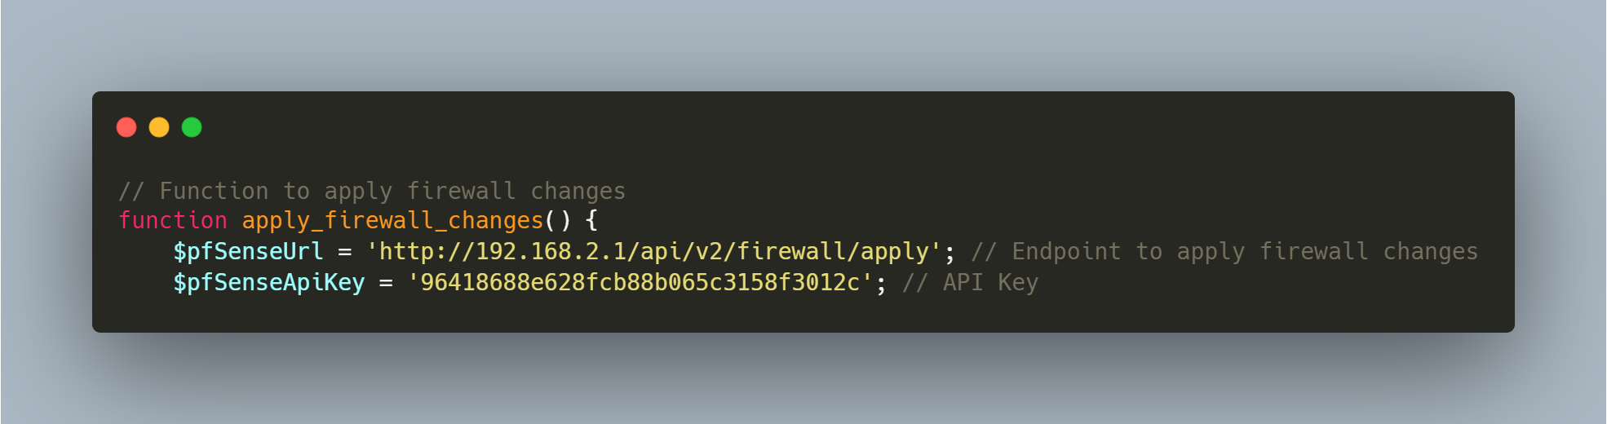
Updates an alias, applies firewall rule changes after updating aliases.

Slide 26
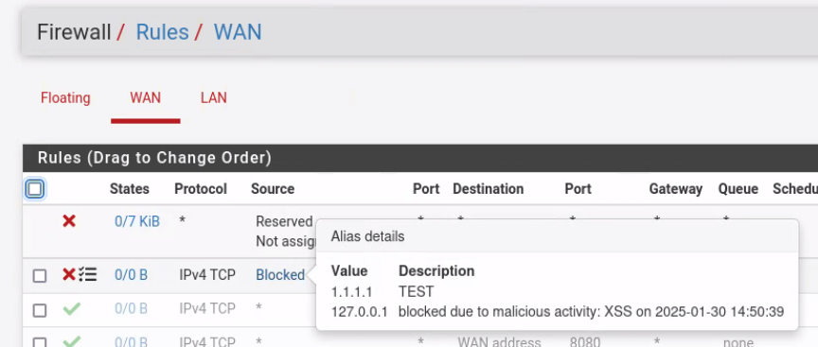
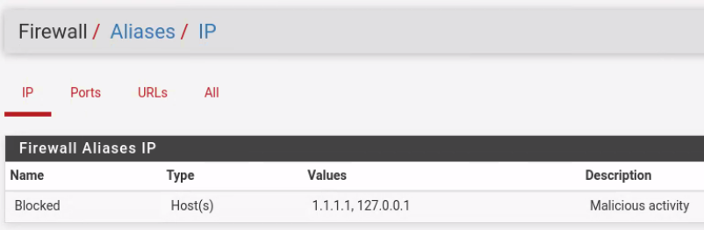
After Block Triggerd from API
Real-Time Protection: Immediate action is taken to block malicious traffic.
No Manual Intervention: The system automatically responds to threats based on predefined rules.

Slide 27

Thank You

