Slide 1
Al-Najah National University
Mechanical engineering department
Mechanical systems
Prepared by: Ahmad Isteteh
Ali Qadoos
Mohammed Abu-hatab
Mahmoud Hasiba

Slide 2
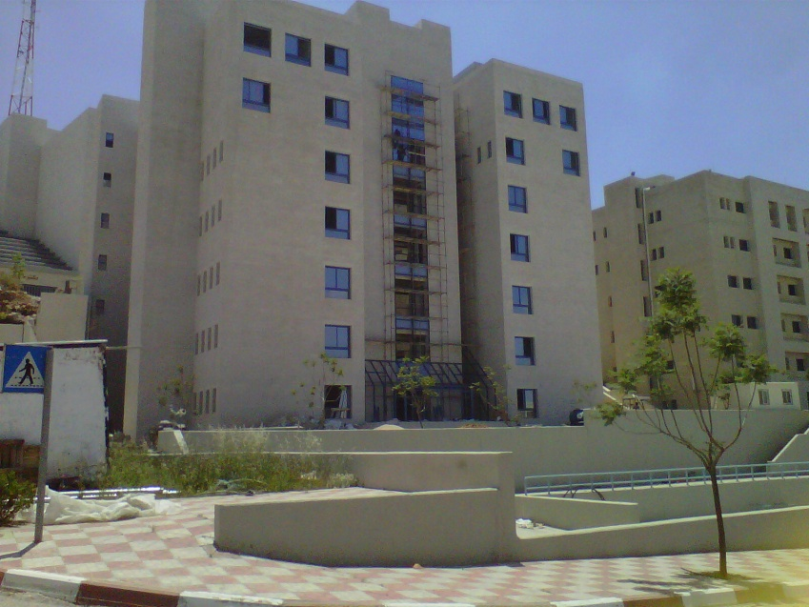
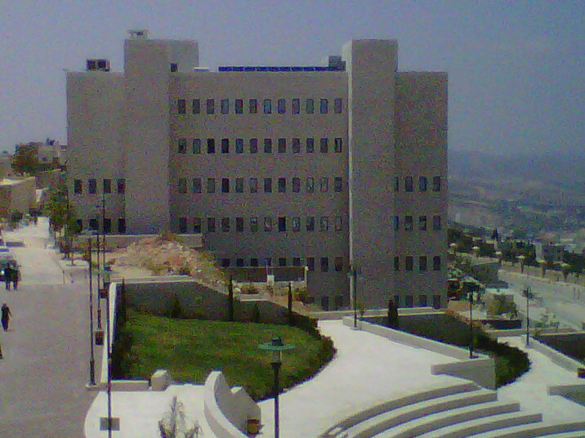
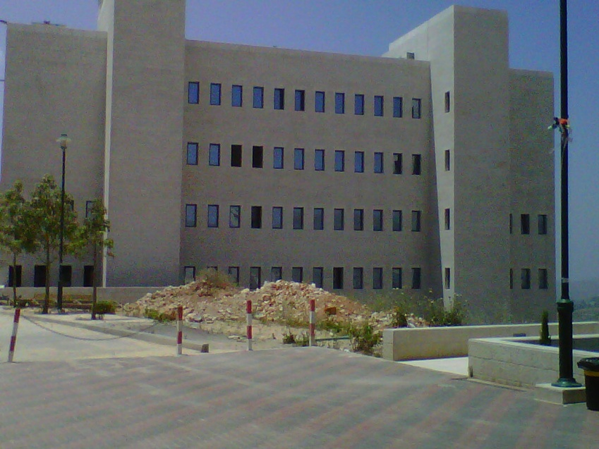
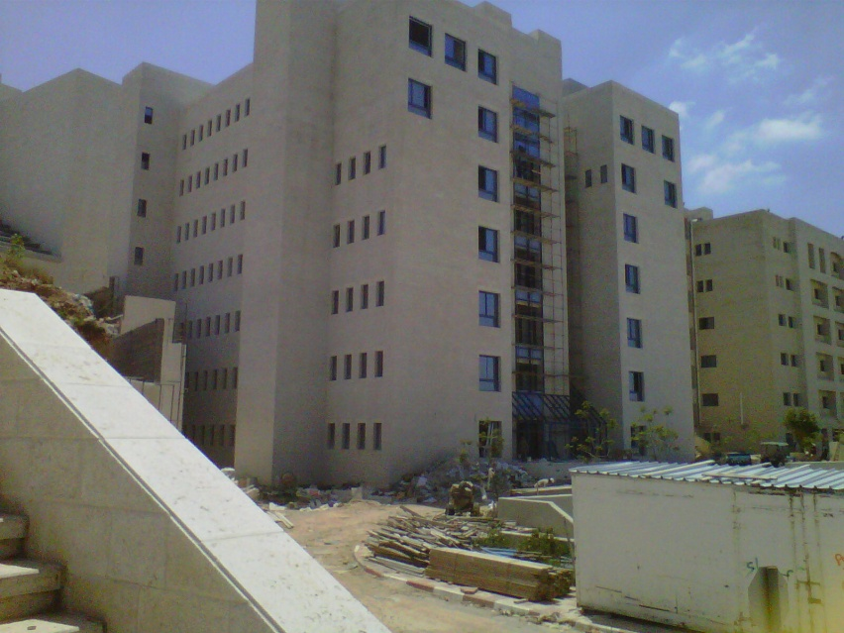
Optical and nursing room

Slide 3
Building floors applications
Floors | Use
Third basement | Mechanical rooms, class rooms and labs
second basement | Class rooms, labs and stores
First basement, Ground floor First floor | Class room and labs
Second floor | Teachers offices
Third floor | Management offices

Slide 4
HVAC system
1- Heating
2- Cooling
Mechanical systems
1- Cold water
2- Hot water
3- Medical gases
4- drainage ,vent
5- fire system

Slide 5
Inside and Outside Design condition
Parameters | Winter | Summer
Tin | 22 | 24
Tout | 4.7 | 33
Φin | 50% | 50%
Φout | 72% | 44%
Win | 8.4 | 9.4
Wout | 4 | 12.5
Tun | 13.35 | 28
Tground | 12 | 13

Slide 6
HVAC system
Sample of calculation for class room1 in ground floor
Heating
Qs= U*A*ΔT……………….inside walls, outside walls, windows and doors
Qs,vent,infilt= 1.2*Vvent*(Ti – To)….ventilation and infiltration for sensible
Ql,vent,infilt= 3*Vvent,infilt*(Wi – Wo)….ventilation and infiltration for latent
Qtotal= Qheating + Qdomestic
Qboiler= 1.1*Qtotal

Slide 7
Cooling
Qs= U*A*ΔT……………….inside walls
Qs= U*A*CLTD_{corr} ….…….outside wall, convection for windows
Qs= A*(SHG)*(Sc)*(CLF)….transmitted windows
Qs,vent,infilt= 1.2*Vvent*(To – Ti)….ventilation and infiltration for sensible
Ql,vent,infilt= 3*Vvent,infilt*(Wo – Wi)….ventilation and infiltration for latent
Qs= qs*n*CLF……………people sensible
Ql= ql*n………………...people latent
Qs= W*CLF…………… .lighting

Slide 8
Qs= qs*CLF…………………..Equipment
Qtotal=∑Qs…………………..total sensible
Qtotal=∑Ql…………………...total latent
Duct design
Vcirculation= Qtotal/1.2(Tcirc – Ti)
Number of diffusers= Vcirc(cfm)/400

Slide 9
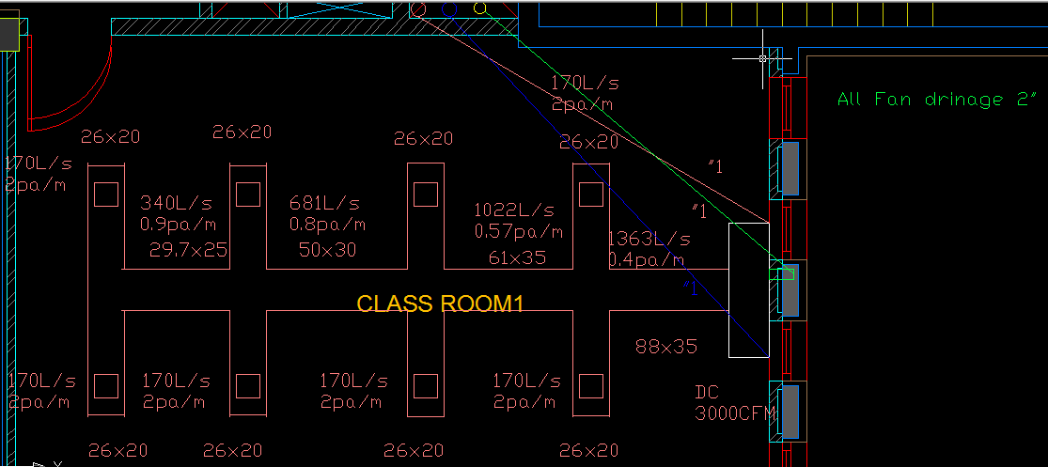
Cooling and Heating

Slide 10
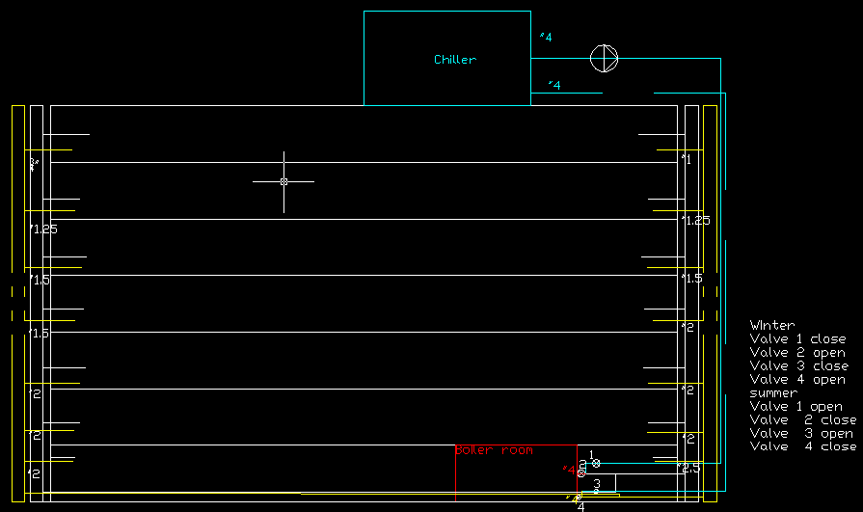
Coling &Heating Riser

Slide 11
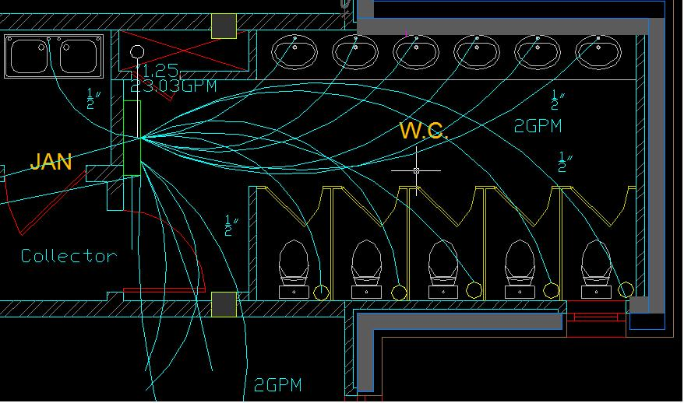
Mechanical systems
Cold water

Slide 12
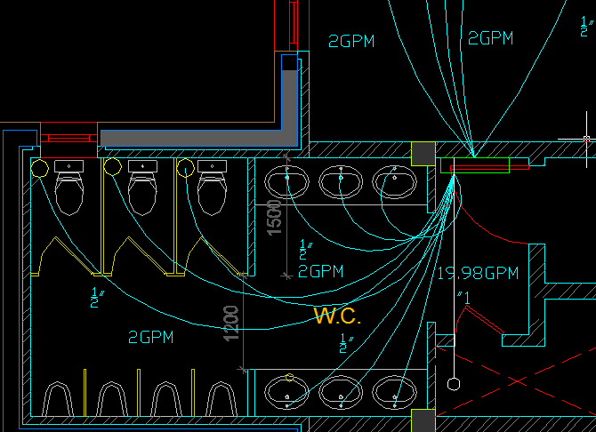
Cold water

Slide 13
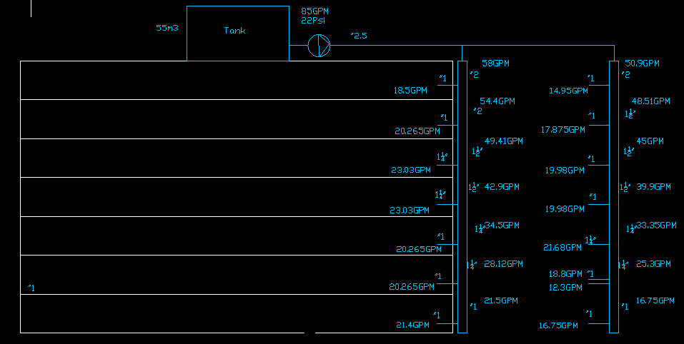
Cold water Riser

Slide 14
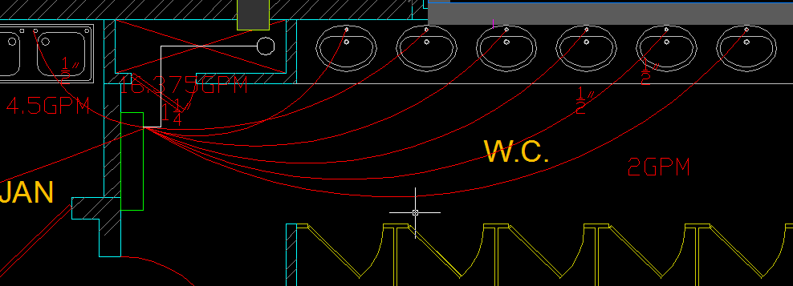
Hot water

Slide 15
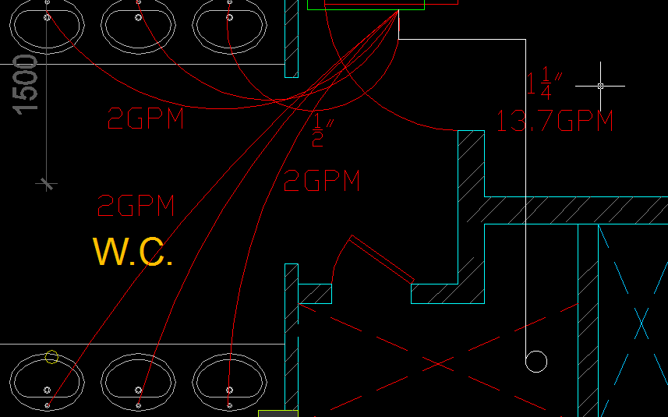
Hot water

Slide 16
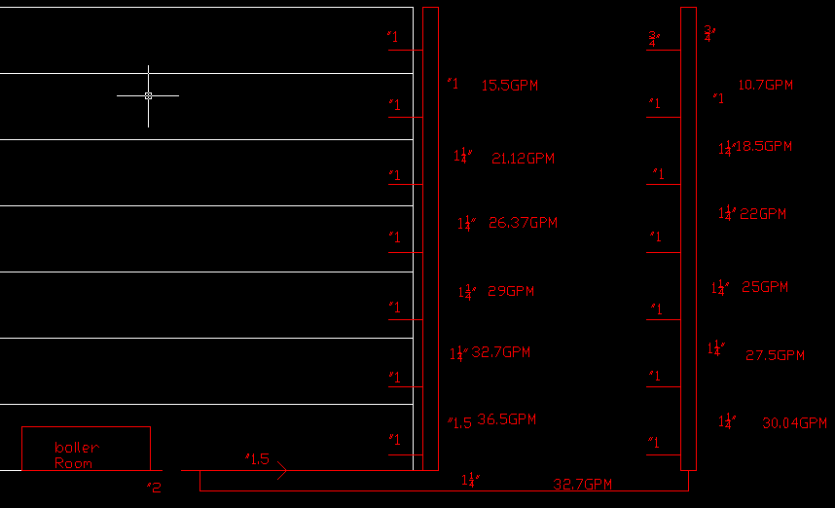
Hot Water Riser

Slide 17
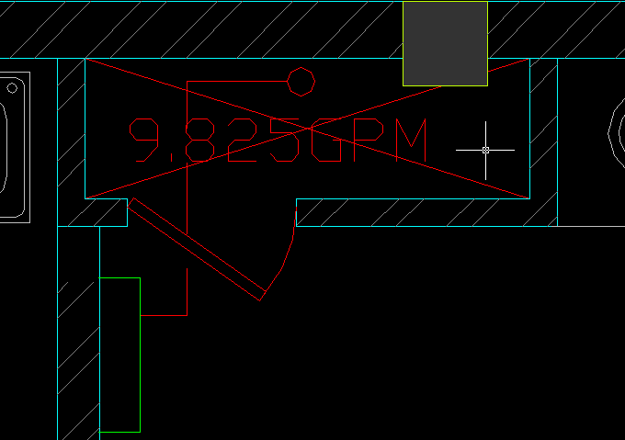
Return Hot Water
¾”

Slide 18
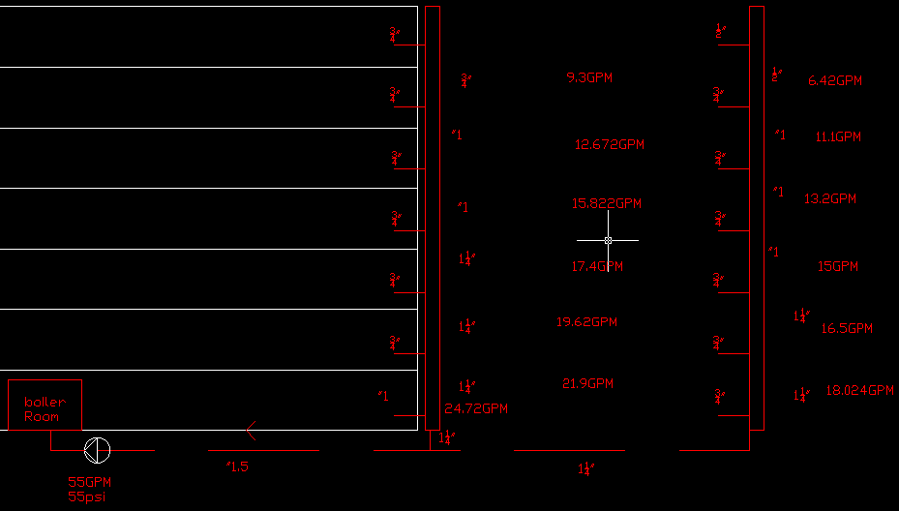
Return Hot Water Riser

Slide 19

Make Up Water

Slide 20
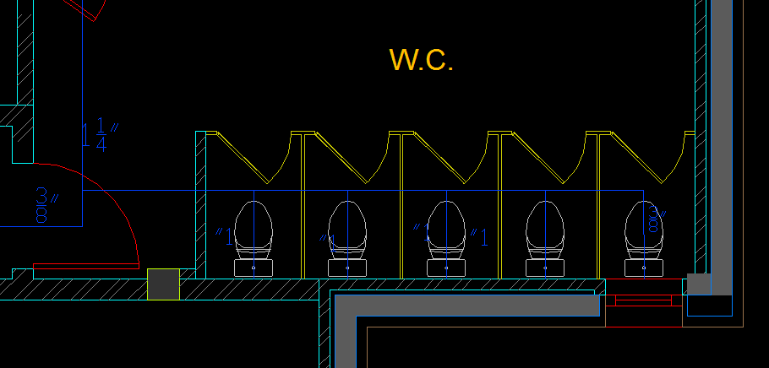
Flush Water

Slide 21
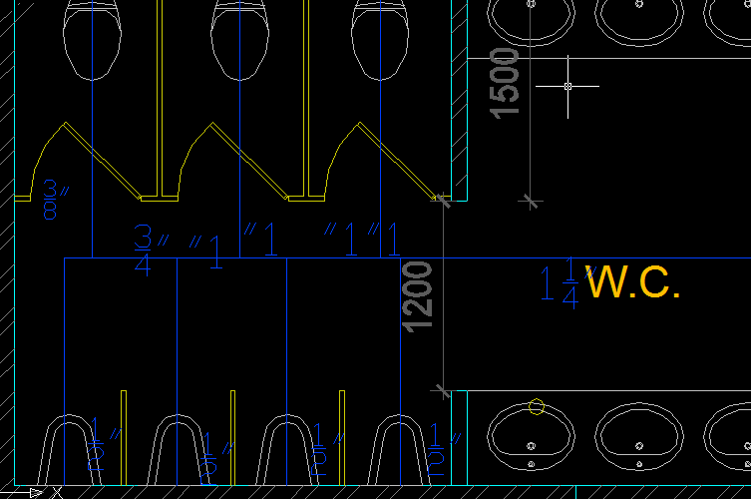
Flush Water

Slide 22
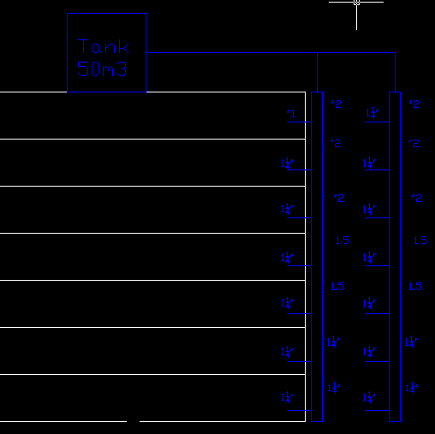
Flush Water Riser

Slide 23
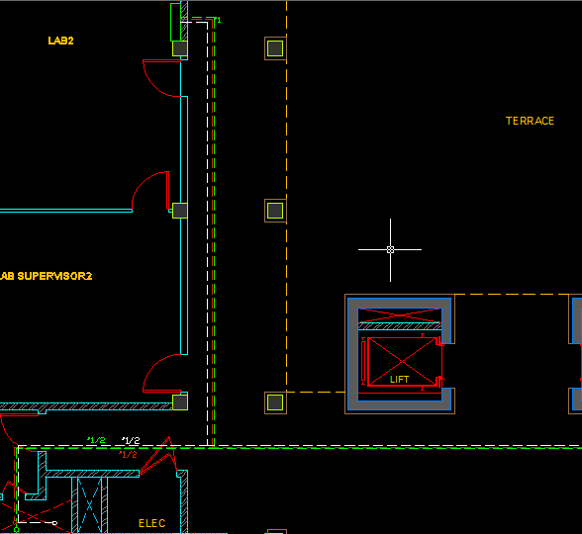
Medical Gases

Slide 24
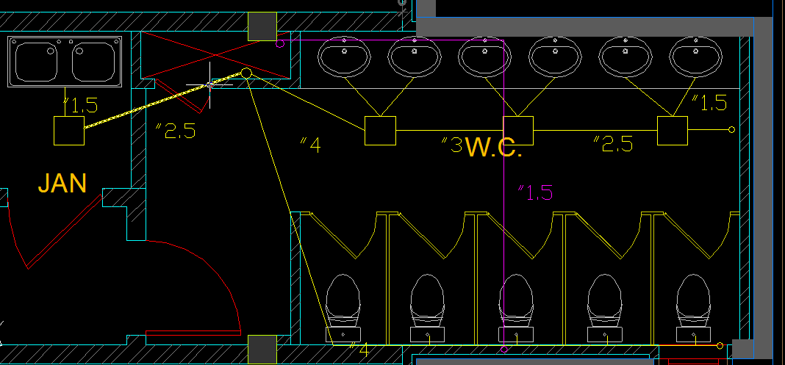
Drainage System

Slide 25
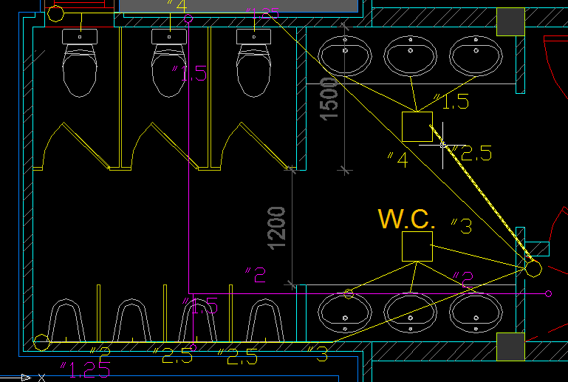
Drainage System

Slide 26
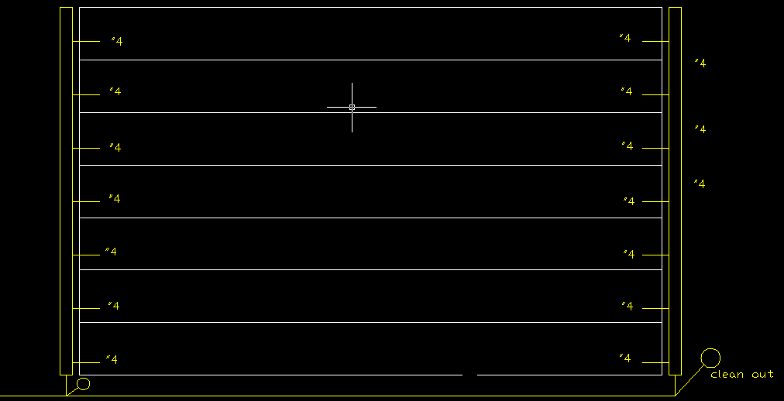
Drainage Stack

Slide 27
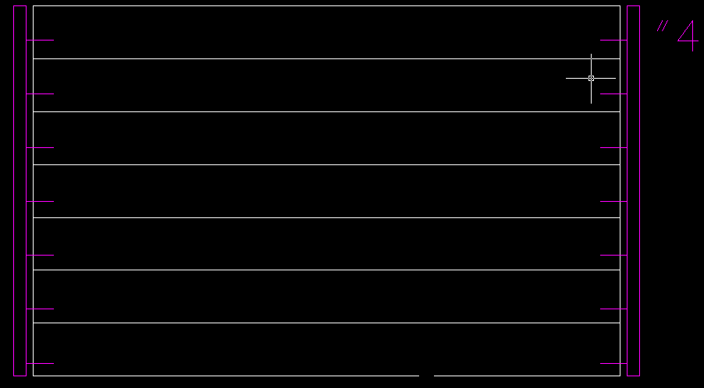
Vent Stack

Slide 28
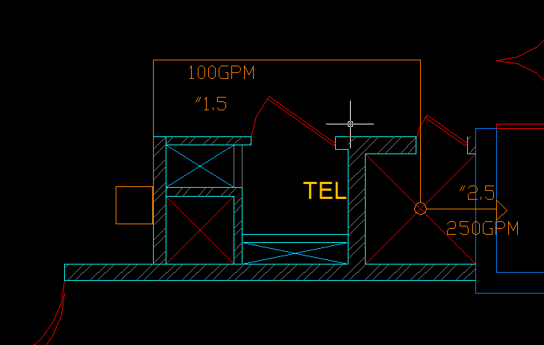
Fire system

Slide 29
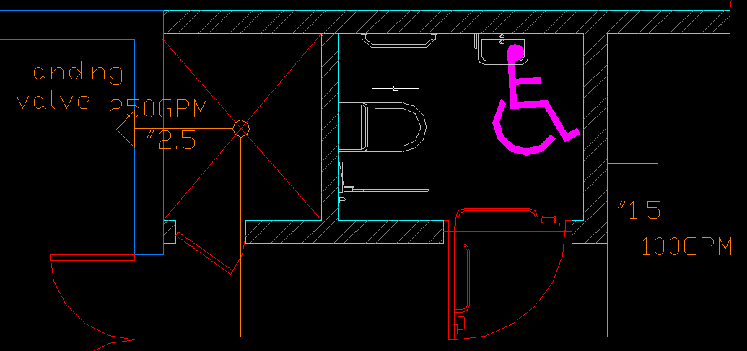
Fire System

Slide 30
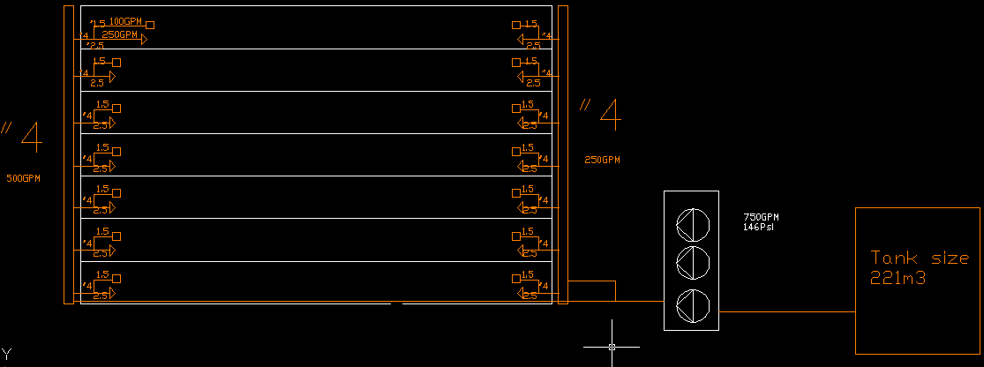
Riser Fire System

Slide 31
Thank you

