Slide 1
ORGANIZE
ORGANIZE YOUR WAY

Slide 2
CONTENTS
01
PROBLEM
What is the main problem that we aim to solve?
02
SOLUTION
What can solve the problem?
03
ARCHITECTER AND TECHNOLOGIES
How is our system built and what technologies it uses?
04
DESIGN
What are the steps that we went through to design our application?
05
FUNCTIONALITY
What does our application offer?
06
SUMMARY
What did we learn and what are our future
works?

Slide 3
Communication Issues
Task Distribution
Progress Tracking
Performance Judging
PROBLEM!
Project management can be tedious!!

Slide 4

SOLUTION:
ORGANIZE
A PROJECT MANAGEMENT AND ORGANIZING APPLICATION

Slide 5

PROJECT ARCHITECTURE AND TECHNOLOGIES
Organize used the MERN stack technologies

Slide 6




WHY MERN?
mongoDB:
-Flexible
-JSON Like
-Mongoose
REACT:
-Fast, Scalable
and Simple.
-Wide Support
-Reusable
Components
nodeJS:
-Javascript
-Lightweight
-Wide Community
-Libraries
Everhwhere!
ExpressJS:
-Very Easy to
Use
- Can Build
Applications
Quickly

Slide 7
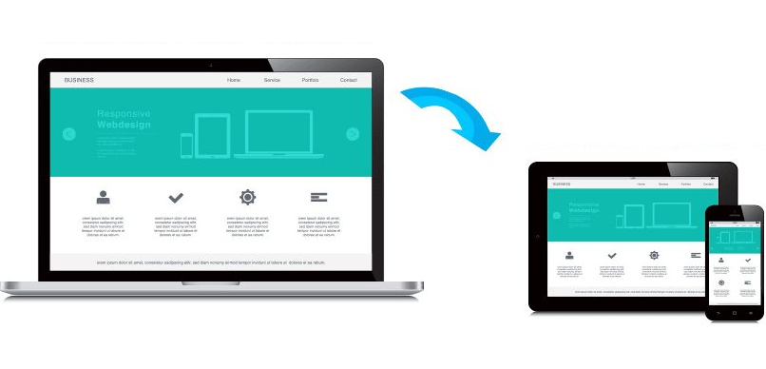
UI DESGIN
1. APPEALING!
2. RESPONSIVE!
3. EASY TO USE!

Slide 8

FEATURES
Management:
1- Add and remove tasks at any time
2- Organize members into teams
3- Teams have their own separate tasks
Communication:
1- Announcements
2- Chatting
3- Video Meetings

Slide 9
Potential Solution was Implemented
Cross-platform Solution
Many Features Were implemented!
A Lot Learnt Through the Process!
SUMMARY
What did we learn?
What did we achieve?

Slide 10



FUTURE WORK
-> MORE TO THE REPORTING SYSTEM
-> EXPAND ON MOBILE APPLICATION
-> SUPPORT THE INVOLVEMENT OF
PROJECT INVERSTORS
-> BUGS/ISSUES AND MORE

Slide 11
THANK YOU

