Slide 1

NeuroLand
A guided tour of the platform
Every screen of the web and mobile apps — discovery, onboarding, the admin, institution, therapist and guardian experiences, and the child's own space.
Almotasembellah Yaser Jararaa & Siwar Diab
Supervisor · Dr. Ashraf Armoush
An-Najah National University · Computer Engineering · 2025–2026
Notes:
Welcome. This is a guided tour of NeuroLand — a care-coordination platform for children and people with disabilities. Rather than dwell on theory, we'll walk through the product itself, screen by screen, on both web and mobile: how families discover and onboard, what administrators, institutions, therapists and guardians each see, and the simplified space we built for the child. Let's begin.

Slide 2
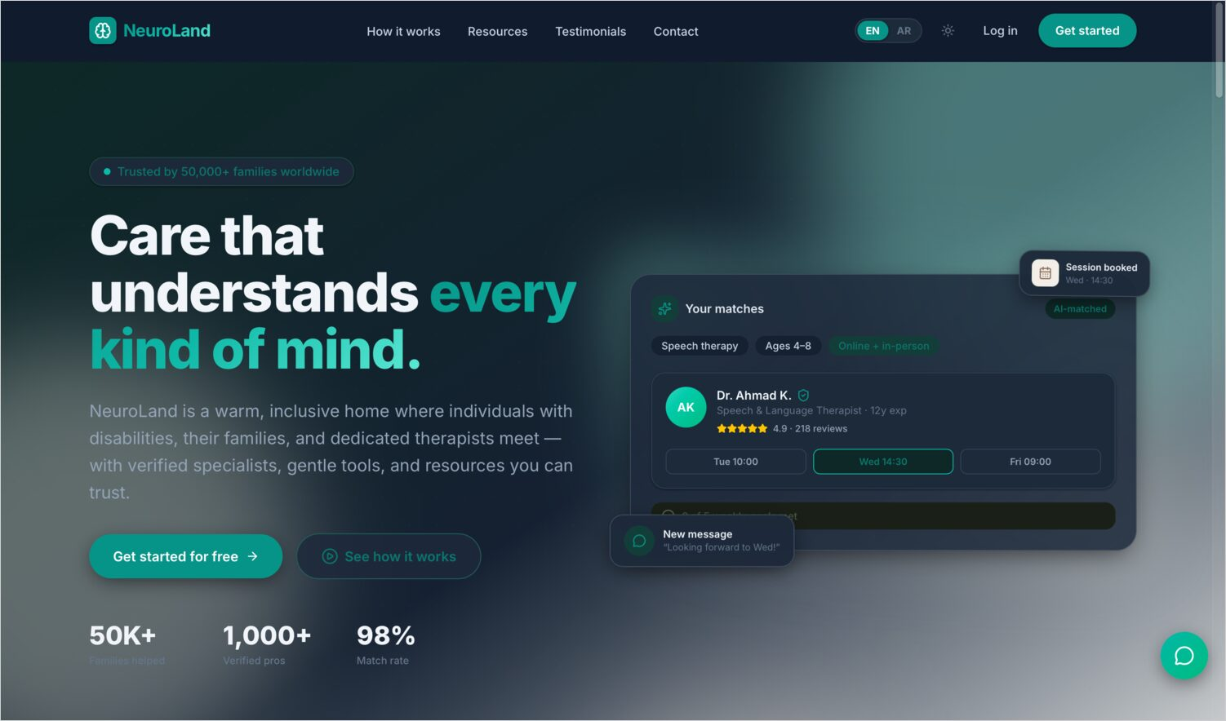
OVERVIEW
What NeuroLand is, in one screen
A single platform — web and mobile, on one shared backend — that brings the whole therapy journey into one place.
Trusted discovery — only admin-verified therapists are listed
One connected care record — sessions, reports, plans & activities link together
Real-time collaboration — messaging, calls and live notifications
Accessible & bilingual — child-friendly, with full Arabic / English RTL
02
Notes:
In one sentence: NeuroLand brings the entire therapy journey — finding a verified therapist, booking and paying, tracking progress, and the child's own activities — into one connected product that runs on web and mobile. It rests on four ideas you'll see throughout the tour: trusted discovery, one connected care record, real-time collaboration, and accessibility by design. Keep these four in mind as we move through the screens.

Slide 3

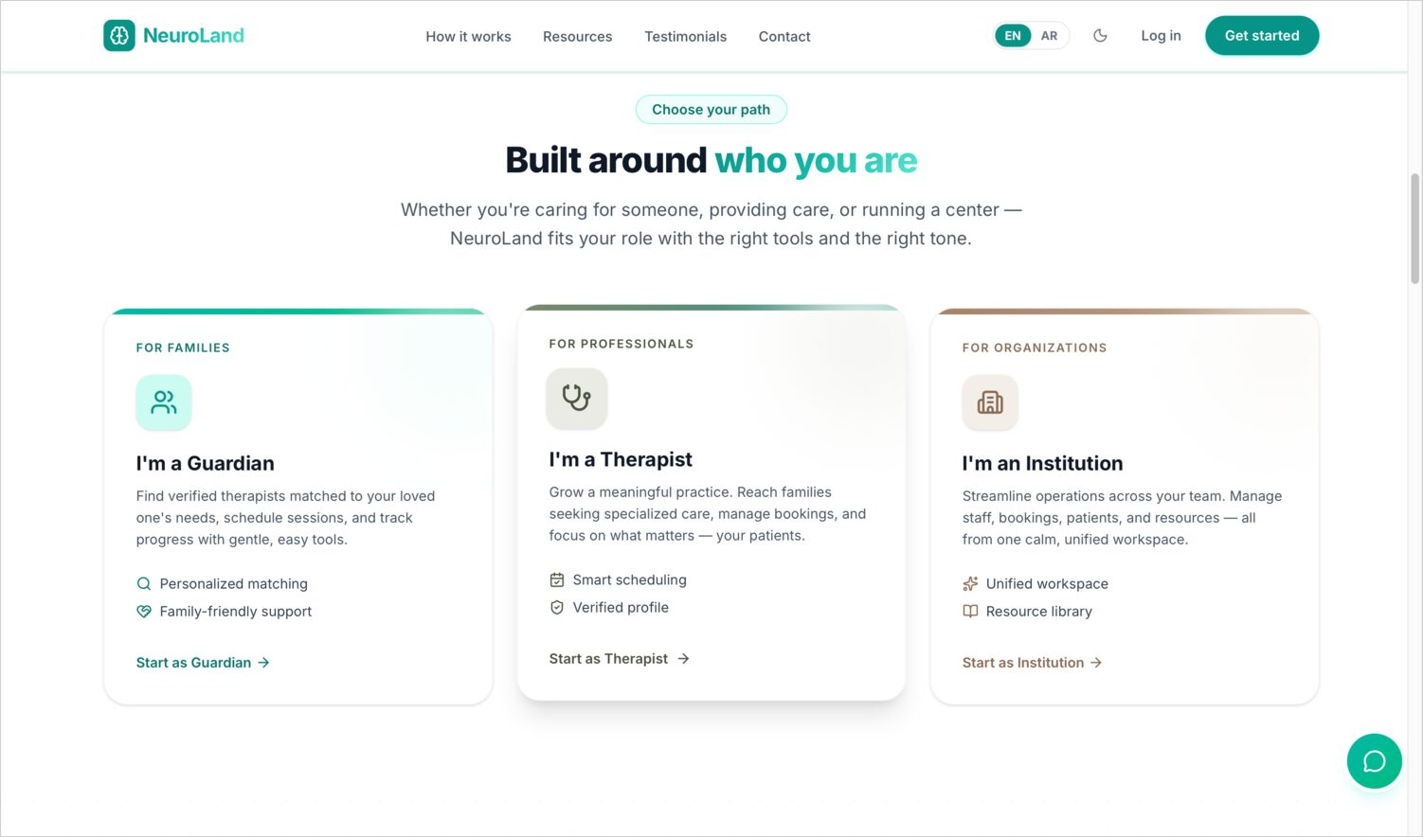




OVERVIEW
Five roles share one system
Guardian
Registers dependents, books & pays, follows progress.
Therapist
Runs sessions, writes reports, builds treatment plans.
Institution
Oversees a therapist roster, enrolments and analytics.
Administrator
Verifies therapists, manages roles, audits everything.
The public role picker at sign-up
Patient (child)
A simplified, PIN-based space with activities & wellness.
03
Notes:
Five roles share the same data. Guardians hold the account and manage their dependents. Therapists deliver care. Institutions — clinics or schools — supervise therapists. Administrators verify and audit. And the patient, the child, gets their own space. On the right is the public role picker every new user starts from. As we tour the platform, we'll visit each of these five experiences in turn.

Slide 4

WEB
PART ONE
The Web Platform
Built with React — five role dashboards plus a public site.
Notes:
Part one: the web platform, built with React. It comprises a public marketing-and-discovery site plus role dashboards for guardians, therapists, institutions and administrators. We'll start at the public front door.

Slide 5
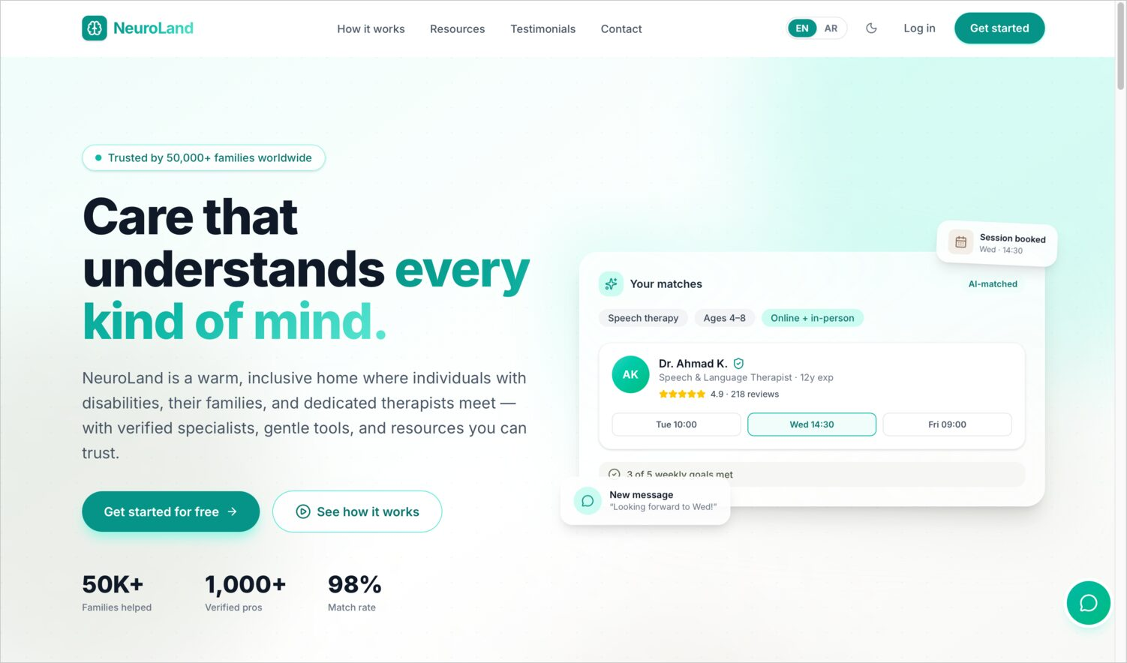
WEB · PUBLIC SITE
A welcoming, trustworthy front door
Landing hero with reach & verification stats
Dark hero with a verified-therapist preview
The marketing site explains the platform and routes each visitor to the right sign-up.
05
Notes:
The public landing site is the front door. It leads with a warm message and headline stats, shows a preview of what a verified therapist match looks like, and guides each visitor toward the correct sign-up path.

Slide 6
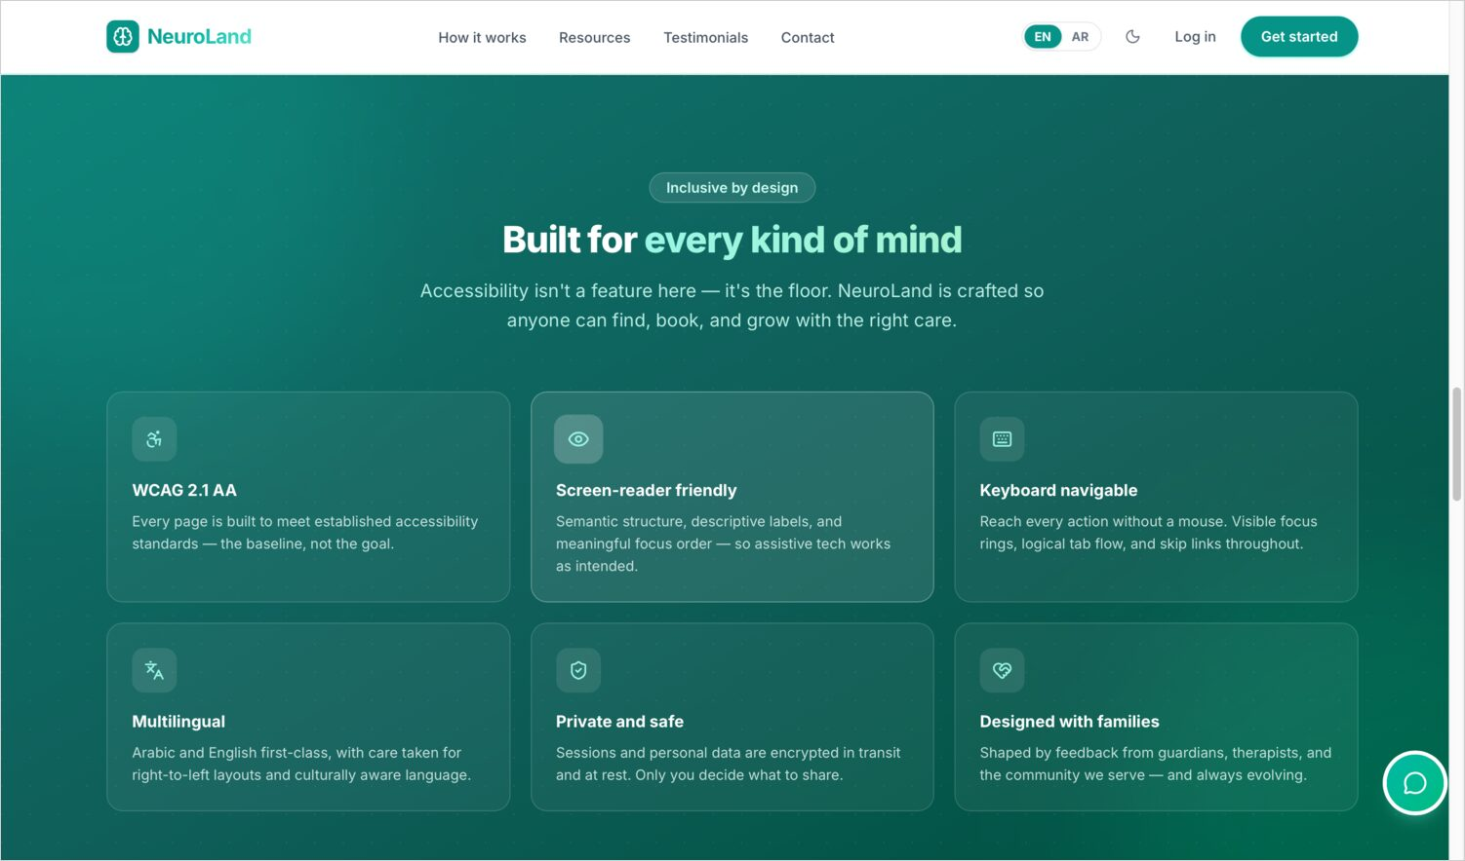
WEB · PUBLIC SITE
Built around people — and accessibility
Role selection — guardian, therapist, institution
Accessibility & trust: WCAG, screen-reader, privacy
Accessibility is advertised up front, because it's a core promise of the product.
06
Notes:
The site is organised around who you are — guardian, therapist or institution — and it foregrounds accessibility and trust: WCAG support, screen-reader friendliness, and privacy. These aren't afterthoughts; they're headline promises.

Slide 7
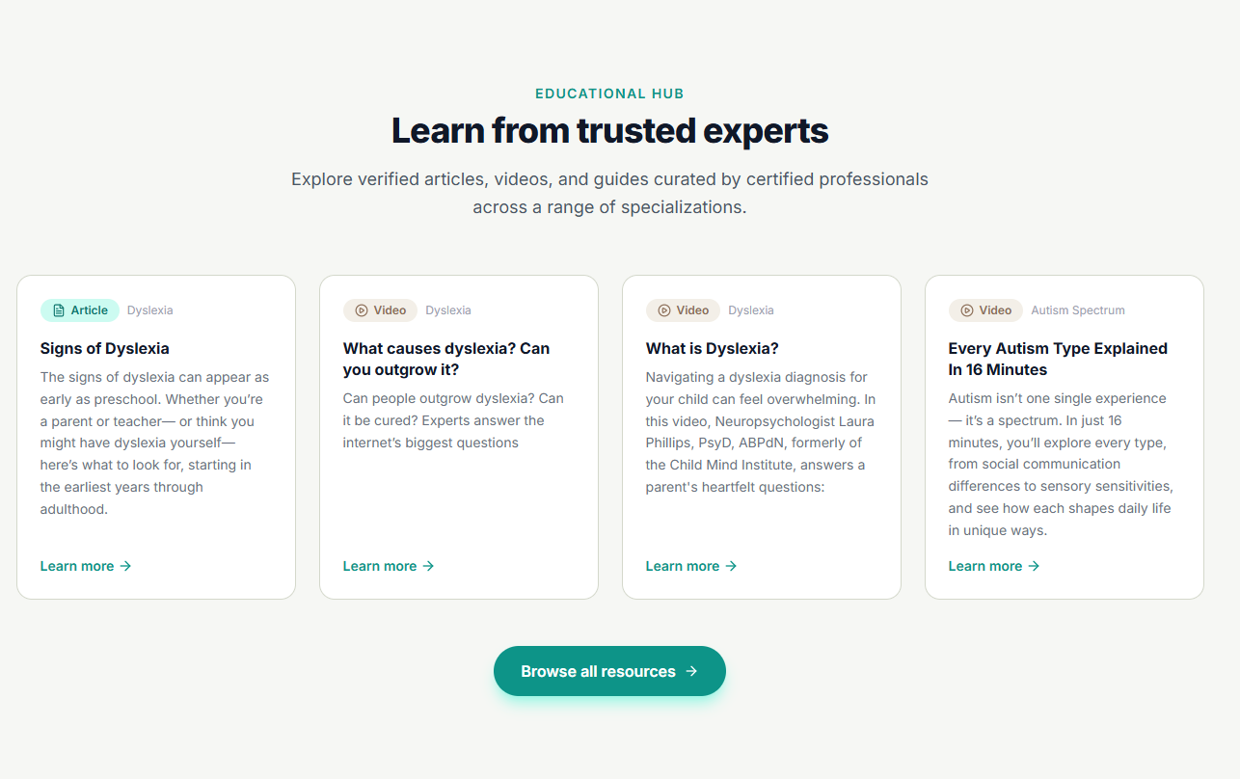
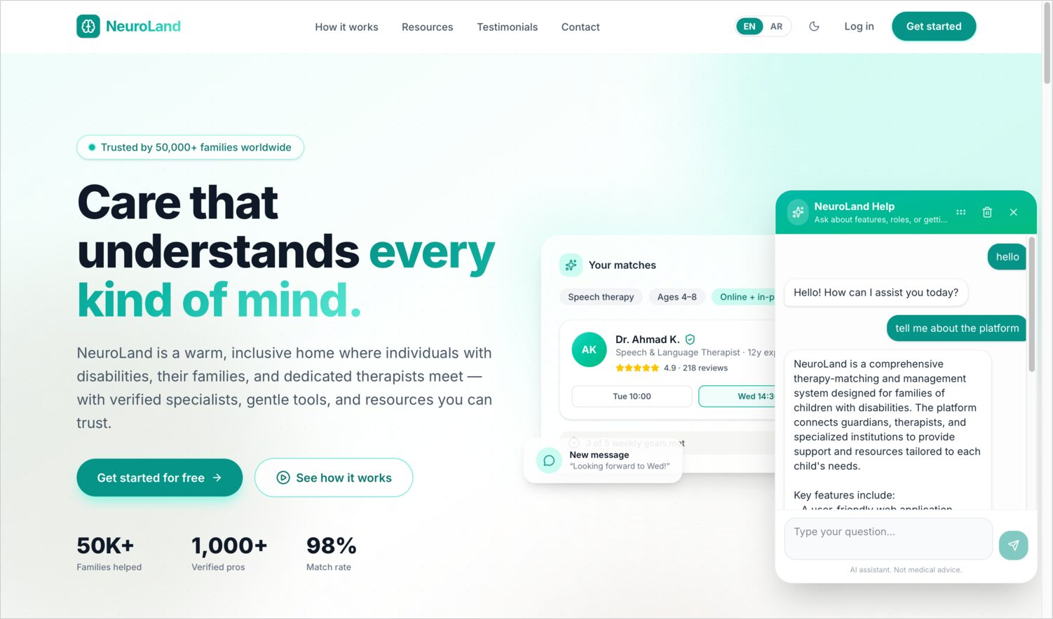
WEB · PUBLIC SITE
Learn, and get help instantly
Educational hub of expert articles & resources
Knowledge-base help chatbot
A resources hub plus an AI help chatbot grounded in the platform's own documentation.
07
Notes:
Beyond marketing, the public site offers an educational hub of articles and resources from verified experts, and an AI help chatbot grounded in the platform's own documentation, so visitors can get answers immediately.

Slide 8
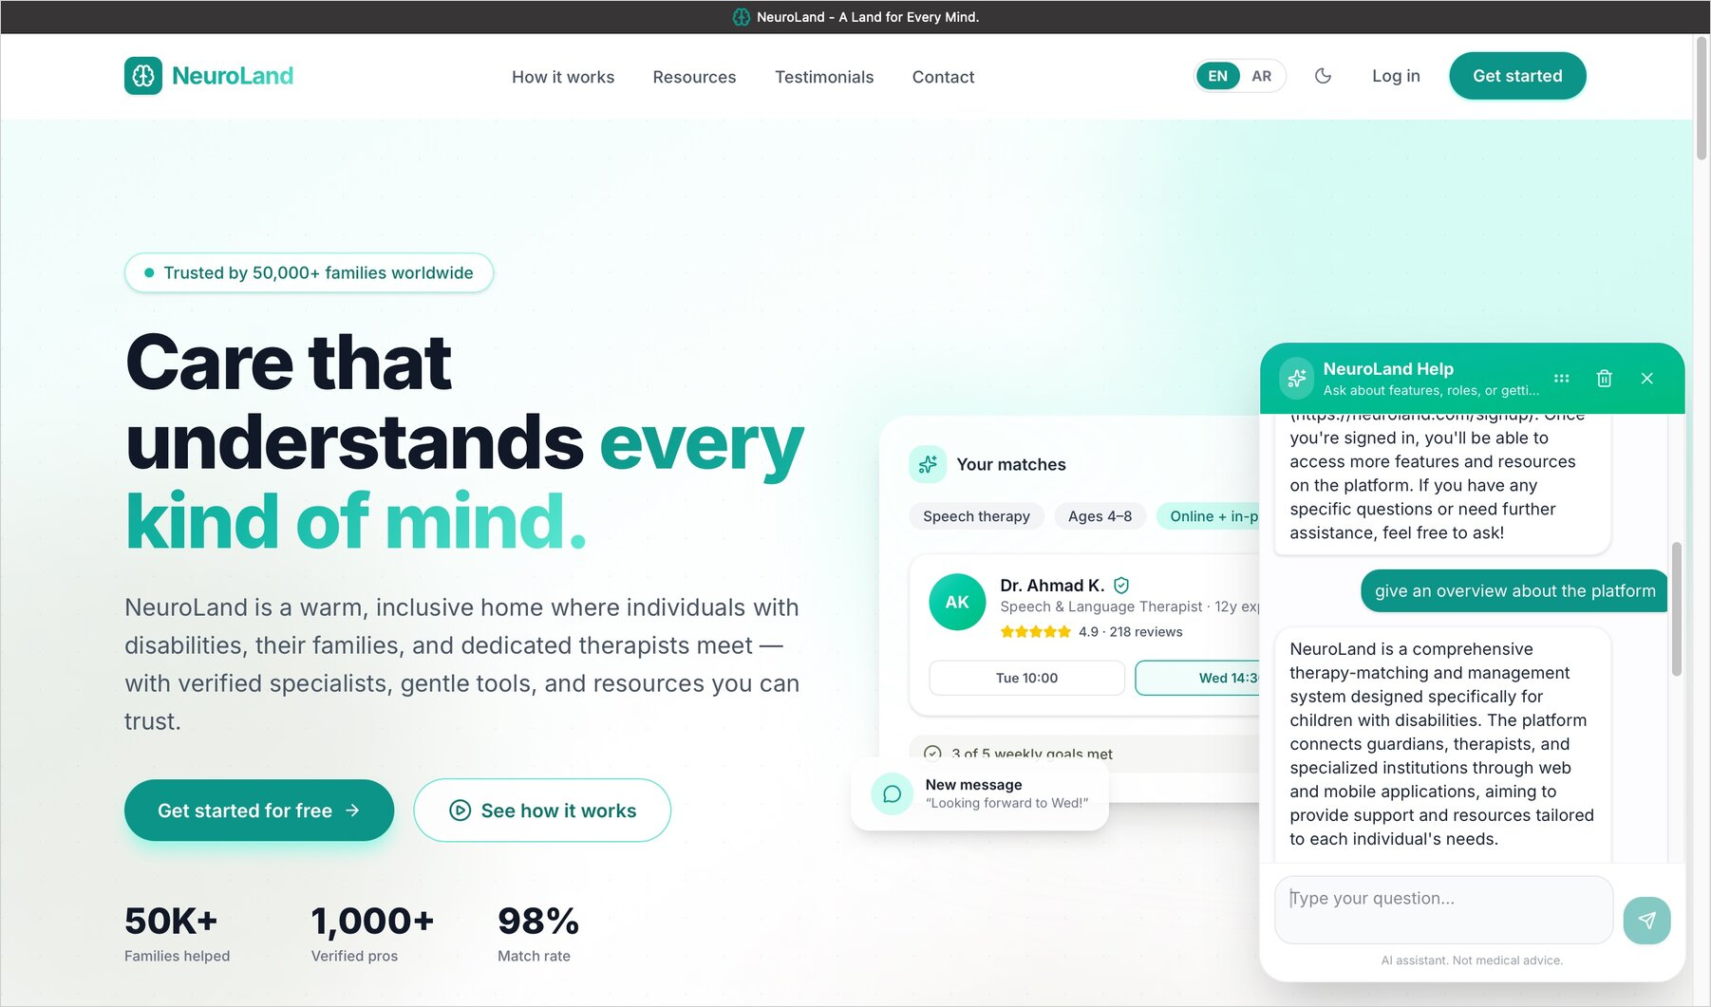
WEB · PUBLIC SITE
The assistant introduces the platform
Ask the in-page assistant “give an overview about the platform” and it answers in plain language — grounded in NeuroLand's own documentation.
08
Notes:
Here's that help assistant in action. A visitor simply types 'give an overview about the platform,' and the assistant answers in plain language — explaining that NeuroLand is a therapy-matching and management system connecting guardians, therapists and institutions across web and mobile. Because it's grounded in our own documentation, it's accurate and always available, so a newcomer can understand the product before they even sign up.

Slide 9
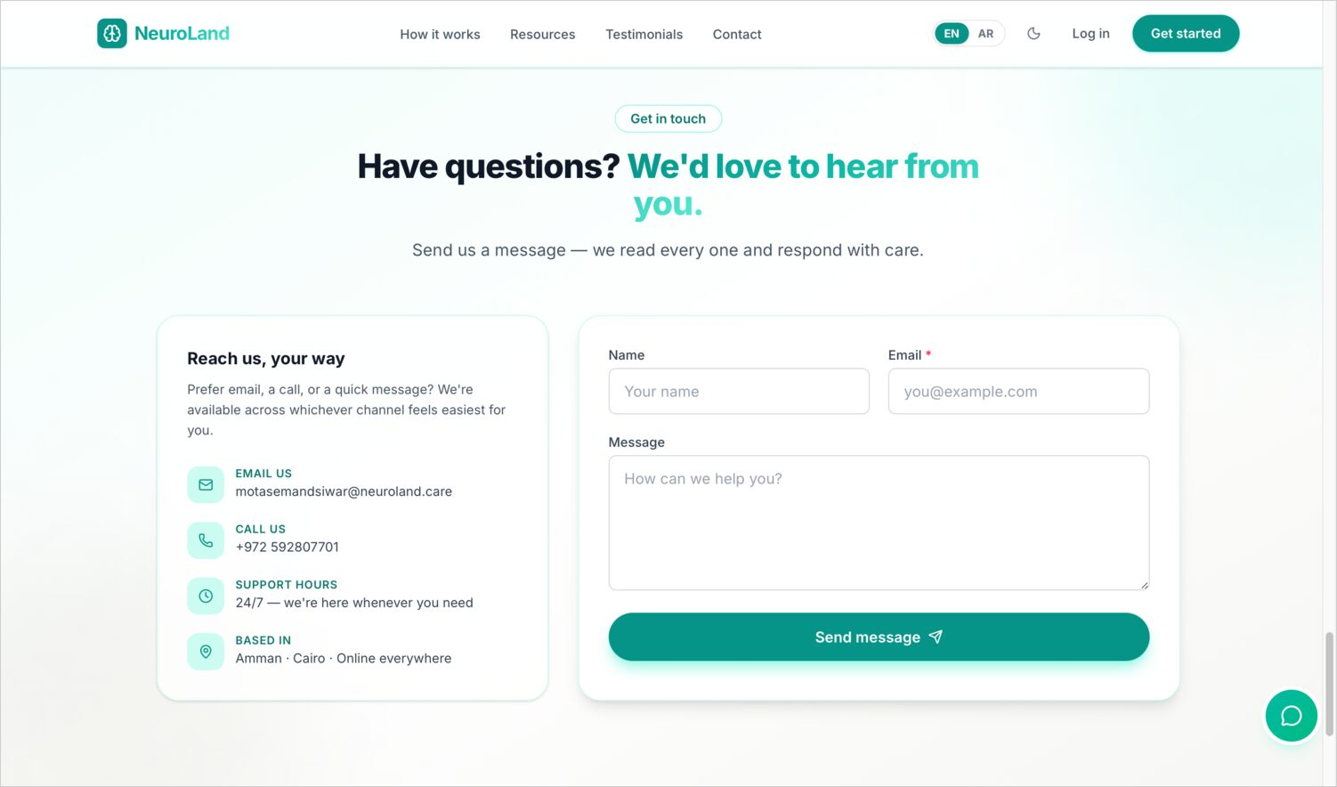
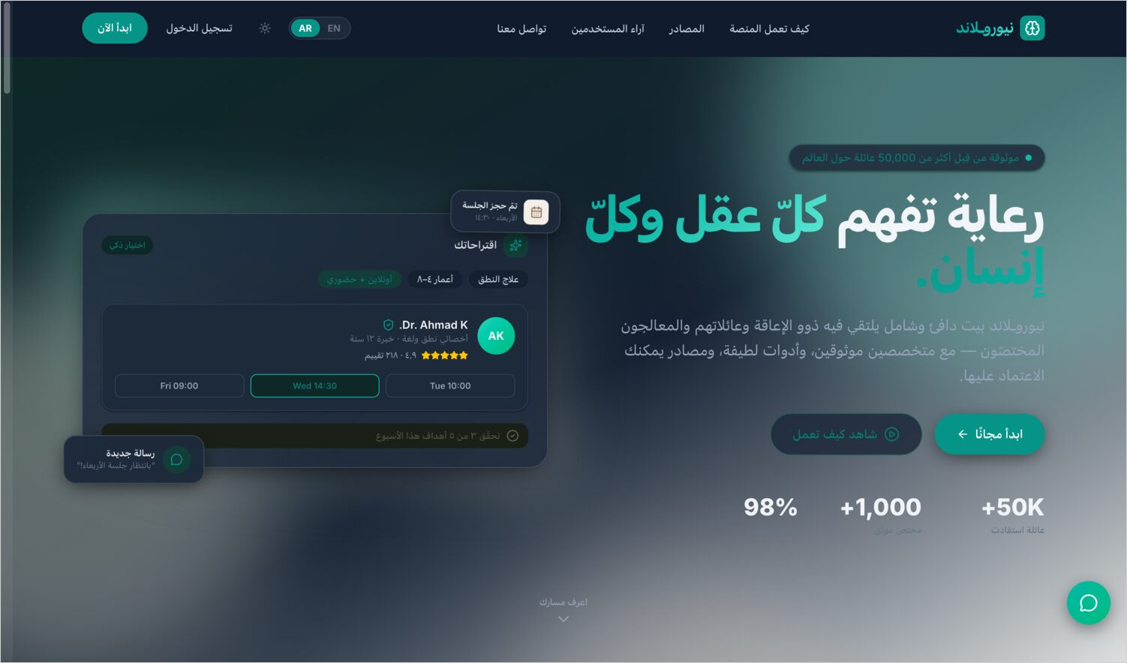
WEB · PUBLIC SITE
Reach out — in either language
Public contact form to administrators
Arabic (RTL) landing hero
Every page is fully bilingual; the entire layout mirrors for Arabic.
09
Notes:
Visitors can contact the team through a public form that lands in the admin inbox. And the entire site is fully bilingual — here's the Arabic hero, with the whole layout mirrored right-to-left.

Slide 10
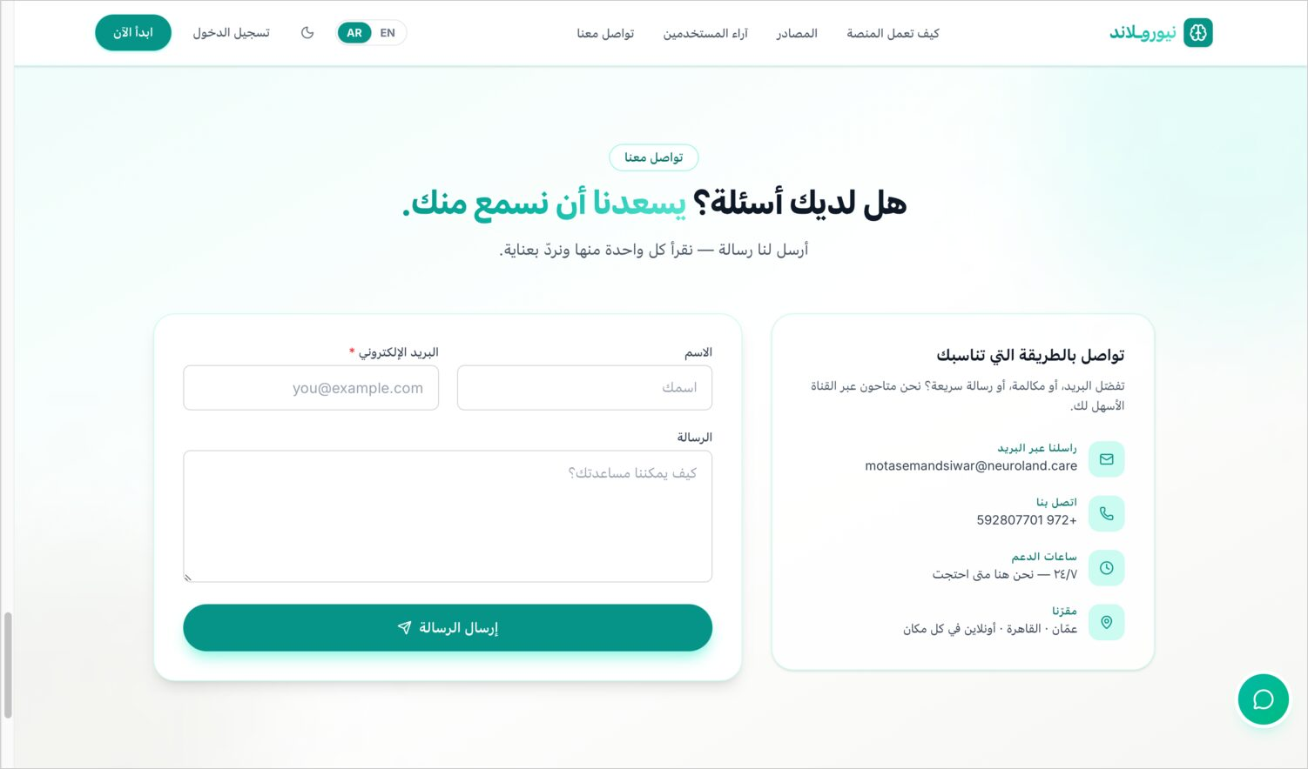
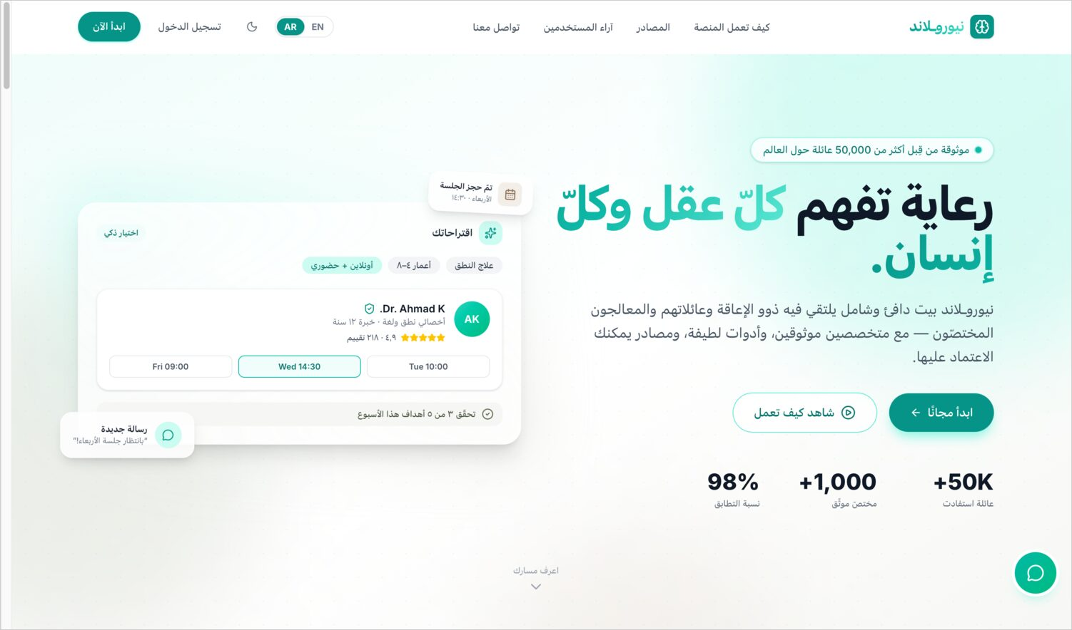
WEB · PUBLIC SITE
Right-to-left, end to end
Arabic contact section, mirrored fields
Arabic care section, mirrored navigation
RTL isn't a translation layer — navigation, forms and content all flip correctly.
10
Notes:
Right-to-left support runs end to end — contact forms, navigation and content all mirror correctly. It's a true bilingual layout, not just translated text dropped into a left-to-right frame.

Slide 11
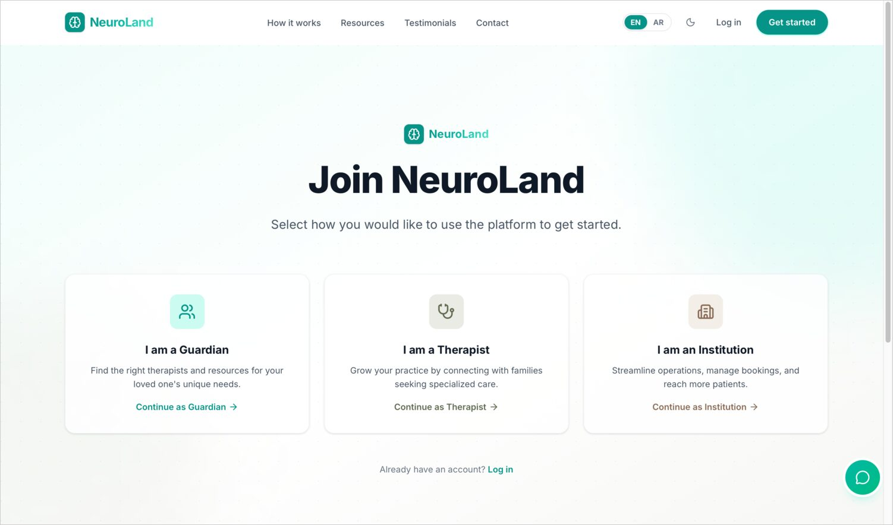
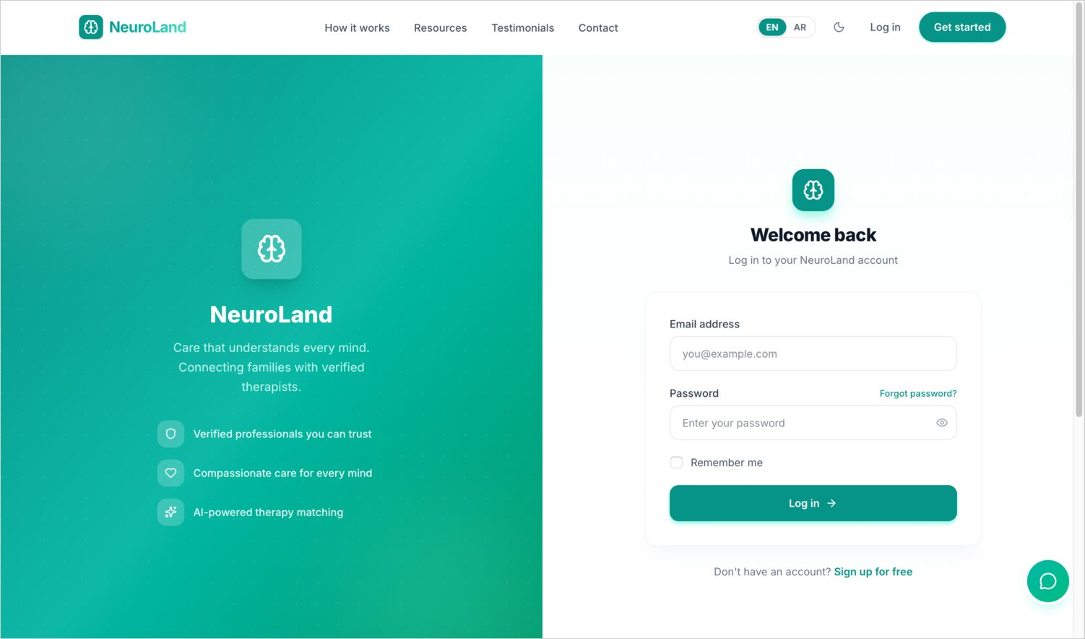
WEB · ONBOARDING
Joining NeuroLand
Account-type selection to begin sign-up
Shared login screen for all roles
Sign-up starts by choosing a role; all roles share one secure login.
11
Notes:
Onboarding begins by choosing an account type. All roles then share one secure login screen with JWT authentication and a hashed-token password reset behind it.

Slide 12
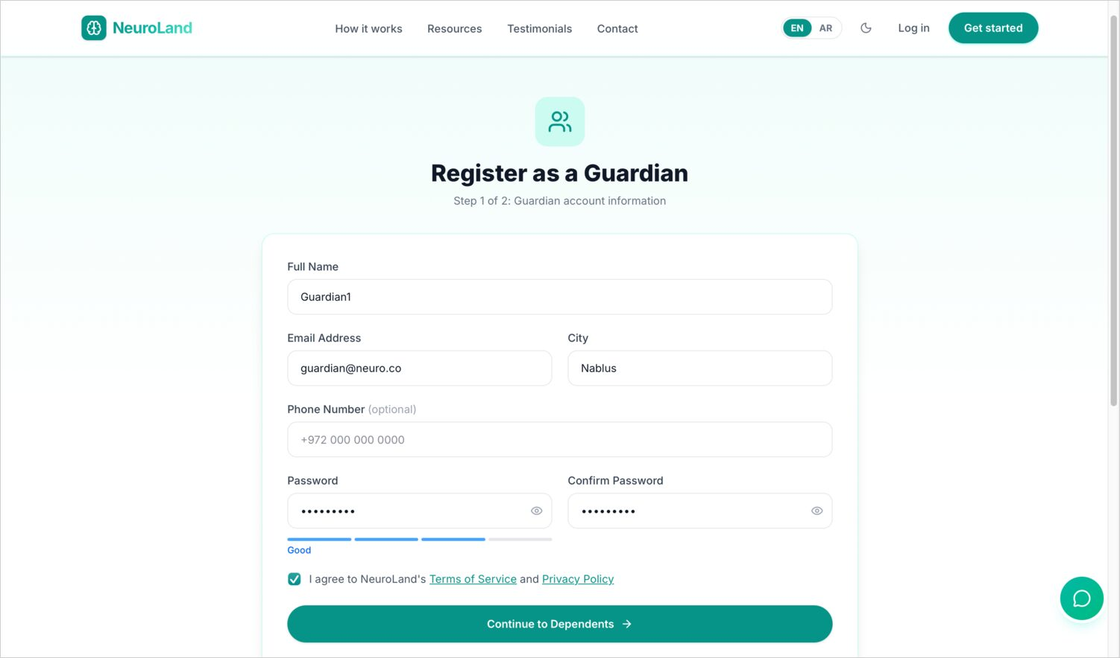
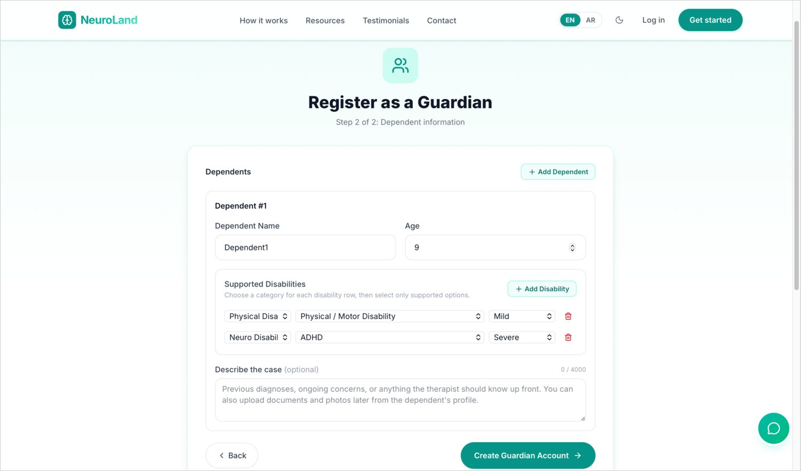
WEB · ONBOARDING
Guardian sign-up
Step one — account details
Step two — add dependents & accessibility needs
A guardian creates their account, then adds each dependent with their conditions and accessibility needs.
12
Notes:
A guardian signs up in two steps: first their own account details, then their dependents — capturing each child's conditions and accessibility needs right at registration, so their experience is personalised from day one.

Slide 13
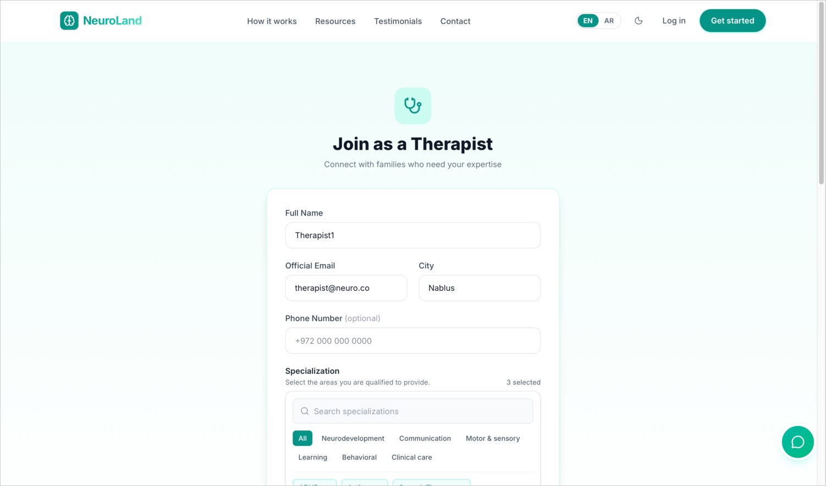
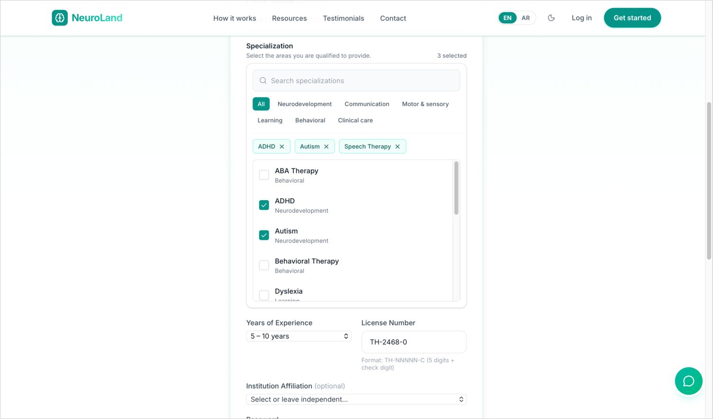
WEB · ONBOARDING
Therapist sign-up
Professional profile
Specialisation selection
Therapists provide a professional profile and pick the specialisations they're qualified for.
13
Notes:
Therapists register with a professional profile and select the specialisations they're qualified to provide — which later drives how guardians find and filter them.

Slide 14
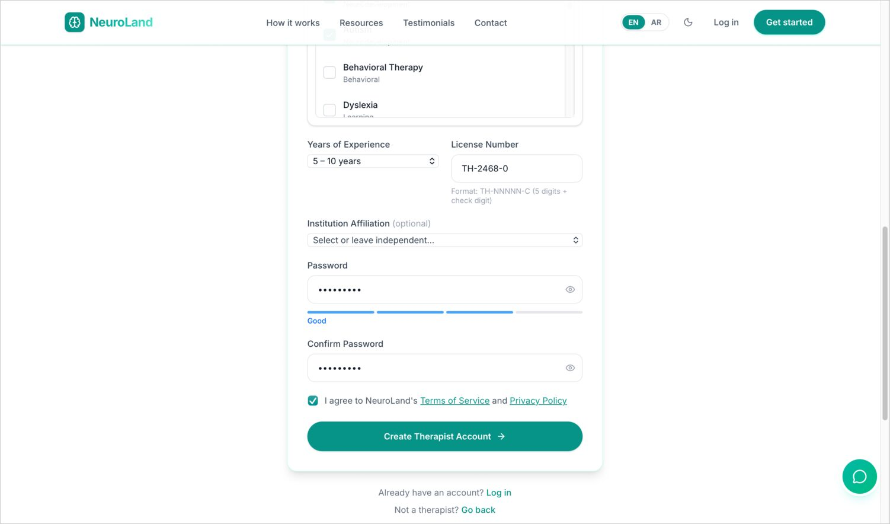
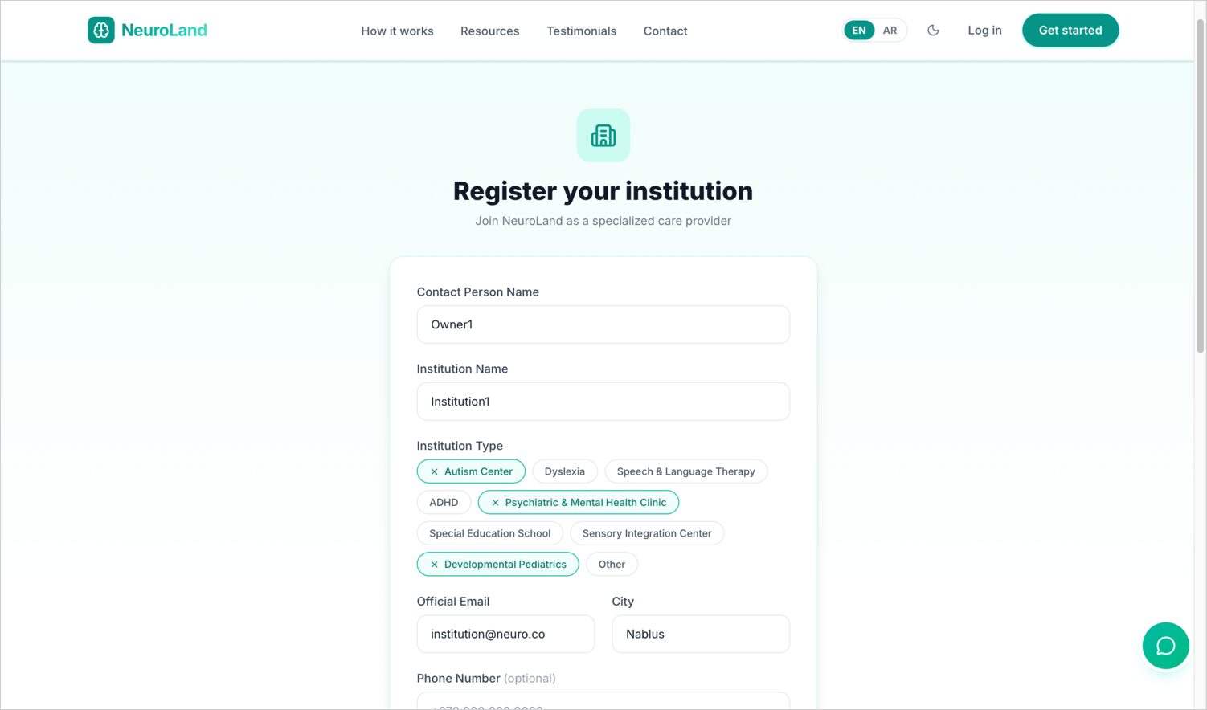
WEB · ONBOARDING
Credentials & institutions
Experience, license number & affiliation
Institution registration for clinics & schools
Therapists submit a license number; institutions register as organisations.
14
Notes:
Therapists also submit experience, a license number, and any institution affiliation. Separately, clinics and schools can register as institutions to manage their own staff and patients.

Slide 15
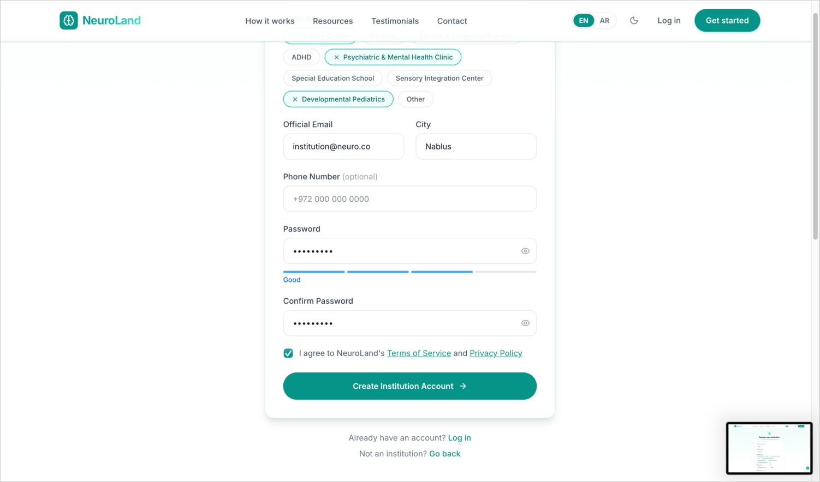
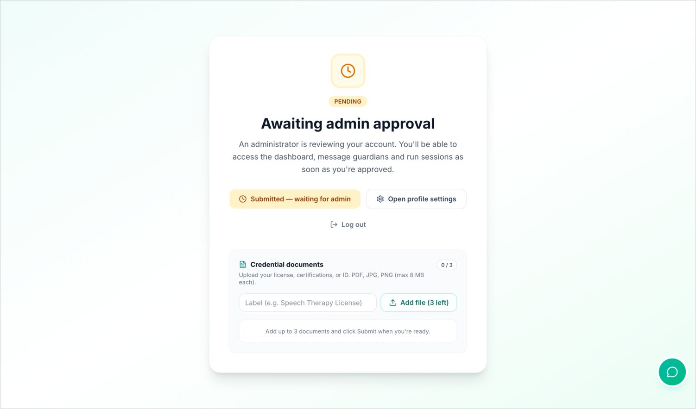
WEB · ONBOARDING
Institution details & the verification gate
Institution contact details
Therapist approval gate — awaiting admin review
A new therapist is blocked from acting until an admin reviews their uploaded credentials.
15
Notes:
After an institution finishes its details, here's a pivotal screen: the therapist approval gate. A newly registered therapist lands here and can't take any action — they upload their credential documents and wait for an administrator to review them. That gate is where the next section begins.

Slide 16

WEB · ROLE 1
Administrator Console
Verification, oversight, audit, finance and platform configuration.
Notes:
The administrator console is the platform's control room — verification, oversight, an audit trail, finance, and configuration. It was the first thing we built, because trust depends on it.

Slide 17
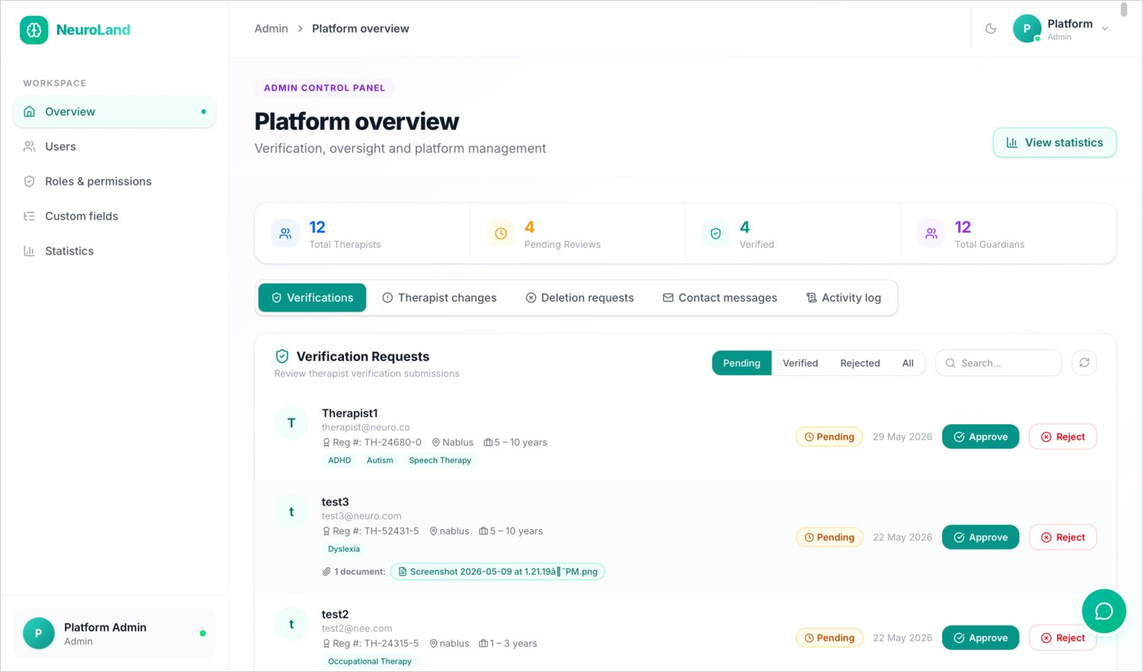
ADMIN · VERIFICATION
Approving therapists, with care
The verification queue is where trust is enforced.
Each therapist sits in a pending queue until reviewed
Admins open uploaded credential documents and license details
One click to approve or reject, with a note back to the therapist
Enforced server-side — the client can never bypass it
17
Notes:
At its heart is the verification queue. Every new therapist sits here pending review. The admin opens their credential documents and license, then approves or rejects with a note. Approval lifts the gate we just saw; rejection sends actionable feedback. Crucially, this is enforced on the server, so the client can never sneak an unverified therapist through.

Slide 18
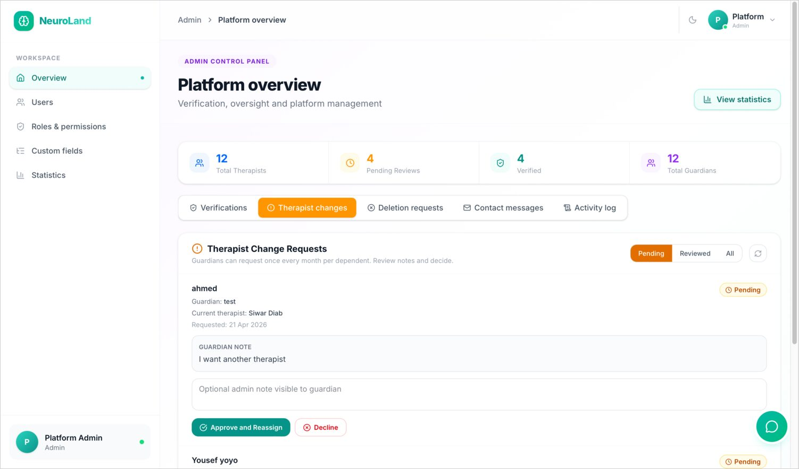
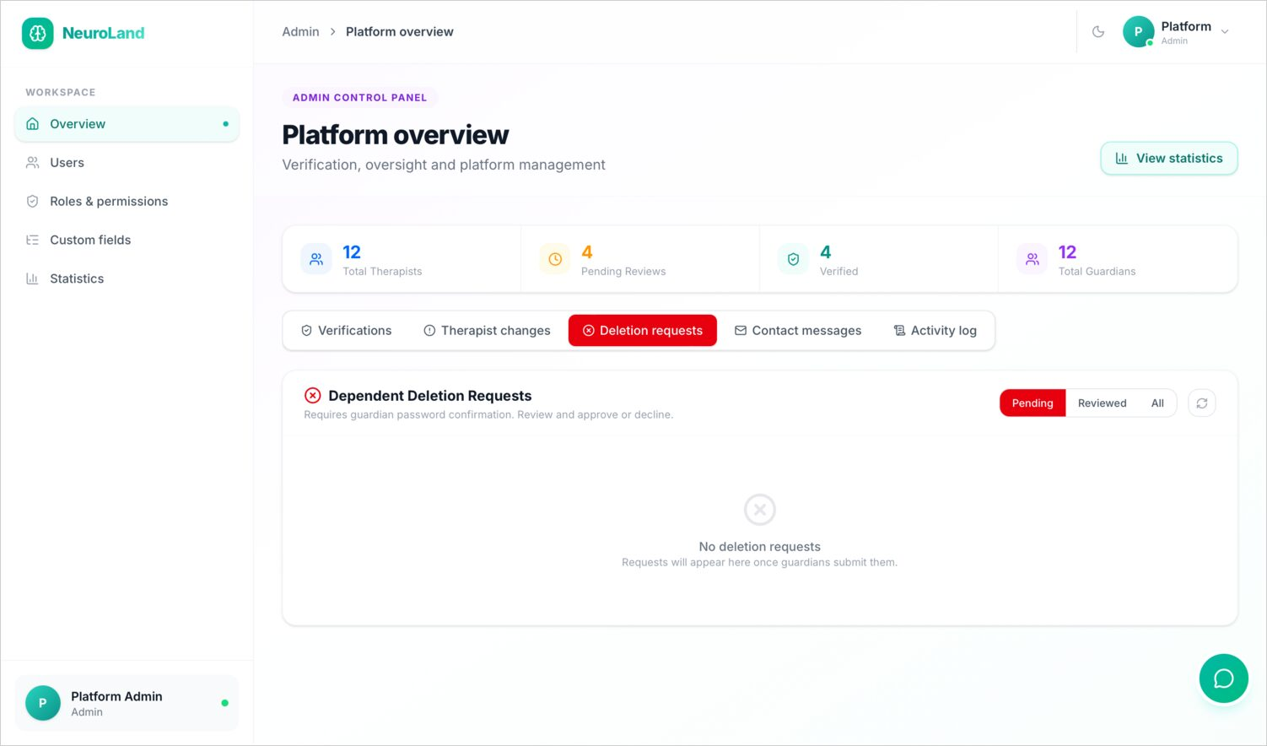
ADMIN · REQUESTS
Reviewing changes & sensitive deletions
Therapist change-request review
Dependent deletion-request review
Sensitive changes — profile edits, dependent deletions — route through admin approval.
18
Notes:
Other sensitive actions also route through the admin: therapists requesting profile changes, and guardians requesting that a dependent record be deleted. Nothing sensitive happens silently.

Slide 19
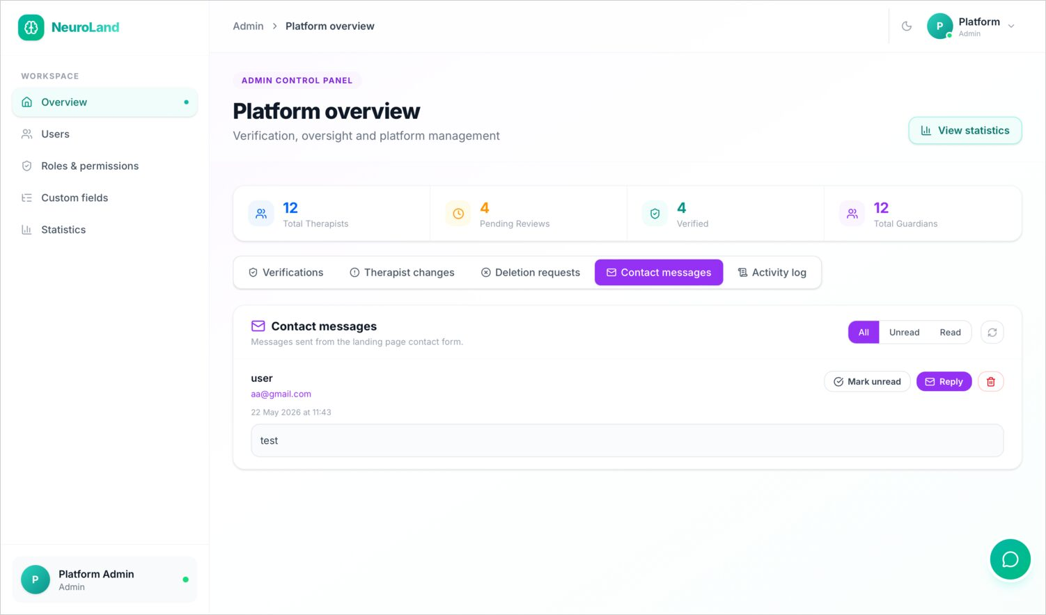
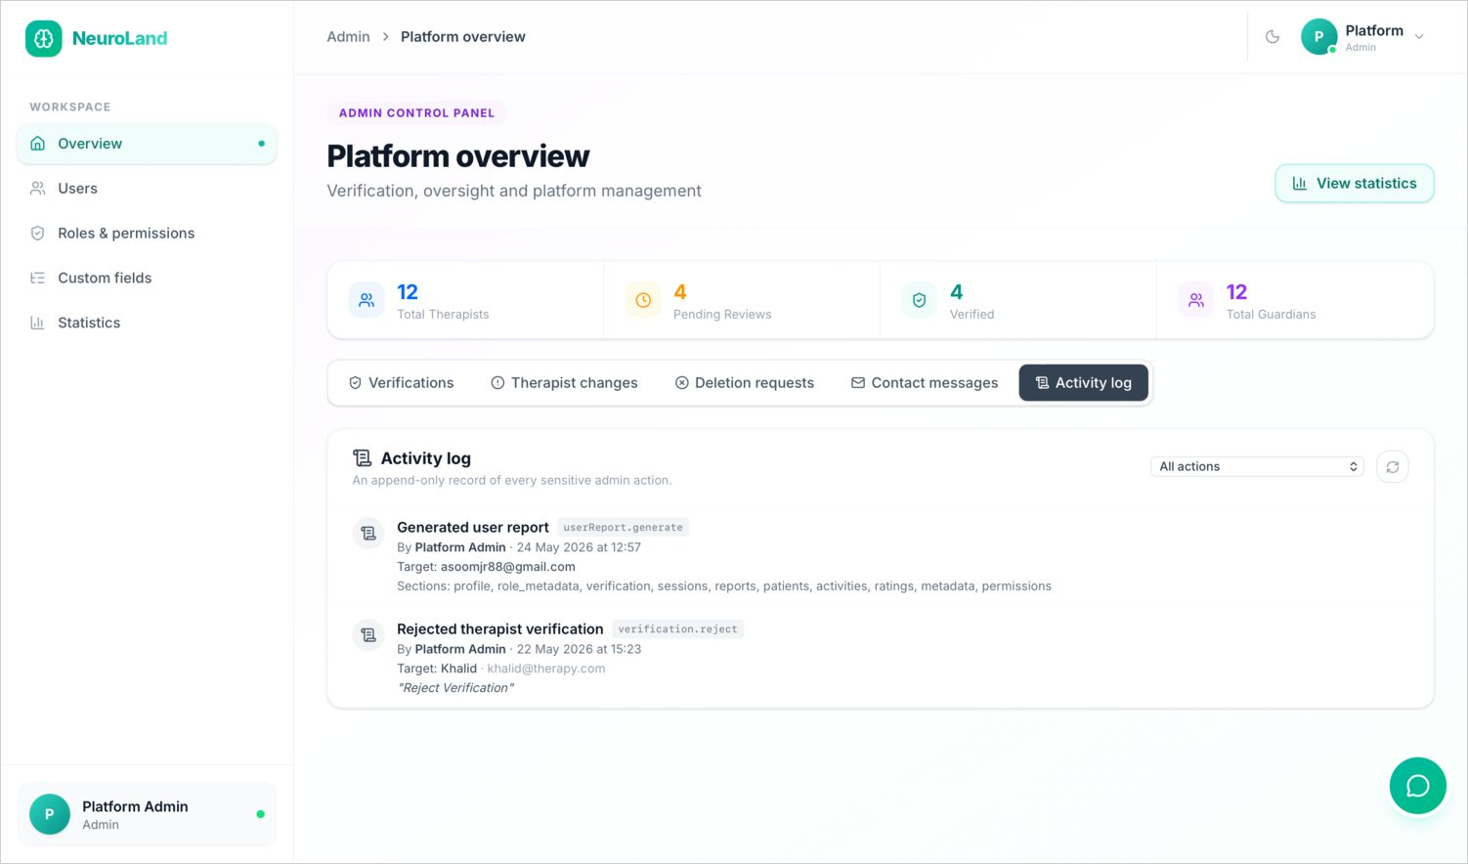
ADMIN · OVERSIGHT
The inbox and the audit trail
Contact messages from the public site
Append-only activity log of every privileged action
Every privileged action is recorded append-only — who did what, to whom, and when.
19
Notes:
The admin handles contact messages forwarded from the public site, and reviews the activity log — an append-only record of every privileged action, capturing who did what, to which record, and when. For a healthcare-adjacent system, that audit trail is essential.

Slide 20
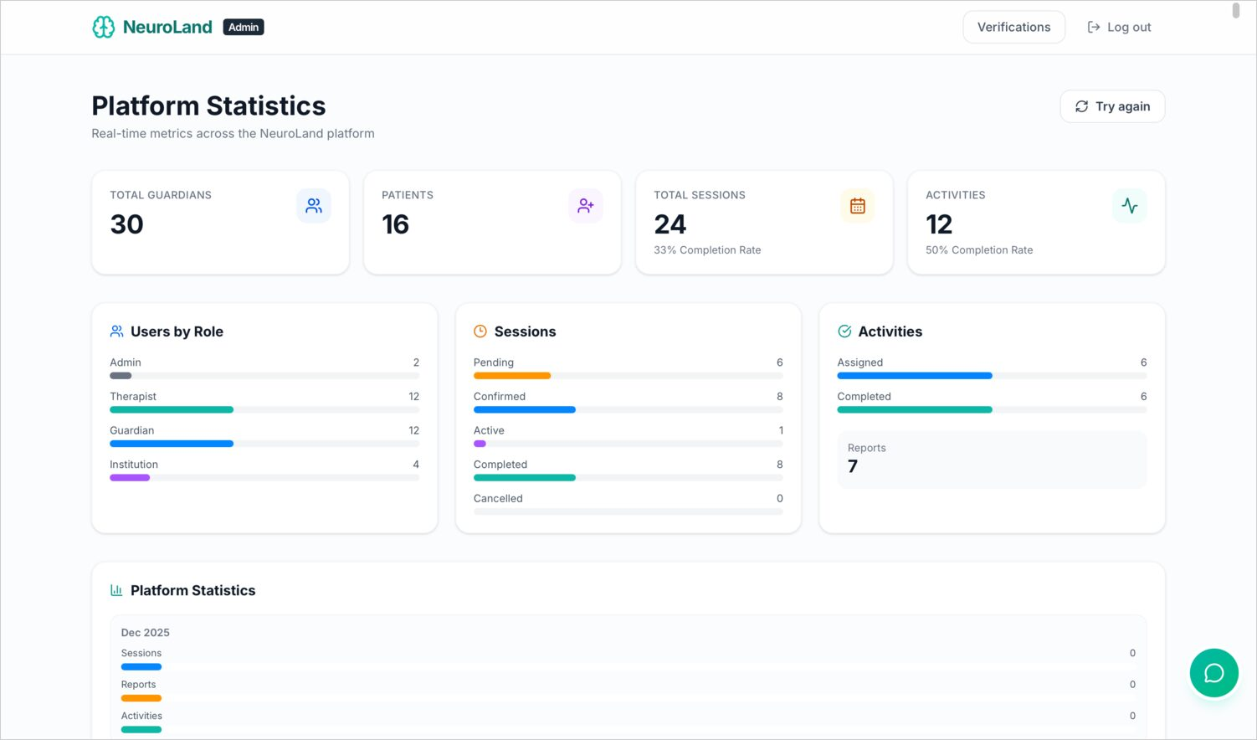
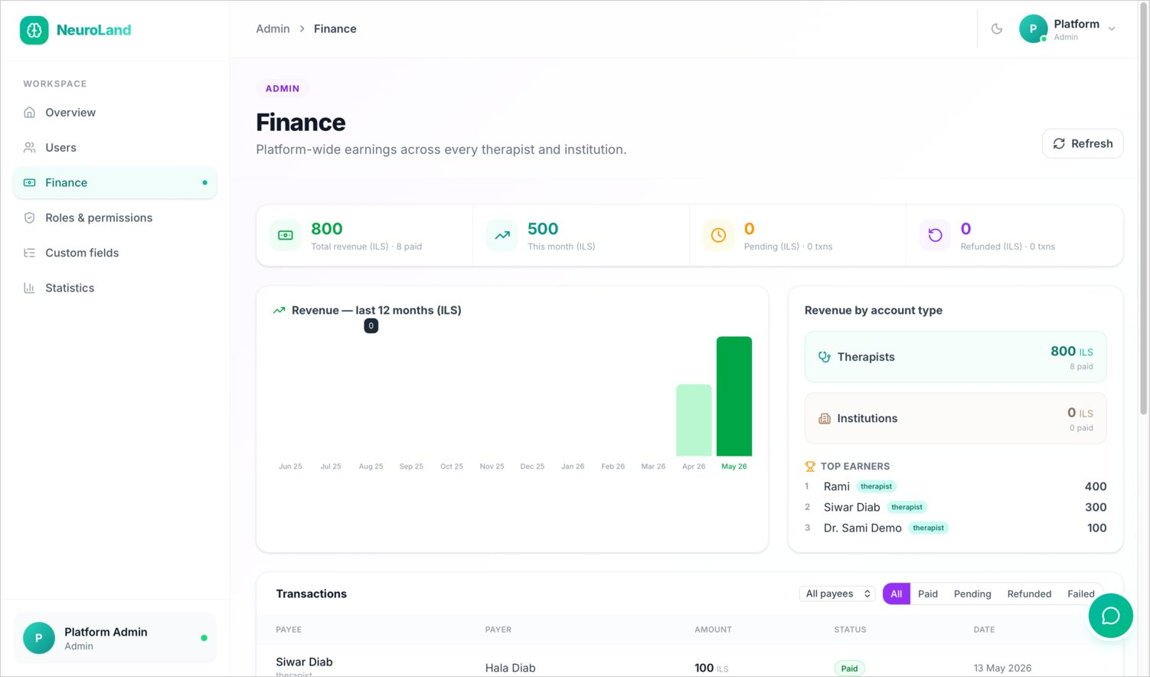
ADMIN · INSIGHT
Knowing the platform's pulse
Platform statistics — users, sessions, activities
Finance — earnings and revenue by account type
Live dashboards summarise platform usage and finances.
20
Notes:
Two dashboards give the admin the platform's pulse: a statistics overview of users by role, sessions and activities; and a finance view of earnings and revenue broken down by account type.

Slide 21
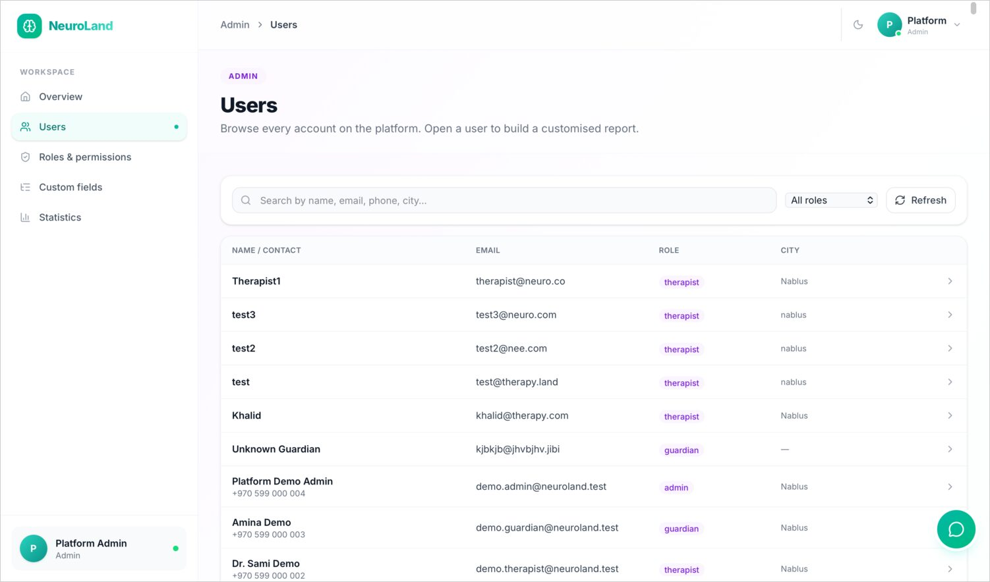
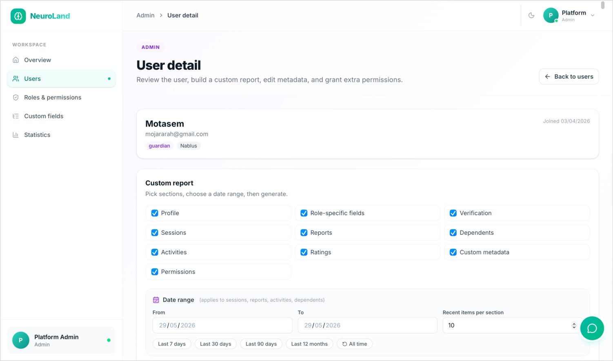
ADMIN · USERS
Every account, and a report for each
Searchable directory of all accounts
Per-user report builder with selectable sections
From any user the admin can assemble a tailored report.
21
Notes:
The admin can browse and search every account in a directory, and open any user to build a tailored report — choosing exactly which sections to include.

Slide 22
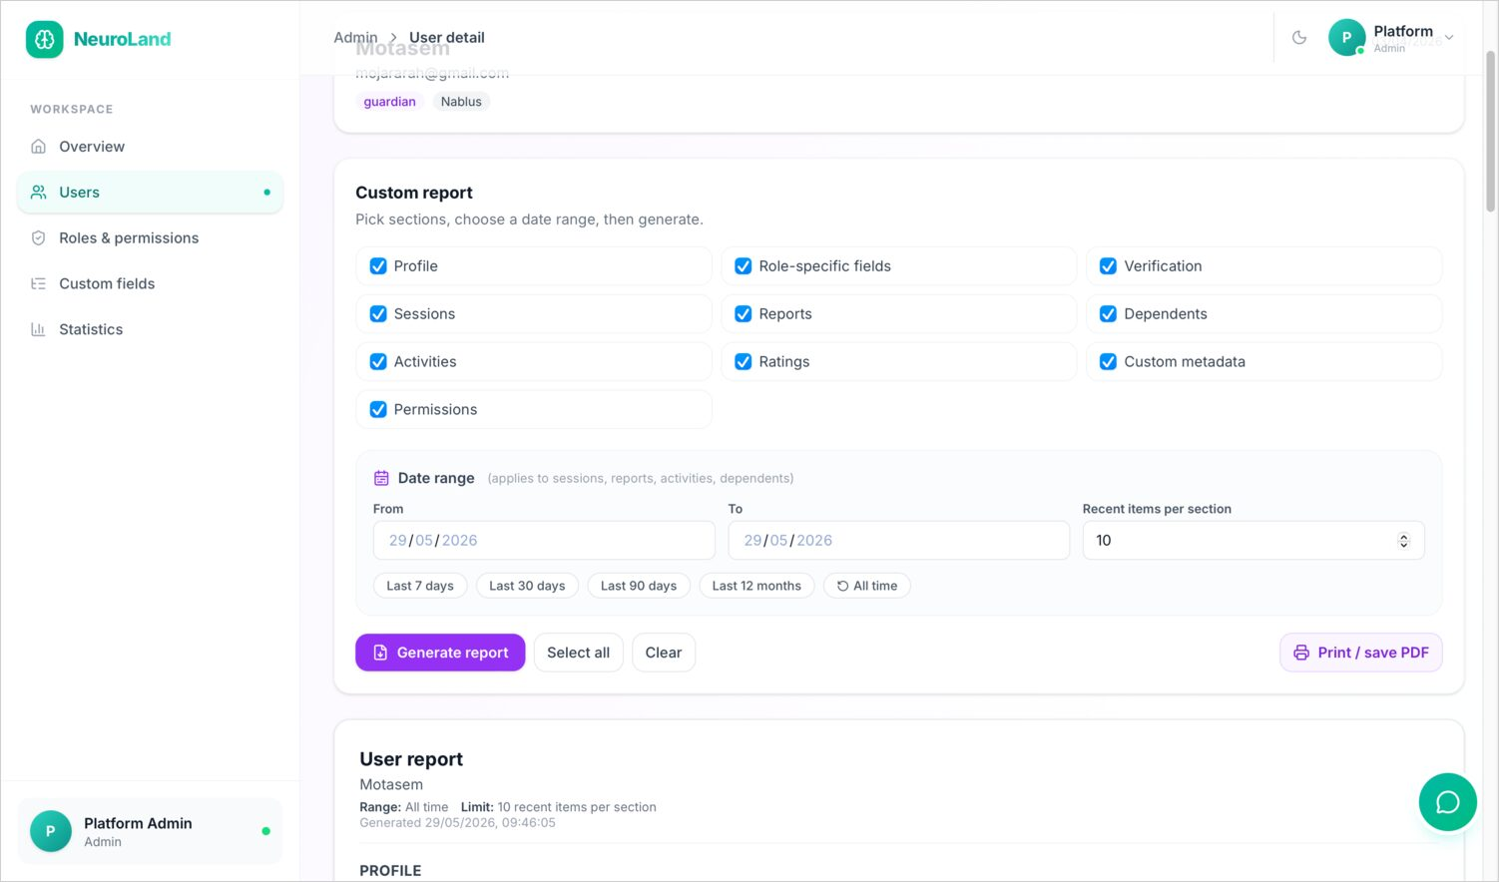
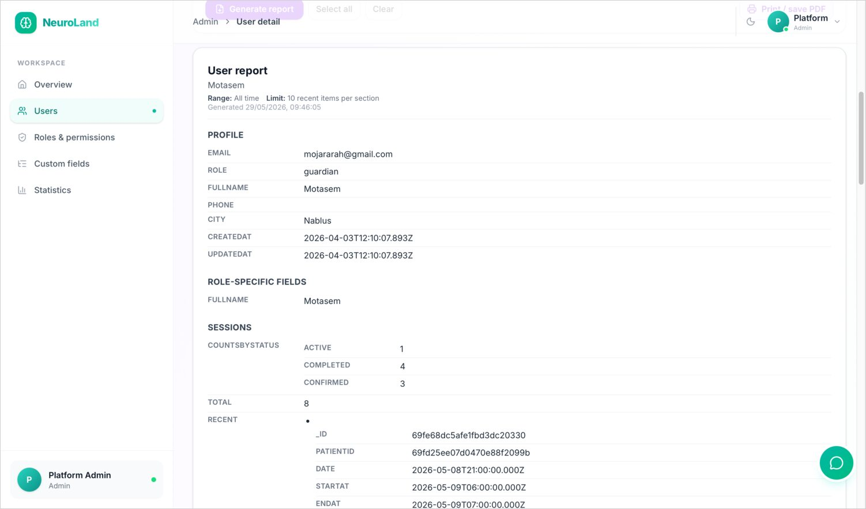
ADMIN · REPORTS
Tailored, printable records
Date-range presets and PDF export
The generated, printable report
Reports support date ranges and export to a clean printable document.
22
Notes:
Those reports support date-range presets and export to PDF, producing a clean, printable per-user record — useful for compliance or for sharing a summary.

Slide 23
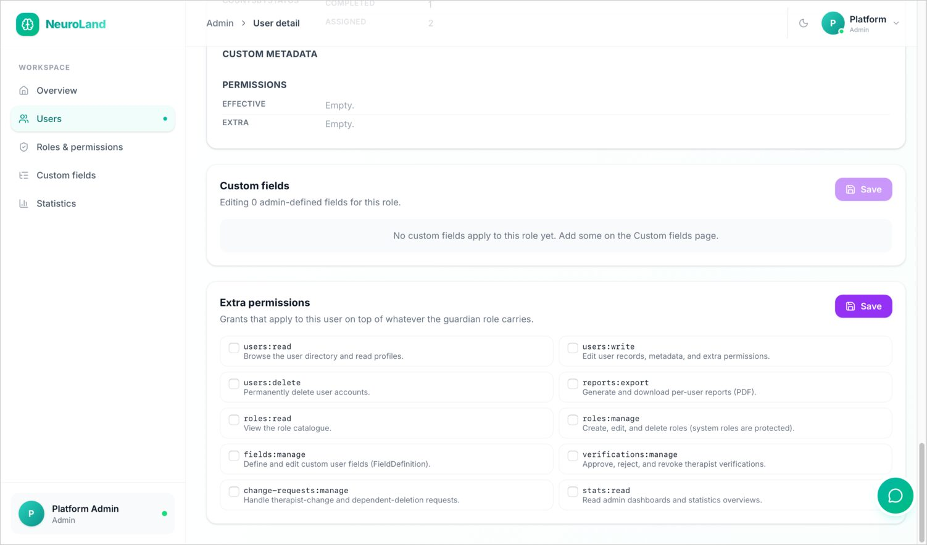
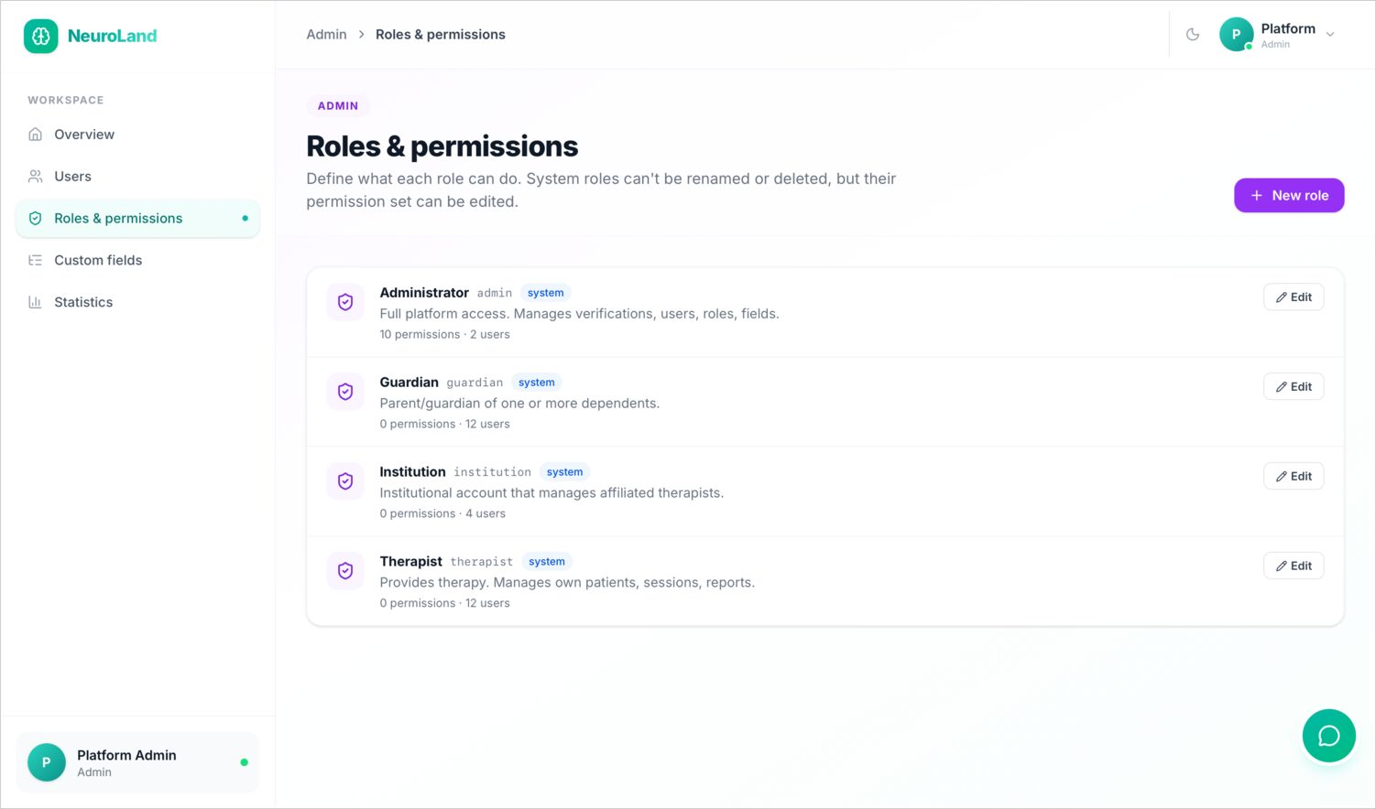
ADMIN · CONFIGURATION
Extensible by design
Per-user metadata & extra permission grants
Roles & permissions with admin-defined roles
Permissions and roles are data the admin can shape — not hard-coded.
23
Notes:
The platform is configurable rather than hard-coded. Admins can attach custom metadata and grant extra permissions per user, and define their own roles with specific permission sets.

Slide 24
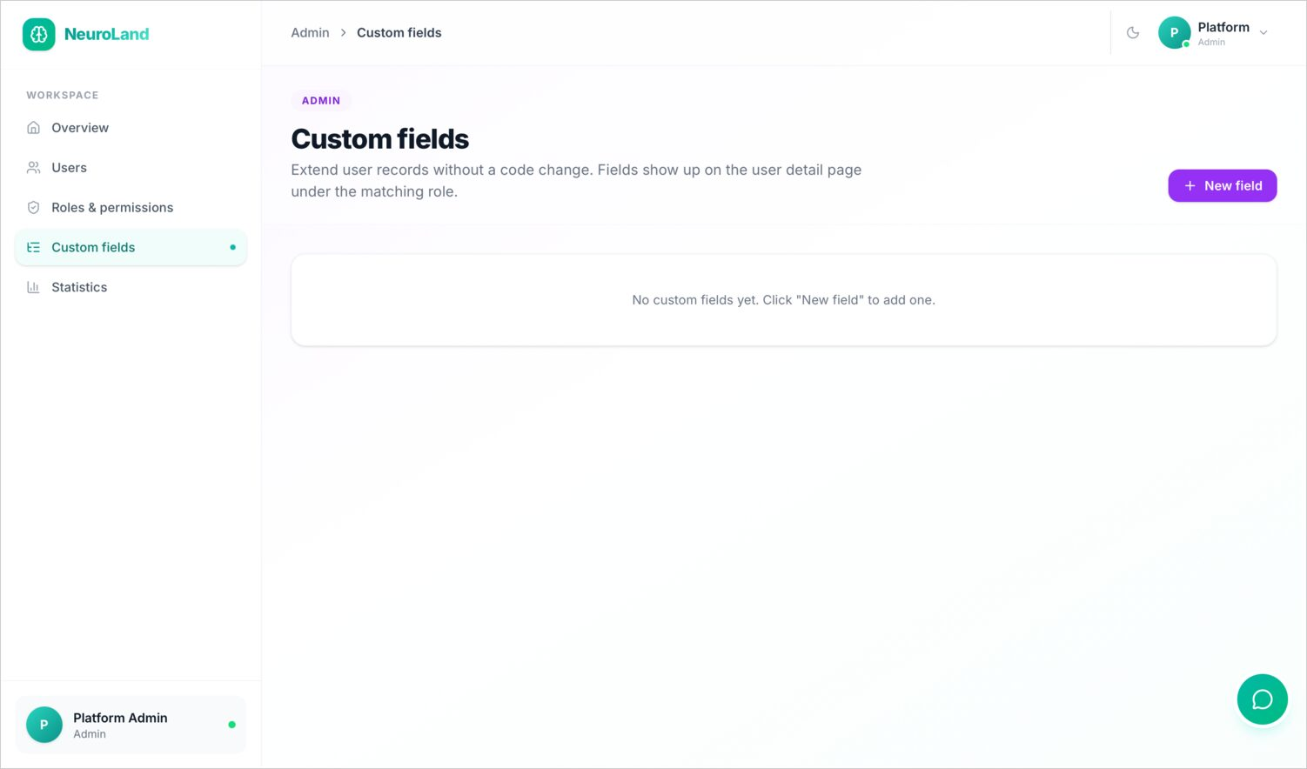
ADMIN · CONFIGURATION
Custom fields without code
The platform bends to the institution's needs, not the other way around.
Admins add custom user fields from the panel
New fields appear on user records automatically
No code change or redeploy needed
Pairs with custom roles for full flexibility
24
Notes:
Finally, admins can add custom user fields without touching code — they appear on user records automatically. Together with custom roles, this lets the platform bend to an organisation's needs instead of forcing the organisation to adapt.

Slide 25

WEB · ROLE 2
Institution Console
Clinics and schools managing a roster of therapists and patients.
Notes:
The institution console is for clinics and schools that employ therapists. It lets an institution lead manage their roster, enrolments, schedule and analytics in one place.

Slide 26
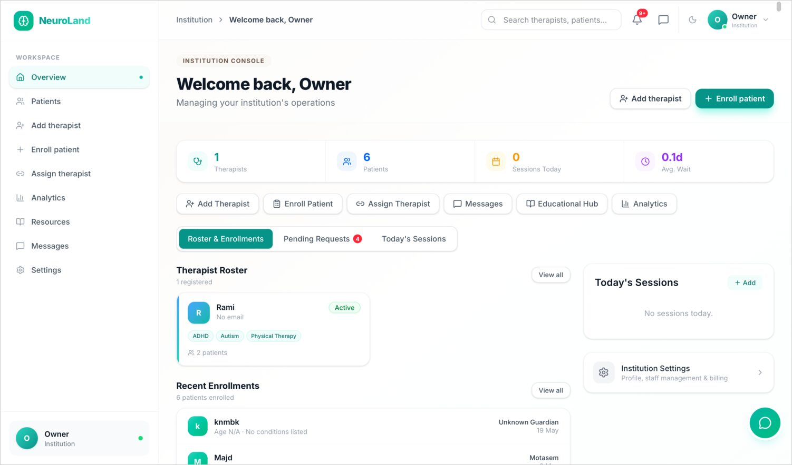
INSTITUTION · OVERVIEW
Running the practice at a glance
One overview ties the institution's people, patients and schedule together.
Therapist roster with status and caseload
Recent enrolments of new patients
Today's sessions across the whole institution
Quick actions to add staff, enroll or assign
26
Notes:
The overview ties everything together: the therapist roster, recent enrolments, and the day's sessions across the whole institution, plus quick actions to add a therapist, enroll a patient, or assign care.

Slide 27
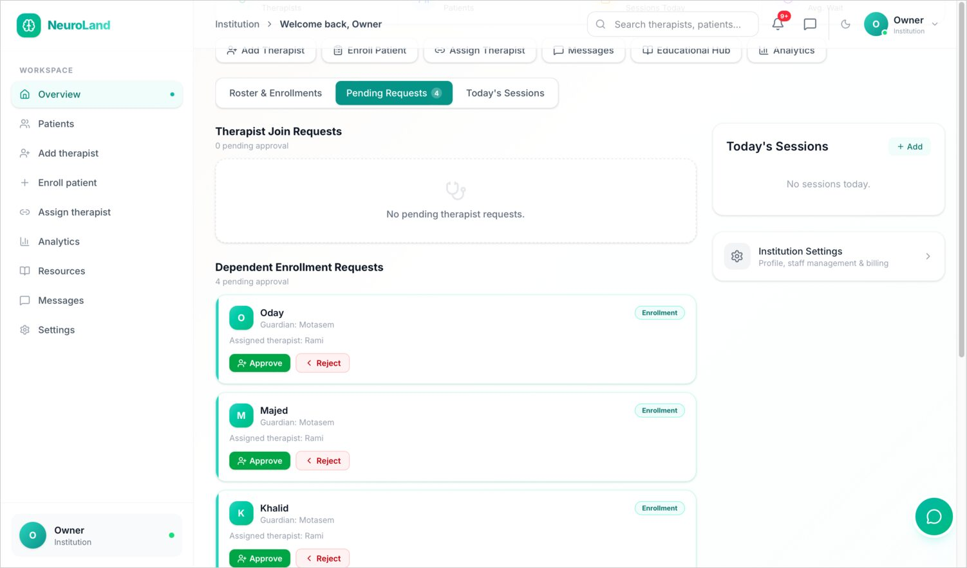
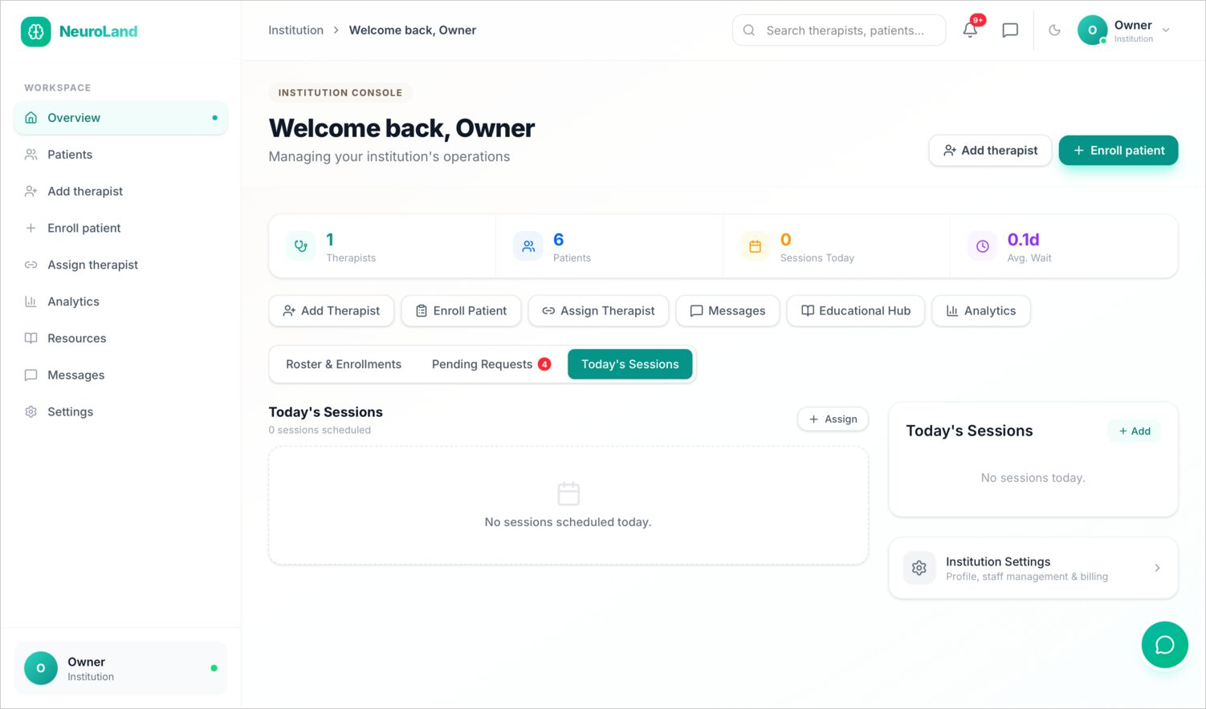
INSTITUTION · OPERATIONS
Approvals and the daily schedule
Pending therapist-join & enrolment requests
Today's sessions across the institution
The institution approves who joins and who's enrolled, and sees the day's schedule.
27
Notes:
The institution approves therapists requesting to join and dependents requesting enrolment, and sees today's scheduled sessions across all its therapists.

Slide 28
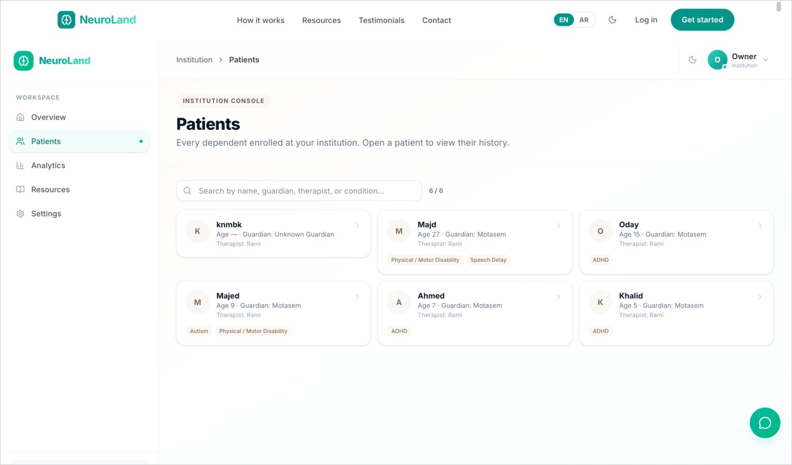
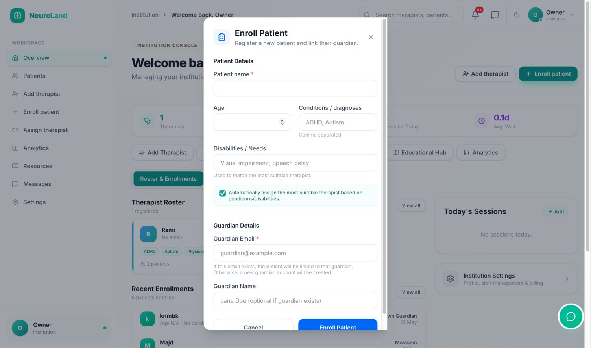
INSTITUTION · PATIENTS
Enrolling and connecting care
Patients enrolled across the institution
Enroll-patient dialog
Enrolment links a dependent to the institution's care.
28
Notes:
It manages all enrolled patients, and the enroll-patient dialog links a guardian's dependent into the institution's care.

Slide 29
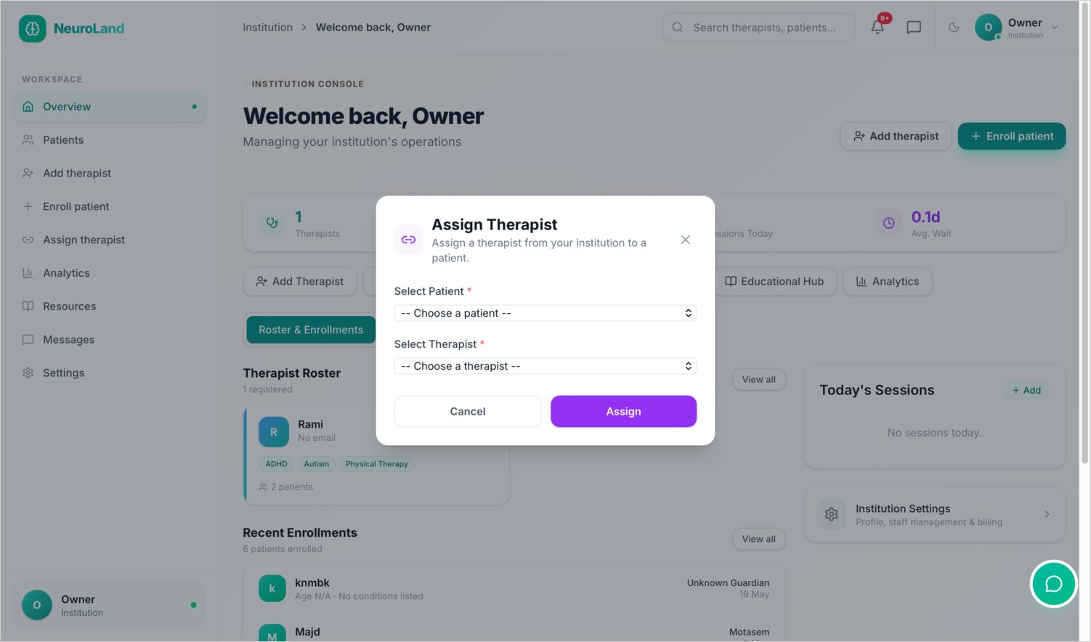
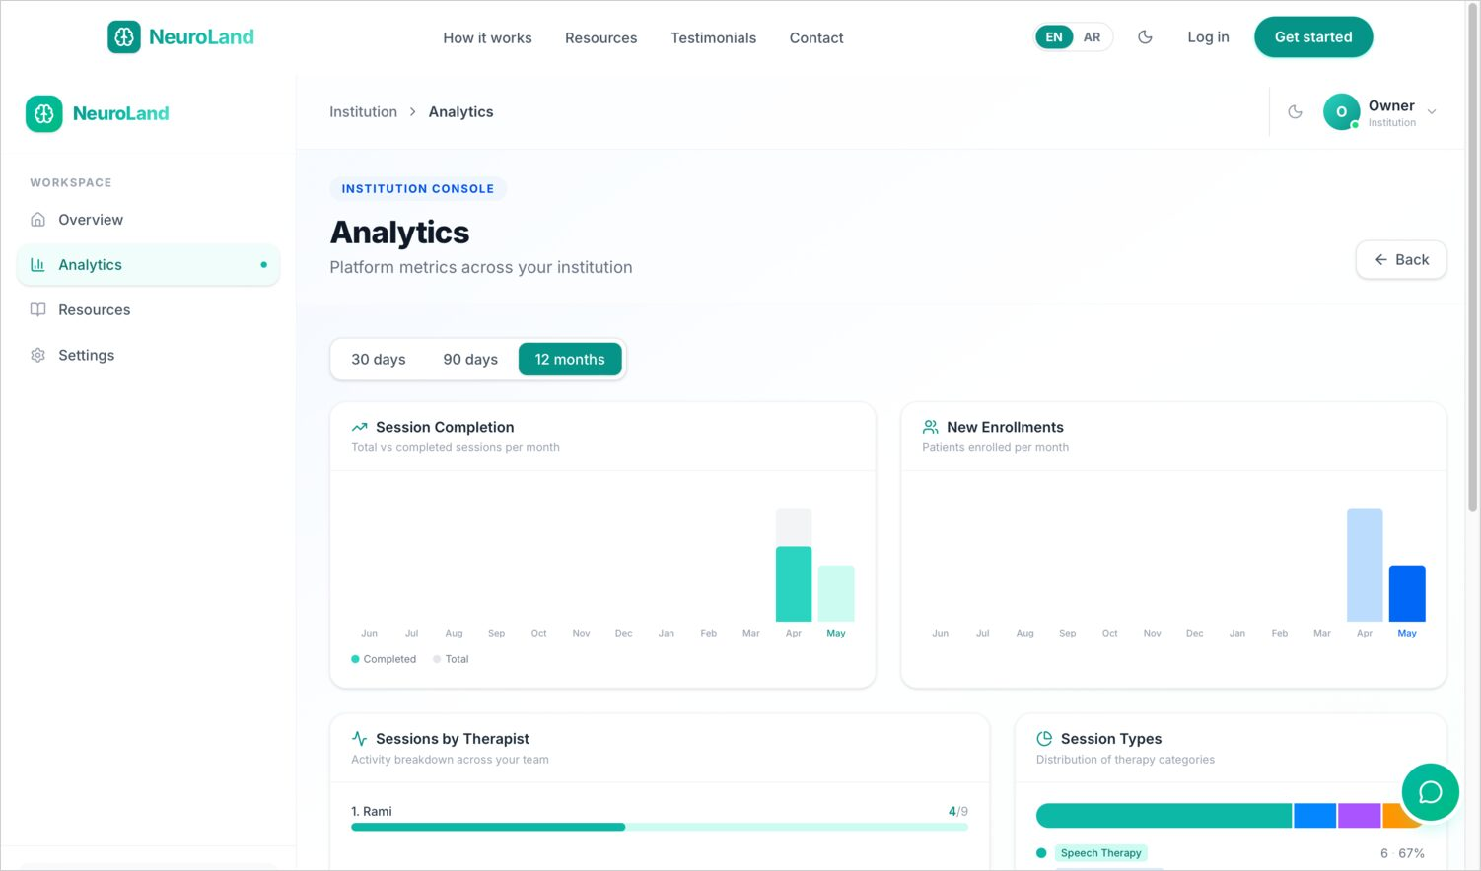
INSTITUTION · CARE
Matching patients to therapists & measuring it
Assign-therapist dialog
Analytics — completion, enrolments, session types
Assign care, then watch completion and enrolment trends.
29
Notes:
The institution assigns the right therapist to each patient, and an analytics view tracks session completion, new enrolments and session-type mix over time.

Slide 30
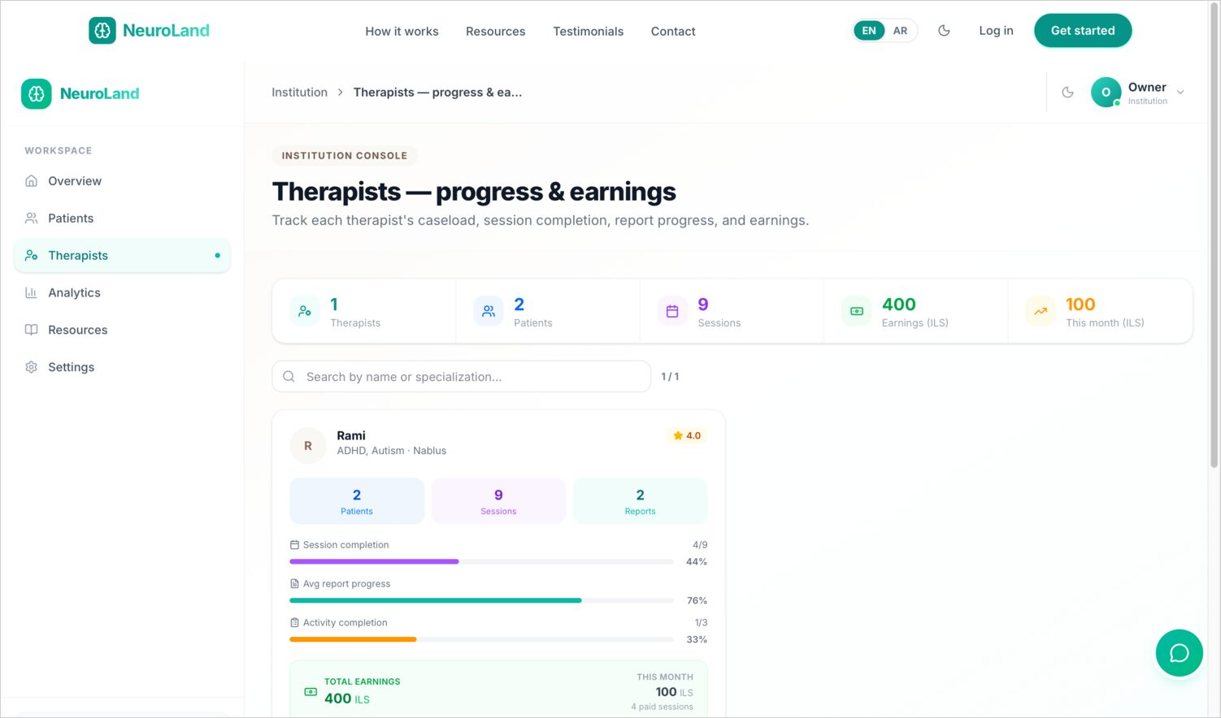
INSTITUTION · PEOPLE
Therapist progress & earnings
A people view that's about quality of care, not just headcount.
Per-therapist caseload and session completion
Report-writing progress
Earnings contribution per therapist
Spot who needs support — or recognition
30
Notes:
And a per-therapist view shows each therapist's caseload, session completion, report progress and earnings — helping the institution see who might need support and who deserves recognition.

Slide 31

WEB · ROLE 3
Therapist Workspace
Where care is delivered — sessions, reports, plans and activities.
Notes:
The therapist workspace is where care is actually delivered: managing patients, scheduling, writing reports, building treatment plans, and assigning activities.

Slide 32
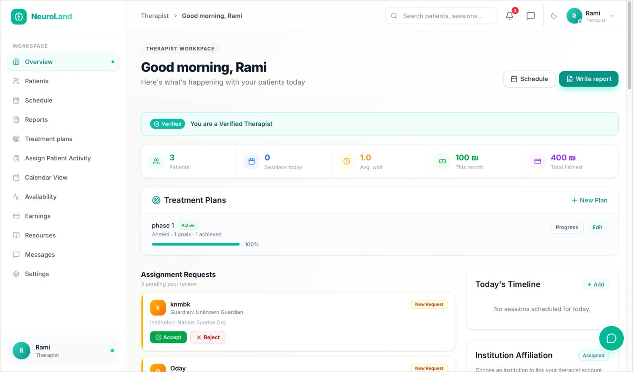
THERAPIST · HOME
The therapist's command center
Everything a therapist needs to start the day.
Verified badge and the day's timeline
Active treatment plans at a glance
Incoming assignment requests
Quick links into every workflow
32
Notes:
The dashboard is the therapist's command center: their verified badge, the day's timeline, active treatment plans, incoming assignment requests, and quick links into every workflow.

Slide 33
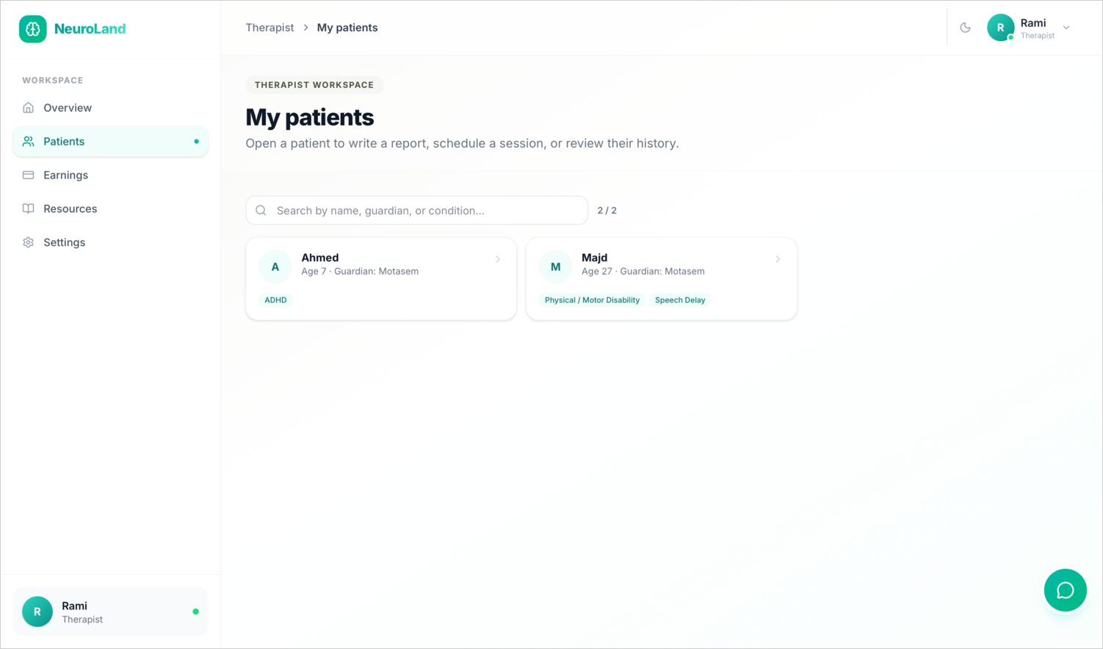
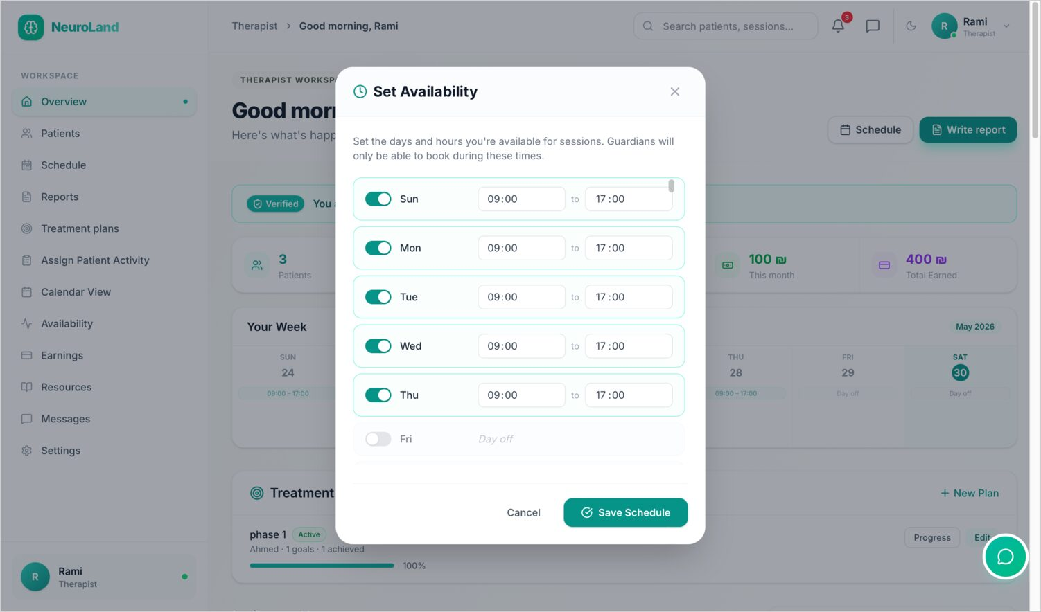
THERAPIST · PATIENTS & TIME
Assigned-patients list
Weekly availability editor
They manage their caseload and set the weekly hours guardians can book.
33
Notes:
They see their assigned patients, and set their weekly availability — defining exactly which hours guardians are able to book.

Slide 34
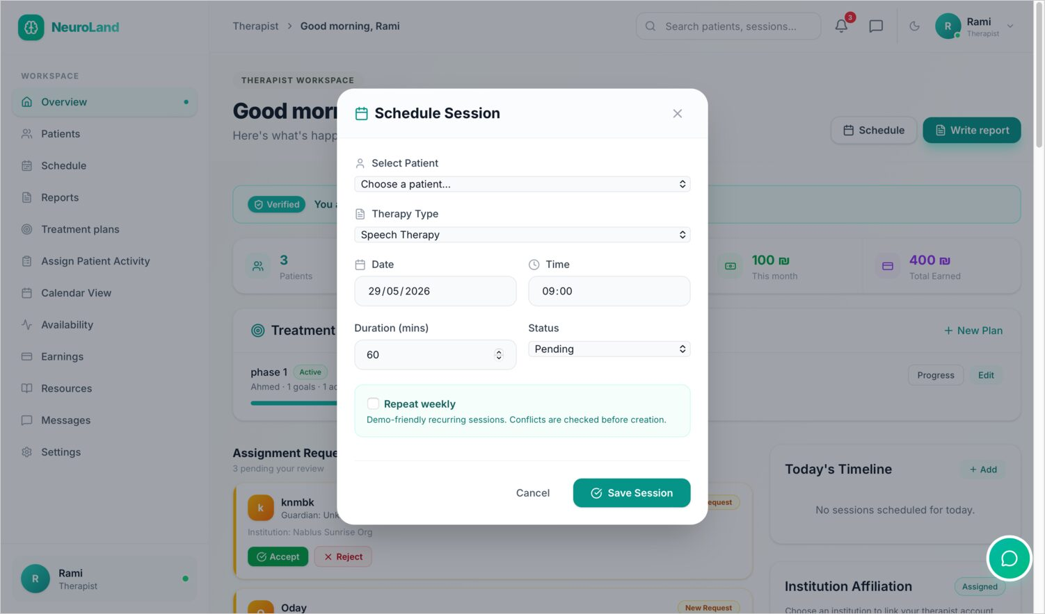
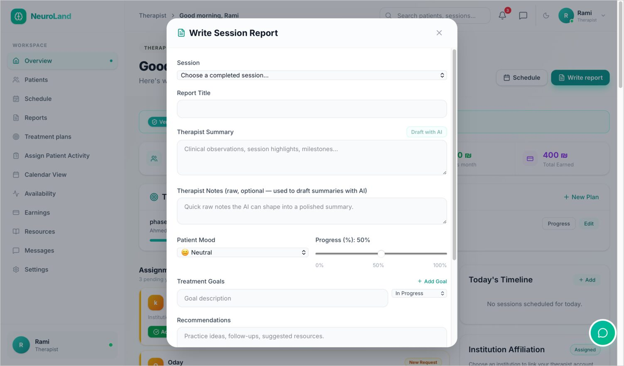
THERAPIST · SESSIONS
Scheduling and documenting a session
Schedule-session dialog
Write-session-report editor
After a session, the therapist writes a structured report.
34
Notes:
They can schedule sessions, and after each one, write a structured report in a rich editor.

Slide 35
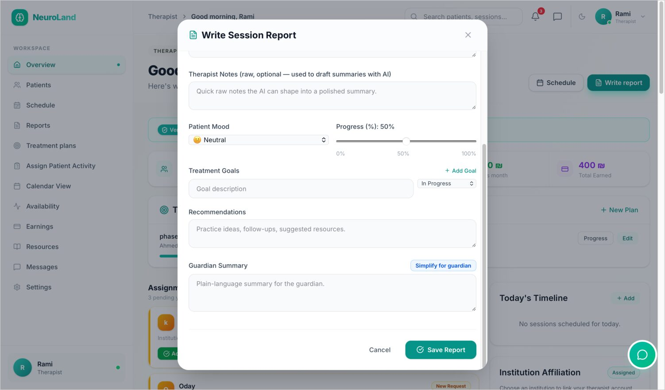
THERAPIST · AI
AI that drafts — never decides
A local AI model speeds documentation while staying safe.
Generates a session-report draft to edit
Rewrites clinical notes into a parent-friendly summary
Redacts personal data before the model sees it
Blocks diagnosis; flags crisis language; always 'review before use'
35
Notes:
A highlight is the AI assistance built into reports. It drafts the write-up and rewrites clinical notes into a parent-friendly summary the guardian will read. But it stays safe: personal data is redacted before anything reaches the locally-hosted model, diagnostic prompts are refused, crisis language is intercepted, and every output is marked 'review before use.' The AI drafts; the therapist decides.

Slide 36
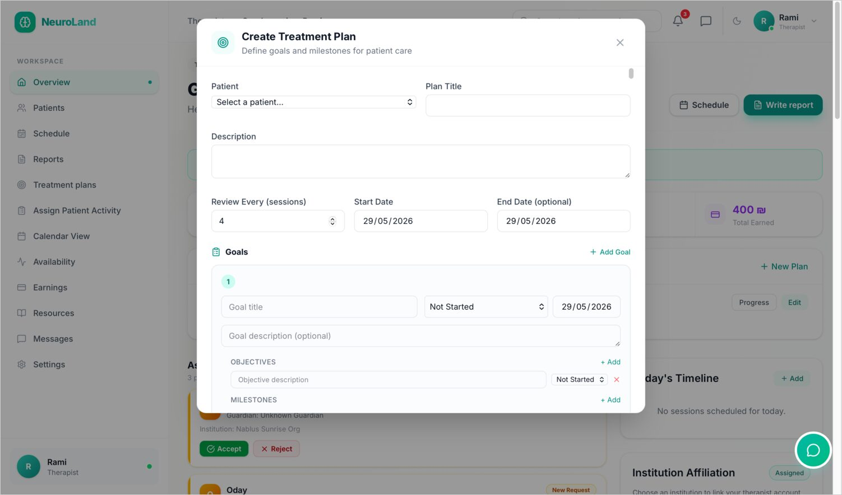

THERAPIST · PLANS & ACTIVITIES
Goals, and the homework between sessions
Create-treatment-plan dialog with goals & milestones
Assign-activity dialog with a guided template
Plans set measurable goals; activities become the child's tasks.
36
Notes:
Therapists build treatment plans made of goals, objectives and milestones, and assign therapeutic activities — often from a guided template — which become tasks in the child's own space between sessions.

Slide 37


THERAPIST · LIBRARY & HISTORY
Library of interactive activities
Weekly summary statistics
A reusable activity library, and a weekly snapshot of their own work.
37
Notes:
There's a library of interactive activities to draw from, and a weekly summary that lets therapists track their own throughput and progress.

Slide 38


THERAPIST · RECORD & INCOME
Past-sessions history with status & payment
Earnings dashboard & payment history
A full session history, and transparent earnings.
38
Notes:
They have a complete session history with status and payment state, and an earnings dashboard with transparent payment history.

Slide 39


THERAPIST · CONTRIBUTE & CONNECT
Educational-hub resource management
Assignment requests & institution affiliation
Therapists can publish resources and manage their affiliations.
39
Notes:
Therapists can also contribute to the educational hub by publishing resources, and manage incoming assignment requests and their institution affiliation.

Slide 40

THERAPIST · ACCOUNT
Staying verified
Verification is a living status, not a one-time gate.
Verification status front and center
A clear requirements checklist
Re-submit credentials if needed
Profile, privacy and notification settings
40
Notes:
Finally, their settings keep verification status front and center, with a checklist of requirements — so being verified is a living status they can maintain, not just a one-time hurdle.

Slide 41

WEB · ROLE 4
Guardian Portal
The family's window — discovery, booking, messaging and progress.
Notes:
The guardian portal is the family's window into care: discovering therapists, booking, messaging, and following each child's progress.

Slide 42

GUARDIAN · HOME
One calm view of the family's care
Everything a busy parent needs, without the clutter.
Upcoming sessions at a glance
Each dependent with quick status
Shortcuts to book, message and view reports
Notifications surfaced where they matter
42
Notes:
The guardian dashboard is one calm view of the family's care: upcoming sessions, each dependent's status, and shortcuts to book, message and read reports — designed for a busy parent.

Slide 43


GUARDIAN · STAY IN TOUCH
Notifications panel — sessions & care updates
In-app messaging with therapists
Live notifications and direct messaging keep families connected.
43
Notes:
Guardians stay connected through a live notifications panel and direct, logged messaging with their child's therapist.

Slide 44


GUARDIAN · DEPENDENTS
Adding a child — and personalising their space
Add-a-dependent: disabilities & conditions
Accessibility preferences & PIN setup
Each dependent gets their own conditions, preferences and login PIN.
44
Notes:
Adding a dependent captures their disabilities and conditions, and sets up their accessibility preferences and a personal PIN — so each child gets a space tuned to them.

Slide 45


GUARDIAN · BOOKING
Find the right therapist, then book
Directory with specialisation & location filters
Book-a-session dialog
Only verified therapists appear; booking is a few taps.
45
Notes:
To get care, guardians search a directory filtered by specialisation and location — showing only verified therapists — and book a session in a few clicks.

Slide 46


GUARDIAN · FOLLOW ALONG
The calendar and the reports
Session calendar for a dependent
Session report with a parent-friendly summary
Reports arrive with the AI-simplified summary parents can actually read.
46
Notes:
They follow along through a per-child calendar, and read session reports — complete with the AI-simplified, parent-friendly summary that makes clinical notes understandable.

Slide 47

GUARDIAN · PROGRESS
Progress Intelligence — the whole story
The feature we're proudest of for families.
Rolls up goal progress and activity completion
Tracks session consistency and report trends
Suggests a sensible next step
One coherent picture across many visits
47
Notes:
The feature we're proudest of for families is Progress Intelligence. For each child it rolls up goal progress, activity completion, session consistency and report trends into one coherent picture — and even suggests a next step — instead of leaving a parent to piece together a dozen scattered visits.

Slide 48


GUARDIAN · MANAGE
Dependent detail — case & report history
Dependent profile with change & deletion requests
Full per-child detail, with controlled change requests.
48
Notes:
Each dependent has a detailed profile with case description and report history, and guardians can submit controlled change or deletion requests — which, you'll recall, the admin reviews.

Slide 49


GUARDIAN · HISTORY & START
Recent sessions across all therapists
Treatment-plan & sessions empty state
A unified history, and a friendly starting point for new dependents.
49
Notes:
There's a unified history across all the family's therapists, and thoughtful empty states that guide a guardian when a dependent is brand new.

Slide 50


GUARDIAN · ACCOUNT
Personal information settings
Change-password screen
Standard, secure account management.
50
Notes:
Account management is standard and secure — personal information and password changes.

Slide 51

GUARDIAN · NOTIFICATIONS
Informed, on their terms
Families decide how much they hear from the platform.
Toggle session reminders
Control care-update alerts
Opt into the weekly digest
Choose channels that suit the family
51
Notes:
And guardians control how they're notified — toggling session reminders, care updates and the weekly digest — so families stay informed on their own terms.

Slide 52

WEB · ROLE 5
The Child's Own Space
A simplified, PIN-based interface a child can use alone.
Notes:
The fifth experience is the one we care most about: the child's own space. It's a simplified, PIN-based interface designed so a child can use it independently.

Slide 53

PATIENT · HOME
Designed for a child, not a clinician
Accessibility moves from a setting to the whole design.
PIN login — no email required
Large, friendly, low-clutter layout
Adjustable font, high contrast, text-to-speech
Nothing punishes a wrong tap
53
Notes:
The patient home is designed for a child, not a clinician. They log in with a PIN — no email needed — into a large, friendly, low-clutter layout, with font scaling, high contrast and text-to-speech, and an interface that never punishes a wrong tap.

Slide 54


PATIENT · THEIR DAY
Assigned activities for the child to complete
Past visits and notes from the therapist
The child sees their tasks and a gentle history of visits.
54
Notes:
The child sees the activities assigned to them, and a gentle history of past visits with their therapist.

Slide 55


PATIENT · IN PLAIN WORDS
Doctor's notes rewritten in child-friendly language
Fun Zone — therapeutic games
Notes are rewritten for the child; therapy becomes play.
55
Notes:
Notes from the doctor are rewritten in plain, child-friendly language, and the Fun Zone turns therapeutic work into games.

Slide 56


PATIENT · FUN ZONE
Learning songs
Social-story books
Songs and social stories round out an engaging, supportive space.
56
Notes:
The Fun Zone also includes learning songs and social-story books — rounding out an engaging, supportive space that the child actually wants to open.

Slide 57

MOBILE
PART TWO
The Mobile App
Built with Expo & React Native — the same platform, in your pocket.
Notes:
Part two: the mobile app, built with Expo and React Native. It talks to the exact same backend, authentication, roles and real-time channel as the web — the whole platform, in your pocket.

Slide 58





MOBILE · ONBOARDING
Sign up and sign in on mobile
Login
Role · Guardian
Role · Therapist
Therapist details
Email verification
The same role-based sign-up, with a six-digit email verification step.
58
Notes:
Onboarding on mobile mirrors the web: sign in, choose a role, fill role-specific details, and confirm a six-digit email code.

Slide 59





MOBILE · GUARDIAN
Dependents and booking
Dashboard
Dependents
Dependent detail
Find a therapist
Book a session
Guardians manage dependents, search verified therapists, and book — all from the phone.
59
Notes:
On mobile, guardians get their dashboard, their list of dependents and each child's detail, and can search for a verified therapist and book a session entirely from the phone.

Slide 60




MOBILE · GUARDIAN
Opening the child's space
Enter PIN
Patient home
Care progress
Quick access
A guardian hands the phone over; the child's PIN opens their simplified space.
60
Notes:
A guardian can hand the phone to their child, who enters their PIN to open the same simplified patient space — home, care progress, and quick access to activities and wellness.

Slide 61



MOBILE · GUARDIAN
The Wellness Hub
Breathing
Mindfulness
Dark mode
Guided breathing and mindfulness exercises — including a calming dark mode.
61
Notes:
The Wellness Hub offers guided breathing and mindfulness exercises, including a calming dark mode — supportive content available any time, not just during sessions.

Slide 62





MOBILE · GUARDIAN
Sessions and payments
Past sessions
Payment
History
Rate session
Upcoming
Pay for sessions, review history, rate experiences, and manage upcoming visits.
62
Notes:
Guardians handle the money and logistics on mobile too: paying for sessions, reviewing history, rating a completed session, and managing upcoming visits with cancel and pay actions.

Slide 63





MOBILE · GUARDIAN
Care records on the go
Add dependent
Assign therapist
Therapists
Reports
Report detail
Adding dependents, assigning therapists, and reading parent-friendly reports.
63
Notes:
They can add a dependent, assign a therapist, see their assigned therapists, and read reports — again with the parent-friendly summary — all on the go.

Slide 64



MOBILE · GUARDIAN
Resources, chat and alerts
Resources
Chat
Notifications
The educational hub, real-time chat, and a live notifications feed.
64
Notes:
And they have the educational resources hub, real-time chat with therapists, and a live notifications feed of reminders and confirmations.

Slide 65





MOBILE · THERAPIST
Patients and progress
Dashboard
Patients
Patient detail
Progress
Sessions
Therapists carry their caseload, patient detail with AI insight, and progress with them.
65
Notes:
Therapists get a full workspace on mobile: their dashboard, patient list, patient detail with Progress Intelligence and AI insight, and today's and upcoming sessions.

Slide 66





MOBILE · THERAPIST
Sessions, reports and activities
Session report
Schedule
Write · AI draft
Progress & goals
Assign activity
The same AI-assisted reporting and treatment workflow, sized for a phone.
66
Notes:
The core clinical workflow comes along: reading reports, scheduling, writing a report with the same AI draft and parent-friendly simplification, setting progress and goals, and assigning activities.

Slide 67



MOBILE · THERAPIST
Availability, requests and verification
Availability
Requests
Verification
Therapists set hours, handle assignment requests, and track their verification.
67
Notes:
They set their weekly availability, accept or reject assignment requests, and track their verification status — the mobile equivalent of the web settings.

Slide 68



MOBILE · THERAPIST
Messaging
Notifications
Messages
Chat
Notifications and real-time chat keep therapists responsive between sessions.
68
Notes:
Notifications and a real-time chat — a conversation list and the live thread — keep therapists responsive to guardians between sessions.

Slide 69





MOBILE · INSTITUTION
The institution, mobile
Dashboard
Team
Enrolments
Today
Resources
Institution leads monitor staff, enrolments, schedule and resources on the move.
69
Notes:
Institution leads can monitor their staff, enrolments, schedule and resources from mobile — useful for someone moving between rooms or sites.

Slide 70


MOBILE · INSTITUTION
Approvals and schedule
Notifications
Today's sessions
Enrolment-approval requests and the day's confirmed sessions, in hand.
70
Notes:
And they act on enrolment-approval requests and see the day's confirmed sessions right in hand. That completes the mobile tour across all the roles.

Slide 71




WRAPPING UP
Constraints & scope
Not a medical device
Trust before action
The platform never diagnoses or prescribes — every AI feature sits behind a safety layer that redacts data and blocks diagnostic prompts.
A therapist can take no action until an admin verifies their credentials — enforced server-side, route guards, and the client UI.
Multi-platform parity
Bilingual & accessible
Web and mobile must behave identically on one shared API and one set of role rules, so logic lives on the server, not the clients.
Full Arabic / English right-to-left and a child-usable, PIN-based interface were hard requirements, not optional extras.
Deliberate scope: payments ship as a working mock, credential files use local storage, and a few admin tools stay web-only — each with a clear path to production.
71
Notes:
To wrap up, a word on the constraints that shaped the build. First, NeuroLand is deliberately not a medical device — it never diagnoses or prescribes, and every AI feature sits behind a safety layer. Second, trust comes before action: no therapist can do anything until an admin verifies them, enforced at three layers. Third, the web and mobile apps had to behave identically, so all role logic lives on the server and the clients stay thin. And fourth, full Arabic-English right-to-left and a child-usable interface were hard requirements. We also made deliberate scope choices — payments are a working mock, credential files use local storage, and a few admin tools are web-only — each with a clear path to production.

Slide 72





WRAPPING UP
Future work
Activate real payments
Object storage for credentials
live settlement, refunds & receipts
signed, private download URLs
Outcome-aware recommender
Two-factor authentication
learn from feedback & completion
for therapists & administrators
Admin tooling on mobile
One-tap record export
verification queue & analytics on the go
a consolidated PDF per dependent
None of these require rethinking the architecture — they build naturally on the foundations already in place.
72
Notes:
Looking ahead, the roadmap is clear. We'd activate a real payment provider with live settlement, refunds and receipts. Move credential storage to private object storage with signed URLs. Extend the therapist recommender so it learns from outcomes like feedback and completion rate. Add two-factor authentication for therapists and admins. Bring the admin verification queue and analytics to mobile. And let a guardian export a dependent's full record as a single PDF, reusing the report builder we already have. Importantly, none of these require rethinking the architecture — they build naturally on the foundations already in place.

Slide 73



WRAPPING UP
Tools & technologies
Frontend (Web)
Mobile
Backend
Intelligence & media
React 19 + Vite 7
Tailwind CSS v4
React Router 7
TanStack Query 5
Expo 54
React Native 0.81
React Navigation 7
Expo Notifications
Node.js + Express 5
Mongoose 9 / MongoDB
Socket.io 4
JWT · bcrypt · Helmet
Ollama (local LLM)
WebRTC + Zoom
Nodemailer + cron
Expo Push
A MERN-family stack extended to mobile with React Native and to intelligence with a self-hosted model — mostly open-source.
73
Notes:
A quick word on what it's built with. The stack is a MERN-family application extended to mobile and to AI. On the web: React 19 with Vite, Tailwind v4, React Router and TanStack Query. On mobile: Expo and React Native with React Navigation and push notifications. The backend is Node with Express 5, Mongoose over MongoDB, Socket.io for real-time, and the security trio of JWT, bcrypt and Helmet. And for intelligence and media we self-host language models with Ollama, use WebRTC with a Zoom fallback for video, Nodemailer with cron for email, and Expo's push service. A deliberate choice throughout was to favour free, open-source components — and to run the AI locally, which keeps sensitive notes private.

Slide 74

WRAPPING UP
Conclusion
NeuroLand turns a fragmented therapy journey into one connected, trustworthy, inclusive system — delivered end-to-end across web and mobile.
Trusted
Connected
Real-time
Inclusive
verified therapists only
one linked care record
live across both apps
child-ready & bilingual
Verification and audit were built as foundations — not afterthoughts — and a child can use the product without an email account. The four pillars promised at the start were each realised, on one shared API.
74
Notes:
In conclusion: NeuroLand takes a fragmented therapy journey and turns it into one connected, trustworthy and inclusive system, delivered end-to-end across web and mobile. Trusted, because only verified therapists are listed and can act. Connected, because every record links into a single care chain and progress view. Real-time, because collaboration works live on both apps. And inclusive, because a child can genuinely use it, with full bilingual support. The decision that shaped everything was to treat verification and audit as foundations rather than afterthoughts — and the four pillars we promised at the very beginning were each realised, on one shared API.

Slide 75
One platform, every screen
Web and mobile · five roles · one connected, trustworthy, inclusive care record.
Thank you — questions welcome
Almotasembellah Yaser Jararaa & Siwar Diab · Supervisor: Dr. Ashraf Armoush
Notes:
That's the full tour — every screen of NeuroLand, across web and mobile, for all five roles, all backed by one connected, trustworthy and inclusive care record. Thank you; I'd be glad to take your questions or demo any flow live.

