Slide 1
Design of water distribution network for Silwan village
By
Ahmad Amen Abassi
&
Mohammed Abd Al-Aziz
&
Mohammed Al-Akhras
Under supervision of
Dr. Hafez Shahen

Slide 2
Introduction
Objectives
Outline
Study
Area
Methodology
Design Results

Slide 3
INTRODUCTION
Importance of water distribution networks
Significance of the work
Notes:
Water is the most important component in the human life which forms 70% of human body.
An important element like water should be available in high level of accessibility, safe, clean, and in adequate quantity
Because of this, Water distribution networks are used to transmit water from the resources to the consumptions. It decreases the effort, time, cost and make the life easier

Slide 4
Objectives
Design water distribution network
Notes:
The main aim of this project is to design a water distribution network capable in providing the population with sufficient quantities of water in accordance with local and international standards

Slide 5

Study Area

Slide 6
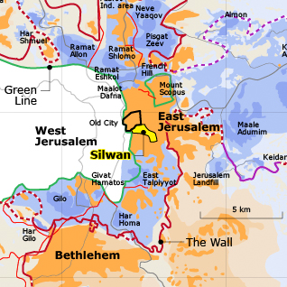
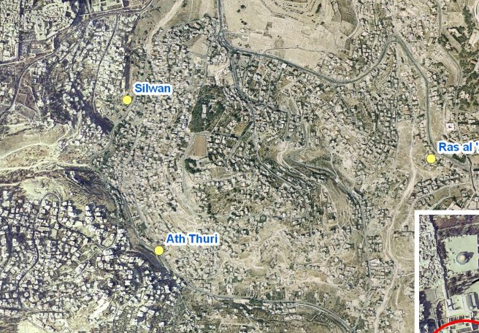
Location
Population
Area
Notes:
Silwan is a Palestinian township located in occupied East Jerusalem. It is just below the southern wall of the Old City near Al
Aqsa Mosque
The population is 45000 capita as PCBS
The area is 5640 donoums

Slide 7
Methodology
Master plan
Population
Maps Analysis
Collecting Data
AutoCAD & GIS
demand
Pipes & node
Result
Water CAD
velocity
Pressure
Design WDN
Contour map
Road network
Building distribution
Reervoirs
Notes:
The methodology that followed in this project, first we collect the needed data, we get the master plan from a surveyor and the population from PBCS, then by using AutoCAD and GIS softwares we extract the countor map, road network and building distribution from the master plan. After this we transferred these maps to watercad to design WDN and we have results on velocities and pressures

Slide 8
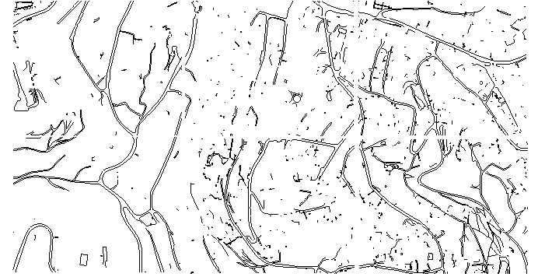
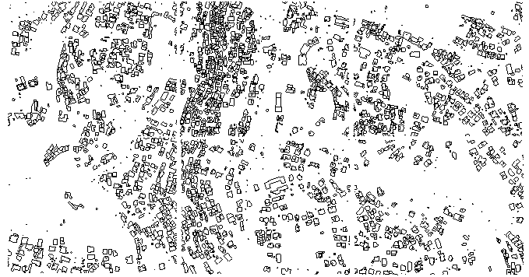
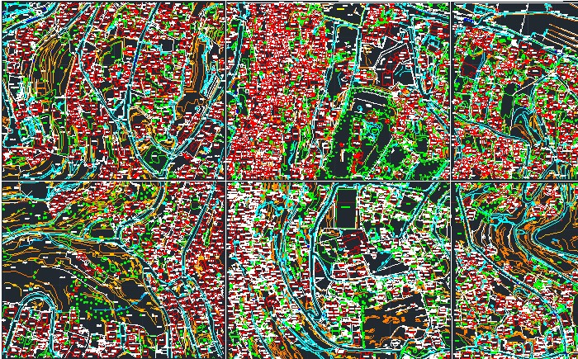
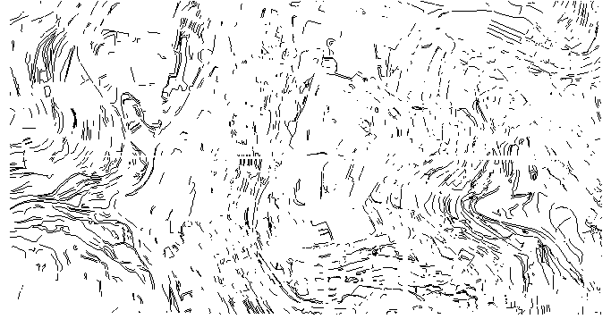
Notes:
Here, we have master plan and we extract the road network, building distribution and countor map.

Slide 9
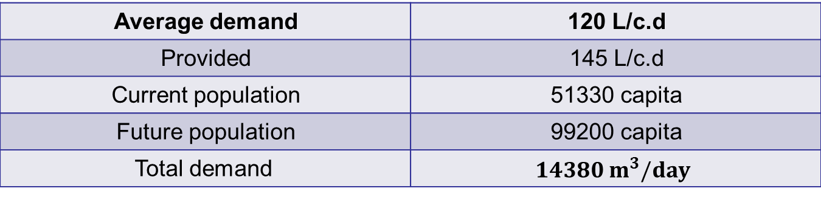
Demand Calculations
120 L/c.d | Average demand
145 L/c.d | Provided
51330 capita | Current population
99200 capita | Future population
$$14380 m^{3}/day$$ | Total demand
Notes:
According to WHO the average demand is …… and we assume that the losses in network is .20 thus we must to provide 145
And according to PBCS the population in 2007 was….. And growth factor is 1.9 thus the current population is …… and consider design period of 35 years the future population is ….. And the future demand is ….

Slide 10
Design Criterias
Pressure
Max: 100 m H2O
Min : 25 m H2O
Velocity:
Max: 2 m/s
Min: 0.2 m/s

Slide 11
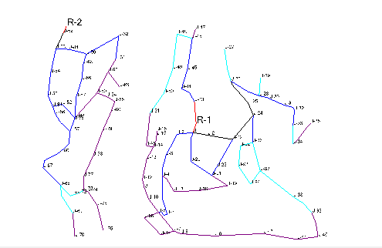
Design Results
Layout of the proposed distribution network

Slide 12
Pipe diameter ( inch) | Length (km)
2 | 2.90
4 | 1.50
6 | 2.80
8 | 0.40
10 | 0.15
Total | 7.80

Slide 13
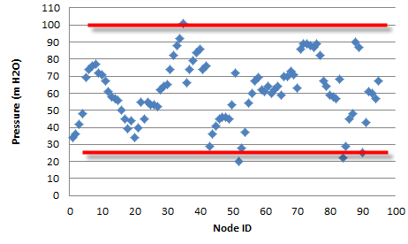
Pressure at nodes

Slide 14
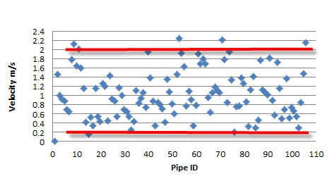
Velocities in Pipes

Slide 15
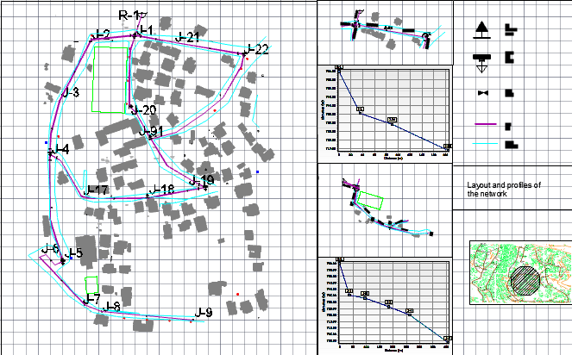
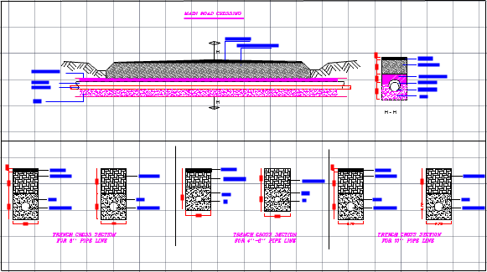
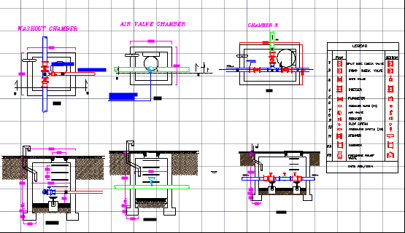
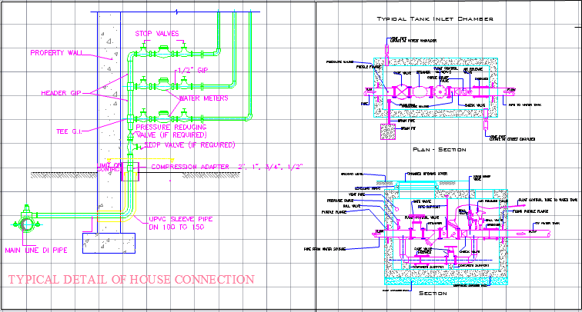
Details

Slide 16
Conclusion

Slide 17
THANK YOU

