Slide 1
CNC drawing simulator
Students : Nadia Zaid
Farah Al-Sa’di
Super visor : Dr. Adnan Al-Salman

Slide 2
Introduction
We believe that technology exist to make our life much easier and comfort .
Each sector or work in our life has a technological solution to make it better , precise, quick and easy for human .
Our project idea came to simulate the role of computer ‘in drawing on wood’ sector .

Slide 3
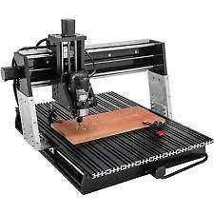
What is CNC?!
CNC -> Computer numerical control.
CNC is the automation of machine tools by means of computers executing pre-programmed sequences of machine control commands. This is in contrast to machines that are manually controlled by hand wheels or levers, or mechanically
automated by cams alone.

Slide 4
Our CNC
Our Project is for making a simulation for how computer can control the machine of drawing on wood which is our CNC machine here.
Making drawings on wood is too much timing consuming and needs a big effort and time when it done by hand, and there is a great possibility of error while drawing especially when we need to repeat the process many times.

Slide 5
G-Code
is the common name for the most widely used numerical control (NC) programming language. It is used mainly in computer-aided manufacturing to control automated machine tools.
G-code is a language in which people tell computerized machine tools how to make something. The "how" is defined by g-code instructions provided to a machine controller (industrial computer) that tells the motors where to move, how fast to move, and what path to follow.
So we used G-Code in our project to control our CNC machine .

Slide 6
A Simplified explanation of G-Code
G-codes are any word in a CNC program that begins with the letter G.
Generally it is a code telling the machine tool what type of action to perform, such as:
Rapid movement.
Controlled feed in a straight line or arc.
Set tool information such as offset.
Switch coordinate systems.

Slide 7
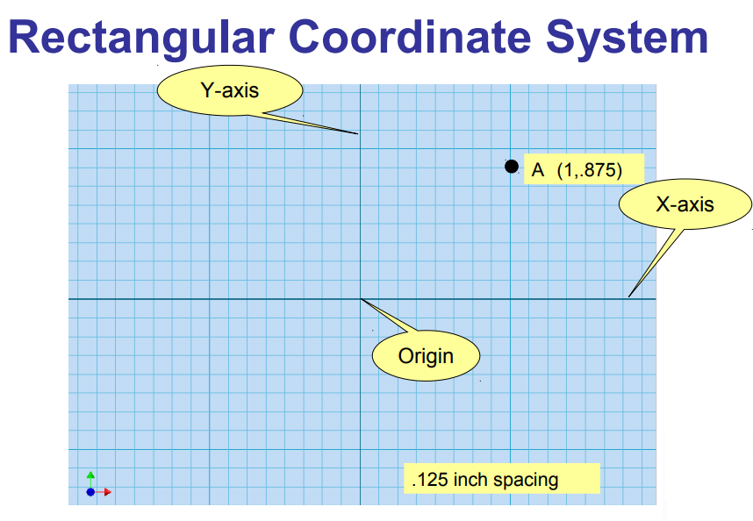

Slide 8
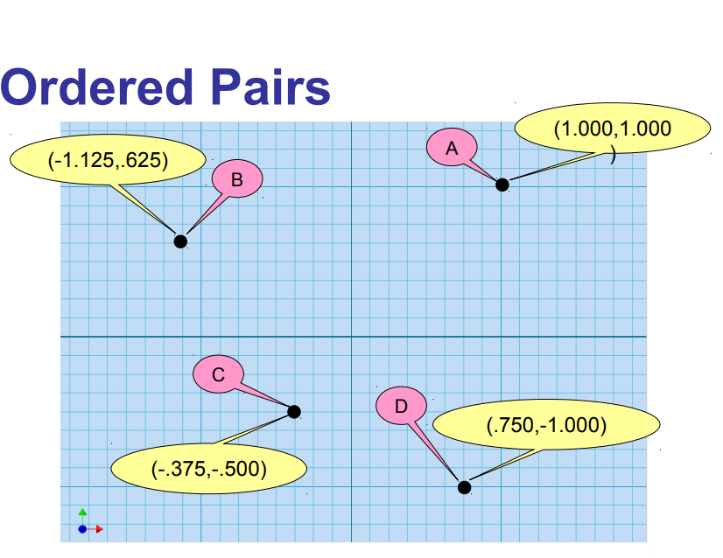

Slide 9
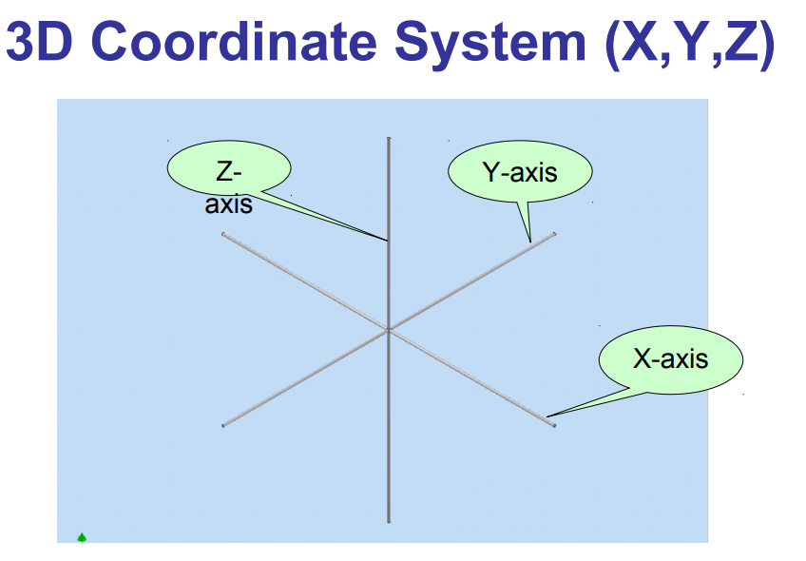

Slide 10
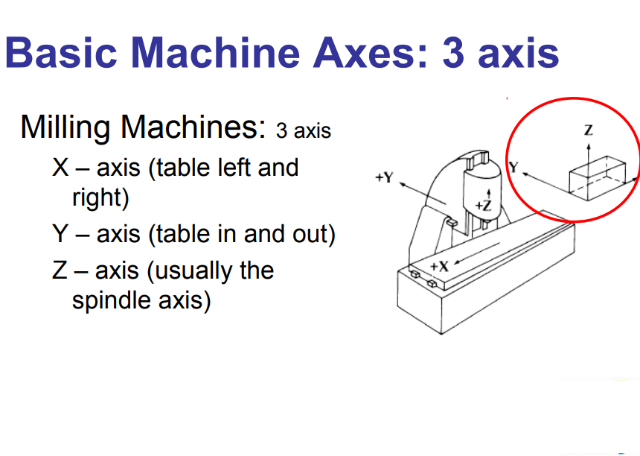

Slide 11
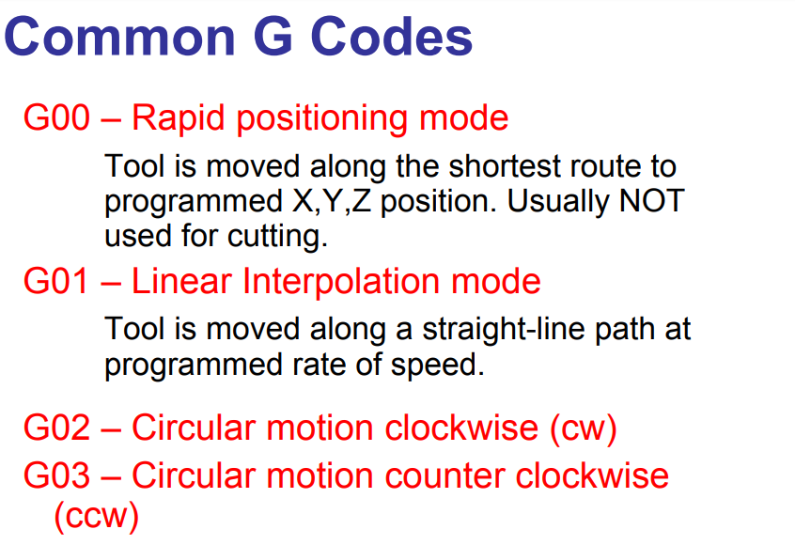

Slide 12
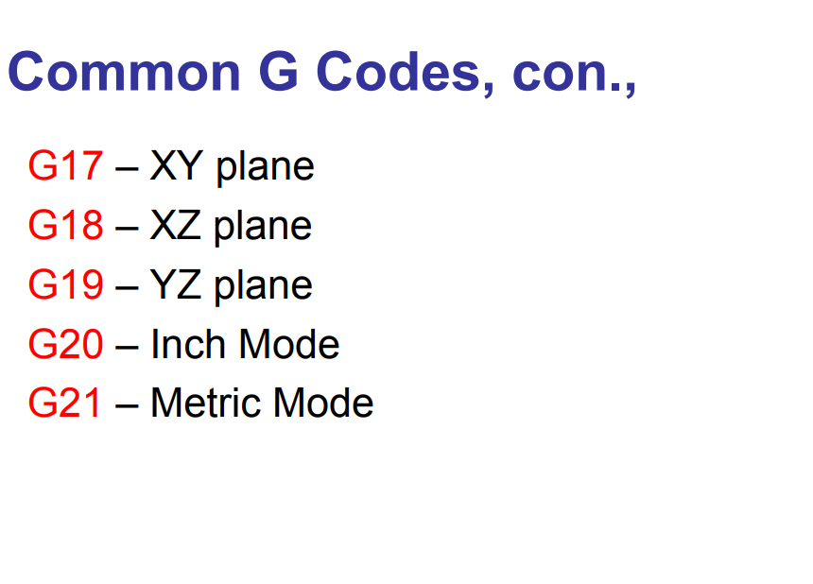

Slide 13
G0 Rapid Move
Format G0XxYyZz X,Y,Z = axes on a three-axis machine x, y, z = distance in incremental units, or absolute coordinates, to which the axes specified by the preceding upper case letter is designated to move
Example: G0X2.00Y2.00Z2.00

Slide 14
G1 Linear Cutting Move
Format G1XxYyZz X,Y,Z = axes on a three-axis machine x, y, z = distance in incremental units, or absolute coordinates, to which the axes specified by the preceding upper case letter is designated to move
Example: G1X-3.50Y-4.00Z1.00

Slide 15
G2 Clockwise Arc
G2XxYyIiJi or G2XxZzIiKi or G2YyZzJiKi
I = X axis, when used to designate a center point position J = Y axis, when used to designate a center point position K = Z axis, when used to designate a center point position i = an incremental value representing the distance in units that the axis specified by the preceding letter is designated to move.
Example: G2X5.00Y-1.00I3.00J2.00

Slide 16
G3 Counterclockwise Arc
Format G3XxYyIiJi or G3XxZzIiKi or G3YyZzJiK
Example: G3Y9.00Z15.00J3.00K6.00

Slide 17

Our Simulator
We tried to use an open source simulator-> “CNC-SIMULATOR”.
the simulator is a solution
to CNC programming because of its ability to automate the design and generate accurate g-code programs in the machining process, which has increased manufacturing efficiency and reduced production cycle times from concept to finished part.

Slide 18

Example for use CNC simulator Program

Slide 19
Our CNC Printer
The basic idea for the design of mini CNC machine can be understand from the work which deals with the development of a prototype CNC machine, controlled by a PC interfaced with low cost embedded microcontroller, we used:
Arduino program: its used for programming microcontroller (its used for one time).
Processing program: its used for upload G-code to microcontroller (it used for each new print job)

Slide 20
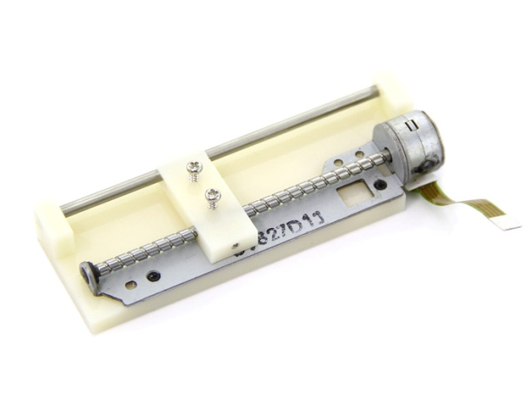
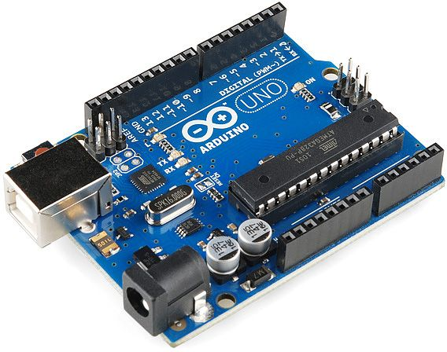
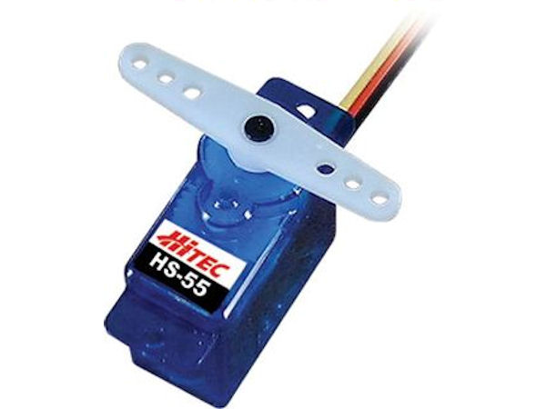
Hardware
While printing or drawing, the proper synchronization of all the three axes through stepper motors and servo motor is most exigent task. These movements can be achieved through the G Code.
Servo Motor : is used for the movement of sketching pen in
up and down in z direction.
Tow Stepper Motor (used for the movement in X & Y axis )
Arduino kit. (controller for all hardware devises)

Slide 21
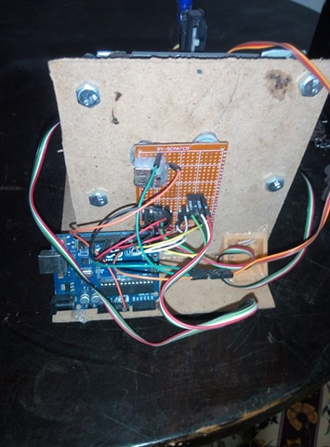
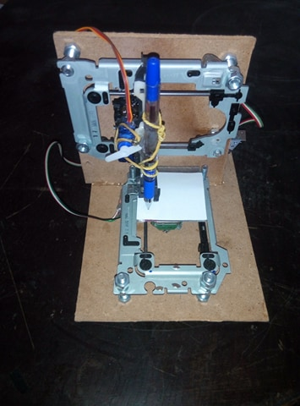
CNC Printer Structure
Note: final work table for our CNC 3x3 cm

