Slide 1
Mechatronics Department
Graduation Project II

Slide 2
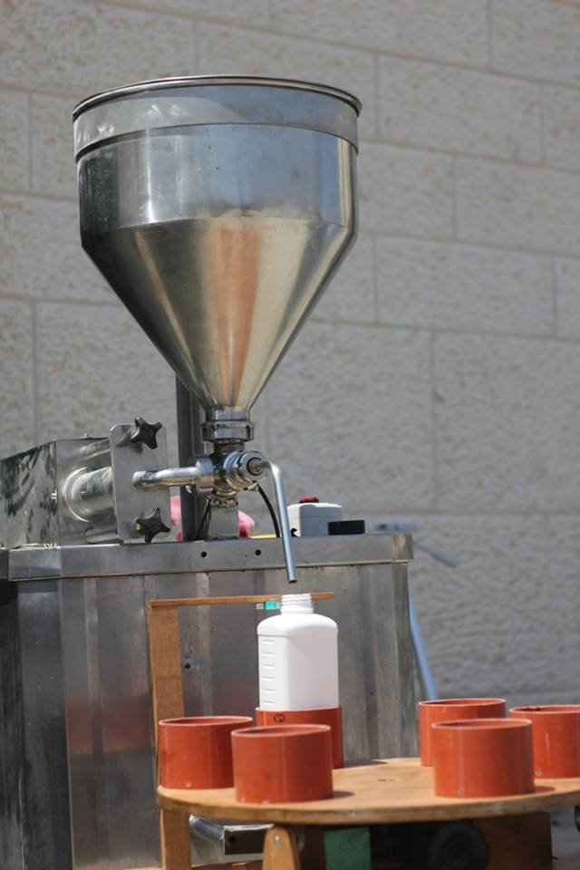
Fluid Filling Machine
Made by:
Mahmoud I. Anbousi
Jamil G. Dwaikat
Dalia Abu-Baker
Ashar Ihbaisha
Supervisor:
Dr. Nidal Farahat

Slide 3

Outline
Introduction.
Mechanical Design.
Control Design.
Methodology.

Slide 4
Introduction
The aim of this project is to make a machine that will help the operation of fluid filling that are packed today by hand, such as some jams, jell, yoghurt and cream.

Slide 5
Introduction
The aim of this project is to make a machine that will help the operation of fluid filling that are packed today by hand, such as some jams, jell, yoghurt and cream.
Why it is important
With liquid filling machines, fluids can be easily packed into containers.
When this process is done manually, there will be a liquid waste due to spillage.
Using of filling machines in order to enhance the efficiency of the processes while reducing the time required for packaging of the products.

Slide 6
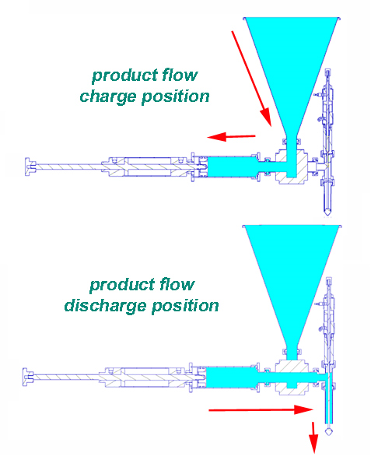
Methodology
Using a piston-pump system, that can perform a suction operation from the machine container full of the desired fluid to be discharged in smaller containers with the desired volume.

Slide 7
Methodology
Why piston pump technology was used?
The volume needed to be filled determined by the chamber diameter and the stroke length of the piston.
Filling is very consistent and insensitive to changes in material viscosity “decrease the speed of the filling when the fluid viscosity increase”.

Slide 8
Mechanical Design
Mechanical Parts
Compressor
Double acting double rod cylinder
Index table
pneumatic Valve
Nozzle and Cone

Slide 9
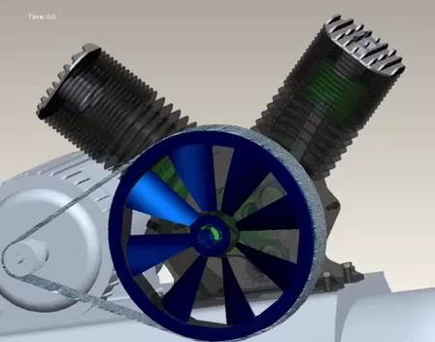
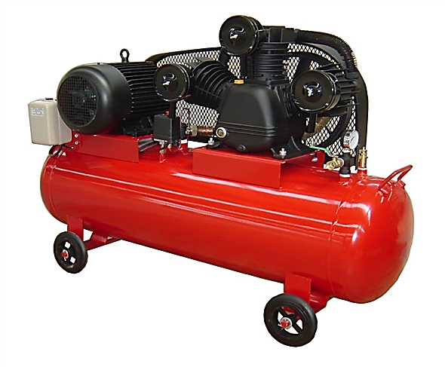
Compressor
An air compressor is a mechanical
device that increases the pressure
of an air by reducing its volume.
For running different air tools,
the best air compressor is need to use
to suite the machine needs.
It is important to know how much PSI
the machine needs, usually it is good
if its value is around 4-6 bars.

Slide 10
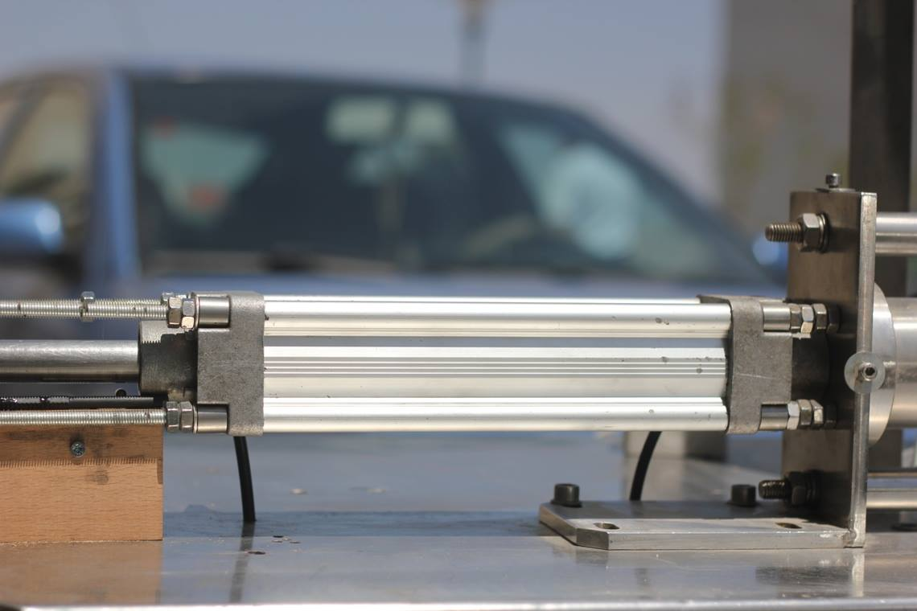
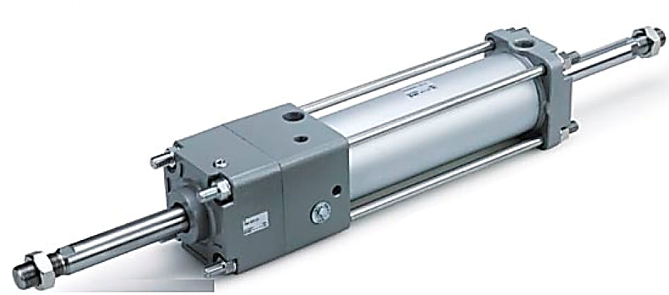
Double Acting Double Rod Cylinder
It is a mechanical device, which use the power of compressed gas to produce a force to cause a linear motion.
Because the operating fluid is an air, any leakage from a pneumatic cylinder will not contaminate the surroundings, making pneumatics more desirable and safe in a condition which cleanliness is a requirement.

Slide 11
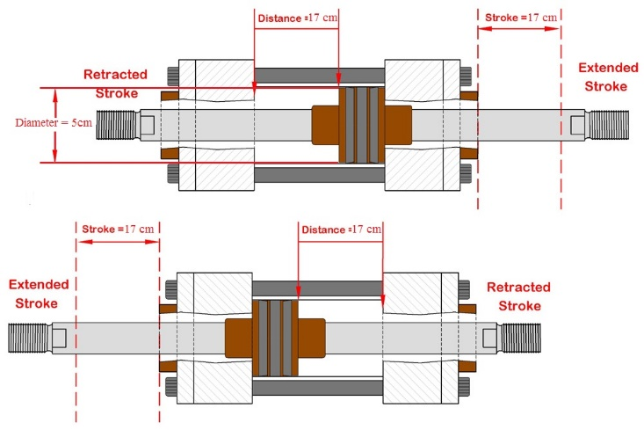
Double Acting Double Rod Cylinder
The double-acting double rod cylinder have two ports to allow air in, one for outstroke and one for in stroke.
The stroke length is 17 cm and the piston diameter is 5 cm.

Slide 12
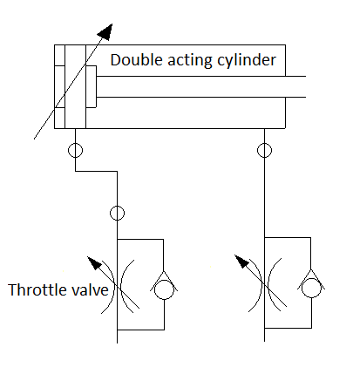
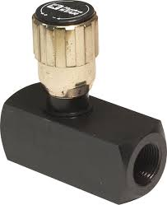
Double Acting Double Rod Cylinder
A pneumatic throttle valves are used to connect between the directional control valve and the double acting cylinder to control the speed of the piston for charging and discharging operation.

Slide 13
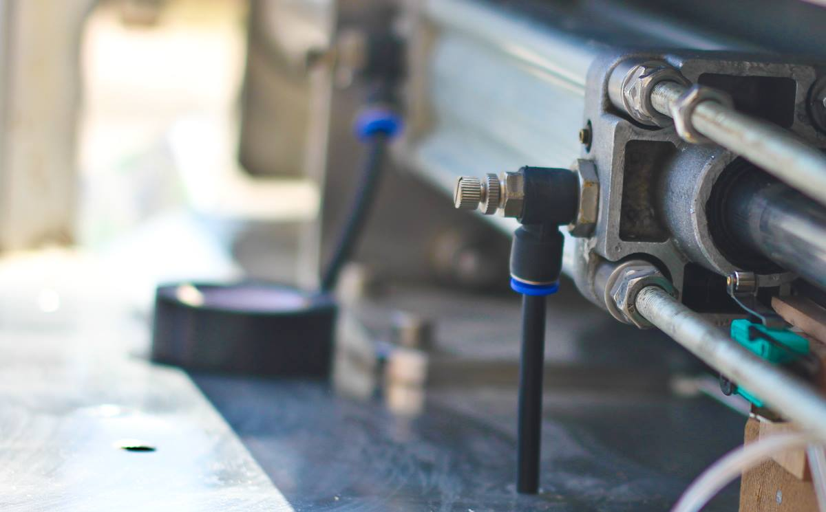
Double Acting Double Rod Cylinder
A pneumatic throttle valves are used to connect between the directional control valve and the double acting cylinder to control the speed of the piston for charging and discharging operation.

Slide 14
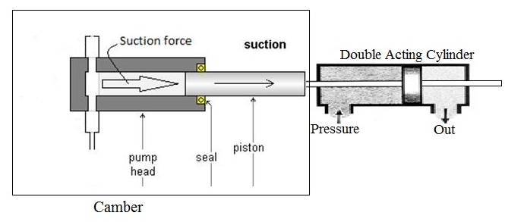
Chamber
It is a storage cylinder used as an empty chamber which will contain the sucked fluid from the cone while charge “retract” operation, and then drain the fluid through the nozzle while discharge operation.

Slide 15
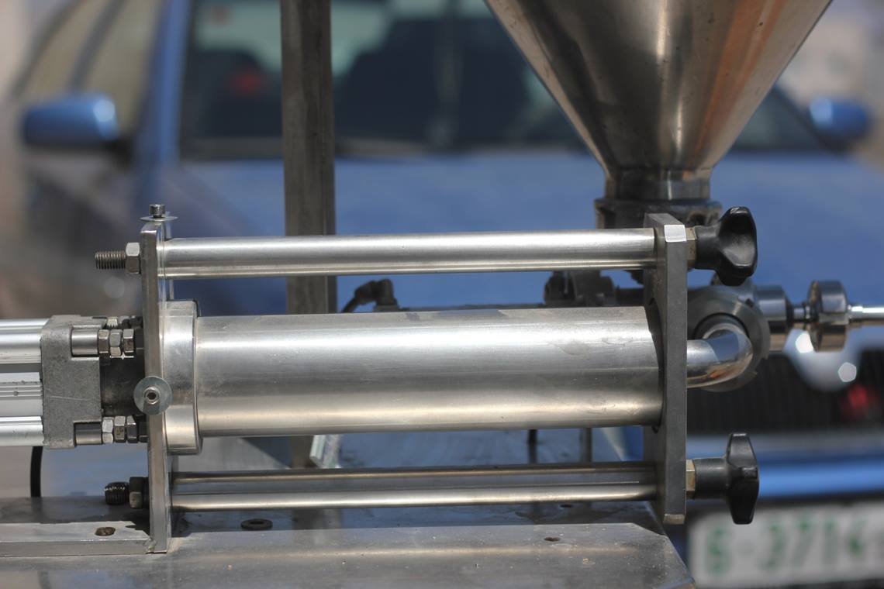
Chamber

Slide 16
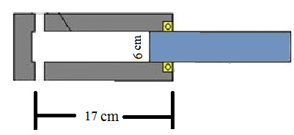
Chamber
Stroke length for the piston is 17 cm, so the chamber length is 17 cm with an inside diameter of 6 cm to get a maximum filling volume of 500 ml.

Slide 17
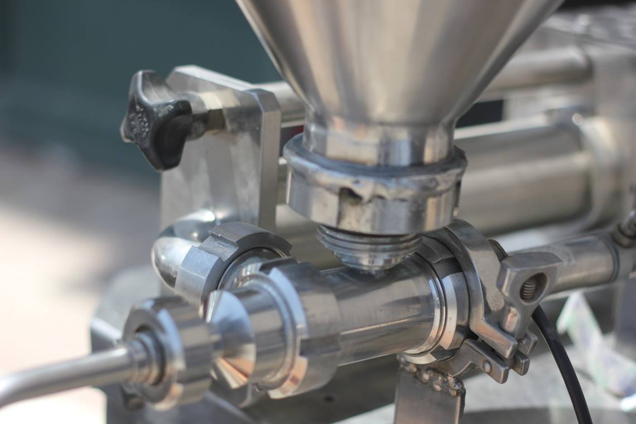
Pneumatic Valve
The pneumatic valve is used to determine the fluid direction.

Slide 18
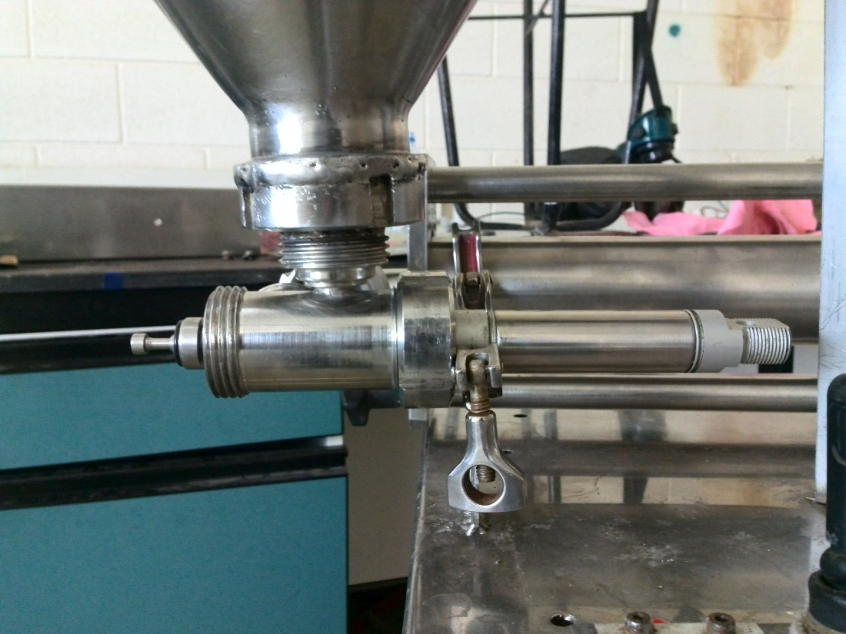
Pneumatic Valve
A double acting cylinder is used to change the direction of the fluid. The first case is when the double acting cylinder is retracted; the fluid path will be from the cone to the storage cylinder and the nozzle will be closed. The second case, when the double acting cylinder is extend, the valve will prevent the fluid to pass from the cone to the storage cylinder and cause the stored fluid to flow through the nozzle.

Slide 19
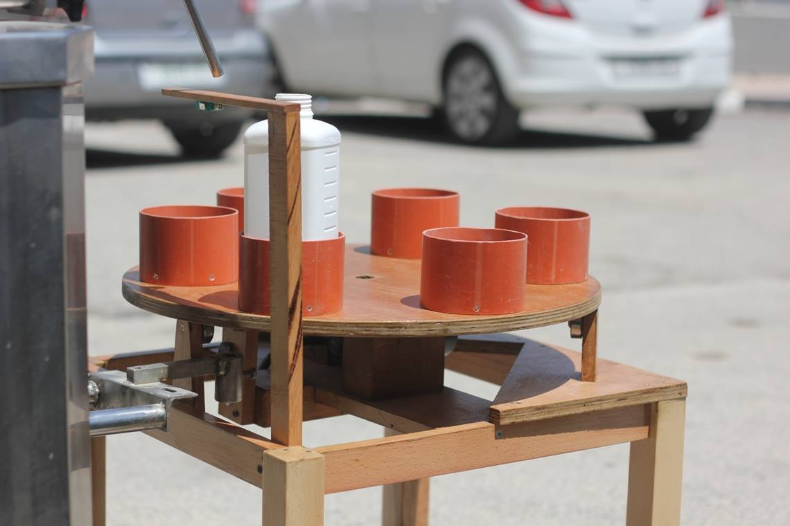
Rotary Index Table
A rotary index table was used to hold the bottles, which are needed to be filled with a fluid. A DC gear motor was used to operate and rotate the index table.
This index table was designed to hold up to six bottles in six positions; a bulge inserted under the rotating disk define these positions. A limit switch was used to touch these bulges and locate the accurate position.

Slide 20
Calculations
The maximum viscosity of the liquid, which can be filled by this machine was calculated depending on
The existing pressure.
The cross sectional area of the piston.
and the suction speed.

Slide 21
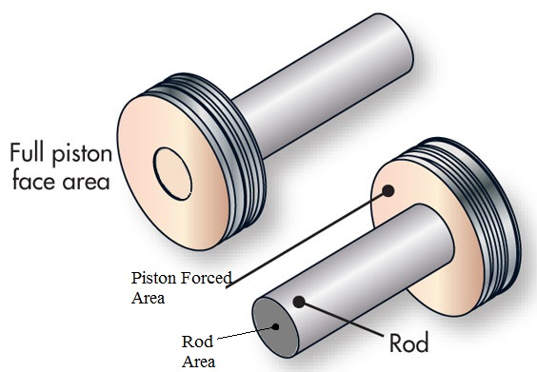




Calculations
$$A=Apiston −Arod$$
$Apiston= π∗r^{2}= π ∗{0.025}^{2}=\text{0.001963}$m2
$Arod= π ∗{0.011}^{2}=\text{0.00038}$ m2
$A=\text{0.001583}$m^2

Slide 22
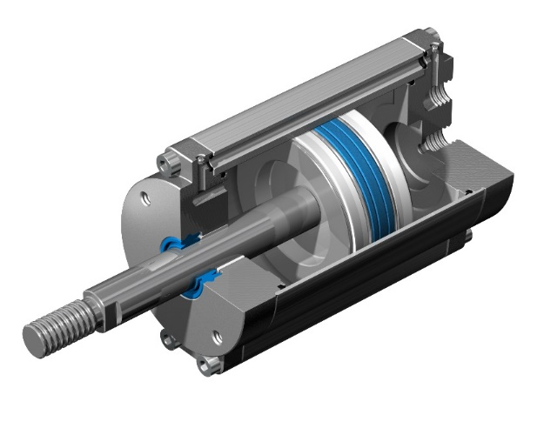



Calculations
Suction Pressure
$P1=5 bars=5∗{10}^{5}\frac{N}{m^{2}}$ “Pa”
$$P1(piston)=\frac{F}{A}$$
$$F=P1 ∗A$$
$F1=\text{791.74}$N same in both directions
F

Slide 23
Calculations
$A1 \left(chamber piston\right)=π ∗ {.03}^{2}=\text{0.002827}$ m2
A1

Slide 24
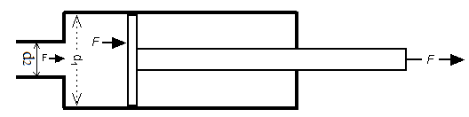


Calculations
The pressure inside the chamber
$$P (champer)=\frac{F}{A1}$$
$P (champer)=\frac{\text{791.74}}{\text{0.002827}}$= 280020.7 Pa

Slide 25
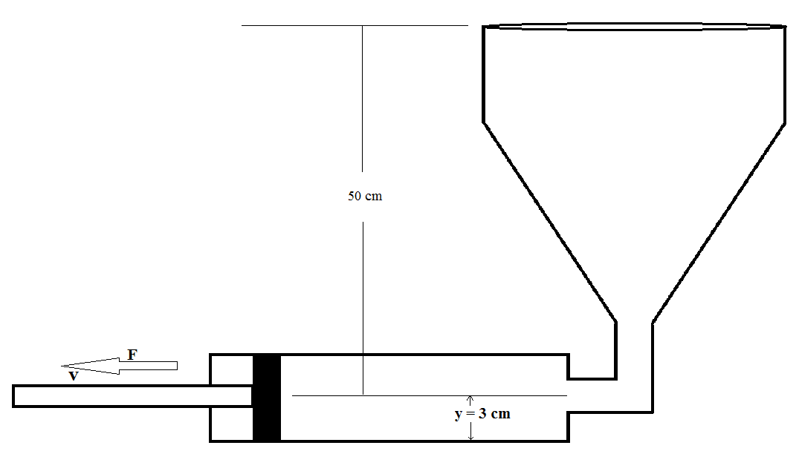

Calculations
$$\text{Dynamic}\text{ (}\text{absolute}\text{) }\text{Viscosity}$$
$$\frac{F}{A}=μ∗\frac{v}{y}$$
$$280020=μ∗\frac{0.08}{0.03}$$
$$μ=105007 Pa.s$$

Slide 26
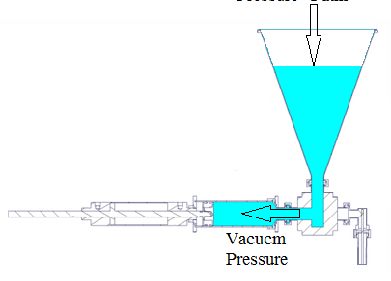
Calculations

Slide 27
Control Design
PIC Microcontroller
Level sensor
Switches
Directional Control Valve
Limit switches

Slide 28
Sensors
Switches
A switch is an electrical component that can break or conduct the current to the circuit.
A switch may be directly manipulated by a human as a control signal to a system, such as a push button or automatically operated which can be used to control the motions of machines, such as limit switches.
Toggle switch
Push bottom
Emergency stop push bottom
Limit switch

Slide 29
Sensors
Switches
A switch is an electrical component that can break or conduct the current to the circuit.
The toggle switch is used to change the operation mode of the machine between manual or automatic with index table.
The Push bottoms are used to start and stop the filling operation.
Toggle switch
Push bottom
Emergency stop push bottom
Limit switch

Slide 30
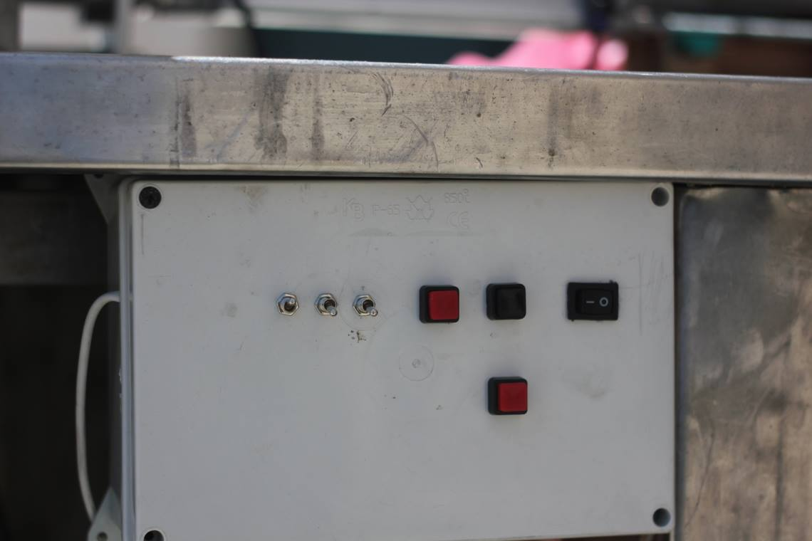
Sensors
Switches

Slide 31
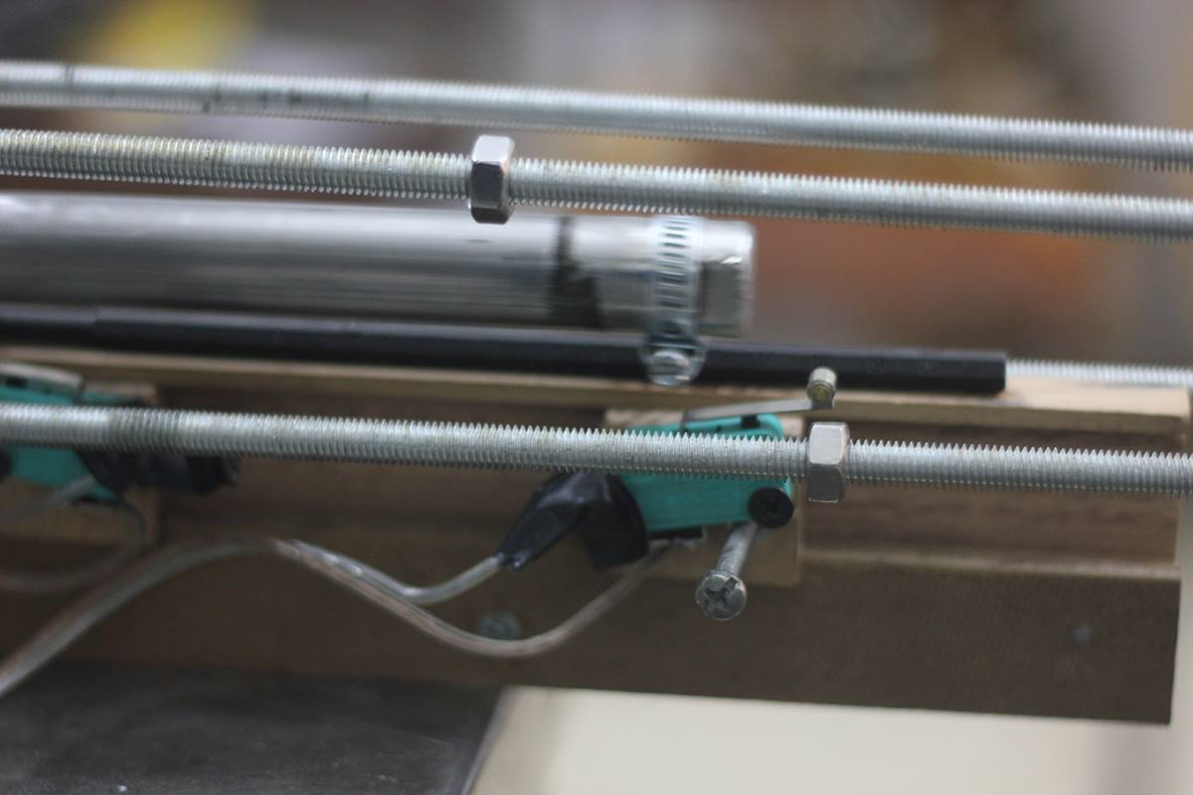
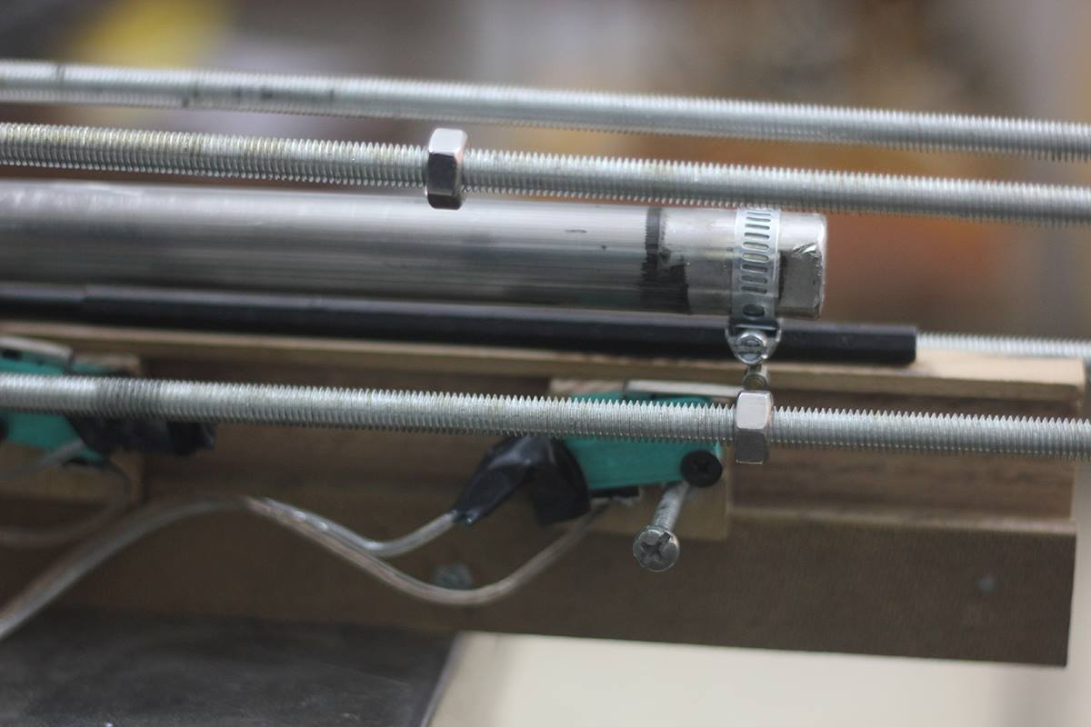
Sensors
Limit switches
A limit switch is a switch operated by the motion of a machine part or presence of an object.
The limit switches are used to:
1- To specify the desired volume of fluid to be filled by placing two limit behind the double rod cylinder “piston” and change the distance between them, this will change the stroke distance of the piston so the volume sucked will change too.

Slide 32
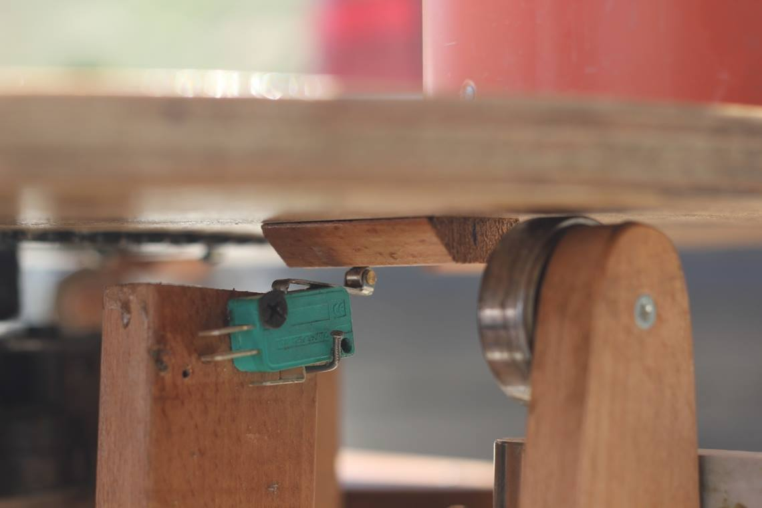
Sensors
Limit switches
A limit switch is a switch operated by the motion of a machine part or presence of an object.
The limit switches were used to:
2- Defined the stop positions for the index table.

Slide 33
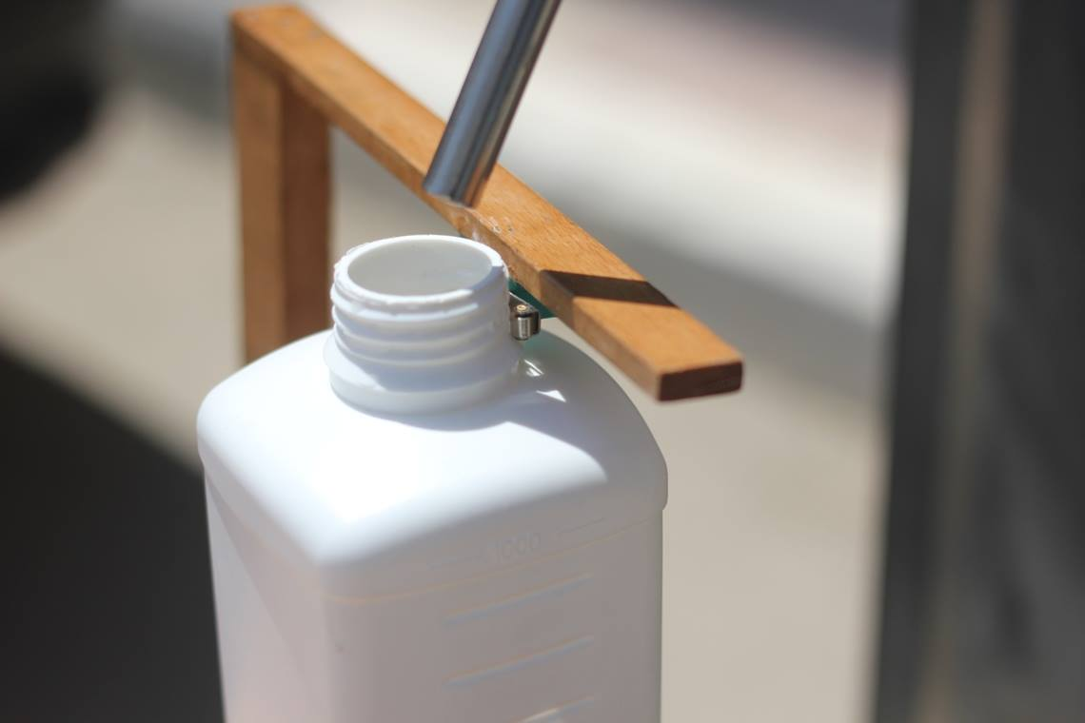
Sensors
Limit switches
A limit switch is a switch operated by the motion of a machine part or presence of an object.
The limit switches were used to:
3- To detect the bottle under the nozzle.

Slide 34
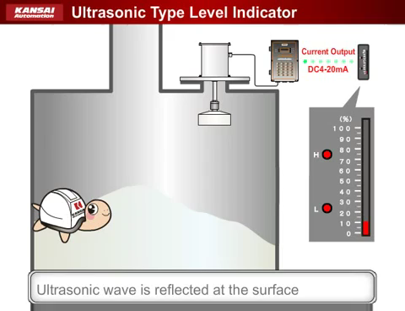
Sensors
Ultrasonic Level Sensor
ultrasonic level sensor operate on the principle of using sound waves to determine liquid, solid or slurries level, by calculate the time lapse between sending the sound wave and receiving the return echo, and convert this time to a distance which is between the sensor and the liquid surface.

Slide 35
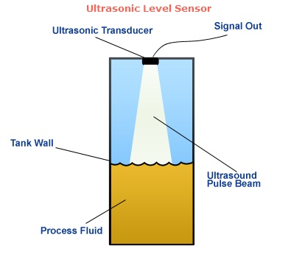

Sensors
Ultrasonic Level Sensor
$$Distance "\text{d}\text{"}=\frac{Velocity of sound∗Time of lapse}{2}$$

Slide 36
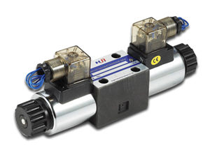
Directional Control Valve
It allows Pressured air to flow into different paths from one or more sources. They usually consist of a spool inside a cylinder that is mechanically or electrically controlled.
Classification
Number ports
Number of positions
Actuating methods

Slide 37
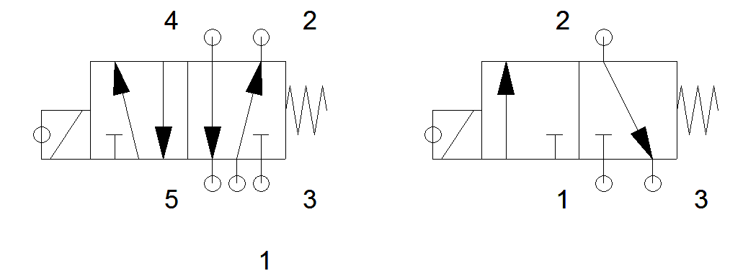
Directional Control Valve
It allows Pressured air to flow into different paths from one or more sources. They usually consist of a spool inside a cylinder that is mechanically or electrically controlled.
A 5/2 and 3/2 directional control valves which have five ports, two spool positions and three ports, two spool positions respectively which are electrically controlled was used.

Slide 38
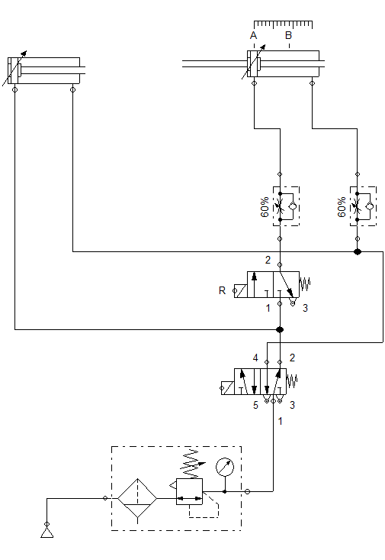
Pneumatic Circuit

Slide 39
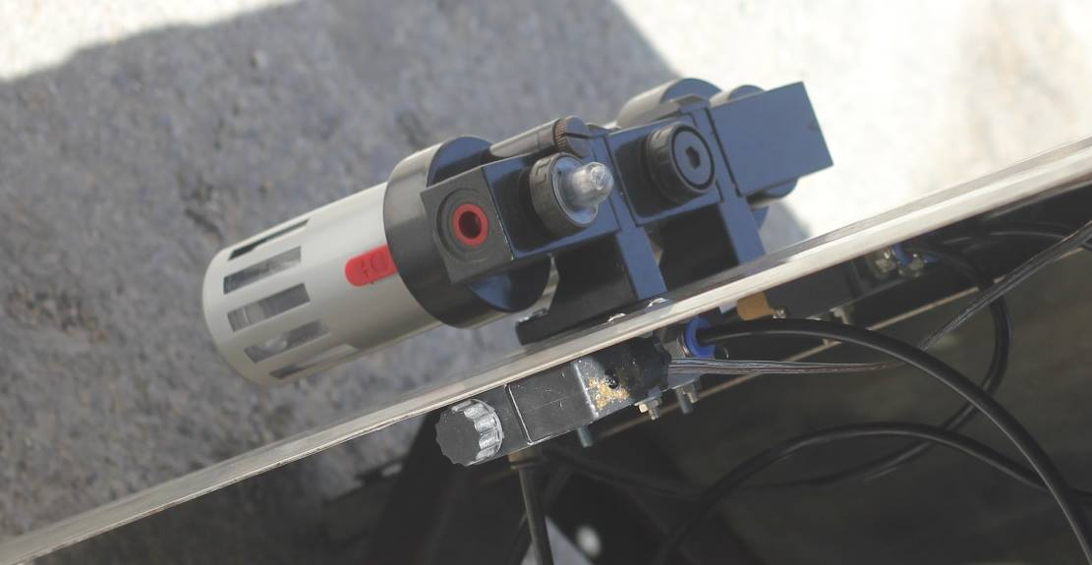
Pneumatic Circuit

Slide 40
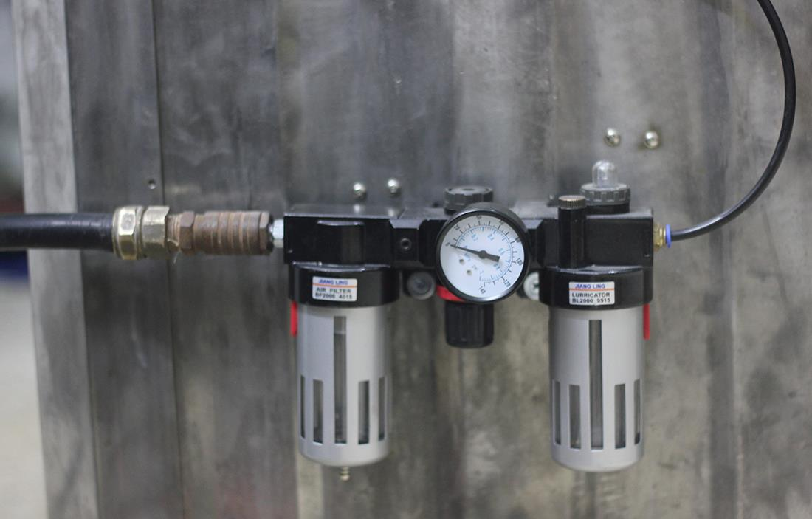
Pneumatic Circuit

Slide 41
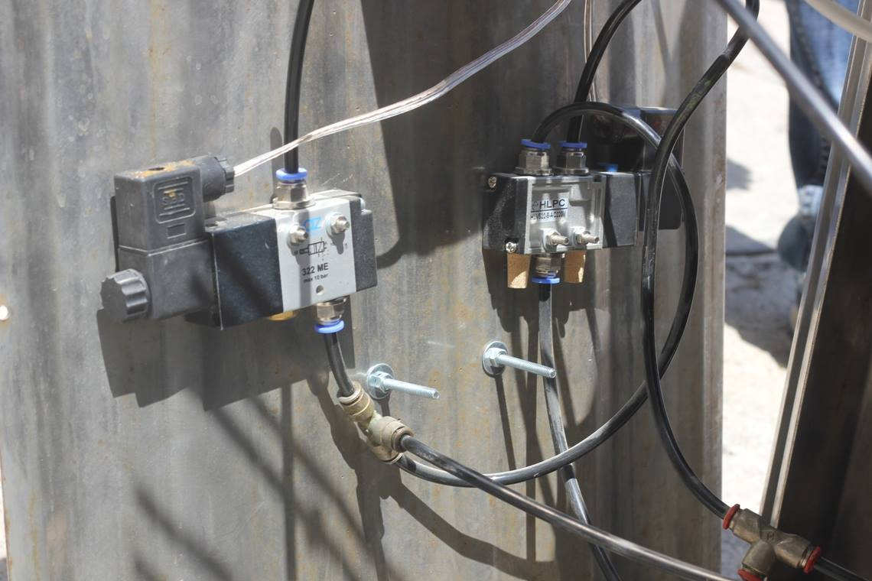
Pneumatic Circuit

Slide 42
Pneumatic Circuit

Slide 43
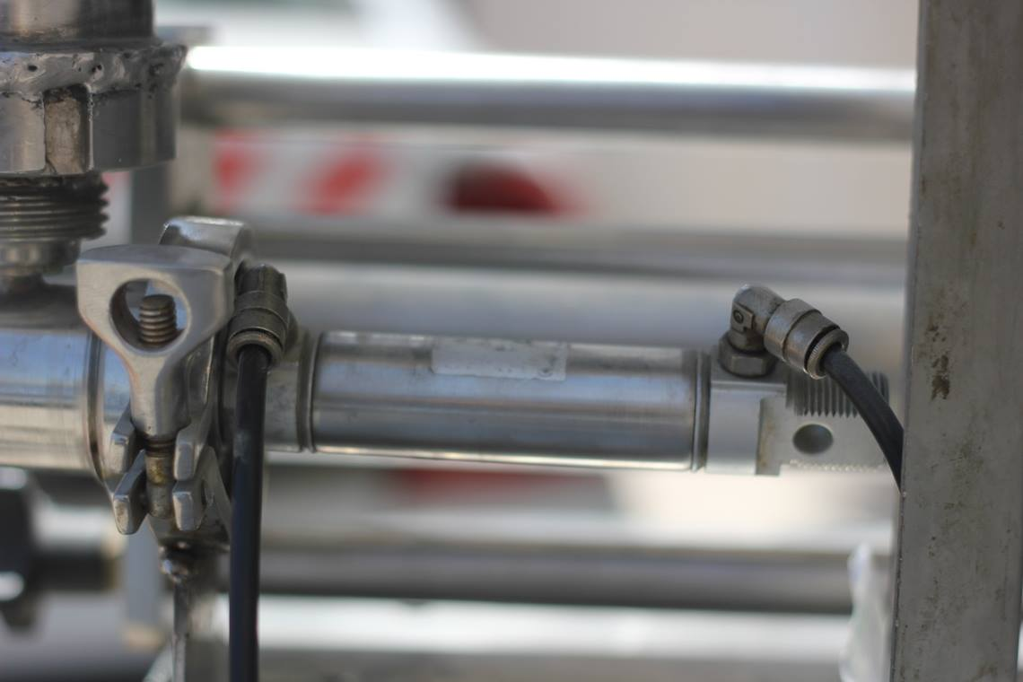
Pneumatic Circuit

Slide 44
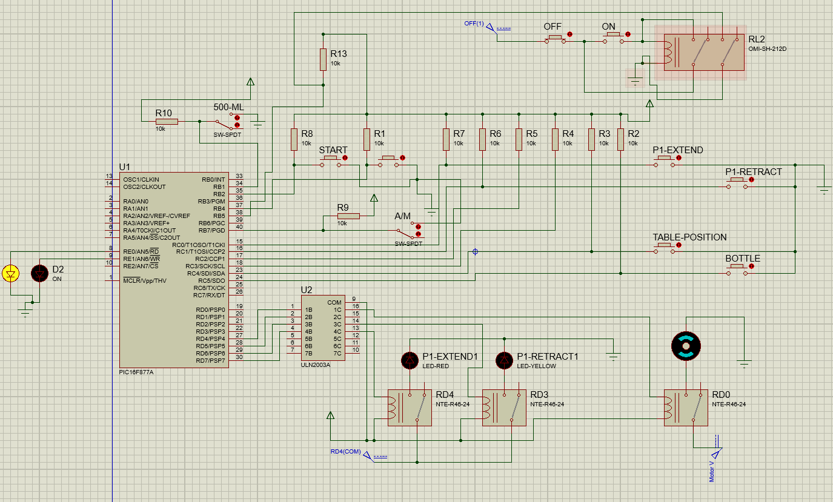
Electrical Circuit

Slide 45
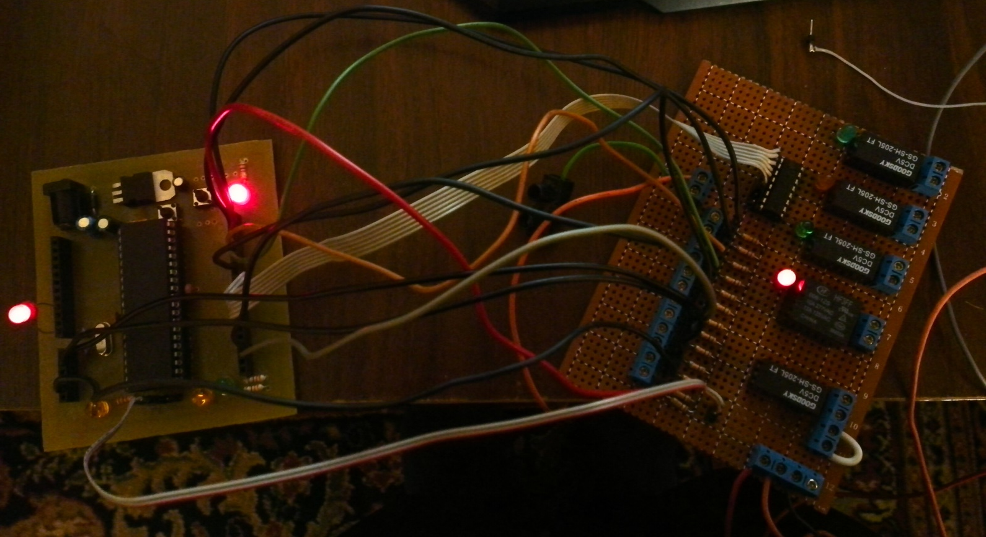
Electrical Circuit

Slide 46
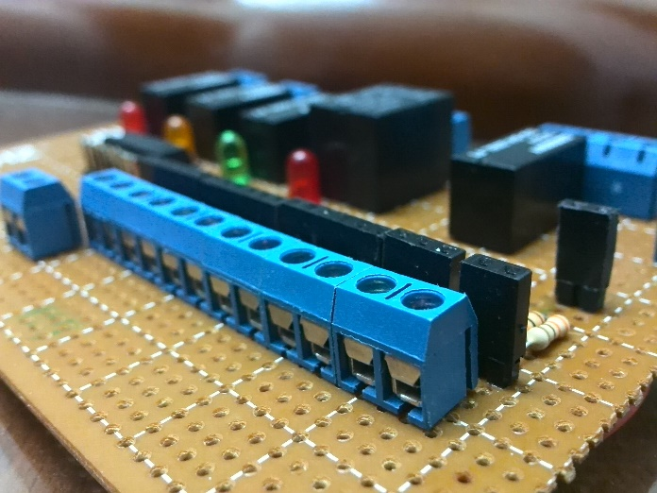
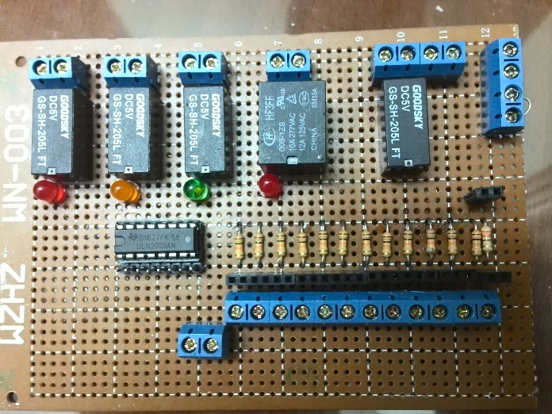
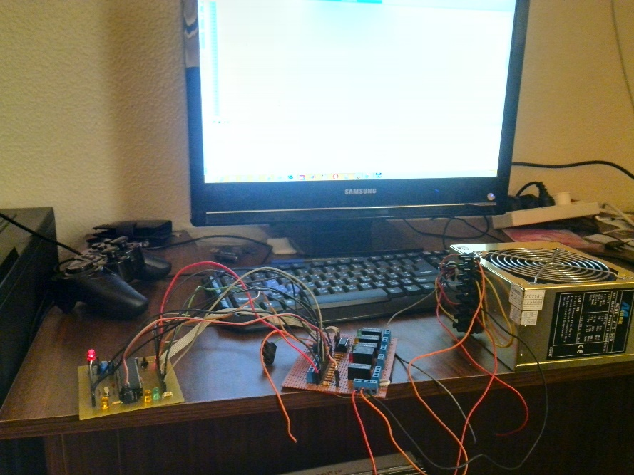
Electrical Circuit

Slide 47
PIC16f877A Code

Slide 48
PIC16f877A Code

Slide 49
Operation

Slide 50
Thank You

