Slide 1
SERVICE CAR
Tamer H. Naana & Mahmood K. AbuSamaha

Slide 2
Outline
Introduction
Overview
Service Car
Tools
Technical Perspective
Constraints
Possible Improvements
Demo

Slide 3
Introduction
Send & receive papers & stuff among each other, in companies.
Employees do the job of going & getting stuff.
Or it is the job of the company messenger.
Time & effort should be saved.
Good arrangement needed for several orders.

Slide 4
Overview
Robotizing the company messenger.
Automating pick-up & delivery process.
Employees order from their place using a mobapp.
Administrator configures the company map on a localhost.
The robot figures out the way to the pick-up & delivery points.
It moves in a shortest path.
It detects & avoids collision with obstacles.

Slide 5
Service Car

Slide 6
Tools
Arduino Mega.
Ionic 2.
Laravel 5.
WiFi module (ESP8266-01).
Servo & DC motors.
Ultra-Sonic transceiver.
Accelerometer.
DC motor encoder w/ 3D-printed 8-hole wheel.

Slide 7
Technical Perspective

Slide 8
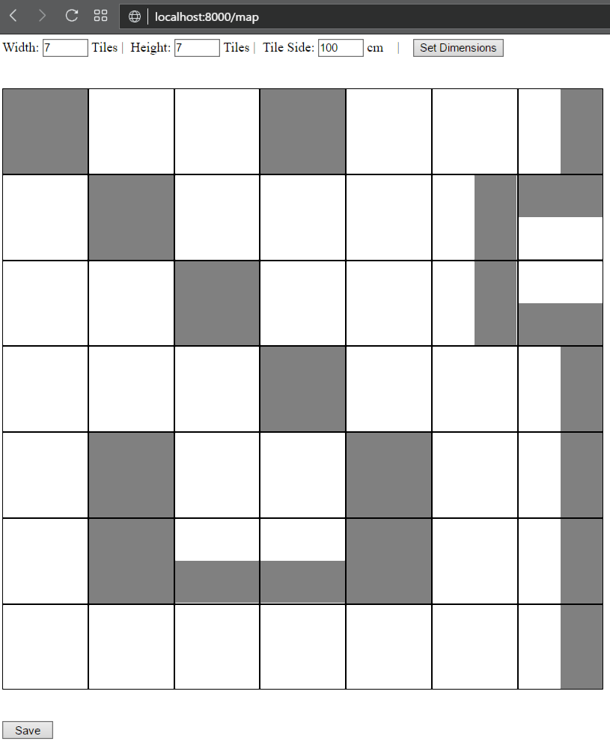

Slide 9
Server

Slide 10
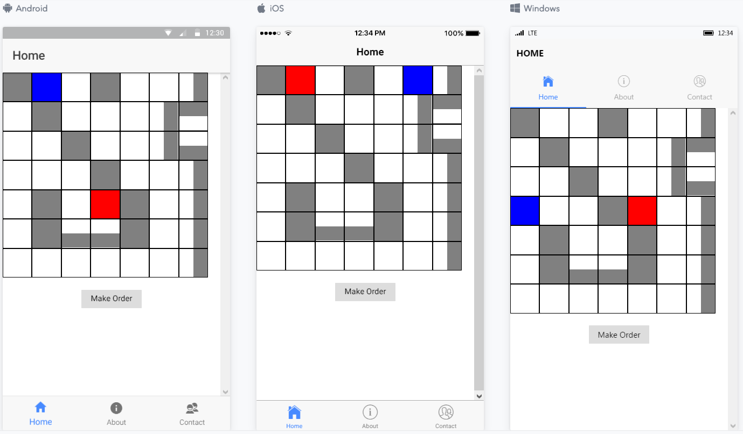

Slide 11
Mobile

Slide 12
Server
Mobile
Gets map
Makes Order

Slide 13
Server
A-Star
Map
Uses
Gets Map Data
Sends Commands
Arduino
Movement
Control

Slide 14
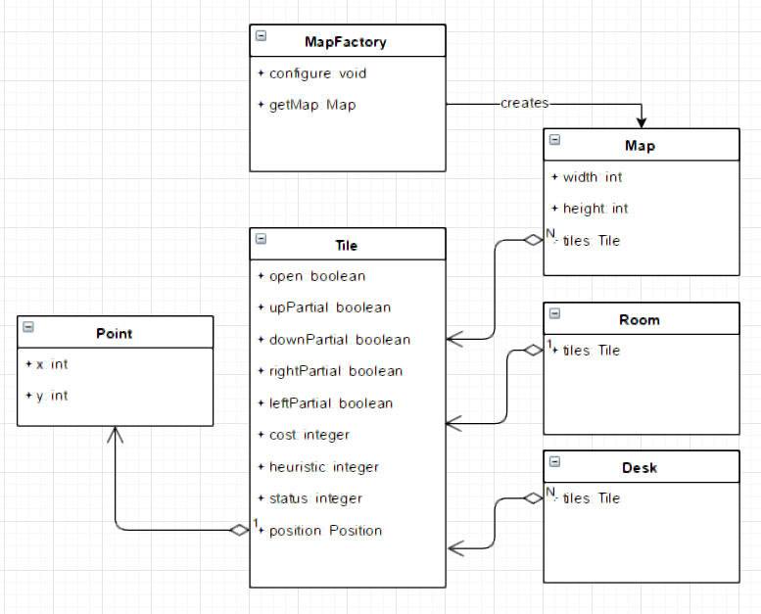

Slide 15
Shortest Path - A*
Evaluation function:
f(t) = c(t) + s(t) + h(t), where t ∈ T, T is a list of all Tiles
Cost: Steps until this tile along the path.
Heuristic: Diagonal Manhattan distance.
Status: The status of the tile.
  Default zero.
  Each closed adjacent side adds one.
  Being partially part of a wall, obstacle or some asset adds one.

Slide 16
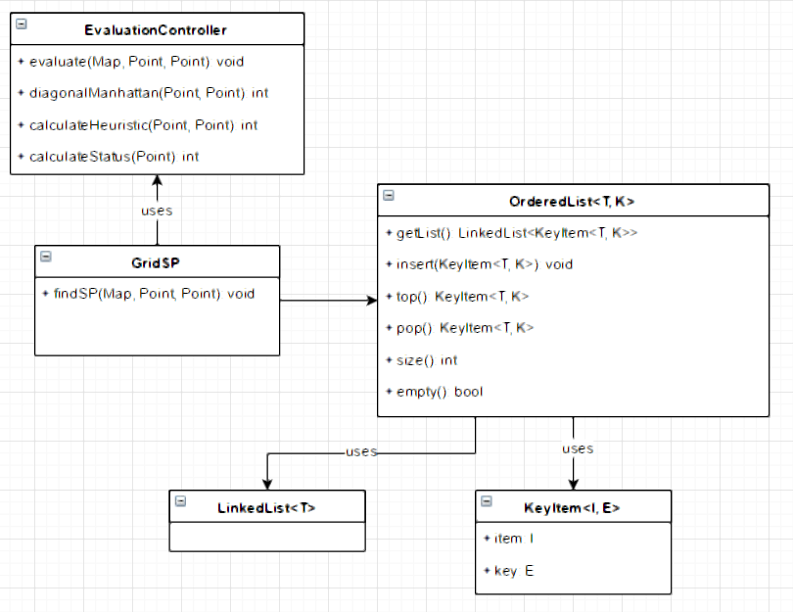

Slide 17
Robotic Localization
Determining where the robot is on a well-known map.
The 100% accurate approach costs more than $50k.
We calculate the distance and track the orientation.

Slide 18
Movement Control
Accelerometer for turning.
DC motor encoder for calculating distance & walking forward & backward.
Calculating holes and wheel circumference.

Slide 19
Collision Avoidance
45
45

Slide 20
Constraints
Time Constraint.
Accuracy & cost factors.
Lack of hardware experience.

Slide 21
Possible Improvement
Better order arrangement.
Better collision avoidance scenarios.
Accurate components.
Multiple robots synchronization.
Better robotic localization.

Slide 22
Demo
Actual
Expected

Slide 23
THANK YOU

