Slide 1

Graduation project (Ⅱ)
"E-Learning Quality Assessment From Students' Perceptive:
Case Study of An-Najah National University"
Supervisor name:
Eng. Tamer Haddad
Group members:
Al-Abbas Abdul Rahim Ahmed
Abdul Rahman Hussam Abu Rabee
Ahmed Rasmi Abu Shehab
Roa'a Amjad Dwikat

Slide 2
:Project outline
Introduction
Statement of the problem
Objects of project
Scope of the work
Importance of this study
standerds and performance indicators
Methodology
Results and Analysis
Discussion
Conclusion and Recommendations

Slide 3
: Introduction
Statement of The Problem :
Since the end of 2019, the world has faced Corona Virus (Covid19) epidemic, which compel schools and universities in the whole world to replace the traditional educational process by e-learning process to ensure a successful continuation of the educational process.

Slide 4
The study questions :
1-How well do the standards for content quality and e-course design at An-Najah meet international standards?
2-How well do the standards of student support and the quality of administrative services at An-Najah match international standards?
3-How satisfied are the students at An-Najah University with the e-learning system and its quality?
4-Are there statistically significant differences in the average answers of An-Najah students on the quality standards of e-learning due to factors such as (gender, study year, college) at a significant level (0.05).

Slide 5
Objectives of Project :
Identify international standards for the quality of e-learning.
Knowing the extent to which the quality of the university's e-learning system matches international standards.
Knowing the extent of students' satisfaction with the university's e-learning system.

Slide 6
Scope of The Work :
This study is dedicated to An-Najah National University and includes all scientific colleges and colleges of human sciences for the undergraduate and postgraduate stages.
Importance of This Study

Slide 7
Standards
Sharable Content Object Reference Model (SCORM)
consist of a set of criteria to improve the quality of content .
Accessibility
Adaptability
Affordability
Durability
Interoperability
Reusability

Slide 8
European Association for Distance Teaching Universities Standards (EADTU).
This standard concerns the educational processes as a whole .
System strategic management
Delivery of courses
Designing educational content
Student support

Slide 9
Methodology
The study procedures can be summarized as follows:
1-Review previous studies.
2-Set the standards of e-learning quality assessment.
3-Designing a questionnaire.
4-Questionnaire judging by several teachers.
5-Ensure the validity of the study instrument by calculating the alpha-Cronbach parameter.
6-Calculate the size of the representative sample using (Stephen Thompson) equation.
7-Distribute the questionnaire.
8-Using statistical analysis software (SPSS) to analyze data and extract results.

Slide 10
Study Tools
we designed a questionnaire consisting of two main axes :
The first axis consists of data and information for the study sample , the second axis consists of a set of (33) paragraphs through which the standards of electronic education can be measured and its divided into three parts :
standards for the quality of electronic content and course design .
student support and administrative services standards.
student satisfaction

Slide 11
The criterion of five Likert scale was adopted to evaluate the paragraphs:

Slide 12
Tool validity:
The validity of the tool was verified by presenting it to a number of experienced teachers in the field of quality from the department of industrial engineering.
Tool stability:
The stability of the tool was verified by calculating the coefficient (Alpha-Cronbach) for a survey sample consisting of (35) students, which reached (0.92), and this ratio is statistically acceptable .

Slide 13
Study Variables
  Independent variables:
    Gender: ( Male/ Female)
    Study year (1st , 2nd , 3rd , 4th , 5th)
    Academic stage (undergraduate / Postgraduate)
    College (engineering , since , economic ….etc.)
    Specialization
  Non-independent variables:
    The quality standards for e-learning are the class at An-Najah National University, according to the study sample estimates.
­

Slide 14
Study Population and Sample Size
The study population consists of 23,000 students , The size of the study sample was calculated using (Stephen Thompson) equation, which amounted to (438) male and female students.

Slide 15
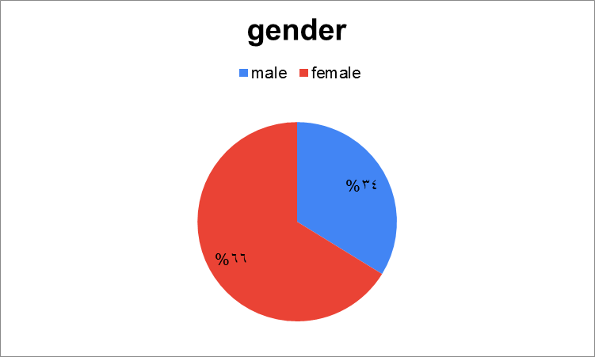
Results and Analysis
Frequencies and Descriptive Statistics
  Frequencies gender

Slide 16
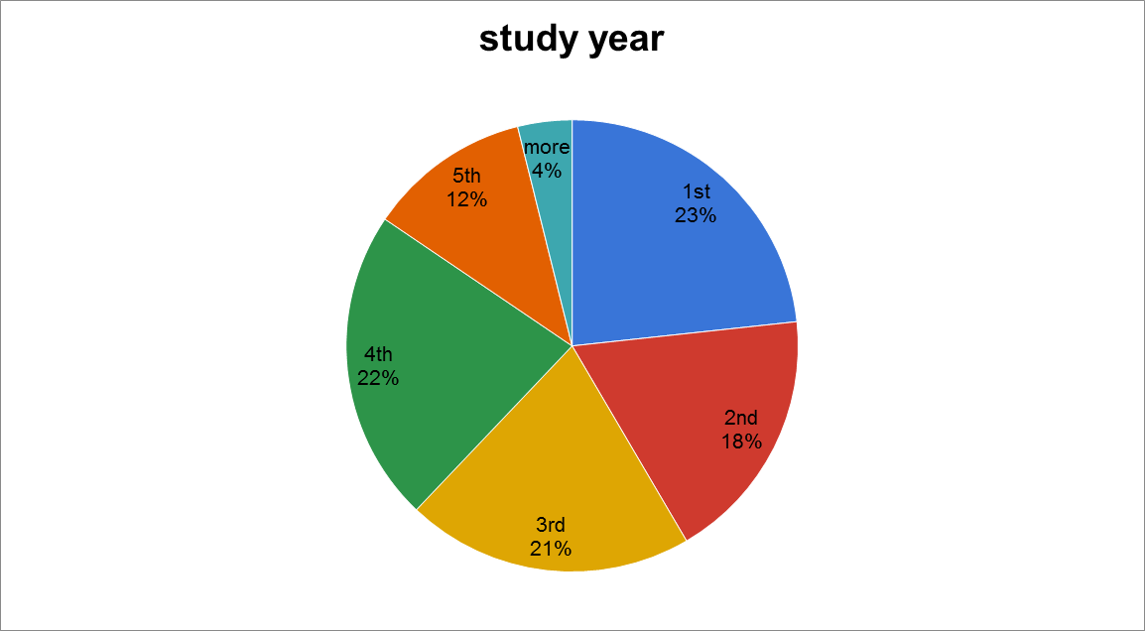
Frequencies of study year

Slide 17
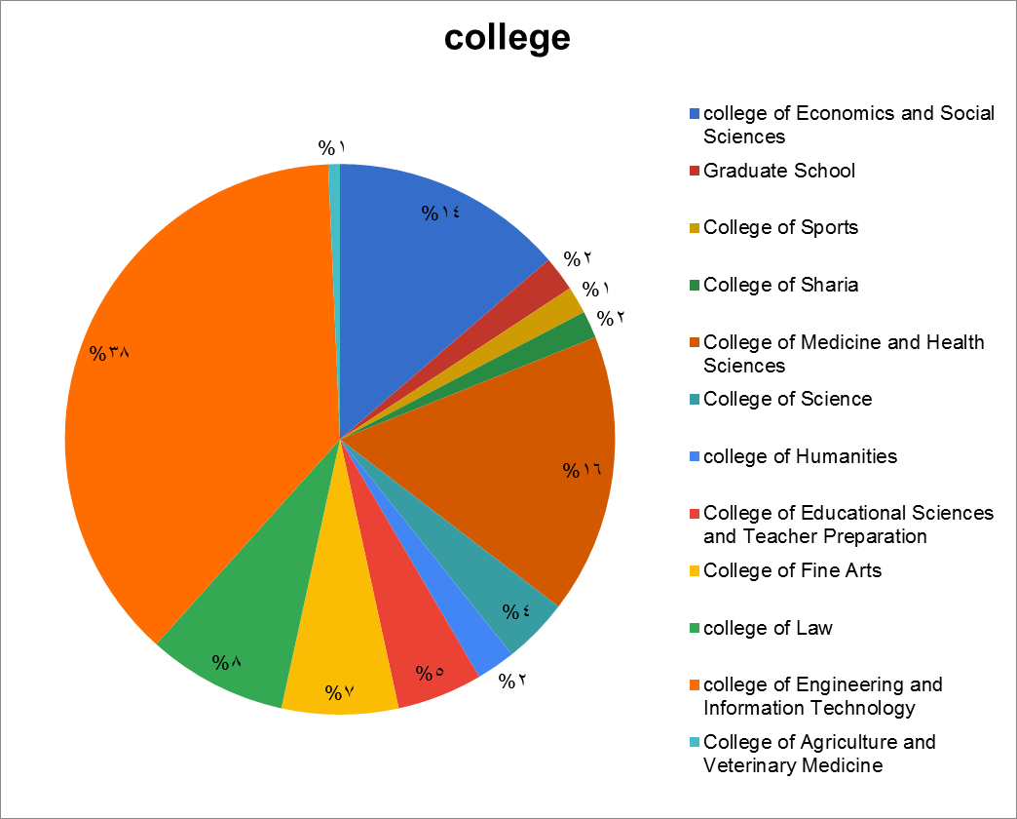
Frequencies of college

Slide 18
The answers of the study questions :
  First Question : content quality and the design of the electronic course .
  The qustines related to the contant quality standards :
The degree of presence | standard deviation | The arithmetic mean | Theoretical mean | paragraph | no
medium | 1.14 | 2.81 | 3 | [The educational goals in the electronic courses I studied were clear.] | 1
low | 1.21 | 2.54 | 3 | [The mechanisms and means of distance education are specific and clear and help in understanding the educational content. | 2
medium | 1.14 | 2.67 | 3 | [Designing the educational content takes the nature of the course into consideration.] | 3
low | 1.13 | 2.32 | 3 | [Present educational content in a way that takes into account individual differences between learners.] | 4
medium | 1.17 | 2.85 | 3 | [The educational material is presented in the courses in a logical and sequential manner.] | 5
medium | 1.19 | 2.84 | 3 | [Designing the educational content in a way that is compatible with the educational objectives of the course.] | 6
medium | 1.23 | 2.75 | 3 | [Ability to review, develop and update educational content] | 7
low | 1.18 | 2.44 | 3 | [The evaluation and measurement mechanisms in the e-courses that I studied were clear and varied.] | 8
medium | 1.20 | 3.08 | 3 | [The teacher provides the necessary references for the course] | 9
medium | 1.18 | 2.70 | 3 | Domain as a whole

Slide 19
The degree of presence of the paragraphs was medium , with a rate of (2.7) and a standard deviation of (1.18) .
To definitive this result a T-test was conducted on this domain to examine the possibility of a difference of the applied arithmetic mean (2.7) from the theoretical mean (3),
As shown :
Domain | Test Value = 3
 | T | D.F | Sig. (2-Tailed) | Mean Difference | 95% Confidence Interval Of The Difference
 |  |  |  |  | Lower | Upper
1 | -3.839 | 8 | .005 | -.30000 | -.4802 | -.1198

Slide 20
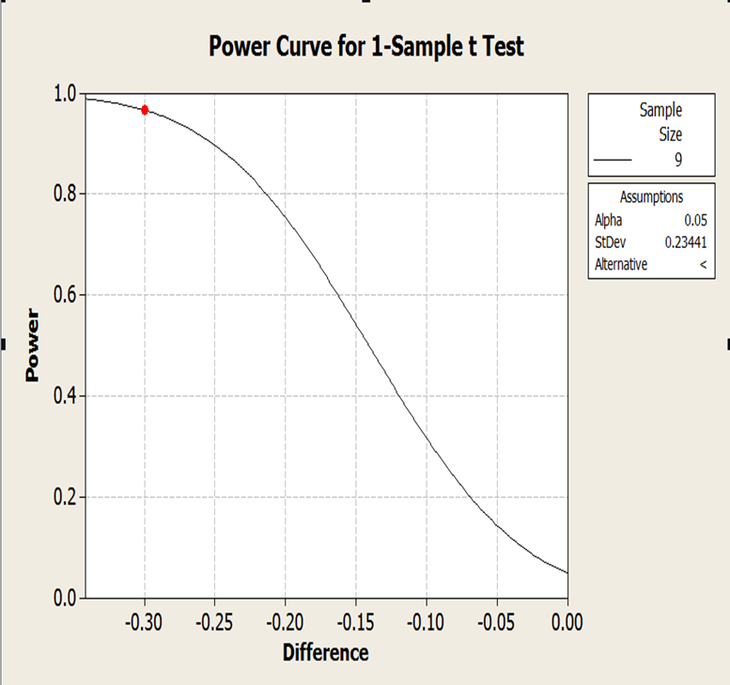
From the T-test table the probability value (P) was (0.005) and the power of the test (0.96) that there is a strong evidence to conclude that the value of the applied arithmetic average is less than the value of the theoretical arithmetic average .

Slide 21
Second Question :student support and the quality of administrative services .
The degree of presence | standard deviation | The arithmetic mean | Theoretical mean | paragraph | no
medium | 1.28 | 3.00 | 3 | [The system used in education (Moodle) provides easy access to educational materials.] | 1
medium | 1.14 | 2.87 | 3 | [The university provides an entry service for electronic libraries and scientific books for students] | 2
medium | 1.24 | 2.63 | 3 | [There are clear mechanisms and instructions for student-teacher interaction.] | 3
medium | 1.26 | 3.36 | 3 | [The teacher is obligated to record the video lectures and make them available for students to refer to later.] | 4
low | 1.15 | 2.58 | 3 | [There is a guide explaining to the student what is expected of him and what skills he must master in order to succeed in the e-learning environment.] | 5
low | 1.14 | 2.28 | 3 | [The university has an infrastructure that serves the e-learning process.] | 6
low | 1.20 | 2.54 | 3 | [The university is taking the necessary measures to develop and improve the e-learning system.] | 7
low | 1.21 | 2.51 | 3 | [The university provides a technical support team for students in the event of any defect in the system.] | 8
low | 1.07 | 2.30 | 3 | [The university's technical support service is efficient and responsive.] | 9
medium | 1.19 | 2.68 | 3 | Domain as a whole

Slide 22
the paragraphs of the second question were of medium degree with a mean (2.68) and a standard deviation (1.19).
To make sure of this definitively, a T-test was conducted on this domain to examine the possibility of a difference of the applied arithmetic mean (2.68) from the theoretical mean (3), as shown in Table :
Domain | Test Value = 3
 | T | Df | Sig. (2-Tailed) | Mean Difference | 95% Confidence Interval Of The Difference
 |  |  |  |  | Lower | Upper
2 | -2.811 | 8 | .023 | -.32556 | -.5927 | -.0584

Slide 23
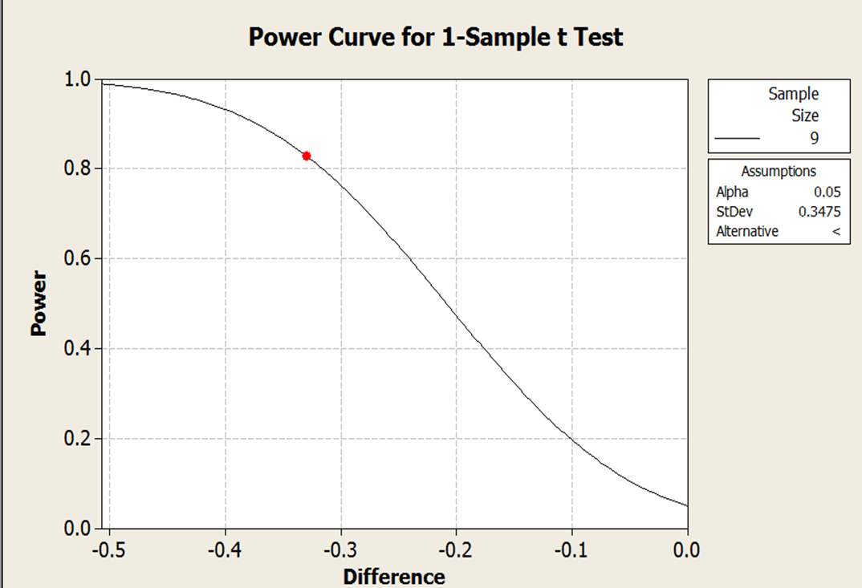
from the T-test table and the power curve the probability value (p) was (0.023) and the power of the test (0.84) that is, ,there is strong evidence to conclude that the value of the applied arithmetic average is less than the value of the theoretical arithmetic average .

Slide 24
Third Question: students satisfaction of e-learning .
The degree of presence | standard deviation | The arithmetic mean | Theoretical mean | paragraph | no
low | 1.22 | 2.52 | 3 | [The education system provides interactive features that facilitate communication and interaction between students.] | 1
low | 1.15 | 2.32 | 3 | [There are clear standards for time lines in which a moderator responds to messages.) | 2
low | 1.24 | 2.57 | 3 | [The electronic learning system at the university is easy to use for the student] | 3
medium | 1.28 | 2.94 | 3 | [The tools used in e-learning are flexible and can be easily accessed via smart devices and mobile phones.) | 4
low | 1.28 | 2.50 | 3 | [When I am given homework, I have time to complete and deliver it.] | 5
low | 1.17 | 2.17 | 3 | [The level of the exams corresponds to the level of teaching.] | 6
medium | 1.19 | 2.64 | 3 | [Questioning the exams depends on the material that is explained in the lecture.] | 7
low | 1.14 | 2.40 | 3 | [There is feedback for activities, seminars, and exams.] | 8
low | 1.16 | 2.07 | 3 | [The electronic examination system enables me to revise the exam after the results appear.] | 9

Slide 25
low | 1.19 | 2.51 | 3 | [The teachers have sufficient experience to deal with the e-learning system.] | 10
low | 1.22 | 2.55 | 3 | [In e-learning, cooperation between students to implement group tasks is easy and easy.] | 11
low | 1.19 | 2.21 | 3 | [E-learning contributes to solving the problems faced by traditional education.] | 12
medium | 1.39 | 3.34 | 3 | [In your opinion, e-learning weakens the social bond among students.] | 13
high | 1.39 | 3.79 | 3 | [The problems of electricity and the Internet had a negative impact on the process of teaching and taking the exams.] | 14
low | 1.29 | 2.00 | 3 | [After my experience of the e-learning process, I want to continue the distance learning system at the university] | 15
low | 1.23 | 2.57 | 3 | Domain as a whole
The previous table shows that the degree of student satisfaction with the e-learning system was low with average (2.57) and standard deviation (1.23).

Slide 26
T-test was conducted on this domain to examine the possibility of a difference of the applied arithmetic mean (2.57) from the theoretical mean (3), as shown in Table :
Domain | Test Value = 3
 | T | Df | Sig. (2-Tailed) | Mean Difference | 95% Confidence Interval Of The Difference
 |  |  |  |  | Lower | Upper
3 | -3.499 | 14 | .004 | -.43133 | -.6957 | -.1670

Slide 27
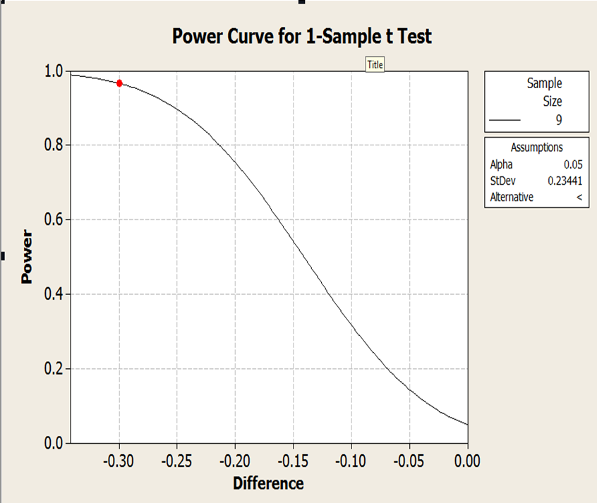
From the T- test and the power the probability value (p) was (0.004) and the test power (0.96) , this is strong evidence to conclude that the value of the applied arithmetic average is less than the value of the theoretical arithmetic average .

Slide 28
Fourth Question: differences in the average answers of students due to factors such as (gender, study year, college) .
  Multivariate Tests (M-ANOVA) was conducted with a significant level (0.05) to find if there is a significant differences in the average answers. Ho : there is no difference , H1: there is difference .
Multivariate Tests
Indication | Sig. | F | D.F | Effect
Not Indicative | .054 | 1.315 | 1 | Gender
Not Indicative | .768 | .915 | 5 | Study year
Not Indicative | .427 | 1.013 | 11 | College
Not Indicative | .460 | 1.008 | 5 | Gender * Study Year
Not Indicative | .389 | 1.021 | 11 | Gender * College
Not Indicative | .747 | .970 | 55 | Study Year * College
Not Indicative | .273 | 1.039 | 55 | Gender * Study Year * College

Slide 29
From the previous table that there are no statistically significant differences between the learners ’estimates related to the quality standards of e-learning, the Multivariate Tests shows that for all factors the significant level is bigger than (0.05) , so we reject H1 , that means there is no significant differences due to these factors .

Slide 30
Discussion
The percentage of conformity with the content quality standards and the design of electronic courses is equivalent to 54%.
The presence and clarity of the educational goals was of a modest percentage.
3- Clarity of the evaluation criteria and method in the courses Was low .
designing the educational content for the nature of the course Was a medium degree.
presenting educational content that takes into account the individual differences between learners was present to a small degree.
Presenting the educational material in the courses was at a medium degree.

Slide 31
7. student support and the quality of administrative services The match to international standards was equivalent to 53.6 % .
8. The university's technical support service is low in efficiency and responsive .
9. the satisfaction rate of students with the e-learning process equivalent to 51.4% which is low degree.
10. The students found it difficult to communicate and interact with each other, in addition to the lack of time that the teacher gives to students to perform an exam or homework assignment , and the level of relatively difficult exams .
11. The multivariate model (M-ANOVA) showed that there are no differences in the students ’answers caused by the factors (gender, academic year, college) .

Slide 32
Conclusion
Through statistical analysis of the students ’answers, a clear picture was obtained about the status of e-learning system followed at An-Najah National University .
Although the results of the questionnaire ranged from weak to medium degree which indicates modest match between the quality of e-learning system in the university and the international standard .
The advancement of the e-learning process or distance education requires studying the problems that students suffer from and treating them , moving towards working with a holistic perspective that includes the quality of inputs, processes and outputs.

Slide 33
Recommendations
First: content quality standard and the design of the electronic course .
Providing clear mechanisms and methods that help in understanding the educational content.
Taking into account individual differences .
announcing the evaluation and measurement mechanisms for the courses .

Slide 34
Second: quality standards of administrative services and student support.
improving and developing the performance of the technical support team in solving the problems that students face and faster in responding to these problems , in addition to publishing the methods of communication between the technical support team and the students.
Third: degree of satisfaction of students .
Determine specific times in which the teacher can answer student inquiries as an alternative to office hours , in addition to taking into account giving students sufficient time while performing exams and home tasks , and working to provide the examination review service .

Slide 35
We also recommend the Palestinian Telecommunications Company and the internet supply companies to work on improving their infrastructure due to problems of interrupting internet .
Finally, we recommend the accreditation and quality authority at the ministry of higher education to work on adopting clear quality standards for e-learning and publishing them officially to universities .

