Slide 1

An-Najah National University
Faculty Of Engineering chemical Engineering Department
Graduation Project
Water Desalination Using Thermochemical Cycles
Prepared by:
Rana Raool
Fayhaa Shreih
Supervision of Dr. Hamdallah Bearat

Slide 2
Outline :
The aim of the project.
Desalination, Definition and method.
Hydrated salts.
Previous work.
Methodology.
Result and Discussion.
Conclusion

Slide 3
Water
Water is the largest part of essential substances for all existence on earth and a source of evolution of human civilization.
The world running in 21st century is facing a major problem and a challenge due to water contamination and salinity.

Slide 4
The aim of this project:
We Produce fresh water from Saline Water by thermochemical cycles using hydrated salts.

Slide 5
Desalination, Definition and method
Removal of salt (sodium chloride) and other minerals from the sea water or saline water to make it suitable for human consumption and/or industrial use
Methods
Ion exchange.
Membrane processes.
Reverse osmosis or RO.
Nano filtration or NF.
Desalination water using thermochemical cycle.

Slide 6
Hydrated salt
A hydrated salt is a crystalline salt molecule that is loosely attached to a certain number of water molecules.
We use three salts:
Sodium sulfate decahydrate (Na₂SO₄.10H₂O).
Magnesium chloride hexahydrate (MgCl₂.6H₂O).
Alum (Potassium aluminium sulfate dodecahydrate) (KAl (SO₄)₂,12H₂O).

Slide 7
Thermochemical cycle
The thermochemical cycle consists of drying the sample in the oven (dehydration), steaming the sample in the box (hydration), and weighing the sample after each step.

Slide 8
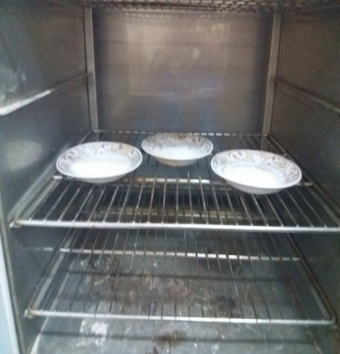
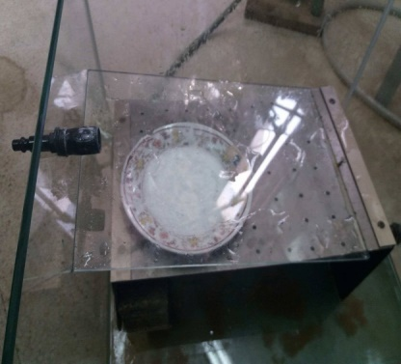

Slide 9
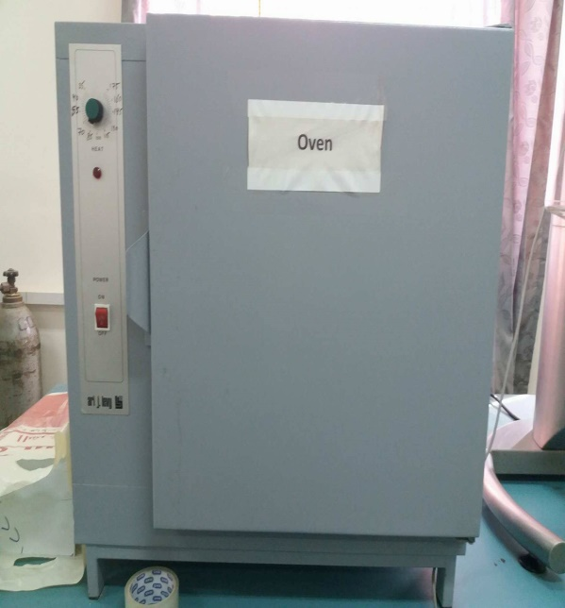

Previous work
Preparing specific amounts of samples of three different hydrated salts.
drying of all samples was done using an oven at 100°C.

Slide 10
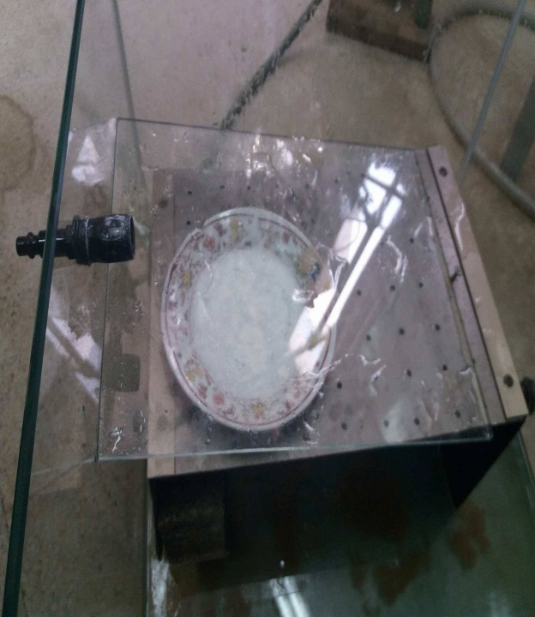
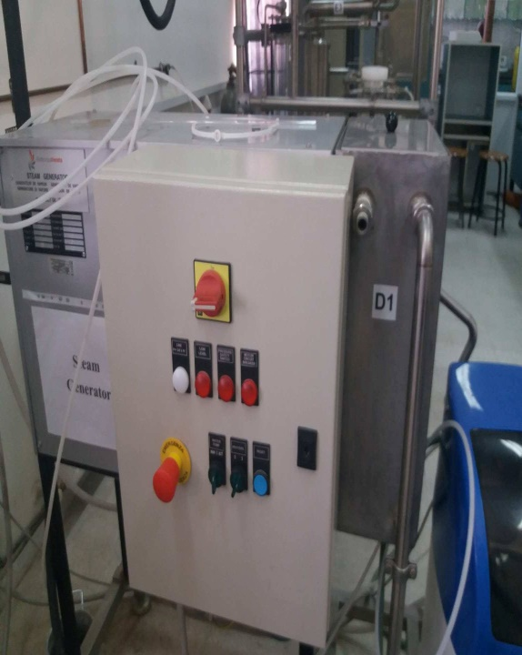
We put the sample in a special chamber (closed glass box) to do the hydration.
Every sample tests in the steam box to do the hydration reaction, and the oven for many cycles.

Slide 11
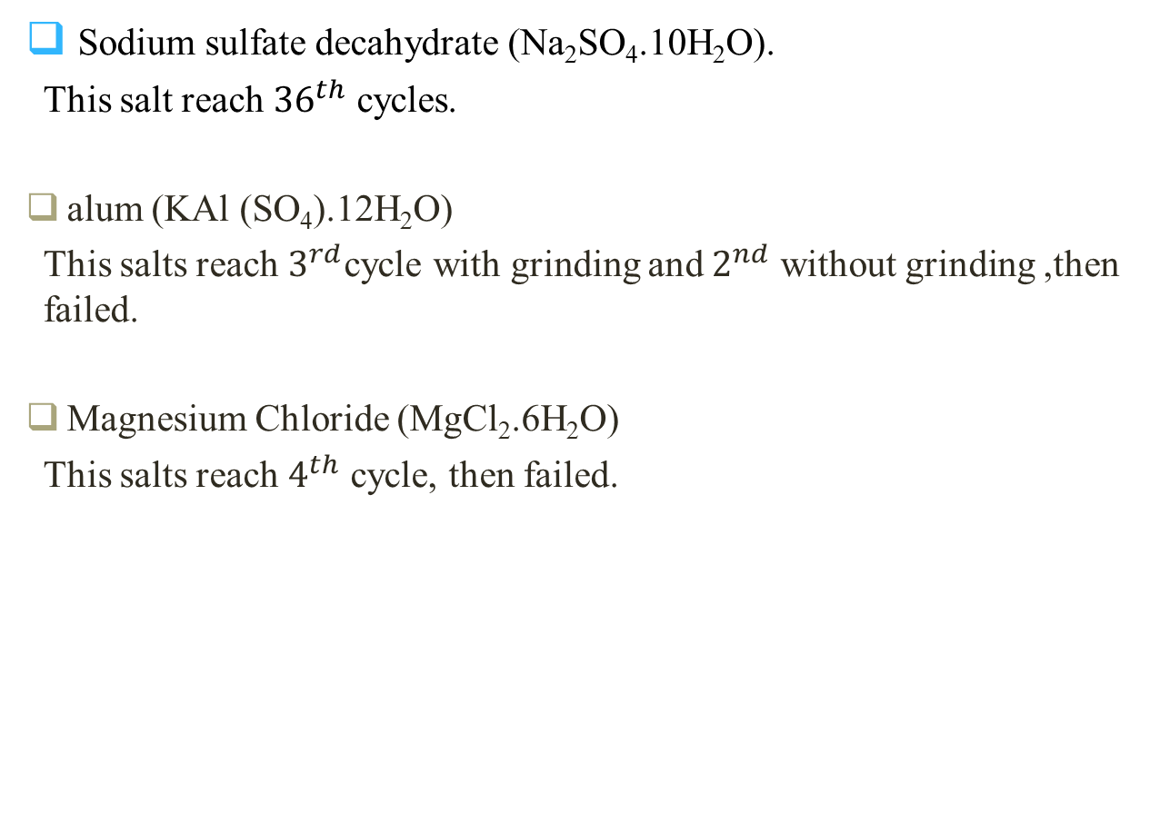
Sodium sulfate decahydrate (Na₂SO₄.10H₂O).
This salt reach ${36}^{th}$ cycles.
alum (KAl (SO₄).12H₂O)
This salts reach $3^{rd}$cycle with grinding and $2^{nd}$ without grinding ,then failed.
Magnesium Chloride (MgCl₂.6H₂O)
This salts reach $4^{th}$ cycle, then failed.

Slide 12
Methodology
The first experiment in this semester done by using reactor
Preparing amount of sample hydrated salts, which is sodium sulfate (Na₂SO₄.10H₂O).
The sample is placed in the reactor and closed tightly.
The sample heated by using heater.

Slide 13
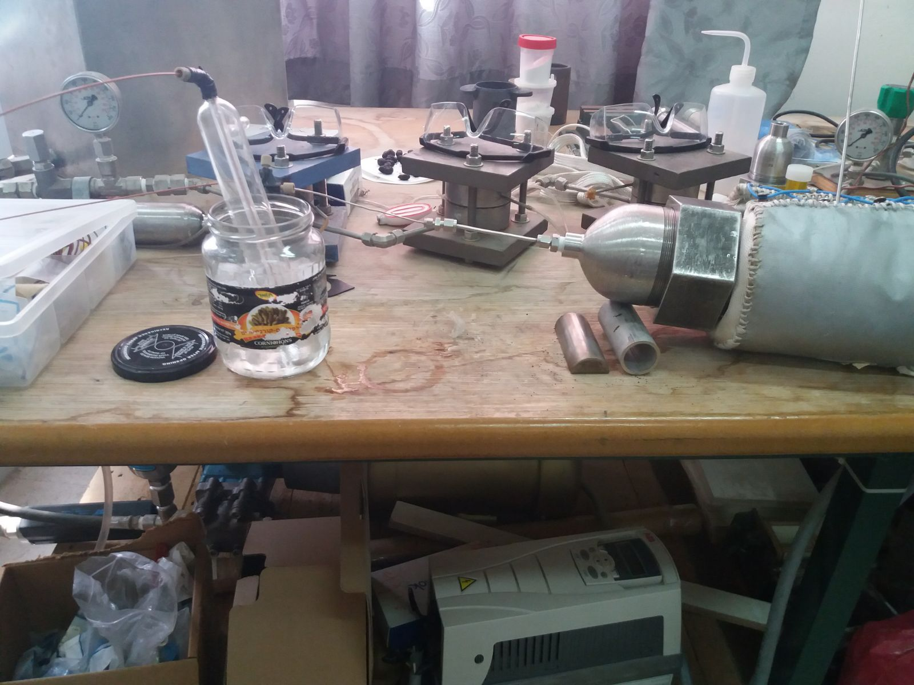
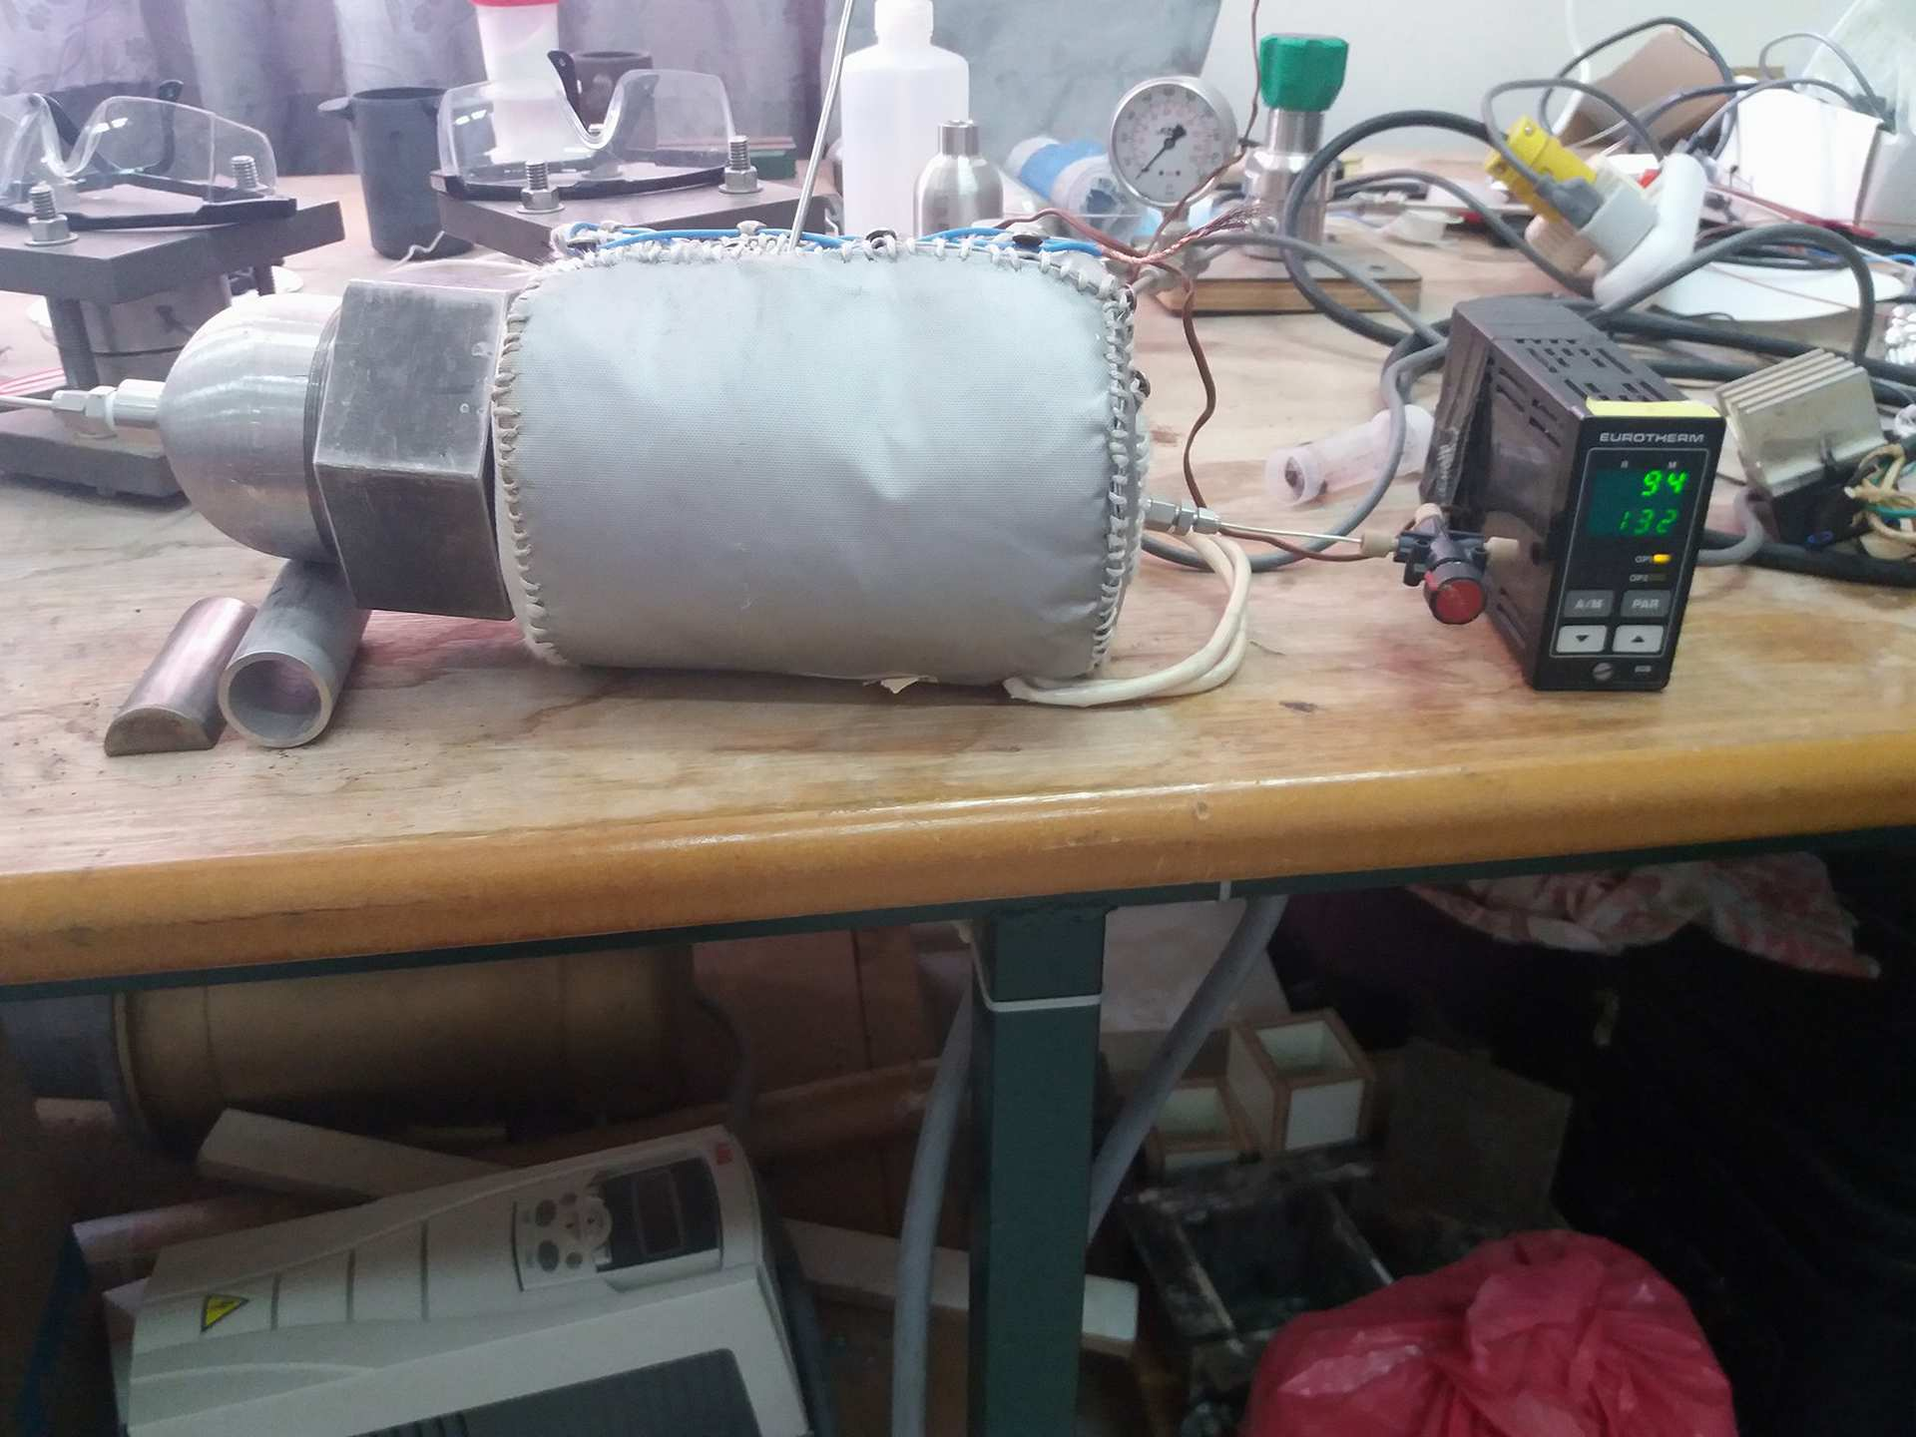
Reactor

Slide 14
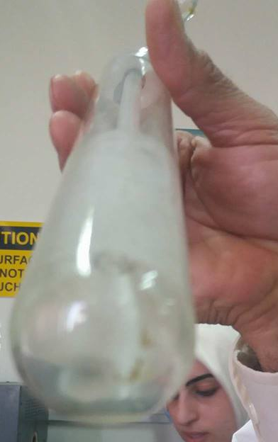
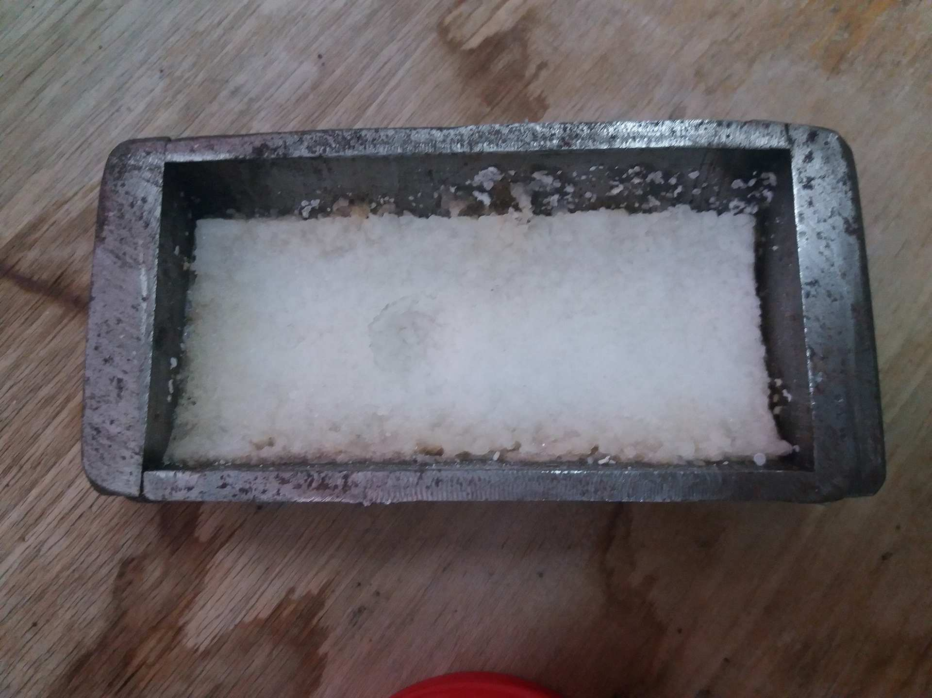
Salt after dehydration
Water produced from this experiment

Slide 15
In the second experiment the processes was improve by using a box of two stages.
Preparing amount of sample hydrated salts, which is sodium sulfate (Na₂SO₄.10H₂O). Complete drying of all samples was done using an oven at 100°C.
In the first stage hot water was put in the bottom of the box and salt in the dish.
The salt was absorbing the steam to reach saturation.
The dish was remove to second stage to dry the sample another time by using heating element and the steam produce from this stage collected by using vacuum trap.

Slide 16
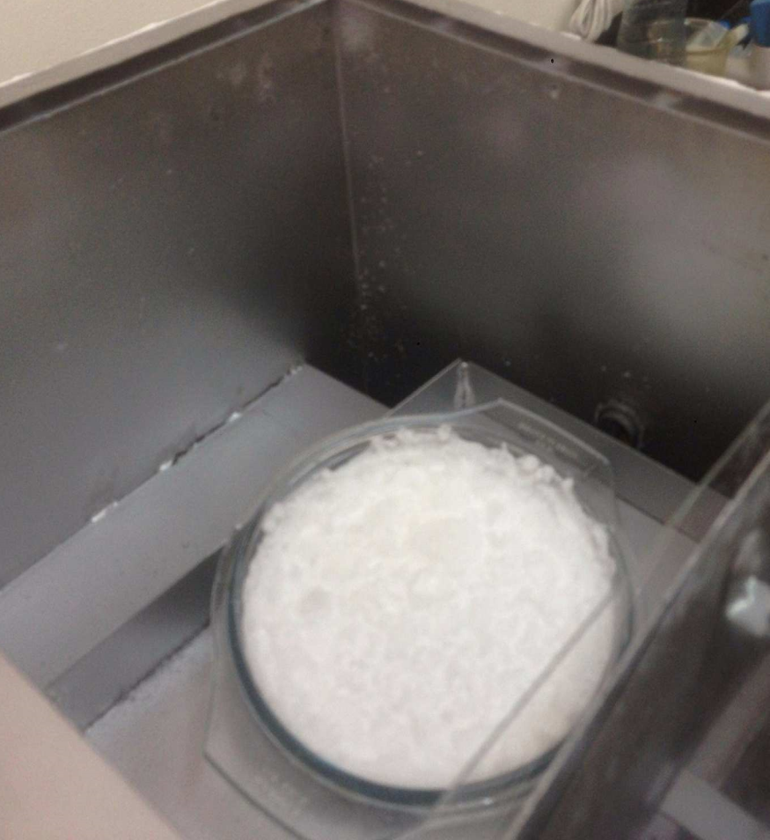
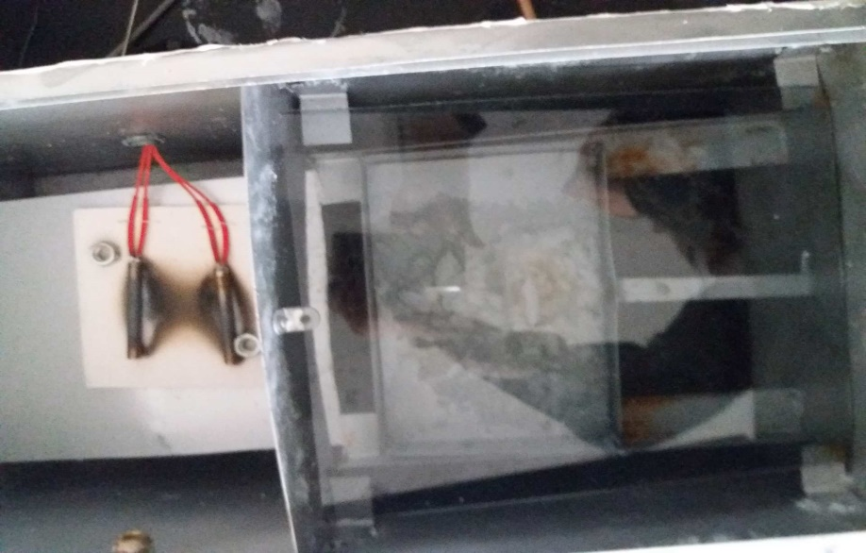
Sample before hydration sample during hydration

Slide 17
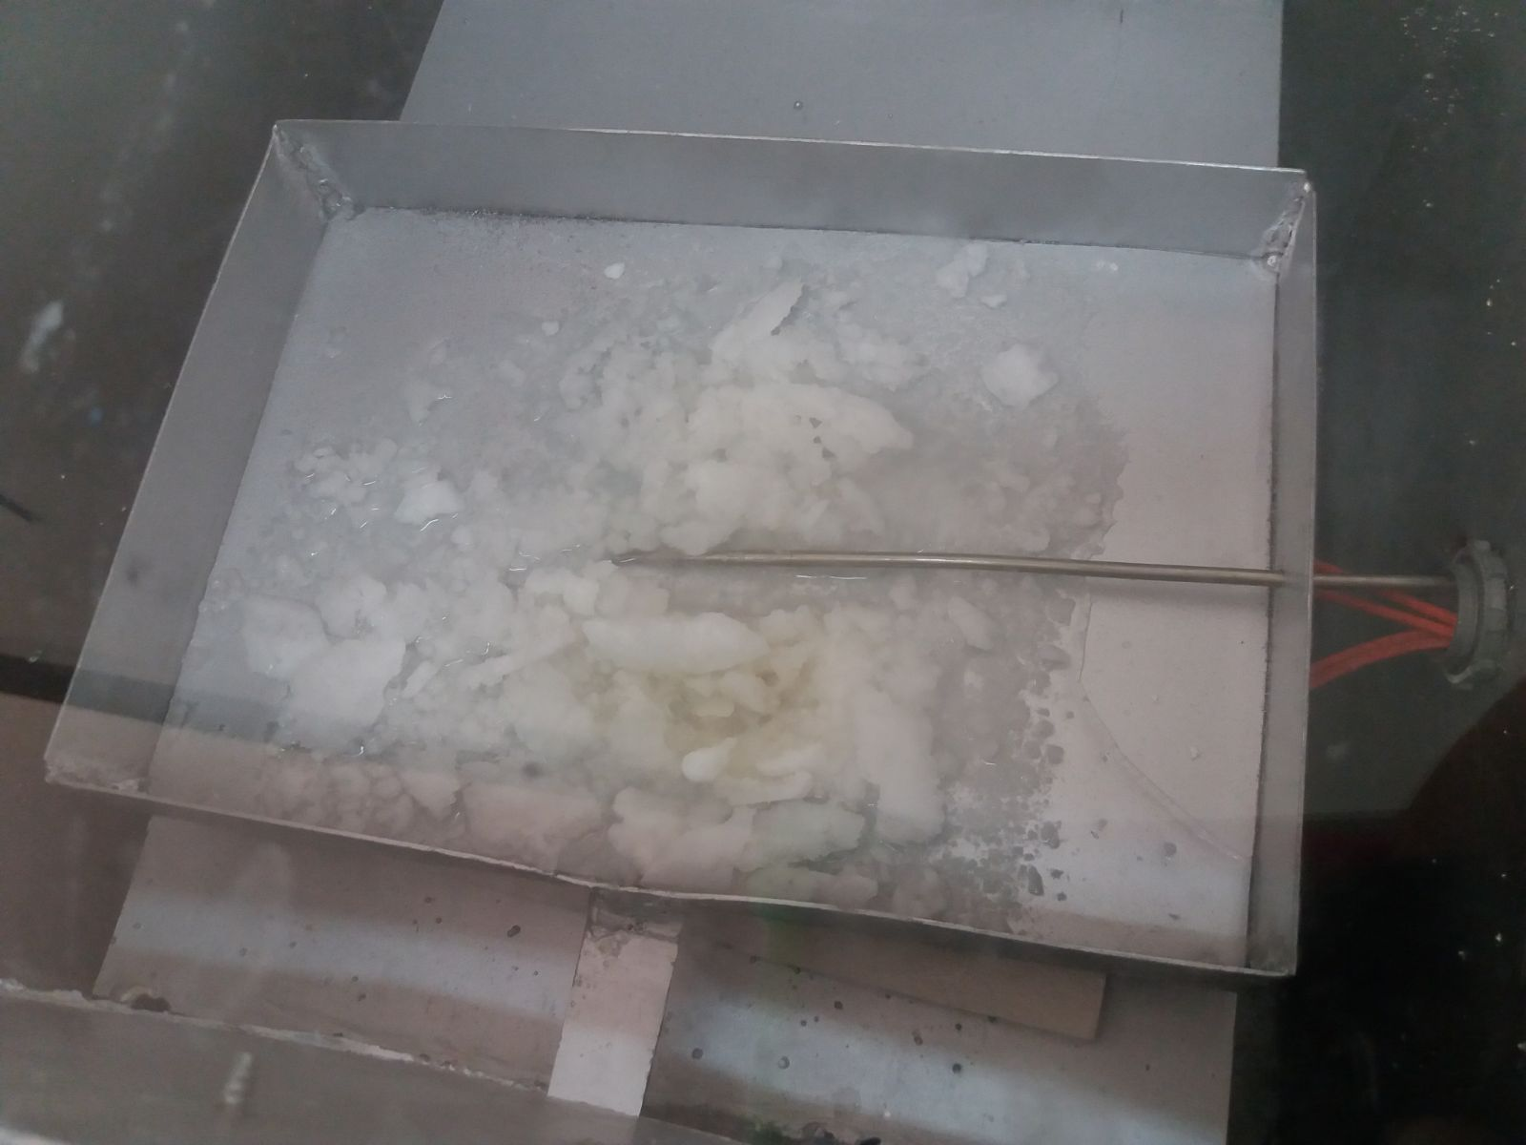
Sample during dehydration

Slide 18
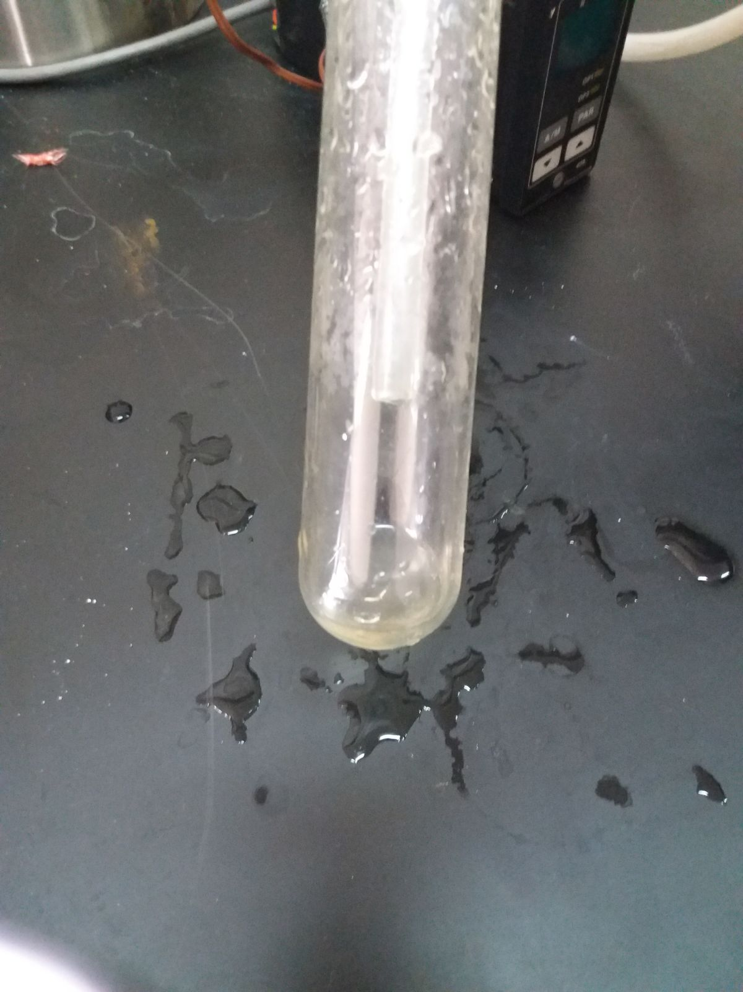
Result and discussion

Slide 19
In the reactor experiment fresh water was produce but the amount of water was very small and also it did not leave the reactor totally.
And in the two stages box we produce a fresh, this is an indicator of the success of the process but it needs to develop and design tightly to prevent the diversion of water and must find a way to move the water in the humidification chamber to increase the efficiency of the process.

Slide 20
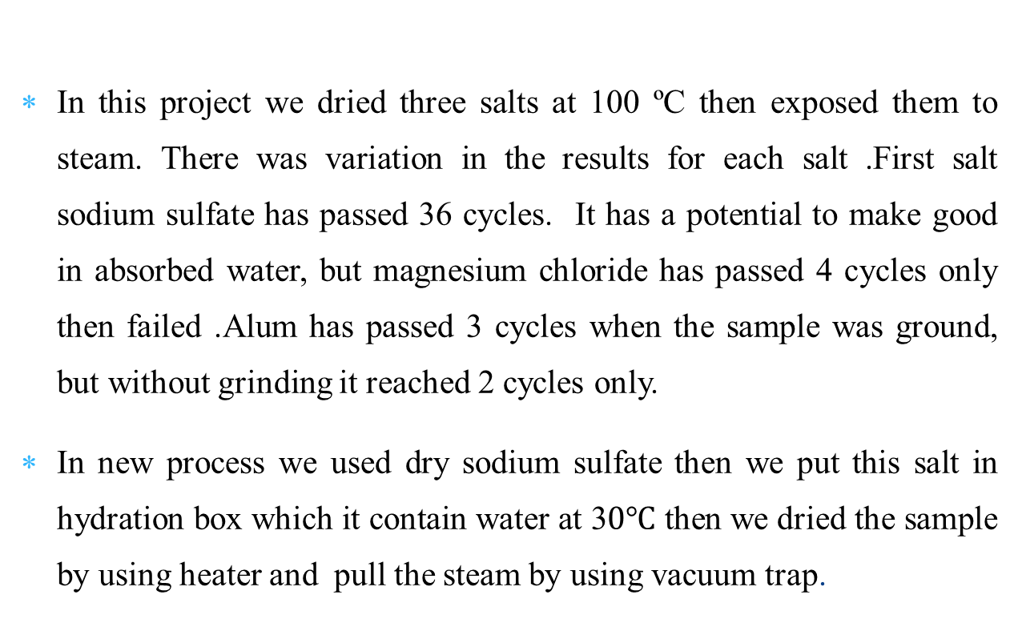
conclusion
In this project we dried three salts at 100 ºC then exposed them to steam. There was variation in the results for each salt .First salt sodium sulfate has passed 36 cycles. It has a potential to make good in absorbed water, but magnesium chloride has passed 4 cycles only then failed .Alum has passed 3 cycles when the sample was ground, but without grinding it reached 2 cycles only.
In new process we used dry sodium sulfate then we put this salt in hydration box which it contain water at 3$0℃$ then we dried the sample by using heater and pull the steam by using vacuum trap.

Slide 21
Thank you

