Slide 1
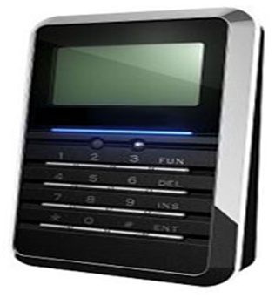
Attendance Monitoring System using RFID Technology
Presented by :
Ayesh Minawi
Sudqi Yaseen
Laila Ghannam
Supervised by :
Dr. Mazen Rasekh

Slide 2
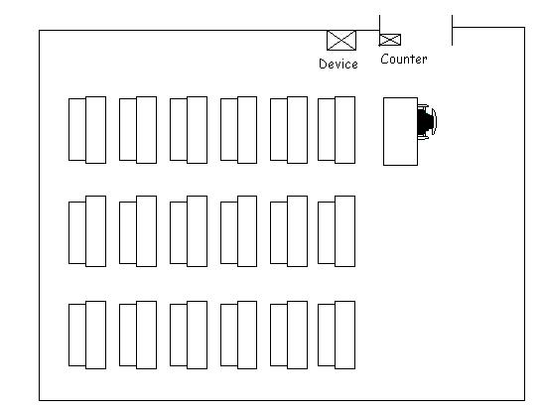
INTRODUCTION
The initial policy on attendance monitoring was approved by the Academic Standards and Development Committee (ASDC).
Monitoring of student engagement is being increasingly undertaken across Higher Education, both internationally and in the UK at the end of 2010.
we’re looking forward to applying
the system in our universities and
start moving side by side with the
world of technology.

Slide 3
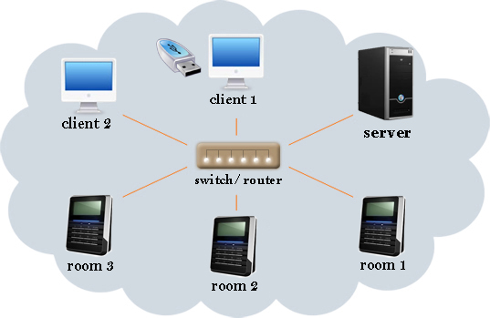
The Full system

Slide 4
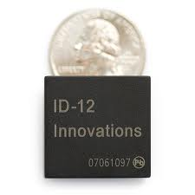

RFID Reader ID-12
Features:
5V supply
125kHz read frequency
EM2400 64-bit RFID tag compatible
9600bps TTL and RS232 output
Magnetic stripe emulation output
100mm read range

Slide 5
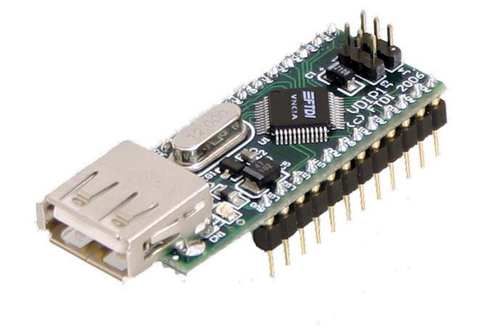
VDIP USB Host Controller
Description:
The VDIP1 module is an MCU to embedded USB host controller development module for the VNC1L IC device.
Features:
Single 5V supply input from USB connection.
Built-in 8/32 bit MCU.
Handles the FAT file structure via a simple command set.
Program or update firmware for data transfer function.
Low power operation (25µA at running,2µA at stand By).

Slide 6
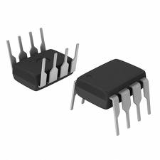
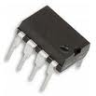
24C65 EEPROM
Description
primary memory which size is 64kbit,
using I2C protocol Interface.
Number of student can be saved in it :
64kbit\8=8kbyte
Every student is represented by 9 bytes
( 8*1024)=8192\9= 910 students.
Real Time Clock DS1302
Backup battery with 9 years life time.
Uses I2C protocol interface.

Slide 7
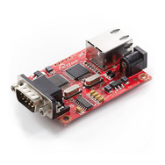
WIZnet Serial-to-Ethernet Gateway - WIZ110SR
Description :
The WIZ110SR is a gateway module that converts RS-232 protocol into TCP/IP and
Vice versa.
Features:
Simple configuration over serial interface
5VDC input voltage
Under 180mA current consumption
Supports password for security

Slide 8
Power Calculation
Parts | Volt (v) | Ampere (mA)
Ethernet Controller | 5 | 180
VDIP1 | 5 | 250
PIC16F877 | 5 | 25
LCD | 5 | 50
Other parts | 5 | 20
The total current =525 mA
Total power consumption=2.875 watt
Backup battery is 600mAh , so 600/525 = 1.14 hour

Slide 9
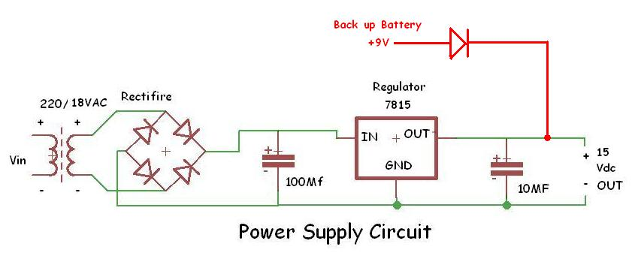
Power Supply
Maximum output current (1 A).
Notes:
And we made a back up p.s if there is an interruption of the main supply

Slide 10
Main Device Blocks
keypad
LCD
RFID Reader
Memory flash
Tags
PC
Microcontroller
Ethernet
Server
Clock
Primary Memory

Slide 11
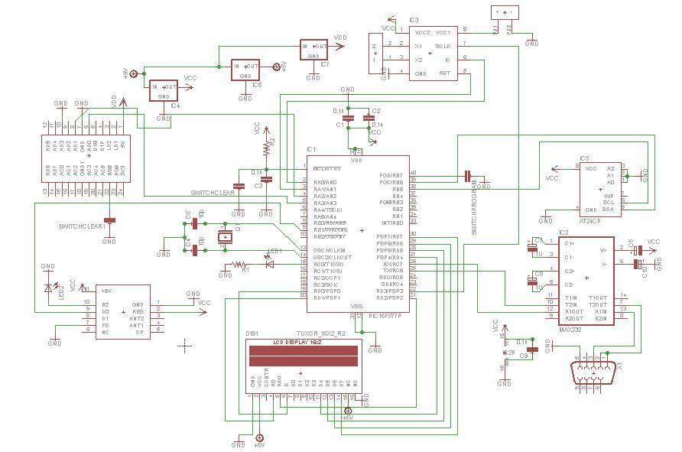
Project Circuit

Slide 12
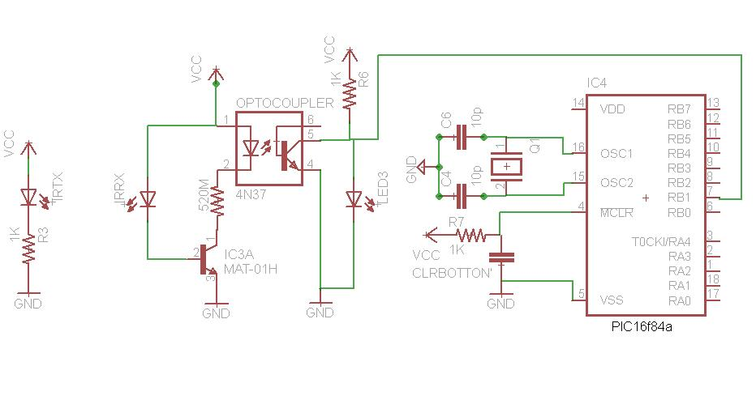
IR Door Counter

Slide 13
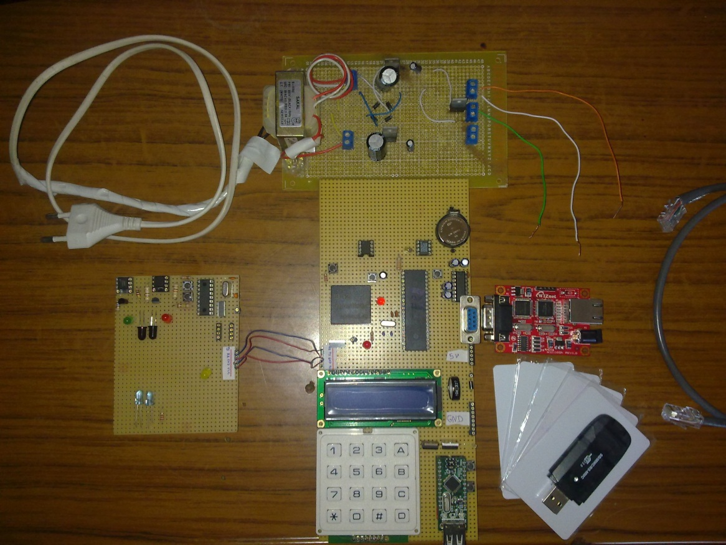

Slide 14
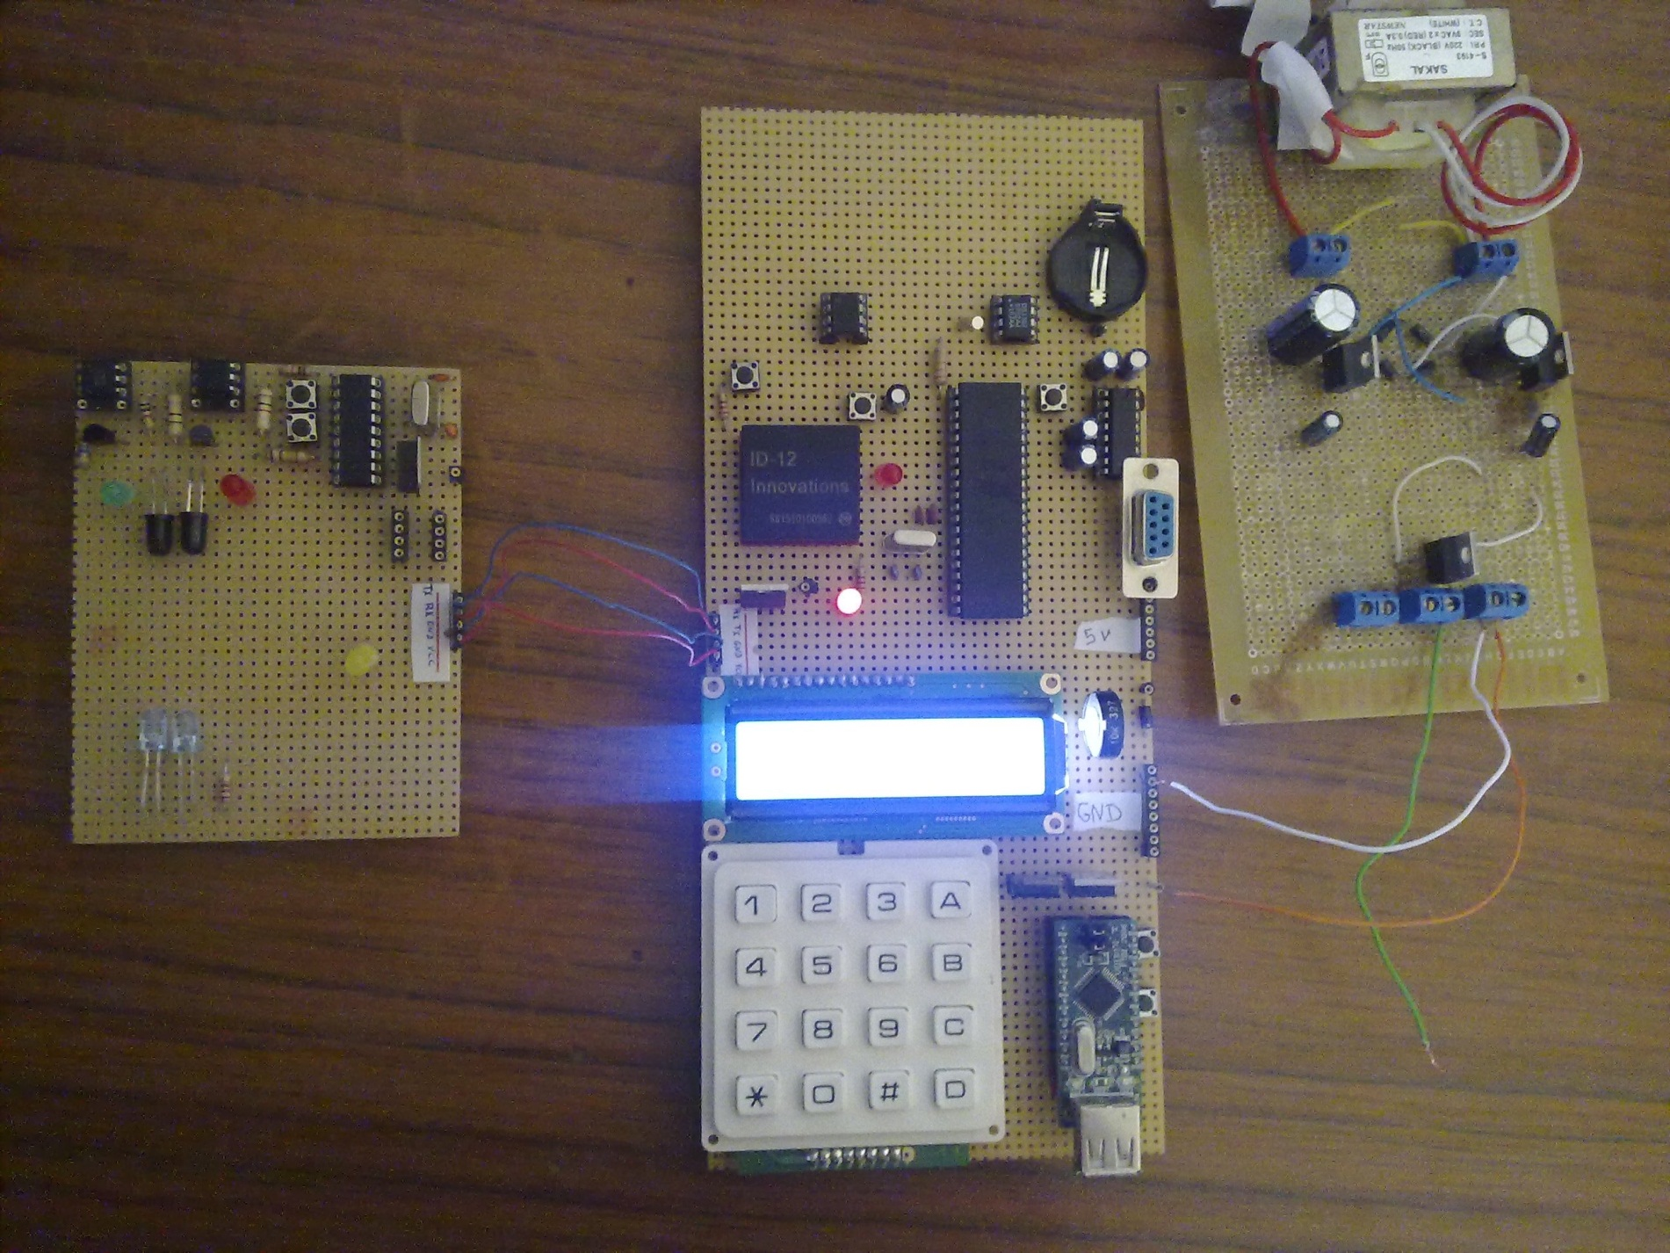

Slide 15
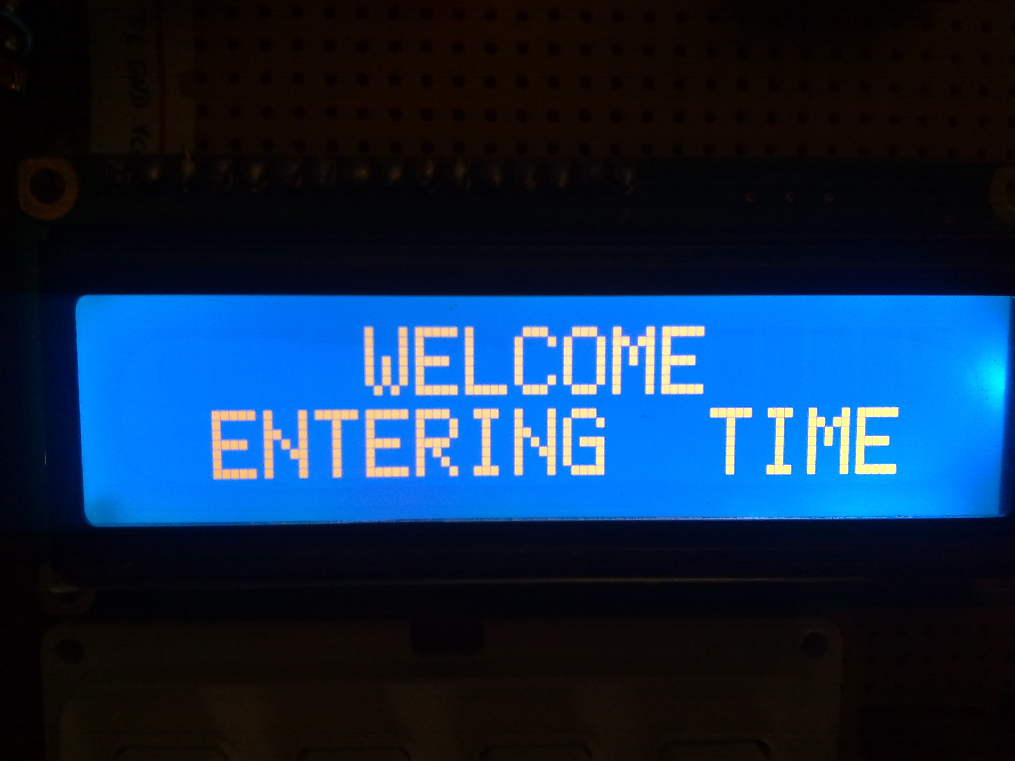

Slide 16
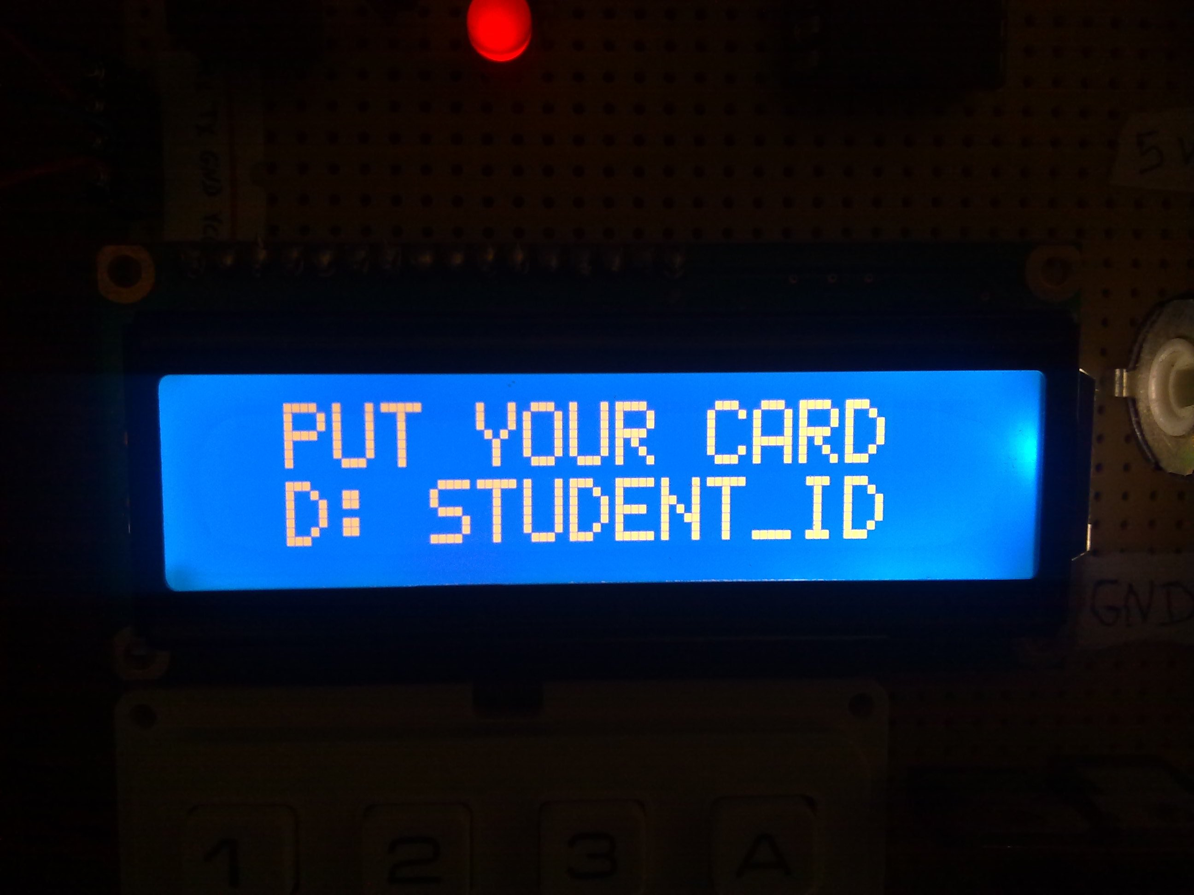

Slide 17
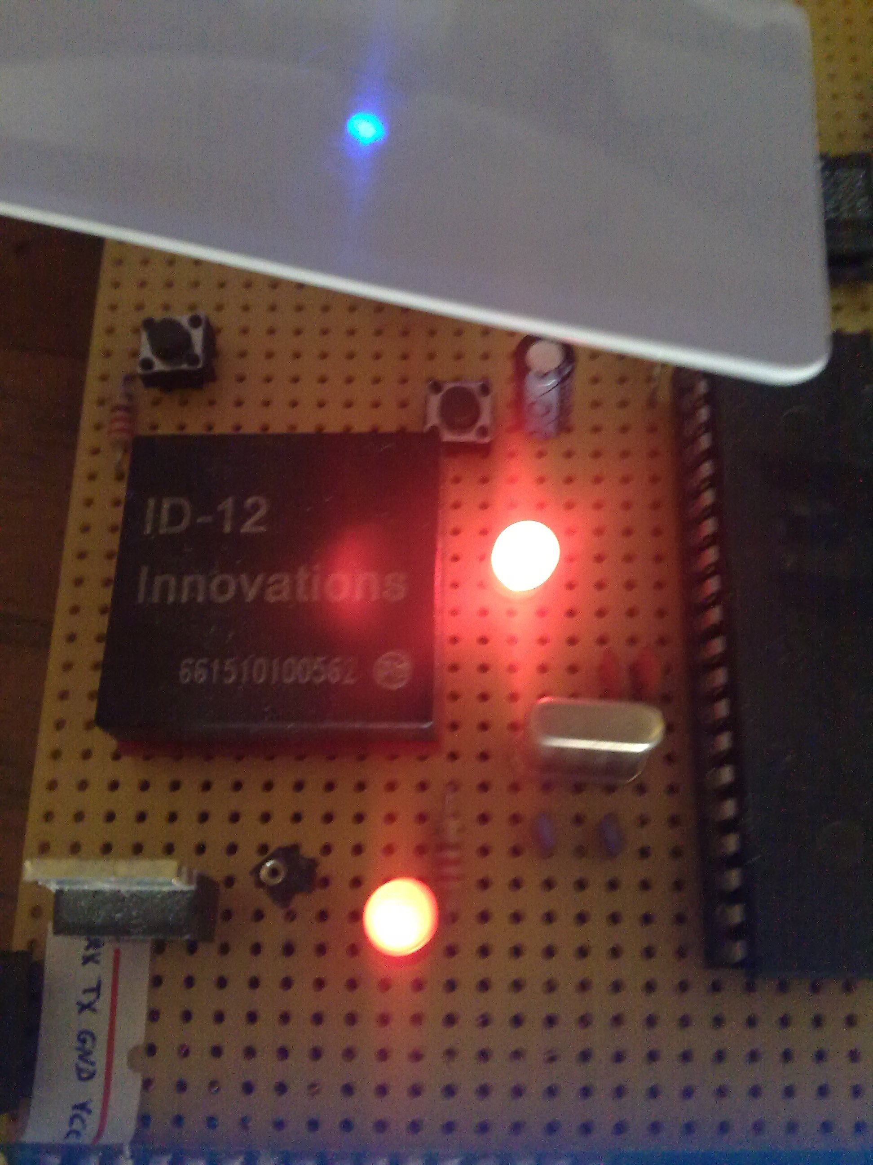

Slide 18
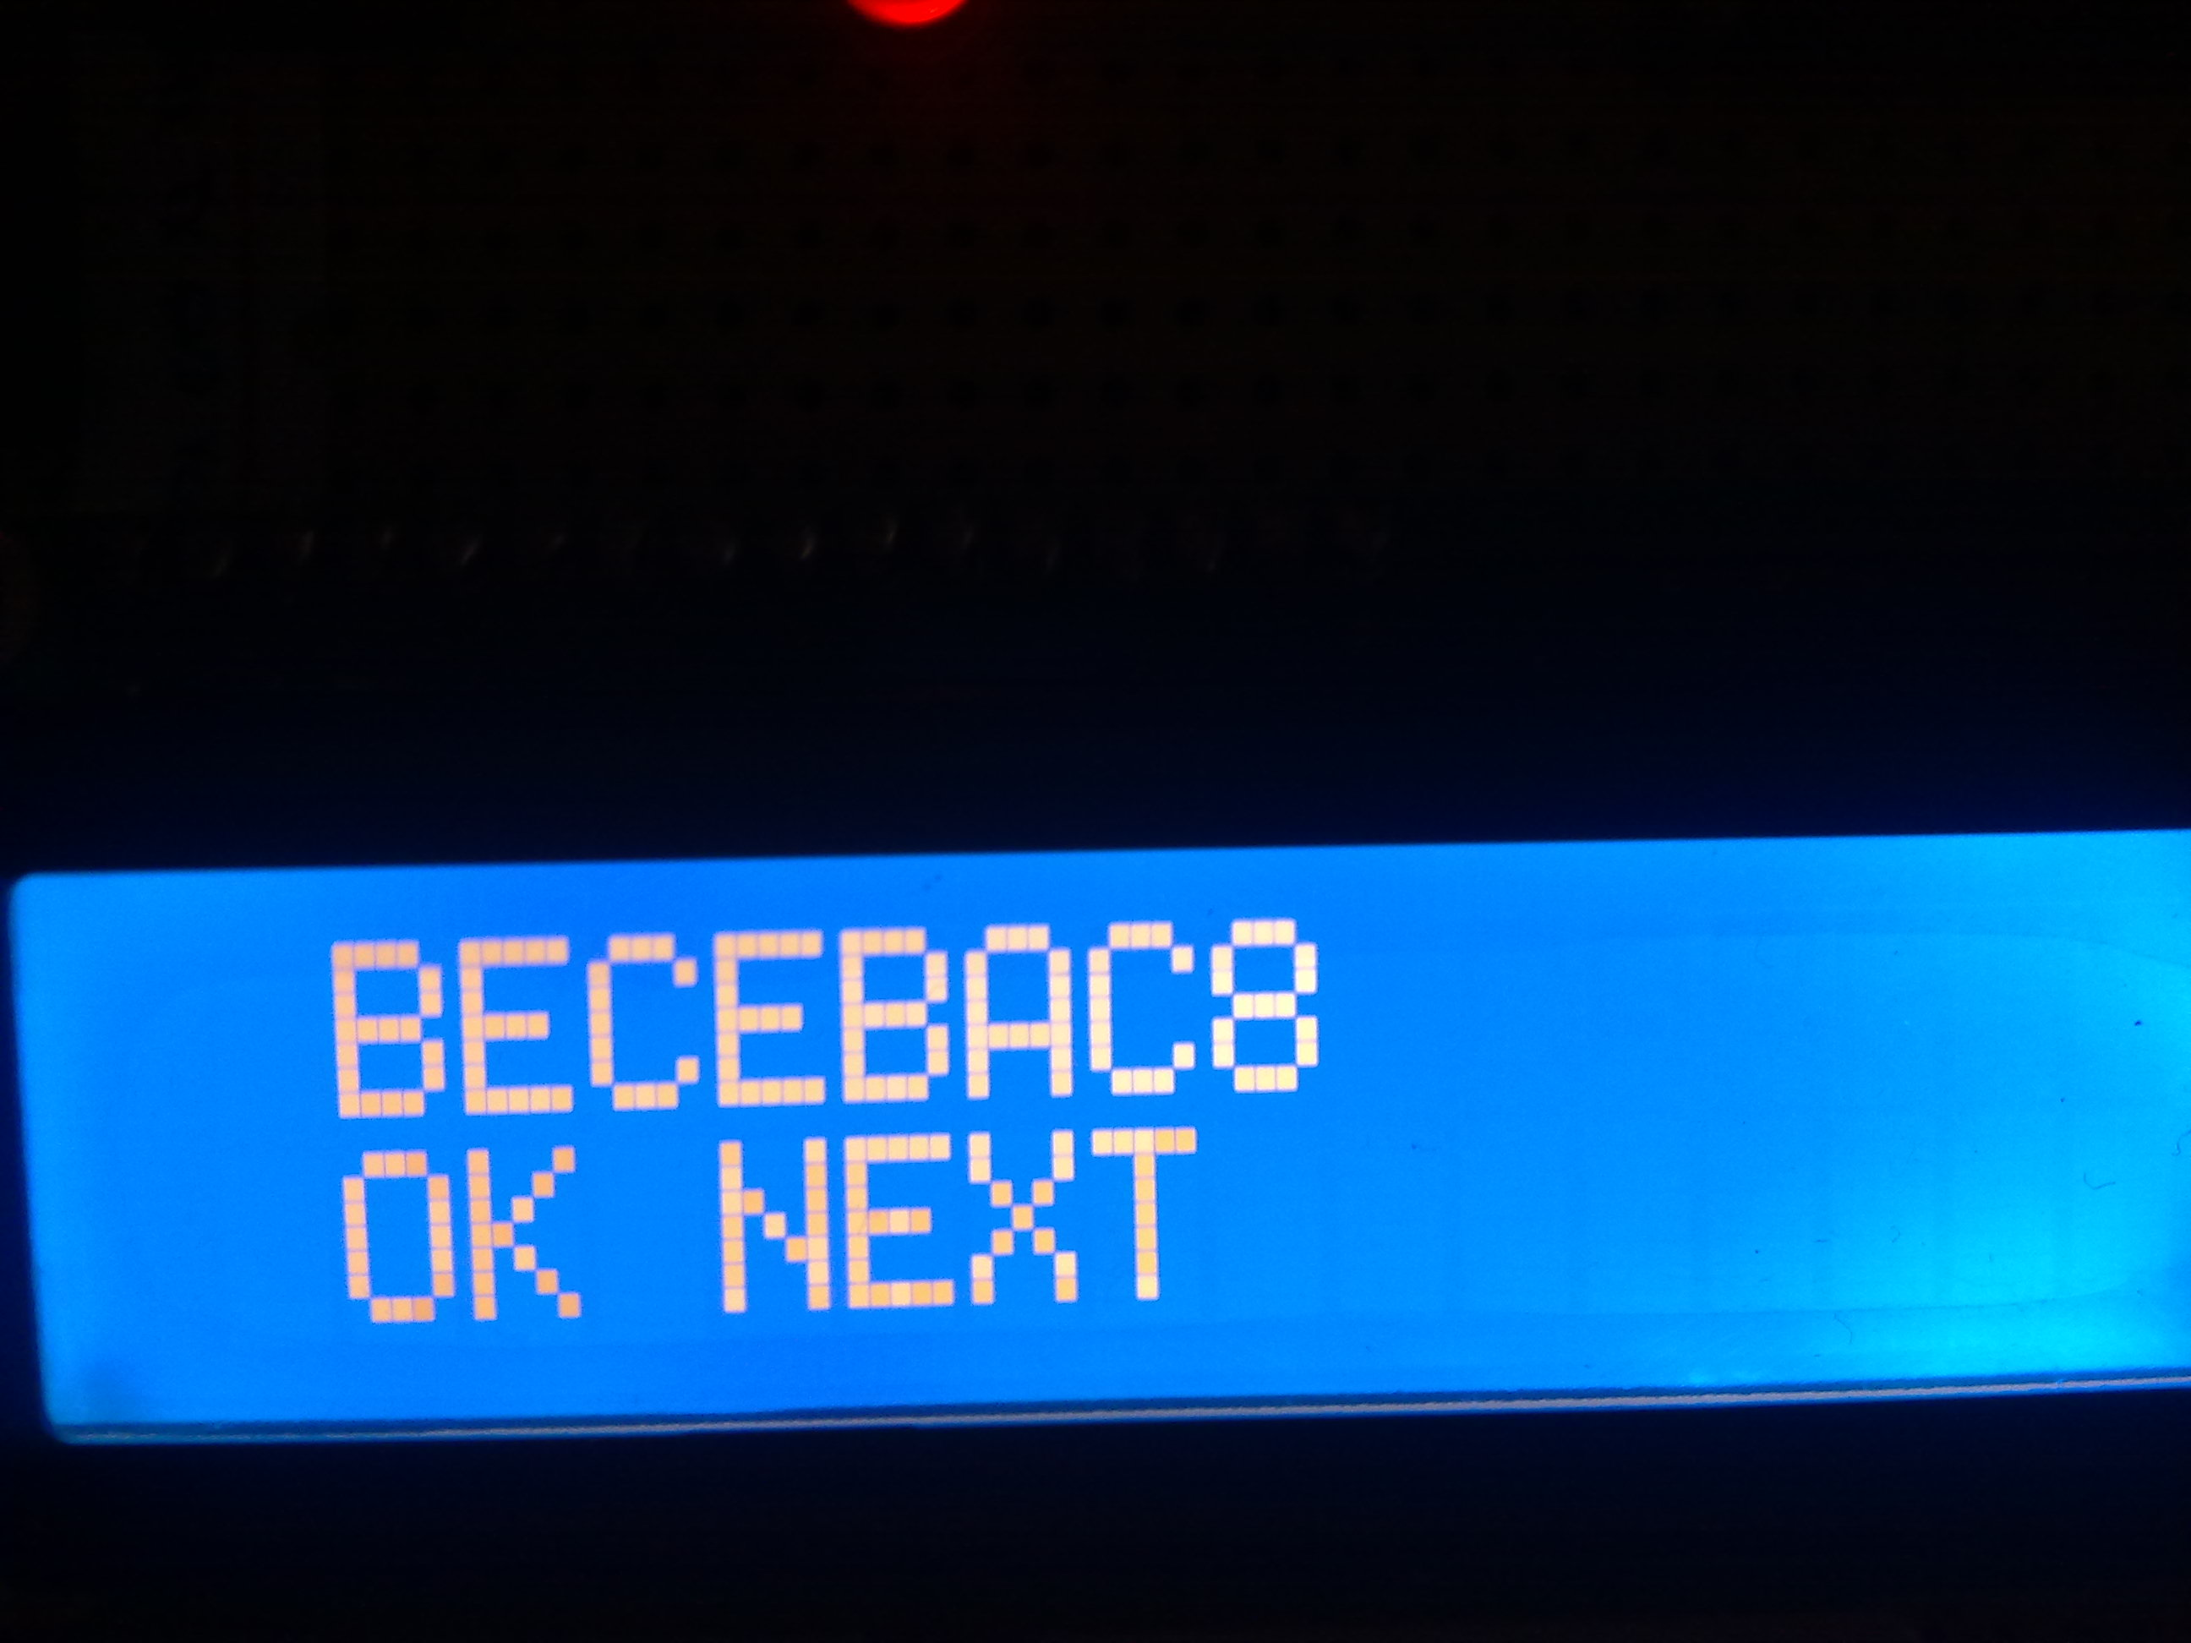

Slide 19
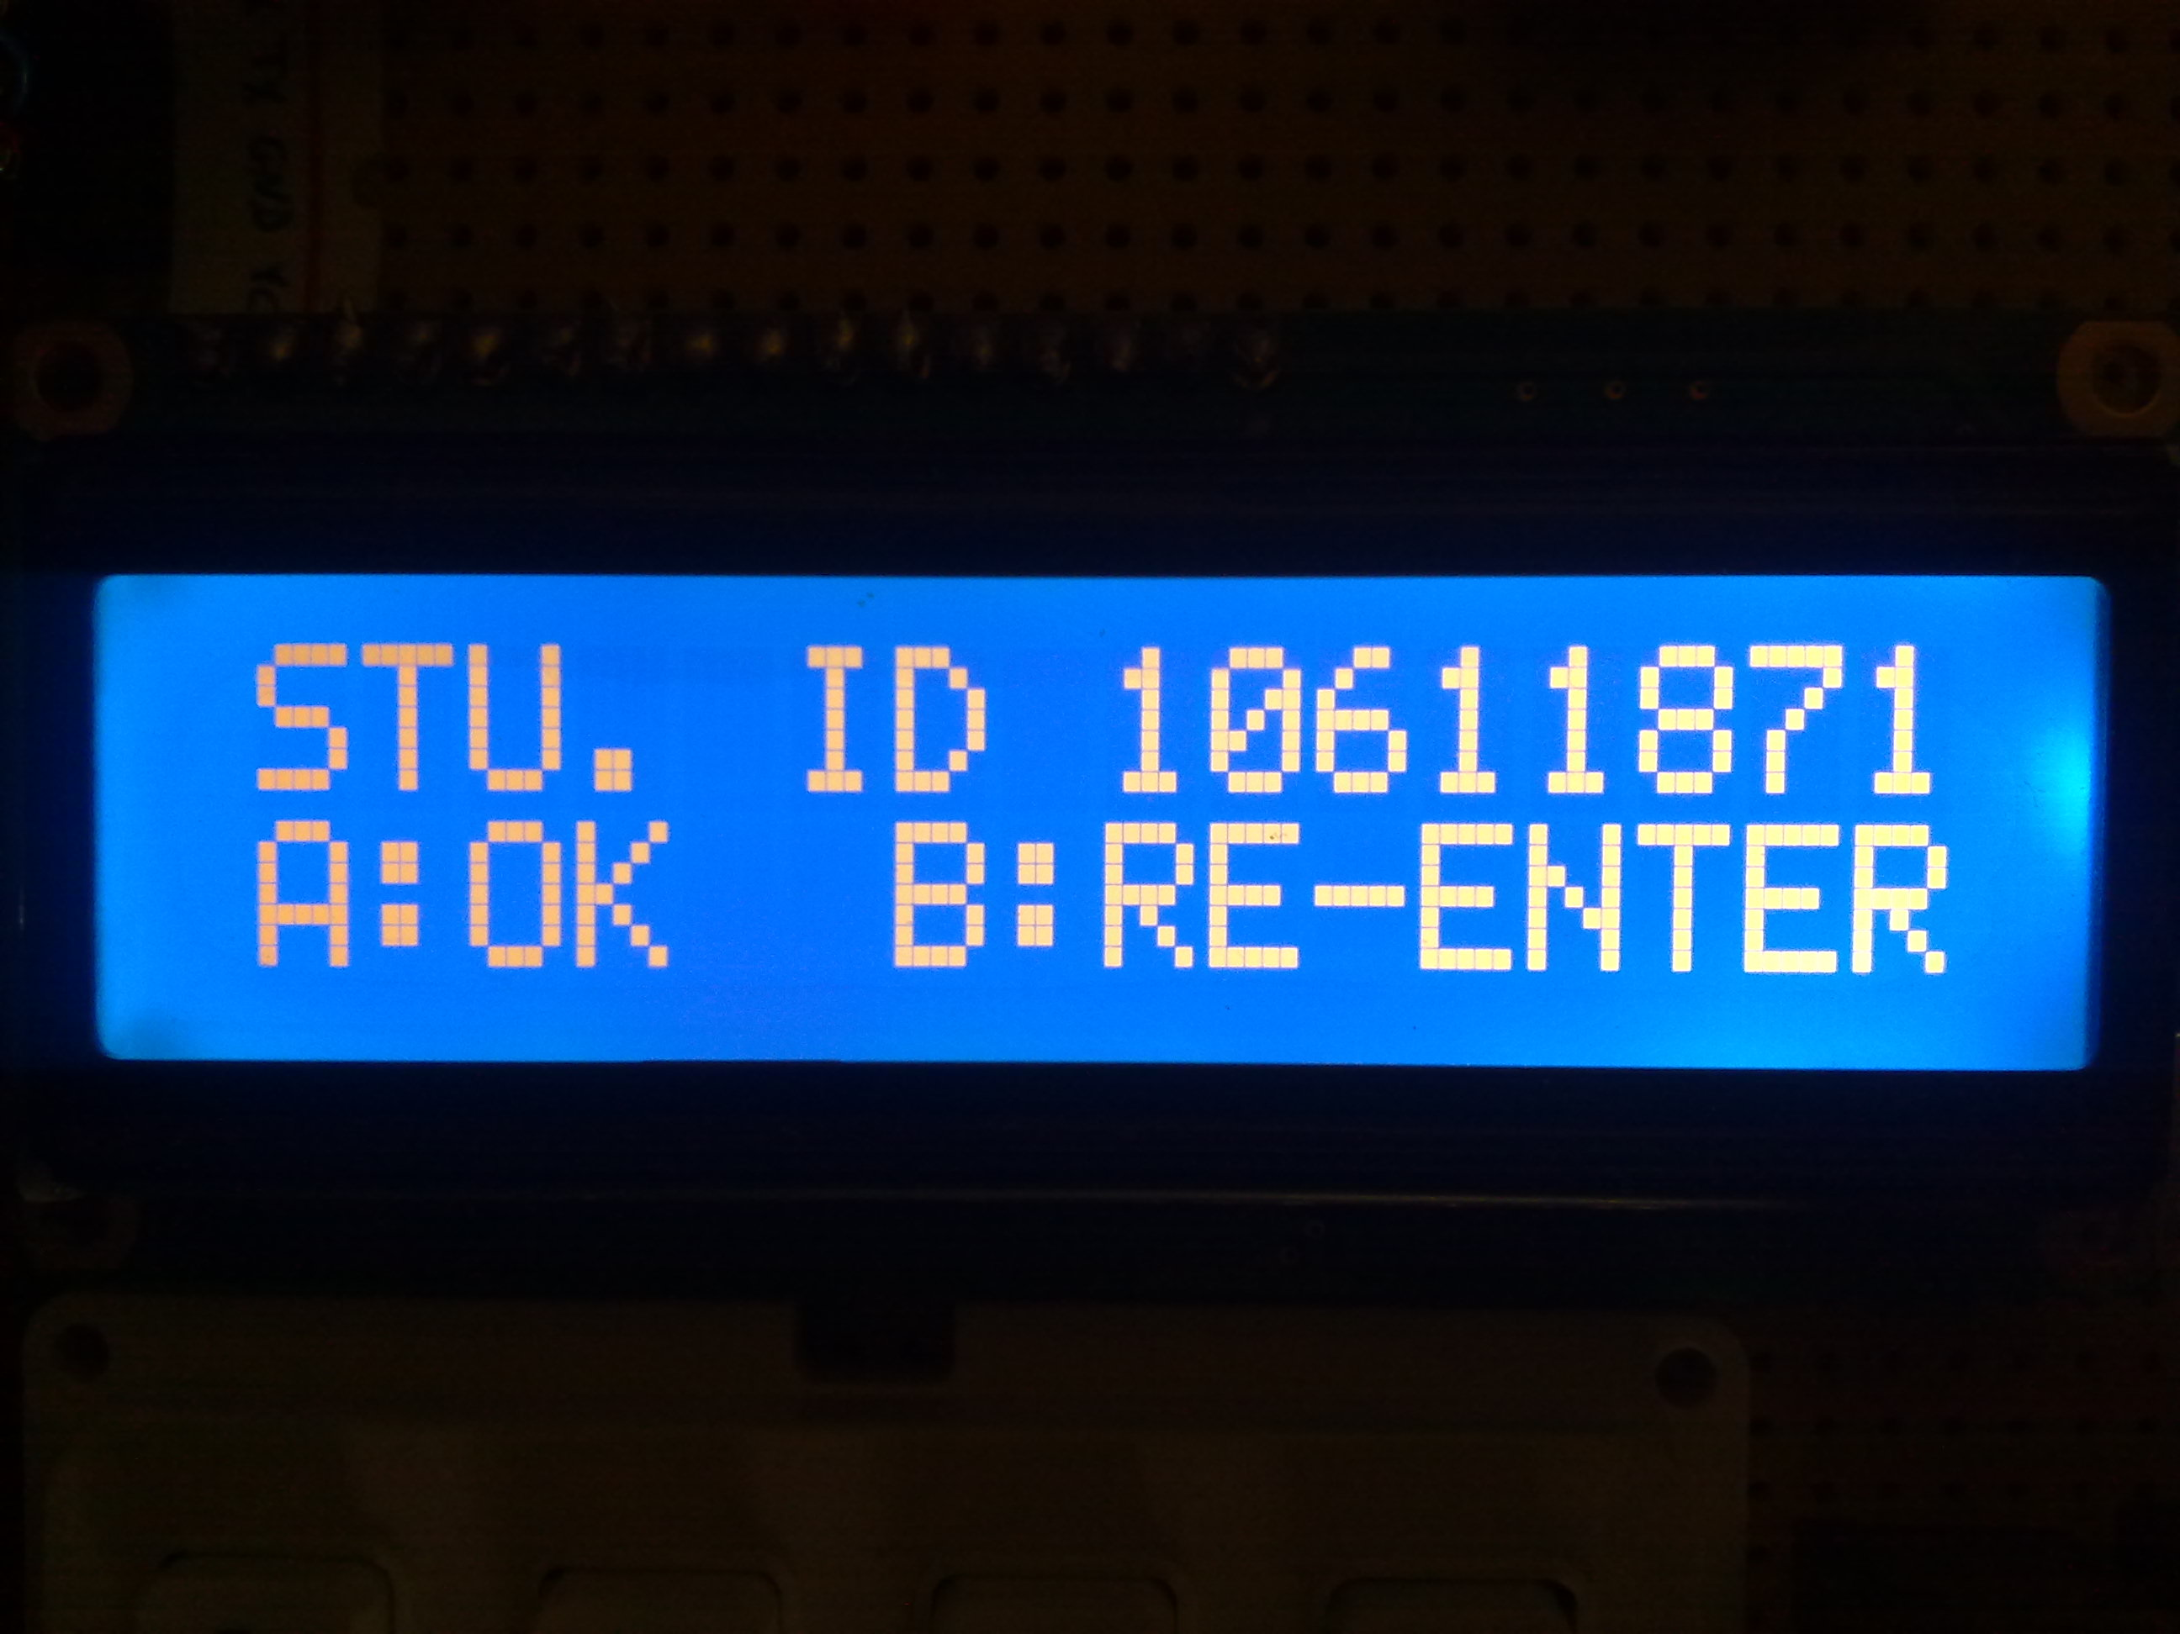

Slide 20
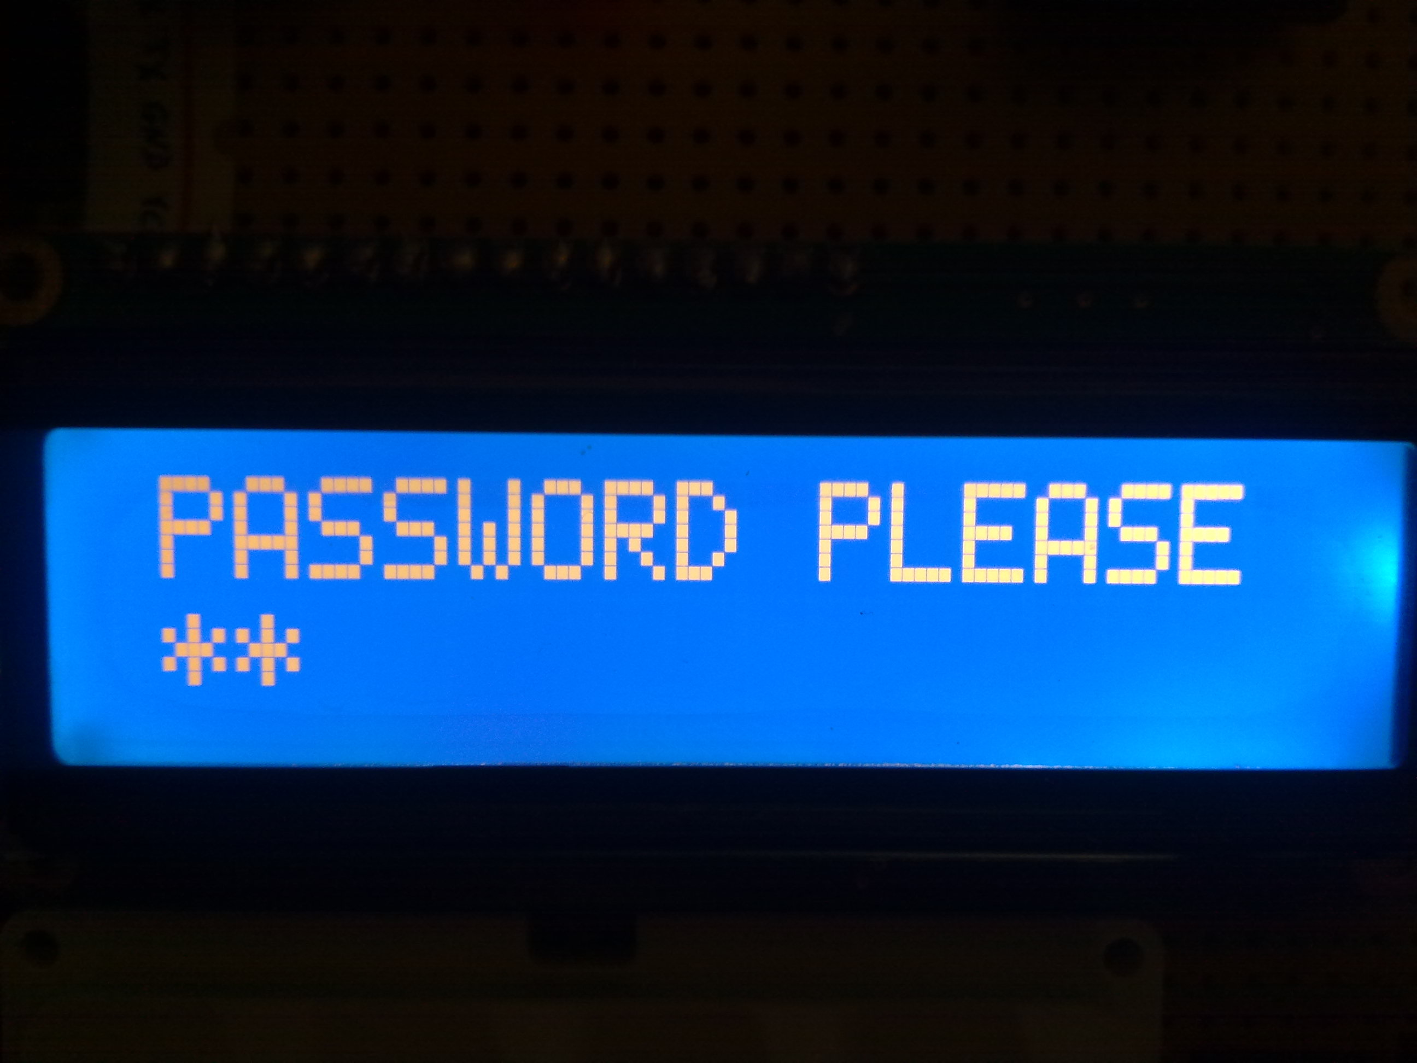

Slide 21
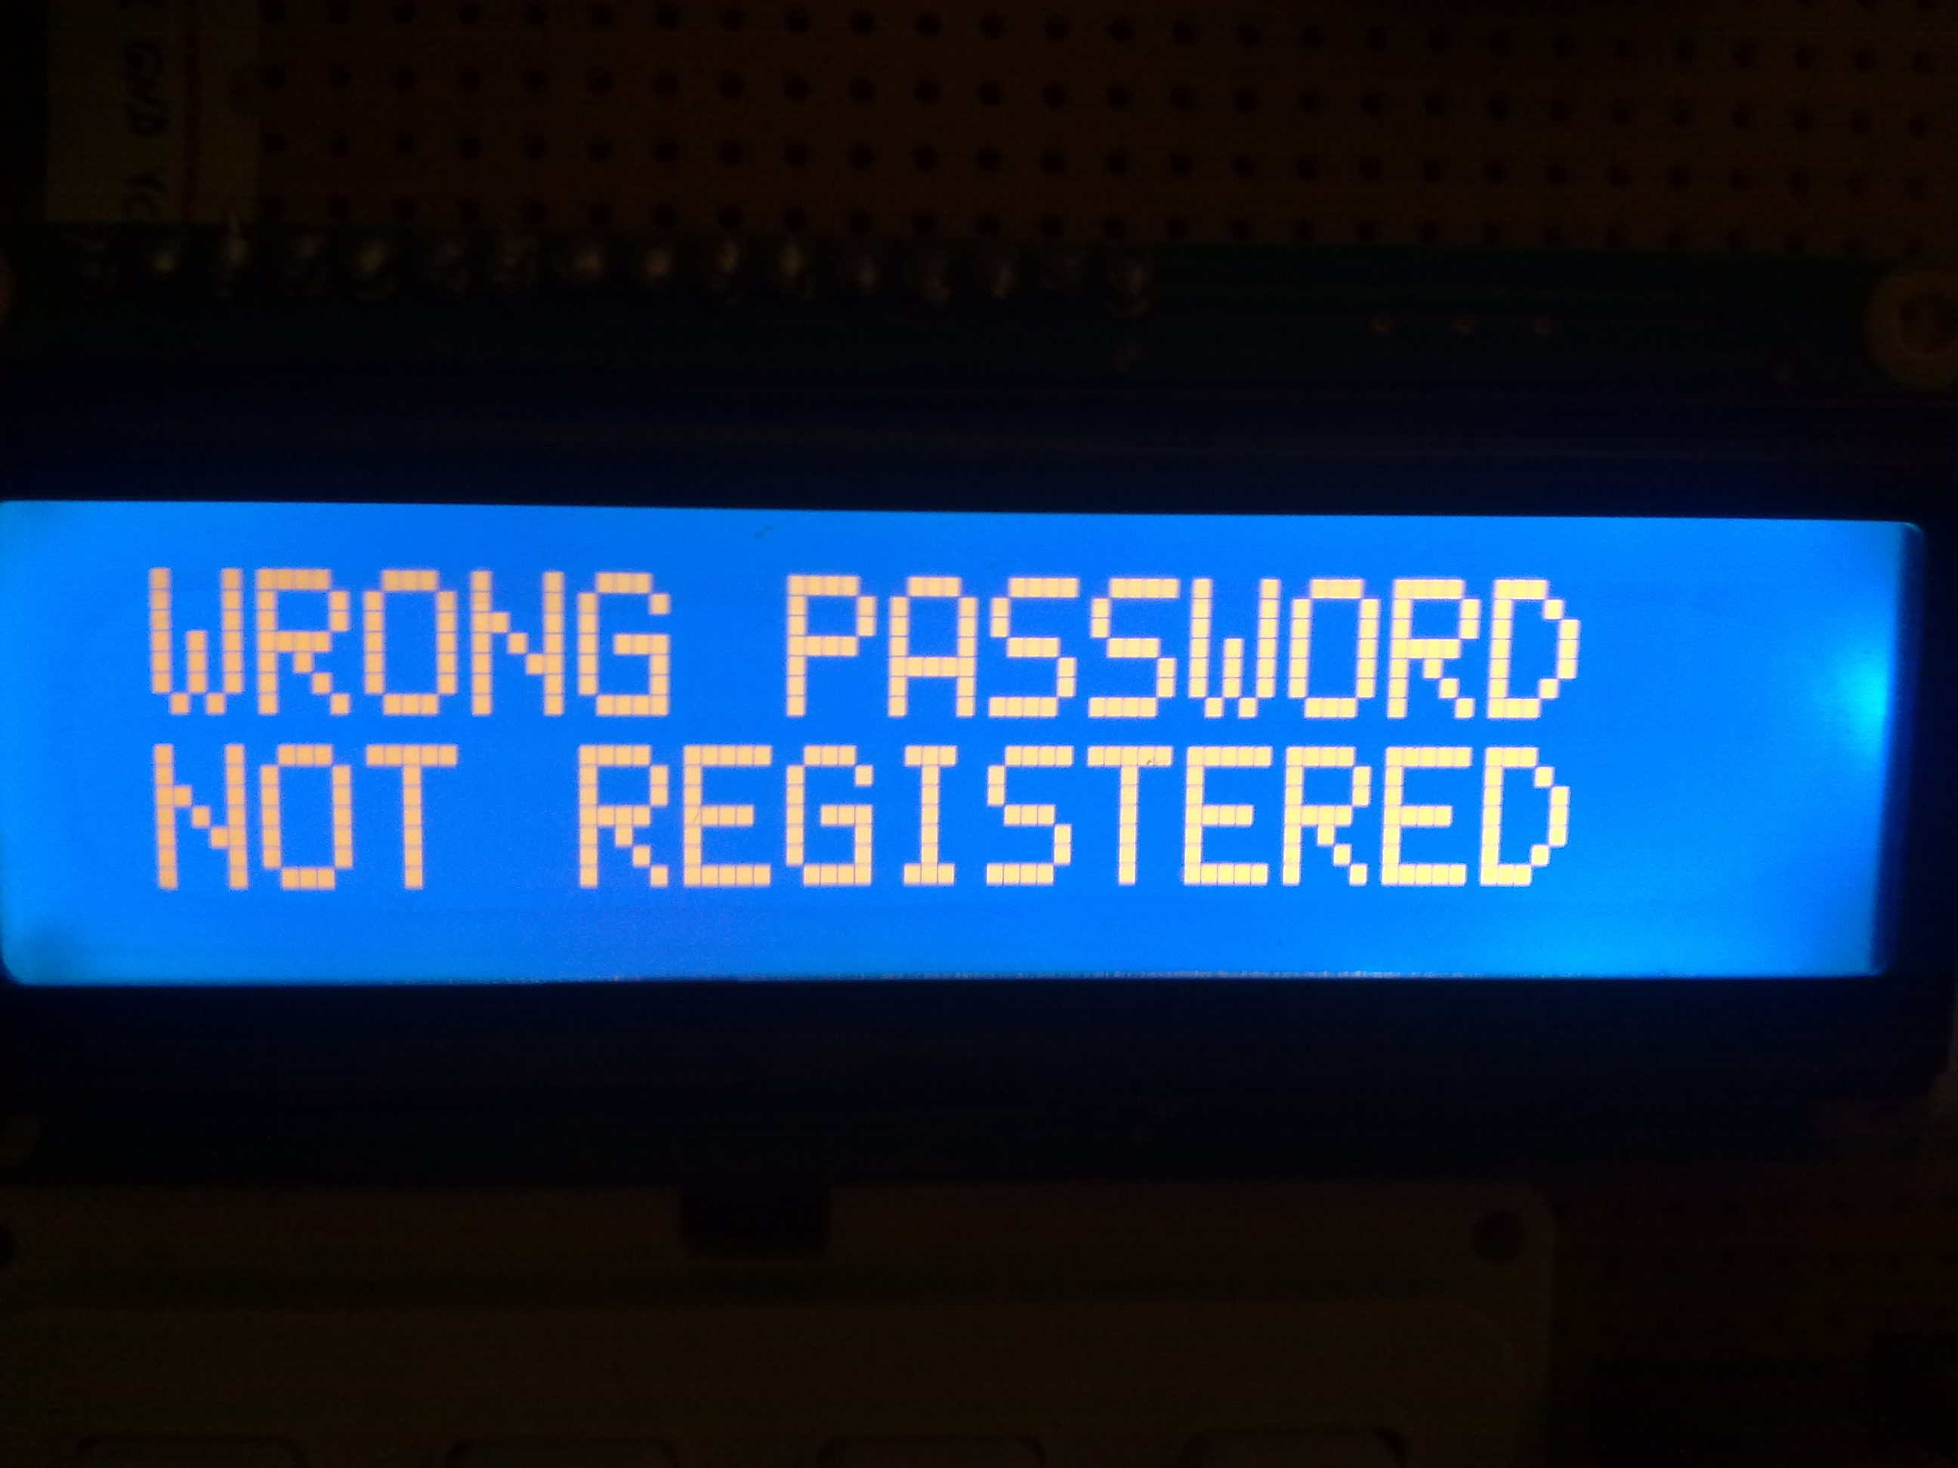

Slide 22
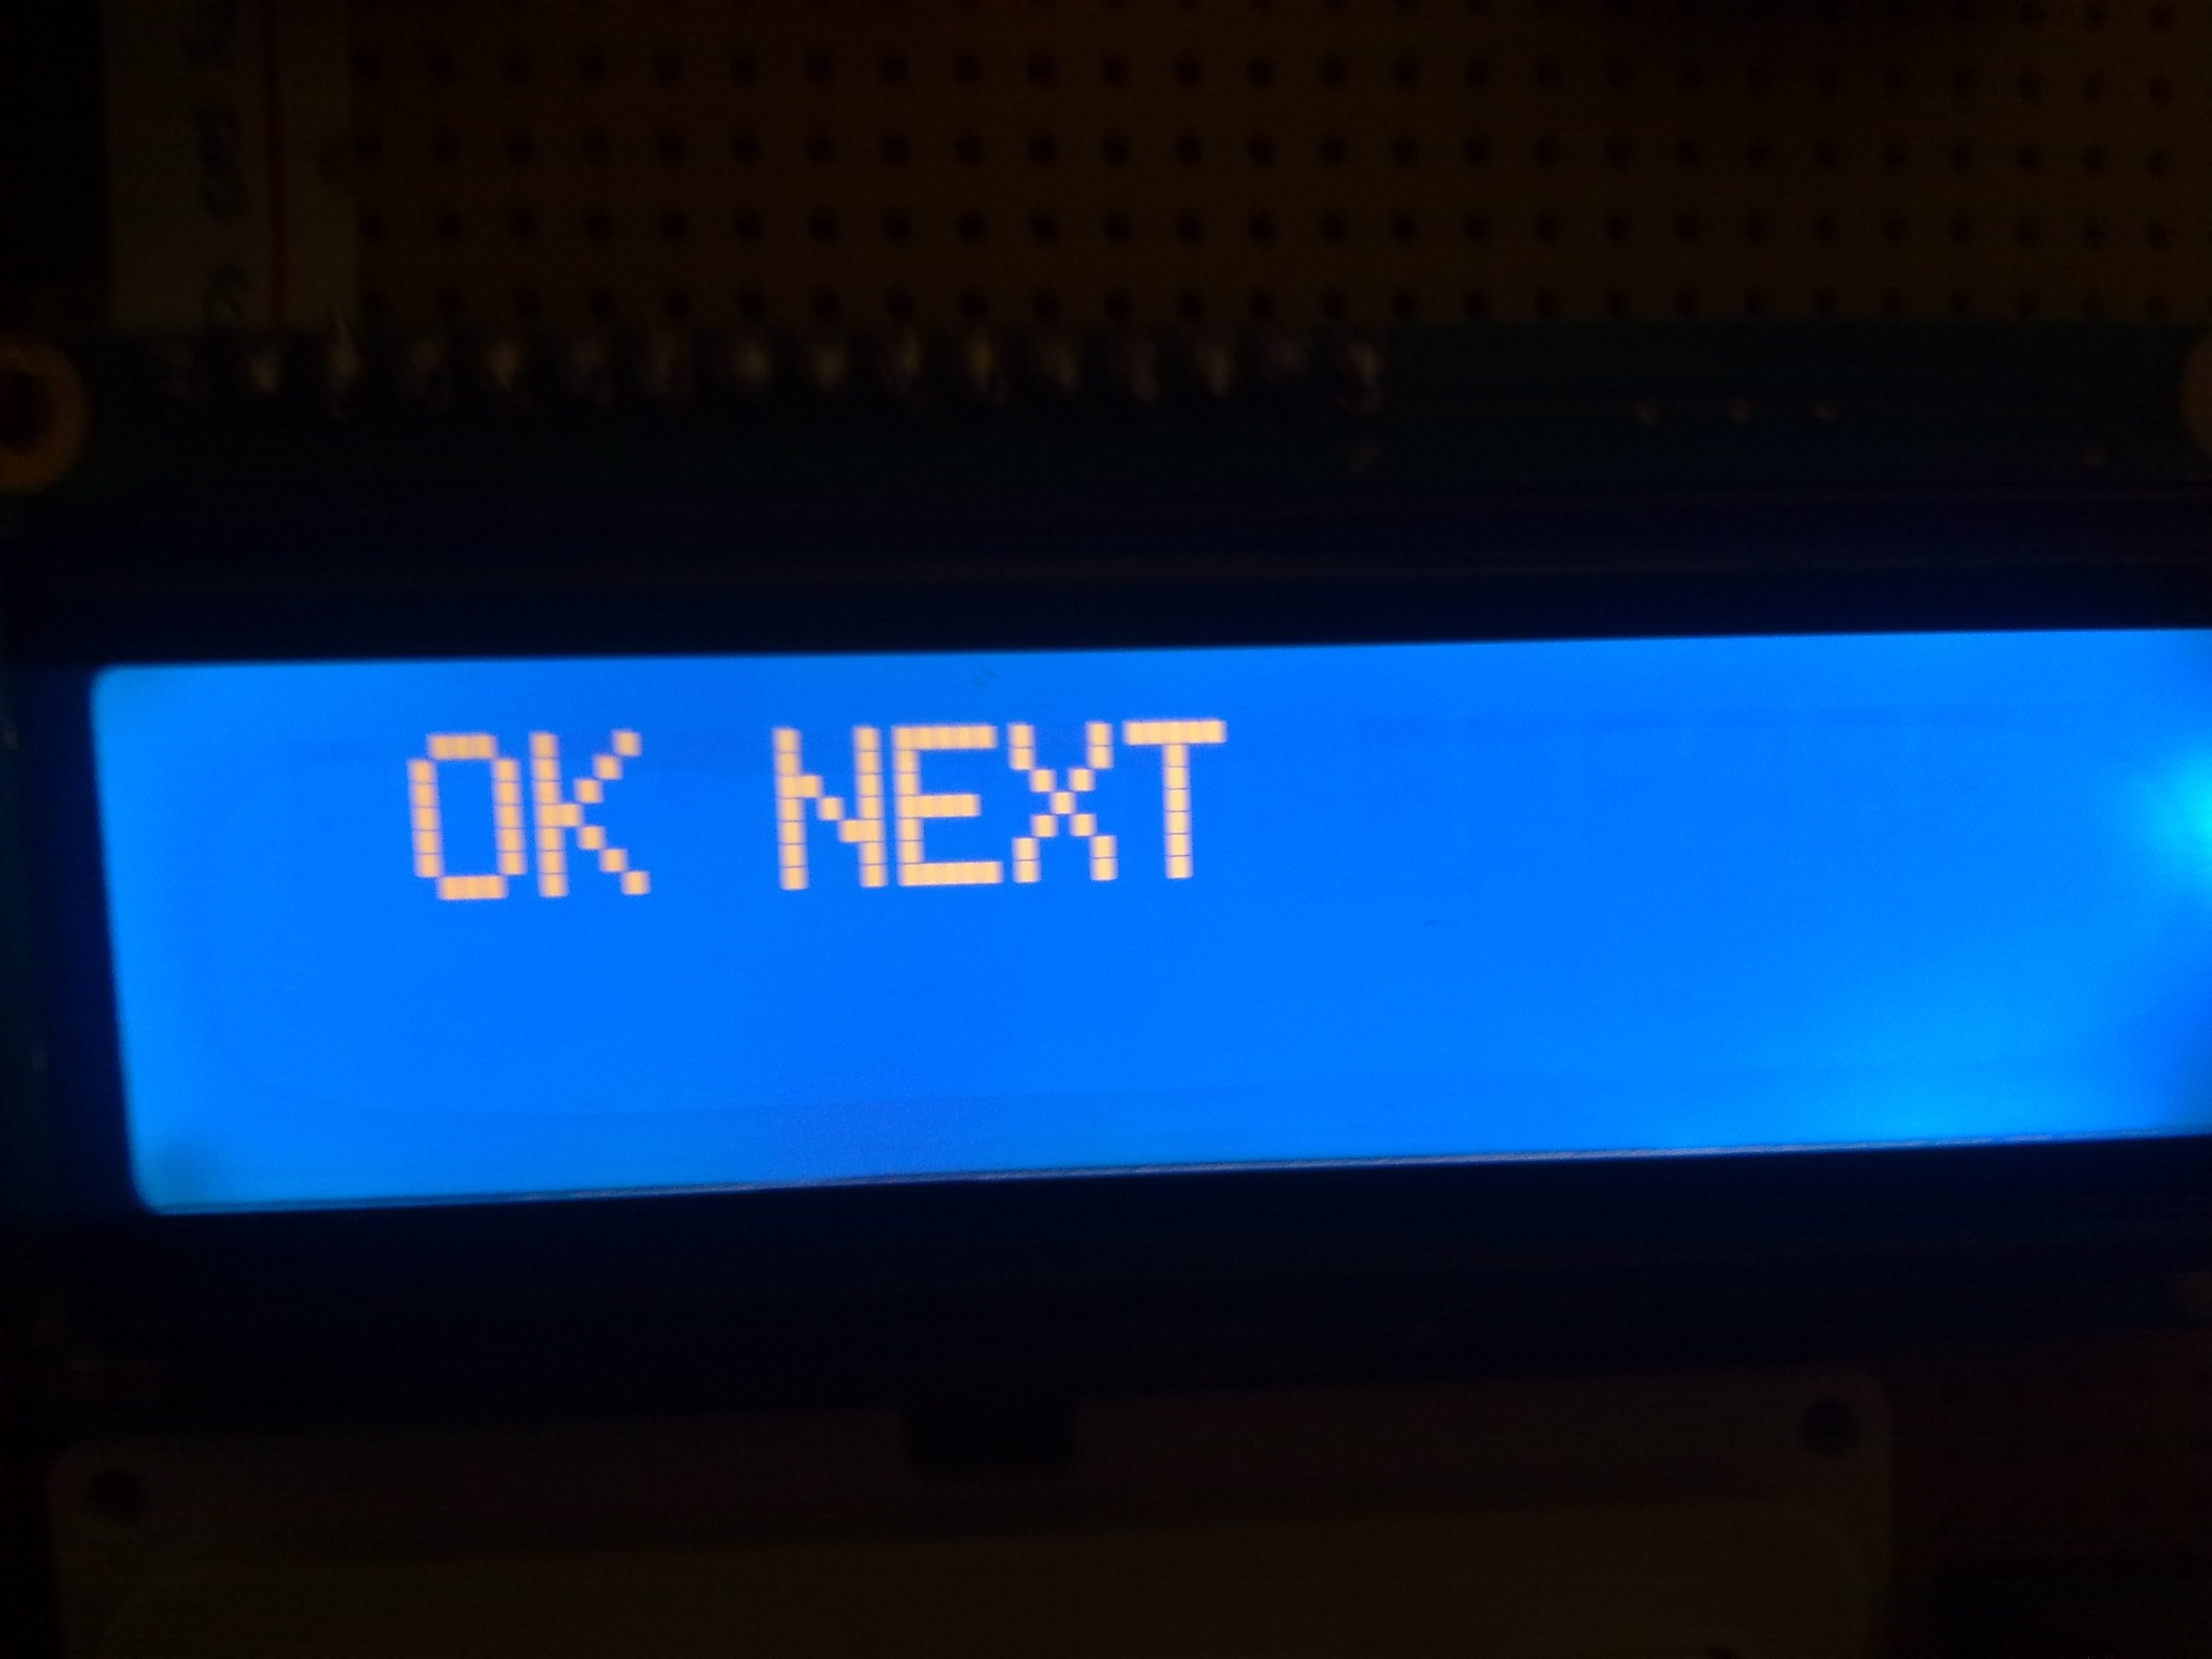

Slide 23
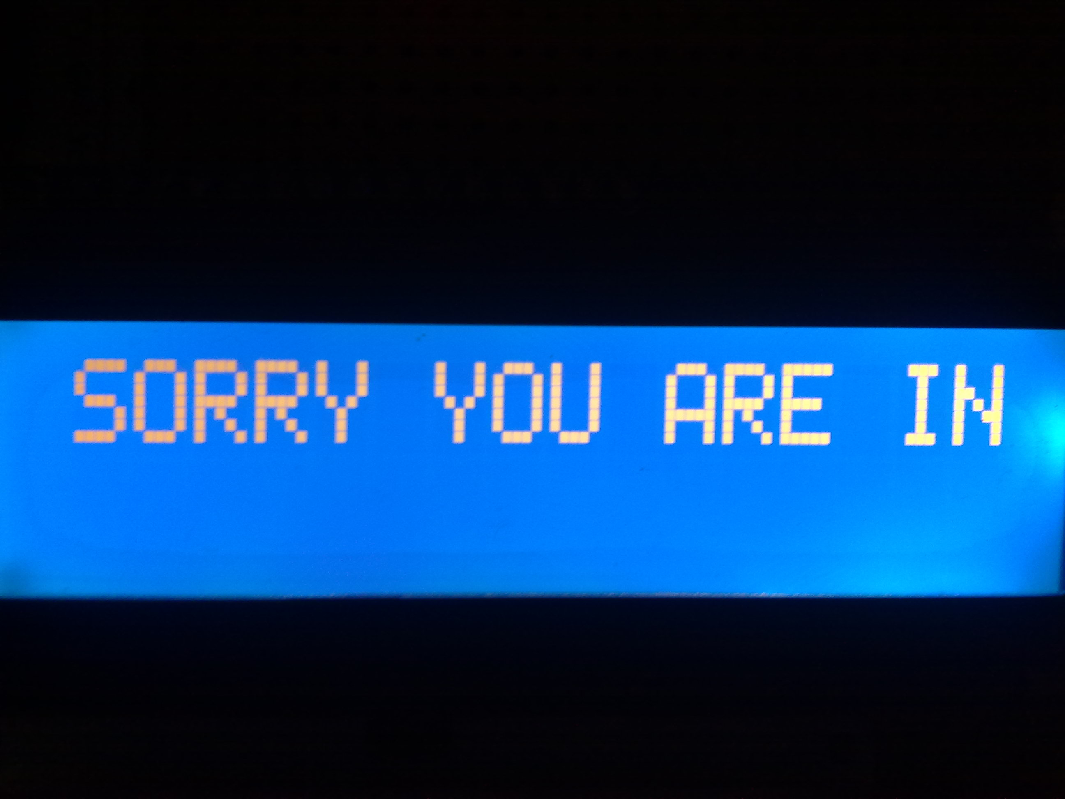

Slide 24
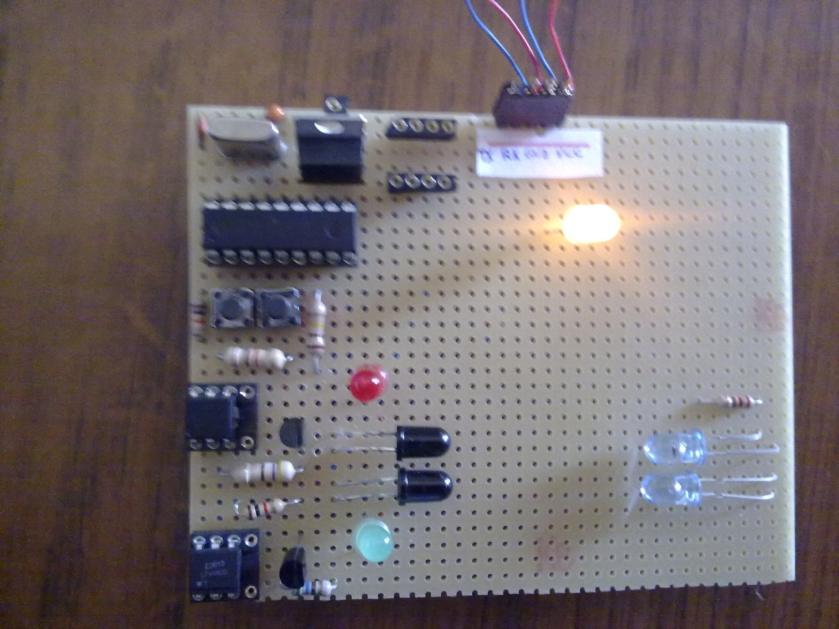

Slide 25
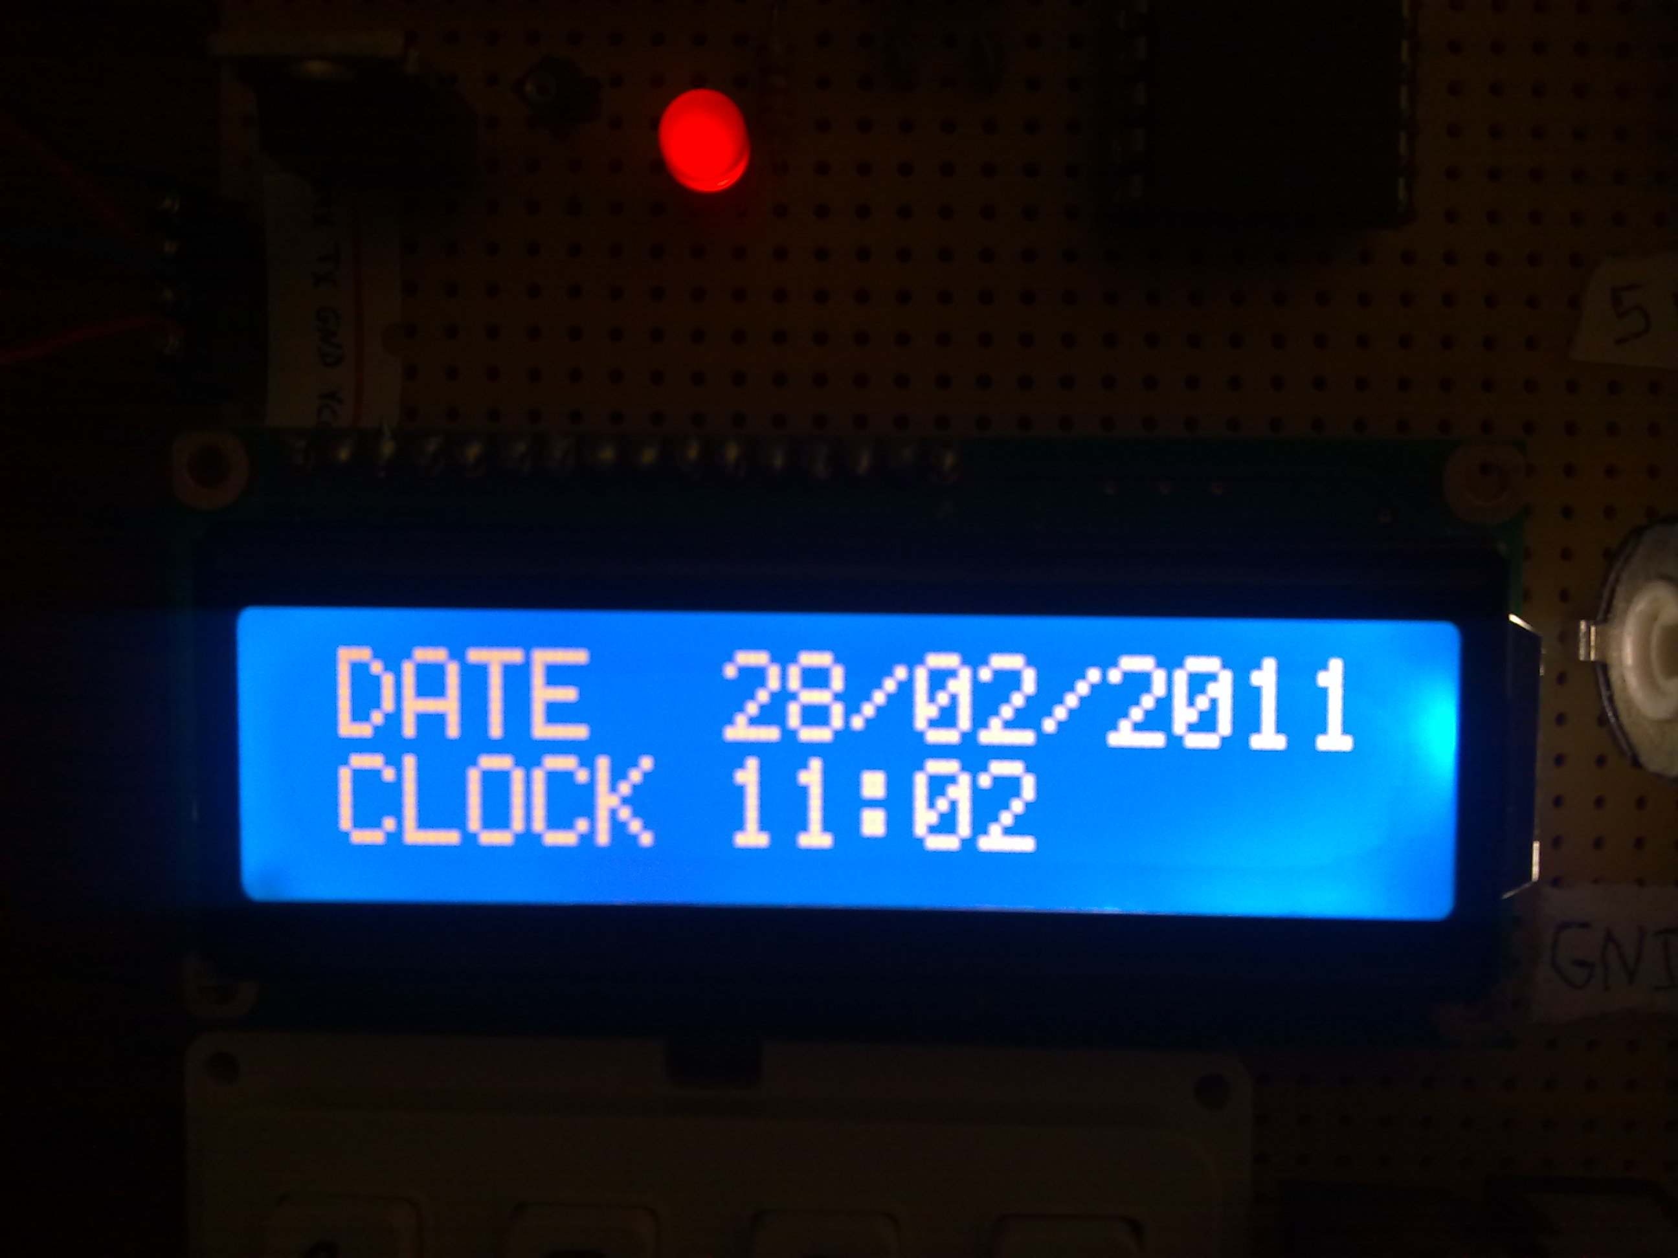

Slide 26
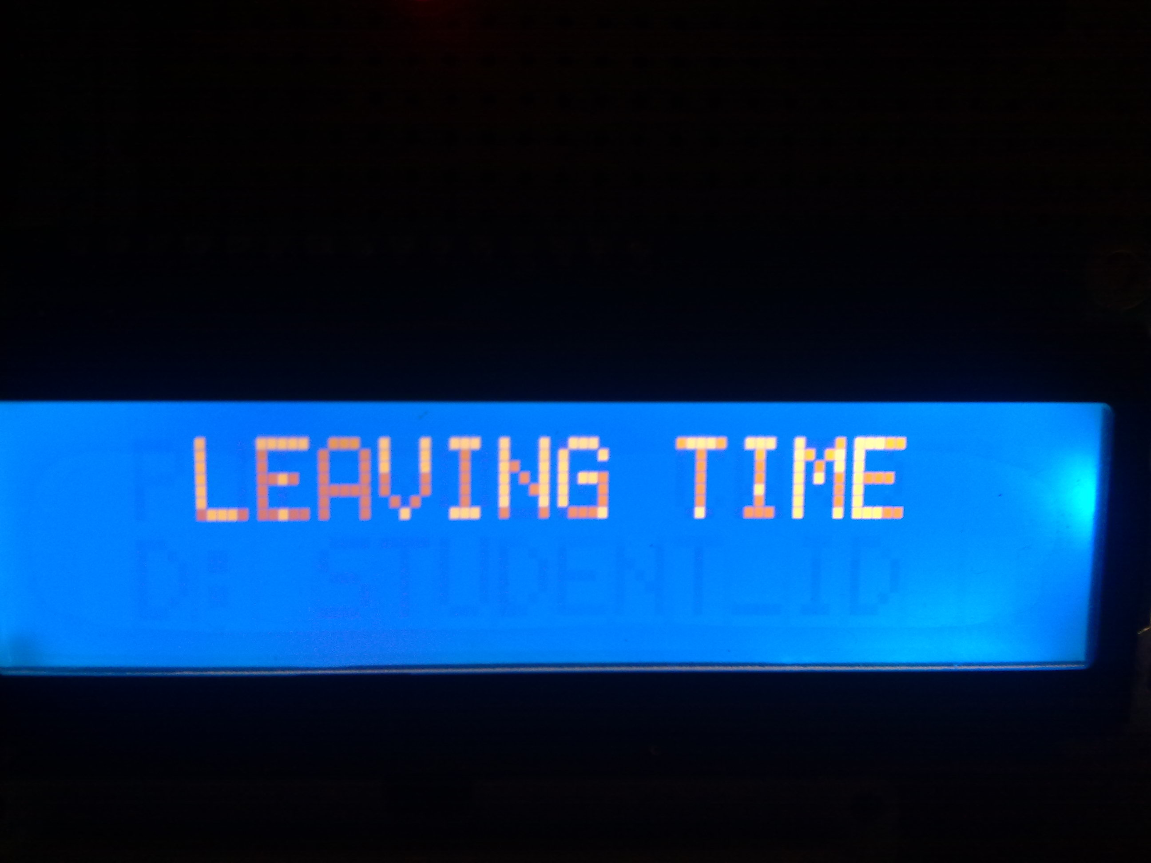

Slide 28
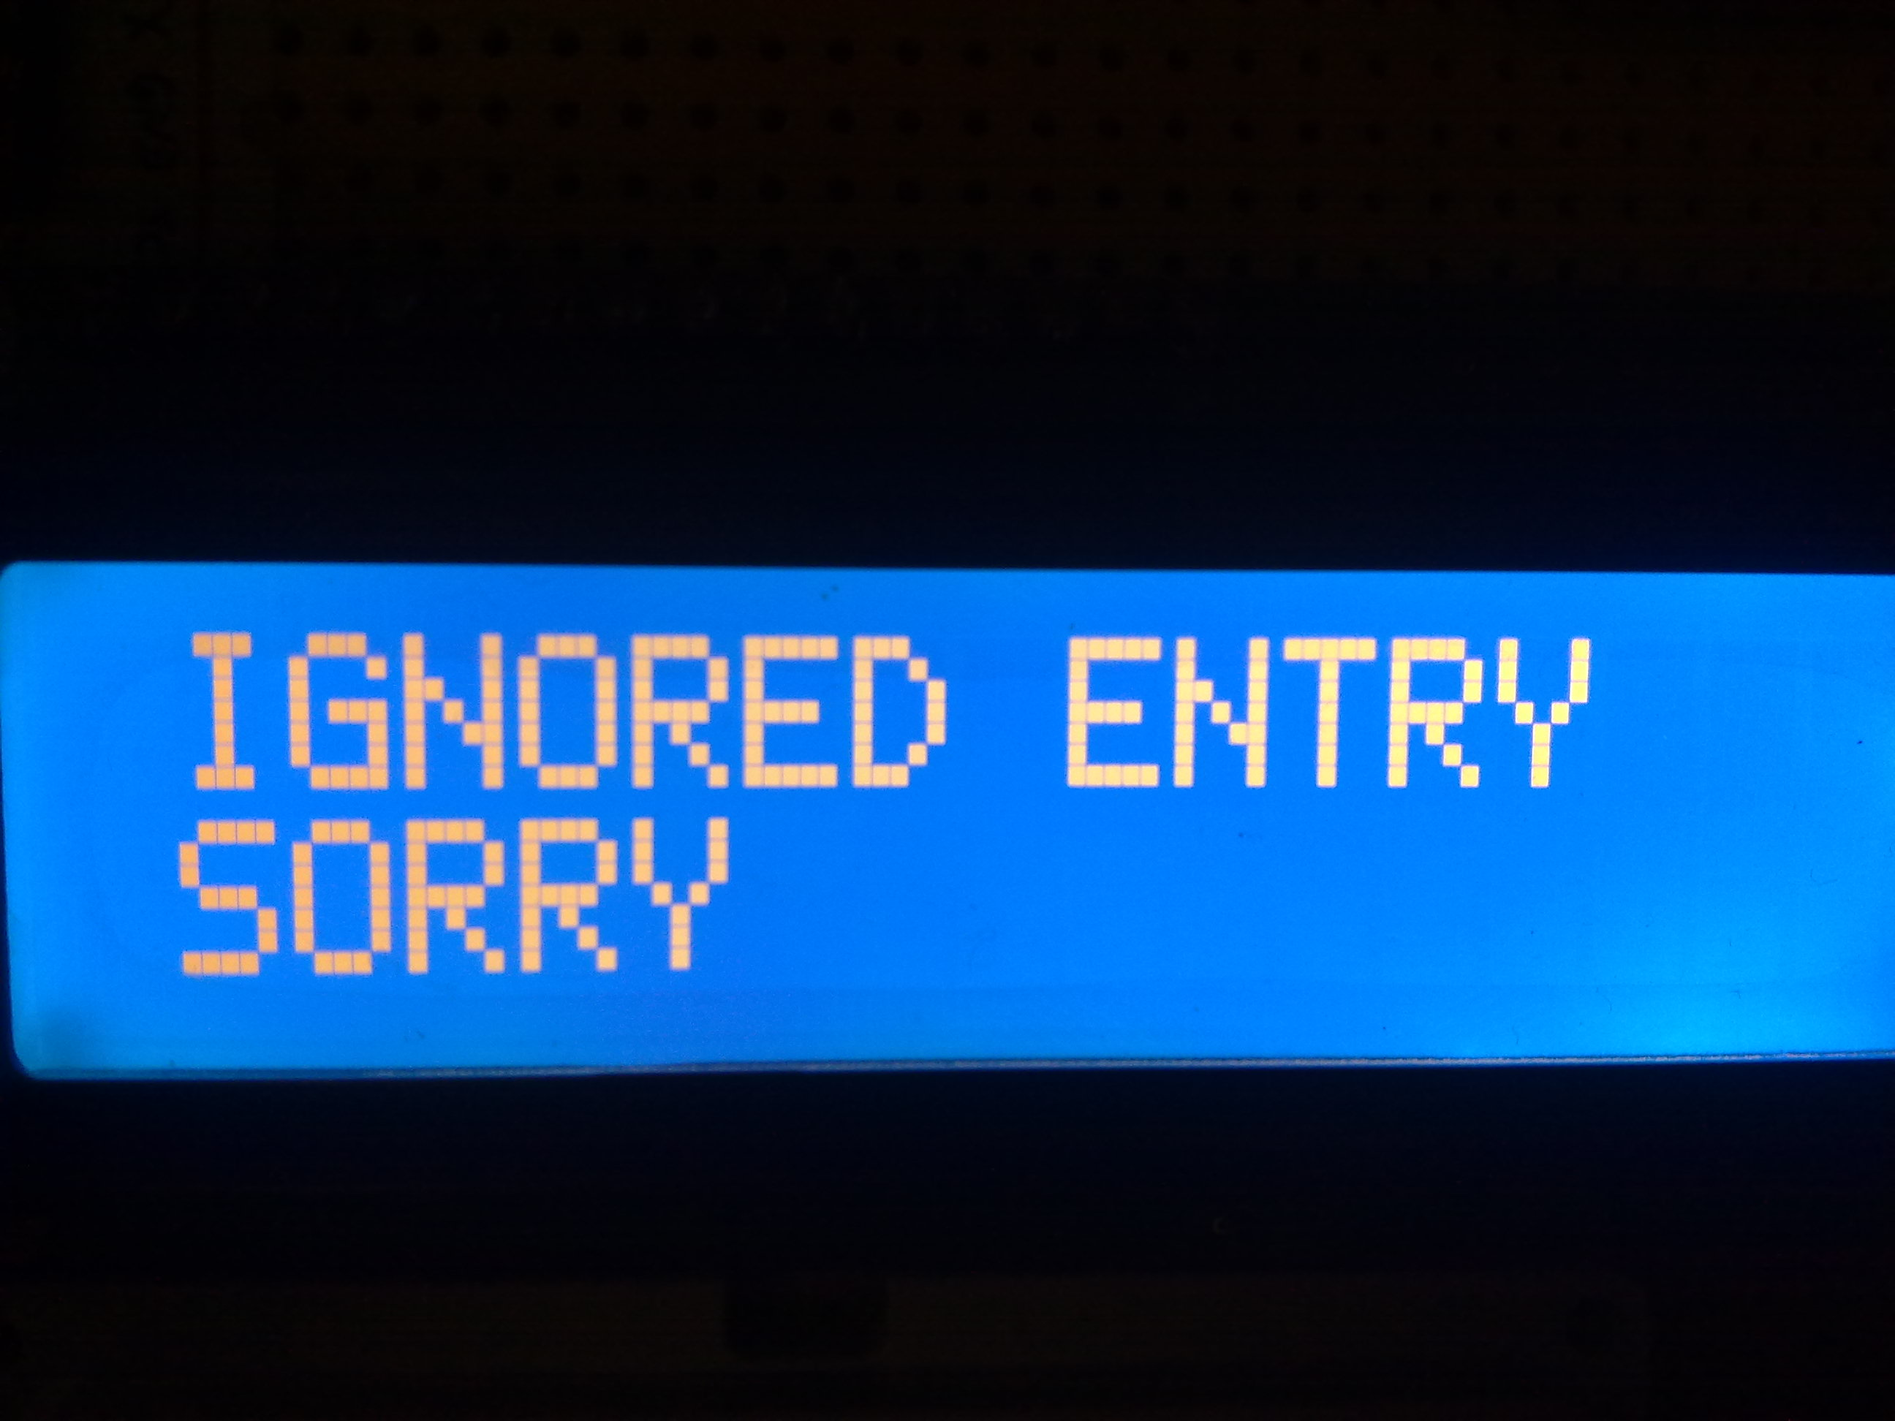

Slide 29
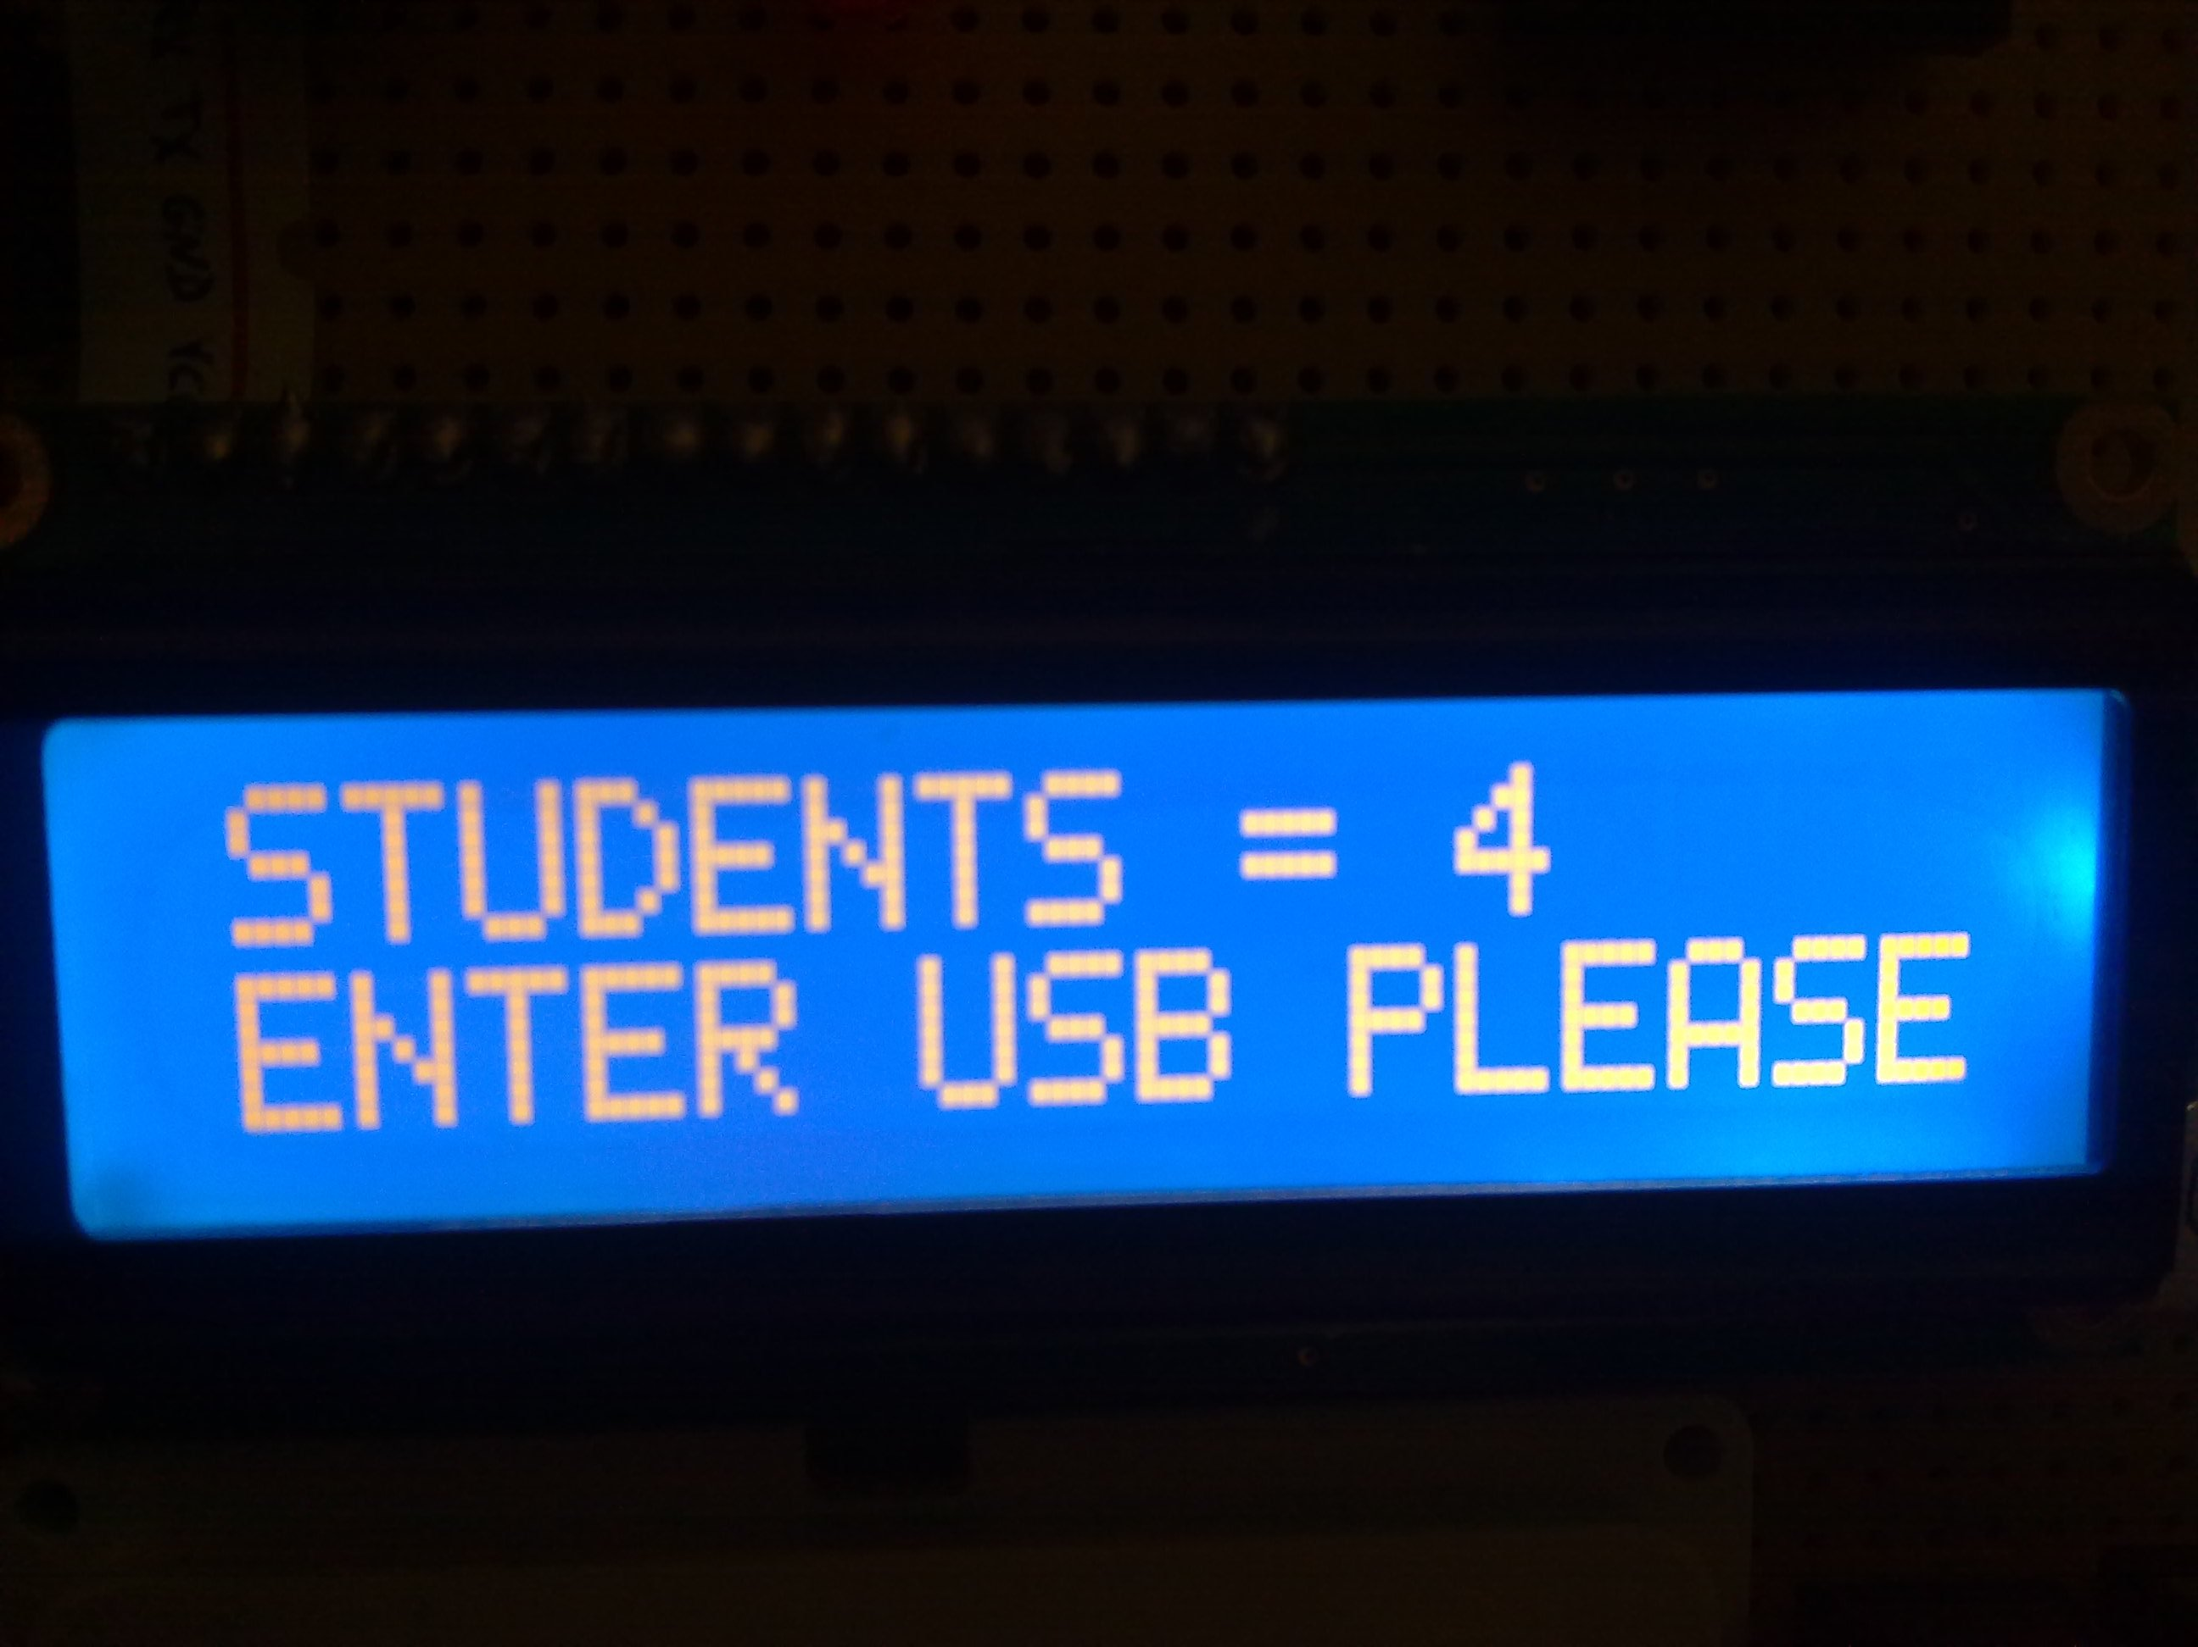

Slide 30
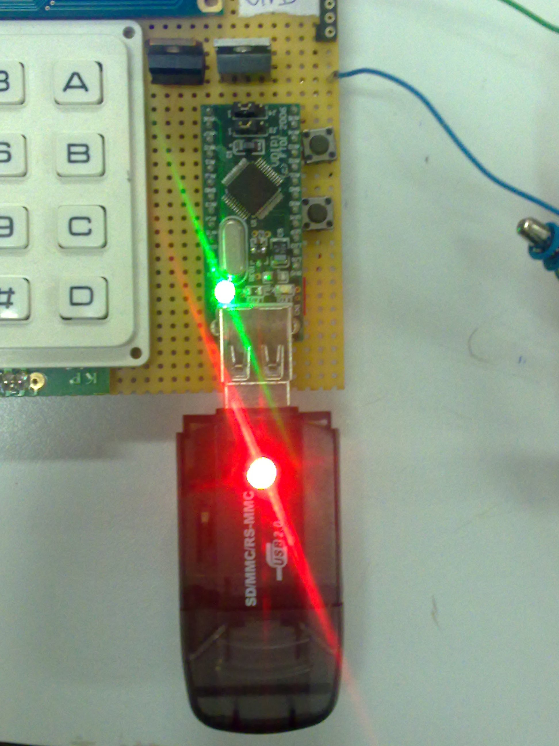

Slide 31
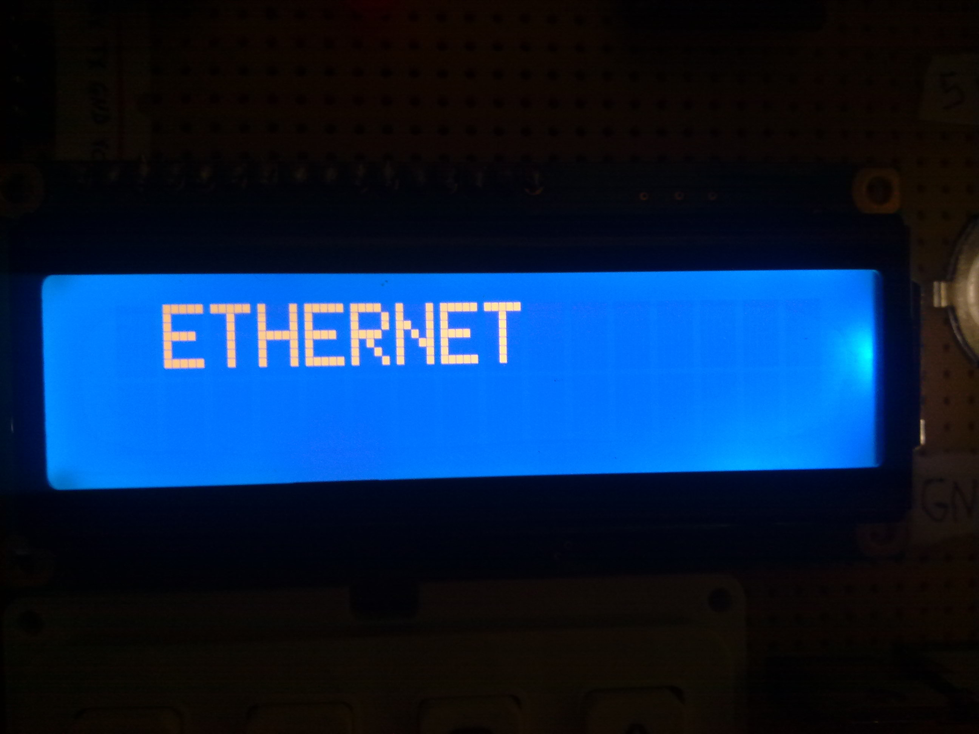

Slide 32
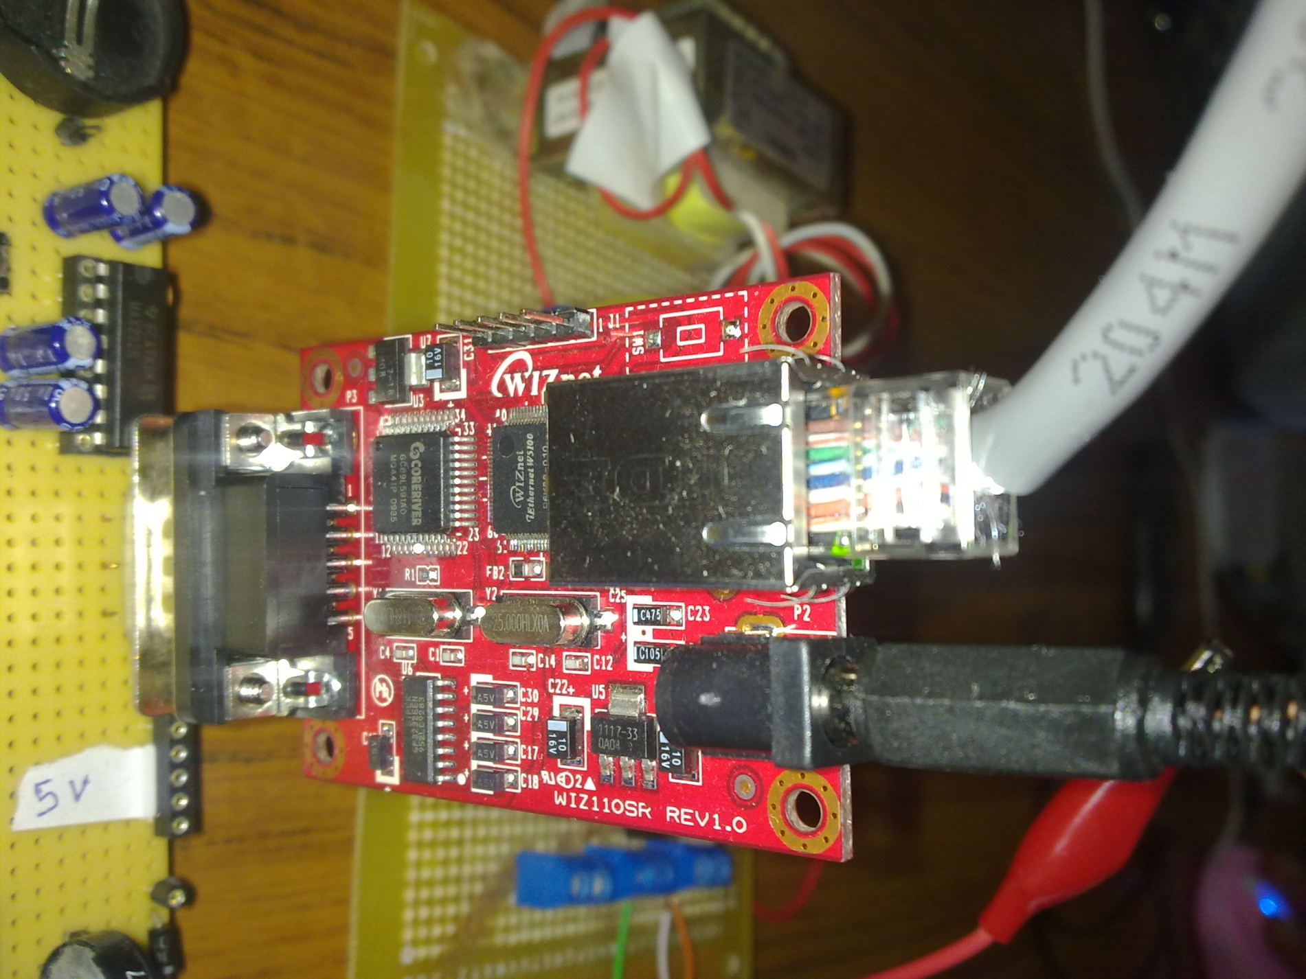

Slide 33
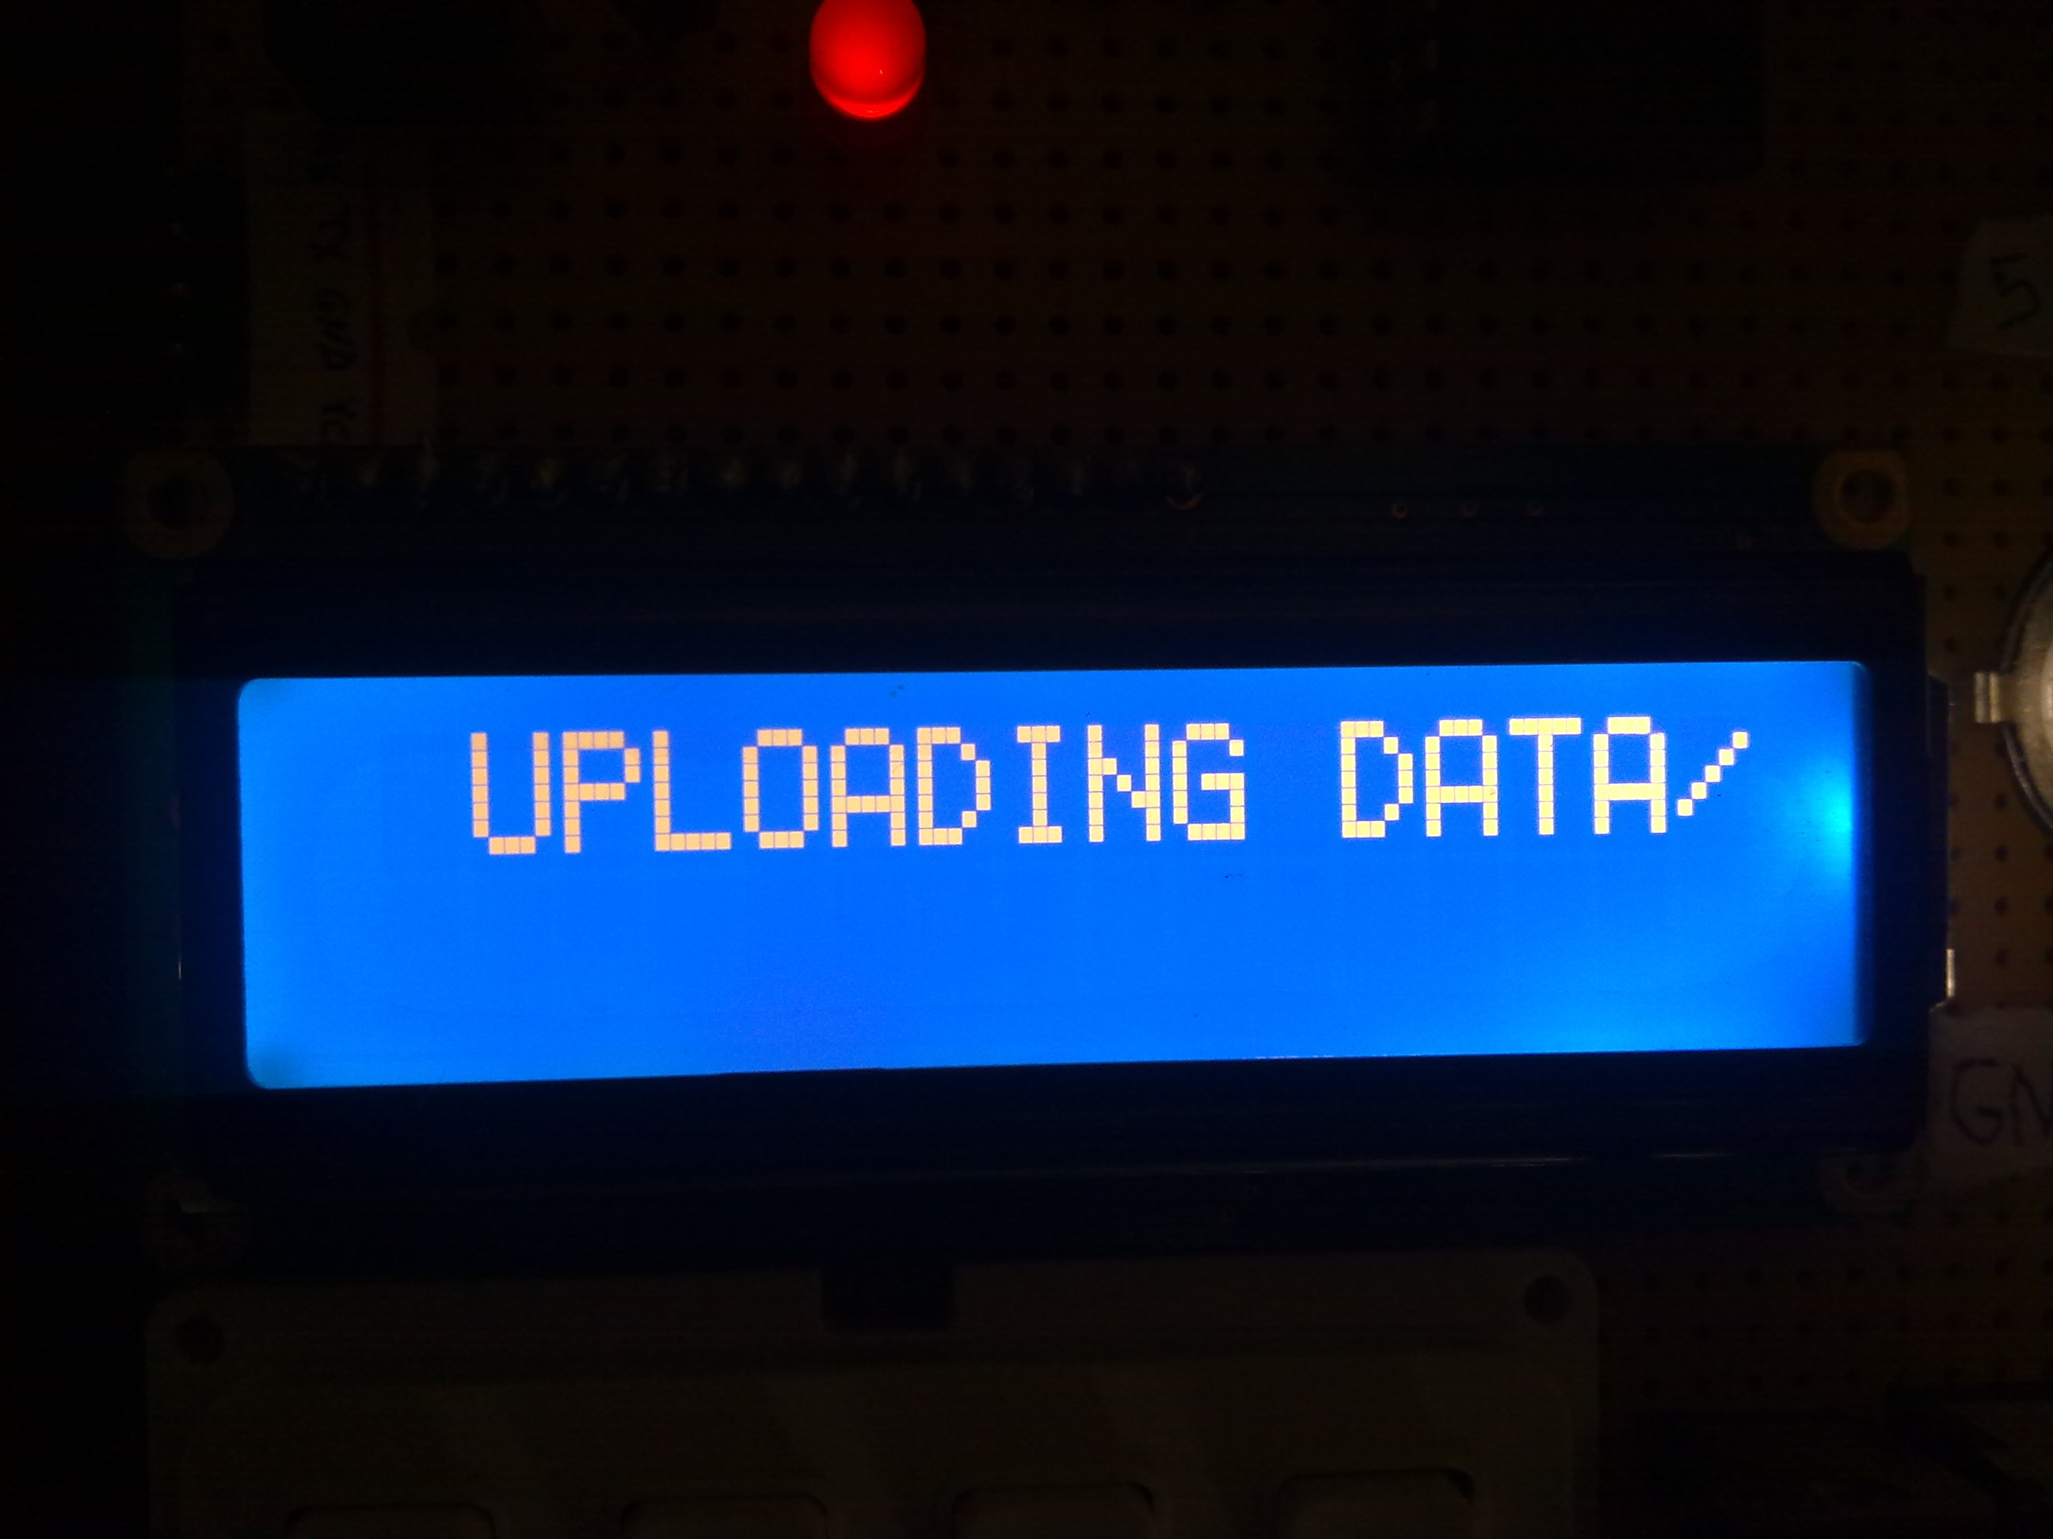

Slide 35
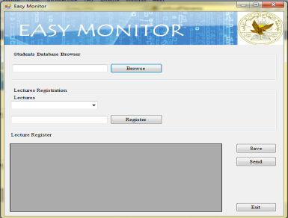
‘Easy Monitor’ software
Lecturer get the data from USB memory.
‘Easy Monitor’ software analyze the data to show attendance.
Data sent to Attendance monitor website.

Slide 36
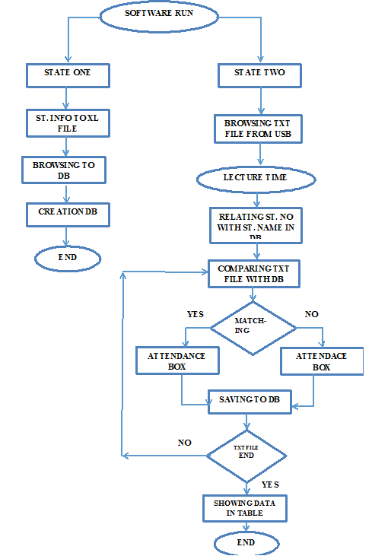

Slide 37
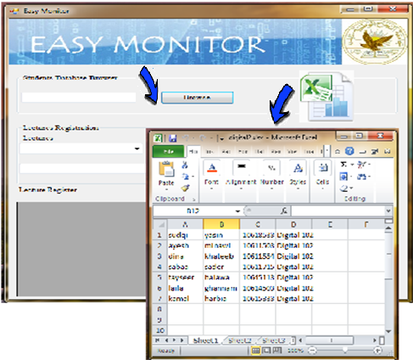
Browsing Database from an Excel table files

Slide 38
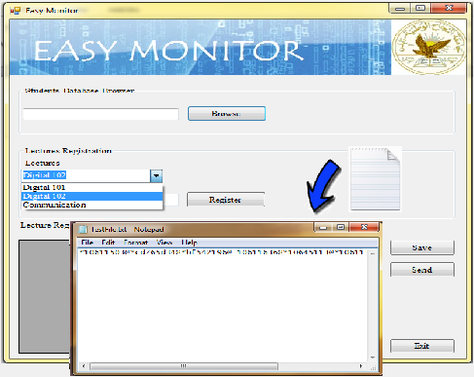
Selecting Lecture Name according to Database.
Browsing Attendance Text file from USB flash

Slide 39
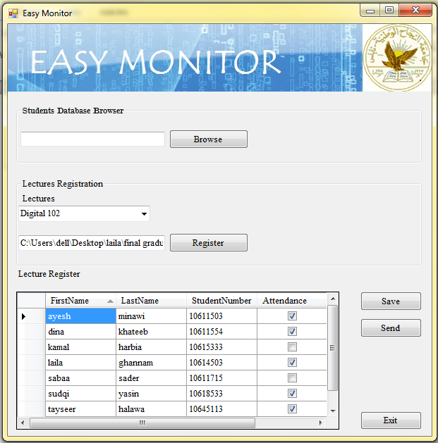
Register Table with attendance check

Slide 41
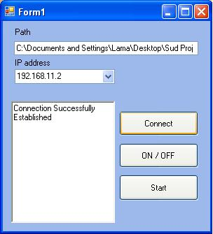
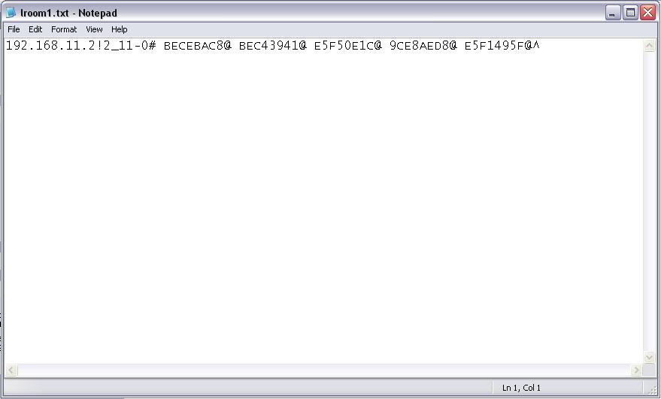

Server interface with the devices via IP address.
Retrieved text file from the device

Slide 42

System Website

Slide 44
Economical study
Element | Price ( In $)
Lcd+keypad + PIC16F877 + basic cct | 45 $
VDIP1 | 35$
Ethernet Controller + RFID reader | 60$
EEPROM | 2.5$
REAL TIME CLOCK + Requirment Element | 16$
Two IR sensor (full element ) | 7.5$
PIC16F84a+basic cct + Regulator+sockets | 12$
Bord for the counter | 1.5$
Flash Memory | 5$
Power Supply Unit | 8.5$
Pcb for the project | 29 $
Cover of the project | 25$
RFID Tag | 1$ each
Total price = 257 $ + Profits

Slide 45
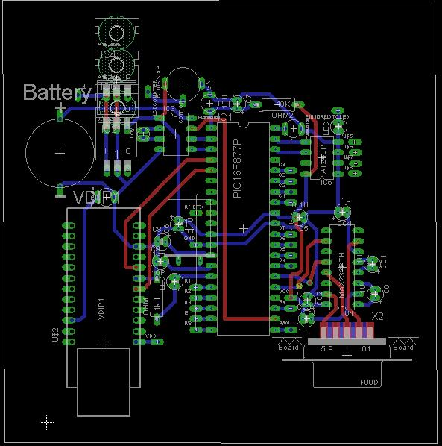
PCB Design

Slide 46
Conclusion
This project is a full system for student monitoring in colleges, and high education institutes.
The system support two different types of outputs :
USB flash memory, and Ethernet.
The device is supported with friendly using software for data analysis and previewing .
Lecturers need no more wasting time, and effort to have their Attendance Register .
Attendance Register now, easily uploaded to Database and so ‘Zajel’ website .

Slide 47
Thank You All
Any Questions ?

