Slide 1

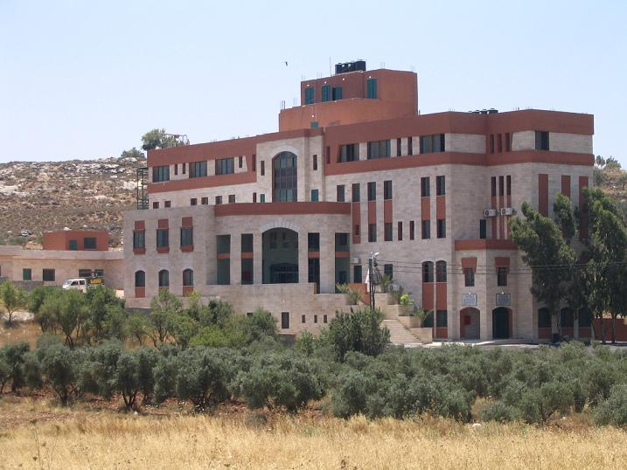

Slide 2
General Scope of Project
Redesign of " Hewara Hospital“, which aimed to meet the needs of health services,
surgery and particularly child services, for Huara region and villages around .
Project Objective:
Architectural ,structural ,environmental and mechanical redesign
of Hewara hospital

Slide 3
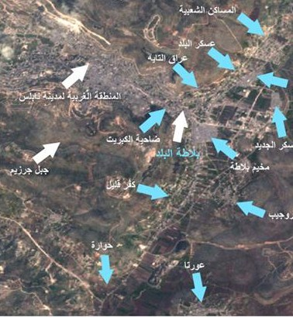
: Location
Land for the project at Huara in Nablus , which is located in
the north of West Bank

Slide 4
Architectural modifications
Structural design
Environmental design
Internal system design
Main tasks

Slide 5
Architectural modifications

Slide 6
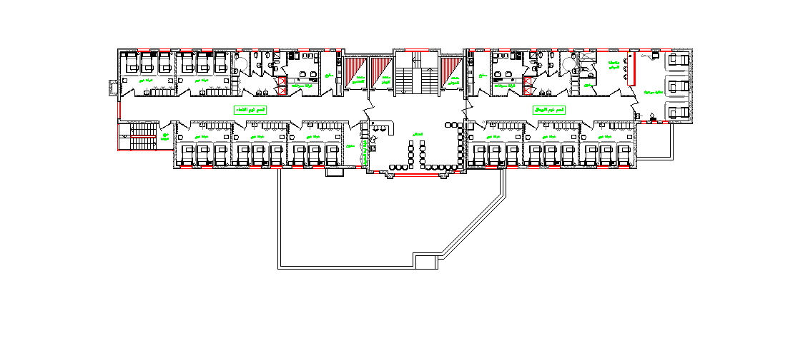
2
3
1
4
FIRST FLOOR

Slide 7
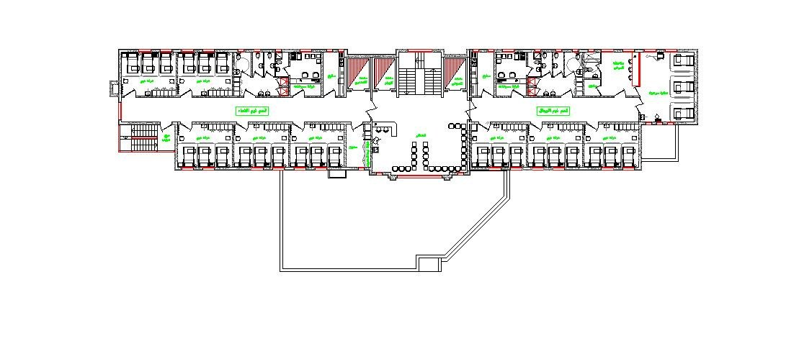
SECONED FLOOR

Slide 8
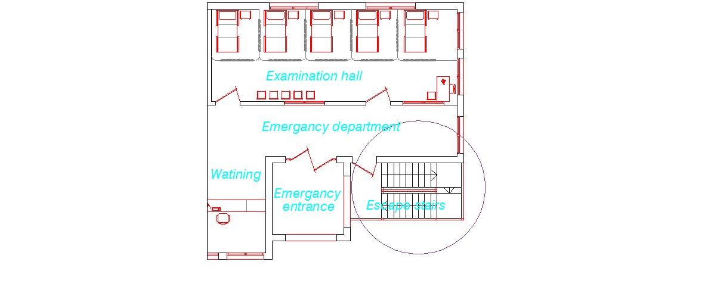
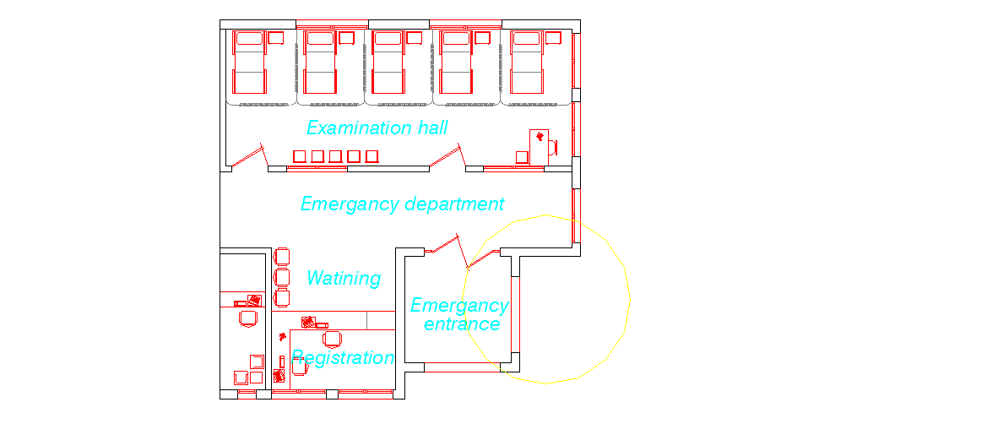
Arcitictural modifications
1- Anew staircase is added to the building for emergencies and special cases.

Slide 9
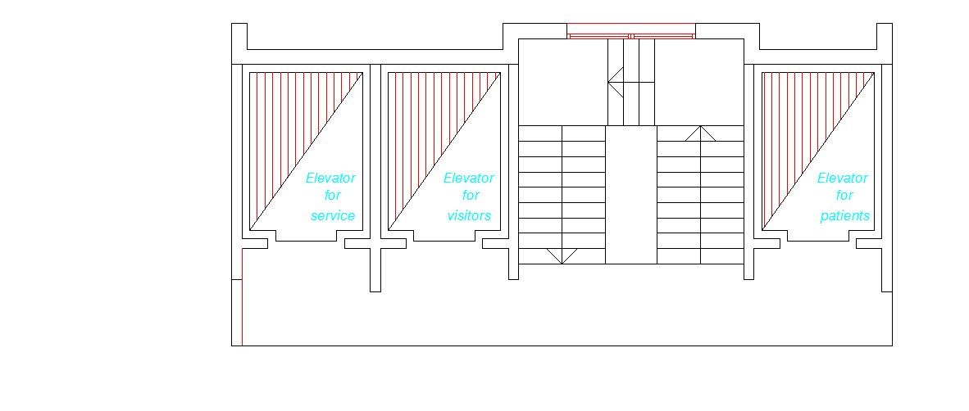
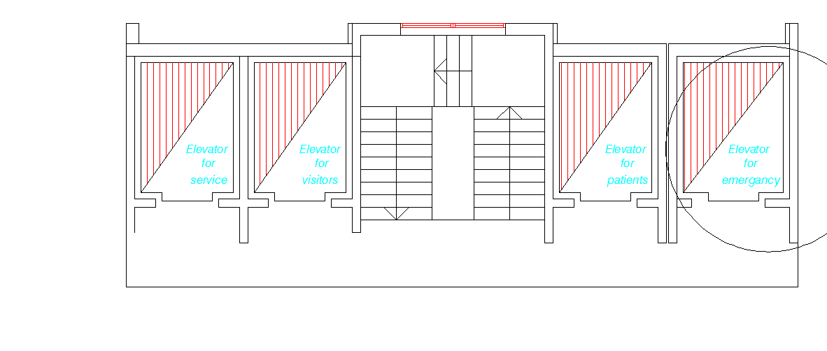
2- An Elevator for emergency is added to the building

Slide 10
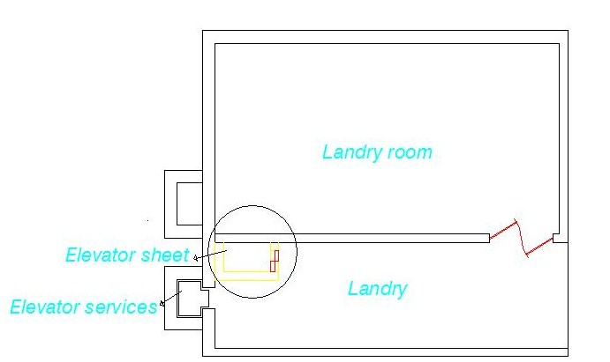
An elevator for dirty blanket to be washed in laundry hall is added to the building

Slide 11
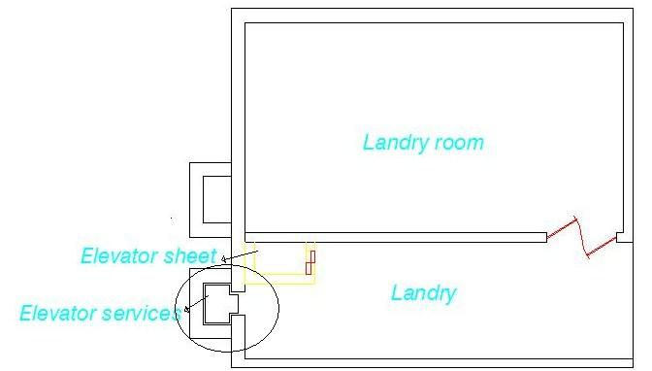
An elevator for service is added to the building

Slide 12
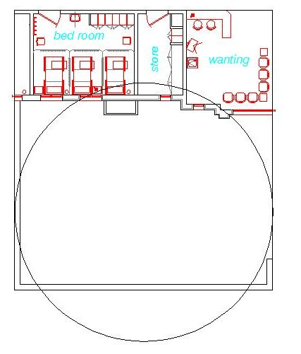
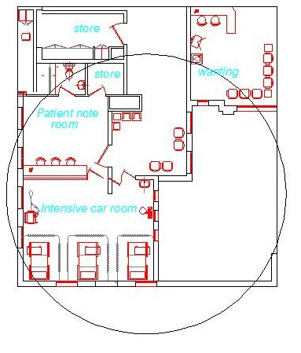
The sixth modification is :
An additional part was added to the second floor(( intensive care unit))

Slide 13
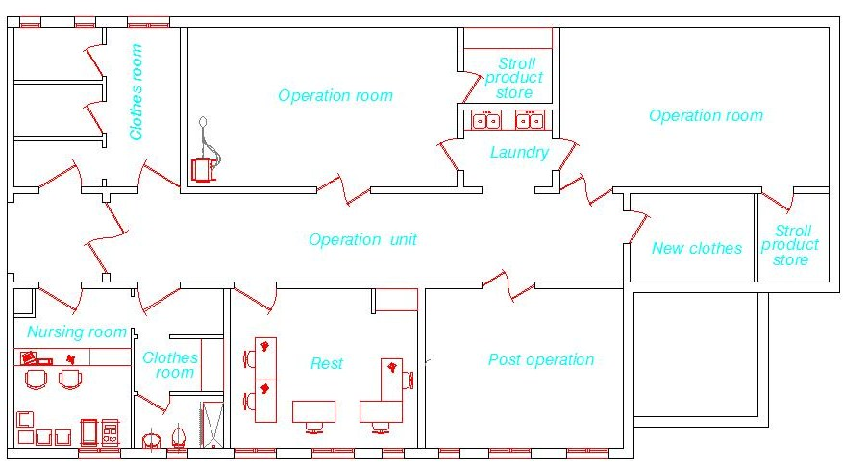
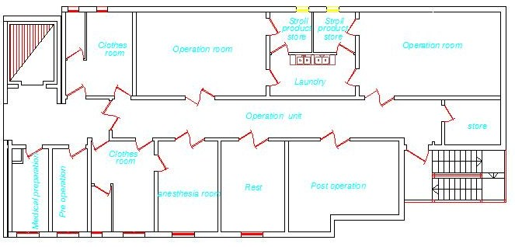

Slide 14
Structural Systems

Slide 15
Design steps:
1- Divide the building into two blocks.
Structural Design
2- Preliminary Design.
3- Computer modeling using SAP.
4- Design the structural elements using SAP analysis results.
5- Hand calculation to design other structural element (shear wall ,
Retaining wall ,water tank).

Slide 16
Design codes
The structural design will be according to :
**ACI 318-08 (2008) (American Concrete Institute) code is used as a reference for design in our project.
**UBC- 97( Uniform Building Code) is used to calculate the equivalent static force of the earthquake
** analysis and design are done using 3D model using SAP2000 program.

Slide 17
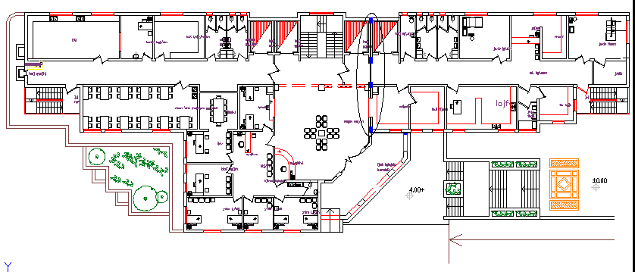
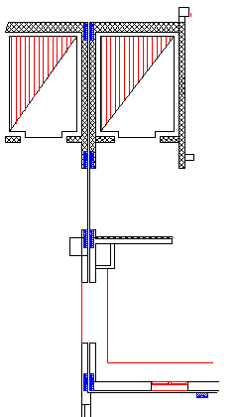
Structural and expansion joints

Slide 18
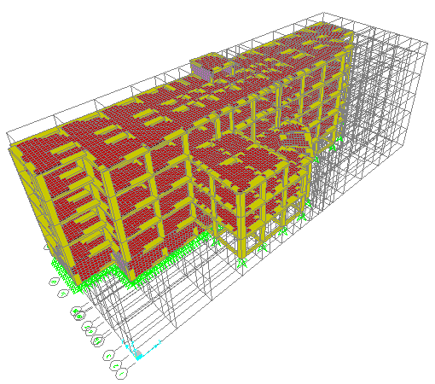
Project description:
Building consists of five stories as shown below :

Slide 19
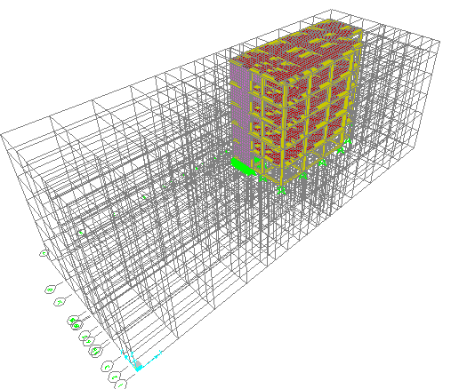
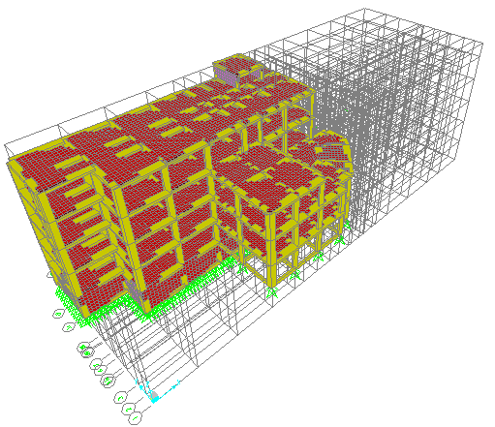
Building is divided into two blocks using structural joints As shown below:
Block 1
Block 2

Slide 20
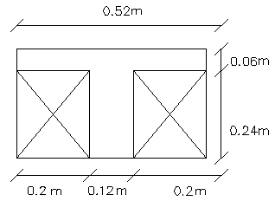
Preliminary Design:
**Ribbed slab thickness
The critical span length is 5.83 m (one-end continuous),
and the required slab thickness is:
h=L_{n}/18.5=5.83/18.5=0.31 m(one-end continuous).
h≈ 0.3m
Thus, ribbed slab of( 30) cm thickness is used shown :
** Preliminary beam dimensions
1-For main beams:
hidden beam
h= 0.30 m
B=85 cm
2-For secondary beams:
hidden beam
h= 0.30 m
B=70 cm

Slide 21
**Preliminary dimension for columns
Column | Tributary area(m² ) | P_{u} | Ag(cm²) | Dimension
C₁ | 8.4 | 144.7t | 1447 | 25*70
C₂ | 21.68 | 152.6t | 1526 | 25*50
C₃ | 12.1 | 133.92t | 1339 | 25*75
C₄ | 18.87 | 133t | 1330 | 50*50
C₅ | 14.87 | 104.68t | 1047 | 25*50
C₆ | 13.69 | 96.34t | 963.4 | 20*60

Slide 22
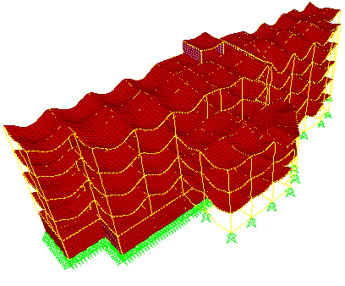
Structural analysis:
** analysis and design are done using SAP2000 program.
Model Verification:
compatibility check is achieved
as shown below:
1-COMPATABILITY Check

Slide 23
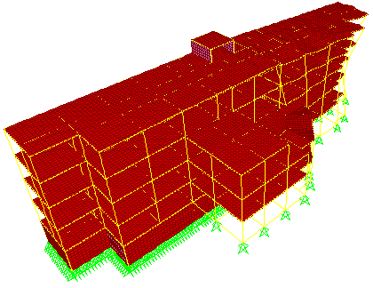
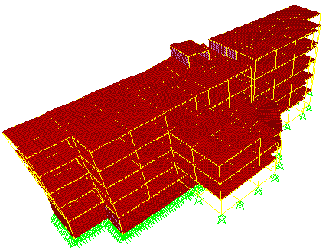
As shown below there are some modes shapes with periods:
a-Mode 1 with period = 0.69s
b-Mode 2 with period = 0.6799s

Slide 24
2-REACTIONS CHECK
reaction | SAP weight | Manual weight | % of error
DL | 8002.6 | 8033.73t | 0.4%
LL | 1245.08 | 1246.1 | 0.08%

Slide 25
3- INTERNAL FORCES CHECK
*internal forces for beams ,slabs ,and columns
For beams:
Error (%) | Mu (SAP) | Mu (Manual) | Wu (t/m) | Tributed width | L(m) | Beam | Floor #
50.75 | 28.54 | 14.05 | 3.31 | 2.35 | 5.83 | 13-A-B | 3rd
41.13 | 16.35 | 9.62 | 3.87 | 2.75 | 4.46 | 1-E-G | 1st
15.19 | 25.55 | 21.67 | 5.24 | 3.725 | 5.75 | 11-Q-R | 2nd
50.88 | 11.40 | 5.60 | 3.31 | 2.35 | 3.68 | 13-S-T | basement
1.62 | 29.84 | 29.36 | 6.98 | 4.96 | 5.8 | 9-D-F | Ground
10.27 | 20.44 | 18.34 | 7.54 | 5.36 | 4.41 | 4-G-I | Ground
252.4 | 2.19 | 7.72 | 8.16 | 5.8 | 2.75 | 11-12-C | 3rd

Slide 26
For columns
Error% | Pu (SAP) | Pu (manual) | # of floor | Tributary area(m²) | Tributed width | COLUMN | FLOOR #
93.6 | 69.90 | 135.31 | 5.00 | 6.85 | 5.27 | A-13 | basement
31.9 | 166.6 | 219.70 | 4.00 | 37.42 | 0.00 | R-11 | Ground
13.5 | 129.9 | 112.78 | 3.00 | 24.58 | 0.00 | I-9 | 1st
81.1 | 34.9 | 63.31 | 2.00 | 11.69 | 4.50 | E-1 | 2nd
20.9 | 32.8 | 25.93 | 1.00 | 8.15 | 4.24 | F-9 | 3rd
41.7 | 48.4 | 68.64 | 2.00 | 22.78 | 0.00 | E-4 | 2nd
20.4 | 164.1 | 130.67 | 4.00 | 21.61 | 0.00 | D-12 | Ground
43.0 | 35.1 | 50.21 | 1.00 | 24.43 | 4.71 | T-13 | 3rd

Slide 27
For slabs:
Error % | Mu(SAP) | Mu(manual) | Wu(t/m) | L(m) | slab | Floor #
113.4 | 2.24 | 4.77 | 1.12 | 5.83 | R-S-12-13 | basement
14.4 | 2.68 | 2.29 | 1.12 | 4.04 | D-E-1-4 | Ground
184.4 | 1.66 | 4.72 | 1.12 | 5.8 | D-C-12-13 | 1st
210.7 | 1.52 | 4.72 | 1.12 | 5.8 | B-C-9-11 | 2nd
212.7 | 0.87 | 2.73 | 1.12 | 4.41 | G-I-11-12 | 3rd
124.9 | 2.14 | 4.80 | 1.12 | 5.85 | N-P-9-11 | 2nd
70.0 | 1.83 | 3.11 | 1.12 | 4.71 | G-I-4-9 | 1st

Slide 28
Design of structural elements using SAP analysis results:
* Design will include the following elements :
1) Beams ( main beam & secondary beam) .
2) Columns .
3) Floor systems [slabs ( one way rib slab)].
4) Footings.
5) Shear walls.
6) Retaining walls.
7) Water tank.
8) Stairs.

Slide 29
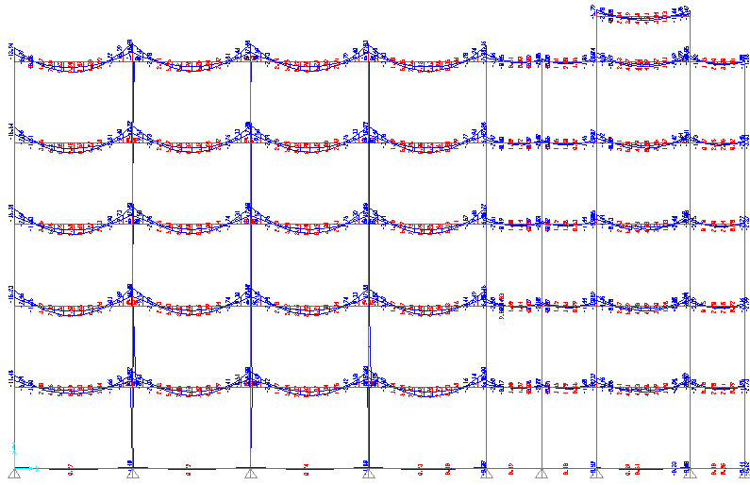
Design of beams using SAP analysis results:
Mu_{(-)ve} =13.94t.m Mu_{(-)ve} =18.74t.m
Mu _{+ve} =9.99t.m

Slide 30
Sample calculation to check B1 dimensions (hidden beam):
1- Design for positive moment:
Mu _{+ve}= 9.99 Ton.m
ρ _{max} >ρ= 4.35×10⁻³ > ρ_{min}
OK
As = ρ ×b × d = 4.35×10⁻³ ×110×24= 11.6 cm² < As from SAP (14.48 cm²)
2- Design for negative moment at right side of beam:
Mu _{(-)ve} _{at right side} =13.94t.m
ρ _{max} >ρ= 6.19×10⁻³ > ρ_{min}
OK
As = 16.34 cm² < As from SAP (21.43 cm²)
3- Design for negative moment at left side of beam
Mu _{(-)ve} =18.74t.m
ρ _{max} >ρ= 8.5×10⁻³ > ρ_{min}
As =22.12 cm² < As from SAP (22.47 cm²)
OK

Slide 31
Beams Reinforcement
Beam | B1 | B2 | B3 | B4 | B5 | B6 | B7 | B8
Bottom steel-extended | 10φ18 | 10φ18 | 8φ14 | 7φ14 | 9φ16 | 9φ18 | 8φ14 | 6φ14
Top steel- extended | 4φ18 | 4φ18 | 4φ14 | 6φ14 | 5φ16 | 4φ18 | 6φ14 | 6φ14
Top steel-cut off (at right side of beam) | 4φ18 | 6φ18 | 2φ14 | ---- | 3φ16 | 3φ18 | 1φ14 | ----
Top steel-cut off (at left side of beam) | 5φ18 | 6φ18 | ---- | ---- | 7φ16 | 4φ18 | ---- | ----
For exterior beams we use hooked bars
Ld≥12 db
φ18 | φ16 | φ14 | bar diameter
25 | 20 | 20 | Ld(cm)

Slide 32
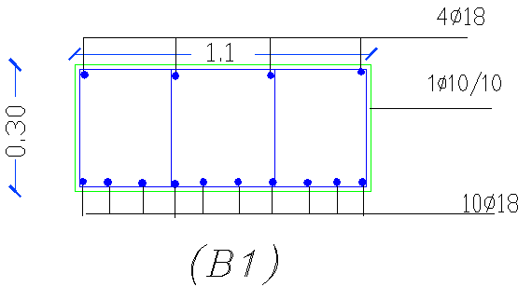
Beam 1 reinforcement section

Slide 33
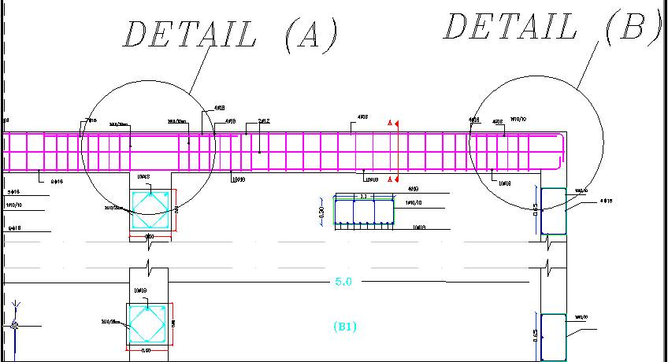
Beams reinforcement Detail

Slide 34
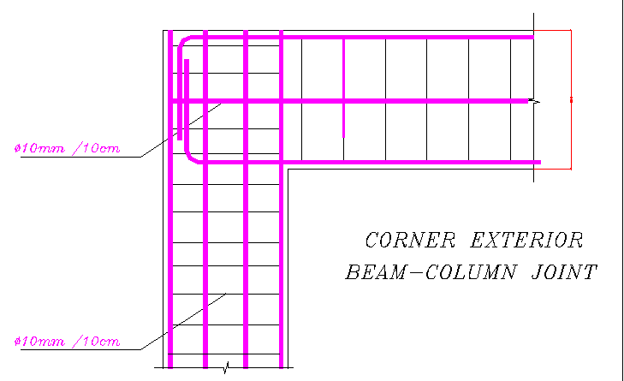
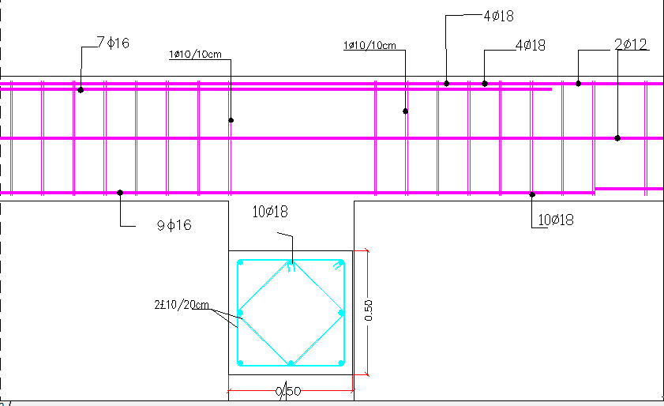
Detail A:
Detail (B):

Slide 35
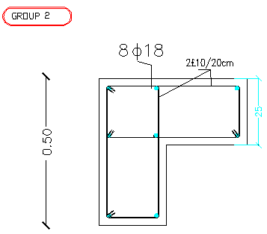
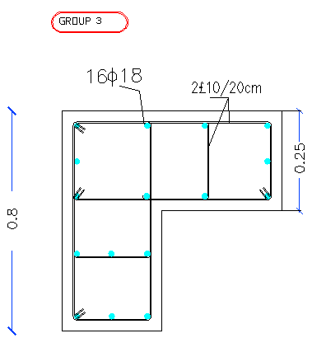
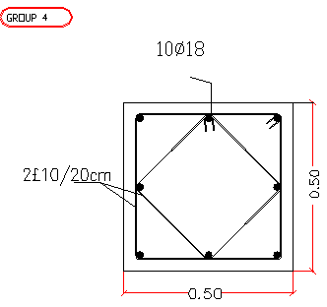
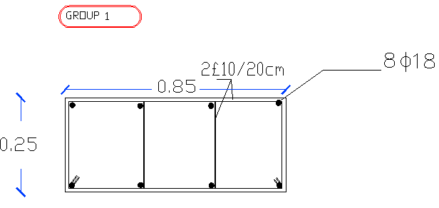
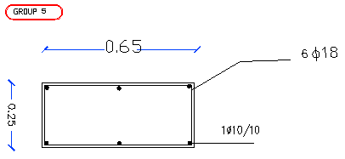
Columns reinforcement

Slide 36
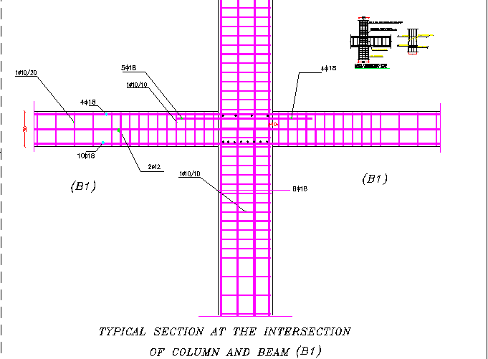
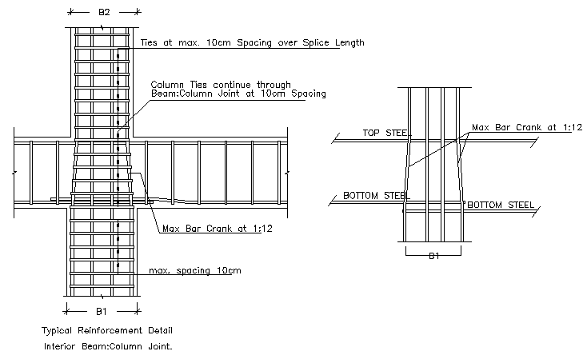

Slide 37
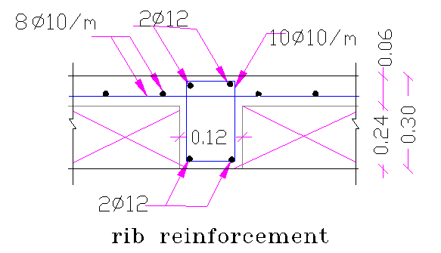
Design of slabs using SAP analysis :

Slide 38
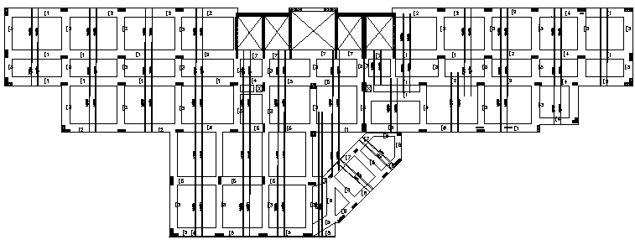

Slide 39
single Footings Reinforcement
Shr. Steel in short dir. | Steel in long dir. | Shr. Steel in long dir. | Steel in long dir. | Dimension | Depth | Footing
4φ16 | 4φ16 | 6φ16 | 6φ16 | 1.5*1.1 m | 0.5 | F1
5φ18 | 5φ18 | 6φ18 | 6φ18 | 1.2*1.6 m | 0.6 | F2
9φ18 | 9φ18 | 10φ18 | 10φ18 | 2.1*1.5 m | 0.8 | F3
5φ16 | 5φ16 | 5φ16 | 5φ16 | 1.2*1.2 m | 0.5 | F4
3φ14 | 3φ14 | 4 φ 14 | 4 φ 14 | 1.1*0.7 m | 0.4 | F5
11 φ 18 | 11 φ 18 | 14 φ 18 | 14 φ 18 | 2.5*1.9 m | 0.9 | F6
14 φ 18 | 14 φ 18 | 18 φ 18 | 18 φ 18 | 2.7*2.1 m | 1.0 | F7

Slide 40
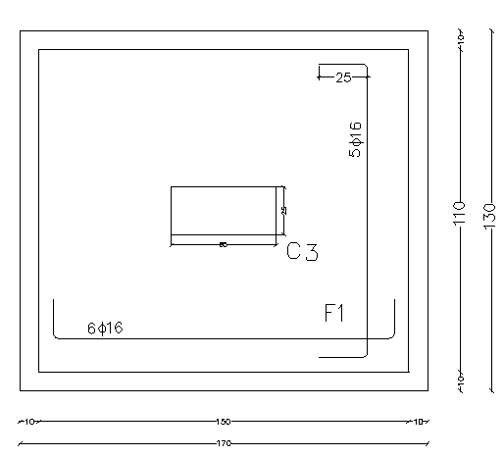
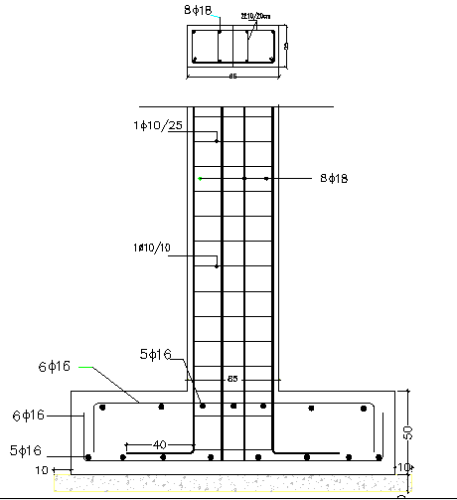
Plan for F1 reinforcement
section for F1 reinforcement with col.3

Slide 41
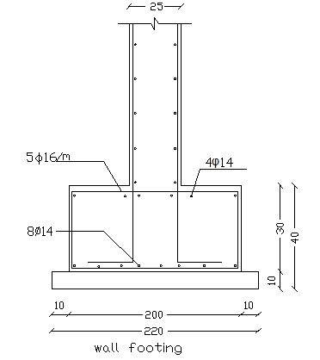
=
Design of Wall Footing
design of wall footing with 0.3 m thickness , 2 m width
As short dir. /m | As shrinkage/m | As long dir. | As min/m | As/m | ρ | Mu | qu(kN/m2) | Footing type
5φ16/m | 5φ16 /m | 8φ14 | 612 | 1839.6 | 0.0054 | 226.27 | 626.36 | wall footing

Slide 42
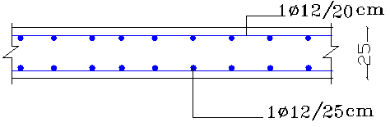
Design of the walls:
** Design of shear walls
*Check shear
φ V_{c1} =72.37 t
*V_{u1 (sap)} =28.2t < φV_{c1} OK
* φ Vc₂=3.44 t >V_{u2(SAP)}=1.7 t OK
*Check capacity
φ P_{n}>P_{u(sap)}
OK
Steel in horizontal direction:
As=0.002×100×25= 4.0 cm²
use 1 ф10/20cm tow layer
Steel in vertical direction :
As=0.0014* 100*25cm²
use 1ф12/25cm tow layer.

Slide 43
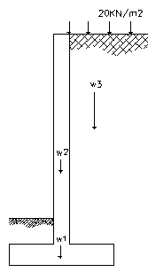
**Design of retaining walls
*Wall reinforcement
Vertical steel
As =2505 m²
Use ϕ 18
N =10 bars
S =100 cm
Use 100 mm use 1ϕ18 /100mm
Shrinkage steel
As min = 0.003 *b *h=900 mm² /m
N= 4 bars/m
Use 1ϕ18 /250mm
weights on retaining wall

Slide 44
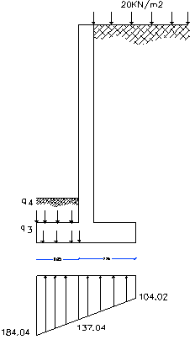
Design of base (h=40cm)
*Design of toe
*Toe reinforcement
Mu =15.05 KN.m
As=120.9 cm²
Use Asmin =0.0018 *1000 *400 =720 mm²/m
Assume ϕ 14 ,N =5
Use 1ϕ14 /200mm
Shrinkage for toe:
Use1ϕ14 /200mm
Soil weights &soil pressure on toe

Slide 45
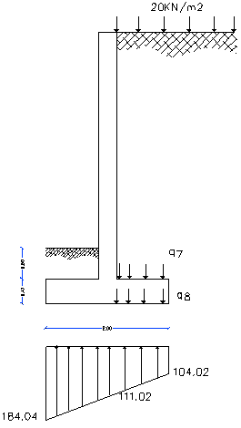
*Design of heel
*Heel reinforcement
Mu =18.47 KN.m
As= 148.5 mm² Use Asmin =720 mm²/m
Assume ϕ 14 ,N =5
Use 1ϕ14 /200mm
Shrinkage for toe:
Use1ϕ14 /200mm
Soil weights &soil pressure on heel

Slide 46
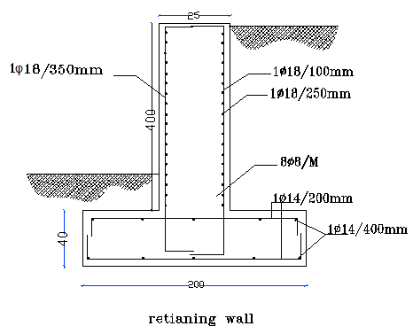
Reinforcement of Retaining wall

Slide 47
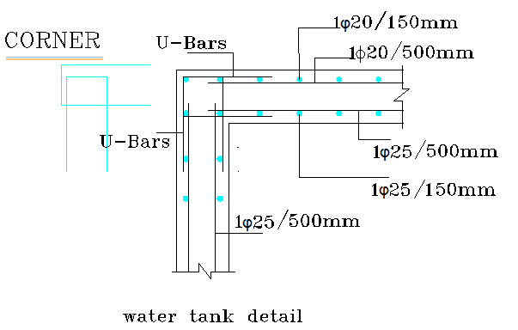
Design of water tank
Vertical steel
use1φ 25 /150 mm
Use 1φ20 /500 mm
Check minimum steel
Vertical steel
As _{shrinkage} =0.003*bh=1500 mm²/m
horizontal steel
Horizontal steel
As _{shrinkage} =0.005*bh=2500mm²/m
Detail for reinforcement the water tank

Slide 48
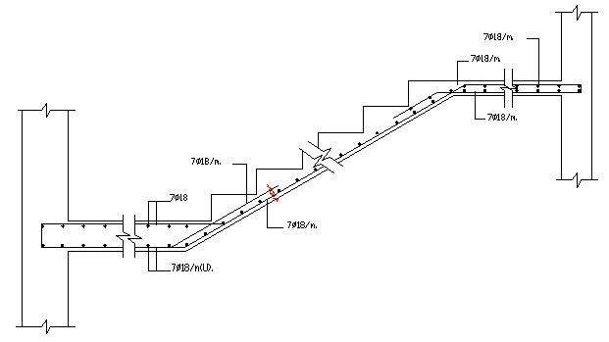
Stairs reinforcement detail

Slide 49
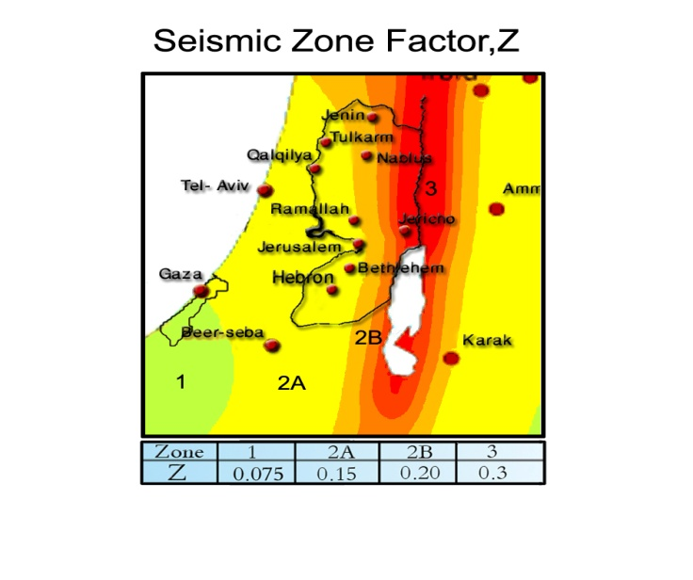
Seismic Design
seismic analysis for region:
City name: Nablus.
Area Name: Hewara
Zone: 2B
Z = 0.20
0.24=Ca
0.32=Cv

Slide 50
Environmental system

Slide 51
Climate
temperature
In summer the temperature reaches 31.9 C ⁰ and in winter reaches
5.7C ⁰
Rain :
Limited to winter and autumn- 80% of rainfall is in the period between the months of December first and March
Moisture :
Summer: 61.9% iWinter reach to 69.7%
Wind:
Prevail in the Nablus area two types of winds are south-western and north-west, where the annual rate up to the wind speed to 4.7km per hour

Slide 53
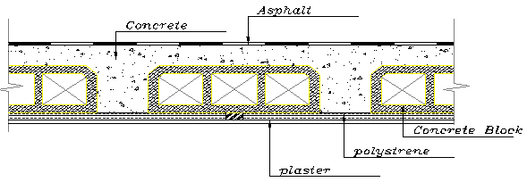
Solar Insulation
..*In the ceiling (be used polyester as an insulation);
The value of heat loss without use insulation =.65w/m2.c
The value of heat loss with use insulation =.3 w/m2.c

Slide 54
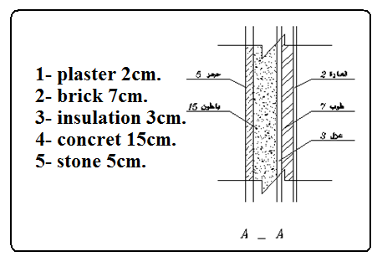
..*In the wall (be used rock wool as an insulation);
The value of heat loss without use insulation =3 w/m2.c
The value of heat loss with use insulation =.9 w/m2.c
..*For window used double glass

Slide 55

Cantilever
In the north and south elevation used Horizontal shutter to protect from the sun at 11 o'clock in may
The shutter length is .7 m

Slide 56

Solar chimney
In the north and south elevation used solar chimney for ventilation

Slide 57

Vertical Shatter
In the west and east elevation used vertical shutter to protect from the sun
The slop angle is 45

Slide 59
Internal Design
Heating, ventilation and air-conditioning (HVAC) systems:
We Used water to air system in the project,
Heating load calculation
Q Total=592.5 Kw
V circulation = 3450.663 CFM
(60x60) provide 300 CFM
N# diff = 24 diffuser (30*30) .
Air handler unit
We used air handler unit with capacity 4000CFM

Slide 60

,

Slide 61
Cooling load
floor
Q total = 592.5 Kw
ceiling
Q s= 592.5 Kw
V cir =3450.5 CFM
N# diffuser = 24
use 24 (30*30)
window

Slide 62


Slide 63
Internal system

Slide 64


Design For Fire Resistance
This project used hoses as the type of fire protection because its more practical than others :
Standpipes and hoses with a separate water reserve, up feed pumping, and fire department connections used in this project are for first-aid firefighting before the fire trucks arrive.

Slide 65



Slide 66



Slide 67


Elevator design
From the solution try elevator of 250 fpm and 3500 lb
Dimension of the elevator is 2.5 m and at least a depth of 3.5 meters and the door of the cart slot exclusively with width 1.5 m and high is 2.13-meter
The width of .85 m and the depth is .55

Slide 68

Acoustical Design Systems
Trees between the hospital to reduce street noise

Slide 69

-Increasing the value of the STC of the wall by filling the spaces between the layers and props mat of rock wool which helps in the sound absorption
- sound insulation for floors and that the work of the so-called floating floor put the foundations of metal or wood placed between the two plates of steel Albulitherin above a thin layer of concrete with reinforcing bars and then a small sand Tiles

Slide 70

 | 𝛼i | si | 𝛼isi
Walls(plaster) | 0.03 | 64 | 1.92
Ceiling | 0.03 | 20 | 0.6
Floor(Tiles) | 0.03 | 20 | 0.6
Seats (1.5x16 seats) | 0.88 | 24 | 21.12
Doors | 0.04 | 2.7 | 0.108
Glass | .18 | 9.2 | 1.656
 |  | 140 | 26.004
 | 𝛼i | si | 𝛼isi
Walls(plaster) | 0.03 | 68.1 | 2.043
Ceiling | 0.03 | 50 | 1.5
Floor(Tiles) | 0.03 | 30.8 | 0.616
Seats (1.5x16 seats) | 0.88 | 24 | 21.12
Doors | 0.04 | 2.7 | 0.108
Glass | .180 | 9.2 | 1.656
Absorptive material | 0.8 | 34 | 17
 |  | 218.8 | 44.043
= (0.36 ∈ (0.3-0.9)OK
=Not OK.(0.28∉ (0.3-0.9))
increasing Absorptive material
Will use the units mural Soundproof a sound-absorbing tiles with a high degree of double-sided and are a lovely color of quartz and resin and the label has the advantage of durability and easy cleaning

Slide 71
plumping system
Diameter for meter
Meter diameter | 4 inches | 3 1/2 inches | 3 inches | 2 1/2 inches | 2 inches
Friction loss (psi) | 0.2 | 0.38 | 0.85 | 1.9 | 6
Diameter for pipe
2 in | 2 1/2 in | 3 in | 3 1/2 in | 4 in | 5 in |  | pipe diameter
10 | 3.5 | 1.5 | 0.7 | 0.35 | 0.13 |  | loss /100 ft
21.5 | 7.5 | 3.2 | 1.5 | 0.75 | 0.28 |  | loss /214.5 ft

Slide 72


Slide 73


Slide 74




Electrical System
E= 500 lux
a= 5.2 m
b=3.9m
A= 20.3m2
Class D
δ=1.25 clean
ζ= 65%
K=
From table of room utilization factor; U=0.79
F=
=24707.8 lumen
N=

Slide 75
N | LLf | Uf | F | Em Lux | Area | B | L | Name
6 | 0.726 | 0.38 | 6640 | 500 | 22.5 | 4.5 | 5 | غرفة المدير
6 | 0.726 | 0.38 | 6640 | 500 | 22.5 | 4.5 | 5 | غرفة نائب المدير
4 | 0.726 | 0.38 | 6640 | 500 | 16.4 | 3.5 | 4.69 | غرفة الاجتماعات
6 | 0.726 | 0.38 | 6640 | 500 | 21.6 | 4 | 5.4 | غرفة موظفين
4 | 0.726 | 0.38 | 6640 | 500 | 15.3 | 3.4 | 4.5 | غرفة موظفات
10 | 0.726 | 0.38 | 6640 | 500 | 38.0 | 4 | 9.5 | غرفة الطعام والاستراحه
6 | 0.726 | 0.38 | 6640 | 500 | 21.0 | 3.5 | 6 | غرفة انتظار والسكرتيره
4 | 0.726 | 0.38 | 6640 | 500 | 15.8 | 3.5 | 4.5 | محاسبين
4 | 0.726 | 0.38 | 6640 | 100 | 30.0 | 5 | 6 | مخزن ادويه
6 | 0.726 | 0.38 | 6640 | 100 | 28.6 | 5.5 | 5.2 | مخزن مواد غذائية
15 | 0.726 | 0.38 | 6640 | 300 | 90.0 | 9 | 10 | صالة انتظار
4 | 0.726 | 0.38 | 6640 | 500 | 15.8 | 3.5 | 4.5 | صيدلية
8 | 0.726 | 0.38 | 6640 | 500 | 29.7 | 4.46 | 6.65 | مختبر
4 | 0.726 | 0.38 | 6640 | 500 | 15.8 | 3.5 | 4.5 | بنك الدم
7 | 0.726 | 0.38 | 6640 | 500 | 23.9 | 4.5 | 5.32 | تصوير اشعه
6 | 0.726 | 0.38 | 6640 | 500 | 23.4 | 4.5 | 5.2 | تصوير تلفاز
6 | 0.726 | 0.38 | 6640 | 500 | 23.4 | 4.5 | 5.2 | ارشيف وتسجيل
1 | 0.726 | 0.38 | 6640 | 500 | 5.0 | 2 | 2.5 | تحميض
1 | 0.726 | 0.38 | 3200 | 200 | 2.3 | 1.5 | 1.5 | حمامات
24 | 0.726 | 0.38 | 4000 | 100 | 268.0 | 4 | 67 | ممرات
10 | 0.726 | 0.38 | 6640 | 500 | 36.0 | 4 | 9 | مطبخ
4 | 0.726 | 0.38 | 6640 | 500 | 13.1 | 4.5 | 2.91 | مشرفة تغذية
 |  |  |  |  |  |  |  | المجموع

Slide 76


Slide 77
Total Power | Power Socket | # Socket | Name
1250 | 250 | 5 | Manger room
1250 | 250 | 5 | Help maneger room
1000 | 250 | 4 | غرفة الاجتماعات
1500 | 250 | 6 | Employee room
1500 | 250 | 6 | Employee room
2250 | 250 | 9 | Food
1750 | 250 | 7 | Secretary room
2000 | 250 | 8 | Accountant room
1250 | 250 | 5 | Medicine room
1250 | 250 | 5 | Food store
2250 | 250 | 9 | Wafting
1250 | 250 | 5 | Pharmacy
2750 | 250 | 11 | Lap
2250 | 250 | 9 | Blood bank
1000 | 250 | 4 | تصوير اشعه
1750 | 250 | 7 | TV photo
1750 | 250 | 7 | Record
500 | 250 | 2 | تحميض
1250 | 250 | 5 | Bath room
2500 | 250 | 10 | Corridors
2250 | 250 | 9 | Kitchen
1000 | 250 | 4 | مشرفة تغذية
35500 |  |  | Sum

Slide 78


Slide 79

THANK YOU
?
?
?
?
?
?
?
?
?
?
?
?
?
?
?
?
?
?
?
?
?
?
?
?
ANY QUESTIONS

