Slide 1


Slide 2
Contents
The Idea of the Project
About the store
problems
Solution
Our Methodology
Analysis Phase
Design Phase
Development Phase
Implementation Phase

Slide 3
The Idea of the Project
Our project is about implementing Customer Relationship Management system with all it’s various functions such as: sales, marketing, and customer support.
Another point, is that we’re developed an online store specifically for the Drift store.

Slide 4
About the store
Drift is a men's clothing store that was launched on February 2nd, 2015 in Nablus, by Muneer Maqbool.
In its beginnings, the store was limited to selling clothes physically from the store, which means that the online purchase service was not available, until later on, the online purchase service became available via social media queries.

Slide 5
Problems
Lack of consistency in the work.
Messy and random data.
Inability to target customers in advertising campaigns.
The sales cycle is long and complicated.
The absence of reports

Slide 6
Solution
Through the use of customer relationship management systems, Drift Store will be able to save customers, products and sales data in one central system, thus getting rid of the problem of dispersion and randomness of data.
In addition, to developing customer support strategies, which will affect customer retention rates positively.

Slide 7
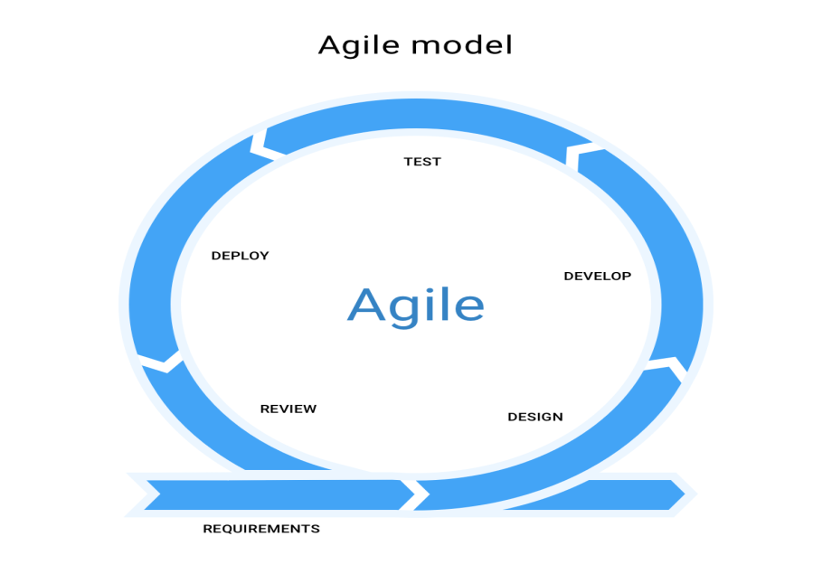
Our Methodology

Slide 8
Analysis Phase
Determine system requirements.
Determine who will be involved in the project.
Determine the length of the project schedule and assign responsibilities.
Determine what tools will be used to develop the system.
Determine the project cost.
Conduct a feasibility study.

Slide 9
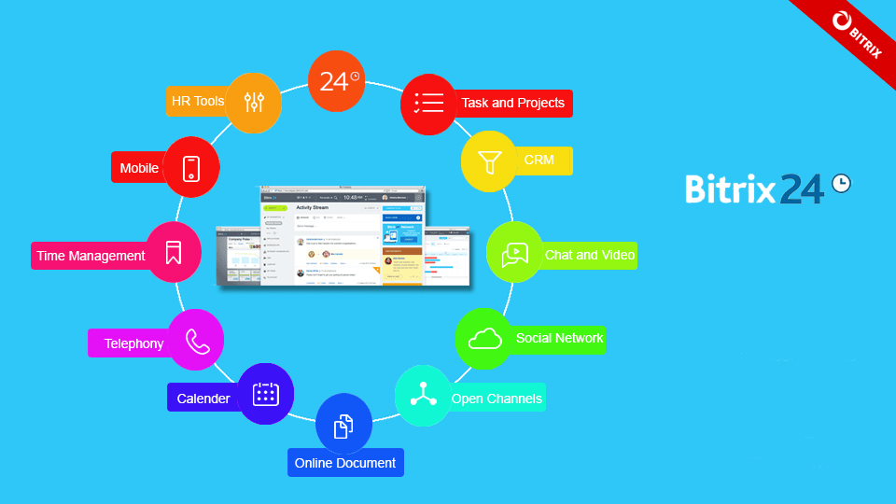
Tool Used

Slide 10
Design Phase
Building Context diagram.
Building Data flow diagram (DFD).
Building use case diagram.
Building entity–relationship diagram (ERD).
Building class diagram.
Data dictionaries design.
Coding system design.

Slide 11
Development and Implementation Phase
Online store development.
Customer relationship management system implementation:
  General settings configuration.
  Leads configuration.
  Deals configuration.
  Contact configuration.
  Inventory management configuration.
  Orders configuration.
  Delivery service and payment system.
  CRM Marketing.
  CRM Analytics.

Slide 12
Thank You!
Any Questions?

