Slide 1

An-Najah National University
FACULTY OF ENGINEERING
Mechanical engineering department
Effect of heat treatment on the fatigue life.
Supervisor: Done by :
Muhannad Ramahi
Dr. Osayd Abdul Fattah Mohammad Salameh
Fakhry Alshalabi
Jehad Tayeh

Slide 2
Outline
Abstract.
Introduction.
Iron – carbon phase diagram.
C-Curve (TTT diagram).
Steel alloy 1010.
Equipment.
Experimental procedure .
Results and analysis.
Discussion.
Conclusion and recommendation.

Slide 3
Abstract
In this project we must study the effect of heat treatment in the fatigue life, by increasing the quenching temperature above A1 to 1150 (maximum solubility limits).
After quenching and tempering we should study the fatigue life using fatigue testing machine and find the relation between the heat treatment temperature and number of cycles of the steel.

Slide 4
Introduction
In our project we will find the relation between quenching temperature and number of cycle for steel alloy 1010 ,this search is not done yet , so maybe there is no relation, that’s what we want to figure out from our project.

Slide 5
Importance of study
If we got a positive relationship of heat treatment and fatigue life ,this will offer an alternatives process to increase the fatigue life instead of shot peening , and carburizing with lower cost.
This project will contribute to the development of systematic education in the laboratories of the university education and to develop and support the industrial sector which is based on such industries.

Slide 6
Iron – carbon phase diagram

Slide 7
Iron - carbon phase diagram
The iron – carbon diagram shows the austenite region (γ) varies from 723 cº - 1495 cº
In our project we will use austenite region (γ) starts from 750 cº to 1100 cº maximum solubility limits.

Slide 8
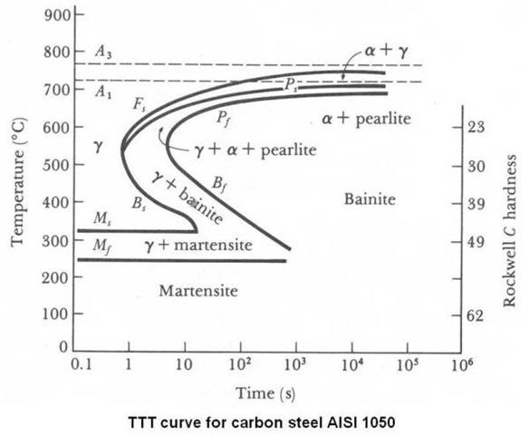
C-Curve (TTT diagram)

Slide 9
C-Curve ( TTT diagram)
From (TTT diagram) if we make a rapid cooling the austenite transform to martensite ( BCC unit cell transform to BCT unit cell ) which has high hardness.

Slide 10
Steel alloy 1010
In our project we choose steel alloy 1010.
AISI 1010 carbon steel is a plain carbon steel with 0.10% carbon content. This steel has relatively low strength but it can be quenched and tempered to increase strength.

Slide 11
Equipment
Different equipment's were used in conducting the experimental work in namely:
Nabertherm furnace temperature 0-1100C⁰
Curve turning tool (with triangle knife).
Grinding paper 120,240,320,400.
Quenching oil SAE10.
Turning machine.

Slide 12
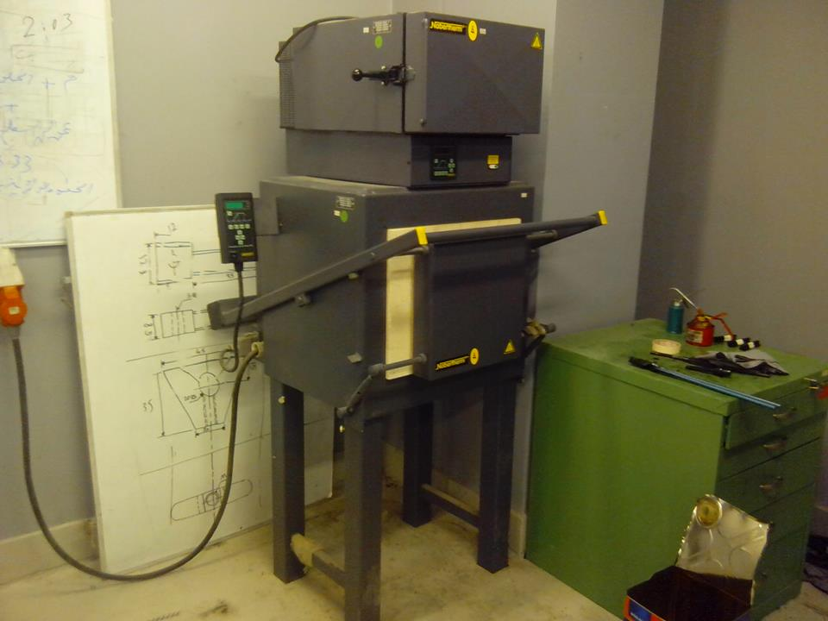
Type of furnace
Description of the furnace:
Maximum temperature 1100 Cº.
Volume of the chamber: 1, 2, 4, 6 or 14 liters .
Has thermo couple type k.

Slide 13
Experimental procedure
Heat the specimen to austenite region. (γ)
From the phase diagram we see the austenite region (γ) starts from 750 cº to 1100 cº maximum solubility limits.
Heat the 21 specimen to 750 cº
The specimen heated for 15 minutes, take the three specimens from the furnace and quench rapidly in oil.

Slide 14
Rise the temperature to 800 cº for the 18 remains specimen and keep it in furnace for 15 minutes ,after that take another 3 specimens from the furnace and quench it in oil.
Continue heating by step 50 cº for the other specimen and another 3 specimens and repeat as the previous step.
Tempering the entire specimen in furnace about 550 cº for 1:30 Hour.

Slide 15
Put one sample (without heat treatment) in fatigue testing machine and take the reading.
Put all the specimen (with heat treatment) individually in the machine on constant load (10 kg) .
Take the reading for number of cycle when the sample is broken.
Draw the relation between quenching temperature and number of cycle.

Slide 16
Results and Analysis:
Results of fatigue experiments are shown in following table:
Number | Load(Kg) | Heat Treatment | Number of cycles
1 | 10 | Without heat | 87250
2 | 10 | 750 | 137150
3 | 10 | 800 | 426706
4 | 10 | 850 | 545868
5 | 10 | 900 | 613442
6 | 10 | 950 | 951038

Slide 17
Scatter representation

Slide 18
Column representation

Slide 19
Discussion
Effect of heat treatment on the fatigue of 1010 alloy steel: The effects of different austenite temperatures namely: 950,900,850,800 and 750 Cº on the fatigue of 1010 alloy steel will be presented and discussed.
Effect of heat treatment at 950 Cº on the fatigue of 1010 alloy steel: it can see from previous figure that there was an enhancement in fatigue; the maximum improvement was 990%. This attributed to the enhancement in mechanical properties that resulted after heat treatment of 1010 steel.

Slide 20
Effect of heat treatment at 900 Cº on the fatigue of 1010 alloy steels: it can see from previous figure that there was an enhancement in fatigue; the maximum improvement was 947%. This attributed to the enhancement in mechanical properties that resulted after heat treatment of 1010 steel.
Effect of heat treatment at 850 Cº on the fatigue of 1010 alloy steels: it can see from previous figure that there was an enhancement in fatigue; the maximum improvement was 525.6%. This attributed to the enhancement in mechanical properties that resulted after heat treatment of 1010 steel.

Slide 21
Effect of heat treatment at 800 Cº on the fatigue of 1010 alloy steels: it can see from previous figure that there was an enhancement in fatigue; the maximum improvement was 389.1%. This attributed to the enhancement in mechanical properties that resulted after heat treatment of 1010 steel.
Effect of heat treatment at 750 Cº on the fatigue of 1010 alloy steels: it can see from previous figure that there was an enhancement in fatigue; the maximum improvement was 57.2%. This attributed to the enhancement in mechanical properties that resulted after heat treatment of 1010 steel.

Slide 22
Conclusions and Recommendation:
Increasing the heat treatment cause to improve the properties of the steel, and increase the fatigue life, the maximum improvements of fatigue life at 950 Cº was 990% comparing with the unheated specimen.

Slide 23


